Slide 1



PFIZER’S
PERSONALIZED MEDICINE INITIATIVE

Slide 2



Table Of Content
01
Problem Statement
02
Stakeholders
03
Methodology
04
Recommended Analysis
05
Conclusion

Slide 3


Problem Statement
Pfizer aims to improve treatment effectiveness by tailoring drugs to individual patients through personalized medicine. This project seeks to analyze clinical trial and genomics data to identify key patient demographics and genetic factors that influence drug efficacy and side effect patterns. By uncovering these insights, Pfizer can develop more effective, targeted treatments, enhance clinical trial designs, and reduce adverse side effects for diverse patient groups. This data-driven approach will help Pfizer advance the future of precision medicine.

Slide 4

Stakeholders
Internal Stakeholders: Pfizer's Research and Development (R&D) team, Data Science Team, and Clinical Researchers.
External Stakeholders: Medical professionals, regulatory bodies, and patients.

Slide 5

KPI’S(KEY PERFORMANCE INDICATOR)
Positive Mutations
Success Rate
Avg Survival Rate (In Months)
471
34.70%
14.96

Slide 6
KPI’S(KEY PERFORMANCE INDICATOR)
Average Efficacy Score
Average Progression Free Survival
Avg Survival Rate (In Months)
11.59
14.96
5.4

Slide 7
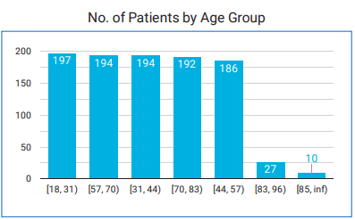
Recommended Analysis
Q1. Analyze the number of patients in each age group?

Slide 8
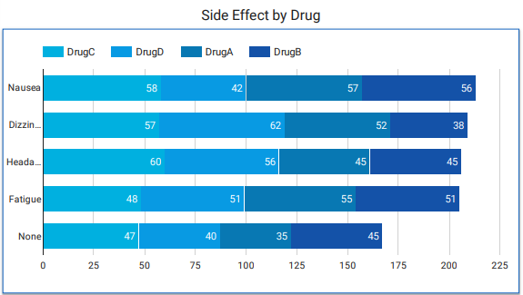
Recommended Analysis
Q2. Analyze the number of side effects reported by drug?

Slide 9
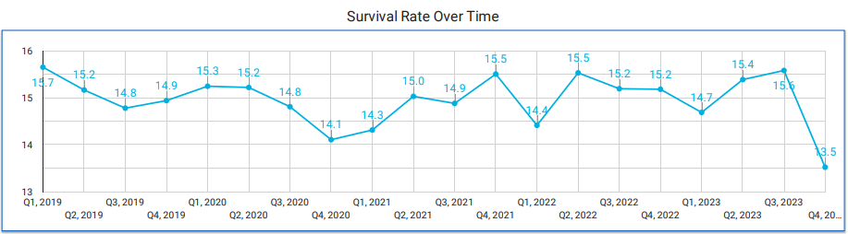
Recommended Analysis
Q3. Analyze Trend Over Time Survival Time ?

Slide 10
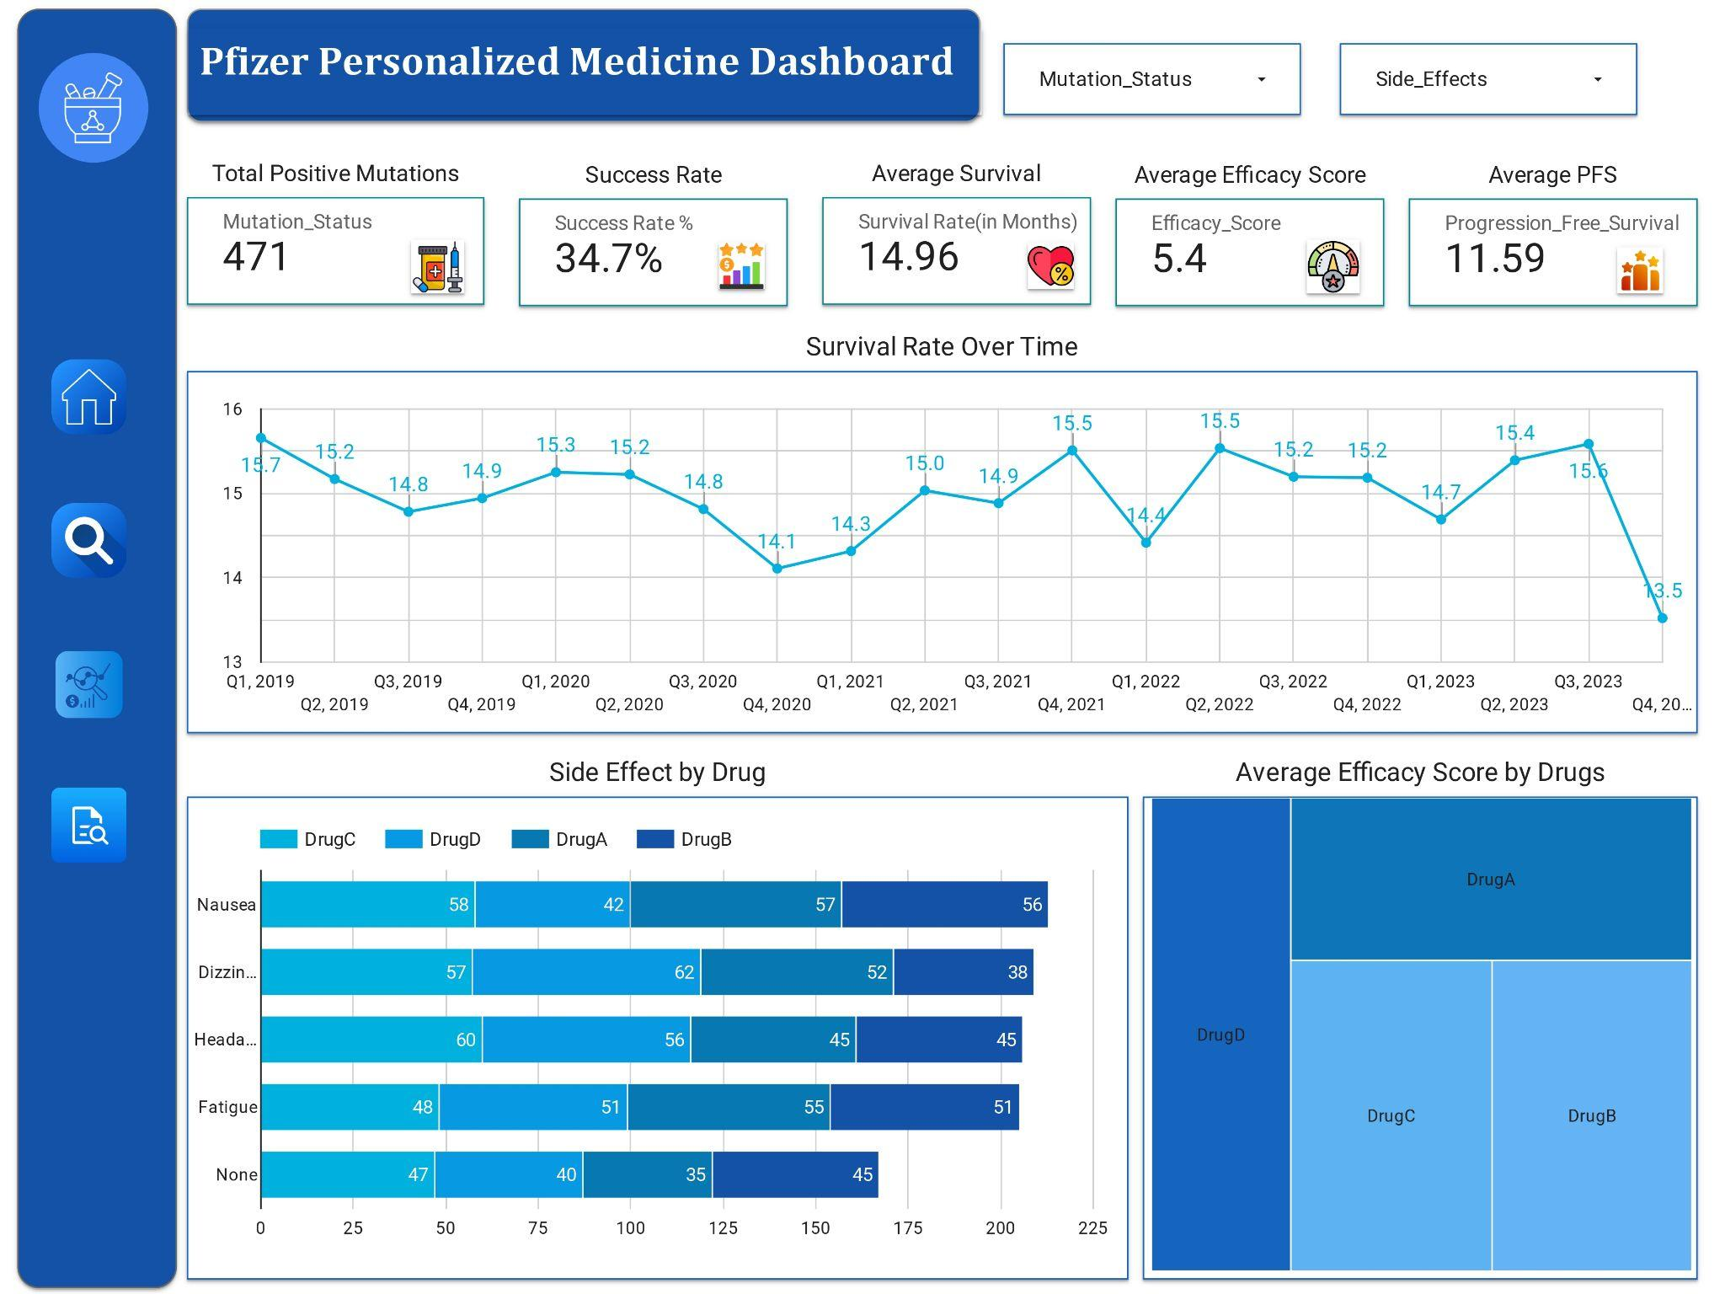

Slide 11
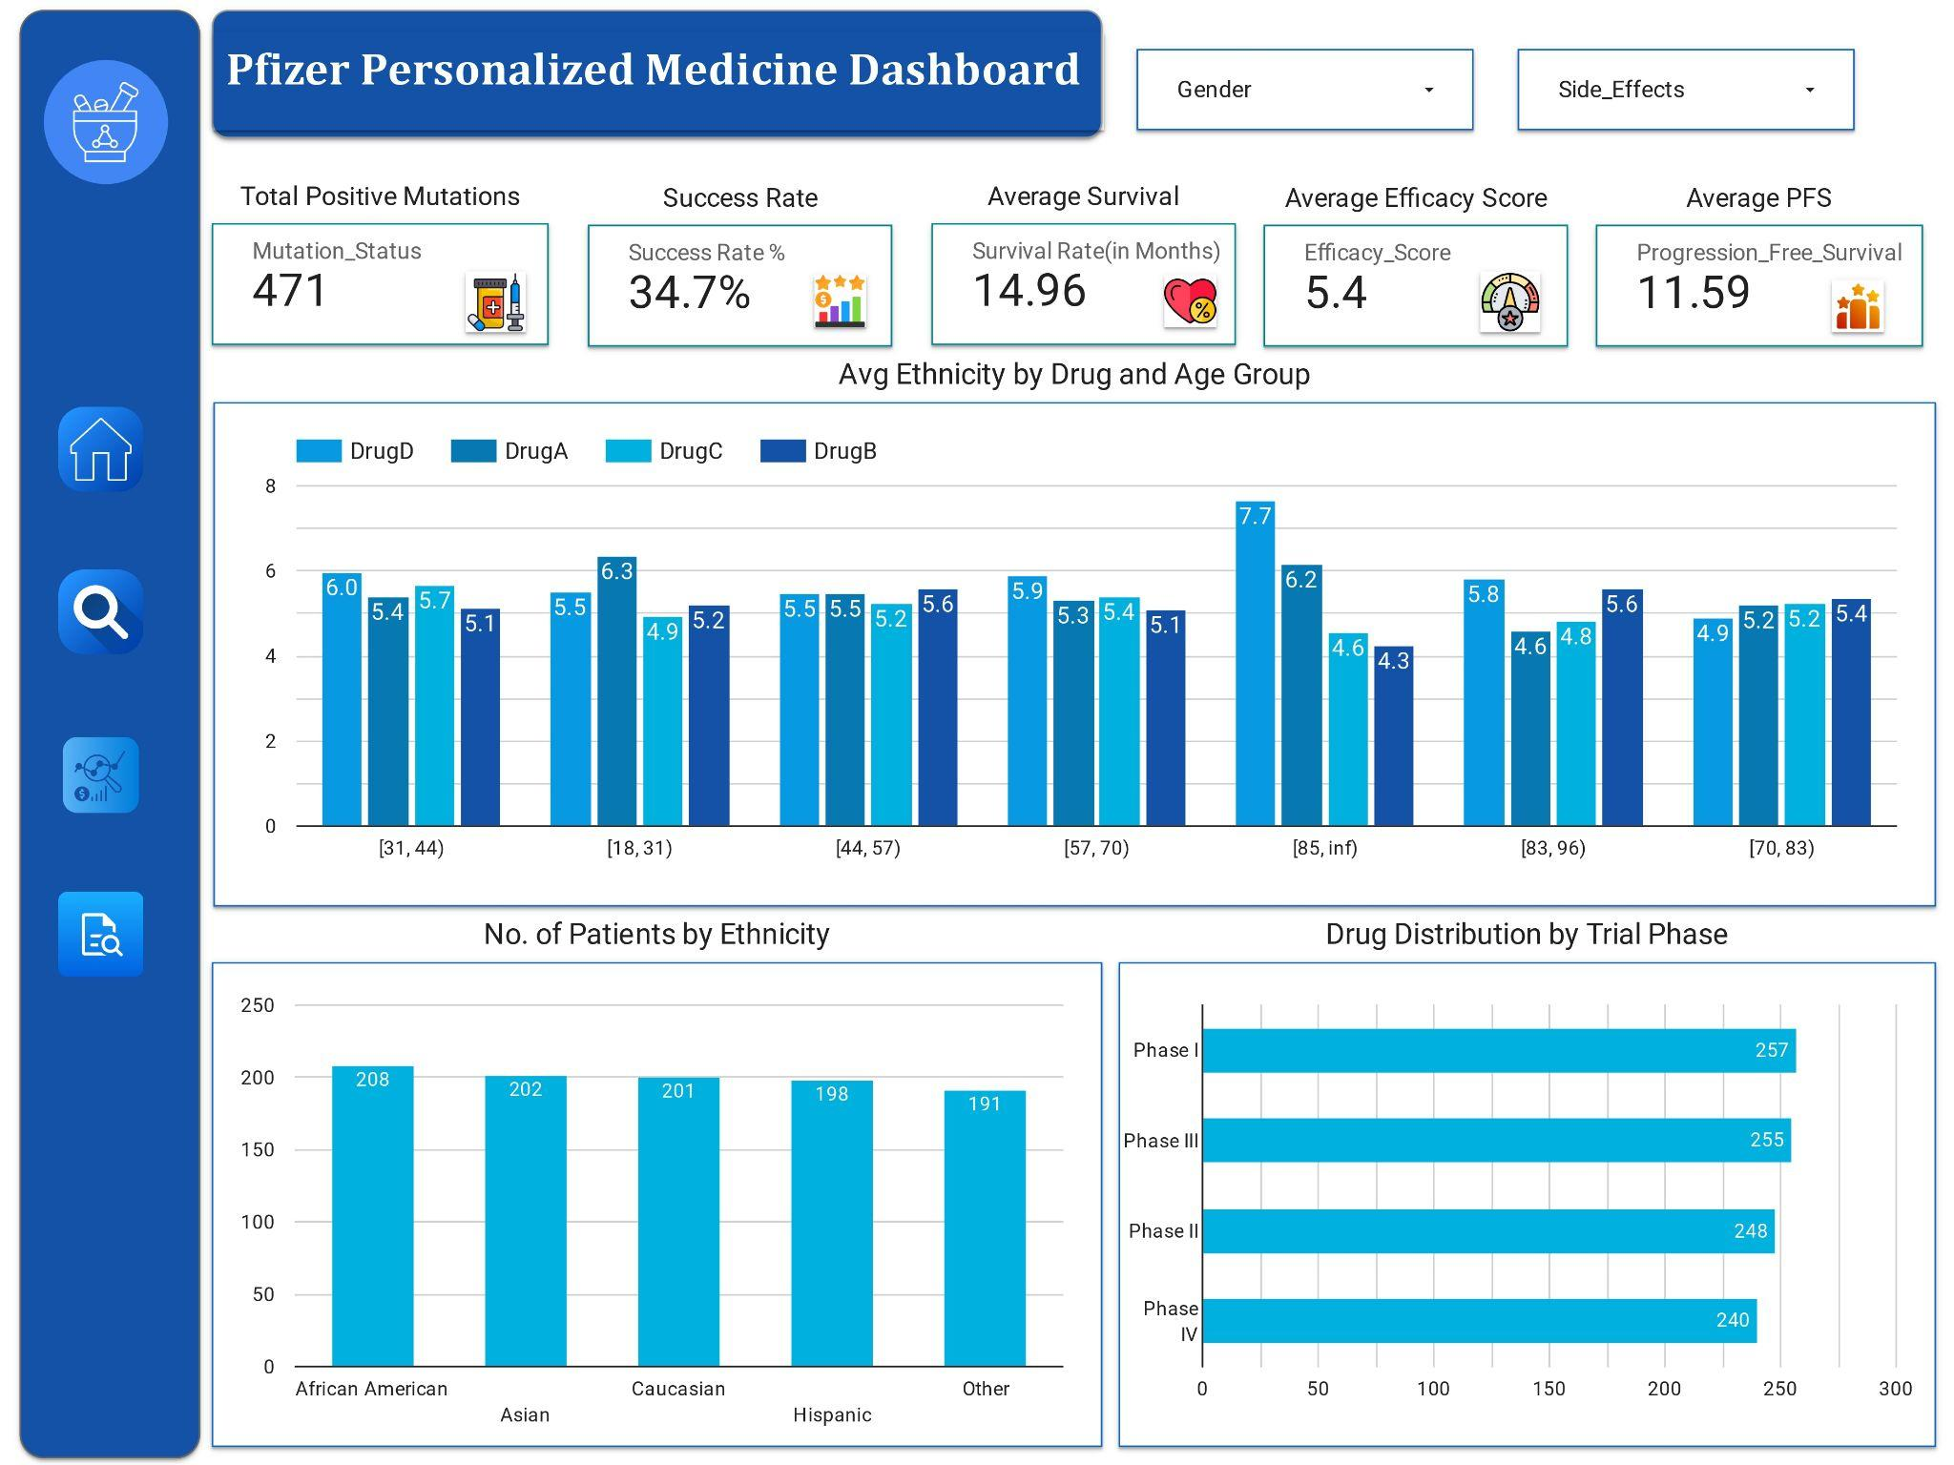

Slide 12
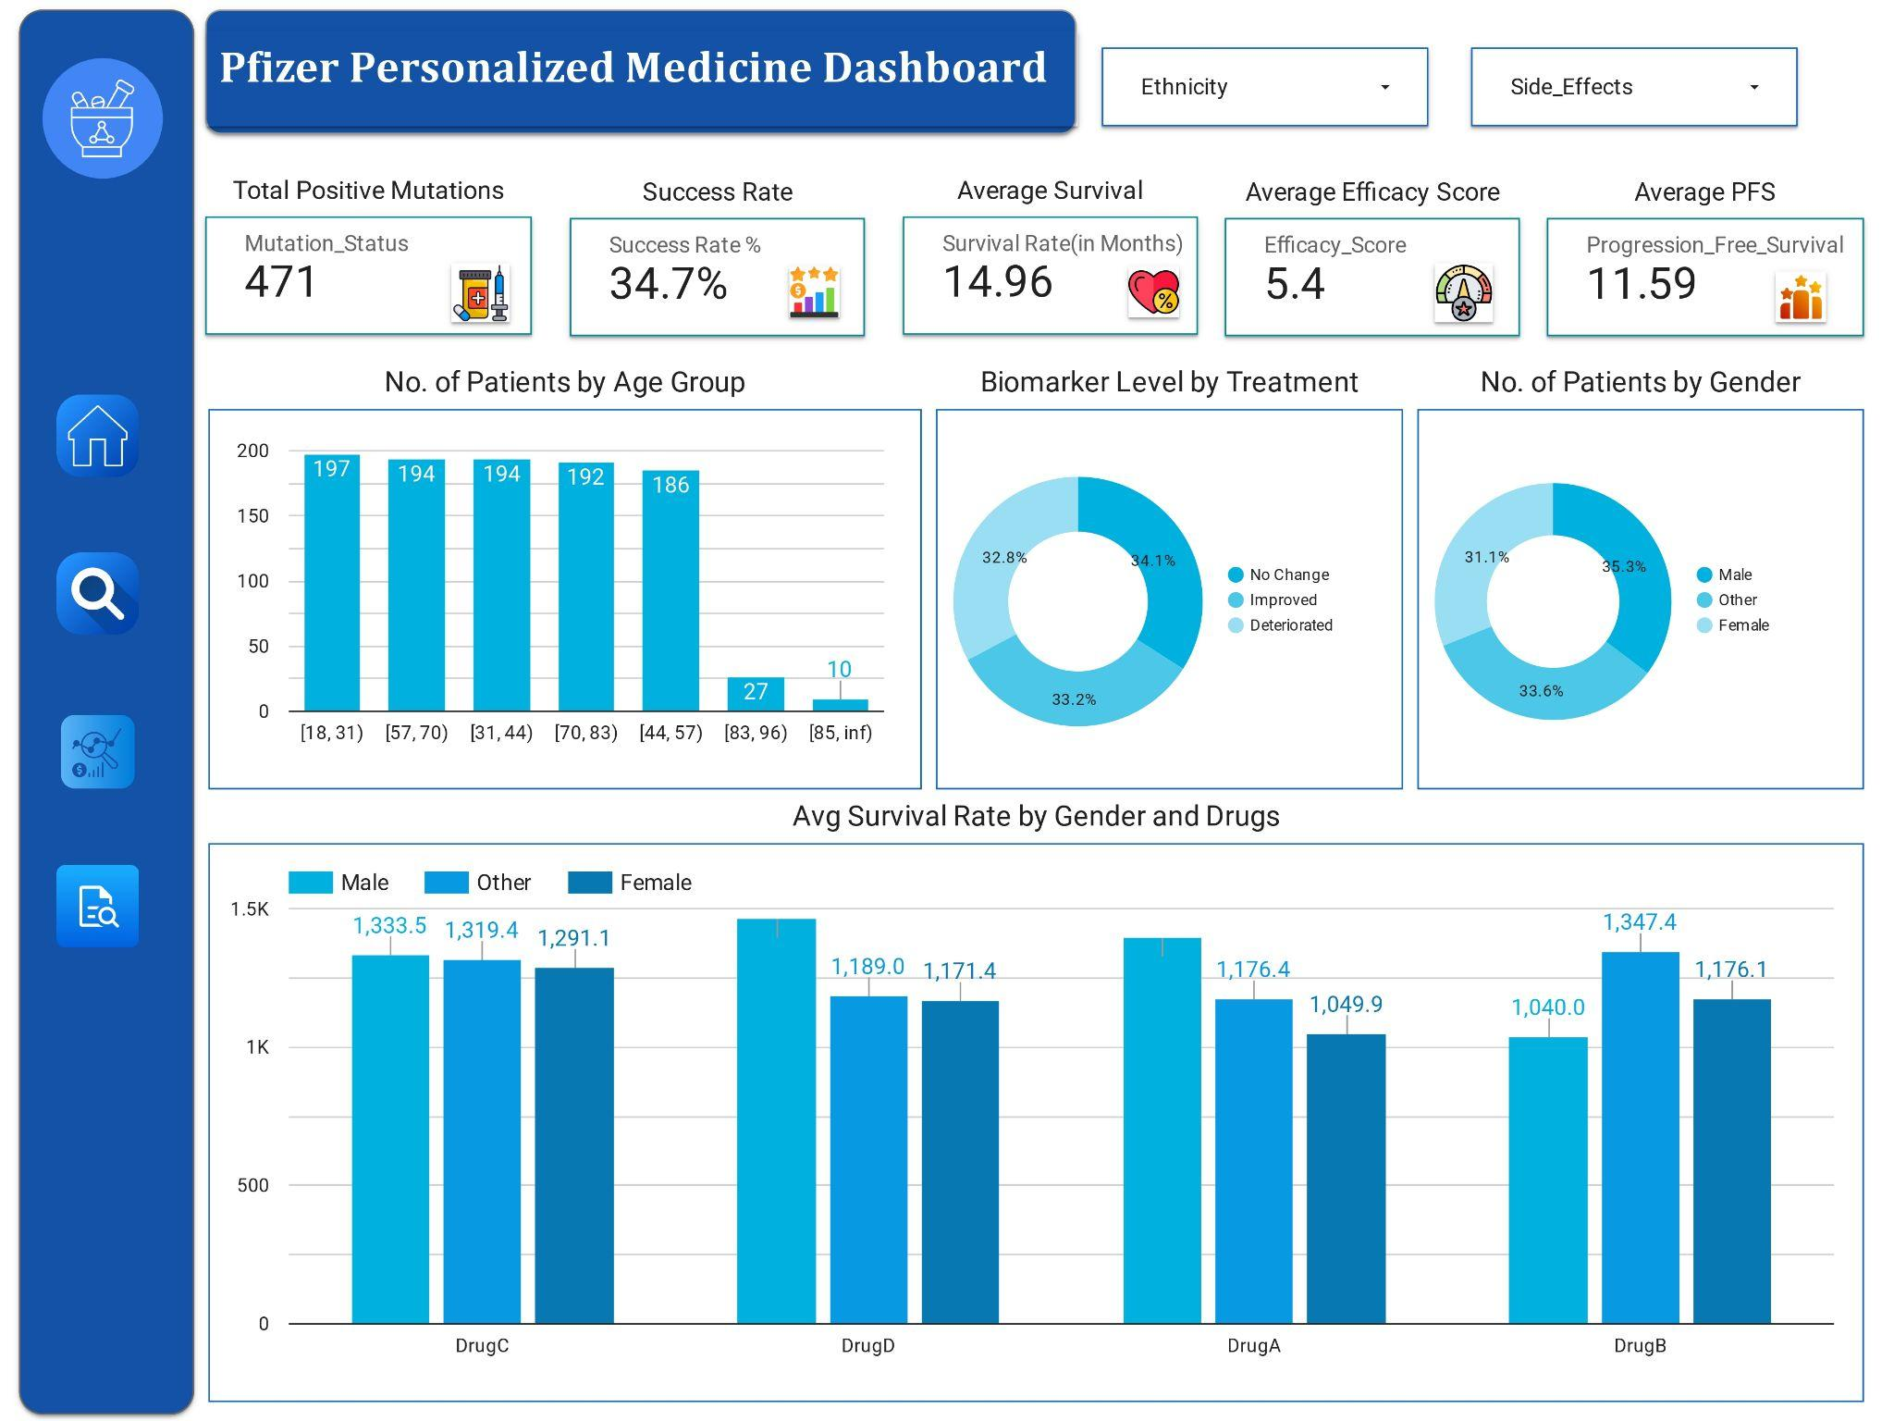

Slide 13
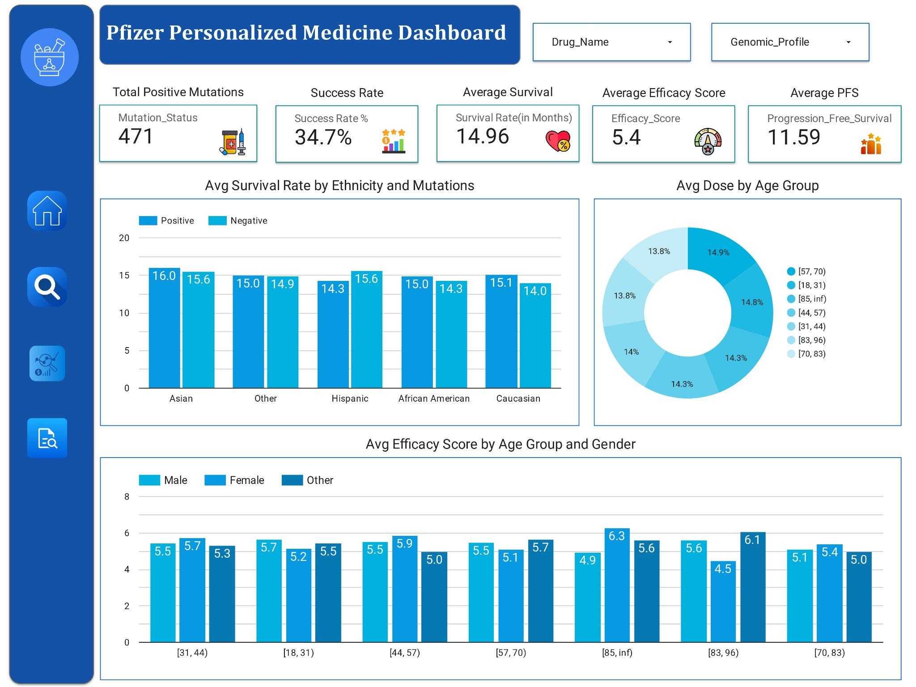

Slide 14
THANK YOU

