Slide 1


Slide 2
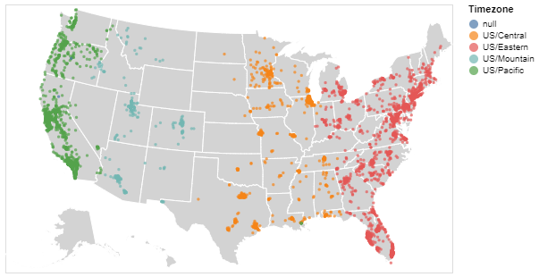
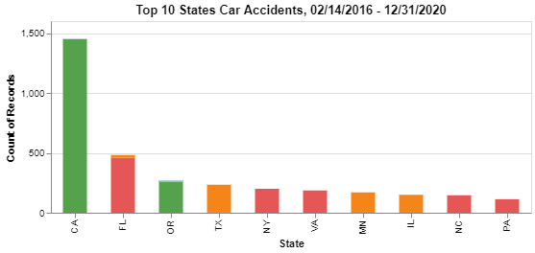
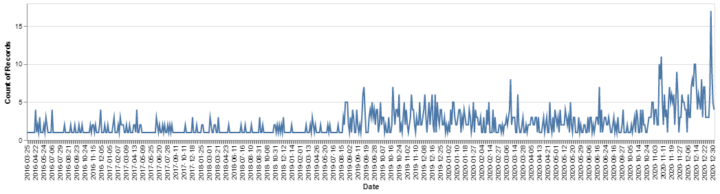
Preliminary Results US Accident 2016-2020 dataset
2019

Slide 3

Datasets
Cleaning/Modifying
Remove unnecessary columns
Correct datatypes
Create new useful columns
US_Accidents_CA2019.csv
Filter from US Accident 2016-2020 dataset
108,310 Records
Attributes:
Location data
time data
weather details
surrounding features
Fatal_CA_Accidents2019_Vehicle.csv
Collected using Fatality Analysis Reporting System (FARS) API
5,085 Records
Lists vehicles associated with each CA 2019 Fatal Accident
Attributes
Casenumber
Make
Model
Year of vehicle
License state
Number of death from vehicle
Speeding and posted speed limit
Road condition
Violation name
Fatal_CA_Accidents2019_CaseDetails.csv
Collected using Fatality Analysis Reporting System (FARS) API
3,317 Records
Attributes:
Location data
time data
road type
number of people, fatalities, vehicles
drunk driver
Collision type
Lighting

Slide 4
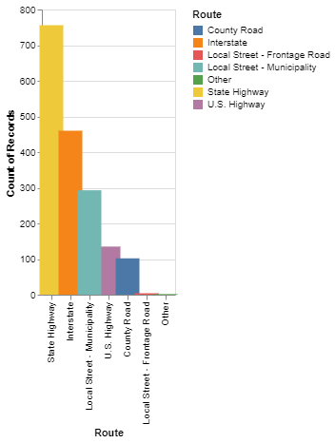
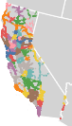
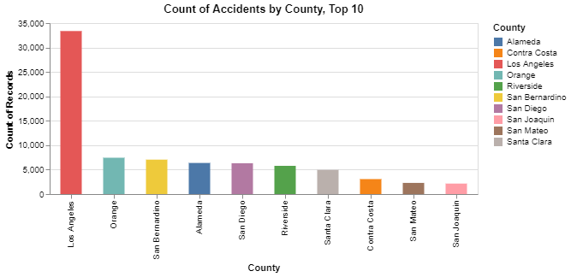
California Spatial Distribution
Hypothesis: Accidents occur more often in populated areas.
Hypothesis: Fatal Accidents occur more often on major roads and interstates
?
Top 10 Counties Population
Los Angeles County
San Diego County
Orange County
Riverside County
San Bernardino County
Santa Clara County
Alameda County
Sacramento County
Contra Costa County

Slide 5
Independent Sample t-Test for the Fatalities by County
We have performed an Independent Sample t-test to find out if our hypothesis can get some support
We have considered the Fatalities as our factor and the groups are the Counties Los Angeles and Orange
Both the treatments are significant as the p-value is less than 0.05.
This supports our hypothesis.
The total number of fatalities in the Los Angeles county (M = 1.03, SD = 4.83) compared to the total fatalities in the Orange county (M = 1.1, SD = 27.47) demonstrated significantly better peak difference, p = 0.0402.

Slide 6
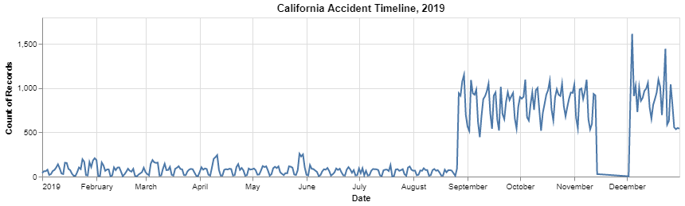
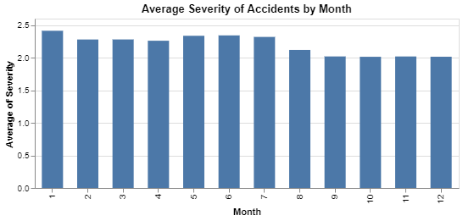
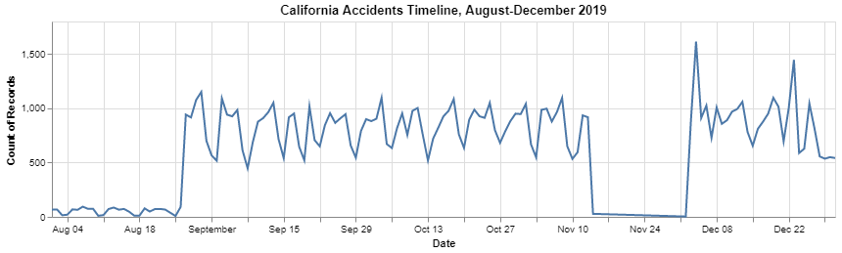
Accidents Yearly Timeline
Hypothesis: Accidents are more common during Holidays such as New Years, Thanksgiving, 4th July, and Memorial Day.
GAP?
Pulse

Slide 7
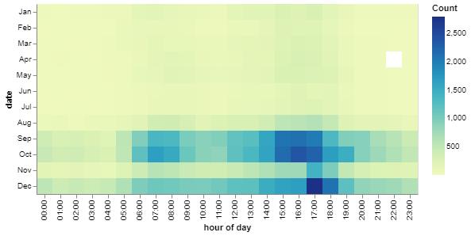
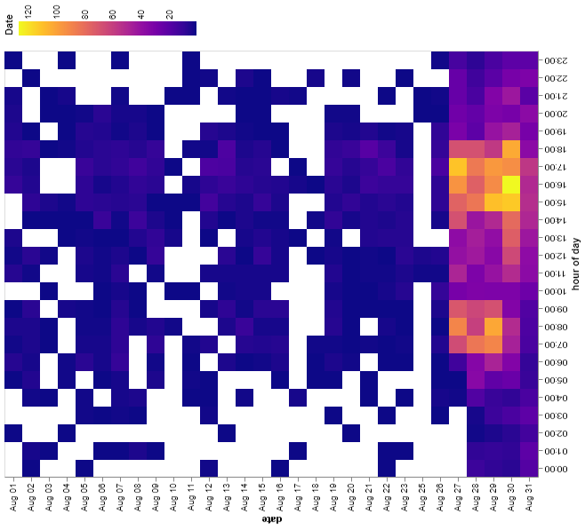
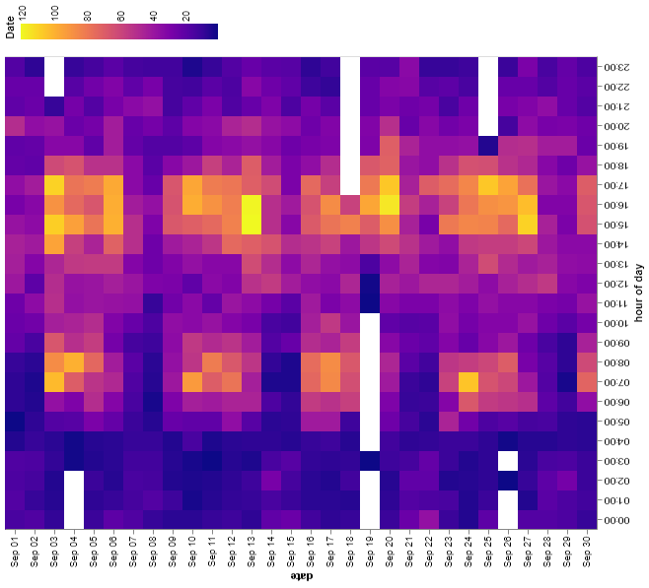
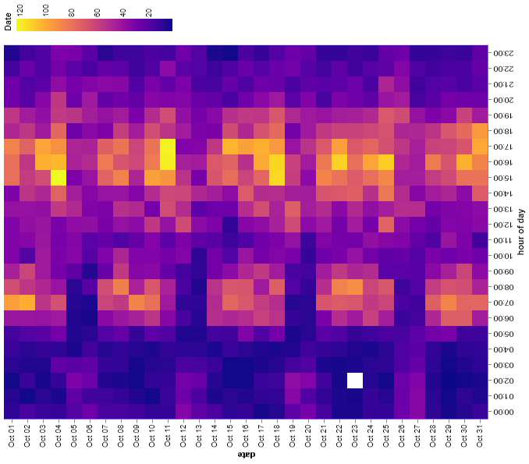
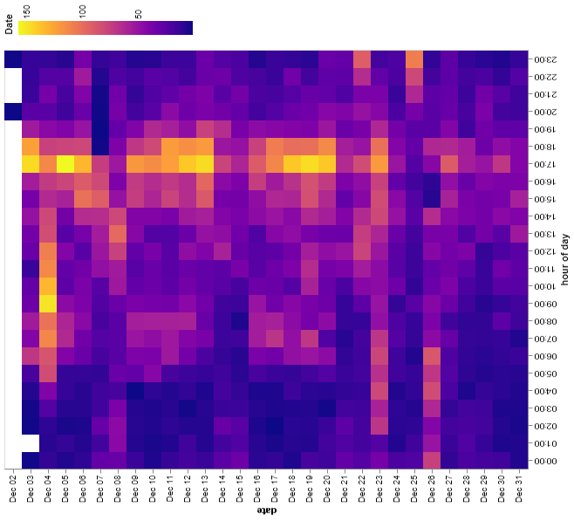
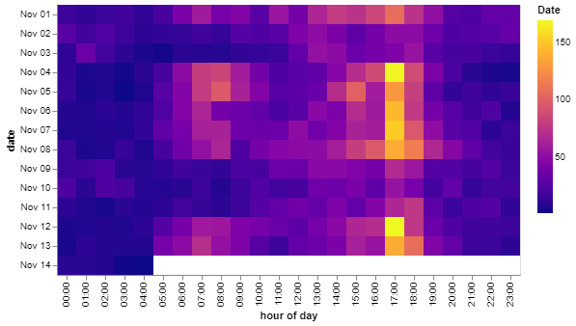
Accidents Heatmaps
Hypothesis: More accidents occur during morning and afternoon rush hours.
Midnight
Noon
Morning
August
September
October
November
December

Slide 8
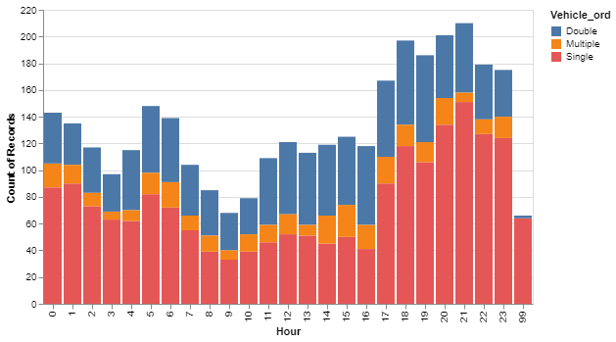
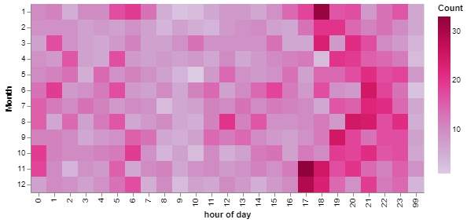
Fatal Accident Timeline
Hypothesis: Fatal Accidents occur most often at night.
9:00 PM
Evenly over months
More in afternoon/evening

Slide 9
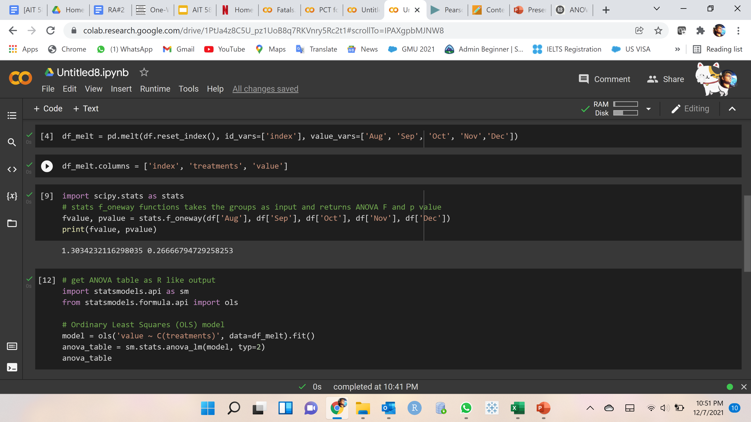
One – Way Anova Test for the Fatalities by month
We have performed a one-way Anova test to find out if our hypothesis can get some support
We have considered the Fatalities as our factor and the groups are the months August, September, October, November and December
F-value obtained : 1.30342
P-value obtained : 0.26666
The p-value is greater than 0.05.
We can conclude that there is no significant difference in the records

Slide 10
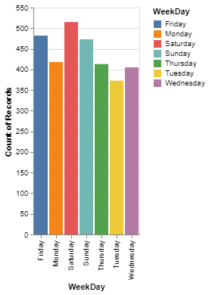
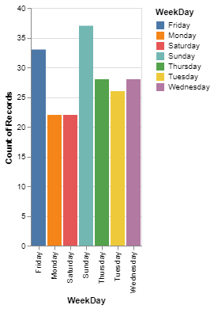
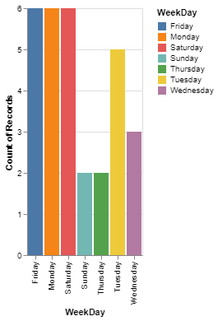
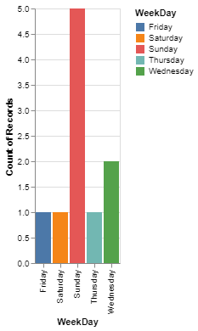
Fatal Accidents Weekday
Hypothesis: Fatal accidents with many fatalities occur more often on the weekends.
1 Fatalities
2 Fatalities
3 Fatalities
4 Fatalities

Slide 11
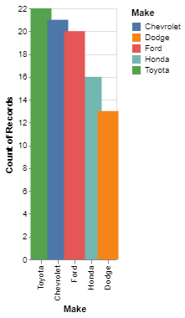
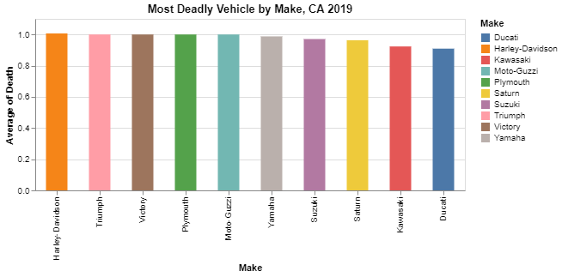
Fatal Accidents by Vehicle
Which Vehicle makes are most involved with Drunk Driving violations?
What vehicle make is most deadly if involved in a car accident?

Slide 12
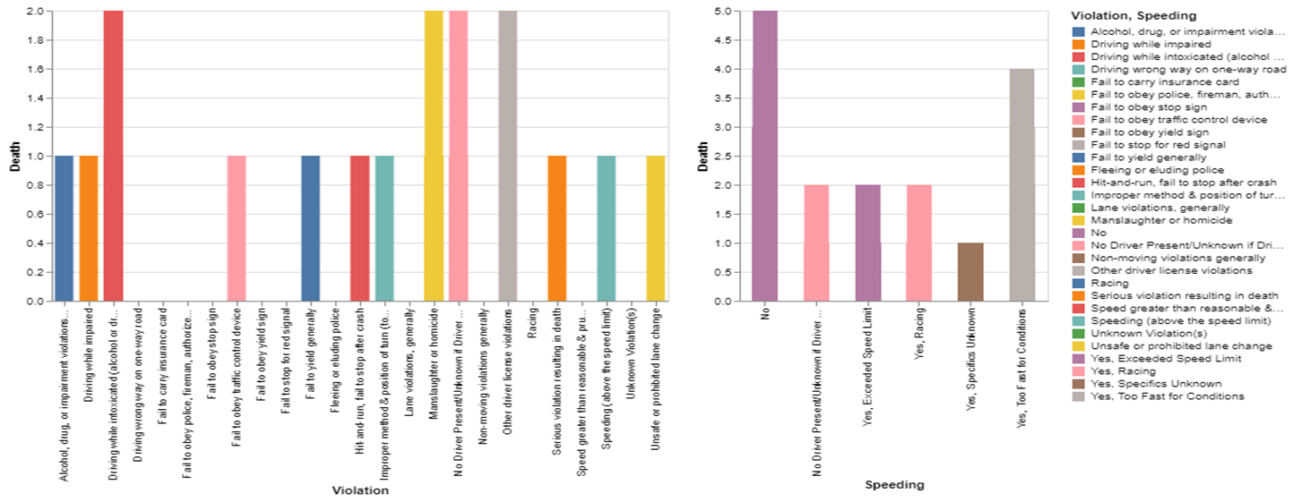
Insights for Causes of Fatalities due to Violations:
Fatalities are mostly caused by the
following violations:
•Driver is intoxicated,
•Non licenced driver,
• Lane violations,
•Homicide of the driver.
Fatalities are mostly caused by the following
speeding violations:
•Driving too fast for conditions,
•Racing ,
•Exceeding speed limit
And no Fatalities, if the driver is not obeying traffic signs, police, or driving wrong way, or for not carrying insurance card. And more fatalities occur when the driver is not speeding.

Slide 13
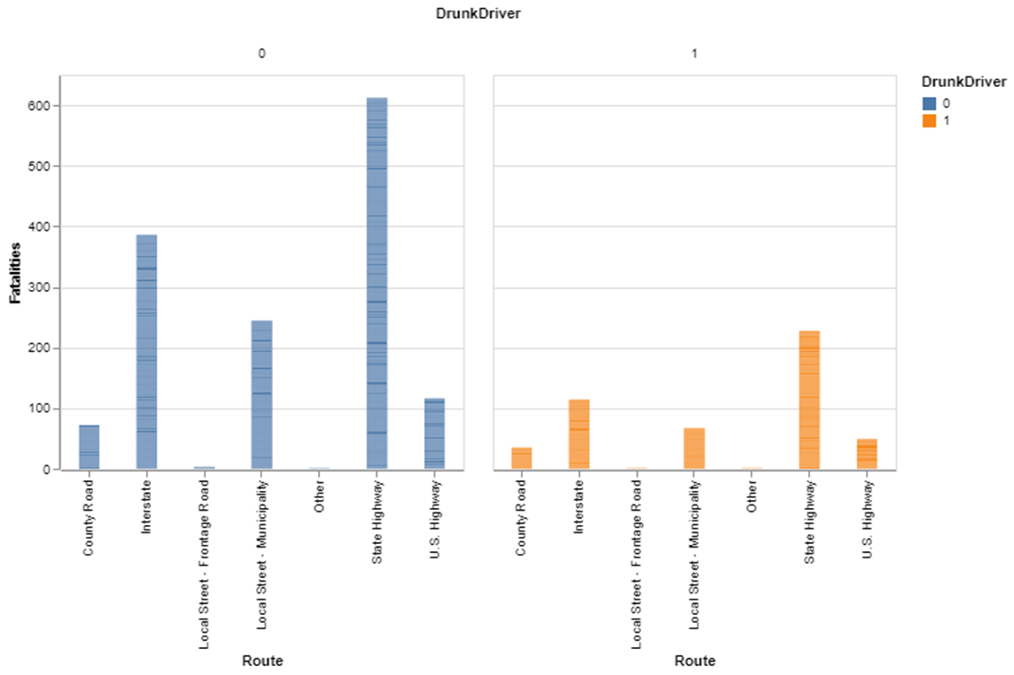
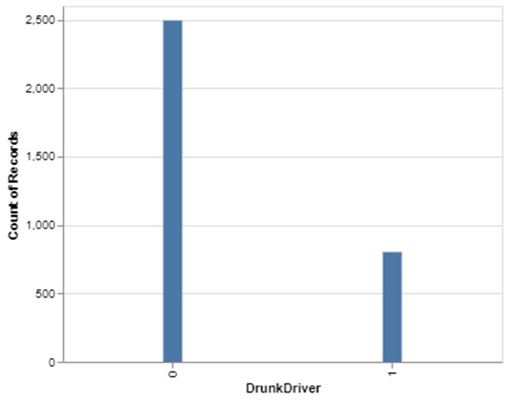
Drunk driving statistics in CA,2019
About 25% of the accidents occur in CA are caused by drunken drivers.
Fatalities are higher at state highways both when the drunk is sober or intoxicated

Slide 14
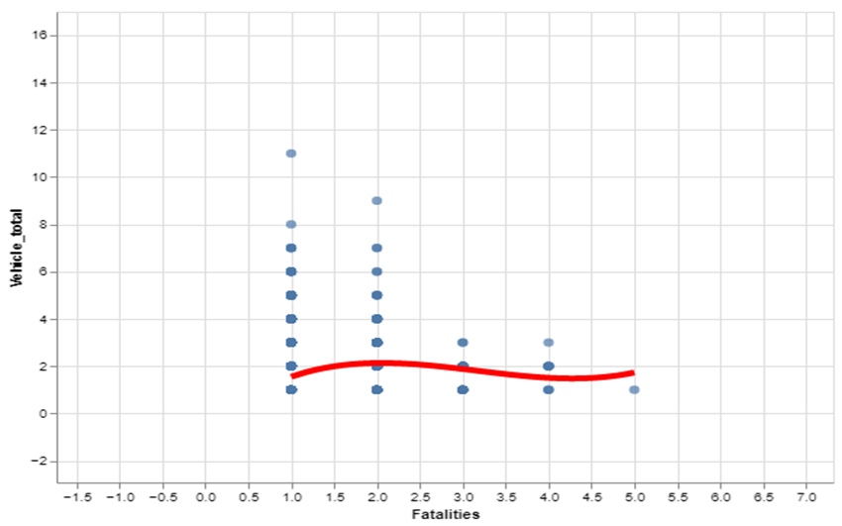
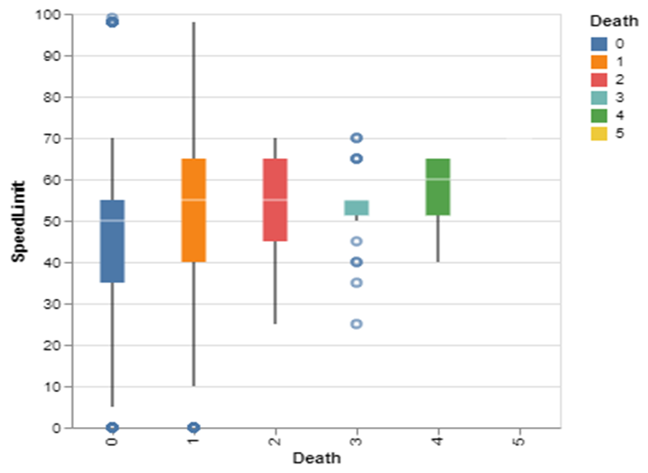
Interesting insights form the plots:
Relationship between Fatalities and number of vehicles involved in an accident.
More fatalities occur when the speed limit is high for that road.

Slide 15
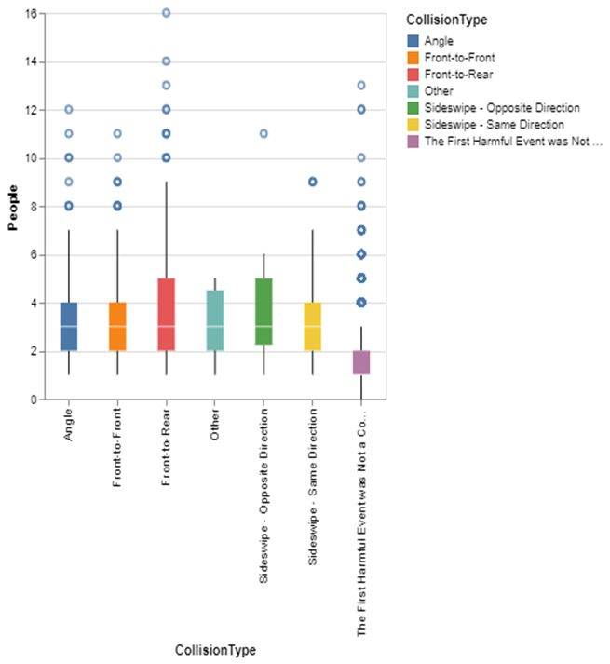
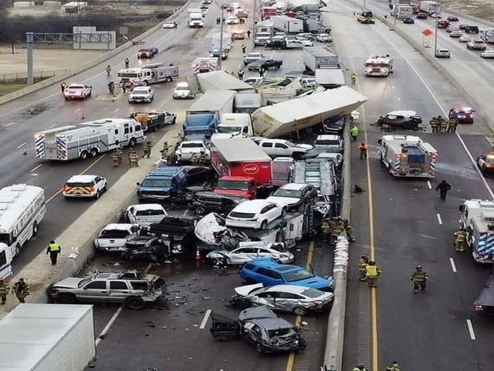
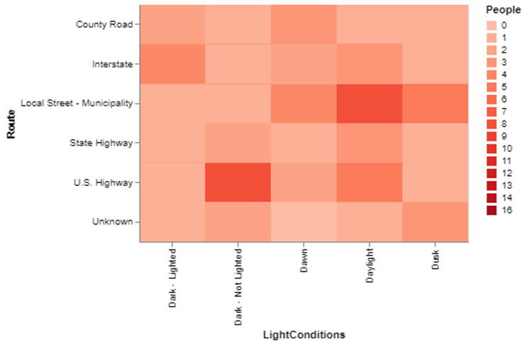
Interesting insights form the visualizations:
Number of people involved in the accident is more for the Front to Rear collision type, side-wise(opposite direction) collision type.
Number of people involved in the accident is more on U.S Highway and Local street with dark light and daylight conditions, respectively .

Slide 16
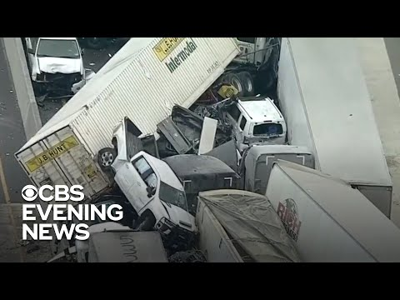

Slide 17
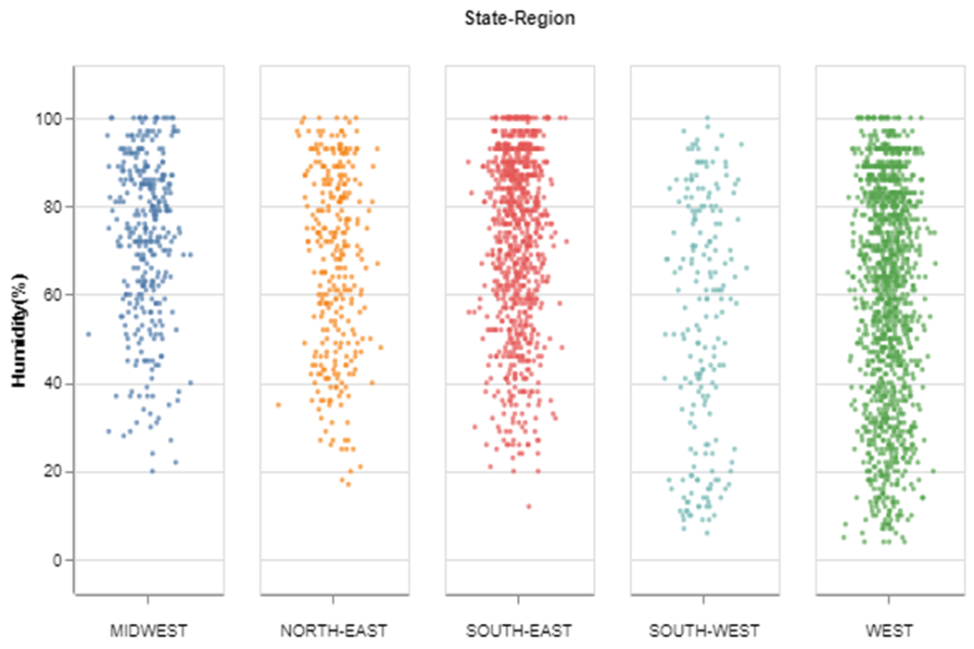
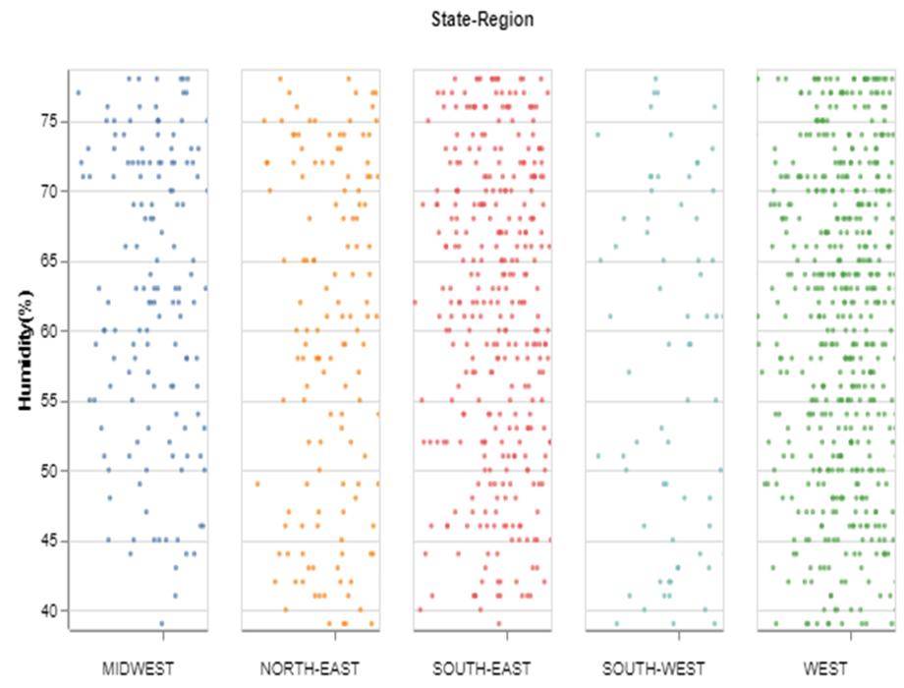
Interactive visualizations:
Direct Manipulation is performed on the strip plot visualization plotted between Humidity(%) and State-Region. Interactive techniques helps us to see the intensity of humidity(%) for a particular range at different state regions.
Interactive technique helped us to understand that the Humidity(%) range of 40%-75% could most commonly occurs at West region of USA.

Slide 18
Thank you

