Slide 1

Capstone Project
University Success Analysis

Slide 2
Introduction
The database we will be using is the Educational database.
It is a fictitious database designed to represent the data management needs of the Universities.
It consists of several tables capturing different information on university rankings from different systems, ranking criteria, and university-specific data. This database provides valuable insights into the Education industry and serves as an educational resource for learners and professionals interested in database management and analysis.

Slide 3

ER Diagram

Slide 4


Slide 5


Slide 6
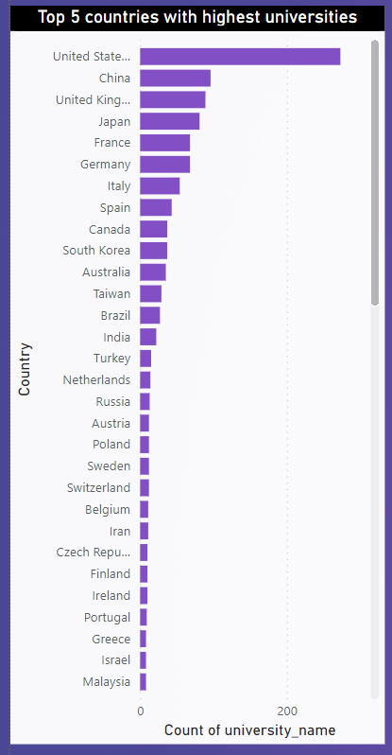

Summary
As we can clearly analyse that top 5 countries with highest universities are US , China , UK , Japan and France .
With bottom 5 ranking we have Uruguay, Uganda ,Serbia, Qatar and Puerto Rico

Slide 7
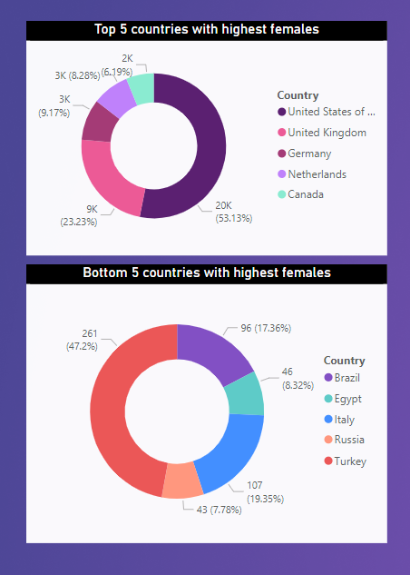
Female Students Count
As we can clearly see that the top 5 countries with highest females are US , UK , Germany , Netherlands and caranda. And as per data we can analyse that the country with higher GDP contributes more female counts. Hence with bottom 5 counties ,GPD is also can be the main factor i.e. Brazil , Egypt ,Italy and Turkey

Slide 8
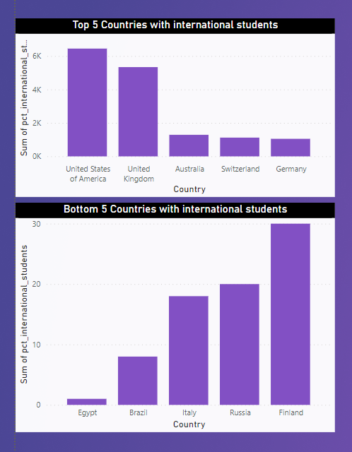
International Affairs
Having international students in a university plays a crucial role in spreading diversity. As per the Data we can clearly notice that the top 5 countries and bottom 5 countries are the countries with respective Top/Bottom female count.

Slide 9
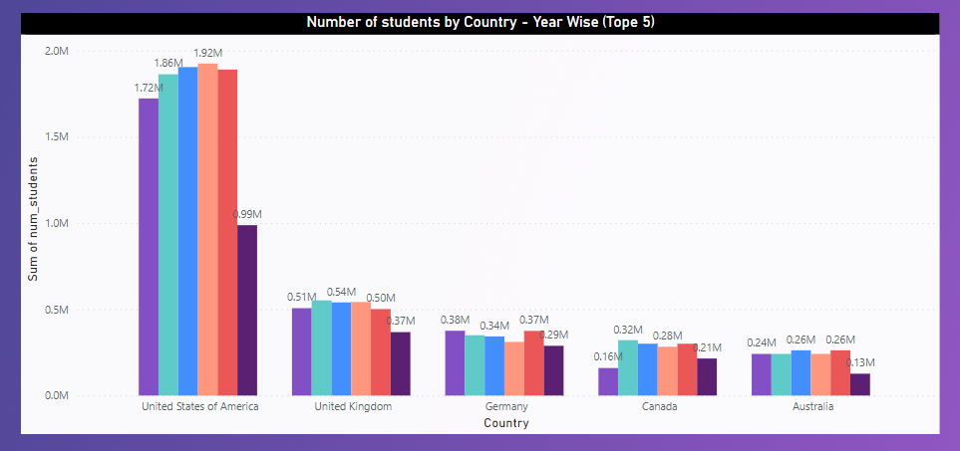
Student by country count
As per Analysing we can come to the conclusion that US , UK , Germany are the most promising countries when it comes to serving the students on national and international lever year on year. And These are land of most top ranked universities as well.

Slide 10

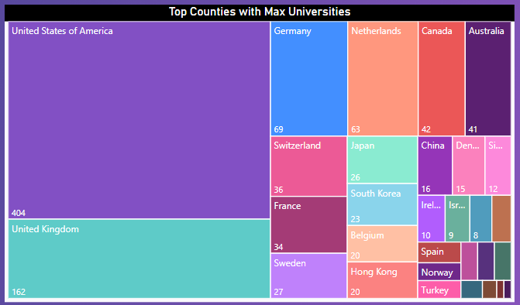
As per the required data set the top countries with max universities are mentioned below. But as well the data of 2023. These are the updated list.

Slide 11
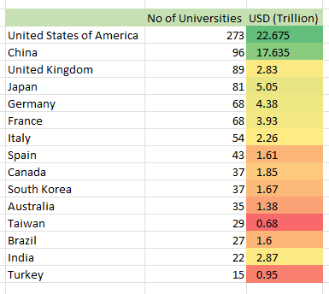
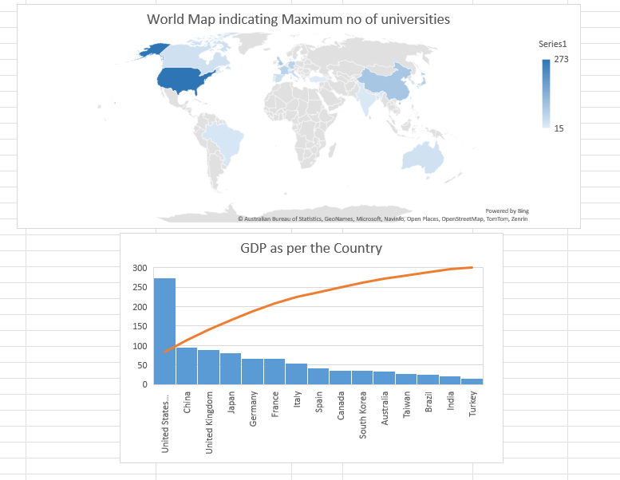
1. Is there a correlation between a country's GDP and the number of universities?
Yes, there is a positive correlation between a country's GDP and the number of universities. This means that countries with higher GDPs tend to have more universities.
There are a number of reasons for this correlation. First, wealthier countries have more resources to invest in education. This includes funding for universities and research. Second, wealthier countries have a higher demand for higher education. This is because there are more jobs that require a college degree.
A study by the Organization for Economic Co-operation and Development (OECD) found that there is a strong positive correlation between GDP per capita and the number of universities per capita. The study also found that the correlation is stronger for public universities than for private universities.

Slide 12
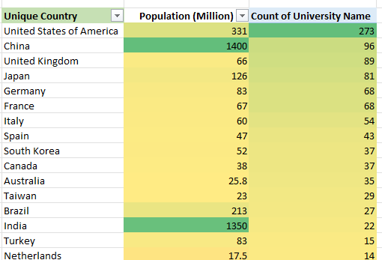
Is there a relationship between a country's population and the number of universities?
As per the limited data set we can easily analyze that population is directly proportional to the no of universities in max number of case.(2021)
Taking data from the recent report we can conclude that .
Yes, there is a positive correlation between a country's population and the number of universities. This means that countries with larger populations tend to have more universities.
There are a number of reasons for this correlation. First, larger countries have a larger pool of potential students. This means that there is a greater demand for higher education in larger countries. Second, larger countries have more resources to invest in education. This includes funding for universities and research.

Slide 13
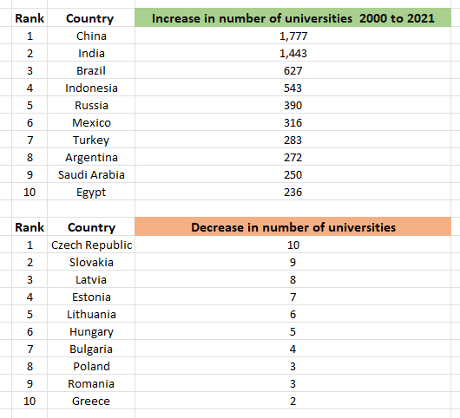
How has the number of universities changed over the years in each country?
As per the data is difficult to come to the certain conclusion so we need to compare the Y-o-Y university growth as follows ( Taken the data from Google and required data set )
As you can see, China has seen the largest increase in the number of universities over the past 20 years. This is likely due to China's rapid economic growth and its increasing demand for higher education
As you can see, the Czech Republic has seen the largest decrease in the number of universities over the past 20 years. This is likely due to a number of factors, including budget cuts to higher education and a decline in the number of students enrolling in university.
It is important to note that these changes in the number of universities are just averages. There may be significant variation within each country. For example, some countries may have seen a decrease in the number of public universities, while others may have seen an increase in the number of private universities.

Slide 14
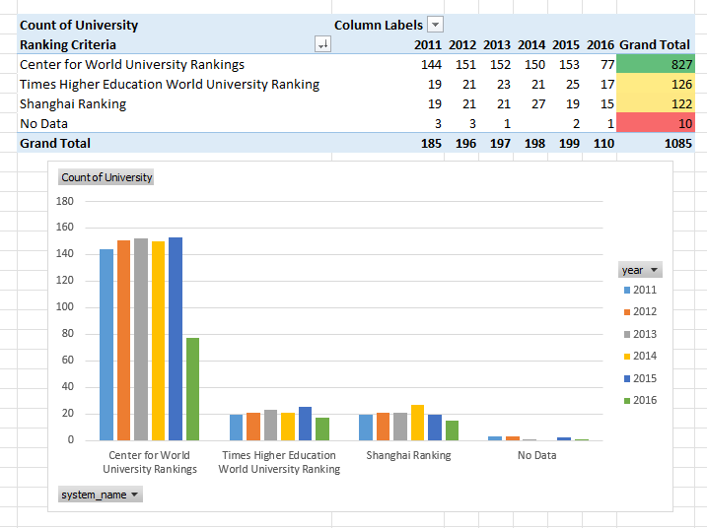
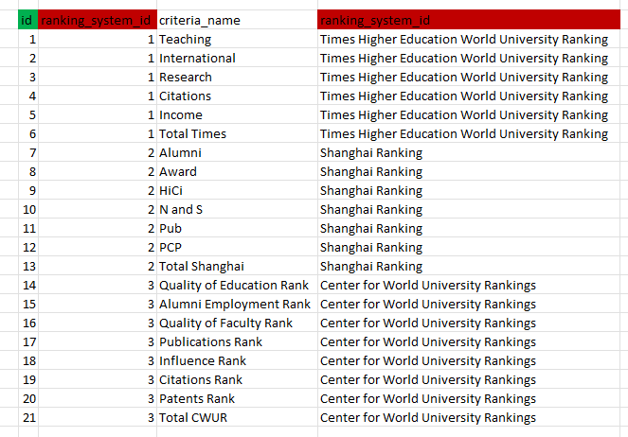
Are there any common criteria used by different ranking systems?
As we can analyse that the most of the universities takes consideration of centre of world university ranking system and compared with other ranking.

