Slide 1

D.K.T.E. Society’s Textile and Engineering Institute, Ichalkaranji
CSE (Artificial Intelligence and Machine Learning) | Community Engagement Project
MAHARASHTRA TRANSIT SERVICE
Smart Bus Tracking & Passenger Management System for Maharashtra
Developed by: Aayaan D. Kalawant, Kunal S. Sapate, Omkar N. Chougule, Yash V. Tare, Vivek M. Chougale
Guide: Prof. Shreya Demanna | HOD: Prof. Dr. S.K. Shirgave | 2026

Slide 2
Problem Statement
MSRTC runs 2.5 lakh+ daily trips for about 7.5 crore passengers a year, yet 86% of passengers report unreliable bus information.
No real-time visibility
No crew tracking
Manual ticketing
No live bus location or ETA for commuters
No central record of driver and conductor assignments
Long queues and revenue leakage
No rural monitoring
Unreliable planning
Remote routes lack monitoring and safety checks
Passengers cannot plan journeys, trust drops
Maharashtra Transit Service | DKTE, Ichalkaranji
2

Slide 3
Facility Requirements
1
Real-time GPS tracking over 4G/5G
6
Route visualization (OpenStreetMap/Google Maps)
2
Live location and ETA for passengers
7
REST APIs, WebSocket, PostgreSQL, Redis
3
Digital driver and conductor assignment
8
NIC / Government Cloud hosting
4
Online ticket and pass booking (Razorpay/UPI)
9
Rural route monitoring
5
Fleet management from live GPS data
10
Journey planning using ETA
Maharashtra Transit Service | DKTE, Ichalkaranji
3

Slide 4
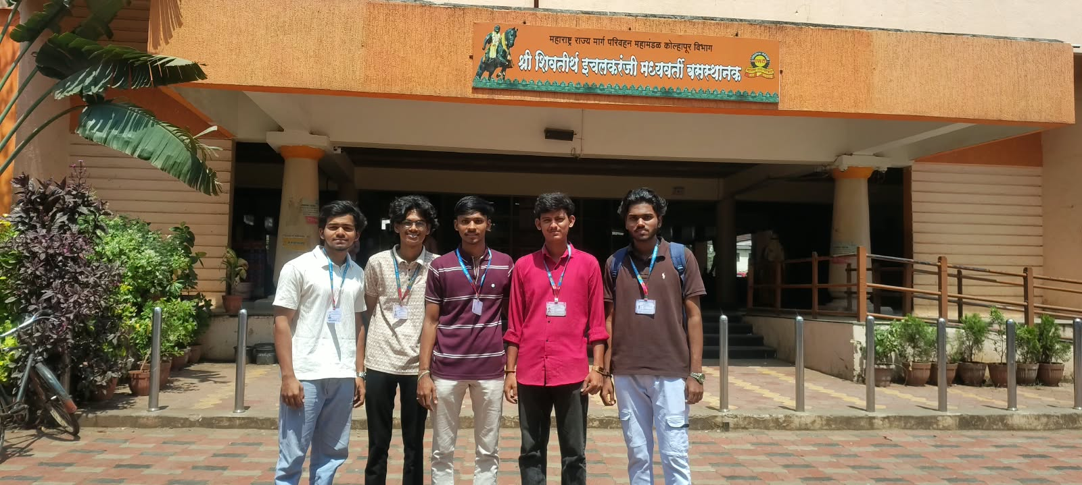
Field Visit
Purpose
Understand passenger, route-monitoring, crew-management and ticketing needs.
Focus areas
Bus tracking and passenger information
Ticketing and crew assignments
Route monitoring
Project team at Shri Shivtirth Ichalkaranji Madhyavarti Bus Stand (MSRTC, Kolhapur Division)
Maharashtra Transit Service | DKTE, Ichalkaranji
4

Slide 5
Technical Solution
GPS tracking
Bus devices + phone fallback, 4G/5G
Backend
Node.js/Python, REST + WebSocket
Data layer
PostgreSQL + Redis live cache
Passenger app
React Native, Android-first
Maps
OpenStreetMap / Google Maps API
Crew portal
Digital driver and conductor records
Booking
Tickets and passes via Razorpay/UPI
Hosting
NIC / Government Cloud
Testing
QA, pilot, phased rollout
Future scope
Crowd, routes, demand forecasting
Maharashtra Transit Service | DKTE, Ichalkaranji
5

Slide 6
Expected Outcomes and Timeline
30%
100%
50%
less passenger wait time
digital crew tracking per bus
less manual ticketing workload
Live bus location visible to passengers within six months of launch; higher public trust through reliability and transparency.
M1–2
M3–4
M5–7
M8–9
M10
M11–12
Research
Design
Development
Booking
Testing
Pilot
Maharashtra Transit Service | DKTE, Ichalkaranji
6

Slide 7
Conclusion
Closes the information gap between passengers and the MSRTC bus network.
Combines live GPS tracking, ETA, digital crew records, online booking and fleet management.
Built on GPS, Node.js/Python, PostgreSQL + Redis, React Native, Razorpay/UPI and NIC cloud.
Foundation for crowd monitoring, route optimization and demand forecasting across Maharashtra.
Thank you
Maharashtra Transit Service | DKTE, Ichalkaranji
7

