Slide 1
USE OF NEURAL NETWORK ALONG WITH OTHER CLASSIC MACHINE LEARNING ALGORITHMS FOR ECG CLASSIFICATION
Kunal Tamang
Master’s in Data Science
Liverpool John Moores University
Supervisor: Dr. Rituparna Datta
July 06, 2022

Slide 2


INTRODUCTION
LITERATURE REVIEW
PROBLEM STATEMENT
RESEARCH METHODOLOGY
RESULTS AND DISCUSSION
CONCLUSION AND REMARKS
OUTLINE

Slide 3
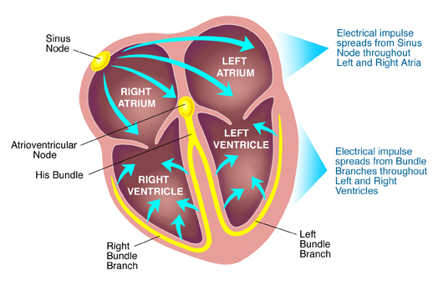
INTRODUCTION
Cardiac Cycle of Heart
Heartbeat originates from SA node (pacemaker).
Electric impulse reaches to AV node and cause the atrial contraction.
From AV node, the impulse transfers to bundle of
His and different bundle branch spreading it to ventricles.
Ventricles contract to eject blood into large arteries
leaving the heart.

Slide 4
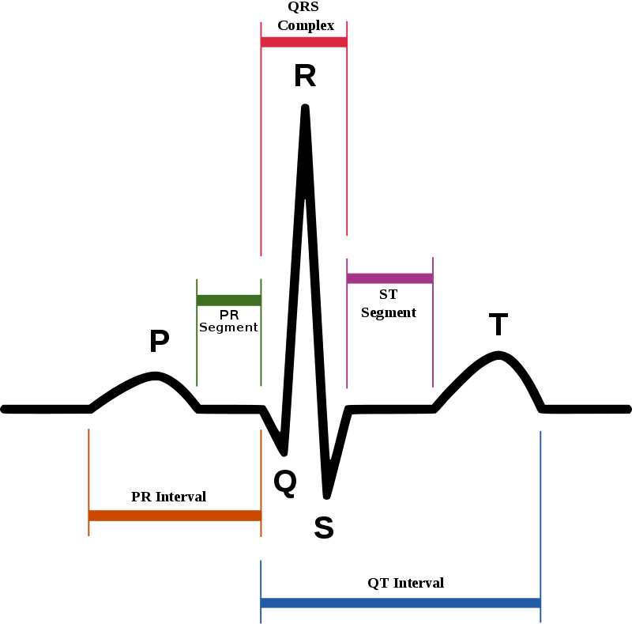
ECG signals have vital importance for heart disease diagnosis.
The features of ECG signals are peaks labelled as P, Q, R, S and intervals represented as PR, RR, QRS, ST and QT.
P wave → atrial depolarization/contraction
QRS wave → depolarization of ventricular
myocardium
ST wave → end of ventricular contraction and
beginning of repolarization
T wave → repolarization of ventricular
myocardium.

Slide 5
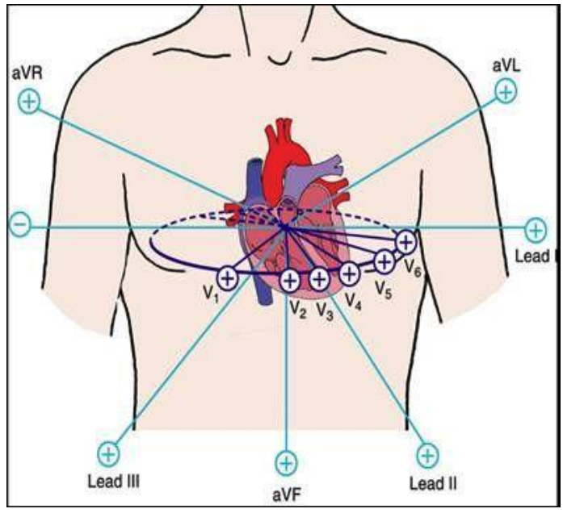
Uses 12-Lead ECG channels of recordings
Six leads on arms and legs:
Lead I, II, III, augmented Voltage Foot (aVF), augmented
Voltage Right (aVR), and augmented Voltage Left (aVL)
Six leads on chest:
V1, V2, V3, V4, V5, and V6

Slide 6
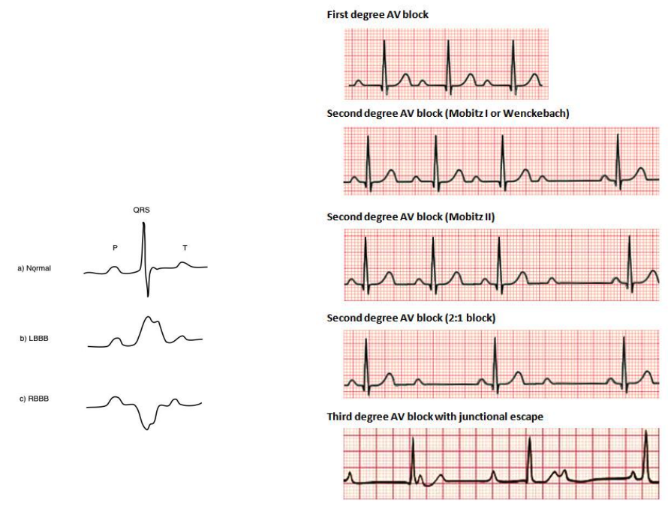
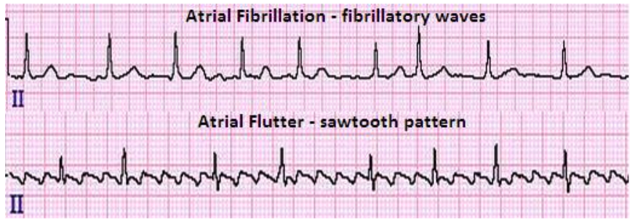
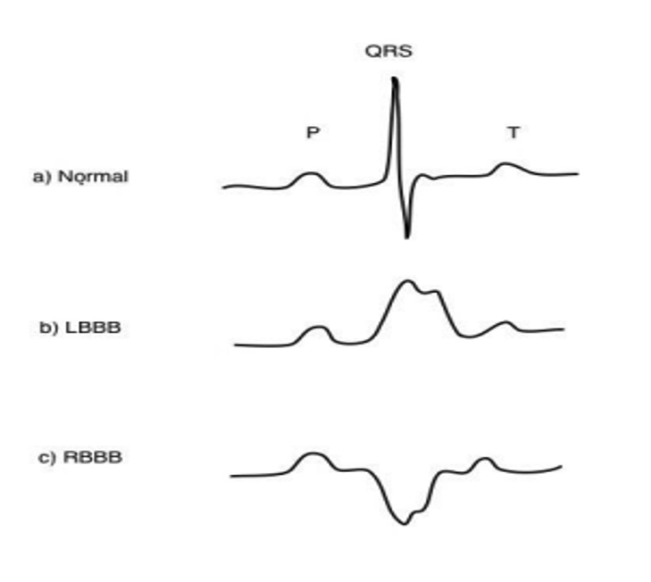
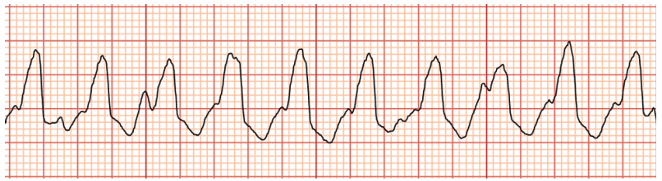
Arrhythmia
Irregular rhythm of heartbeat.
Examples: Premature Ventricular Contraction, Atrial Premature Contraction, Tachycardia, and Bradycardia.
Around 6.1 million people living with Atrial Fibrillation in USA and expected to increase to 12.1 million by 2030.
Fig: Atrial (top) and Ventricular (bottom)
Tachycardia (100-350 Bpm)
Fig: Bradycardia Arrhythmia (0-60 Bpm)

Slide 7
LITERATURE REVIEW
Support vector machine based arrhythmia classification using reduced features.
This research used SVM and MLP with LDA for feature selection to classify six classes of MIT-BIH dataset
showing SVM performance better than MLP.
Song et. al. (2005)
ECG beat classifier designed by combined neural network model.
This research used combined neural network model to classify normal beat, congestive heart failure beat,
ventricular tachyarrhythmia beat, and atrial fibrillation beat.
Guler et. al. (2005)
Support Vector machine-based arrhythmia classification using reduced features of heart rate variability signal.
This research used generalized discriminant analysis (GDA) feature reduction scheme and SVM classifier.
Babak et. al. (2008)

Slide 8
Detection of inter-patient left and right bundle branch block heartbeats in ECG using ensemble classifiers.
This research used majority vote approach to discriminate Normal, LBBB and RBBB. LDA classifier was used
for N and RBBB, SVM for LBBB and RBBB and minimum distance classifier (MDC) for LBBB and N.
Huang et. al. (2014)
A Study on Arrhythmia via ECG Signal Classification Using the Convolutional Neural Network.
This research used 12-layer deep one dimensional convolutional neural network for the classification of five
different classes of Arrrhythmia dataset.
Wu et. al. (2021)
A Hybrid Deep Learning Approach for ECG-Based Arrhythmia Classification.
This research used the combination of two different model: 2D convolutional neural network and Long Short-
Term Memory (LSTM) network for MIT-BIH arrhythmia database.
Madan et. al. (2022)

Slide 9
PROBLEM STATEMENT
Analyze ECG waveforms to detect abnormalities.
Use MIT-BIH Arrhythmia dataset.
Processing waveform for smooth classification.
Use Machine learning models: KNN, Random Forest and XGBoost.
Use Deep learning models: MLPNN and CNN.
Comparing classifiers to show the one having best performance.
Talk about scope of research and future works that can be done.

Slide 10
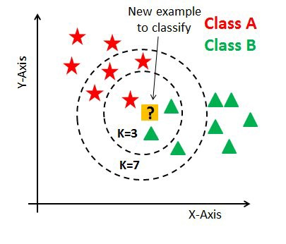
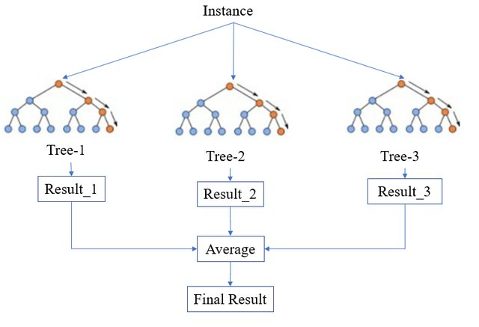
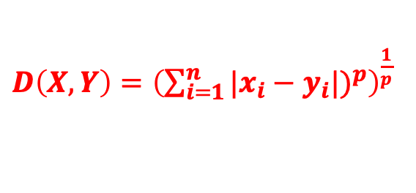
RESEARCH METHODOLOGY
K-Nearest Neighbor:
Finds minimum distance between training data and reference values in feature space.
Distances like Hamming, Euclidean and Minkowski distance used to find nearest neighbor.
Hyperparameter optimization using RandomizedSearchCV. (K=1)
$D\left(X,Y\right)={\left(\sum_{i=1}^{n}{|x_{i}−y_{i}|)^{p}}\right)}^{\frac{1}{p}}$
Random Forest:
Uses bootstrap aggregating ensemble method.
Avoids overfitting by selecting random set of features.
There are number of hyperparameters like number of trees, maximum split, maximum depth, etc.
(max_depth=96, max_samples=0.9, min_samples_split=3,
n_estimators=61)

Slide 11
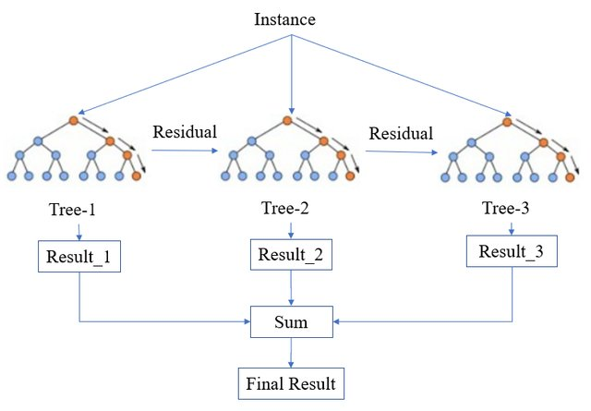
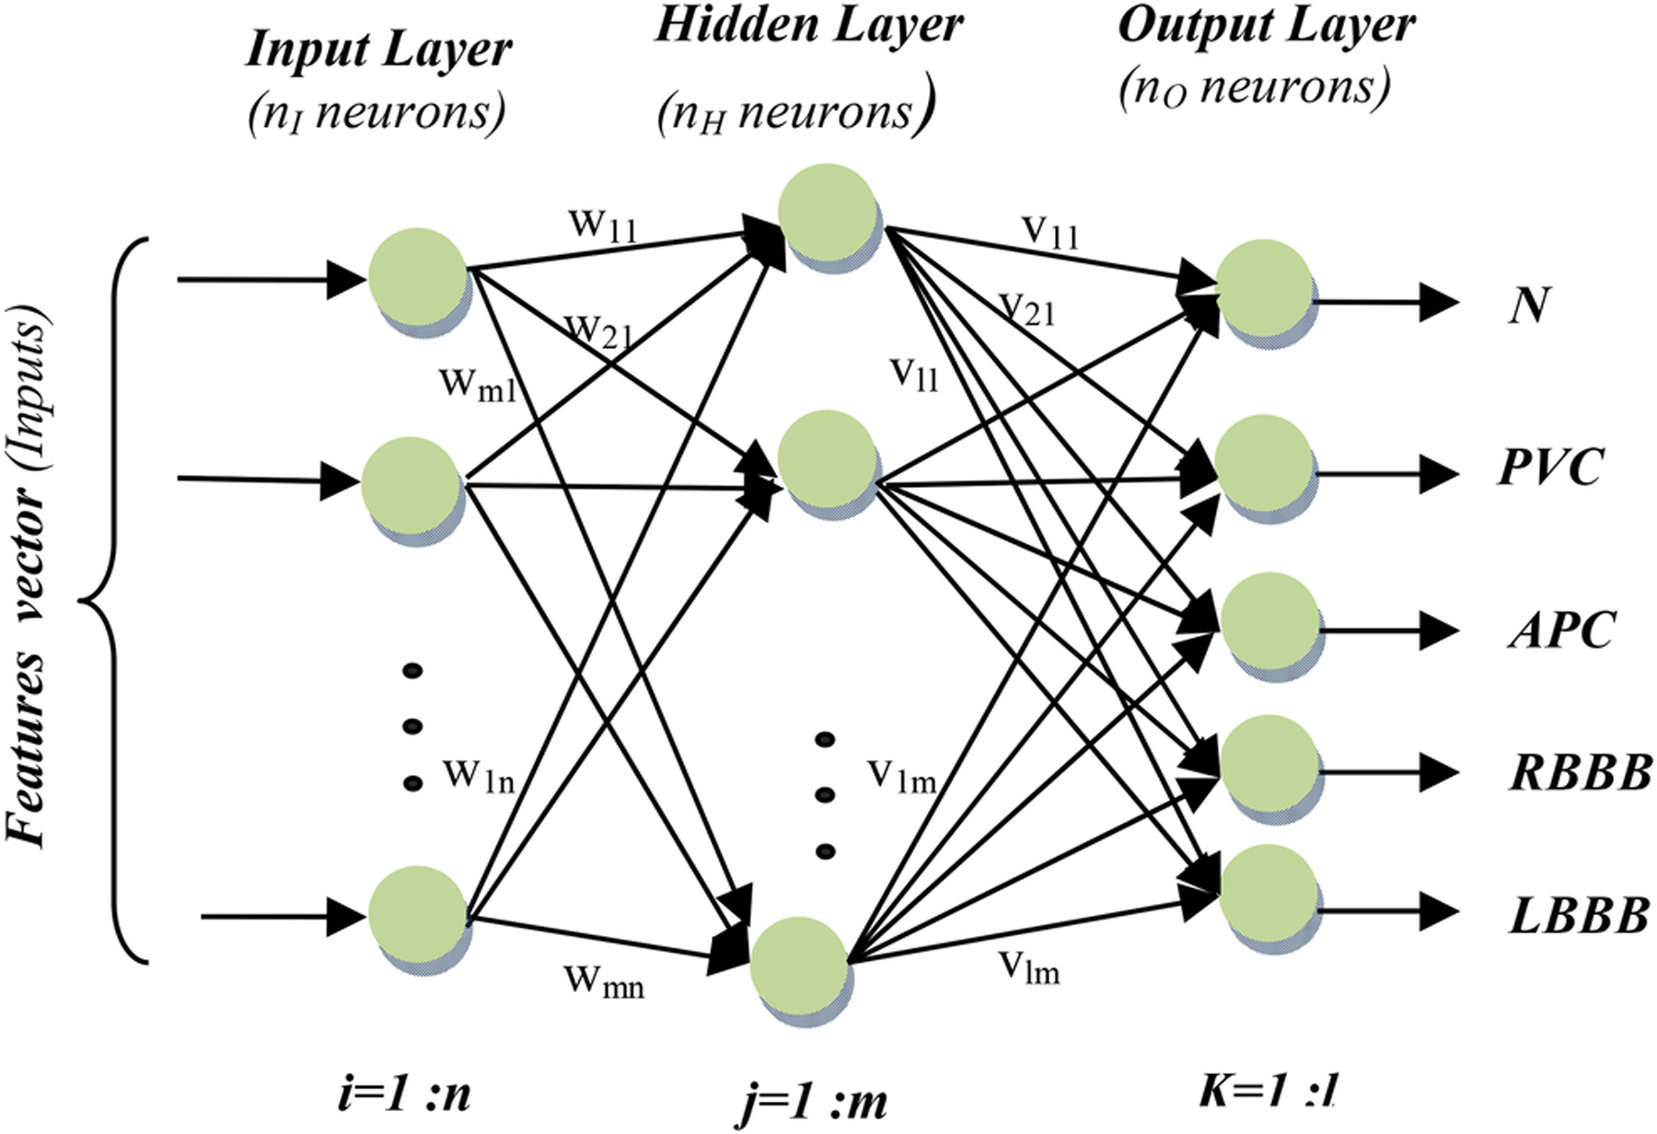
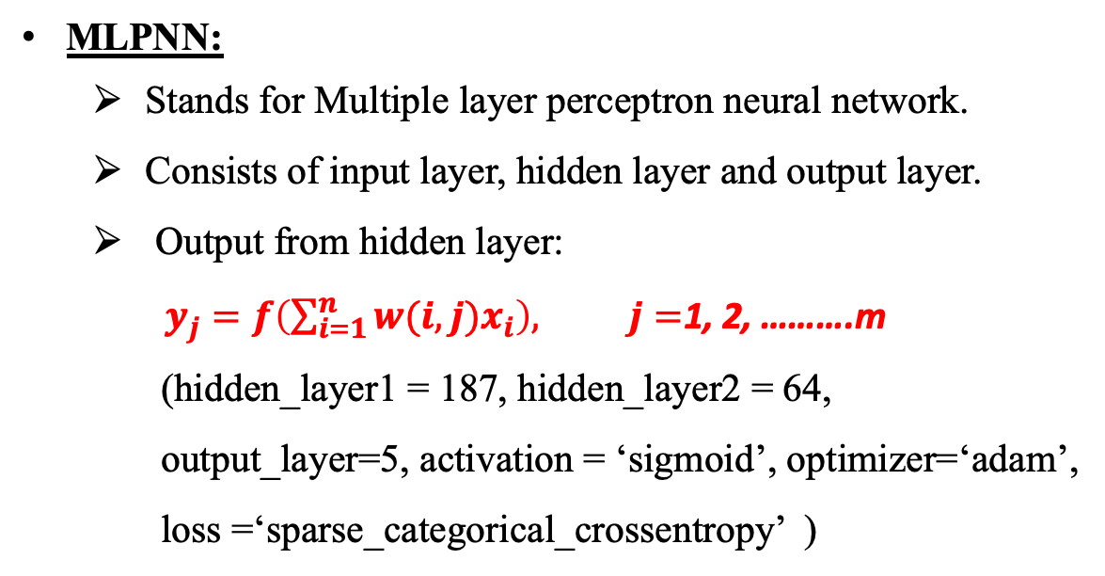
XGBoost:
Stands for Extreme Gradient Boosting.
Decreases classification variability from ensemble of multiple trees.
Uses pruning strategy to fix errors made from earlier trees.
Hyperparameters learns through gradient boosting method.
(learning_rate=0.1, n_estimators=200)
MLPNN:
Stands for Multiple layer perceptron neural network.
Consists of input layer, hidden layer and output layer.
Output from hidden layer:
$y_{j}=f\left(\sum_{i=1}^{n}{w(i,j)x_{i}}\right), j=$1, 2, ……….m
(hidden_layer1 = 187, hidden_layer2 = 64,
output_layer=5, activation = ‘sigmoid’, optimizer=‘adam’,
loss =‘sparse_categorical_crossentropy’ )

Slide 12
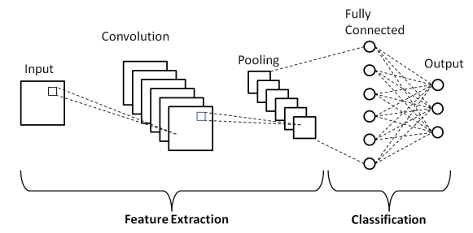
CNN
Stands for Convolutional Neural Network.
Consists of five different layers: input layer, convolutional layer, pooling layer, fully connected layer and output layer.
Convolution layer: extract high level features like
edges of input.
Pooling layer: reduces dimension of feature map
and number of parameters making computation
faster.
(Conv1D_layer=(32,64,128), kernel_size=(3,3,5),
padding=‘same’, activation=‘relu’,
hidden_layer1= 512, hidden_layer2 = 1024,
activation_output=‘softmax’, optimizer=‘adam’,
loss =‘sparse_categorical crossentropy’)

Slide 13
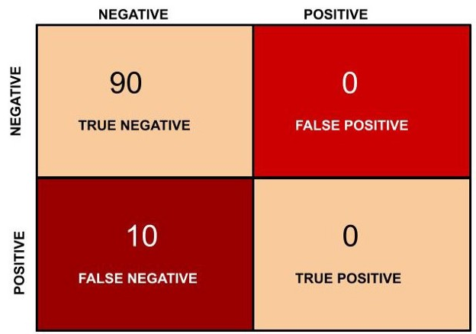




Performance Metrics
Predicted
Confusion Matrix:
Total | Positive | Negative
Positive | True Positive (TP) | False Negative (FN)
Negative | False Positive (FP) | True Negative (TN)
Accuracy = $\frac{TN+TP}{TN+FP+TP+FN}$
Precision = $\frac{TP}{TP+FP}$
Actual
Recall = $\frac{TP}{TP+FN}$
F1-Score = 2 $∗ \frac{Precision∗Recall}{Precison+Recall}$
Accuracy is 90% in second figure but there are 0 true
positive values So we need metrics like precision,
recall and F1-score.

Slide 14
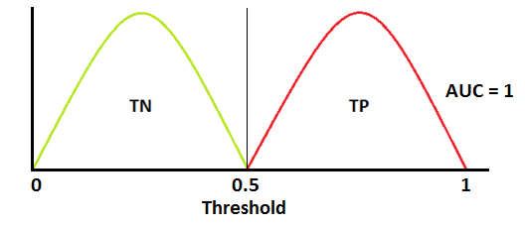
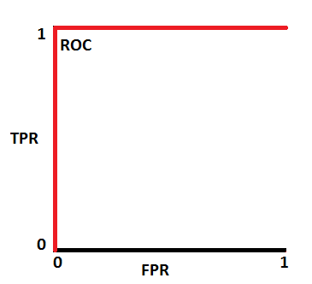
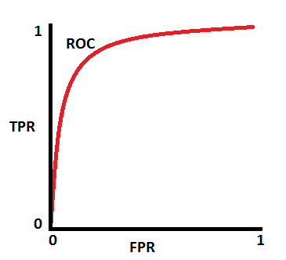
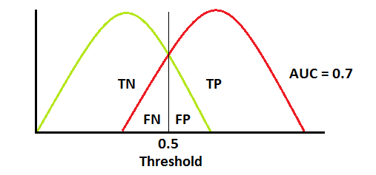
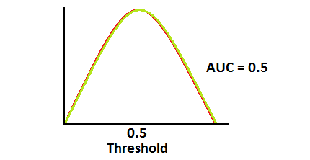
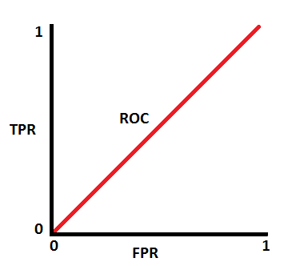
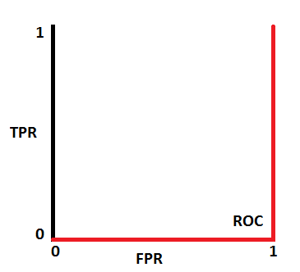
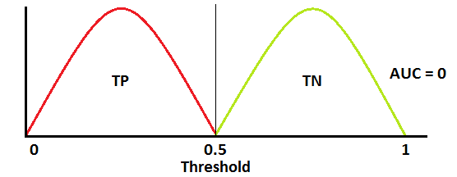
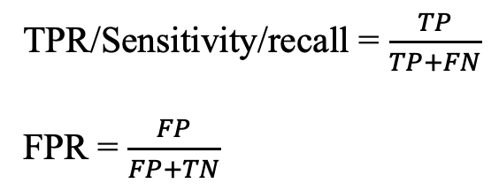
ROC curve:
Stands for Receiver Operation Characteristics Curve.
TPR/Sensitivity/recall = $\frac{TP}{TP+FN}$
FPR = $\frac{FP}{FP+TN}$
Higher the AUC, better the model is.

Slide 15
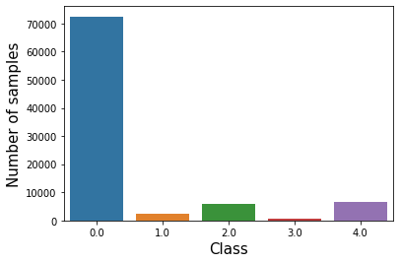
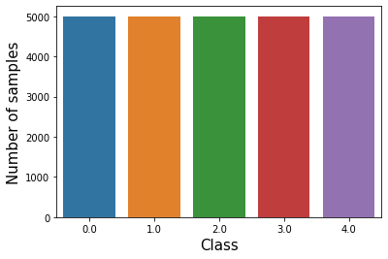
RESULTS AND DISCUSSION
Data preprocessing:
Dataset: Open-source MIT-BIH Arrythmia dataset
Class 0: Normal beats, Class 1: Atrial Premature, Class 2: Premature Ventricular Contraction,
Class 3: Fusion beats of Ventricular and Normal, Class 4: Fusion of paced and normal
Resampling the data to down sample the class with higher frequency and up-sample the class with lower frequency.
Class | Number of samples
0 | 72471
1 | 2223
2 | 5788
3 | 641
4 | 6431

Slide 16
Accuracy and F1 score:
The F1-score for minority classes are lower due to class imbalance.
KNN Accuracy: 91%
XGBoost Accuracy: 90%
Random Forest Accuracy: 95%
Random Forest performs better than other algorithms.
Class | Precision | Recall | F1-score | Support
0 | 0.99 | 0.94 | 0.96 | 18118
1 | 0.40 | 0.79 | 0.53 | 556
2 | 0.80 | 0.93 | 0.86 | 1448
3 | 0.41 | 0.81 | 0.54 | 162
4 | 0.96 | 0.96 | 0.96 | 1608
Accuracy |  |  | 0.91 | 21892
Macro Avg | 0.71 | 0.89 | 0.77 | 21892
Weighted Avg | 0.96 | 0.93 | 0.94 | 21892
KNN
Class | Precision | Recall | F1-score | Support
0 | 0.99 | 0.83 | 0.90 | 18118
1 | 0.41 | 0.79 | 0.54 | 556
2 | 0.82 | 0.91 | 0.86 | 1448
3 | 0.36 | 0.86 | 0.51 | 162
4 | 0.95 | 0.97 | 0.96 | 1608
Accuracy |  |  | 0.90 | 21892
Macro Avg | 0.71 | 0.87 | 0.76 | 21892
Weighted Avg | 0.96 | 0.85 | 0.89 | 21892
XGBoost
Class | Precision | Recall | F1-score | Support
0 | 0.99 | 0.96 | 0.97 | 18118
1 | 0.52 | 0.81 | 0.63 | 556
2 | 0.84 | 0.94 | 0.89 | 1448
3 | 0.46 | 0.85 | 0.59 | 162
4 | 0.96 | 0.97 | 0.96 | 1608
Accuracy |  |  | 0.95 | 21892
Macro Avg | 0.77 | 0.90 | 0.82 | 21892
Weighted Avg | 0.96 | 0.95 | 0.96 | 21892
Random Forest

Slide 17
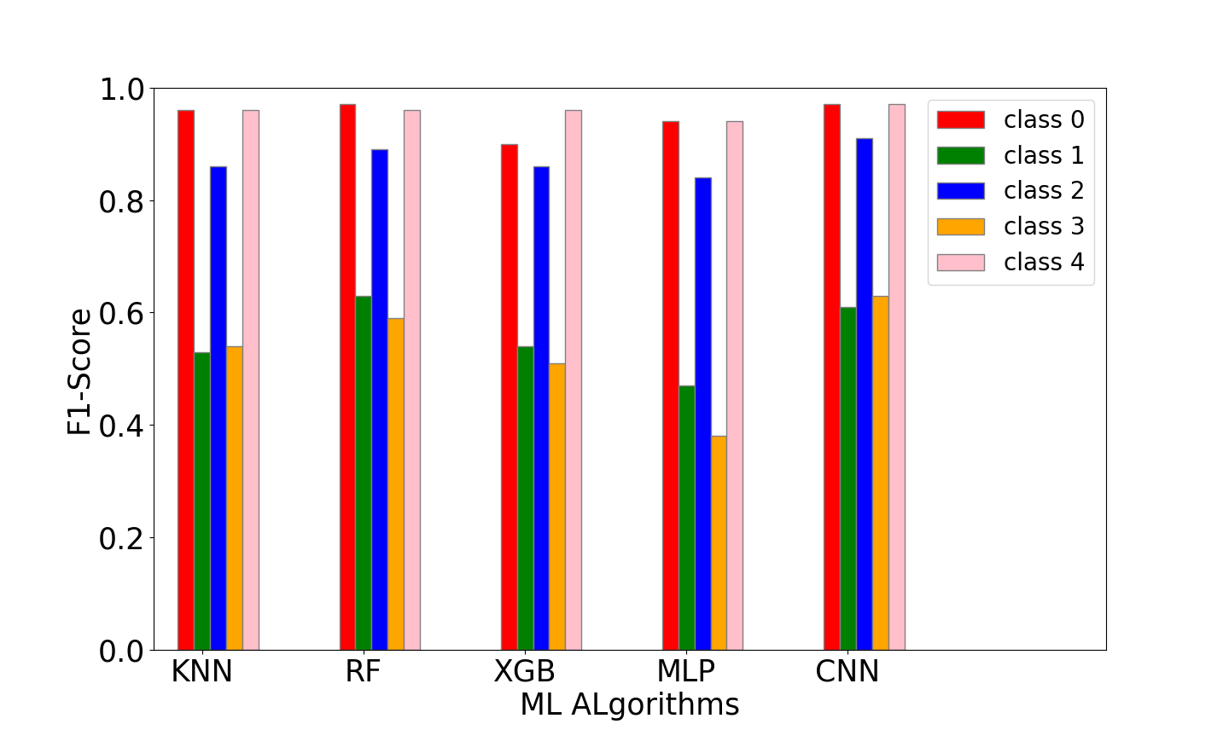
MLPNN Accuracy: 89%
CNN Accuracy: 96%
F1-score for minority classes improved for CNN
Class | Precision | Recall | F1-score | Support
0 | 0.99 | 0.95 | 0.97 | 18118
1 | 0.47 | 0.86 | 0.61 | 556
2 | 0.87 | 0.95 | 0 .91 | 1448
3 | 0.50 | 0.88 | 0.63 | 162
4 | 0.95 | 0.98 | 0.97 | 1608
Accuracy |  |  | 0.96 | 21892
Macro Avg | 0.76 | 0.93 | 0.82 | 21892
Weighted Avg | 0.97 | 0.95 | 0.96 | 21892
CNN
Class | Precision | Recall | F1-score | Support
0 | 0.99 | 0.90 | 0.94 | 18118
1 | 0.33 | 0.82 | 0.47 | 556
2 | 0.76 | 0.93 | 0.84 | 1448
3 | 0.24 | 0.88 | 0.38 | 162
4 | 0.93 | 0.96 | 0.94 | 1608
Accuracy |  |  | 0.89 | 21892
Macro Avg | 0.65 | 0.90 | 0.71 | 21892
Weighted Avg | 0.95 | 0.90 | 0.92 | 21892
MLPNN

Slide 18
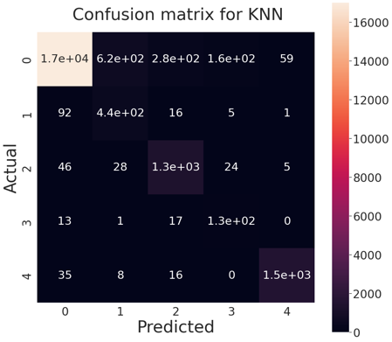

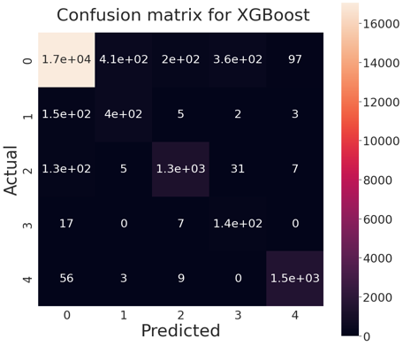


Confusion Matrix:
The diagonal element represents the predicted number of samples from a class which actually belongs to same class.
CNN and Random Forest models predicts more number of samples accurately compared to other models.

Slide 19
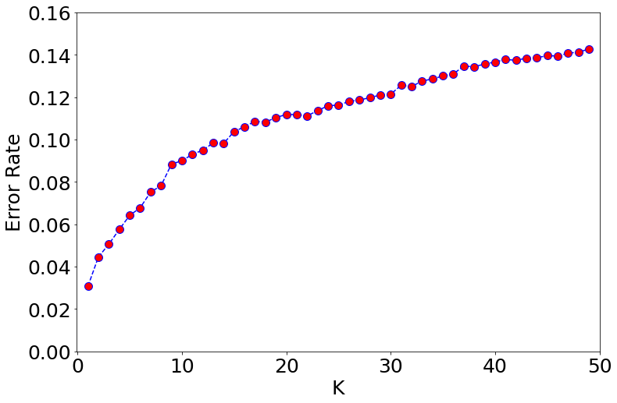
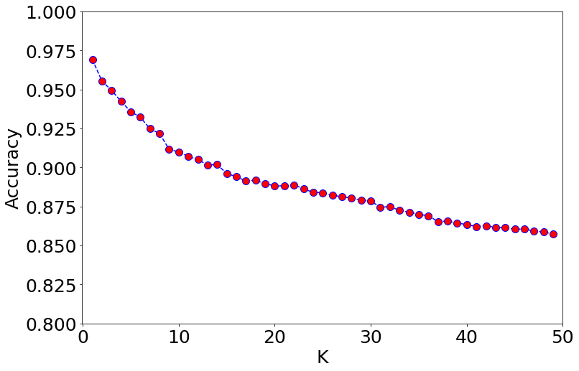
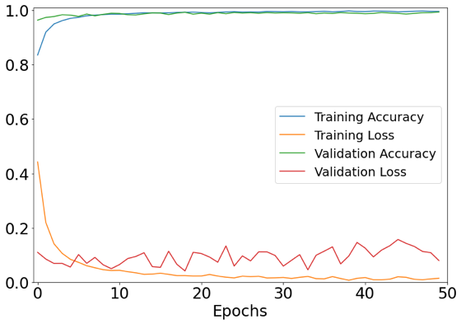
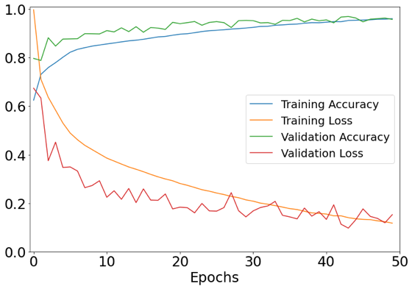
Loss Function:
The graph of error/accuracy with respect to ‘k’ shows the optimal value of nearest neighbor as 1.
The graph training and testing accuracy/loss with respect to epoch shows how they saturate giving the optimal value of epoch as 50.
KNN
MLPNN
CNN

Slide 20
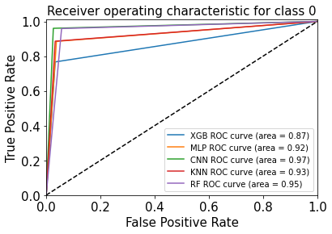
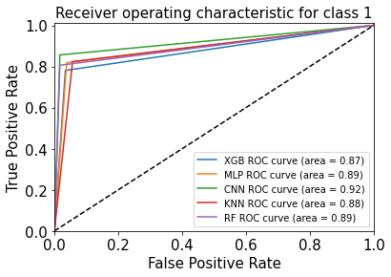
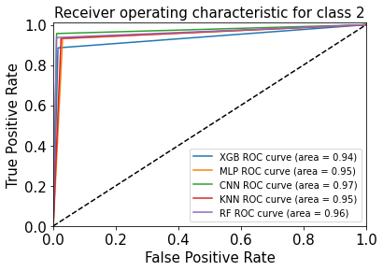
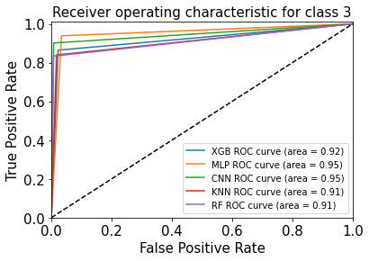
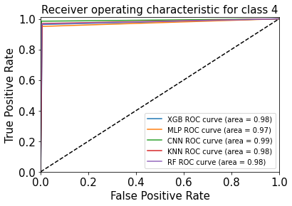
ROC Curve:
The graph shows the performance of each model for each class showing the area under the curve.
CNN and Random Forest performs better compared to other algorithms.

Slide 21
CONCLUSION AND REMARKS
The comparison among our five different algorithms shows that Convolutional Neural Network (accuracy -> 96%) and Random Forest (accuracy -> 95%) performs very well in our classification problem.
We also used F1-score and ROC curve for 5 different classes showing these two algorithms performing better than others.
The performance of all these algorithms can be improved by optimizing hyperparameters with a more detailed analysis.
This work can be good initiation for understanding the problem and looking for more efficient and reliable solution.
One can look for better architecture, combination of different models like CNN and LSTM, reducing the noise in signal as well as trying other algorithms like Recurrent Neural Network.

Slide 22
REFERENCES
Pławiak, P., (2018b) Novel methodology of cardiac health recognition based on ECG signals and evolutionary-neural system. Expert Systems with Applications, 92, pp.334–349.
Zubair, M., Kim, J. and Yoon, C., (2016) An automated ECG beat classification system using convolutional neural networks. 2016 6th International Conference on IT Convergence and Security, ICITCS 2016.
Zhang, Z., Dong, J., Luo, X., Choi, K.S. and Wu, X., (2014) Heartbeat classification using disease-specific feature selection. Computers in Biology and Medicine, 461, pp.79–89.
Acharya, U.R., Oh, S.L., Hagiwara, Y., Tan, J.H., Adam, M., Gertych, A. and Tan, R.S., (2017) A deep convolutional neural network model to classify heartbeats. Computers in Biology and Medicine, [online] 89August, pp.389–396. Available at: https://doi.org/10.1016/j.compbiomed.2017.08.022.
E., T., El-Sayed, A. and R., S., (2016) A Survey on Classification of ECG Signal Study. Communications on Applied Electronics, 65, pp.11–16.
Li, H., Yuan, D., Ma, X., Cui, D. and Cao, L., (2017) Genetic algorithm for the optimization of features and neural networks in ECG signals classification. Scientific Reports, [online] 7January, pp.1–12.
Available at: http://dx.doi.org/10.1038/srep41011.

Slide 23
Song, M.H., Lee, J., Cho, S.P., Lee, K.J. and Yoo, S.K., (2005) Support vector machine based arrhythmia classification using reduced features. International Journal of Control, Automation and Systems, 34, pp.571–579.
Güler, I. and Übeyli, E.D., (2007) Multiclass support vector machines for EEG-signals classification. IEEE Transactions on Information Technology in Biomedicine, 112, pp.117–126.
Asl, B.M., Setarehdan, S.K. and Mohebbi, M., (2008) Support vector machine-based arrhythmia classification using reduced features of heart rate variability signal. Artificial Intelligence in Medicine, 441, pp.51–64.
Huang, H., Liu, J., Zhu, Q., Wang, R. and Hu, G., (2014) A new hierarchical method for inter-patient heartbeat classification using random projections and RR intervals. BioMedical Engineering Online, 131, pp.1–26.
Wu, M., Lu, Y., Yang, W. and Wong, S.Y., (2021) A Study on Arrhythmia via ECG Signal Classification Using the Convolutional Neural Network. Frontiers in Computational Neuroscience, 14January, pp.1–10.

Slide 24
Abstract
Electrocardiogram (ECG) is widely used instrument to monitor the diagnoses of cardiovascular system. It takes a highly skilled experts with a lot of experience to diagnose the ECG signal which consumes a lot of time as well as medical resources. The problem of accurately classifying the ECG signal is very challenging. The results are limited because of shallow feature learning architectures. The problem also relies on looking for the most appropriate features for classifying these ECG signals appropriately. Therefore, Machine learning (ML) solutions as well as Artificial Neural Networks are prevalent to analyze and classify ECG data. Machine learning Algorithms are applied to build a model and the performance of these different models can be differentiated based on evaluation metrics. Artificial Neural Networks learn tasks by examples and composed of stacked transformation. It has recently been popular due to its success in variety of task and therefore, it has lot of potential in improving various clinical practices. It has been shown by various studies that with enough data, ANN can show the accuracy to the level of human-expert cardiologist. In this research, different ML models like KNN, XGBoost, and Random Forest and deep learning model like MLPNN and CNN will be trained, and their performance will be presented based on evaluation metrics. In our paper, we will also discuss about the problems encountered in ECG classification, ANNs classifiers, feature extraction tools, pre-processing techniques, ECG database and measures to evaluate the performance. Furthermore, this paper will represent the limitation, performance, and details of each of the classifier and present the detail analysis of best possible classifier based on evaluation index.

Slide 25
THANK YOU !

