Slide 1

A/B testing Report
Growth Product and Engineering team (GloBox)

Slide 2

Pre-Analysis
The A/B test is being conducted to increase revenue in the food and drink category on the GloBox website by testing a banner highlighting key products, with the goal of providing a recommendation on whether to launch the experience to all users.

Slide 3
Hypothesis
Null Hypothesis: There is no significant difference in total revenue between the control group and the treatment group.
Alternative Hypothesis: The treatment group will have a significantly higher total revenue than the control group.

Slide 4

VERSION B
VERSION A

Slide 5
Metrics of Analysis
Conversion Rate
Average Order Value

Slide 6

Exploratory Data Analysis
The metrics for the control group showed that there were 24,343 users who placed a total of 24,343 orders, resulting in a total revenue of $82,145.90 and an average order value of $3.37.
The metrics for the treatment group showed that there were 24,600 users who placed a total of 24,600 orders, resulting in a total revenue of $83,415.33 and an average order value of $3.39

Slide 7
Exploratory Data Analysis
The analysis showed that the treatment group had a higher conversion rate than the control group.
The control group's conversion rate was 0.039, while the treatment group's conversion rate was 0.046, representing a 0.71% increase.
The difference in average order value between the two groups was 1.63%, with version B having a higher average order value.

Slide 8
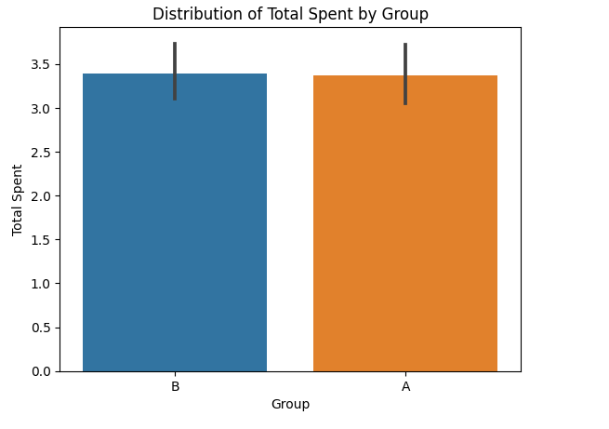
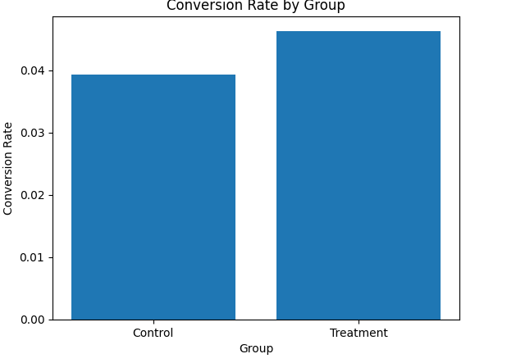
Conversion plot
Distribution Plot of the groups

Slide 9
Statistical Analysis
At a confidence level of 95 %, the Alpha value of 5%, and the probability of observing a result as extreme or more extreme than the one obtained if the null hypothesis is true is 0.0001 which is less than the alpha value suggesting strong evidence against the null hypothesis. This indicates that the results are statistically significant and the experiment is successful.
The chi-squared statistics of 14.76. The magnitude of this value indicates a moderate-to-strong degree of deviation from the null hypothesis.

Slide 10
Discussion
The results of this A/B test provide evidence that version B of the website is more effective in driving revenue than version A. However, it is important to note that other factors beyond the website version may have influenced the results, such as the time of day or the type of customer accessing the website. To ensure the validity of the test, it is recommended to perform the test over a longer period and with a larger sample size.

Slide 11

Recommendation
The A/B test analysis showed that version B of the website is more effective in generating revenue than version A.
The treatment group had a higher conversion rate, average order value, and total revenue than the control group.
These findings suggest that version B should be implemented as the new version of the website.

