Slide 1
Improvements in ATS-2
Kundadanti Kurhe

Slide 2
What is ATS-2 Tool
ATS-2 is the tool for managing ATS (Automated Test Selection) files for single as well as multiple test targets.
Helps to modify test configuration
To Compare and Search Requirements(Single as well as Multiple), Parameters, Test-package etc.

Slide 3
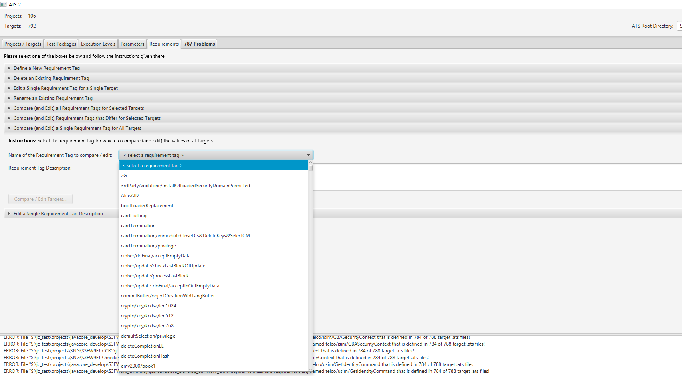
Existing Functionality / Behavior
While searching and comparing any Requirements, Parameters or Test Packages we can’t enter those values directly, We need to scroll-down, sometimes this was time consuming.
`

Slide 4
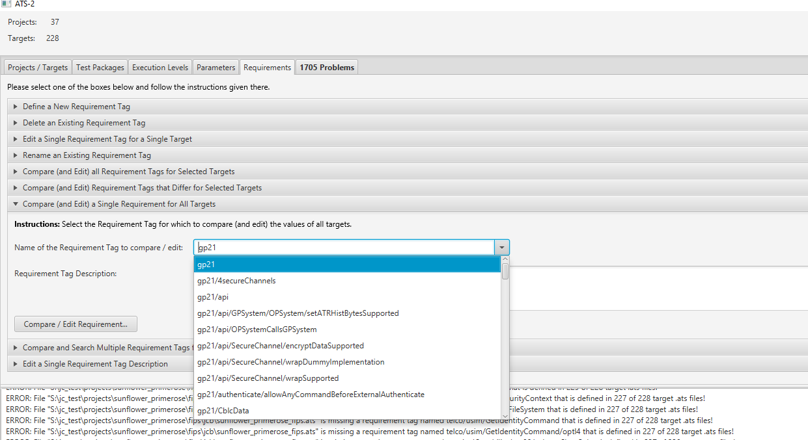
After Improvement
While entering text into search box we will get related data only.
`

Slide 5
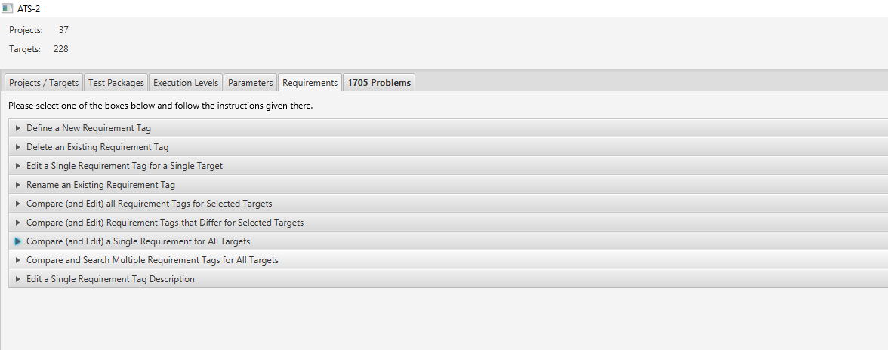
Added New Feature
Added new feature in Requirements Tab Pane By adding Accordion tab for Comparing and search multiple requirements for All Targets.
`

Slide 6
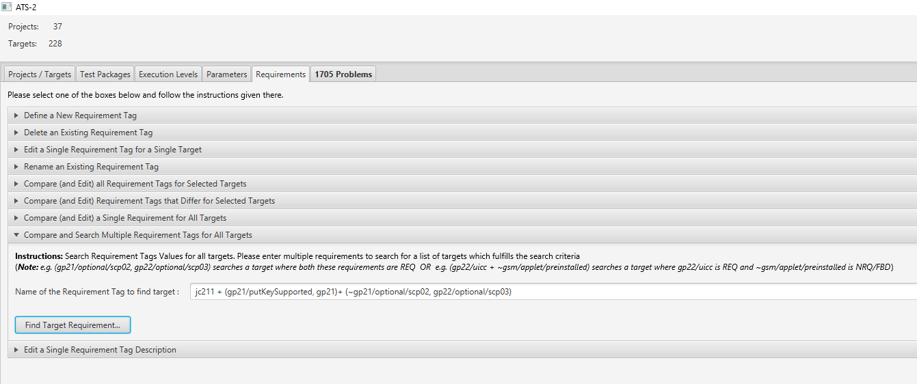
We can enter Multiple Requirements to search for the list of targets which fulfill the search criteria, e. g. is given below

Slide 7
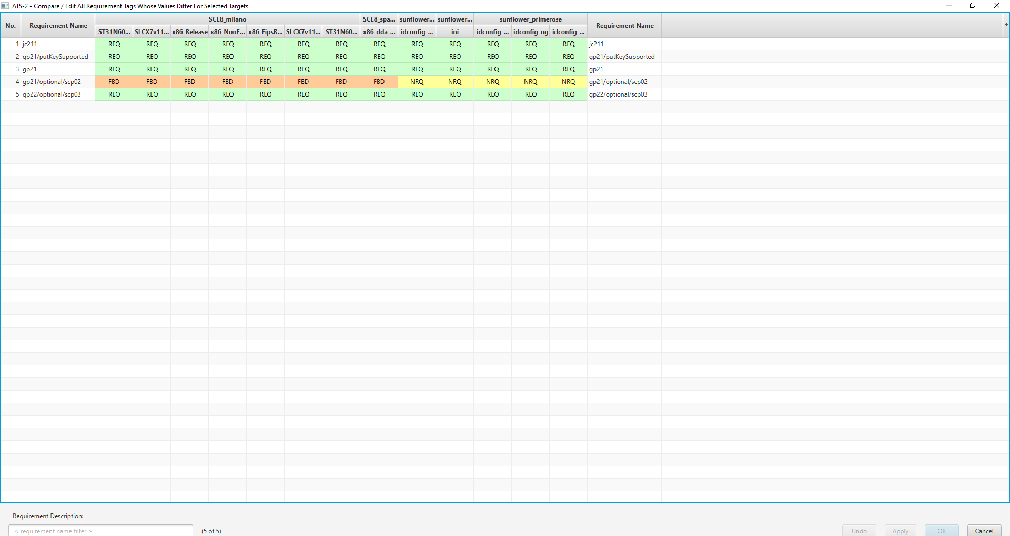
Click on the Find Target requirement button, we get the List

Slide 8
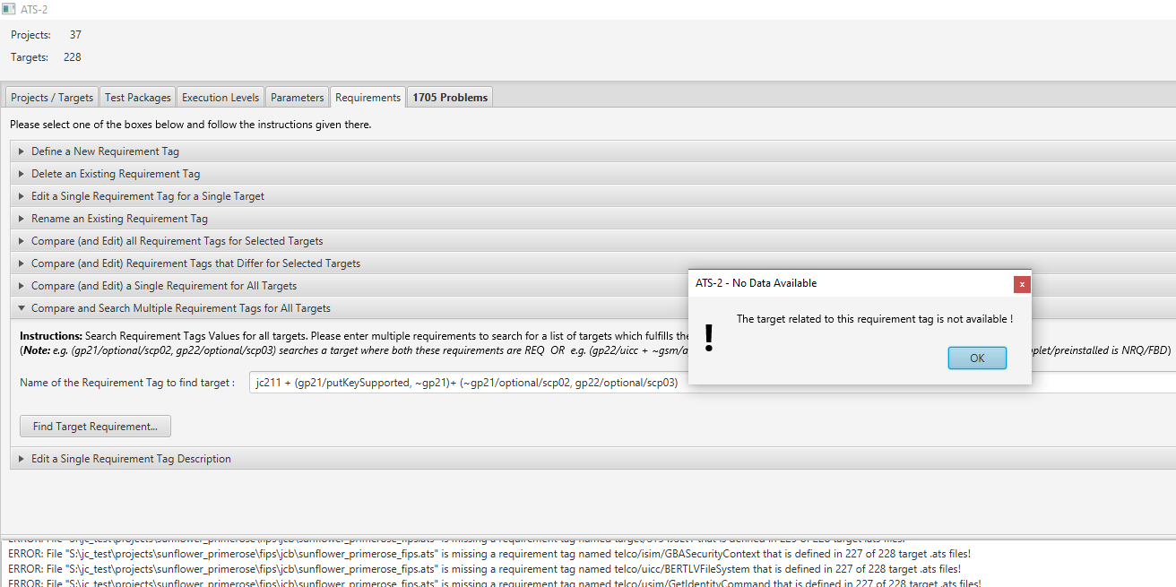
If one of the Requirement is not available in any of the target, then we will get pop-up window

Slide 9
Thank You

