Slide 1
Customer Churn Analysis
Data Analyst Internship Project Presentation
Prepared By: Afzal Rangrej & Team
Tools Used:
Python
SQL
FastAPI
Power BI

Slide 2
Project Overview
Analyze telecom customer churn, identify churn drivers, segment customers by value, and provide business insights using Power BI.
This project focuses on analyzing customer churn in a telecom company.
Using customer demographic, service, and revenue data, we identified churn drivers, segmented customers based on value, and developed interactive Power BI dashboards.
The objective is to help management understand customer behaviour and make data-driven retention decisions.

Slide 3
Problem Statement
High customer churn impacts revenue and growth. The objective is to identify risk factors and improve retention.
Data-driven insights are required to improve customer retention and loyalty.
Customer churn negatively impacts profitability and customer lifetime value.
Understanding churn behaviour is essential for effective retention strategies.
The goal is to identify high-risk customers and reduce future churn.

Slide 4
Project Objectives
Analyze customer churn patterns.
Measure churn rate and retention trends.
Identify major churn drivers.
Segment customers by value.
Analyze revenue contribution.
Support data-driven business decisions.

Slide 5
Dataset Overview
Dataset Name: Telco Customer Churn Dataset
Total Records: 7,032 Customers
Target Variable: Churn
Major Attributes:
Customer Demographics
Contract Information
Revenue Metrics
Business Goal:
Understand churn behaviour
Identify high-risk customers
Support retention strategies

Slide 6
Methodology
Data Collection
↓
Data Cleaning
↓
Feature Engineering
↓
Exploratory Data Analysis
↓
Dashboard Development
↓
Business Insights
↓
Deployment

Slide 7
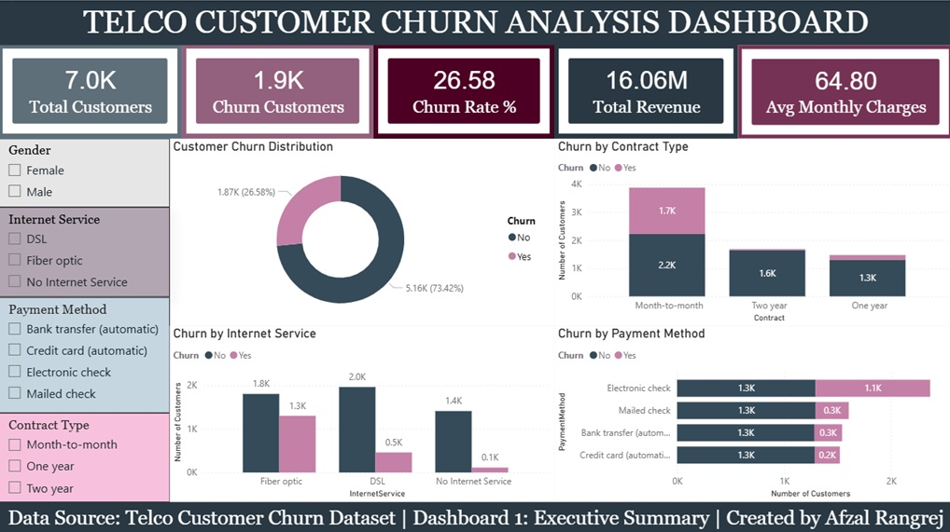
Dashboard 1: Executive Summary

Slide 8
Dashboard 1 : Key Insights
Overall churn rate is 26.58%.
Month-to-Month customers churn the most.
Fiber Optic users show higher churn.
Electronic Check customers have higher churn.
Total revenue generated is ₹16.06M.
Contract type and payment method strongly influence churn.

Slide 9
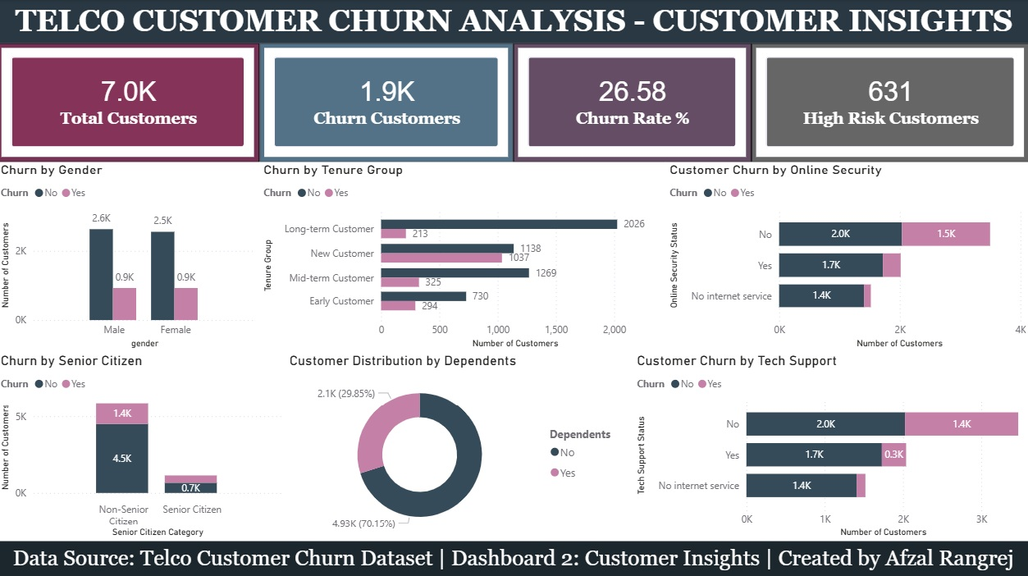
Dashboard 2: Customer Insights

Slide 10
Dashboard 2 : Key Insights
Overall churn rate remains 26.58%, with 631 High-Risk Customers identified.
Gender has minimal impact on churn, as male and female customers show similar churn patterns.
Senior Citizens exhibit higher churn risk compared to non-senior customers.
New and short-tenure customers are more likely to churn than long-term customers.
Customers without Online Security show significantly higher churn levels.
Customers without Tech Support are more likely to leave the company.
One Line Conclusion :
Online Security, Tech Support, customer tenure, and senior citizen status are the strongest churn indicators in this dashboard.

Slide 11
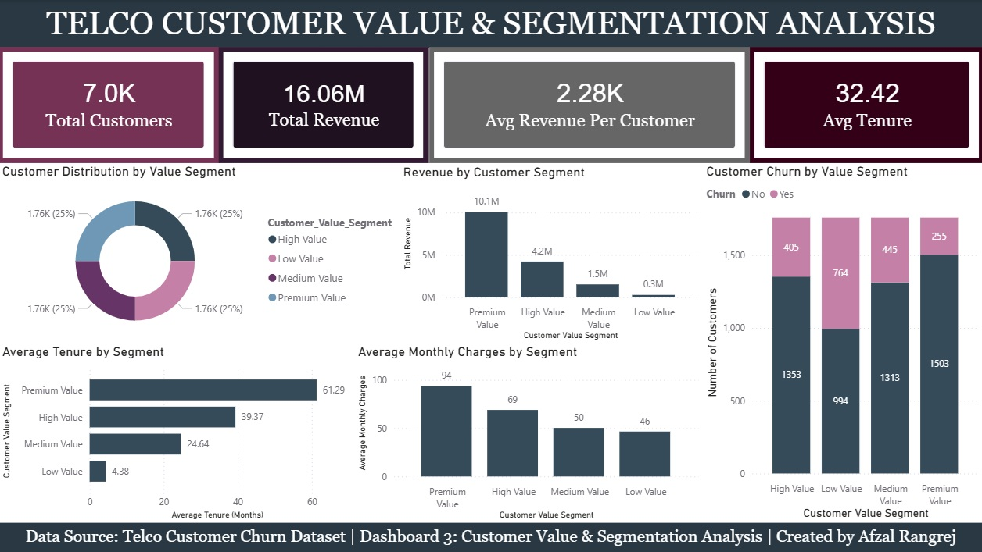
Dashboard 3: Customer Value Segmentation

Slide 12
Dashboard 3 : Key Insights
Total Revenue generated is ₹16.06M from 7,032 customers.
Premium Value Customers contribute the highest revenue (₹10.1M), making them the most valuable segment.
Premium customers have the highest average tenure (61.29 months), indicating strong loyalty.
Premium customers also pay the highest monthly charges (₹94 average).
Low Value Customers generate the least revenue (₹0.3M) and have the shortest tenure (4.38 months).
The Low Value Segment shows the highest churn count (764 customers), indicating a retention challenge.
One Line Conclusion :
Premium customers drive the majority of revenue and show the strongest loyalty, while Low Value customers represent the highest churn risk and retention opportunity.

Slide 13
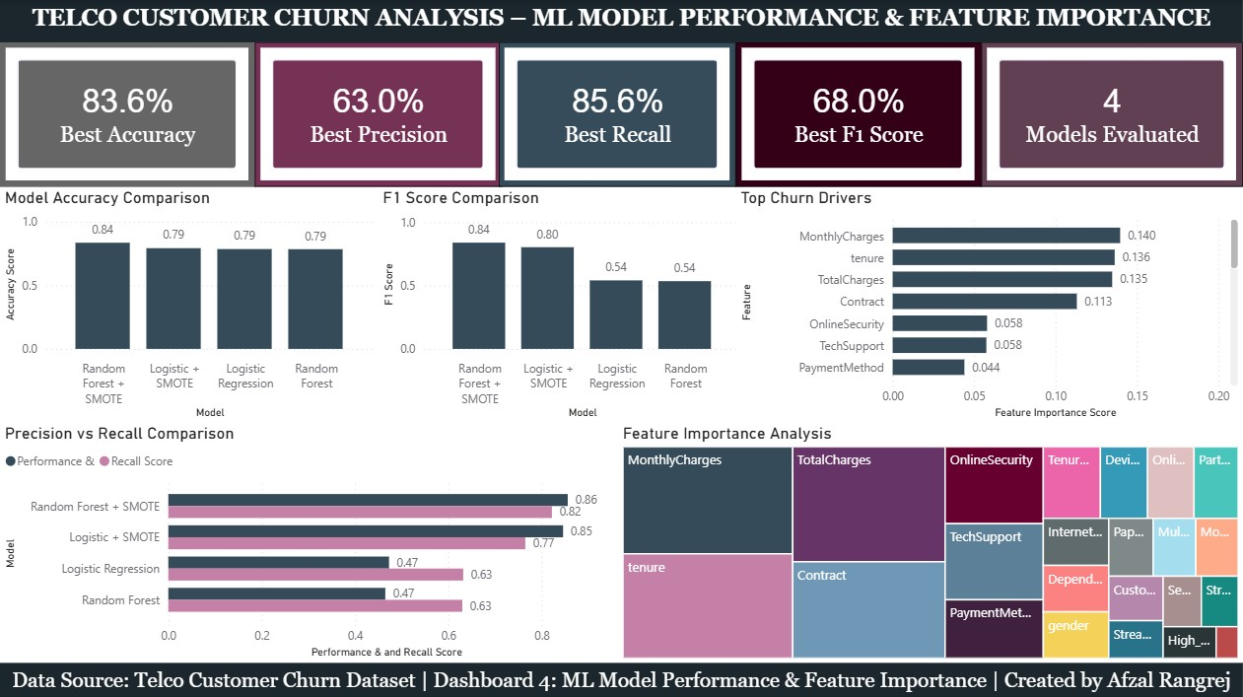
Dashboard4: ML Model Performance & Feature Importance

Slide 14
Dashboard 4 Key Insights
Random Forest + SMOTE was the best-performing model, achieving 83.6% accuracy, 85.6% recall, and 68.0% F1-score.
Applying SMOTE improved model performance by addressing class imbalance and enhancing churn prediction capability.
Monthly Charges, Tenure, and Total Charges were identified as the most influential factors driving customer churn.
Contract type significantly impacts retention, with customers on flexible contracts showing a higher likelihood of churn.
Service-related features such as Online Security and Tech Support also play an important role in customer retention.

Slide 15
Business Recommendations
Encourage customers to switch from Month-to-Month contracts to One-Year or Two-Year plans through discounts and loyalty benefits.
Provide bundled Internet + Online Security + Tech Support packages to reduce churn risk.
Launch targeted retention campaigns for High-Risk Customers before contract renewal periods.
Focus on Low-Value and New Customers with personalized offers to increase engagement and lifetime value.
By focusing on contract retention, service bundling, customer segmentation, and proactive engagement, the company can significantly reduce churn and improve customer lifetime value.

Slide 16
Docker Deployment of Customer Churn Prediction API
Objective:
Containerize the FastAPI application using Docker.
Ensure consistent execution across different environments.
Simplify deployment and scalability.
Technologies Used:
Docker Desktop
Docker Engine
Docker Hub
FastAPI
Unicorn
Python 3.11

Slide 17
Docker Deployment of Customer Churn Prediction API
Deployment Workflow:
FastAPI Application
↓
Docker file
↓
Docker Image Build
↓
Docker Container
↓
API Running on Port 8000
↓
Docker Hub Repository

Slide 18
Docker Containerization Process
Step | Description
1 | Created Dockerfile
2 | Created requirements.txt
3 | Built Docker Image
4 | Ran Docker Container
5 | Tested FastAPI API
6 | Verified Swagger UI
7 | Pushed Image to Docker Hub

Slide 19
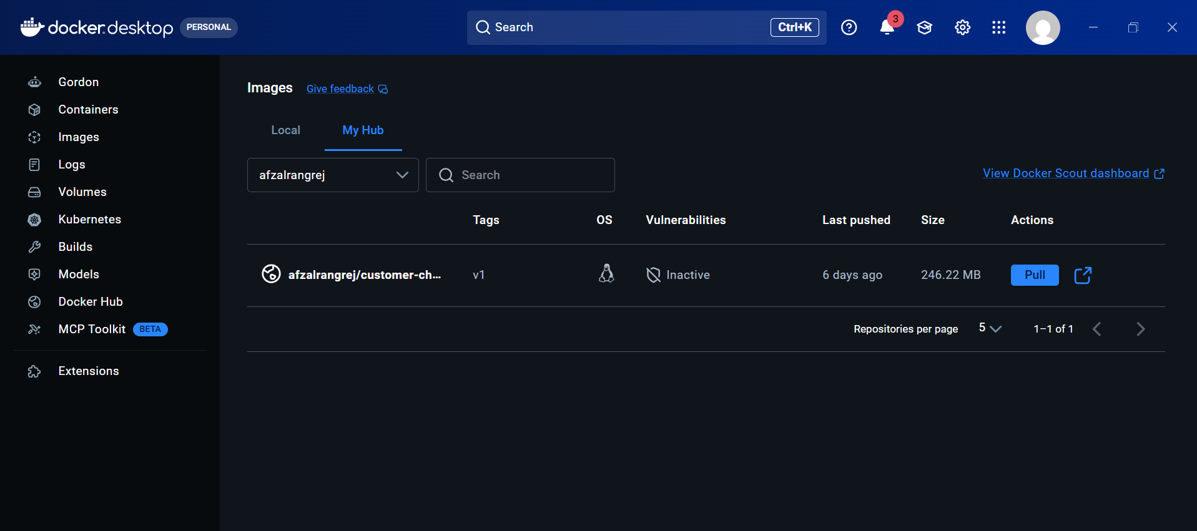
Docker Desktop

Slide 20
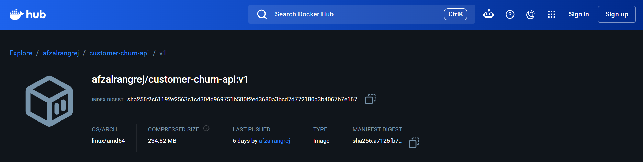
Docker Hub Desktop

Slide 21
Tools & Technologies
Power BI – Interactive Dashboard Development & Reporting
Power Query – Data Cleaning, Transformation & Preparation
DAX (Data Analysis Expressions) – KPI Measures, Calculations & Business Metrics
Microsoft Excel / CSV Dataset – Data Source Management
Python (Pandas) – Data Processing & Feature Engineering
FastAPI – API Development & Data Integration
SQL – Data Querying & Analysis
GitHub – Version Control & Project Documentation

Slide 22
Conclusion
Analyzed 7,032 customer records to identify churn patterns and customer behaviour.
Discovered key churn drivers including month-to-month contracts, lack of security/support services, and high-risk customer segments.
Built three interactive Power BI dashboards to monitor KPIs, customer insights, and value segmentation.
Provided data-driven recommendations to improve customer retention, increase revenue, and support business decision-making.
Closing Statement :
The project successfully transformed customer data into actionable business insights, enabling better retention strategies and long-term customer value growth.

Slide 23
Thank You
Afzal Rangrej
& Team
Data Analyst Intern Customer Churn Analysis Project

