Slide 1
B. Tech (IT)
Detection and Mitigation of DDoS Attacks in SDN Environment
Presented by:
Group 4
Under the supervision of:
Dr. Amitabha Nath
Department of Information Technology
North-Eastern Hill University

Slide 2
Outline
Problem Statement
Introduction and Motivation
Architecture
DDoS
Attack
Objectives
Existing Work
Dataset
Models
Emulation
Custom Dataset
Real time implementation
Mitigation
Final results
Limitations
Future Wok

Slide 3
Problem Statement
Detection and Mitigation of DDoS Attacks in SDN Environment

Slide 4
Introduction and Motivation

Slide 5



SDN controller
(Centralized Control)
Tightly Coupled Control Plane
And Data Plane
Open Flow
Messages
Data Flow
Forwarding Devices
Data Flow
Open Flow Switch
(programmable Switch)
Traditional Networking
Software Defined Networking

Slide 6
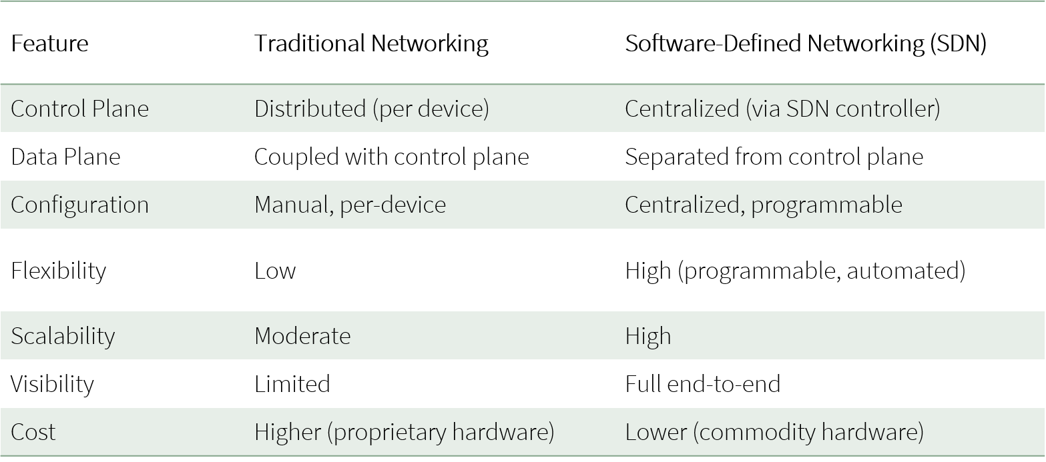

Slide 7

Services
Services
Application Layer
North Bound Interface
Control Layer
SDN Controller
Control Path
Infrastructure Layer
South Bound Interface
Data Path
OpenFlow Switch
SDN Architecture

Slide 8
What’s The issue?
Despite these advantages, SDN has its security challenges. SDN has a centralized brain—the SDN controller—that manages all the decisions for the network. While this centralization makes the network smarter and more efficient, it also creates a single point of failure.
Therefore, if attackers can overload the controller, they can:
Freeze network decision-making
Crash the controller
Cause massive downtime across the entire network

Slide 9
Planes
Application Plane: This is the topmost layer, where network applications reside. These applications interact with the controller via northbound APIs to request network resources, apply policies, or respond to changes in the network.
Control Plane: The control plane is the ”brain” of the network and plays a pivotal role in network intelligence and decision-making. It communicates with the data plane via protocols like OpenFlow, collecting network information and dictating how switches should handle traffic.
Data Plane: This is the lowest layer, composed of network forwarding devices such as switches and routers (e.g., OpenFlow-enabled switches). These devices handle actual packet forwarding based on instructions from the control plane. They are simplified to perform only forwarding functions.

Slide 10
Communication Interfaces
Southbound API Enables communication between the controller and the data plane. Used to install flow rules and retrieve statistics.
Northbound API Enables communication between applications and the controller for policy enforcement, monitoring.

Slide 11
DDoS (Distributed Denial of Service)
A DDoS attack, or Distributed Denial of Service attack, is a cyberattack where a large number of devices (often hacked or infected with malware) work together to overwhelm a targeted server, website, or network with huge amounts of traffic.
The goal is to disrupt normal traffic and make the service slow, unstable, or completely unavailable to legitimate users.
Hence the major vulnerability of SDN environment is DDoS attack as what better than this attack to overwhelm a system.

Slide 12








Legitimate User
Handler
Huge amount of traffic
Attacker
Victim Network
Compromised Devices
DDos Attack

Slide 13
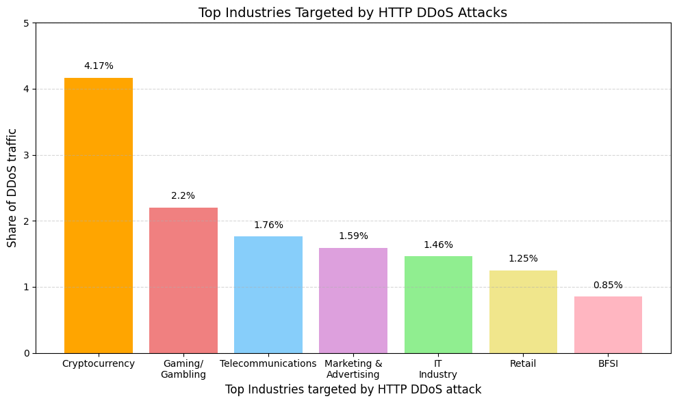
https://www.sciencedirect.com/science/article/pii/S1574013724000753

Slide 14
DDoS attacks in the Control plane :
Controller resource saturation. (The controller is overwhelmed with processing each packet in message).
Bandwidth exhaustion of data control channel, and (The link between switch and controller gets congested)
DDoS attacks in the Data plane:
(i) Flow table overloading, (millions of unique flows fills up the rule table)
(ii) Buffer saturation

Slide 15
Attack (TCP SYN floods Application Layer)
TCP floods often mimic real traffic more closely.
Other types of attacks including UDP-based floods are easier to detect/block.
Each new SYN packet may trigger a new packet_in to the controller. The controller becomes a bottleneck.
In general, SDN controllers suffer more from TCP SYN floods.

Slide 16
Objectives
To design an SDN testbed using Mininet and Ryu controller.
To simulate Application-layer DDoS attacks (TCP SYN floods) within the SDN environment.
Obtaining the Dataset and performing cleaning , scaling, labeling and feature selection.
To develop and evaluate various ML models including Random Forest (RF), XGBoost, SVM, and CNNusing custom and public datasets.
To identify the best-performing model based on metrics like accuracy, precision, recall, and F1-score, and integrate it into the Ryu controller.
To implement real-time flow monitoring and feature extraction directly within the SDN controller.
To deploy mitigation strategies that dynamically block or limit malicious traffic in real-time

Slide 17
Existing Work

Slide 18
Paper Name and Authors | What’s It About | Results / Performance
Performance Evaluation of SDN DDoS Attack Detection and Mitigation Based Random Forest and K-Nearest Neighbors Machine Learning Algorithms (Mayadah A. Mohsin and Ali H. Hamad) | Compared Random Forest (RF) and K-Nearest Neighbors (KNN) for DDoS detection in an SDN environment using Mininet and Ryu controller | RF outperformed KNN with nearly 99% accuracy
Distributed Denial of Services (DDoS) Attack Detection in SDN Using Optimizer-Equipped CNN-MLP (Sajid Mehmood et al.) | Proposed a hybrid CNN-MLP model using SHAP-based feature selection and Bayesian optimization on CICDDoS2019 and InSDN datasets | Achieved 99.95% (CICDDoS2019) and 99.98% (InSDN) accuracy
Enhanced DDoS Detection Using Advanced Machine Learning Techniques in SDN (C. Srinivas et al.) | Introduced an ensemble of RF, KNN, and XGBoost for SDN-based DDoS detection | RF (~99%), KNN (~98%), XGBoost (~97%) accuracy
DDoS Attack Detection Using MLP and Random Forest (Ashfaq Ahmad Najar and Manohar Naik S) | Evaluated RF and MLP on CICIDS2017 and CICDDoS2019 datasets in SDN setup | RF achieved nearly 99% accuracy
DDoS Detection in SDN using Machine Learning Techniques (Venkatarri Marriboyina) | Compared RF, SVM, DT, and KNN on CICDDoS2019 | RF (98.5%) > SVM (97.2%) > DT (95.8%) > KNN (94.3%)
Distributed Denial of Services (DDoS) attack detection in SDN using Optimizer-equipped CNN-MLP (Wadee Alhalabi et al.) | Used deep learning models (RNN, LSTM, GRU) for SDN traffic classification | GRU: 99.47% (multi-class), RNN: 99.99% (binary)
A DDoS attack detection based on deep learning in software-defined Internet of things (Wang et al. (2020)) | Applied deep CNN for real-time DDoS traffic classification in SDNs | CNN(~99%) accuracy with minimal false positives

Slide 19
Dataset
CICDDoS-2019 Dataset by Canadian Institute for Cybersecurity
Focus: Application-layer DDoS attacks (TCP/UDP-based).
Dataset Overview:
88 features, including packet size, flow duration, protocol headers.
Labelled traffic (attack vs. benign) for supervised learning.
Why choose CICDDoS-2019?
Covers traditional DDoS tactics still prevalent today.
High feature granularity enables deep traffic analysis.

Slide 20
Category | Features | What They Do
Flow Identification | Flow ID, Source IP, Source Port, Destination IP, Destination Port, Protocol, Timestamp | Identify individual flows (sender/receiver) and timing
Flow Timing | Flow Duration, Flow IAT Mean, Flow IAT Std, Flow IAT Max, Flow IAT Min, Fwd IAT Total, Fwd IAT Mean, Fwd IAT Std, Fwd IAT Max, Fwd IAT Min, Bwd IAT Total, Bwd IAT Mean, Bwd IAT Std, Bwd IAT Max, Bwd IAT Min, Active Mean, Active Std, Active Max, Active Min, Idle Mean, Idle Std, Idle Max, Idle Min | Measures gaps between packets, session duration, active/idle states
Packet Statistics | Total Fwd Packets, Total Backward Packets, Total Length of Fwd Packets, Total Length of Bwd Packets, Fwd Packet Length Max, Fwd Packet Length Min, Fwd Packet Length Mean, Fwd Packet Length Std, Bwd Packet Length Max, Bwd Packet Length Min, Bwd Packet Length Mean, Bwd Packet Length Std, Min Packet Length, Max Packet Length, Packet Length Mean, Packet Length Std, Packet Length Variance, Average Packet Size, Avg Fwd Segment Size, Avg Bwd Segment Size | Capture packet size and number stats in flow

Slide 21
Category | Features | What They Do
Flag Counts | SYN Flag Count, FIN Flag Count, RST Flag Count, PSH Flag Count, ACK Flag Count, URG Flag Count, CWE Flag Count, ECE Flag Count, Fwd PSH Flags, Bwd PSH Flags, Fwd URG Flags, Bwd URG Flags | Counts of specific TCP flags in the packets
Throughput | Flow Bytes/s, Flow Packets/s, Fwd Packets/s, Bwd Packets/s | How fast data is moving through the flow
Bulk Transfer Features | Fwd Avg Bytes/Bulk, Fwd Avg Packets/Bulk, Fwd Avg Bulk Rate, Bwd Avg Bytes/Bulk, Bwd Avg Packets/Bulk, Bwd Avg Bulk Rate | Measures bulk data transfer rates
Subflow Features | Subflow Fwd Packets, Subflow Fwd Bytes, Subflow Bwd Packets, Subflow Bwd Bytes | Further split into subflows
Window Size & TCP Options | Init_Win_bytes_forward, Init_Win_bytes_backward, act_data_pkt_fwd, min_seg_size_forward | TCP settings and minimal segment size
Others/Metadata | SimillarHTTP, Inbound | Miscellaneous; HTTP similarity, inbound connection flag
Label | Label | Attack label (SYN)

Slide 22
Feature Selection: Pearson Correlation Coefficient (PCC)
PCC quantifies the linear correlation between two continuous variables, returning a value between-1 and +1:
• Values close to +1 or-1 indicate strong correlation.
• Values close to 0 suggest independence.
This measure is taken for detecting multicollinearity, which can lead to overfitting and biased feature importance in machine learning models
Categorical/non-numeric features must be removed before computing the correlation matrix or heatmap
Categorical Feature Removal Before Correlation:
Feature | Reason
Source/Destination IP | Device-specific → causes overfitting
Source/Destination Port | Arbitrary values → no behavioral meaning
Protocol | Already represented by other flow features

Slide 23
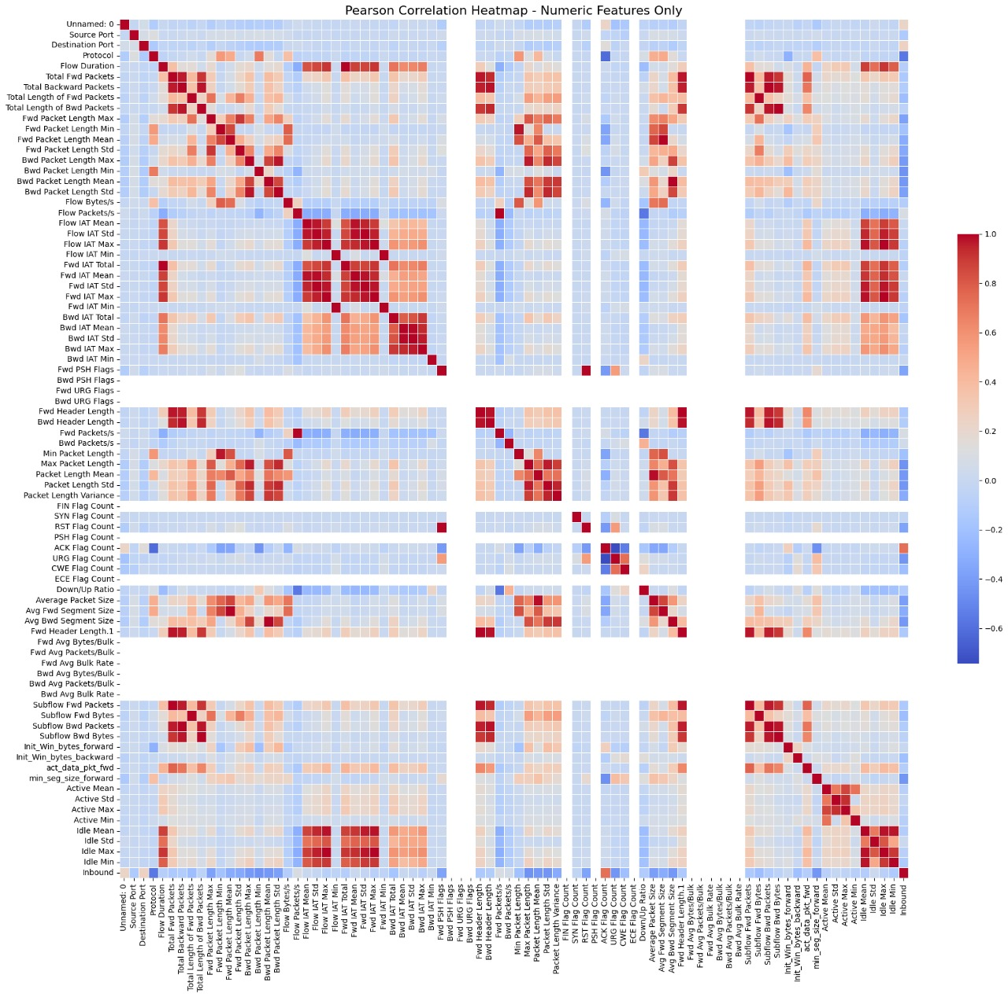
The correlation matrix was calculated using the pandas library, and a heatmap was visualized using seaborn :
This correlation heatmap highlights feature pairs with strong correlation. Clusters of red squares (|r| ≥ 0.9) indicated groups of highly related features

Slide 24
Summary of retained features and those removed due to high correlation:
Selected Feature | Correlated Features Removed | Rationale
Flow Duration | Fwd IAT Total, Bwd IAT Total, Flow IAT Mean, Active Mean, Idle Mean | Total session time; simpler and more stable
Total Fwd Packets | Subflow Fwd Packets, Fwd Packets/s, Fwd Header Length | Avoids duplication from subflows
Total Backward Packets | Subflow Bwd Packets, Bwd Packets/s, Bwd Header Length | Complements forward count; others are partial views
Fwd Packet Length Mean | Fwd Packet Length Max/Min/Std, Fwd Segment Size Avg, Fwd URG/PSH Flags | Mean is more general and stable
Bwd Packet Length Mean | Bwd Packet Length Max/Min/Std, Bwd Segment Size Avg, Bwd URG/PSH Flags | Mean is more general and stable
Flow Bytes/s | Total Length of Fwd/Bwd Packets, Fwd/Bwd Bulk Bytes, Avg Bulk Size | Combined byte volume with time produces a compact signal.
Flow Packets/s | Fwd/Bwd Packets/s, Subflow Packets/s | Flow-wide frequency is sufficient
Average Packet Size | Packet Length Max/Min/Mean | Single general size metric
Packet Length Std | Fwd/Bwd Packet Length Std, IAT Std | Measures size variability without directional redundancy

Slide 25
Removal of Sparse, Redundant, and Low-Value Features
Several remaining features were excluded even though they weren’t highly correlated. These were dropped based on domain knowledge, statistical analysis, and interpretability.
A. Protocol Flags and TCP Internals
Examples: ACK Flag Count, FIN Flag Count, URG Flag Count, Fwd/Bwd URG/PSH Flags Reason: They were mostly constant or zero even in attack traffic.
B. TCP Window and Header Sizes
Examples: Init_Win_bytes_forward, Init_Win_bytes_backward, Fwd/Bwd Header Length Reason: Low variance, mostly zero
C. Bulk Transfer Features
Examples: Fwd/Bwd Bulk Bytes, Avg Bytes/Bulk, Bulk Packets Reason: Mostly zero
D. Subflow Features
Examples: Subflow Fwd Bytes, Subflow Bwd Bytes, Subflow Packets Reason: Duplicates of total flow metrics already included (Total Fwd/Back Packets)
E. IAT and Activity Time Features
Examples: Flow IAT Mean/Max/Min, Fwd/Bwd IAT Mean/Std, Active/Idle Max/Min/Mean Reason: Low variance, mostly zero

Slide 26
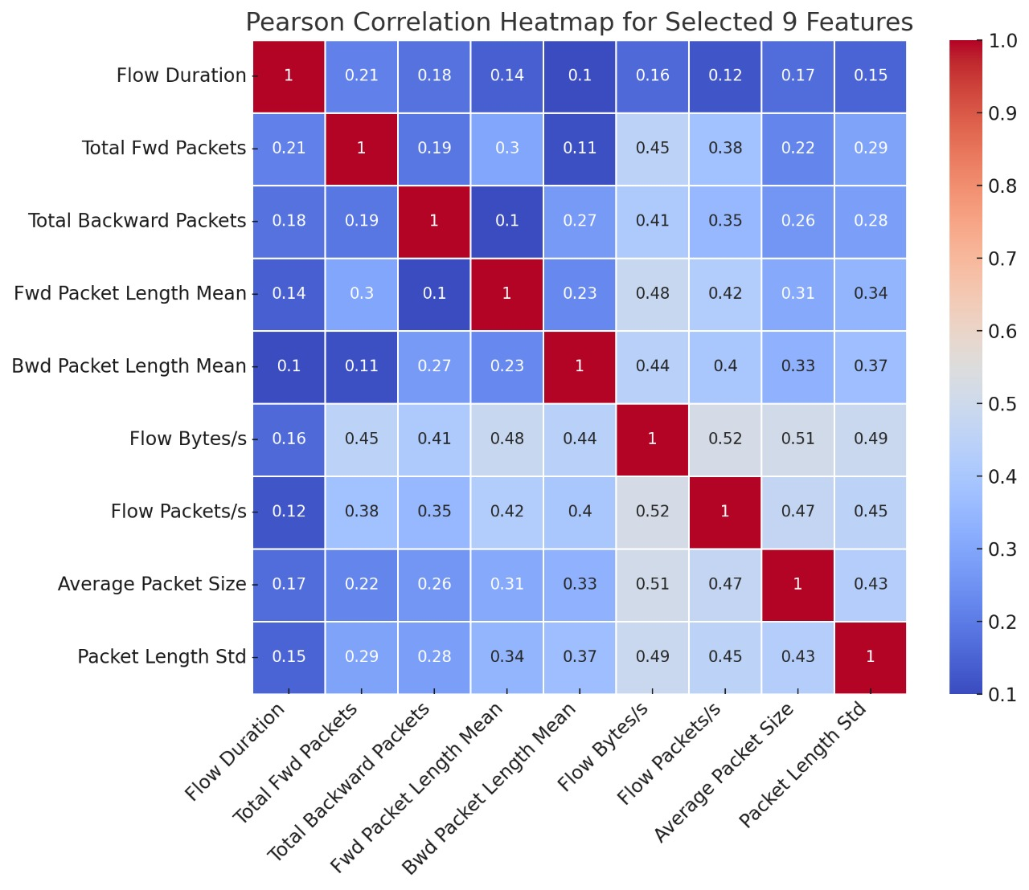
Final Feature Set
Feature | Behavior Captures
Flow Duration | Total duration of the communication
Total Fwd Packets | Count of packets sent by source
Total Backward Packets | Count of response packets
Fwd Packet Length Mean | Average packet size in the forward direction
Bwd Packet Length Mean | Average packet size in the backward direction
Flow Bytes/s | Byte rate over the entire flow
Flow Packets/s | Packet rate over the entire flow
Average Packet Size | General measure of flow payload size
Packet Length Std | Variability of packet sizes — low variance may imply attack patterns

Slide 27
Data Cleaning and Preprocessing
1. Column Name Cleaning:
Removed leading/trailing whitespaces from column names
2. Replacing Infinite Values:
Converted all inf and -inf values to NaN
Prevents issues caused by extreme/undefined values (e.g., divide by zero)
3. Removing Missing Data:
Dropped rows containing NaN
4. Label Encoding: Transformed text labels (e.g., 'BENIGN', 'DDoS') into numeric format

Slide 28
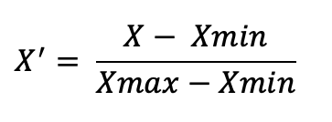
6. Undersampling:
The dataset was heavily imbalanced:
→ Attack = 10,171,913 cases
→ Benign = 30,662 cases
Under sampling was applied to balance the dataset
library: sklearn.utils and module: resample
7. Normalization :
Used Min-Max Scaler to remove scale bias between features.
This scaled all values to the [0, 1] range without distorting relative differences.

Slide 29
Models Used for Performance Evaluation
Random Forest (RF) :
Tree-based → excellent for tabular data
Robust to outliers and noisy flow stats
XGBoost :
Gradient-boosted trees → highly accurate on structured/tabular data
Fast, optimized for large datasets with many flows
Support Vector Machine
Great for binary classification (Attack vs. Benign)
Convolutional Neural Network
Can learn patterns from structured numeric input

Slide 30
Random Forest
Training Procedure:
Hyperparameter Tuning (GridSearchCV):
Parameters Tested:
n_estimators: 200, 300 → Number of trees in the forest
max_depth: None, 20 → how deep each decision tree can grow
min_samples_split: 2 → Minimum samples required to split a node
min_samples_leaf: 1 → Minimum samples required at a leaf node
Cross-validation: 3-fold CV
Best Parameters Found: n_estimators: 300, max_depth: Nonemin_samples_split: 2, min_samples_leaf: 1

Slide 31
Support Vector Machine (SVM) Classifier
Training Procedure:
SVM classifier was trained using the Radial Basis Function (RBF) kernel, which allows for non-linear decision boundaries and is well-suited for complex classification problems like DDoS detection.
from sklearn.svm import SVC svm_model = SVC(kernel='rbf', probability=True, random_state=42) svm_model.fit(X_train, y_train)

Slide 32
XGBoost Classifier
Training Procedure:
Key Parameters:
use_label_encoder=False → disables deprecated label encoder
eval_metric='logloss’ → monitors classification error during training
n_estimators=100 → trains 100 boosting rounds (trees)

Slide 33
Convolutional Neural Network (CNN)
Training Procedure:
Original feature matrix reshaped to 3D format: (samples, features, 1)
Layers:
Conv1D(filters=32, kernel_size=2, activation='relu’) → Learns local patterns in feature sequences
MaxPooling1D(pool_size=1) → Slight dimensionality reduction
Conv1D(filters=64, kernel_size=2, activation='relu’) → Learns higher-level feature maps
Flatten() → Converts 3D feature maps to 1D vector
Dense(64, activation='relu’) → Fully connected layer for decision making
Dropout(0.5) → Randomly drops 50% of neurons during training → reduces overfitting
Dense(output_classes, activation=‘sigmoid’) → Final layer for multi-class classification

Slide 34
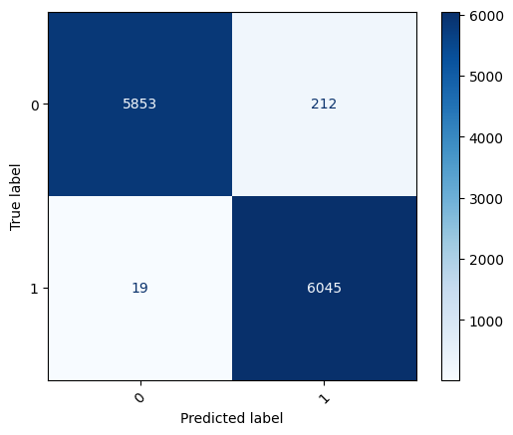
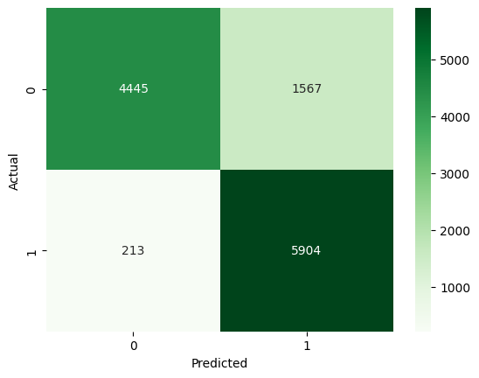
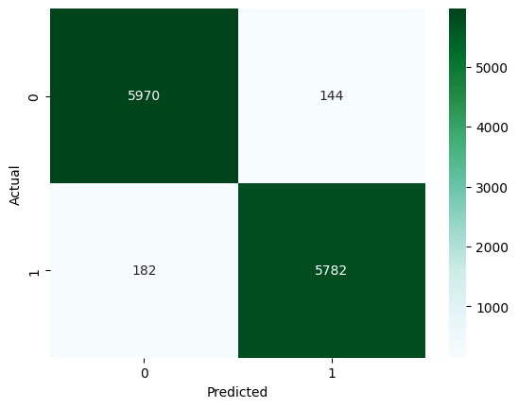
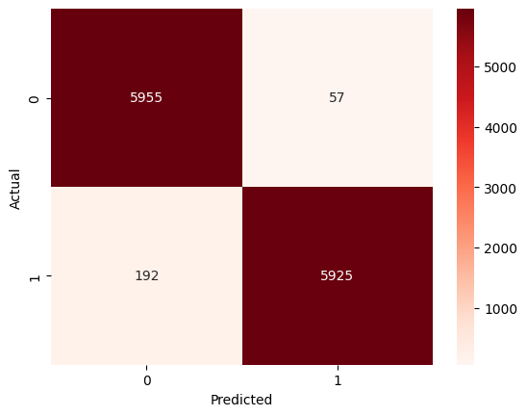
Confusion Matrix
Random Forest
SVM
accuracy=99.65%
precision=99.87%
recall=99.77%
f1_score=99.82%
accuracy=85.74 %
precision=87.48%
recall=85.74%
f1_score=85.59 %
CNN
XGBoost
accuracy=97.30%
precision=97.57%
recall=96.95%
f1_score=97.30%
accuracy=98.11%
precision=96.58%
recall=98.11%
f1_score=98.15%

Slide 35
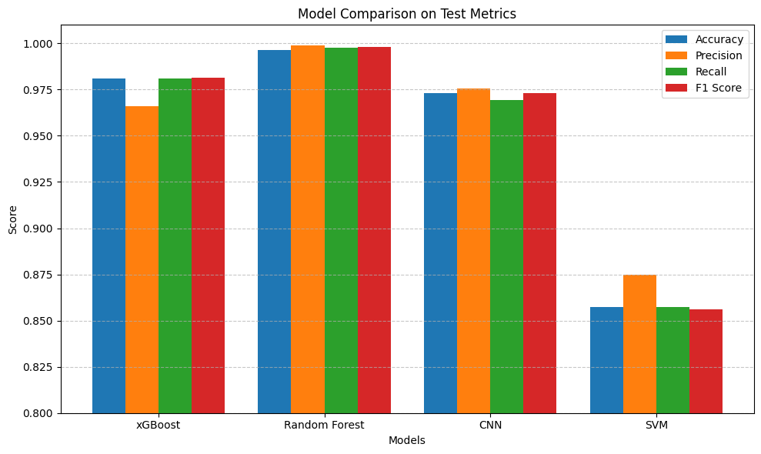

Slide 36
Emulation
The SDN environment was emulated on a Linux (Ubuntu 20.04) system with the following keytools:
Mininet: An SDN network emulator used to simulate the network topology and run host-switch-controller environments.
Ryu Controller: A default Ryu controller(simple_switch_13.py) was used for monitoring and feature extraction and for real-time implementation a custom SDN controller was used to monitor flow-level events and apply custom logic for packet processing, feature extraction, and mitigation actions.
Scapy: A packet manipulation tool used to generate custom attack traffic such as TCP SYN floods with spoofed IPs.
tcpdump: It is a powerful command-line packet analyzer used for capturing and inspecting network traffic in real time.
Iperf: A network testing tool used to generate legitimate traffic for baseline comparisons and flow behavior analysis.

Slide 37
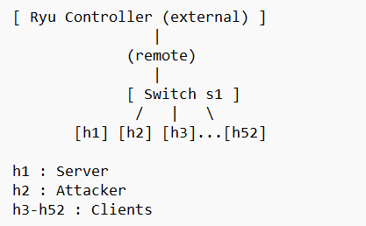
The Ryu Controller is started on a terminal outside mininet.
In another terminal, a custom topology is created in mininet.
Traffic is simulated with the help of tools like iperf and scapy. We have used iperf for legitimate clients and scapy for simulating ddos attacks.
The packets are captured using tcpdump into a .pcap file.

Slide 38
Custom Dataset
9 selected features are extracted from the .pcap file into a .csv file.
Each flow is labeled as either attack (1) or benign (0) based on the Mininet session it was generated in — all flows from normal traffic sessions are labeled 0, and all flows from attack sessions are labeled 1.
This custom dataset is then combined with the CICDDoS-2019 dataset and fed to the models for training and testing.

Slide 39
Real-Time Implementation
For real-time implementation the trained Random Forest model is integrated into the Ryu Controller to make real time predictions.
self.model = joblib.load("rf_trained2_20250617_0928.joblib")
Traffic Simulation is done in mininet using tools like iperf and scapy.
When packets are being simulated, the model starts making predictions which can be monitored with the help of logs.
The next section will discuss on implementation of mitigation after the model predicts a flow as an attack.

Slide 40
Mitigation
The mitigation system works in conjunction with the previously trained Random Forest (RF) model, which classifies traffic flows as either benign or malicious based on statistical flow-level features.

Slide 41







Feature Extraction
Traffic Monitoring
Flow Identification
Trained Model
Malicious Traffic
Traffic Classification
Drop Rules
Normal Traffic
Real Time mitigation

Slide 42
Traffic Monitoring: The Ryu controller listens for PACKET_IN messages. These contain metadata about incoming flows.
Flow Identification: Extract the flow tuple (src IP, dst IP, src port, dst port, protocol, IP version).This becomes the Flow ID used for classification and tracking.
Feature Extraction (9 features)
Classification:
If fewer than 20 flows classified, use:threshold = 0.5 (default)
Once ≥ 20 flows are analyzed, compute:threshold = 75th percentile of the last N probability scoresIf flow score ≥ threshold, then:Treat it as malicious
5. Mitigation via Flow Rule Installation
6. Flow Timeout and Cleanup

Slide 43
MITIGATION
Mitigation via Flow Rule Installation. If a flow is classified as malicious (i.e., its probability exceeds the current threshold):
A high-priority drop rule is installed on the switch using OpenFlow with no actions, immediately blocking future packets from that flow.
The flow ID is added to the blocked_flows dictionary to avoid reprocessing and redundant classification.
Blocked flows are removed from memory after 300 seconds (5 minutes).
Inactive flows are cleared from statistics tracking after 60 seconds.

Slide 44
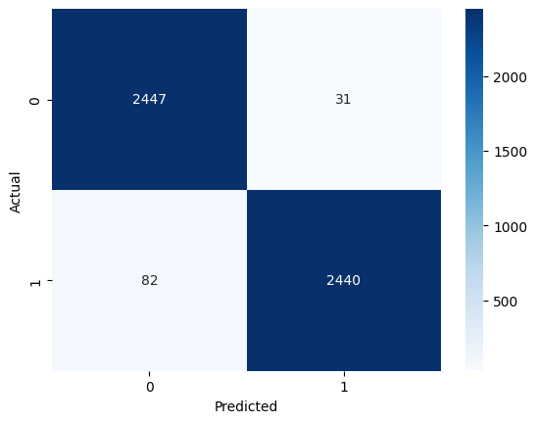
Real-Time Results
In the real-time SDN environment using the trained Random Forest model, the system achieved high performance in detecting and mitigating DDoS attacks based on flow-level features. The results from live traffic classification are as follows:
Accuracy | 97.74%
Precision | 98.75%
Recall | 96.75%
F1 Score | 97.74%

Slide 45
Limitations
Simulated Environment Limitation: The system was tested in Mininet with the Ryu controller, which, despite being useful for prototyping, does not accurately reflect the complexity and scale of real-world SDN networks.
Real-World Challenges Not Captured: Key real-world factors such as geographic distribution of switches, diverse traffic, hardware constraints, and network unpredictability are absent in the simulation, potentially affecting model performance in actual deployment.
Scalability and Robustness Unverified: The promising detection results in the simulated setup need validation in large-scale or real SDN environments to ensure the system remains effective under real traffic loads and hardware limitations.

Slide 46
Future Work
Real-World Deployment: Implement the system in an actual SDN environment to assess its scalability, latency, and robustness under realistic network conditions.
Multi-Class Classification: Expand the model to detect and distinguish between multiple types of DDoS attacks (e.g., TCP, UDP, HTTP), enabling more granular threat identification.
Adaptive Learning: Integrate online or adaptive learning techniques to keep the system responsive to evolving traffic patterns and emerging attack vectors without constant offline retraining.

Slide 47
Thank you
Group 4-
1. Kundan Kumar Jha
2. Ibapalei Shadap
3. Georgepaton Marbaniang
4. Chadong Lowang

