Slide 1

Skills Git
Cycle 1 Technical Overview
AI Occupation Personas: architecture, data model, key flows
Engineering onboarding deck · Audience: backend, frontend, data, platform
commit cycle-1/occupations-personas-capture
2026-05 · Skills Git LLC

Slide 2
2
What we shipped — Cycle 1
5 waves, 4 new bounded contexts, all gates green
5
4
5
18
waves of work
new bounded contexts
Alembic migrations
ADRs locked
T-01 to T-15
occupations · personas · capture · vault
0006 -> 0010
team/decisions.md
809
168
0
tests passing
new endpoints + 30-skill seed
regressions in 456 legacy skills
module · integration · smoke
occupations · personas · capture · vault
all validate green post-migration
Skills Git · Cycle 1 Technical Overview
2 / 20

Slide 3
3
The two new product types
Occupation vs Persona — both are first-class skill kinds (ADR-004)
Occupation
Persona
kind = occupation
kind = persona
Curated, graph-linked bundle of existing skills. Listed and sold as one product.
Practitioner overlay — recorded memory_neurons that compose onto a parent occupation.
Storage
Skill row + occupations side-table
Storage
Skill row + personas side-table
Members
occupation_skills join (role: core/supporting/optional)
Members
persona_neurons join (kind=memory_neuron skills)
Example
skillsgit-curated/ai-devops-engineer (30 skills, 7 domains)
Example
jane-devops-demo/incident-veteran (7 neurons)
Vault output
domains/{domain}/{slug}.md tree, 250 KB zip
Vault output
personas/{handle}/{slug}/ subtree
License
1 per buyer, composition_role=occupation
License
N per buyer, gated on parent_occupation_id ownership
Skills Git · Cycle 1 Technical Overview
3 / 20

Slide 4
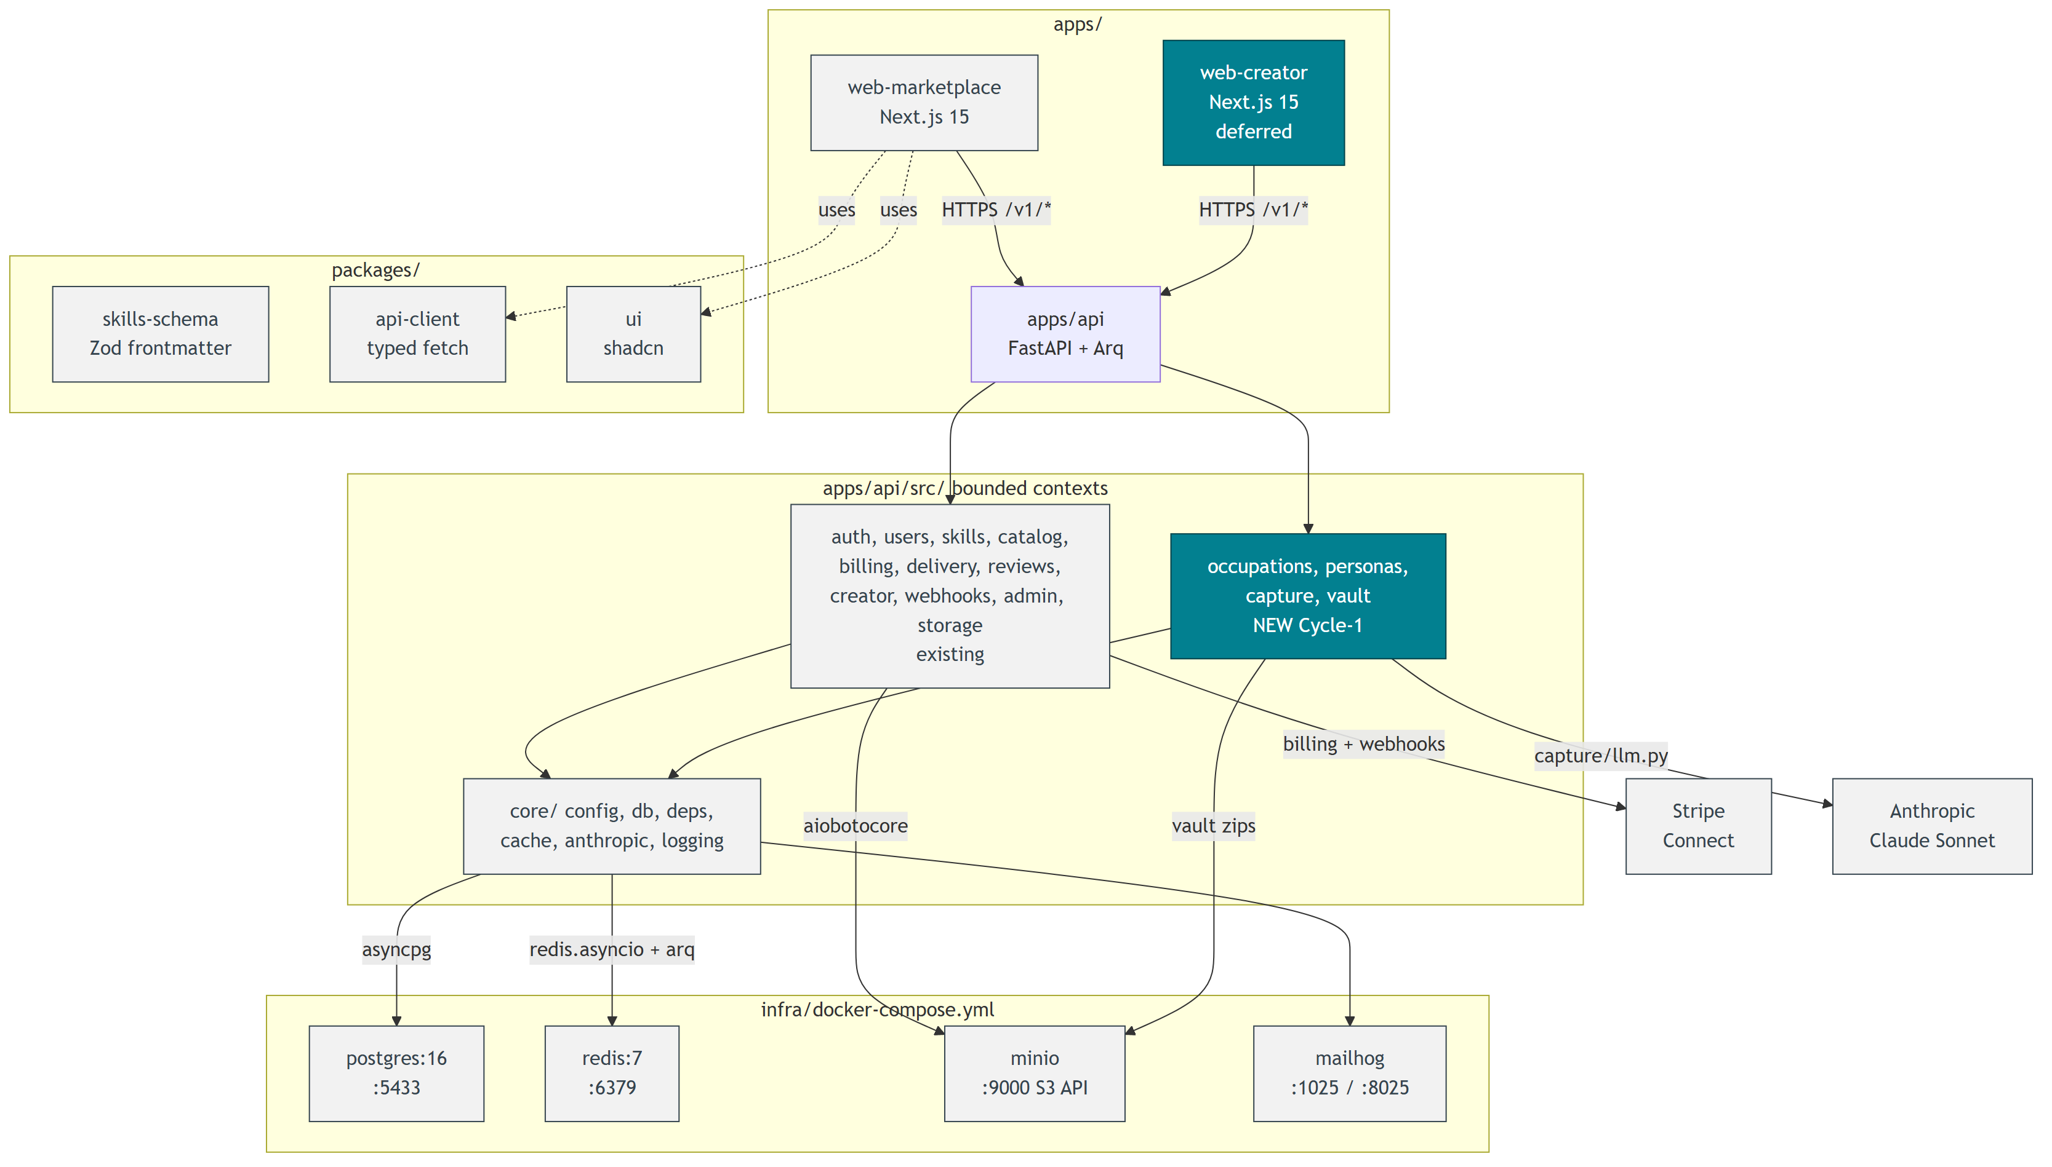
4
Architecture at a glance
Recovered from docs/diagrams/00-system-overview/high-level-architecture.drawio
3 apps · 3 packages · 4 infra services
apps/api — FastAPI + Arq worker
all /v1/* routers mount in main.py
apps/web-marketplace — Next.js 15
buyer UX (active)
apps/web-creator — Next.js 15
capture + persona builder (Cycle 2 deferral)
packages/{skills-schema, api-client, ui}
Zod, openapi codegen, shadcn
docker-compose: pg/redis/minio/mailhog
host ports :5433, :6379, :9000, :8025
Skills Git · Cycle 1 Technical Overview
4 / 20

Slide 5
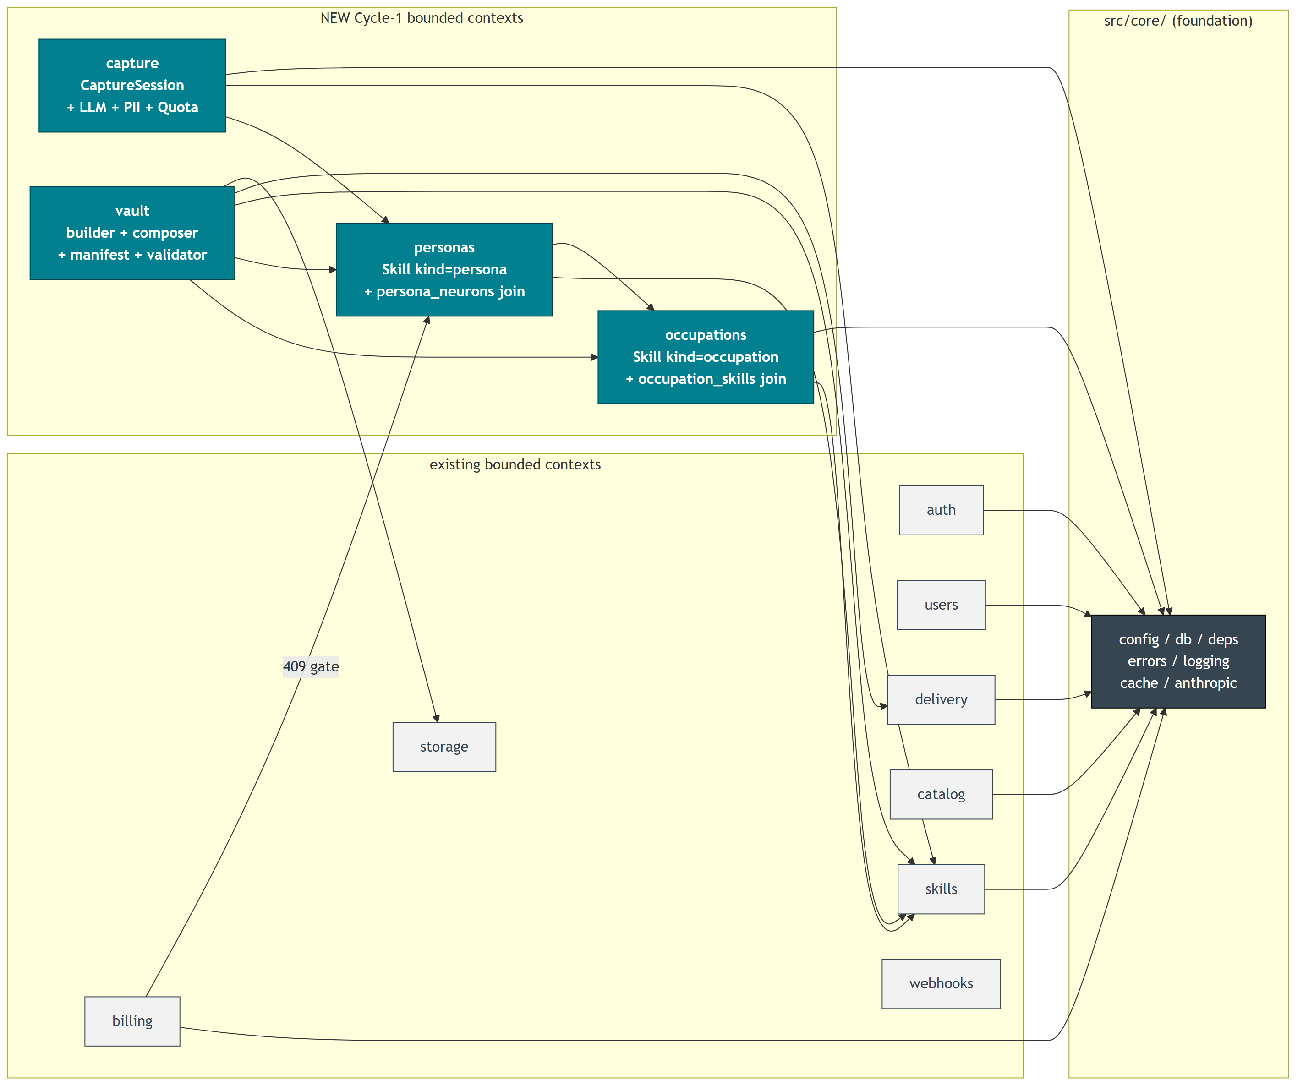
5
Backend module graph
src/* bounded contexts — 4 new (teal) layer on top of existing
4 new bounded contexts
occupations/
Skill kind=occupation + occupation_skills join. Schemas, service, router, 55 tests.
personas/
Skill kind=persona + persona_neurons. 409 gate on parent. 59 tests.
capture/
CaptureSession + LLM + PII + Redis quota + Arq job. 77 tests.
vault/
builder + composer + manifest + validator. 53 tests.
All four lean on src/core/ for db, deps, cache, logging.
Skills Git · Cycle 1 Technical Overview
5 / 20

Slide 6
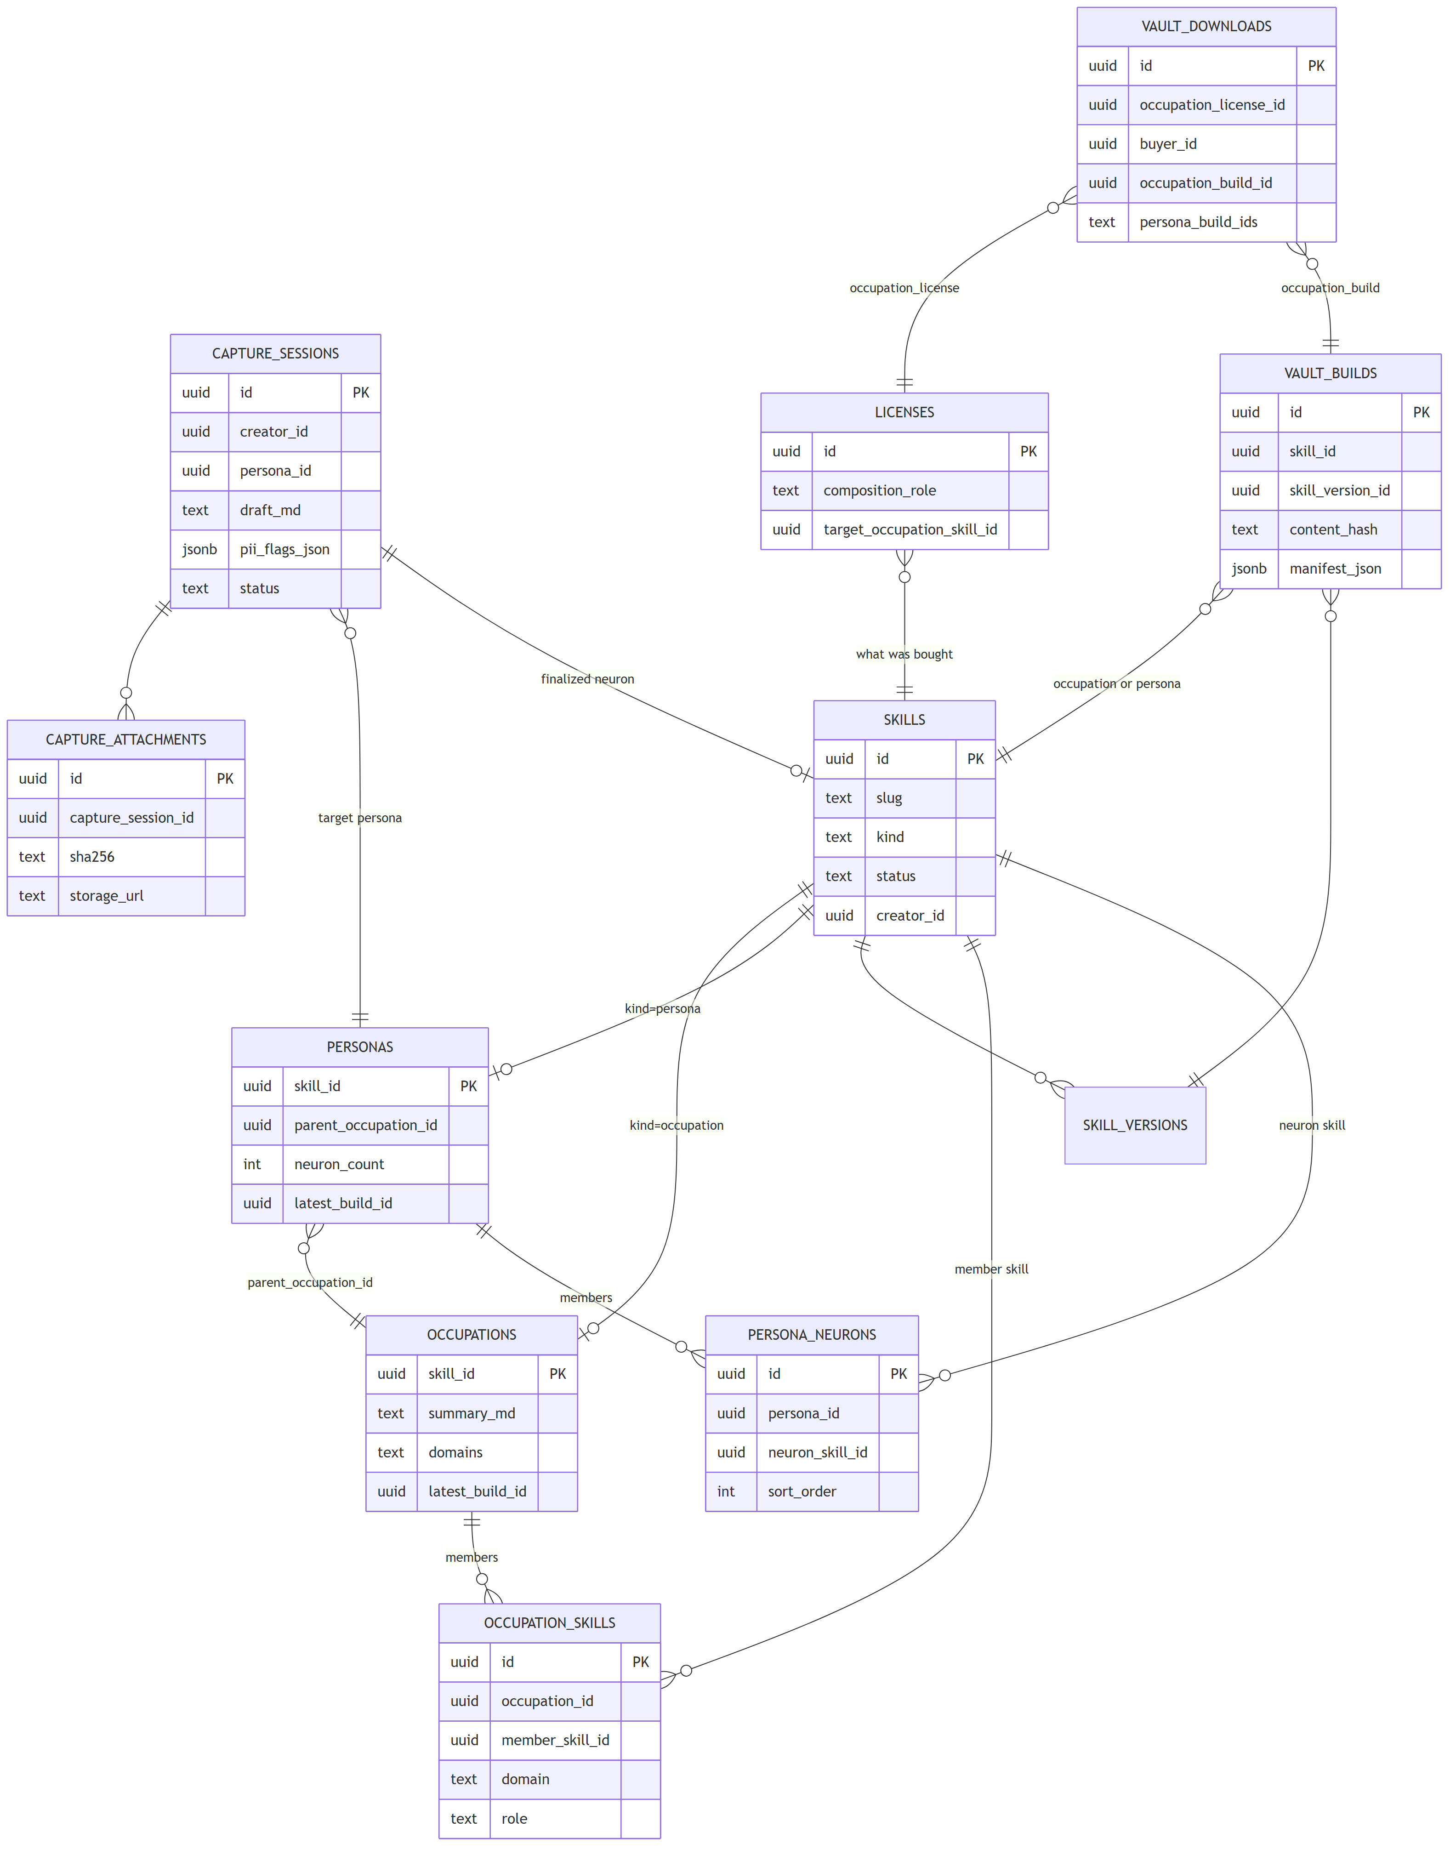
6
Data model deltas
8 new tables + skills.kind discriminator + license composition columns
Tables introduced (migrations 0006-0010)
ER (excerpt)
Table | PK | Key FKs | Mig
occupations | skill_id | skills.id | 0006
occupation_skills | id | occupation_id, member_skill_id | 0006
personas | skill_id | skills.id, parent_occupation_id | 0007
persona_neurons | id | persona_id, neuron_skill_id | 0007
capture_sessions | id | creator_id, persona_id, finalized_neuron_skill_id | 0008
capture_attachments | id | capture_session_id | 0008
vault_builds | id | skill_id, skill_version_id | 0009
vault_downloads | id | occ_license_id, buyer_id, occ_build_id | 0009
skills.kind widens: skill (default) · occupation · persona · memory_neuron | licenses + composition_role + target_occupation_skill_id (snapshot)
Skills Git · Cycle 1 Technical Overview
6 / 20

Slide 7
7
skills.md spec extension
ADR-009 — 5 new optional frontmatter fields; 452 legacy skills still validate green
# ─── New optional fields (ADR-009) ───────────────
kind: skill | occupation | persona | memory_neuron
# default: skill
links:
- target: <slug or vault path>
relation: applies | extends | contradicts
| see-also | recorded-instance-of
weight: 0..1 # informational
parent_occupation_id: <uuid>
# required when kind=persona
neuron: # required when
situation: "" # kind=memory_neuron
decision: ""
outcome: ""
recorded_at: ISO-8601
confidence: 0..1
vault_path: "" # builder-authored;
# creators MUST NOT set
Backward compat
extra='forbid' widens to accept 5 new named fields; nothing else changes. Existing files parse + validate unchanged.
Validator codes
frontmatter.neuron.required_for_memory_neuron · persona.missing_parent · vault_path.creator_authored_forbidden
Single source
prompts/shared/skills-md-spec.md is amended in lockstep with apps/api/src/skills/validator.py.
Zod mirror
packages/skills-schema/ hand-maintained today; pnpm codegen as Cycle 2 task (open question O-3).
Skills Git · Cycle 1 Technical Overview
7 / 20

Slide 8
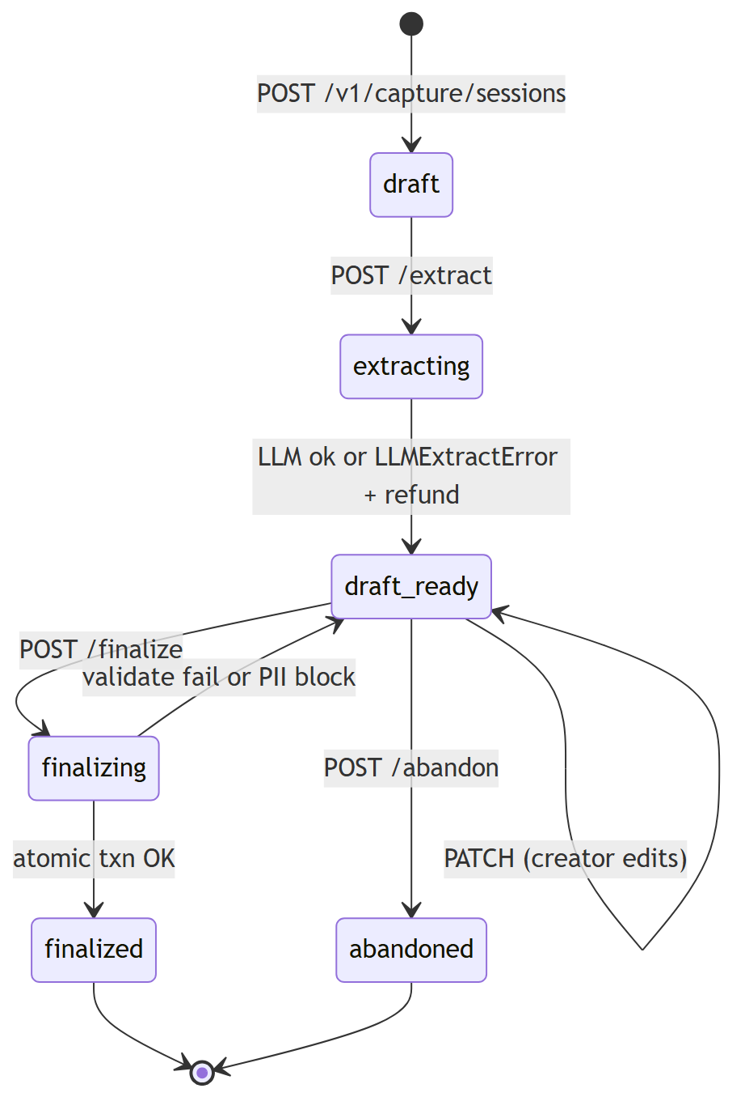
8
Capture pipeline
Draft → extracting → draft_ready → finalized. Source: apps/api/src/capture/
Where the work happens
extract_neuron Arq job
capture/jobs.py · stub via SKG_CAPTURE_LLM_STUB=1; prod uses capture/llm.py + Claude
Redis-backed quota
capture/quota.py · key capture:quota:{creator}:{YYYY-MM} · cap 10/month · 429 on overrun
PII scan
capture/pii.py · SECRET_PATTERNS hard-block + warn list; re-scan at finalize
Atomic finalize transaction
validate_file -> INSERT skills/skill_versions -> S3 put -> persona_neurons -> attachments copy -> UPDATE session
POST /v1/capture/sessions/{id}/finalize
-> service.finalize_session() # apps/api/src/capture/service.py
-> ONE Postgres txn; ANY step fails => full rollback (ADR-015)
Skills Git · Cycle 1 Technical Overview
8 / 20

Slide 9
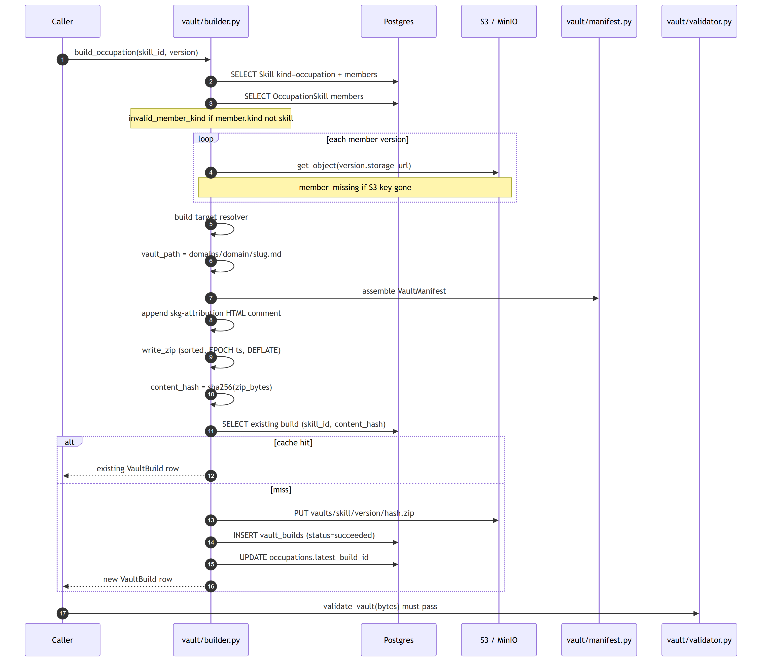
9
Vault build pipeline
build_occupation + build_persona produce deterministic content-addressed zips
Determinism
EPOCH_TIMESTAMP zip entries
Sorted filenames
_derive_vault_id is UUIDv4 over inputs
Same content_hash idempotent
# apps/api/src/vault/builder.py
def build_occupation(
session, skill_id,
version=None,
force_rebuild=False,
) -> VaultBuild:
...
hash = sha256(zip_bytes)
if existing(skill_id, hash):
return existing # idempotent
s3.put(vaults/{id}/
{ver}/{hash}.zip)
return INSERT vault_builds
Skills Git · Cycle 1 Technical Overview
9 / 20

Slide 10
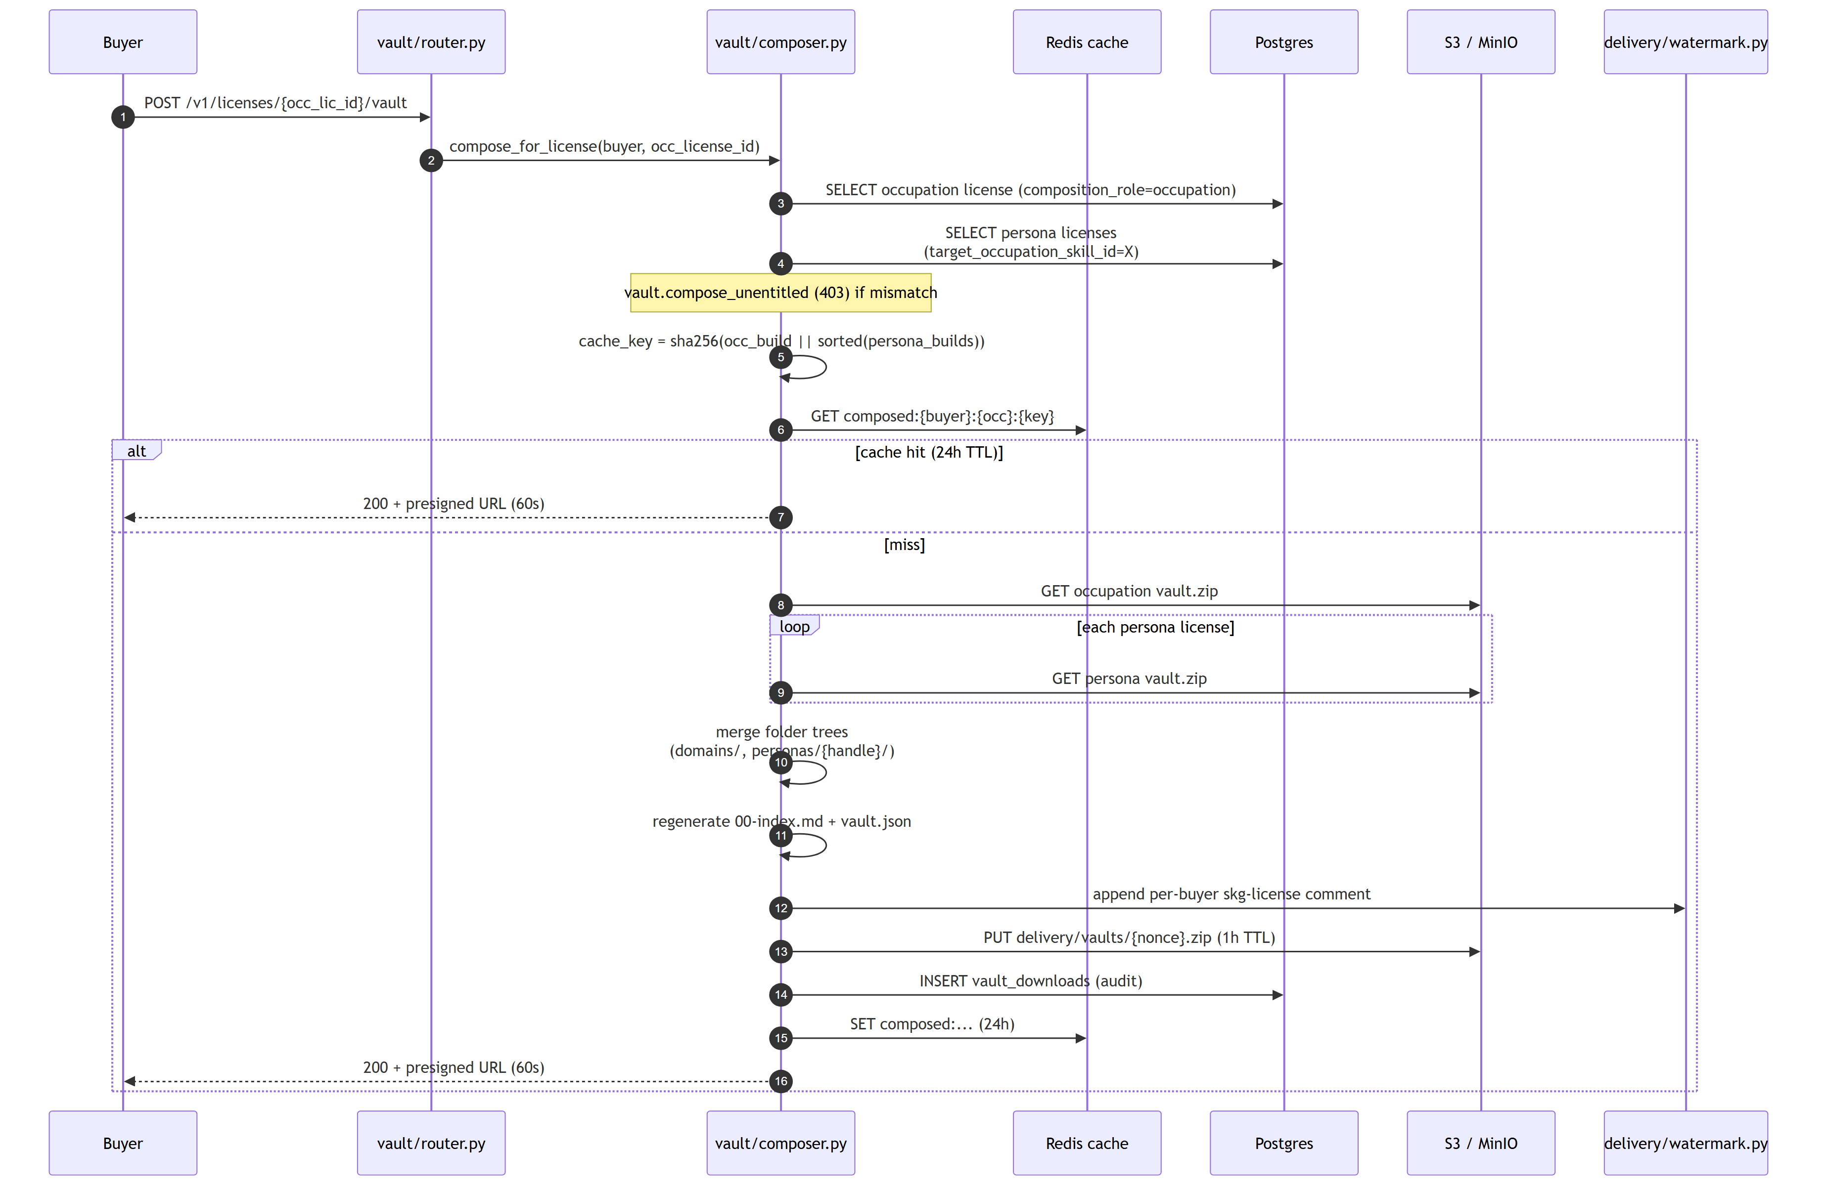
10
Vault composition (delivery-time merge)
compose_for_license: occupation + N personas -> per-buyer watermarked zip
Cache + audit
Cache key
composed:{buyer}:{occ}:{sha256(occ_build || sorted(persona_builds))}
TTL 24h
auto-invalidates on any input hash change
Presigned 60s
delivery/vaults/{nonce}.zip · 1h S3 lifecycle
Audit row
vault_downloads (per call, snapshot of license set)
Per-buyer watermark
delivery/watermark.py append-only HTML comment
Skills Git · Cycle 1 Technical Overview
10 / 20

Slide 11
11
Demo CLI — Layer C
Reference loader, not a hosted runtime (ADR-018). scripts/demo_devops_agent.py
$ uv run python -m scripts.demo_devops_agent \
--prompt "AWS bill is up 40%" \
--occupation skillsgit-curated/ai-devops-engineer \
--persona jane-devops-demo/incident-veteran
== REFERENCE LOADER ==
Not a hosted runtime.
Built per ADR-018: a sample integration buyers can copy. Their own agent reads the vault — Skills Git ships the format, not the inference.
Consulted neurons (extracted from Claude's JSON answer)
vault_path | creator | version | kind
domains/cost/cloud-cost-audit.md | skillsgit-curated | 1.0.0 | skill
domains/cost/cloud-cost-alert-designer.md | skillsgit-curated | 1.0.0 | skill
personas/jane-devops-demo/incident-veteran/2024-11-cost-spike-egress-debug.md | jane-devops-demo | 1.0.0 | memory_neuron
domains/observability/cardinality-cost-reviewer.md | skillsgit-curated | 1.0.0 | skill
Attribution resolved via vault.json.attribution_index built by vault/builder.py; consulted_block parsed by demo_devops_agent.py:_parse_consulted_block
Skills Git · Cycle 1 Technical Overview
11 / 20

Slide 12
12
API surface (new endpoints)
All mounted under /v1; ErrorResponse + cursor pagination conventions inherited
Method | Path | Auth scope | Module
POST | /v1/occupations | creator | occupations
POST | /v1/occupations/{id}/skills | creator (owner) | occupations
POST | /v1/occupations/{id}/build | creator (owner) | occupations + vault
GET | /v1/occupations/{handle}/{slug} | public | occupations
POST | /v1/personas | creator | personas
POST | /v1/personas/{id}/publish | creator (owner) | personas
GET | /v1/personas/{id}/neurons | entitlement-gated (404 leak-proof) | personas
POST | /v1/capture/sessions | creator | capture
POST | /v1/capture/sessions/{id}/finalize | creator (owner) | capture
GET | /v1/vault-builds/{id} | creator (owner) or admin | vault
POST | /v1/licenses/{occ_lic_id}/vault | license owner or admin | vault
GET | /v1/me/vault-downloads | current user | vault
Also extended: POST /v1/checkout/sessions adds a 409 persona.requires_parent_occupation gate (billing/router.py). Webhooks add: occupation.published · persona.published · persona.composed_into_vault.
Skills Git · Cycle 1 Technical Overview
12 / 20

Slide 13
13
Test fleet
pytest src/ tests/ -> 809 green. mypy --strict + ruff clean.
Module breakdown (apps/api/src/<ctx>/tests/)
191
13
Context | Tests | Notes
occupations | 55 | 21 service + 34 router
personas | 59 | 27 service + 32 router; 409 gate
capture | 77 | 18 PII + 10 quota + 22 svc + 27 router
vault | 53 | builder 31 + composer 22
integration | 13 | tests/integration/test_*_flow.py
module tests
integration tests
5
546
parser unit tests
legacy tests (zero regression)
Snapshot fixtures in tests/fixtures/vaults/expected-* catch vault.json drift. Stub LLM via SKG_CAPTURE_LLM_STUB=1. Snapshot regen via UPDATE_VAULT_SNAPSHOTS=1.
Run: cd apps/api && SKG_CAPTURE_LLM_STUB=1 uv run pytest src/ tests/
Skills Git · Cycle 1 Technical Overview
13 / 20

Slide 14
14
CI / CD
Per-PR gates + nightly smoke run hits the full demo pipeline
Per-PR
Nightly smoke
.github/workflows/ci.yml
.github/workflows/team-smoke.yml
lint (ruff)
typecheck (mypy --strict)
pytest (sqlite for unit, pg for integration)
pnpm build (web-marketplace)
alembic check (head only / down-then-up)
cron 17 3 * * * UTC + per-PR + manual
Postgres 16 + Redis 7 service containers
SKG_CAPTURE_LLM_STUB=1; no Anthropic egress
End-to-end: build_devops_vault -> build_devops_persona -> demo CLI snapshot-only -> diff against expected fixtures
Fails loudly on vault.json drift
Skills Git · Cycle 1 Technical Overview
14 / 20

Slide 15
15
External integrations
Three external services; everything else is in-tree under infra/docker-compose.yml
Stripe Connect
Anthropic Claude
S3 object layout
billing + webhooks
capture + demo CLI
storage + delivery
POST /v1/checkout/sessions handles any kind
transfer_data.destination = creator's connected acct
Webhook events ratify license rows
No multi-creator splits per transaction (ADR-002)
capture/llm.py (model: claude-sonnet-4-7)
core/anthropic.py shared SDK factory
Free tier: 10 captures / month / creator
Demo CLI is a reference loader (ADR-018)
skills/{id}/{ver}/{hash}.md — individual files
vaults/{skill_id}/{ver}/{hash}.zip — vault builds
delivery/vaults/{nonce}.zip — composed (1h TTL)
attachments/personas/{persona}/{sha256}.{ext}
Skills Git · Cycle 1 Technical Overview
15 / 20

Slide 16
16
Local dev — getting going
Bring the stack up, run the migrations, then exercise the demo path
# 1. Stack up — pg :5433 · redis :6379 · minio :9000 · mailhog :8025
docker compose -f infra/docker-compose.yml up -d
# 2. Apply migrations (creates the 5 new tables + skills.kind column)
cd apps/api && uv run alembic upgrade head
# 3. Frontends — turbo: web-marketplace :3000 · api :8000
cd ../.. && pnpm install && pnpm dev
# 4. Build Layer A — curated DevOps occupation (450 base + 30-skill bundle)
cd apps/api
uv run python -m scripts.publish_curated
uv run python -m scripts.build_devops_vault
# 5. Build Layer B — sample persona overlay (7 neurons)
uv run python -m scripts.build_devops_persona
# 6. Run Layer C demo
export ANTHROPIC_API_KEY=sk-ant-...
uv run python -m scripts.demo_devops_agent \
--prompt "AWS bill is up 40%" \
--occupation skillsgit-curated/ai-devops-engineer \
--persona jane-devops-demo/incident-veteran
Skills Git · Cycle 1 Technical Overview
16 / 20

Slide 17
17
Drift items found during diagramming
17 spec-vs-code reconciliation items — Cycle 2 candidates
Compose endpoint
Stale model id in capture
Returns 200 + presigned URL synchronously, not the spec'd 202 + job + 200.
capture/service.py hardcodes claude-sonnet-4-6; validator allowlist drift.
vault/router.py · spec team/02-api-surface.md §4
apps/api/src/capture/service.py
vault_downloads on miss only
Vault folder name
Insert happens only on cache MISS, so repeat downloads from cache aren't audited.
Spec says base/<slug>; builder emits domains/<domain>/<slug>.md. Composer + validator both already accommodate.
apps/api/src/vault/composer.py · audit gap
team/03-vault-generation.md vs vault/builder.py
17 drift items total — full inventory in team/dev-diary.md §Cycle 2 candidates and per-folder docs/diagrams/*/README.md
Skills Git · Cycle 1 Technical Overview
17 / 20

Slide 18
18
Cycle 2 roadmap
What lands next — drawn from open questions + Cycle 1 retro
FRONTEND
Capture UX + persona dashboard + occupation page
T-09 / T-10 / T-11 — wireframed in team/04-capture-flow.md; the data + APIs are ready, the UI is the gap.
BILLING
Paid personas + Stripe Connect transfer_data wiring
ADR-016 Q-1 deferred. Data model already supports it; persona price field is a no-op today.
CAPTURE
BYOK for capture LLM
creator_api_keys table + per-call key selection. Unblocks creators who hit the 10-captures/month free cap.
DELIVERY
MCP delivery mode (alongside vault bundle)
ADR-001 explicitly defers. vault_builds artifact is already designed to be served either way.
QA
Real-DB-driven snapshot tier in CI
Existing fixtures cover a 3-skill subset; a tier hitting the full 30-skill curated build catches curated-seed drift.
COMMUNITY
Recruit a real DevOps practitioner persona
ADR-016 Q-4 — jane-devops-demo is sample data; replace with a real recorded practitioner.
Skills Git · Cycle 1 Technical Overview
18 / 20

Slide 19
19
Where to read more
Every file is on disk — these are the authoritative pointers
ARCH
team/00-architecture.md
Component diagram + 5 data flow scenarios (curator builds vault, creator publishes persona, capture, compose, agent answers).
DATA
team/01-data-model-deltas.md
Every new column + table with PK / FK / index + per-migration ordering.
API
team/02-api-surface.md
Full /v1/* surface, error code namespace, audit log additions, webhook payloads.
ADRs
team/decisions.md
18 ADRs. ADR-004 (kind discriminator), ADR-006 (compose-on-download), ADR-010 (attribution comment), ADR-018 (CLI as reference loader).
DIARY
team/dev-diary.md
Per-wave build journal + retrospective + Cycle 2 candidates queue.
TESTS
team/test-plan.md
Acceptance matrix per T-task; flips from pending -> passed as agents close out.
VAULT
docs/vault-format.md
Buyer-facing format spec with manifest example + 50-line Python reference loader.
HOWTO
docs/capture-howto.md
Creator walkthrough — capture a situation, edit the draft, publish into a persona.
DIAGRAMS
docs/diagrams/
40 native draw.io diagrams across 10 subsystems. Each folder has a README.
Skills Git · Cycle 1 Technical Overview
19 / 20

Slide 20
Q & A
Ready for the codebase — pick a module, open the diary entry for its wave, dive in.
Issues
Diary
Specs
github.com/skillsgit/issues
team/dev-diary.md
team/decisions.md · 00-09-*.md
Skills Git · Cycle 1 Technical Overview · commit cycle-1/occupations-personas-capture

