Slide 1
Ranking System with Divide and Conquer
Presented By: Jagirdar Mushiruddin

Slide 2
Introduction.
Importance of efficient sorting in academic ranking systems.
Divide and conquer is the best sorting algorithm.
Breakdown of sorting tasks into smaller sub-problems.
Conquering sub-problems individually and merging results.
Purpose: Explore application of divide and conquer in sorting student ranks.

Slide 3
Merge Sort Algorithm:
Divide Operations:
Split the array into two halves recursively until each sub-array has only one element.
Dividing the array into smaller sub-arrays allows for easier sorting.
Continues dividing until individual elements are reached.
Merge Operations:
Merge two sorted sub-arrays into a single sorted array.
Comparing elements from both sub-arrays, insert the smaller one into the result
array.
Repeat the process until all elements are merged into the result array.
Merging combines sorted sub-arrays back together into a fully sorted array.

Slide 4
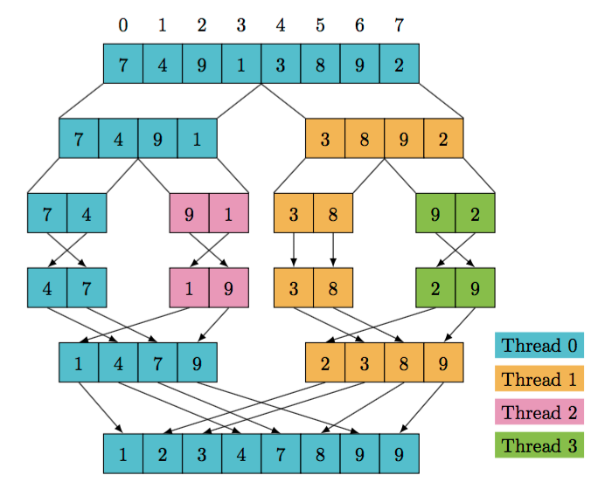

Slide 5
Advantages.
Stable sorting preserves relative order of equal elements.
Consistently efficient with O(n log n) time complexity.
Well-suited for linked lists due to its structure.
Easily parallelizable for faster processing.
Predictable performance across various data distributions.
No worst-case scenario, ensuring reliable performance.

Slide 6
Disadvantages.
Requires additional memory for merging, increasing space complexity.
Not an in-place algorithm, necessitating extra memory proportional to input size.
Complexity in implementation compared to simpler sorting methods.
Slower for small datasets due to overhead of recursion and merging.

Slide 7
Conclusion.
The divide and conquer approach, demonstrated by merge sort, offers an efficient solution for sorting student ranks. Despite challenges such as space complexity and reduced efficiency for small datasets, its stable, consistent, and scalable performance makes it a valuable tool in educational ranking systems. Understanding its strengths and limitations empowers educators and developers to make informed decisions in designing and implementing ranking systems.

