Slide 1
Comparative Analysis,
Optimization & Explainable AI
Sports Image Classification
Dataset: 100 Sports Image Classification
Google Colab • TensorFlow / Keras • 100-class classification
Student: P.KUNDAN SADHU YASWANTH | Institution: CSE
CANVA-STYLE RESEARCH DECK
Sports Image Classification • 1

Slide 2
Problem, Motivation & Research Aim
100
14,492
7
70/15/15
Sports classes
Images after cleaning
Architectures
Stratified split
• Sports may share similar environments, equipment, poses and backgrounds.
• The study compares predictive performance together with model size and practical efficiency.
• A controlled benchmark supports architecture selection, optimization and explainability analysis.
Research Questions
• Which model leads baseline accuracy / F1 / ROC-AUC?
• Which model has the smallest parameter count?
• Does CBAM improve ResNet50?
• How does the accuracy–efficiency trade-off change?
Sports Image Classification • 2

Slide 3
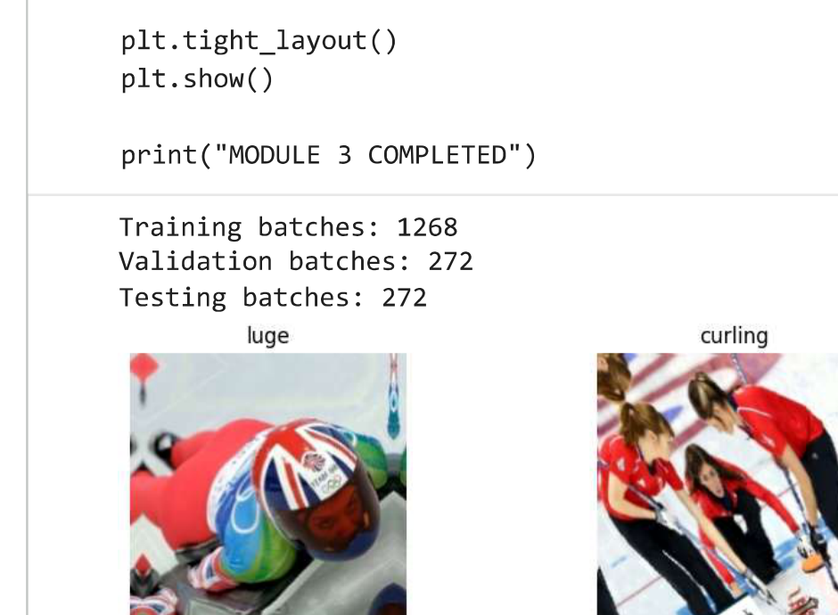
Dataset Source & Statistics
14,492
100
224×224
CC0
0
Images
Classes
Target size
Listed license
Invalid
Kaggle source
gpiosenka • 100 Sports Image Classification
https://www.kaggle.com/datasets/gpiosenka/sports-classification
Exact duplicates reported by the notebook: 0
Sample classes from notebook: luge • curling • arm wrestling • BMX • basketball • roller derby
Sports Image Classification • 3

Slide 4
Dataset Cleaning & Quality Control
01
File discovery
Collect supported image extensions
Cleaning outcome
02
Validity check
PIL verification • 0 invalid
0
0
03
Exact duplicate check
SHA-256 • 0 exact duplicates
Invalid
Exact duplicates
04
Leakage check
Split overlap checked
• Exact duplicates only are removed by hashing.
• Near-duplicate detection is a future enhancement.
05
Label encoding
100 classes → integer IDs
Sports Image Classification • 4

Slide 5
Preprocessing, Augmentation & Data Split
INPUT PIPELINE
• Decode → 3 channels → resize 224×224 → float32.
• Training: RandomFlip, Rotation 0.1, Zoom 0.15, Contrast 0.1.
• Validation and test use deterministic preprocessing.
• tf.data: shuffle (train) → batch 8 → prefetch(AUTOTUNE).
TRAIN • 10,144 images • 70%
VALIDATION • 2,174 images • 15%
TEST • 2,174 images • 15%
STRATIFIED 70 : 15 : 15
Sports Image Classification • 5

Slide 6
Experimental Environment & Baseline Configuration
Google Colab
Adam
Environment
Optimizer
TensorFlow / Keras 2.20.0
3×10⁻⁴
Framework
Learning rate
GPU available • model to insert
Categorical cross-entropy + label smoothing 0.1
Hardware
Loss
224×224×3
1
Input
Baseline epochs
8
EarlyStopping + ReduceLROnPlateau
Batch size
Callbacks
Sports Image Classification • 6

Slide 7
Seven Model Architectures
ResNet50
ResNet50 + CBAM
EfficientNetB4
ConvNeXt-Tiny
Residual CNN
Skip connections
Attention CNN
Channel + spatial attention
Compound-scaled CNN
Depth / width / resolution
Modern CNN
Modern convolutional design
MobileNetV2
Xception
DenseNet121
Lightweight CNN
Inverted residuals
Separable CNN
Depthwise separable convolution
Dense CNN
Dense feature reuse
Sports Image Classification • 7

Slide 8
Training & Evaluation Workflow
1
2
3
4
5
Train
Common split + baseline settings
Validate
Early stopping / LR reduction
Test
Held-out 2,174 images
Measure
Accuracy • Precision • Recall • F1 • AUC
Profile
Parameters • training • inference
Evaluation on the held-out test set
Sports Image Classification • 8

Slide 9
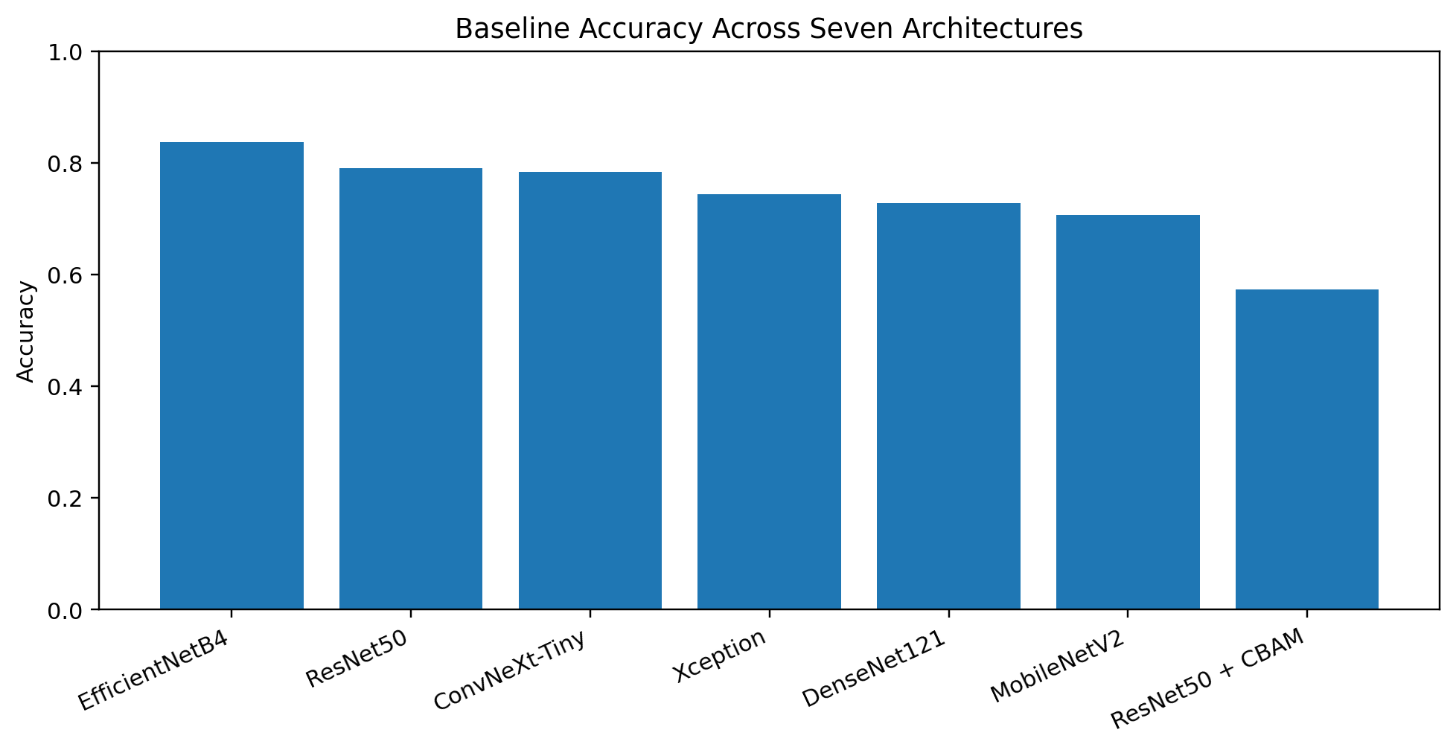
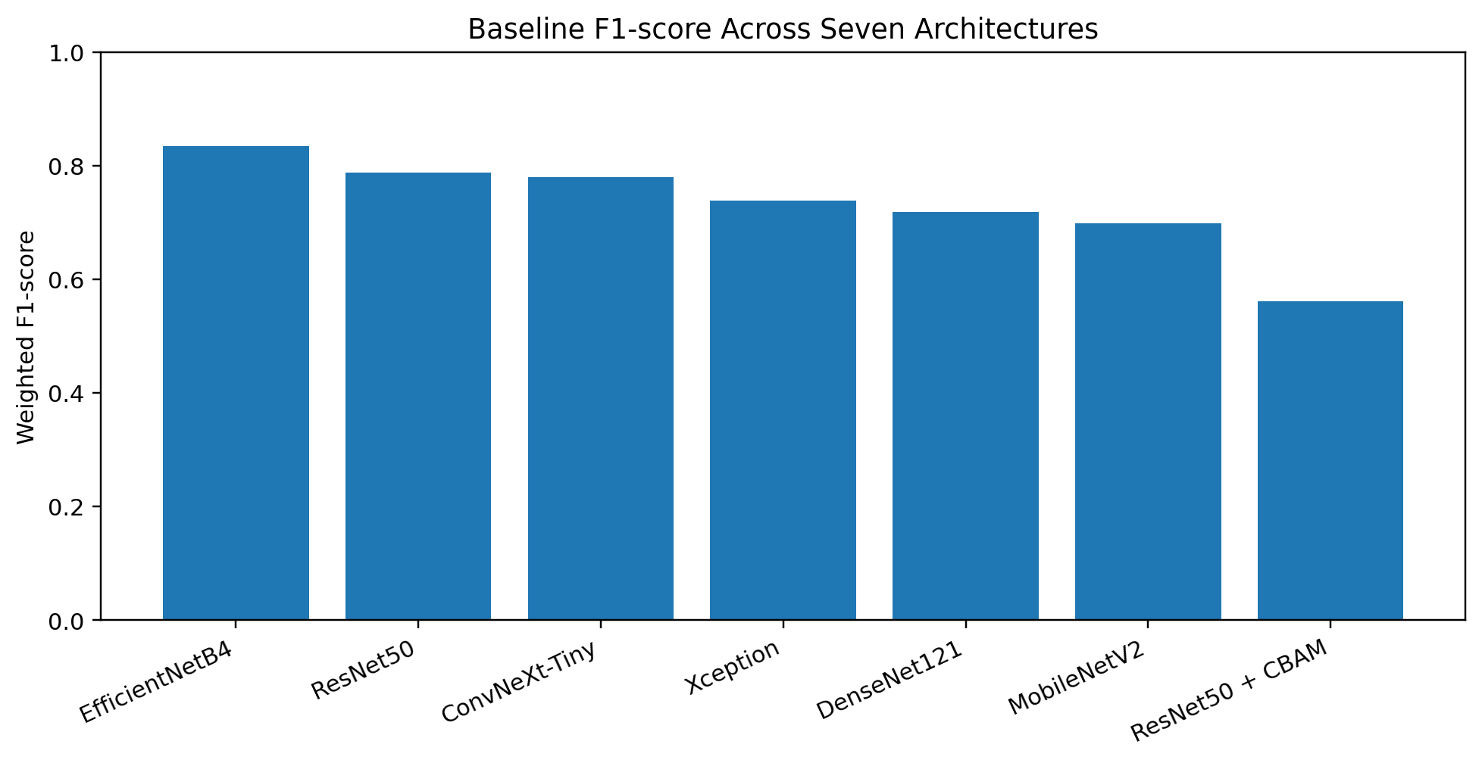
Baseline Performance Comparison
Sports Image Classification • 9

Slide 10
Baseline Results: Seven Models
Model | Accuracy | F1 | ROC-AUC | Parameters
EfficientNetB4 | 0.8376 | 0.8345 | 0.9978 | 17.86M
ResNet50 | 0.7898 | 0.7882 | 0.9957 | 23.80M
ConvNeXt-Tiny | 0.7833 | 0.7801 | 0.9967 | 27.90M
Xception | 0.7438 | 0.7385 | 0.9946 | 21.07M
DenseNet121 | 0.7282 | 0.7187 | 0.9930 | 7.14M
MobileNetV2 | 0.7061 | 0.6988 | 0.9923 | 2.39M
ResNet50 + CBAM | 0.5727 | 0.5617 | 0.9782 | 24.85M
Rounded values transcribed from the supplied Colab export. Use the saved comparison CSV for final unrounded values.
Sports Image Classification • 10

Slide 11
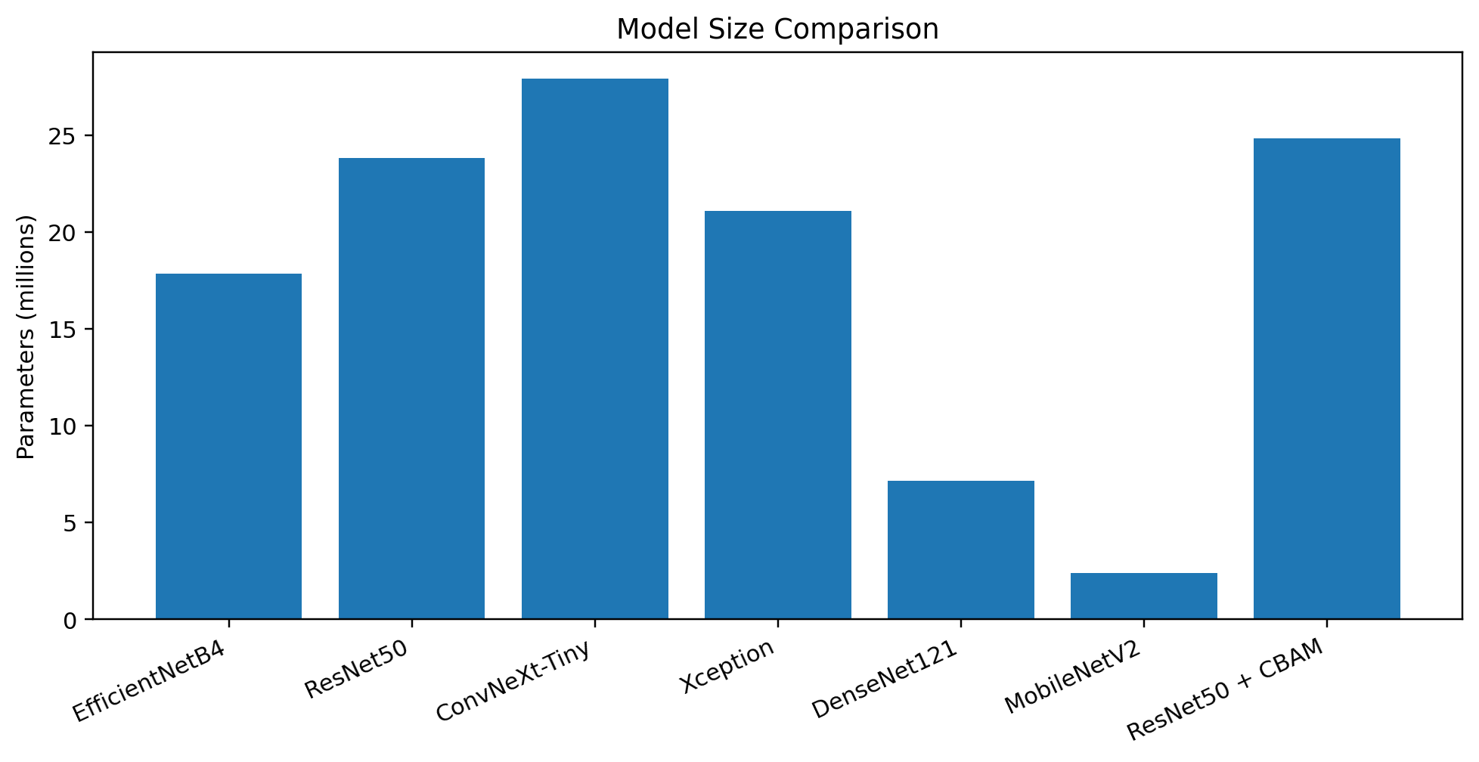
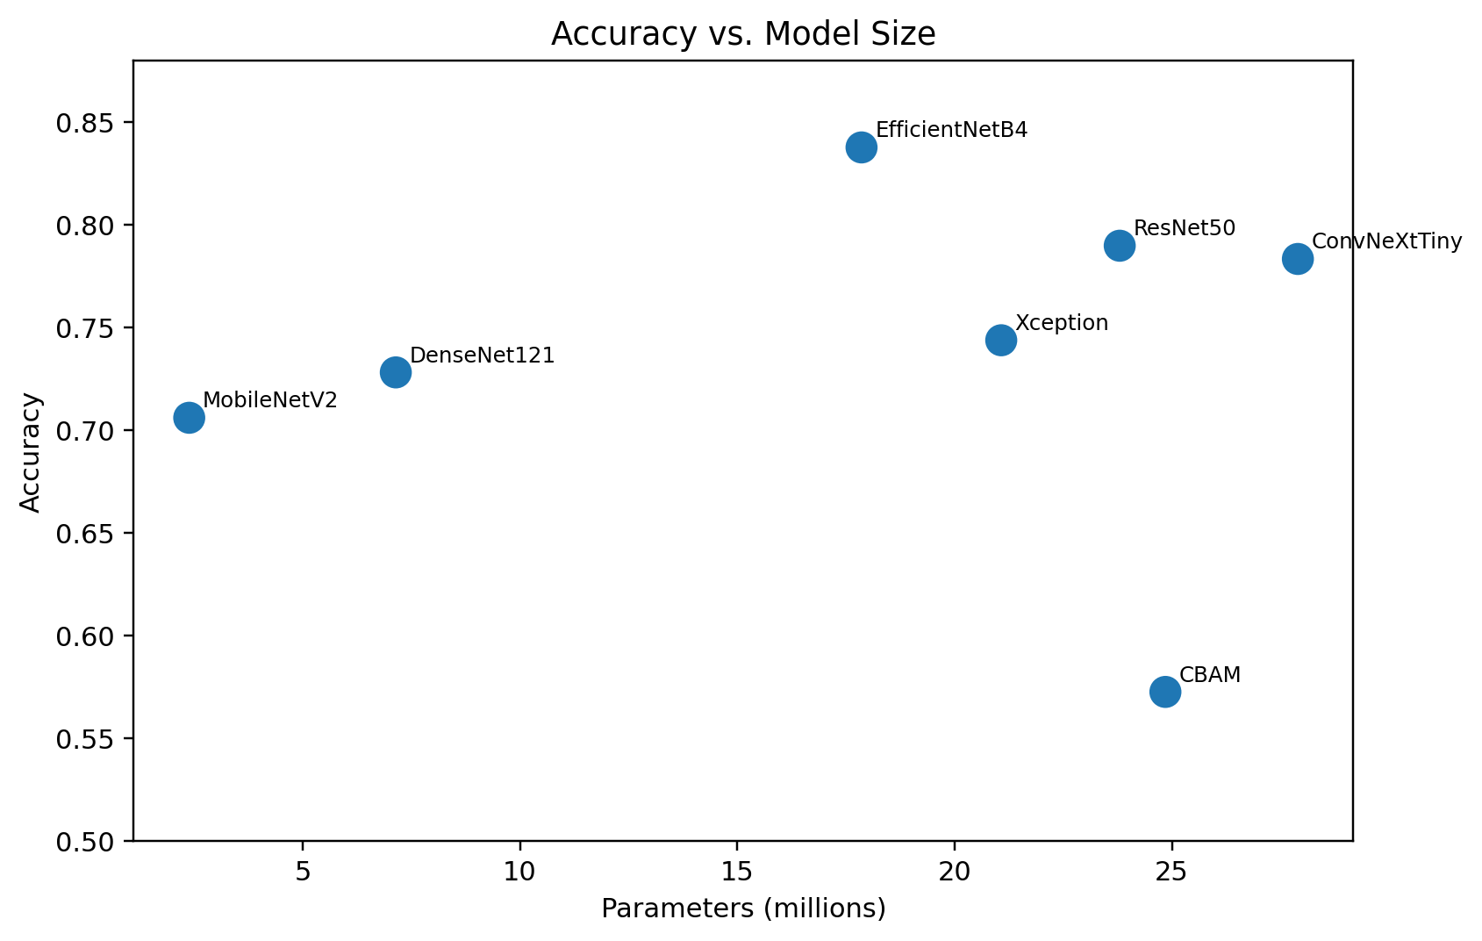
Model Size & Accuracy–Efficiency View
Sports Image Classification • 11

Slide 12
Baseline Best-Model Candidate
EfficientNetB4
Selection principle
Baseline candidate
• Combine predictive metrics with parameter count and inference speed.
• Do not use accuracy alone.
• Add Module 6 inference benchmark before final submission.
• Highest visible baseline accuracy: 0.8376
• Highest visible weighted F1-score: 0.8345
• Highest visible ROC-AUC: 0.9978
• Parameter count: 17,860,291
VERIFY FINAL CSV + INFERENCE BENCHMARK
Sports Image Classification • 12

Slide 13
Optimization Roadmap
BASELINE
EfficientNetB4
Frozen backbone
LR = 3e-4
OPT 1
Fine-tuning
Unfreeze final 20–30 layers
LR ≈ 1e-5
OPT 2
Learning-rate optimization
Compare schedules
+ convergence
OPT 3
Regularization / augmentation
Tune dropout + augmentation
FINAL
Optimized model
Retest + profile
Only executed results should be presented as optimization evidence
Sports Image Classification • 13

Slide 14
Optimization Results: Baseline → Final
Stage | Accuracy | F1 | ROC-AUC | Inference | Status
Baseline EfficientNetB4 | 0.8376 | 0.8345 | 0.9978 | [insert] | Completed
Optimization 1 | [insert] | [insert] | [insert] | [insert] | Run / insert
Optimization 2 | [insert] | [insert] | [insert] | [insert] | Run / insert
Optimization 3 / Final | [insert] | [insert] | [insert] | [insert] | Run / insert
• Report reason + configuration for each technique.
• Use the same held-out test set for every stage.
• Add best validation epoch, training duration and saved checkpoint.
Sports Image Classification • 14

Slide 15
Explainable AI (XAI)
Grad-CAM
Occlusion Sensitivity
Gradient-based heatmap over a convolutional feature layer.
Mask patches and measure the change in target-class probability.
• Include easy correct, difficult correct, and incorrect examples.
• Interpret whether highlighted areas correspond to athlete, equipment, activity or background.
• The supplied export showed a Keras nested-model graph issue in the original direct-backbone Grad-CAM implementation.
• If a saliency method is used instead, label it as saliency—not Grad-CAM.
Sports Image Classification • 15

Slide 16
Key Findings, Limitations & Future Scope
83.76%
0
0
2.39M
Best visible baseline accuracy
Invalid images
Exact duplicates
MobileNetV2 parameters
• EfficientNetB4 led the visible baseline accuracy, F1-score and ROC-AUC.
• MobileNetV2 had the smallest parameter count among the seven models.
• CBAM did not improve ResNet50 in the one-epoch baseline run.
• Limitations: one-epoch baseline, exact-duplicate-only cleaning, and incomplete optimization/XAI evidence in the supplied export.
• Future: near-duplicate checks, longer repeated training, FLOPs/memory/energy profiling, and transformer extensions.
Sports Image Classification • 16

Slide 17
References & Final Submission Checklist
• Kaggle – 100 Sports Image Classification: https://www.kaggle.com/datasets/gpiosenka/sports-classification
• He et al. (2016), Deep Residual Learning for Image Recognition, CVPR.
• Tan & Le (2019), EfficientNet, ICML.
• Liu et al. (2022), A ConvNet for the 2020s, CVPR.
• Sandler et al. (2018), MobileNetV2, CVPR.
• Chollet (2017), Xception, CVPR.
• Huang et al. (2017), DenseNet, CVPR.
• Woo et al. (2018), CBAM, ECCV.
• Selvaraju et al. (2017), Grad-CAM, ICCV.
Before submission
✓ Exact GPU + inference time
✓ Full class-distribution graph
✓ Optimization 1–3 results
✓ Baseline vs final graph
✓ 2+ XAI visualizations
✓ Replace all placeholders
READY TO IMPORT INTO CANVA
Sports Image Classification • 17

