Slide 1
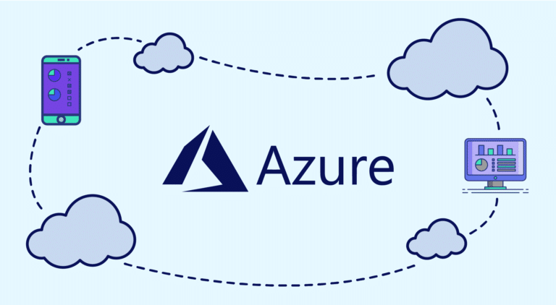
Presented By:- Kundan Gawande(28806)

Slide 2
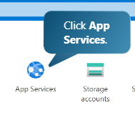
Create Web Application Uisng Microsoft Azure
Step no 1:- Click on app services

Slide 3
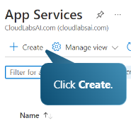
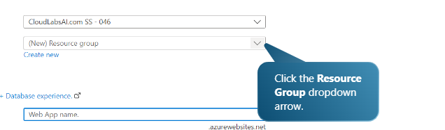
Step no 2:- Click on Create
Step no 3:- Click on Resource Group

Slide 4
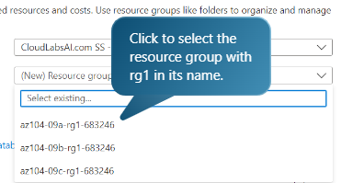
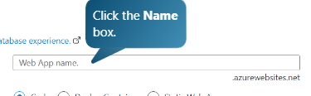
Step no 4:- Select the resource from the drop down menu
Step no 5:- Give the Web App Name

Slide 5

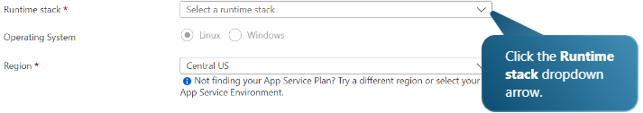
Step no 6:- This the sample name
Step no 6:- Select the stack for the web app

Slide 6


Step no 7:- for example select php 7.4
Step no 8:- Select the Operating System

Slide 7
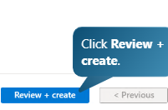

Step no 9:- After Selecting all details click on review and create.
Step no 10:- Then it will validate and give the total cost requried.

Slide 8
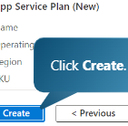

Step no 11:- After taking a look of the cost , click on create.
Step no 12:- It will initialize to create the web app and will start the deployment process.

Slide 9
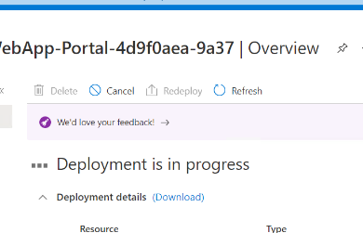

Step no 13:- This shows deployment in progress.
Step no 14:- Deployment completed .

Slide 10
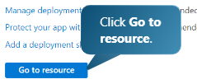
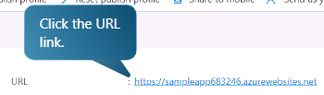
Step no 15:- To check whether the web app is created or not.
Step no 16:- We will get the URL for application created , by clicking on the URL we will be redirected to the website.

Slide 11
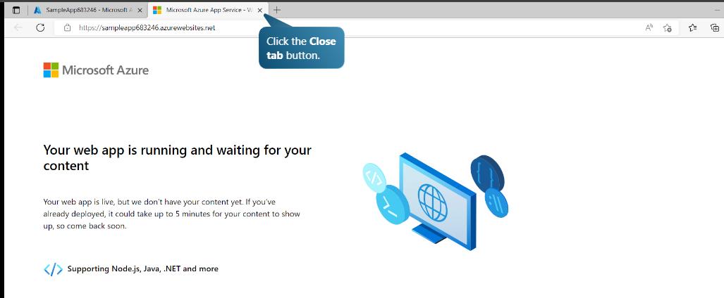
Step no 17:- This displays our web application created.

Slide 12


Slide 13
Cloud Service Types
Software as a service (SaaS)
Platform as a service (PaaS)
Infrastructure as a service (IaaS)
Infrastructure as a Service:-
is a cloud service where companies rent IT resources like servers, storage, and networks instead of buying and managing them.
It's like outsourcing your computer hardware. The cloud provider gives you the basic building blocks (like virtual machines, storage, and internet access), and you use them to run your apps and services.

Slide 14
Software-as-a-Service :-
means using software over the internet instead of installing in on your computer. You don't have to worry about downloading, updating, or maintaining anything- the company that provides the software handles all of that.
Platform as a Service:-
It is a type of cloud service that gives developers the tools they need to build and launch apps online without setting up any hardware and software themselves.With PaaS, everything runs on the provider's server and is accessed through a web browser.

