Slide 1
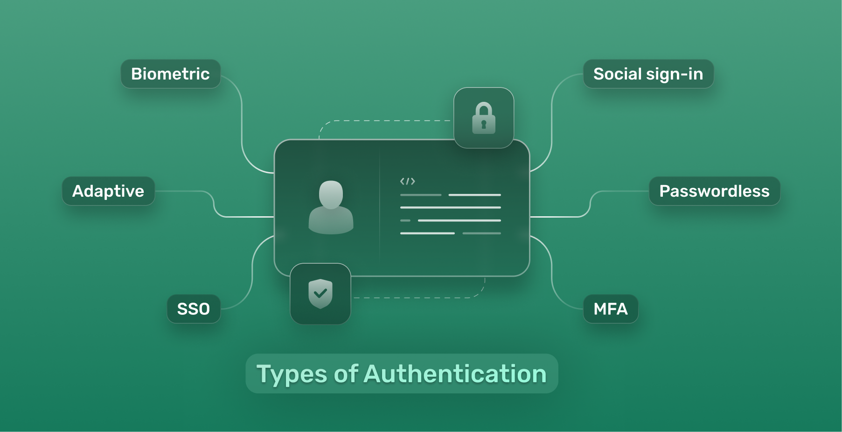
Authentication
Authentication is the process of verifying identity before granting access to a system or application.

Slide 2
Types of Authentications:-
Single-factor: Just a password
Two-factor (2FA): Password + OTP (SMS/email/app)
Biometric: Fingerprint, retina, voice
Certificate-based: X.509 certificates
Token-based: OAuth, JWT

Slide 3


Example Scenario:
An employee logs into Office 365 with a password and is prompted for an OTP from their mobile
authenticator app.

Slide 4

Authentication Providers:
● Okta
● Auth0
● Microsoft Entra ID
● Ping Identity
● Duo Security (by Cisco)

