Slide 1
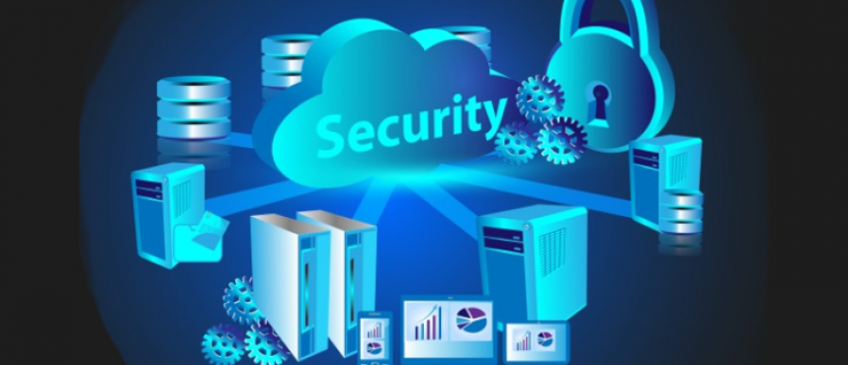
Weekly Presentation
Presented By:- Kundan Gawande(28806)

Slide 2
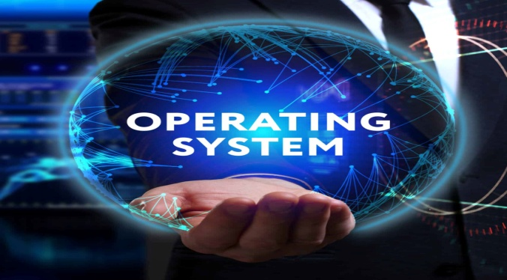
Operating System
An operating system (OS) is system software that manages computer hardware and software resources, and provides common services for computer programs
Function of Operating System:-
Process Management
Memory Management
File System Management
Device Management
User Interface

Slide 3
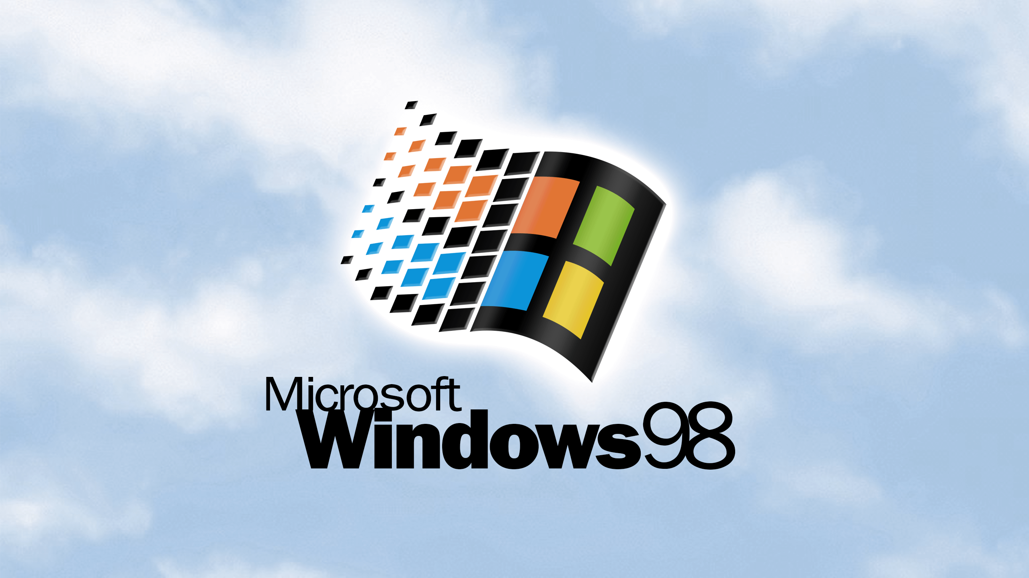

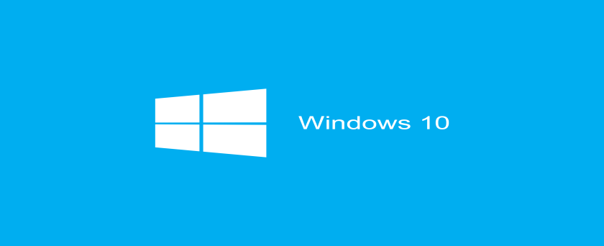
Types of Operating:-
Single-User and Multi-User OS
Multitasking and Real-time OS
Distributed OS
Network OS

Slide 4
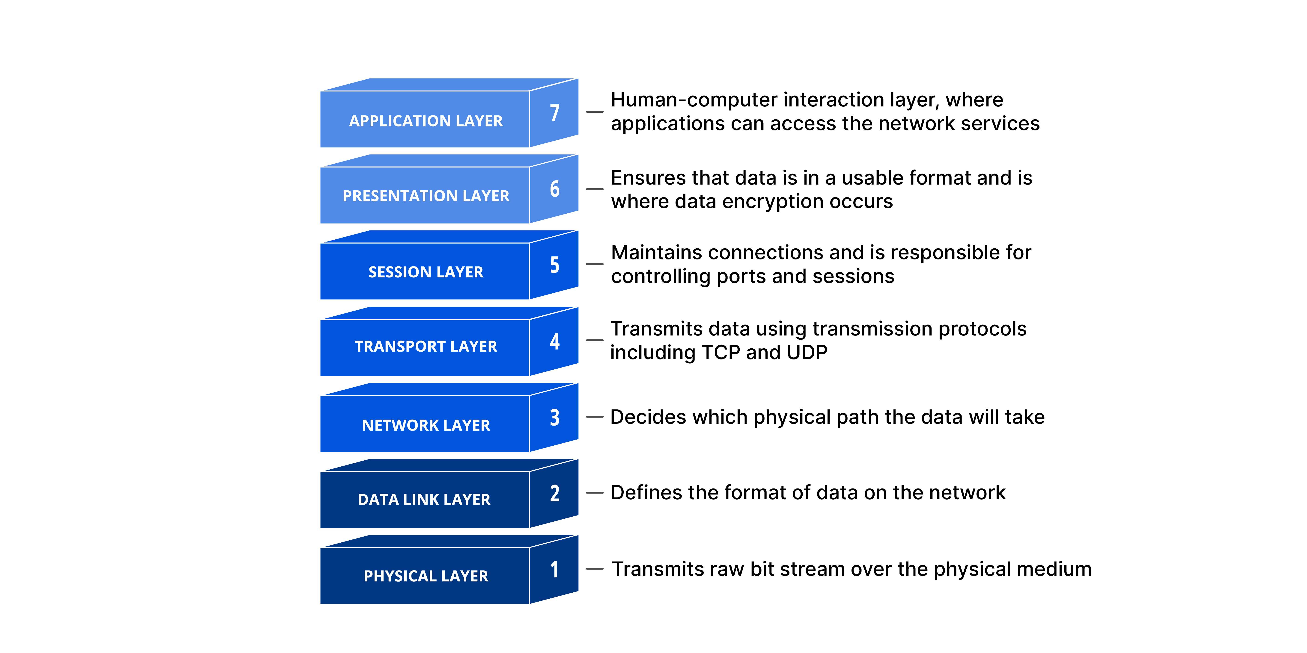
OSI model

Slide 5

What is Cyber Security ??
It are the Measures taken to protect a computer or a computer system( as on a network) against unauthorized access or attacks.

Slide 6
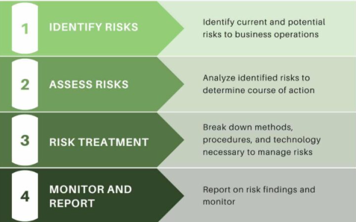
Risk Management

Slide 7
Points: Identify Risks First, find out what could go wrong—like someone stealing data or a virus damaging your system. Assess the Impact Understand how bad it would be if the risk actually happened. Would it cause small problems or big losses? Reduce the Risk Take steps to protect your systems—like using strong passwords, installing antivirus software, and updating software regularly. Monitor Regularly Keep checking for new threats and make sure your protection methods are still working. Have a Plan Be ready with a plan to fix things quickly if something bad does happen—like a backup or emergency response.

Slide 8

Common Cyber security Risks
Malware(viruses)
Phishing Attacks
Insider Threats
Weak Passwords

Slide 9
Best Practices & Conclusion
Implement strong passwords
Regular security training for employees
Keep systems updated
Use antivirus & firewalls
Backup data regularly
Conclusion: Effective risk management protects business continuity and data security.

Slide 10
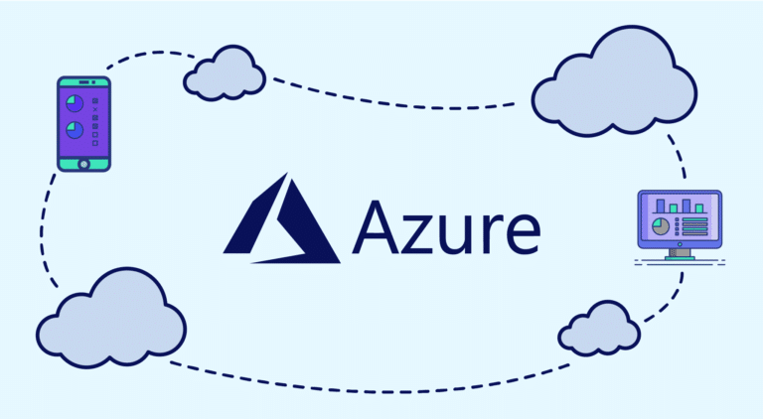
Presented By:- Kundan Gawande(28806)

Slide 11
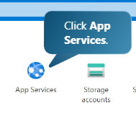
Create Web Application Uisng Microsoft Azure
Step no 1:- Click on app services

Slide 12
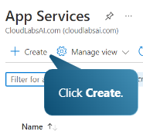
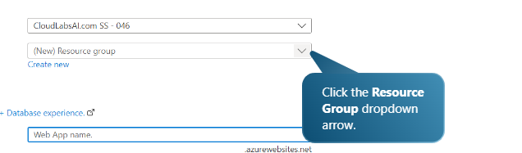
Step no 2:- Click on Create
Step no 3:- Click on Resource Group

Slide 13
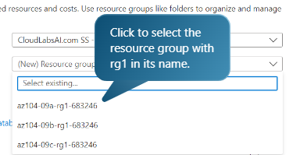
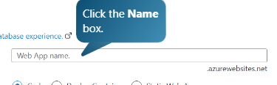
Step no 4:- Select the resource from the drop down menu
Step no 5:- Give the Web App Name

Slide 14

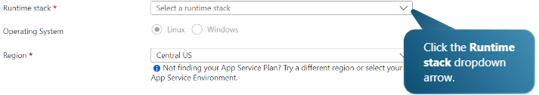
Step no 6:- This the sample name
Step no 6:- Select the stack for the web app

Slide 15


Step no 7:- for example select php 7.4
Step no 8:- Select the Operating System

Slide 16
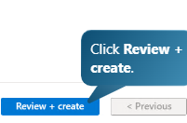

Step no 9:- After Selecting all details click on review and create.
Step no 10:- Then it will validate and give the total cost requried.

Slide 17
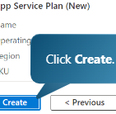

Step no 11:- After taking a look of the cost , click on create.
Step no 12:- It will initialize to create the web app and will start the deployment process.

Slide 18
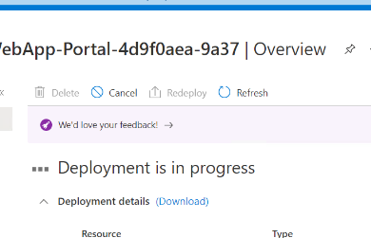

Step no 13:- This shows deployment in progress.
Step no 14:- Deployment completed .

Slide 19
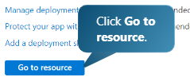
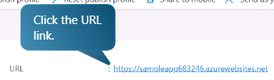
Step no 15:- To check whether the web app is created or not.
Step no 16:- We will get the URL for application created , by clicking on the URL we will be redirected to the website.

Slide 20
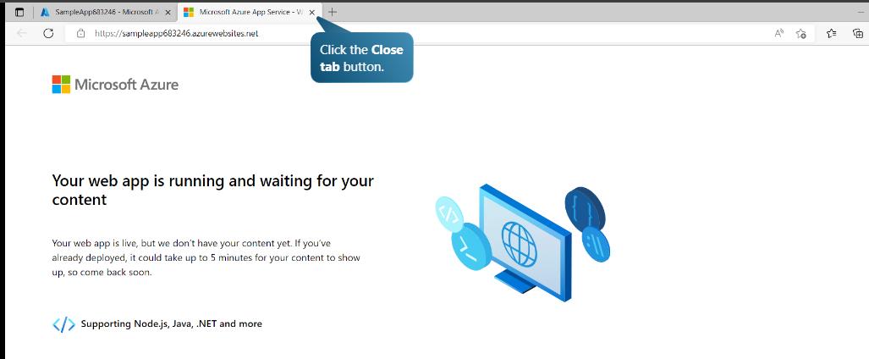
Step no 17:- This displays our web application created.

Slide 21


Slide 22
Cloud Service Types
Software as a service (SaaS)
Platform as a service (PaaS)
Infrastructure as a service (IaaS)
Infrastructure as a Service:-
is a cloud service where companies rent IT resources like servers, storage, and networks instead of buying and managing them.
It's like outsourcing your computer hardware. The cloud provider gives you the basic building blocks (like virtual machines, storage, and internet access), and you use them to run your apps and services.

Slide 23
Software-as-a-Service :-
means using software over the internet instead of installing in on your computer. You don't have to worry about downloading, updating, or maintaining anything- the company that provides the software handles all of that.
Platform as a Service:-
It is a type of cloud service that gives developers the tools they need to build and launch apps online without setting up any hardware and software themselves.With PaaS, everything runs on the provider's server and is accessed through a web browser.

