Slide 1
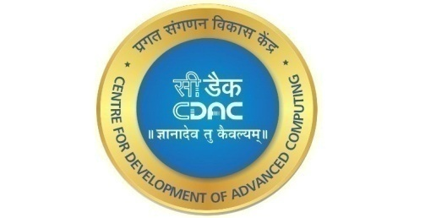
INFRA-SECOPS
Presentation
on
Project Presented by:
ANUSHKA KALE
VISHAKHA KHARAT
SAURABH SINGH
KUNDAN PAGARE
SONALI ZOL
PG_DHPCSA
CDAC ACTS
PUNE

Slide 2
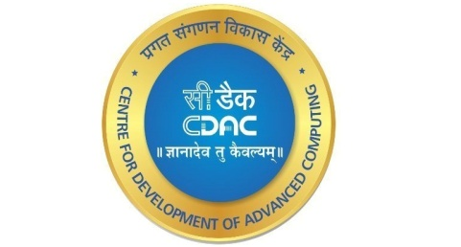
Contents
Project Overview
Requirement Description
Data Flow
Git Concept
AWS
Jenkins
Jenkins Pipeline
Trufflehog3
Webgoat
Result
Conclusion

Slide 3
Project Overview
This project aims to implement the Infrastructure framework in DevSecOps to provide a secure software development process that meets the security requirements of the organization.
The project will involve the identification and analysis of security requirements, the integration of security controls into the software design and architecture, the implementation of security controls

Slide 4
Requirement Description
System Requirement User Interface
EC2 Instance Ubuntu
Software Requirement
GIT
Jenkins 3.Docker
OWASP ZAP
Apache Maven version-
Trufflehog3
WebGoat
Dast
Hardware Requirement
Windows 10 or 11
Ubuntu 30GB HD, 1GB RAM
t2-medium 4GB RAM
t2-micro 1GB RAM

Slide 5
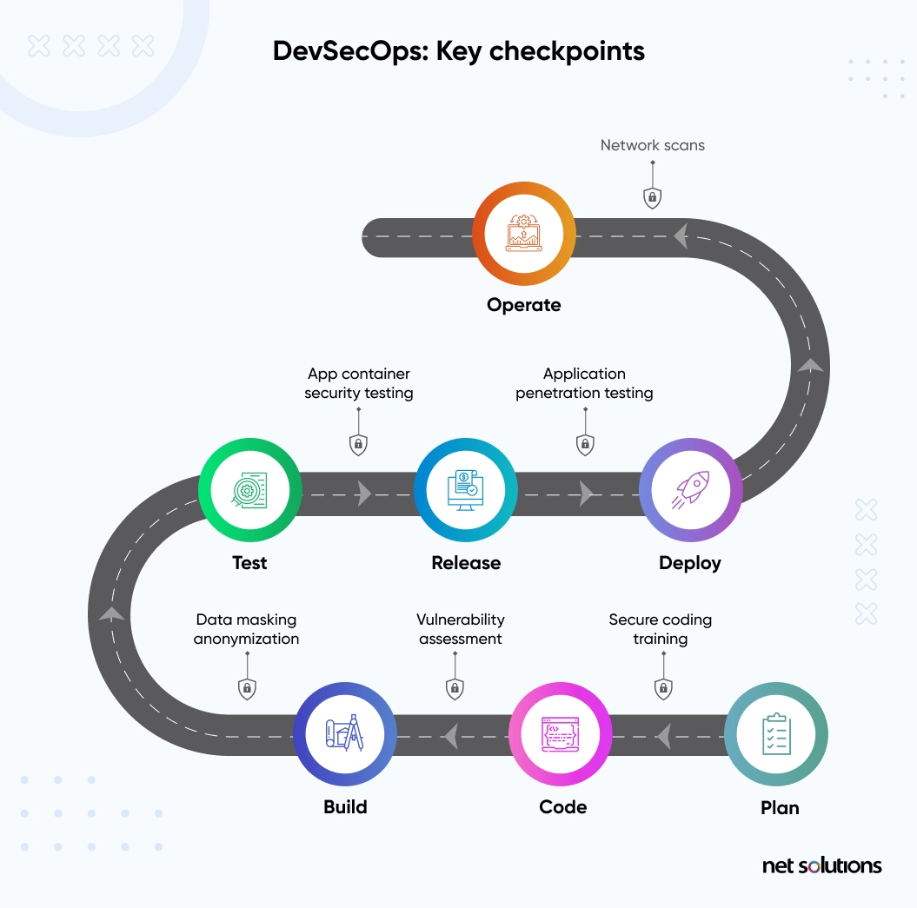
DATA FLOW

Slide 6
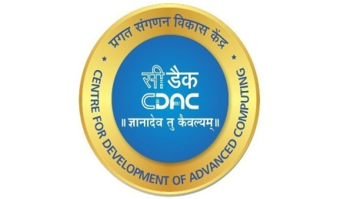
Jenkins Pipeline
Git clone
Check secrets
Webgoat Deployment
DAST

Slide 7
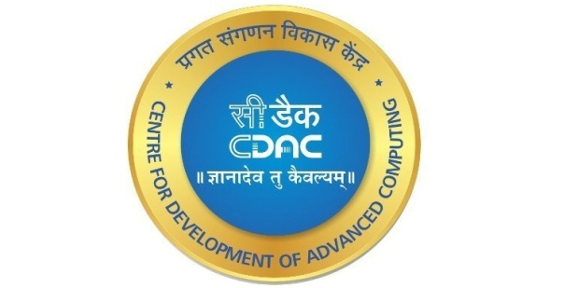
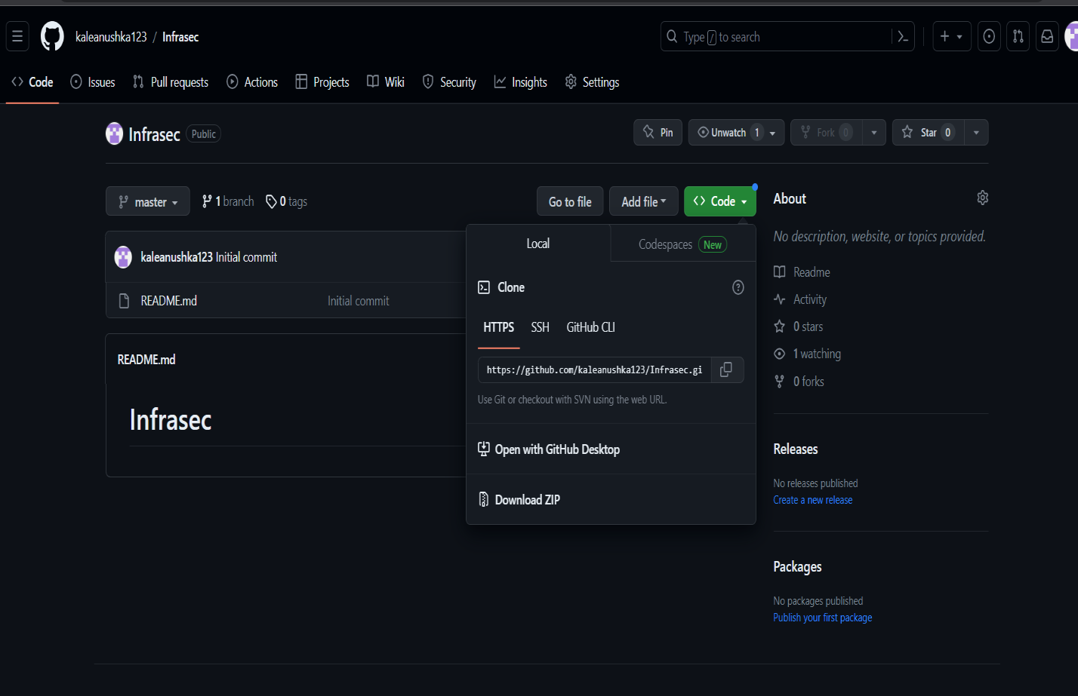
Git Concept

Slide 8
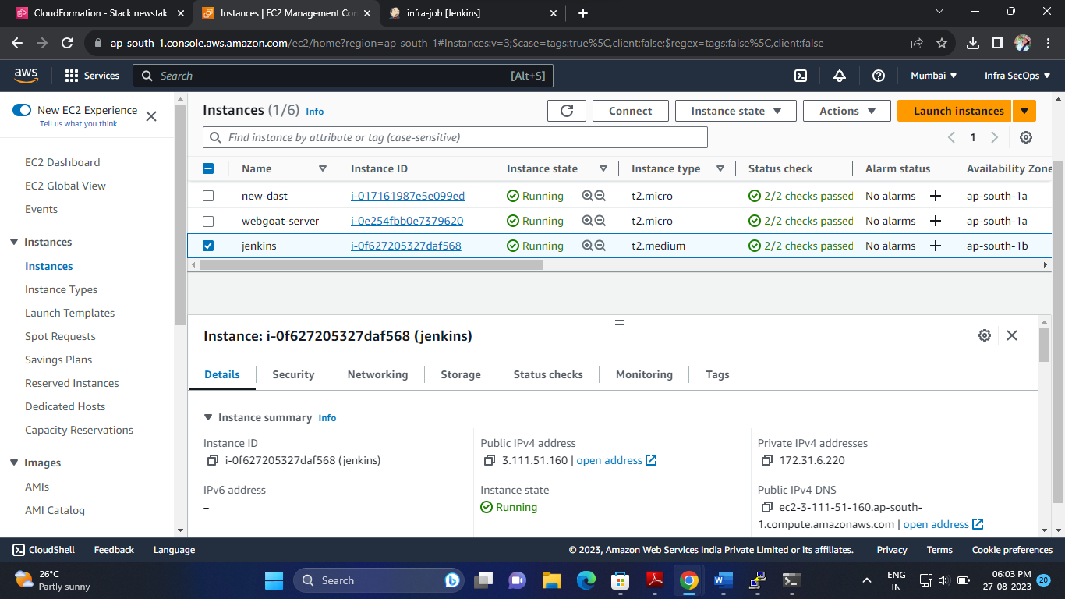
AWS

Slide 9
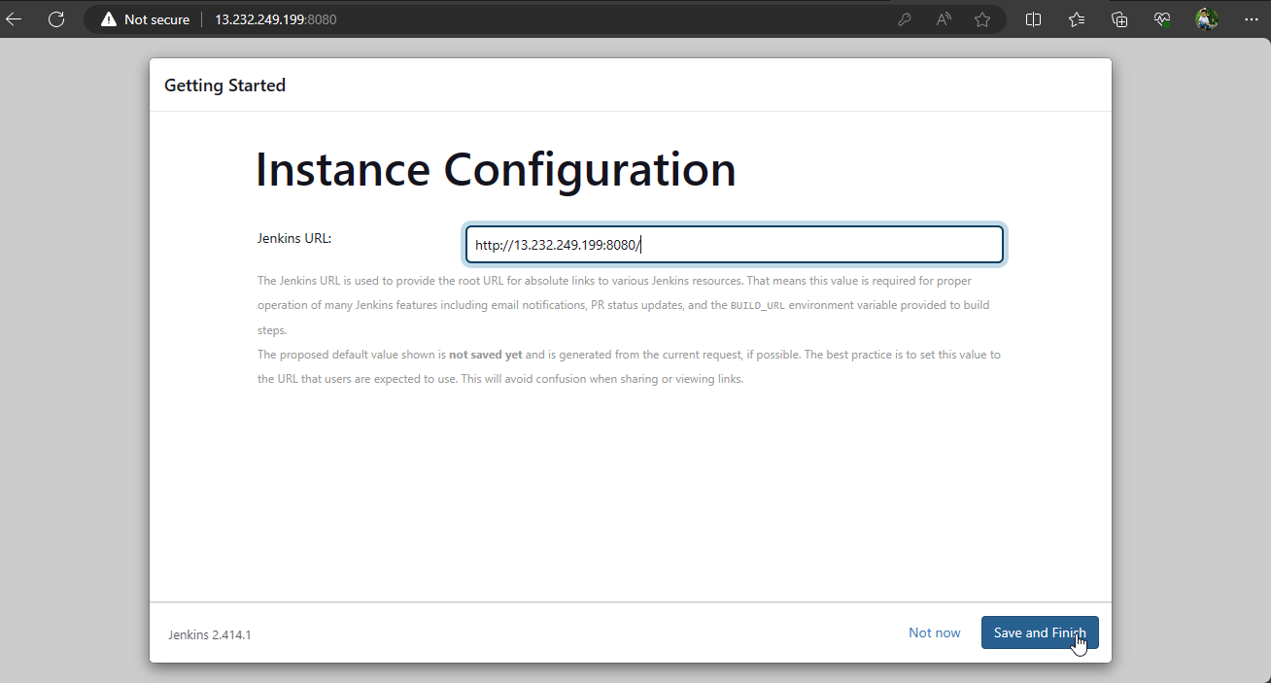
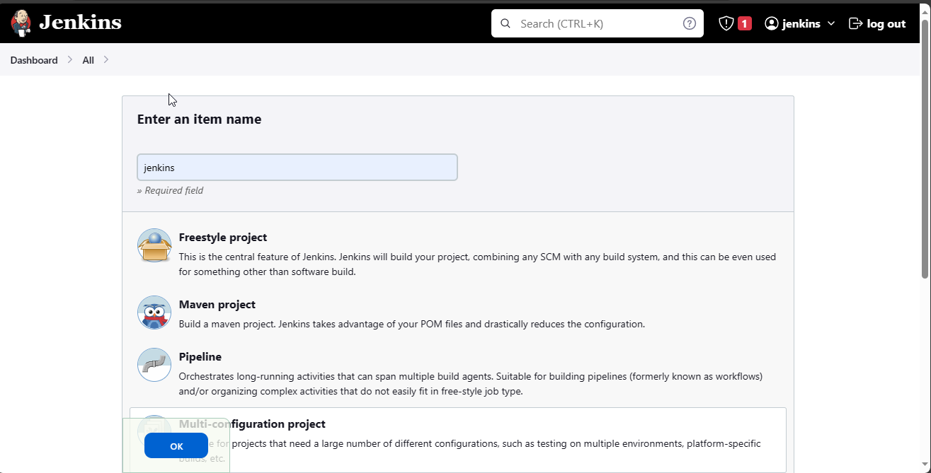
Jenkins

Slide 10
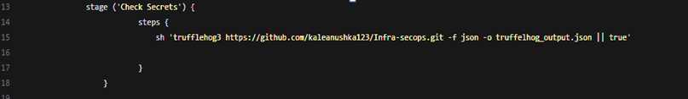
Trufflehog3
Trufflehog is an open-source security tool that is used to search for secrets and sensitive information in code repositories.
It is designed to identify and alert developers to any instances of sensitive information such as passwords, API keys, and other confidential data that may have been accidentally committed to a code repository.

Slide 11
Maven
Maven is a build automation and dependency management tool primarily used for Java projects. It was developed by Apache Software Foundation
Maven simplifies the build process by managing dependencies and providing a consistent build process across different projects
It uses a central repository called Maven Central to download project dependencies, which makes it easy to manage and update dependencies for a project.
Maven is a popular tool for Java developers to manage the build process and dependencies of their projects, and it can help to improve project organization and reduce build errors.

Slide 12
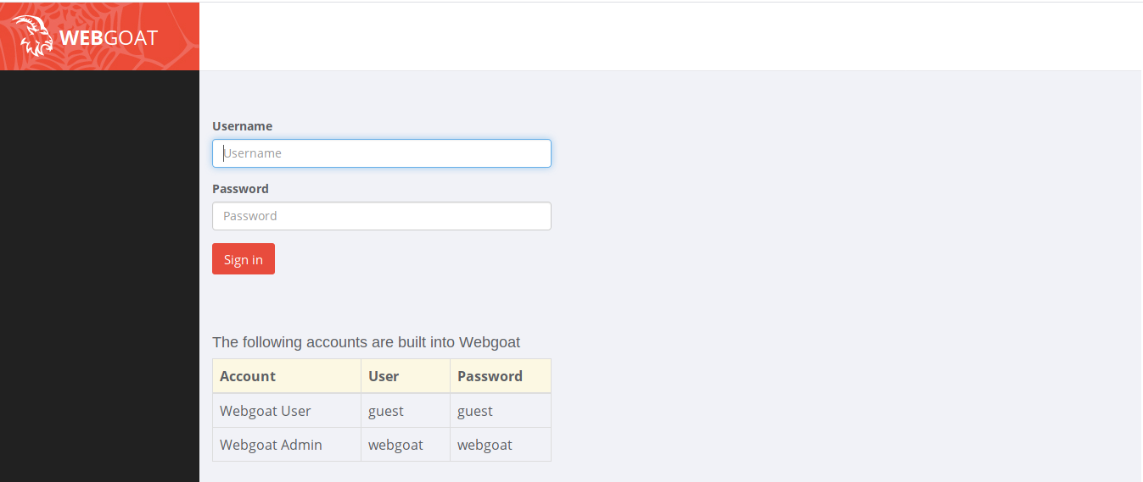
WebGoat
WebGoat is intentionally insecure web application maintained by OWASP designed to teach web application security lessons.

Slide 13
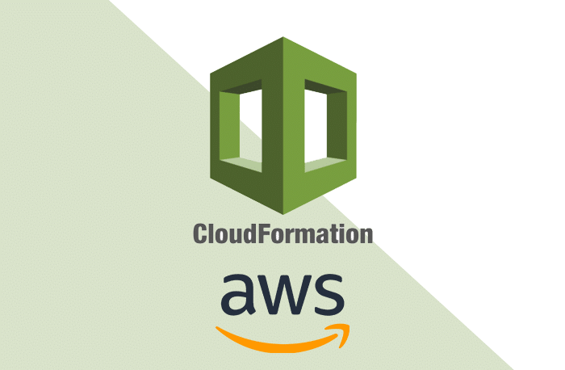
Cloudformation
AWS Cloudformation is a service that allows you to define infrastructure as code(IAC) using templates .
By using cloudformation to deploy an application server like webgoat we are ensuring consistant and repeatable deployement.
AWS CloudFormation is a service that helps you model and set up your AWS resources so that you can spend less time managing those resources and more time focusing on your applications that run in AWS.

Slide 14
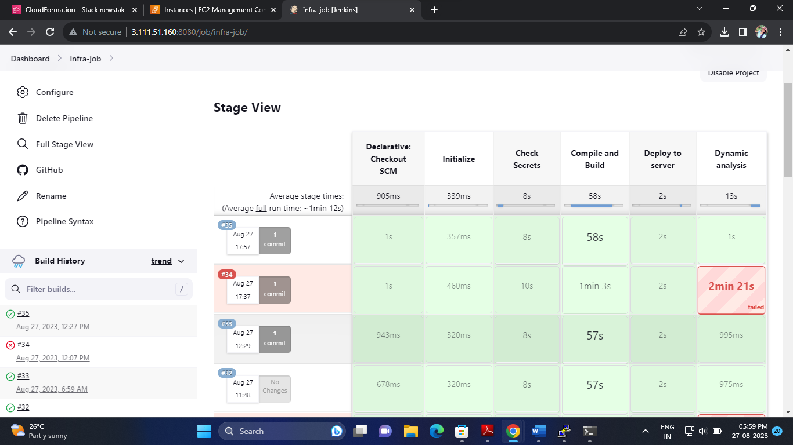
Results

Slide 15
Conclusion
In This way we have developed an Infrastructure Environment for security operations and awareness ensuring infrastructure consistency using Jenkins Pipeline which enhance the security posture of our applications.

