Slide 1



Sift: Intent–Hunk Alignment Verification
for AI-Generated Code Changes
Review 3
Group No: 24
Category: Product
COLLABORATOR
FACULTY GUIDE
N/A
Dr. T. Senthil Kumar, Professor, CSE Department
TEAM MEMBERS
Roll No | Name | Photo | Email ID | Mobile No | GitHub URL
CB.SC.U4CSE23037 | Kundhave S |  | kundhave05@gmail.com | 9344268947 | https://github.com/Kundhave
LinkedIn Product Demo: N/A
This presentation is prepared for Course
23CSE473 – Neural Networks & Deep Learning | Review 3
GitHub Repository: https://github.com/Kundhave/sift
Notes:
Introduce the project: Sift is a local verification layer that checks whether each diff hunk written by an AI coding agent serves the developer's stated intent. This is Review 3, so the deck covers the base paper, dataset status, the trained model, all experiments, the working application and the tests. Team 24 is a single-member team; the faculty guide is Dr. T. Senthil Kumar.

Slide 2
Abstract: what Sift does and what was measured
Sift is a local verification layer between an AI coding agent and the developer.
It consolidates the session's chat turns into one intent, labels each diff hunk Aligned or Misaligned (Collateral, Scope-Expansion, Purpose-Drift), calibrates the confidence, explains the verdict and ranks hunks for review.
A ModernBERT-base cross-encoder is compared with five non-neural baselines, three neural baselines and a GAN-style baseline on repository-disjoint splits of Sift-IA v1.0.
0.726
0.868
hard-tier pairwise AUC (B4/B5: 0.551)
NDCG@5 (random order: 0.724)
22.9 MB
18,000
INT8 ONNX student, CPU p95 66.9 ms
hunk-intent pairs, 15 repositories
Honest weak spot: main macro-F1 0.680 is below B5 logistic regression (0.698); the advantage is ranking on the hard tier.
All numbers: test split, single seed 473, labels constructed (no human validation).
Sift | Review 3 | 23CSE473 NNDL
2
Notes:
Sift consolidates a multi-turn coding session into one intent, scores every diff hunk as aligned or misaligned, types the drift, calibrates the confidence and ranks hunks for review. The four tiles are test-split numbers from results/master_comparison.csv and results/latency_size_onnx.json. Macro-F1 is honestly below logistic regression; the gain is in ranking.

Slide 3
Introduction: the review bottleneck
The problem
Agents emit large multi-file diffs faster than a developer can review them.
Code that compiles and passes tests can still contain collateral edits, unrequested features or off-purpose changes.
Why scalar signals fail
Lines changed or files touched are identical for every hunk in one diff.
Ordering hunks by diff lines equals random order (NDCG@5 0.724).
Objective
Consolidate the session intent, label every hunk Aligned or Misaligned, type the drift.
Rank hunks, with calibrated confidence and an explanation.
Three drift types of a misaligned hunk (counts in Sift-IA v1.0)
Collateral: 1,782
unrequested change next to the requested one, in a different file
Scope-Expansion: 1,307
unrequested feature or behaviour in a file the session already edits
Purpose-Drift: 871
serves a different purpose: the requested change is absent
Why deep learning: judging one hunk against an intent needs both texts read jointly, which a cross-encoder does.
Sift | Review 3 | 23CSE473 NNDL
3
Notes:
AI coding agents now produce multi-file diffs faster than anyone can read them, so the question becomes whether every hunk serves what the developer asked. Diff-level scalars like lines changed are the same for all hunks in a diff, so ordering by them equals random: NDCG@5 0.7236 from baselines.json. The drift-type counts are the sums of the three splits in dataset_statistics.csv.

Slide 4
Related work: five journal papers and the base paper
# | Paper, venue, year | Method and finding | Relation to Sift (gap)
1 | Xu et al., Code Comment Inconsistency Detection Based on Confidence Learning. IEEE TSE 50(3), 2024 | MCCL: remove dataset noise by confidence learning, then detect inconsistent pairs | Motivates our denoising stage. Gap: method-comment pairs, not hunks
2 | Huang et al., Are your comments outdated? J. Softw. Evol. Proc. 37(1), 2025 | CoCC: supervised classifier for outdated comments | Validates supervised pair classification. Gap: no calibration or ranking
3 | Yang et al., RComSync. Empirical Software Engineering 31(4), 2026 | In-context learning plus reranking for comment sync | Supports ranking. Gap: cloud LLM, not local
4 | Fan et al., Exploring LLMs for Code-Change-Related Tasks. ACM TOSEM 34(6), 2025 | LLMs with in-context learning vs PEFT; bigger is not always better | Justifies a compact fine-tuned encoder
5 | Wang et al., Best practices for code pre-trained models on SE classification. Expert Syst. Appl., 2025 | Embedding vs fine-tuning of code PTMs | Informs fine-tuning. Gap: single-input, not pair classification
B | Northcutt, Jiang & Chuang, Confident Learning. JAIR, 2021 (base paper) | Prune, count, rank to find label errors; model-agnostic | Used to find the 569 known label flips
Gap: no paper pairs a developer's multi-turn intent with individual diff hunks.
Sift | Review 3 | 23CSE473 NNDL
4
Notes:
These are the five SCImago-indexed journal papers from the Review 2 literature survey. All treat natural-language to code consistency, and none conditions on a multi-turn developer intent at hunk level. The last row is the base paper chosen for Review 3, covered on the next two slides.

Slide 5
Base paper: Confident Learning (JAIR 2021)
What it proposes
A data-centric framework that finds label errors by estimating the joint distribution of noisy and true labels under class-conditional noise. Model-agnostic; open-source as cleanlab.
Reported results (paper, CIFAR-10 test accuracy %)
Method | 20% noise | 40% noise
Confident learning (C_ỹ,y*) | 91.1 | 86.7
INCV | 87.8 | 84.4
Co-Teaching | 81.2 | 62.9
Baseline | 78.4 | 60.2
Key idea: prune, count, rank
Count: per-class threshold t_j = mean self-confidence; confident joint C[ỹ,y*] estimates the noise transition matrix
Sparsity 0; mean of ten trials in the paper.
Also finds real label errors in ImageNet (e.g. 645 missile images labelled as the parent class projectile), MNIST and Amazon Reviews.
Assumes class-conditional noise; proves conditions under which it exactly finds label errors.
Prune: remove examples likely mislabelled (prune by class or by noise rate)
Rank: order by self-confidence p(ỹ=i; x); train on the cleaned set
Northcutt, Curtis G.; Jiang, Lu; Chuang, Isaac L. Journal of Artificial Intelligence Research, 2021.
Sift | Review 3 | 23CSE473 NNDL
5
Notes:
The standard paper is Northcutt, Jiang and Chuang, Confident Learning, JAIR 2021. Its key idea is to estimate the joint distribution of noisy and true labels using per-class thresholds, then prune and rank examples; it is model-agnostic and open-sourced as cleanlab. The CIFAR-10 accuracies are copied from Table 2 of the paper (ppt/standard_paper.pdf).

Slide 6
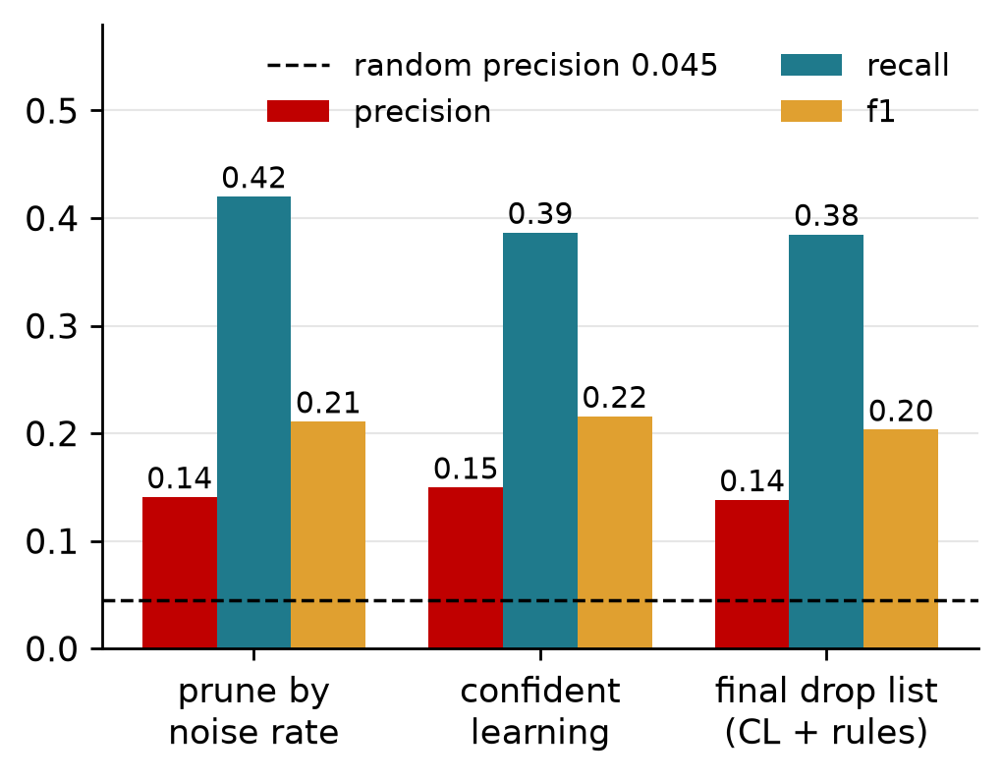
How Sift uses it: finding the 569 label flips
Procedure
Out-of-fold probabilities for all 12,600 training rows from the cross-encoder.
cleanlab confident learning flags suspected label errors, scored against the known flips.
Rules remove non-semantic and duplicate hunks first.
Result
Flagged 1,470, true flips found 220: precision 0.150, recall 0.387.
Random flagging would give precision 0.045.
Final drop list (CL + rules): precision 0.138, recall 0.385.
Better than random, but a weak detector: most flagged rows are not true flips.
Sift | Review 3 | 23CSE473 NNDL
6
Notes:
Sift-IA's training labels carry 569 deliberately flipped rows with ground truth, so confident learning can be scored directly. cleanlab was run on out-of-fold probabilities from the cross-encoder. It flagged 1,470 rows; 220 are true flips, giving precision 0.150 and recall 0.387, about three times the random precision 0.045. It is a weak detector, and we say so.

Slide 7
Related model papers: what Sift reuses
Paper | Role in Sift
Panthaplackel et al., Deep Just-In-Time Inconsistency Detection, AAAI 2021 | Closest prior task: comment vs code change
Herzig & Zeller, The Impact of Tangled Code Changes, MSR 2013 | Motivates our limitation: seed commits may be tangled
Nogueira & Cho, Passage Re-ranking with BERT, 2019 | Cross-encoder pattern: concatenate texts, classify from [CLS]
Warner et al., ModernBERT, 2024 | Encoder backbone (8k context), fine-tuned
Feng et al., CodeBERT, EMNLP Findings 2020 | Code-aware baseline (reduced training)
Lin et al., Focal Loss for Dense Object Detection, ICCV 2017 | Alignment loss for the 78:22 class ratio
Guo et al., On Calibration of Modern Neural Networks, ICML 2017 | Temperature scaling on validation
Hinton et al., Distilling the Knowledge in a Neural Network, 2015 | Distillation to the MiniLM student
Sundararajan et al., Axiomatic Attribution (Integrated Gradients), ICML 2017 | Token attributions for explanations
Han et al., Co-teaching, NeurIPS 2018 | Noisy-label training; named, not run
No new architecture is claimed; published results on other tasks are not comparable with ours.
Sift | Review 3 | 23CSE473 NNDL
7
Notes:
Every component of Sift is an existing method; the contribution is the task framing, the pipeline and the dataset. The first three rows are the closest research area (code-comment inconsistency and tangled changes). Co-teaching is named in the design and a helper exists, but it was not run. The note: published numbers are not comparable with ours because tasks and data differ.

Slide 8
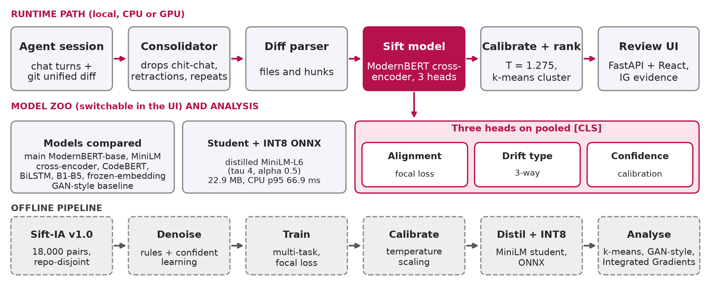
Proposed method: system architecture
Everything runs locally; the UI can switch between the main model, the INT8 student and the baselines.
Sift | Review 3 | 23CSE473 NNDL
8
Notes:
Top row is the runtime path: session, consolidation, diff parsing, the cross-encoder with three heads, calibration and ranking, and the review UI. The middle row shows the compared models and the distilled INT8 student. The bottom row is the offline pipeline that produced everything in results/. Calibration temperature 1.275 and the INT8 numbers come from calibration.json and latency_size_onnx.json.

Slide 9
Model, loss and heads
Cross-encoder (ModernBERT-base)
Input: [CLS] consolidated intent [SEP] hunk
149.0 M parameters, 22 layers, 768 hidden, 12 heads
Pooled [CLS] feeds three heads
Setting | Value
Max length / batch | 512 / 8 x 2 (effective 16)
Optimiser, lr | AdamW, 2e-05, cosine, 10% warm-up
Precision | bf16, gradient checkpointing
Epochs | up to 6, early stop (patience 2)
Training rows | 10,128 of 12,600 after denoising
Best val macro-F1 | 0.716
Train time | 28 min, peak 3.1 GB
Hardware | RTX 4050 Laptop, 6 GB
Seed | 473 (single seed)
Heads and loss
Alignment: 2-class, focal loss (gamma = 2)
Drift type: 3-class, masked to misaligned rows
Confidence: calibration head; temperature scaling afterwards
L = 0.6 L_align + 0.3 L_drift + 0.1 L_cal
FL = -alpha (1 - p_t)^gamma log p_t
Known method, new task: ModernBERT, focal loss and temperature scaling are existing techniques.
Sift | Review 3 | 23CSE473 NNDL
9
Notes:
The input is intent, separator, hunk, up to 512 tokens. The pooled vector feeds three heads: alignment, drift type masked to misaligned rows, and a confidence head. Loss weights are 0.6, 0.3 and 0.1 with focal loss, gamma 2, on the alignment term. Training took about 28 minutes on the 6 GB RTX 4050; the settings table is from experiments/runs/full/config.json and results/hyperparameters.csv.

Slide 10
Dataset: Sift-IA v1.0
Split | Repos | Sessions | Hunks | Aligned | Misaligned
Train | 7 | 4,266 | 12,600 | 9,828 | 2,772
Validation | 5 | 921 | 2,700 | 2,106 | 594
Test | 3 | 924 | 2,700 | 2,106 | 594
Total | 15 | 6,111 | 18,000 | 14,040 | 3,960
How labels are built
Aligned: a real hunk from the seed commit that produced the intent.
Misaligned: a donor hunk from a different commit inserted into the session.
Collateral: donor touches a different file. Scope-Expansion: same file, session hunks kept. Purpose-Drift: same file, own hunk removed.
Difficulty tiers (misaligned): random 1,960, hard 2,000
Train on label, evaluate on label_clean; val and test labels are clean.
Repositories
Train: black, click, express, fastify, flask, requests, rich
Validation: chalk, got, koa, sqlmodel, typer
Test: attrs, axios, httpx
Measured language mix (hunks)
Python 10,205, JavaScript 6,726, TypeScript 1,069 (val only; test has none)
Limit: constructed labels, no human validation yet; only Python and JavaScript in test.
Sift | Review 3 | 23CSE473 NNDL
10
Notes:
Sift-IA v1.0 has 18,000 hunk-intent pairs from 15 open-source repositories, split by repository so no repository appears in two splits. Aligned hunks are real hunks from the seed commit; a misaligned hunk is a donor hunk from a different commit inserted into the session, so labels are determined by construction, not by a human. Language counts are the measured ones from the released files (they differ slightly from the planning figures).

Slide 11
IEEE DataPort: dataset record and status
IEEE DataPort record
https://ieee-dataport.org/documents/sift-ia-intent-implementation-alignment-dataset-code-diff-hunks-produced-ai-coding-agents
Status (supported by our records)
Record link is listed in the project submission tracker.
Dataset description document prepared (IEEE DataPort template).
DOI to be inserted once the upload is published; not yet claimed.
Licences: MIT, BSD-3-Clause, Apache-2.0 sources; licence texts included.
Release contents (per the description)
Three CSV splits (12,600 / 2,700 / 2,700 rows) and a JSONL copy.
Noise manifest: 4,529 rows with ground-truth noise labels.
sessions.csv with 6,111 sessions and source repositories file.
Blind 900-sample gold annotation sheet (labels withheld).
Four scripts that regenerate the dataset from a fixed seed.
Doubles as a denoising benchmark: five noise types shipped with ground truth.
Sift | Review 3 | 23CSE473 NNDL
11
Notes:
The dataset record link is listed in the submission tracker. A dataset description document for Sift-IA v1.0 has been prepared following the IEEE DataPort template; that document itself says the DOI will be inserted once the upload is published, so we do not claim the dataset is published or has a DOI. The 900-sample gold annotation sheet has labels withheld; human validation is future work.

Slide 12
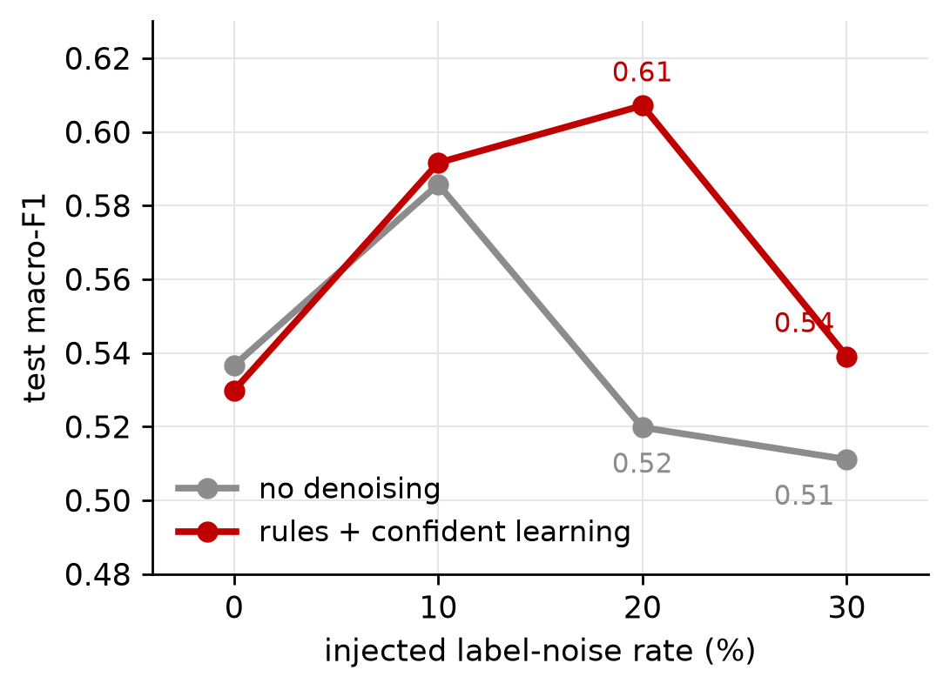
Noise analysis and denoising
Noise type | Rows | Handling
Intent-turn | 2,730 | consolidation drops chit-chat, retractions, repeats
Duplicate hunk | 937 | rule filter
Non-semantic | 714 | rule filter (whitespace, lockfile, version bump)
Label flip (train only) | 569 | confident learning
Truncation | 198 | flagged as exceeds_max_len
4,529 of 18,000 rows (25.2%) carry at least one noise type.
Rules removed 886 rows; confident learning flagged 1,470.
At 20% noise: denoise 0.607 vs 0.520. Reduced setting, one seed, not monotonic.
Sift | Review 3 | 23CSE473 NNDL
12
Notes:
Five noise types are shipped with ground truth, covering 4,529 rows or about a quarter of the data. Rules handle non-semantic and duplicate hunks, consolidation handles intent-turn noise, and confident learning targets label flips. The robustness study injects extra label noise on a 3,000-row subset for two epochs: a reduced, single-seed setting, so treat the curve as indicative. Denoising helps at 20 and 30 percent but not at 0.

Slide 13
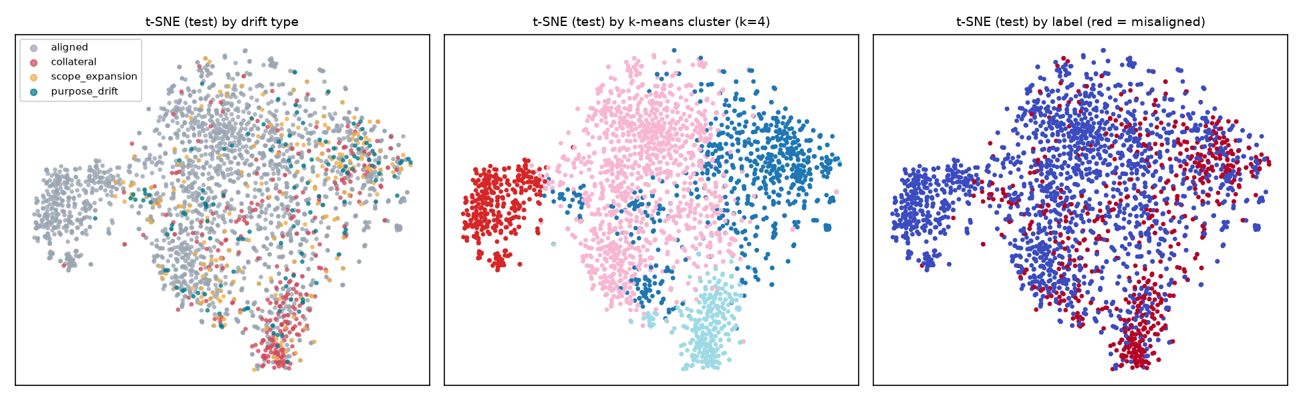
K-means on the model's pooled embeddings
k = 4
0.800
0.102
+0.010
silhouette 0.119
purity vs 0.780 majority
NMI vs alignment
macro-F1 with cluster features
Honest result: k-means adds almost nothing to ranking (NDCG@5 +0.005, single seed).
Sift | Review 3 | 23CSE473 NNDL
13
Notes:
K-means was fit on 768-dimensional pooled embeddings of 4,000 training pairs. k = 4 was chosen by silhouette; there is no sharp elbow. On the test split, cluster purity against alignment is 0.800 versus a 0.780 majority-class rate, so the clusters carry little label information, and adding cluster features to the ranking stage changed macro-F1 by about one point. We report honestly that k-means adds almost nothing; the UI still shows each hunk's cluster and similar flagged hunks.

Slide 14
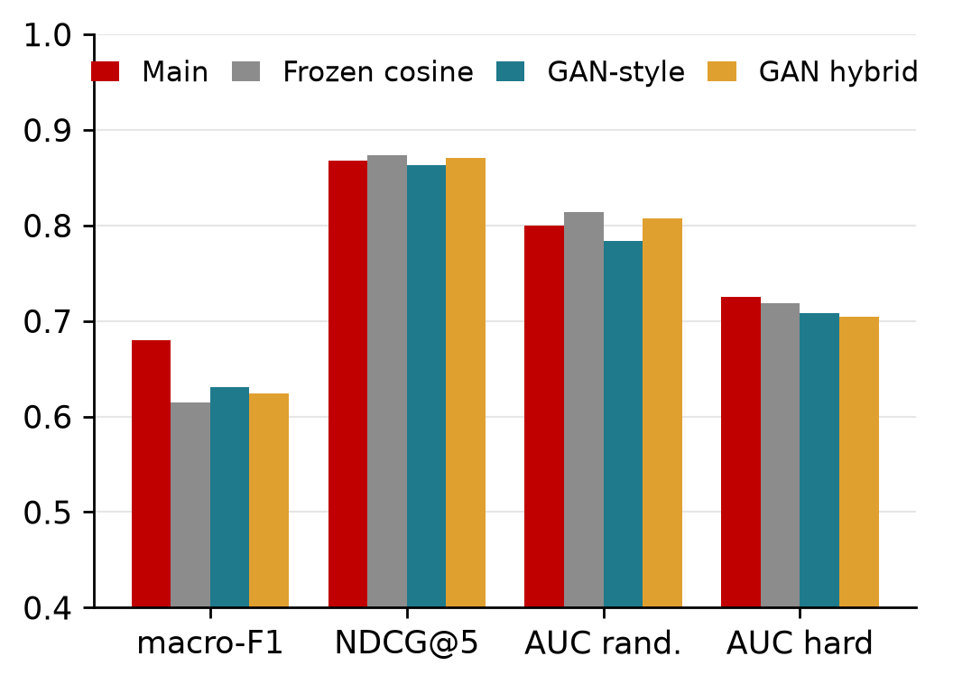
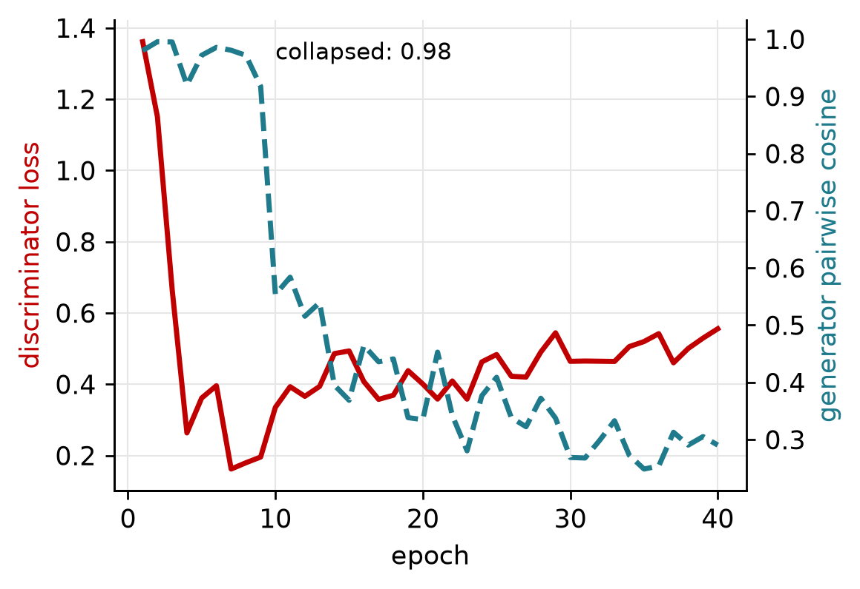
GAN comparison: adversarial baseline on frozen embeddings
Interpretation chosen: adversarially trained scorer on frozen MiniLM embeddings. GAN-style macro-F1 0.630, NDCG@5 0.864 vs main 0.680 / 0.868.
Training instability: generator collapsed at epoch 1, minimum diversity 0.249, final 0.291.
A training-free frozen cosine score reaches NDCG@5 0.874, above the main model.
Sift | Review 3 | 23CSE473 NNDL
14
Notes:
Sift has no natural GAN, so we chose this interpretation and label it plainly: a generator conditioned on the intent embedding produces aligned-hunk embeddings, and the discriminator, trained to separate real aligned pairs from generated ones, is used as the alignment scorer on frozen MiniLM embeddings. It reaches macro-F1 0.630 and NDCG@5 0.864 against 0.680 and 0.868 for the main model. The generator collapsed at epoch 1 (pairwise cosine 0.98) and diversified to about 0.29 by epoch 40, which is the instability we report.

Slide 15
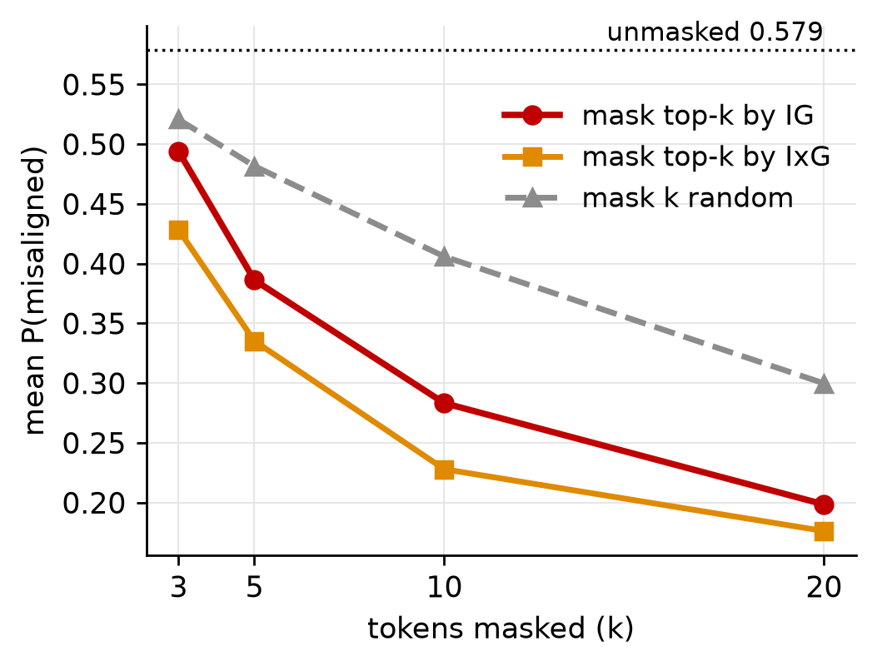
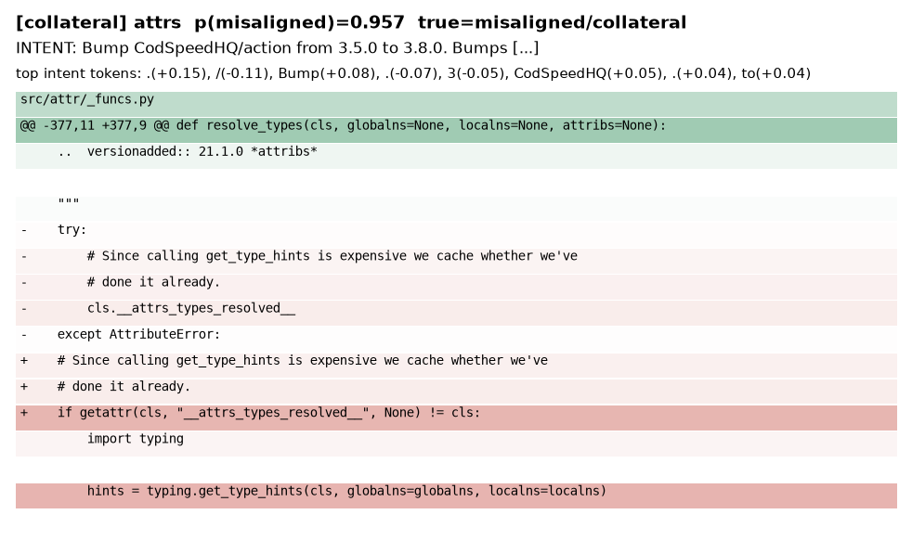
Explainability: Integrated Gradients and faithfulness
Worked example: attrs hunk, P(misaligned) 0.957, truth misaligned / collateral; red lines and tokens push toward misaligned.
n = 100 test pairs; k = 5: 0.386 (IG) vs 0.482 (random)
Attribution is evidence about the model, not proof of the cause.
Sift | Review 3 | 23CSE473 NNDL
15
Notes:
Integrated Gradients, 24 steps with a PAD baseline, gives token attributions that are aggregated to words and diff lines. The faithfulness test masks the top-attributed tokens versus random tokens on 100 test pairs. Masking the top 5 tokens drops mean P(misaligned) from 0.579 to 0.386 against 0.482 for random masking, so attributions are more faithful than chance, though random masking also moves the score because PAD masking is off-distribution. The worked example is an attrs test sample with P(misaligned) 0.957, truly misaligned, collateral.

Slide 16
Results: master model comparison (test split)
Model | macro-F1 | NDCG@5 | AUC random | AUC hard | ECE
B1 random order | n/a | 0.724 | n/a | n/a | n/a
B2 diff lines | n/a | 0.724 | n/a | n/a | n/a
B3 hunk size | n/a | 0.721 | 0.479 | 0.493 | n/a
B4 TF-IDF dissimilarity | n/a | 0.830 | 0.812 | 0.551 | n/a
B5 logistic regression | 0.698 | 0.816 | 0.777 | 0.551 | n/a
Siamese BiLSTM | 0.562 | 0.783 | 0.641 | 0.526 | 0.234
MiniLM-L6 cross-encoder | 0.616 | 0.835 | 0.741 | 0.636 | 0.059
CodeBERT cross-encoder | 0.460 | 0.779 | 0.549 | 0.600 | 0.103
Main: ModernBERT-base | 0.680 | 0.868 | 0.800 | 0.726 | 0.066
Frozen cosine (no training) | 0.614 | 0.874 | 0.814 | 0.719 | n/a
GAN-style (unsupervised) | 0.630 | 0.864 | 0.784 | 0.708 | n/a
Distilled student (fp32) | 0.667 | 0.869 | 0.794 | 0.678 | 0.107
Student INT8 ONNX | 0.667 | 0.869 | n/a | n/a | 0.051
Best per column in bold. n/a = not measured for that model. Single seed 473; baselines had a smaller training budget.
Sift | Review 3 | 23CSE473 NNDL
16
Notes:
All rows use the same repository-disjoint test split and metrics, single seed 473. Bold marks the best value in each column. The main model leads on hard-tier AUC and NDCG@5 among trained models, but B5 has the higher macro-F1 and the frozen cosine score has the highest NDCG@5. The reduced-budget baselines (MiniLM, CodeBERT, BiLSTM) trained far fewer epochs, so part of their gap is budget. Source: results/master_comparison.csv.

Slide 17
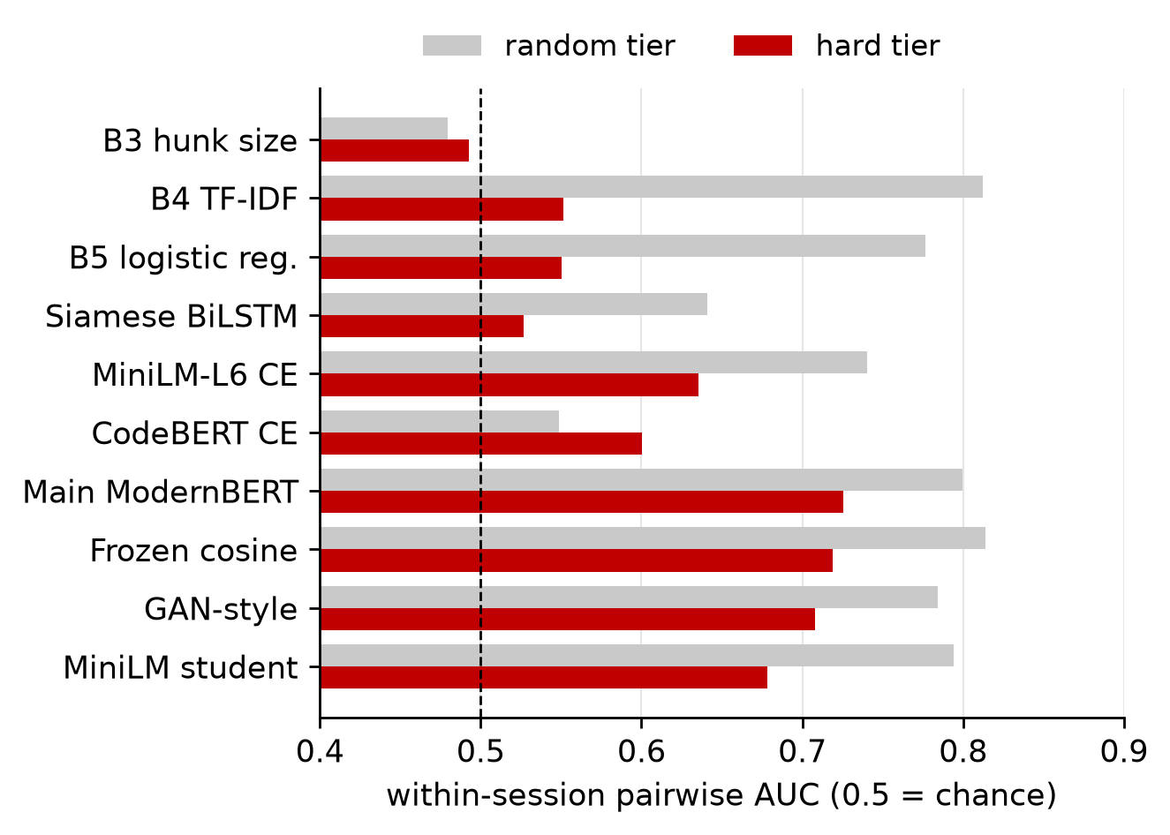
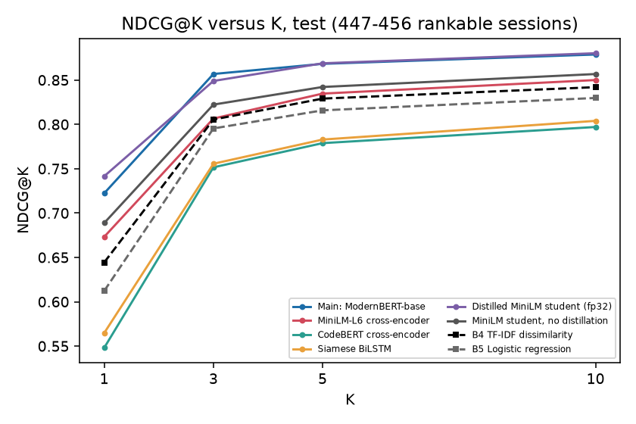
Results: per-tier AUC and NDCG@K
456 rankable test sessions; hard-tier pairs 623, random-tier pairs 607.
Hard tier: main 0.726 vs 0.551 for B4. Random tier: B4 0.812 vs main 0.800.
Sift | Review 3 | 23CSE473 NNDL
17
Notes:
NDCG@5 has a high floor of 0.72 because sessions are short, so we always report per-tier pairwise AUC as well. On the hard tier the main model reaches 0.726 against 0.551 for B4 and B5, which is where the cross-encoder earns its place. On the random tier simple lexical baselines are as good (B4 0.812). The NDCG@K figure covers K of 1, 3, 5 and 10 over the 456 rankable test sessions.

Slide 18
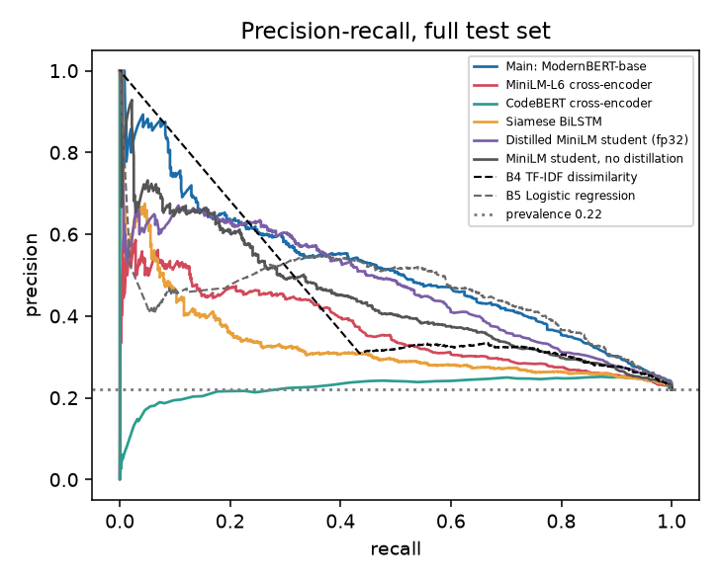
Results: precision-recall curves and confusion matrix
Main model | Pred aligned | Pred misaligned
True aligned | 1,841 | 265
True misaligned | 311 | 283
PR-AUC 0.515 (prevalence 0.22)
ROC-AUC 0.777
Precision 0.516, recall 0.476
Specificity 0.874 at threshold 0.30 (chosen on validation)
Low recall at the chosen threshold: the model ranks better than it classifies.
Sift | Review 3 | 23CSE473 NNDL
18
Notes:
The precision-recall curve is on the full test set with prevalence 0.22, for all models. At the validation-chosen threshold of 0.30 the main model has precision 0.516, recall 0.476 and specificity 0.874; the confusion counts come from results/eval_full.json. The thresholded recall is low, which is why macro-F1 trails B5 even though ranking is better.

Slide 19
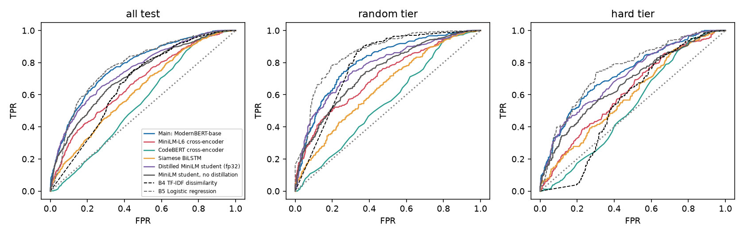
Results: ROC curves per difficulty tier
Pairwise AUC on the hard tier for comparison: main 0.726, B4 0.551.
Panels: all test, random tier, hard tier; every trained model and the lexical baselines.
Sift | Review 3 | 23CSE473 NNDL
19
Notes:
ROC curves for all models on the full test set, the random tier and the hard tier, drawn from the stored test scores. Read them together with the within-session pairwise AUC on the earlier slide, which is the tier metric we rely on. Source: results/roc_curves_per_tier.png.

Slide 20
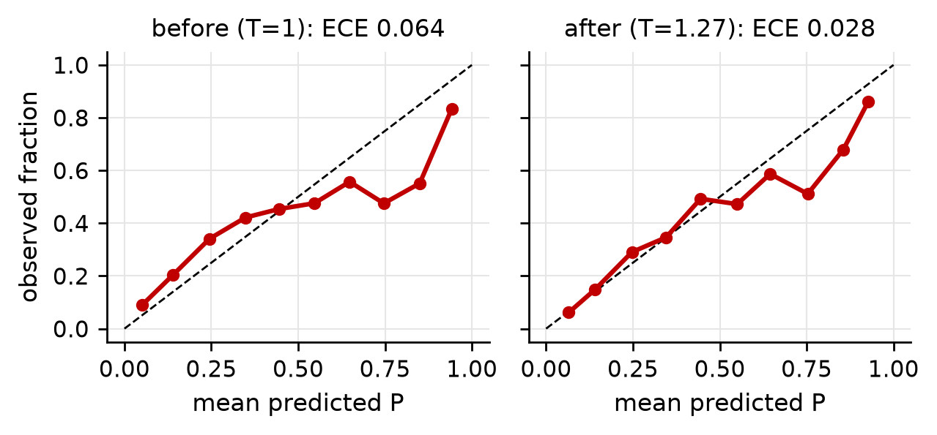
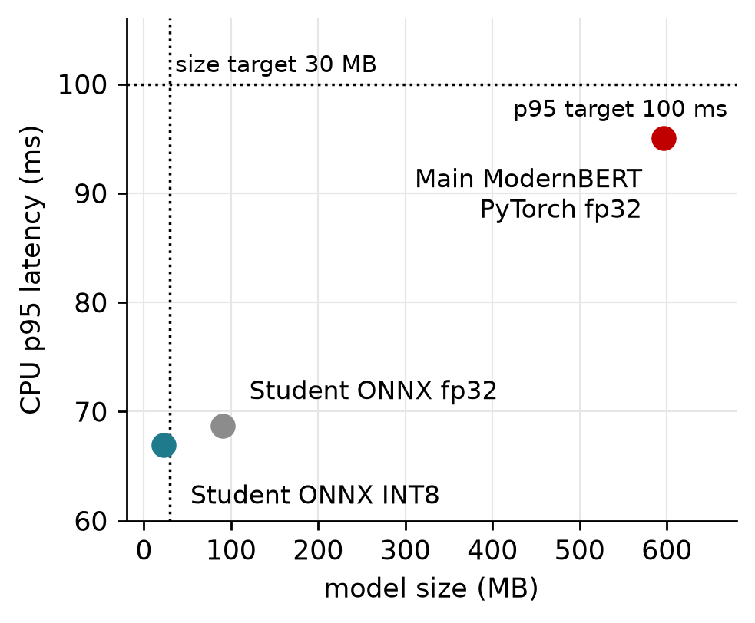
Calibration, size and CPU latency
Model | Size MB | p50 ms | p95 ms
Main (PyTorch fp32) | 596.1 | 94.5 | 95.1
Student ONNX fp32 | 90.4 | 13.4 | 68.7
Student ONNX INT8 | 22.9 | 8.5 | 66.9
Intel i7-13650HX, batch 1. Student timings taken under CPU load; numbers belong to this machine.
Sift | Review 3 | 23CSE473 NNDL
20
Notes:
Temperature scaling fitted on validation, T = 1.275, reduces test ECE from 0.064 to 0.028. The latency table is measured on this machine, an Intel i7-13650HX, batch 1, tokenisation included. The student numbers were taken while the CPU was shared with a training job, so they are not strictly comparable with the main model, which was measured on an idle machine. INT8 reaches 22.9 MB and p95 66.9 ms, meeting the targets of under 30 MB and under 100 ms on this machine only.

Slide 21
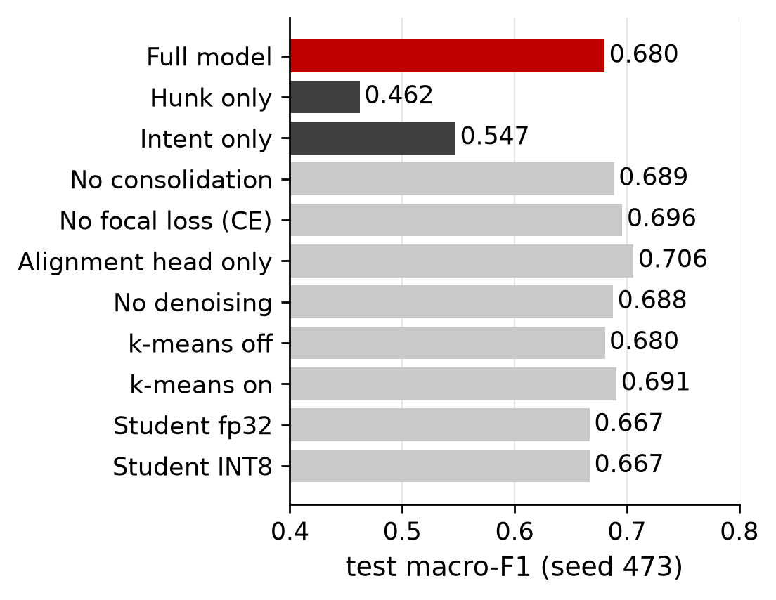
Ablation study (same test split, one seed)
Variant | macro-F1 | Delta | NDCG@5 | AUC hard
Full model | 0.680 |  | 0.868 | 0.726
Hunk only | 0.462 | -0.218 | 0.780 | 0.592
Intent only | 0.547 | -0.133 | 0.726 | 0.501
No consolidation | 0.689 | +0.008 | 0.891 | 0.738
No focal loss (CE) | 0.696 | +0.016 | 0.887 | 0.712
Alignment head only | 0.706 | +0.026 | 0.895 | 0.752
No denoising | 0.688 | +0.007 | 0.902 | 0.767
k-means off | 0.680 | +0.000 | 0.868 | 0.720
k-means on | 0.691 | +0.011 | 0.874 | 0.721
Student fp32 | 0.667 | -0.013 | 0.869 | 0.678
Student INT8 | 0.667 | -0.013 | 0.869 | n/a
Hunk and intent are both essential; the other components are not shown to help (one seed, differences within noise).
Sift | Review 3 | 23CSE473 NNDL
21
Notes:
Only removing the hunk or the intent clearly hurts: macro-F1 drops by 0.218 and 0.133, and intent-only is at chance on tier AUC. Dropping consolidation, focal loss, the multi-task heads or denoising did not hurt and each scores slightly higher macro-F1. With one seed, differences of about 0.01 are within noise, so these runs do not demonstrate that those components help. That is an honest negative finding.

Slide 22
Testing and test design
Category | Framework area | Passed | xfail
Smoke / readiness | Performance / readiness | 6 | 0
White-box | AI Models | 51 | 0
Black-box | Testing Methods | 31 | 2
API partitions | Testing Methods | 43 | 0
Data pipeline + leakage | Data | 17 | 2
Metamorphic | Testing Methods | 8 | 0
Adversarial / red-team | Testing Methods | 17 | 2
Back-to-back (full vs student) | AI Models | 4 | 0
UI end-to-end | Context | 37 | 0
Total |  | 214 | 6
220
0
tests
failed
73.4%
6
line coverage
known defects (xfail)
Coverage: 836 of 1137 statements, src/sift + app/backend; e2e not measured.
Zero repositories are shared across splits (leakage test passes); every failure found is recorded as a defect.
Sift | Review 3 | 23CSE473 NNDL
22
Notes:
The suite follows the Test and Evaluation of AI Models framework categories: performance, testing methods, data, models and context. There are 220 tests: 214 passed, 6 expected failures that are recorded defects (strict xfail) and 0 failed. Line coverage is 73.4 percent over src/sift and app/backend; end-to-end browser tests are not included in that measurement. Source: results/test_summary.json.

Slide 23
Metamorphic tests, red-team rates and defect register
Metamorphic relation | n | Result
Determinism (re-run) | 120 | max |dp| 0
Reorder hunks | 25 | max |dp| 2.1e-06
Whitespace-only edit | 120 | flip 4.2%
Comment-only edit | 120 | flip 3.3%
Identifier rename | 115 | flip 5.2%
Red-team attack | Success
Comment copies the intent | 68%
Comment claims 'implements intent' | 52%
Prompt-injection string | 4%
Irrelevant comment (false alarm) | 2%
50,000-line hunk | survived
ID | Severity | Defect | Status
D-DATA-1 | Low | documented language counts differ from release | open (xfail)
D-DATA-2 | Medium | test split has no TypeScript | open (xfail)
D1 | Medium | plain diff -u multi-file headers merge into previous hunk | open (xfail)
D2 | Low | chit-chat filter is exact-match on 8 phrases | open (xfail)
D3 | High | intent-copy comment flips detected hunks to aligned | open (xfail)
D4 | Medium | 'implements intent' comment flips hunks to aligned | open (xfail)
Open High-severity defect D3: the model partly keys on lexical overlap with the intent.
Sift | Review 3 | 23CSE473 NNDL
23
Notes:
Metamorphic relations hold within tolerance: the model is deterministic and reordering hunks changes scores by about 1e-6, while whitespace, comment and rename edits flip the verdict in 3 to 5 percent of cases. The red-team shows the real weakness: a comment that copies the intent flips 68 percent of detected misaligned hunks to aligned, and a comment claiming the change implements the intent flips 52 percent (17 and 13 of 25). All six defects are open and recorded as strict xfail; no mitigation is implemented yet.

Slide 24
Implementation status: modules
Component | Status | Note
Data loading and verification | Done | counts checked; language mix differs from plan
Diff parser, intent consolidation | Done | rule-based; 97.4% agreement sample
Model, losses, training loop | Done | ModernBERT-base, multi-task, focal loss
Baselines B1-B5, BiLSTM, MiniLM, CodeBERT | Done | reduced budget for neural baselines
Calibration, distillation, INT8 ONNX | Done | T = 1.275; 22.9 MB student
Denoising, noise study | Reduced | co-teaching helper not run
K-means, GAN-style baseline, XAI | Done | k-means adds little
Ablations | Reduced | 6 full runs, one seed; rules-only dropped
Hyper-parameter search | Reduced | 6 Optuna trials, planned 60
Backend API, frontend, tests | Done | 220 tests, 0 failed
Not done: UniXcoder (download stalled), multiple seeds, human-labelled evaluation.
Sift | Review 3 | 23CSE473 NNDL
24
Notes:
Every pipeline stage in the plan exists and ran. Items marked Reduced ran with a smaller budget than planned: six Optuna trials instead of 60, single-seed ablations, and the noise study on a 3,000-row subset. UniXcoder was dropped because its weights did not download, and multiple seeds and human-labelled evaluation were not done. These are listed in results/SUMMARY.md.

Slide 25
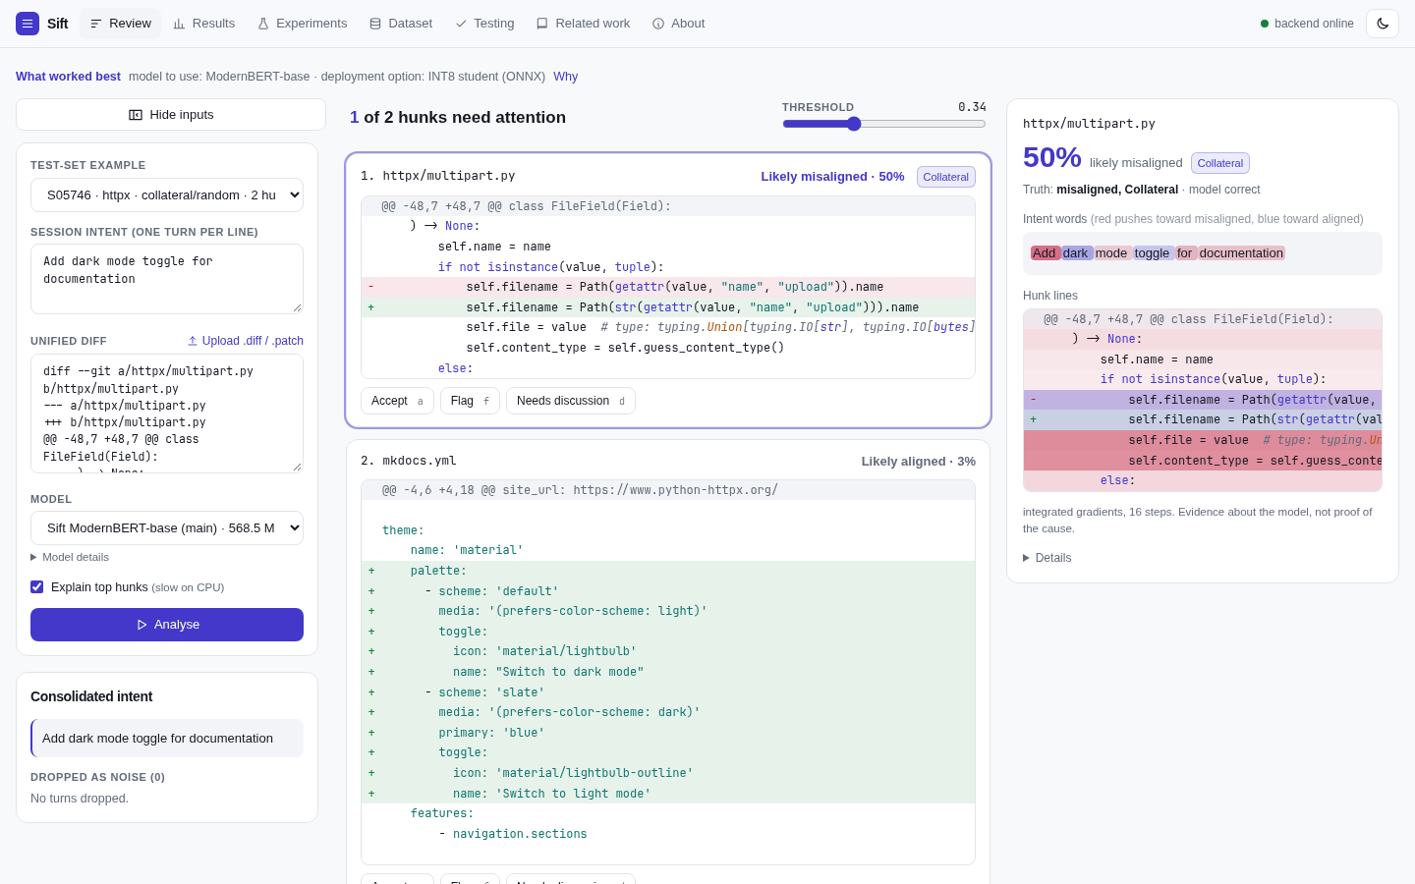
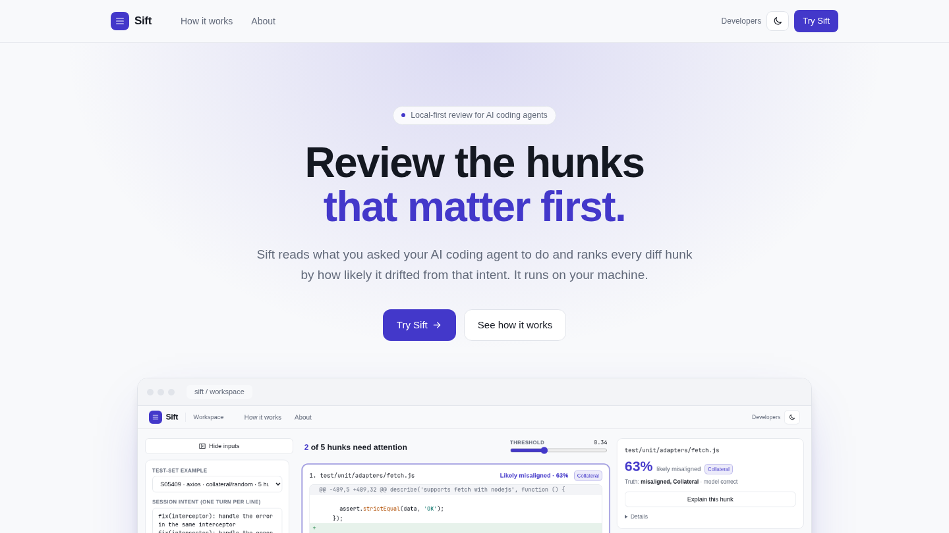
Application UI: review workspace
Right: landing page. Left: workspace after analysis
Ranked hunk cards, threshold slider
Highlighted tokens and lines (IG)
Model switcher: main, INT8 student, baselines
Keyboard: Accept a, Flag f, Discuss d
Real screenshots from the running application; analysis ran on a real test-set sample.
Sift | Review 3 | 23CSE473 NNDL
25
Notes:
The review workspace takes a test-set example or a pasted or uploaded diff, shows the consolidated intent and the turns dropped as noise, and orders hunk cards by misalignment risk with probability and drift-type badge. The right panel highlights intent words and hunk lines by Integrated Gradients, and Accept, Flag and Needs-discussion actions update the review summary. After analysis the ground truth of a test example is shown, as here. This screenshot is from the project's own UI test run.

Slide 26
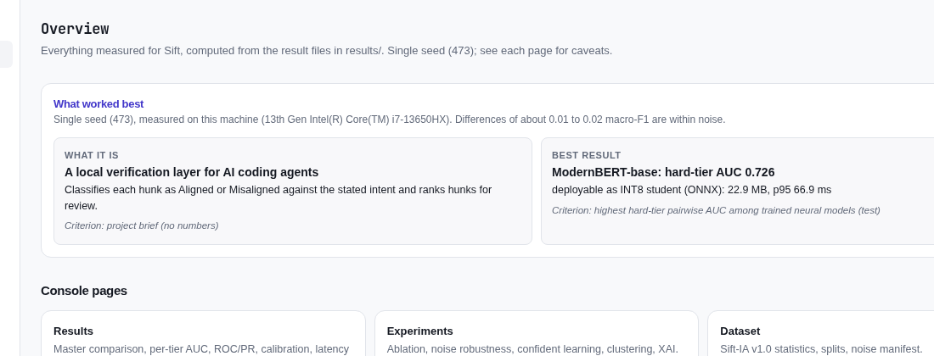
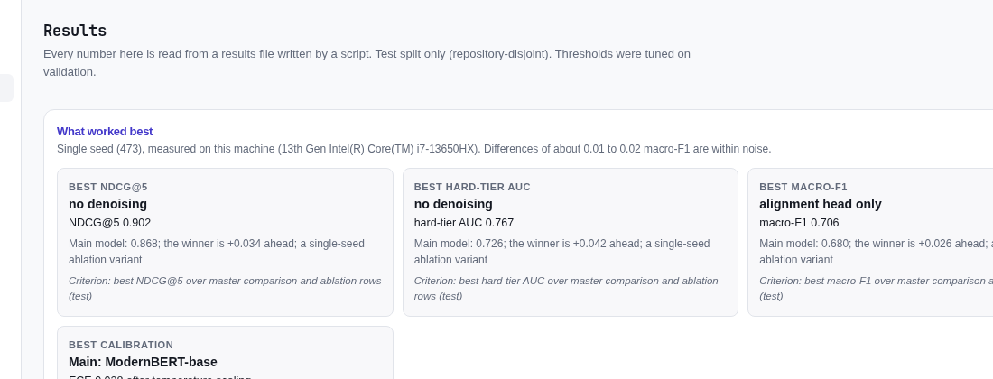
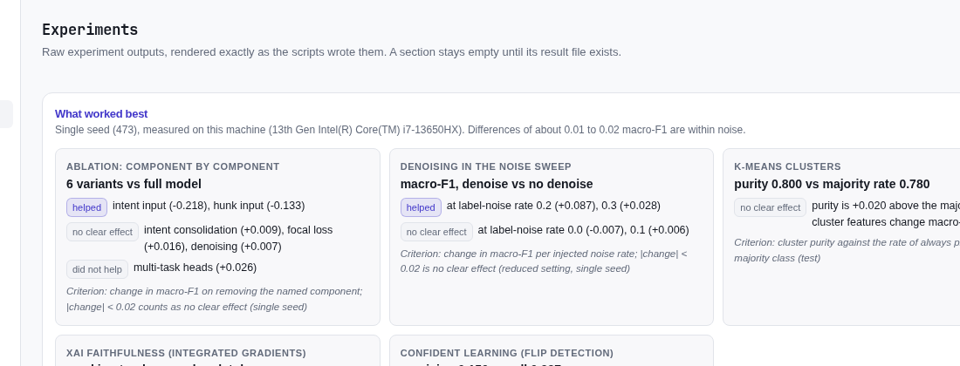
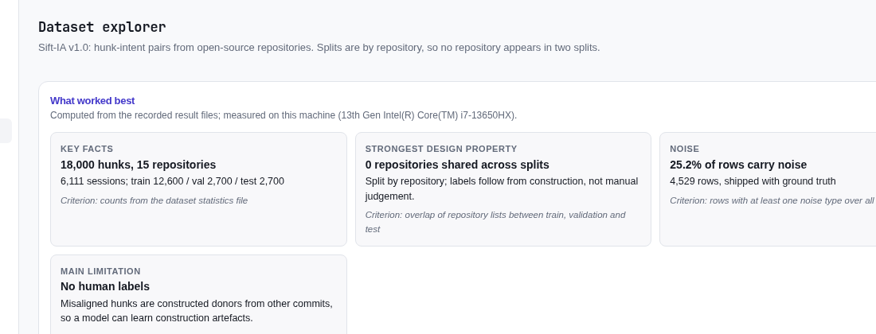
Application UI: developer console
Console overview
Results dashboard
Experiments
Dataset explorer
Console pages: overview, results, experiments, dataset, testing, related work (testing page not shown).
Sift | Review 3 | 23CSE473 NNDL
26
Notes:
The developer console is a second interface in the same build with an overview, results dashboard, experiments page, dataset explorer, testing page and related-work page. Every number on these pages is read from the real result files served by the backend, nothing is hard-coded. Screenshots are from docs/screenshots at desktop width.

Slide 27
Backend API and deployment status
Endpoint | Purpose
POST /api/analyze | turns + diff or sample id: intent, per-hunk P, drift, cluster, rank, attributions
GET /api/samples, /{id} | curated test-set examples with ground truth
GET /api/models | main, student/INT8, baselines for the switcher
GET /api/results/* | JSON behind the dashboards
GET /api/dataset/stats, /api/tests | dataset statistics, test and coverage summary
GET /api/health | readiness; OpenAPI docs at /docs
Deployment
Hosted link: not live yet
Local launch: make demo (backend :8000, UI :5173)
Repository: https://github.com/Kundhave/sift
Deployment package: ready in deploy/ (Dockerfile, Hugging Face Spaces script); not deployed yet, Docker build not run
CPU-only inference by default; no code leaves the machine.
One command starts backend and frontend: make demo.
Sift | Review 3 | 23CSE473 NNDL
27
Notes:
The backend is FastAPI; the model is loaded once and runs on CPU or GPU automatically. Inputs are validated and errors return clear messages. A hosted link is not available yet, so the app is launched locally with make demo; the repository link is the one in the project template.

Slide 28
SDG relevance
SDG 9 (primary): Industry, Innovation and Infrastructure
Trustworthy AI-assisted software engineering
Verification layer between agent and developer
Open, documented dataset and reproducible pipeline
SDG 8 (secondary): Decent Work and Economic Growth
Less reviewer burden: likeliest problems first
Local, CPU-capable: no cloud dependency or code upload
Evidence and limits
Ranking evidence: NDCG@5 0.868 vs 0.724 for random order (test split).
Reviewer time saved is not measured; no user study has been run.
Labels are constructed, so real-world benefit needs human validation.
SDG 9 primary, SDG 8 secondary.
Sift | Review 3 | 23CSE473 NNDL
28
Notes:
SDG 9, Industry, Innovation and Infrastructure, is the primary goal: Sift supports trustworthy AI-assisted software engineering by checking agent output against developer intent. SDG 8, Decent Work and Economic Growth, is secondary: ranking hunks by risk is intended to reduce reviewer burden. We have not measured reviewer time saved; the ranking metrics are the only evidence so far.

Slide 29
Discussion: key findings and weak spots
What the data supports
Hard-tier pairwise AUC 0.726 vs 0.551 for B4/B5.
NDCG@5 0.868 vs 0.724 random order.
Temperature scaling: ECE 0.064 to 0.028.
INT8 student keeps macro-F1 0.667 at 22.9 MB.
Intent-aware joint reading matters: hunk-only and intent-only collapse.
IG masking drops P(misaligned) more than random masking.
Honest weak spots
Macro-F1 0.680 is below B5 (0.698).
Frozen cosine wins NDCG@5 (0.874).
K-means adds little: purity 0.800 vs 0.780 majority.
Ablated variants are not worse (no focal, no multi-task, no consolidation, no denoising).
Confident learning precision 0.150 on known flips.
Single seed; constructed labels; red-team defect D3 open.
Claim scope: hard-tier ranking and compact local deployment, not a new architecture.
Sift | Review 3 | 23CSE473 NNDL
29
Notes:
Left: what the measurements support. Right: the weak spots we state plainly. The main model's macro-F1 is below logistic regression, the training-free frozen cosine score beats it on NDCG@5, k-means adds almost nothing, and four ablated variants score slightly higher than the full model. Everything is single seed with constructed labels, so claims are about ranking on the hard tier and compact deployment, not state of the art.

Slide 30
Conclusion and future work
Conclusion
Hunk-level, multi-turn-intent task framing with its own dataset (Sift-IA v1.0).
ModernBERT cross-encoder improves hard-tier ranking over lexical and size baselines.
Calibrated, explained and compressed to a 22.9 MB INT8 model for local CPU use.
Working UI and API with 220 tests (0 failed) and a recorded defect register.
Future work
Human validation using the 900-sample gold sheet.
Multiple seeds with confidence intervals; full 60-trial search.
Mitigate comment-based evasion (strip comment-only lines before scoring).
Co-teaching, longer baseline training, TypeScript test repositories.
Learned intent consolidation; hosted deployment and user study.
Contribution: task framing, pipeline and dataset; encoder and training methods are existing.
Sift | Review 3 | 23CSE473 NNDL
30
Notes:
In conclusion: Sift is a working, tested, locally runnable system with a trained cross-encoder, baselines, calibration, a compact INT8 student, explanations and a UI. Its measured strength is hard-tier ranking; its limits are the constructed labels, a single seed and comment-based evasion. Future work lists the concrete next steps, starting with human validation of the 900-sample gold sheet.

Slide 31
Member contributions
Member | Contribution (technical)
Kundhave S (CB.SC.U4CSE23037) | One-member team; all work. (1) Task formulation, drift taxonomy and Sift-IA v1.0 dataset construction with noise ground truth. (2) Diff parser, intent consolidation and the ModernBERT multi-task cross-encoder with focal loss. (3) Baselines, ablations, noise and denoising study, k-means, GAN-style baseline and Integrated Gradients. (4) Calibration, distillation and INT8 ONNX export. (5) FastAPI backend, React frontend, test suite and defect register. (6) IEEE DataPort documentation, reports and presentation.
Faculty guide: Dr. T. Senthil Kumar, Professor, CSE Department. Course: 23CSE473 Neural Networks and Deep Learning.
Sift | Review 3 | 23CSE473 NNDL
31
Notes:
Team 24 has a single member, so all work is by Kundhave S. The contribution list covers the full pipeline from dataset to the application and tests. Faculty guide: Dr. T. Senthil Kumar, Professor, CSE Department.

Slide 32
References
[1] C. G. Northcutt, L. Jiang, I. L. Chuang. Confident Learning: Estimating Uncertainty in Dataset Labels. JAIR, 2021.
[2] Z. Xu et al. Code Comment Inconsistency Detection Based on Confidence Learning. IEEE TSE 50(3), 2024.
[3] Huang et al. Are your comments outdated? Detecting code-comment consistency. J. Softw. Evol. Process 37(1), 2025.
[4] Yang et al. RComSync: code-comment synchronization with in-context learning and reranking. Empir. Softw. Eng. 31(4), 2026.
[5] Fan et al. Exploring the Capabilities of LLMs for Code-Change-Related Tasks. ACM TOSEM 34(6), 2025.
[6] Wang et al. Best practices for code pre-trained models on SE classification tasks. Expert Syst. Appl., 2025.
[7] S. Panthaplackel et al. Deep Just-In-Time Inconsistency Detection Between Comments and Source Code. AAAI 2021.
[8] S. Panthaplackel et al. Learning to Update Natural Language Comments Based on Code Changes. ACL 2020.
[9] K. Herzig, A. Zeller. The Impact of Tangled Code Changes. MSR 2013.
[10] B. Warner et al. Smarter, Better, Faster, Longer: ModernBERT. arXiv:2412.13663, 2024.
[11] R. Nogueira, K. Cho. Passage Re-ranking with BERT. arXiv:1901.04085, 2019.
[12] Z. Feng et al. CodeBERT. Findings of EMNLP 2020.
[13] T.-Y. Lin et al. Focal Loss for Dense Object Detection. ICCV 2017.
[14] C. Guo et al. On Calibration of Modern Neural Networks. ICML 2017.
[15] G. Hinton, O. Vinyals, J. Dean. Distilling the Knowledge in a Neural Network. 2015.
[16] M. Sundararajan, A. Taly, Q. Yan. Axiomatic Attribution for Deep Networks. ICML 2017.
[17] B. Han et al. Co-teaching. NeurIPS 2018.
[18] Test and Evaluation of Artificial Intelligence Models Framework (course reference).
[19] Sift-IA v1.0 record on IEEE DataPort (link on the dataset slide).
Sift | Review 3 | 23CSE473 NNDL
32
Notes:
References 1 to 6 are the base paper and the five journal papers from the literature survey. References 7 to 17 are the building-block papers listed in docs/RELATED_WORK.md; items 13 to 17 were cited from memory there and should be checked once more before the final report. The framework is the course testing reference, and the last item is the dataset record.

