Slide 1

Service Oriented Computing EnviRonment (SORCER)
R. Kolonay
S. Burton
M. Sobolewski

Slide 2
Training Goals
Create your own SORCER Workspace
Become familiar with the Eclipse Development Environment
Have SORCER Environment Running
Publishing Providers & Running Requestors
Creating your own Providers & Publishing
Creating your own Requestors & executing
Creating your own Models & Querying

Slide 3
Training Agenda
Thursday
SORCER Overview
Creating your own workspace
Some SORCER Terminology
Running Hello World Examples
Creating Providers & Publishing
Creating Requestors (Job, Task, Context) & Executing calling providers

Slide 4
Training Agenda
Friday
Variables, Filters, Evaluators
Variable fidelity of Variables & their Sensitivities
Creating Models & Publishing & Querying
Using the ModelClient Class from the command line & Matlab
Doing Optimization using Matlab and SORCER Modles

Slide 5
Training Agenda
SORCER Overview
Creating your own workspace
Running Hello World Examples
Creating Providers & Publishing
Creating Requestors (Job, Task, Context) & Executing calling providers

Slide 6



AFRL Air Vehicles Directorate Revolutionary Aerospace Vehicles
Extreme Environments
Large Deformations
Time Varying Shape
MAVs
Higher, Farther, Faster to Lower, Closer, Slower

Slide 7
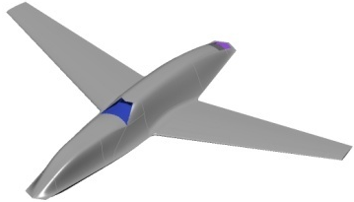
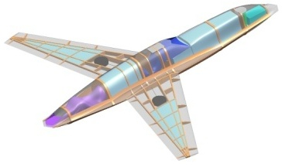
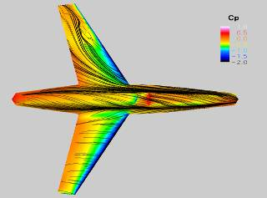
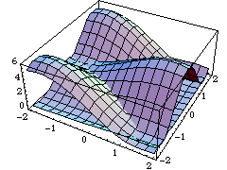
How to Capture the Physics Driving the Design Pre-Milestone A
10000s configurations
Technology
Suite
Conceptual Design Studies
Prototype Representation
10s configuration
Dialable Fidelity
Capture the phenomena driving the design
Configuration & flight condition dependent
Technology suite dependent
Prototype
Experimental
Validation
Prototype Analysis for Design
Prototype Design Space Exploration
Get more (and Better) Information … and get it Earlier
7

Slide 8
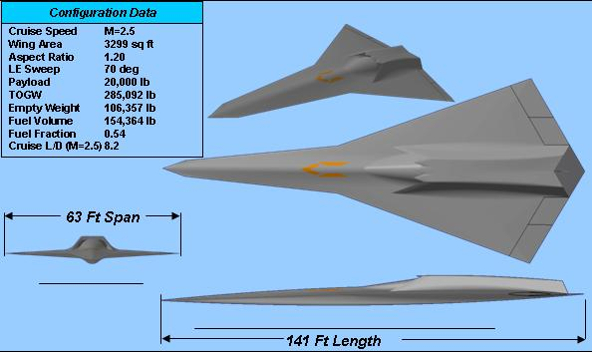
Typical Target Application
LRS Configuration
Baseline configuration and performance data from previous STAV and CESTA studies
SOO Requirements:
Range = 4000 nmi
Payload = 5-10 % weight fraction
Maneuver Loads at Cruise – 2.5 g
Cruise speed: Mach 2.0
Cruise L/D: 8.5-9
Level 1 Flying Qualities
AF-specified mission will be “flown” through mission analysis to determine required fuel weight and TOGW

Slide 9
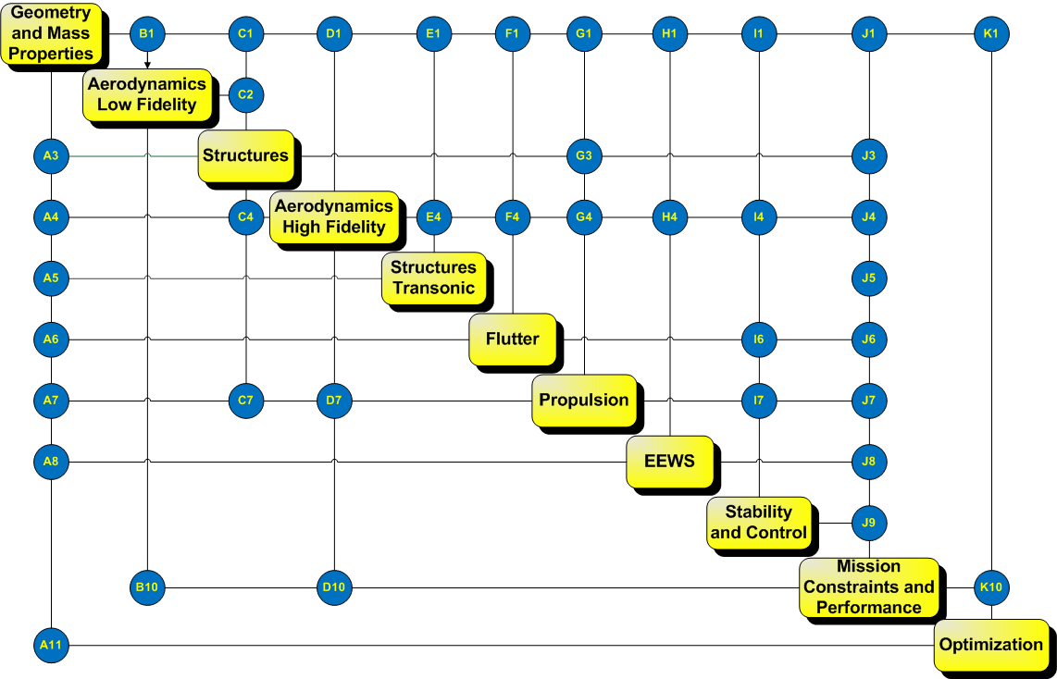
System Level MDMFMSAOwUQ
“Best in Class Approach (BCA)”
Components are one or more engineering computational applications that need to be “glued” together to execute a process. (BTW, components may be on a distributed heterogeneous network)
Need a Computational Environment to Achieve BCA MDMFMSAOwUQ
Need to Maximize Reuse

Slide 10
High Level Requirements for System Level MDMFMSAOwUQ
# of components/applications/Services – 100’s to 1000’s
Run times of services – secs to many days
Data
kilobytes to terabytes
ascii, binary, databases
Distributed (across organizational boundaries) heterogeneous computing environment
Hand held devices to HPC resources
Seamless access to data and services
Process representation with secure communications

Slide 11
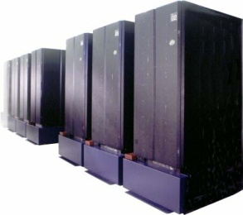

Seamless Access to All Methods, Models, Data, and Computing Resources
High Fidelity Physics
HPC
Engineering/High Fidelity
Clusters
Empirical/Engineering
Desktops

Slide 12
Large Scale Distributed MDA/MDO
LRS High-Level N² Diagram
VT (Blacksburg)
AFRL/RBSD
(WPAFB)
WSU
(Dayton)
Multi-fidelity Multidisciplinary Computations Require Real Time Seamless Access
to Applications, Data & Compute Resources by ALL

Slide 13
SORCER is a Service-Object-Oriented Architecture
A service-oriented product development environment
Provides an open flexible design environment which allows universal availability and incorporation of existing data, tools/methods, processes and hardware as services.
Provides a common way to model your analysis and design process in conjunction with your product data.
A network-based distributed framework
Supports collaboration among geographically distributed engineering and business partners.
SORCER Philosophy – Accessibility, Flexibility & Reusability
SORCER is Research Code!

Slide 14
SORCER is not for the Faint at Heart
MDMFMSAOwUQ (MultiDisciplinary,MultiFidelity,MultiScale, Analysis/Optimizaiton)
Eclipse
Ant
Java
JNA, JNI, SWIG
Network Computing
Object Oriented Concepts
SORCER Concepts

Slide 15
Service Oriented Computing EnviRonment - SORCER
A service-oriented product development environment
SORCER is a programming and computing environment that enables one to perform large scale system level engineering analysis and design space exploration that may be in a distributed heterogeneous computing environment.
SORCER federates a series of Service Providers (which may be distributed) in real time and orchestrates the communication between the Service Providers based on a Control Strategy algorithm defined in an Exertion(process definition) to perform a multi-disciplinary analysis and or design space exploration.

Slide 16
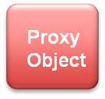
Service Oriented Computing EnviRonment - SORCER
A network-based distributed framework
Service Oriented
Neutrality:
Location
Protocol
Implementation
Mobile
Proxy
Object
Discovery & Register
Discovery & Lookup
Service
Registry
Service
Proxy Object
Service
Provider
Requestor

Slide 17
Training Agenda
SORCER Overview
Creating your own workspace
Running Hello World Examples
Creating Providers & Publishing
Creating Requestors (Job, Task, Context) & Executing calling providers

Slide 18
SORCER SVN Repository
Eclipse IDE
Check-out, update, synchronize
You Local workspace
(central file system)
SORCER SVN Repository
Commit changes
globalhawk
- Can do what ever you like in your workspace
- Once you want others to get your changes – “Commit” to repository
- To Access to svn commands from Eclipse navigator panel – right click- Team

Slide 19
Creating a workspace from an svn repository
Notes/CreateSORCERSandbox.doc
Make the Eclipse workspace directory <workspace dir>
e.g.: mkdir /home/<username>/workspace
Set JAVA_HOME to appropriate JDK directory (if necessary)
Set ANT_HOME to appropriate Ant directory (if necessary)
Set IGRID_HOME to <workspace dir>/iGrid-XX (Required)
Run eclipse from your installation Eclipse Directory
Check Use this as the default and do not ask again
Select Go to the workbench at the top-right corner of the Eclipse window
Click on the menu item Project and unselect Build Automatically
Select File => New => Project…
Select SVN=> Checkout Projects from SVN
Click Next,
Check in Create a new repository location then click Next
Location URL:
svn+ssh://<username>@needVTRepositoryIPaddress/home/svn/sorcer
then click Next
Select Folder: iGrid-XX then click Finalize
Enter your password when asked, then Check in Save Information
In the Check Out As dialog make Project Name for your project in the workspace as needed, for example iGrid-XX.

Slide 20
Building/Compiling SORCER
1.Open (click on >) iGrid-XX in Eclipse Navigator (select the Eclipse’s Perspective in the top-right corner as Resource)
2. Read and follow directions iGrid-XX/README and iGrid-XX/modules/sorcer/README and setup your additional environment variables for example for a class server (called webster) accordingly.
3.Double check if your Java compiler is at least Java 5 compatible.
a. Right-click on the iGrid-XX project in the Navigator view and select Properties.
b. In the Properties window select Java Compiler.
c. Check in Enable project specific settings and then click on Installed JREs at the bottom of Java Compiler view.
d. If required JDK or JRE is not shown in the Installed JREs list, click Add and append it to the list accordingly.
e. Check in the JDK/JRE for Java 5+ in the Installed JREs list and click OK to close the Installed JREs dialog.
4. Right click on iGrid-XX/iGrid-buid.xml
5. Select Run/1 Ant Build
If you have followed all the directions correctly, you should have a successfully compiled SORCER sources and built SORCER libraries (jar files in iGrid-XX/lib).

Slide 21
Configuring the SORCER Environment (sorcer.env)
Must have sorcer.env file in the folder iGrid-10/configs/
If it is not there copy a template fromiGrid-10/templates/sorcer.env to
iGrid-10/configs/sorcer.env and edit it.
# SORCER environment properties
# The OS environment variable IGRID_HOME must be set
# Groups to register/lookup
provider.groups=sorcer.TEST
provider.space.group=sorcer.TEST
#provider.space.name=JavaSpace
#provider.space.name=Blitz JavaSpace
#provider.worker.transactional=true
#worker.transactiona.lease.time=50000
# Service discovery/lookup
# comma separated URLs
#provider.lookup.locators=jini://localhost
# multicast and unicast discovery
provider.lookup.accessor=sorcer.util.ProviderAccessor
# unicast or mixed discovery
#provider.lookup.accessor=sorcer.util.ProviderLocator
# multicast only
#provider.lookup.accessor=sorcer.util.ProviderLookup
# unicast or mixed discovery with QoS capabilities
#provider.lookup.accessor=sorcer.util.QosProviderAccessor
# Code server configuration
provider.webster.interface=${localhost}
provider.webster.port=8000
# Data/file repository configuration
# Scratch directory format:
# ${data.root.dir}/${provider.data.dir}/${provider.scratch.dir}
# ${data.root.dir}/${requestor.data.dir}/${provider.scratch.dir}
# You can and normally do overwrite these properties in your provider or requestor properties
data.root.dir=${iGrid.home}/data
provider.data.dir=provider
requestor.data.dir=requestor
provider.scratch.dir=scratch
data.server.interface=${provider.webster.interface}
data.server.port=${provider.webster.port}

Slide 22
Configuring the SORCER Environment (sorcer.logging)
If logging information is desired (to the console and to .log files), a sorcer.logging file must be in the iGrid-10/configs folder. If it is not present copy the sorrcer.logging template found in the iGrid-10/templates folder to
iGrid-10/configs/sorcer.logging and edit as necessary
# SORCER Logging Configuration File
# Default configuration for handlers associated with the root logger.
# To use this configuration file, specify the parameter
# java.util.logging.config.file on the command line, e.g.,
# java -Djava.util.logging.config.file=sorcer.logging
# Handlers installed for the root logger
handlers=java.util.logging.ConsoleHandler, java.util.logging.FileHandler
# Level for the root logger - is used by any logger
# that does not have its level set
.level=INFO
# Initialization class - the public default constructor
# of this class is called by the Logging framework
#config=sorcer.core.util.Log
# Configure ConsoleHandler
java.util.logging.ConsoleHandler.level=ALL
java.util.logging.ConsoleHandler.formatter=java.util.logging.SimpleFormatter
# Configure Plain Text FileHandler
#handlers=java.util.logging.FileHandler
java.util.logging.FileHandler.level=ALL
java.util.logging.FileHandler.formatter=java.util.logging.SimpleFormatter
java.util.logging.FileHandler.pattern=../logs/sorcer%g.log
java.util.logging.FileHandler.limit=10000000
java.util.logging.FileHandler.count=3
# Configure XML FileHandler (use it with Log Viewer)
#handlers=java.util.logging.FileHandler
#java.util.logging.FileHandler.level = ALL
#java.util.logging.FileHandler.encoding = UTF-8
# replace in the following line the text after the equal sign with your log file destination
#java.util.logging.FileHandler.pattern = ../logs/sorcer%g.log
#java.util.logging.FileHandler.limit = 0
#java.util.logging.FileHandler.count = 0
#java.util.logging.FileHandler.formatter = java.util.logging.XMLFormatter
….

Slide 23
Configuring the SORCER Environment (sorcer browser configuration – ssb.config)
iGrid-10/browser/config/ssb.config
sorcer.sbb.browser.SorcerServiceBrowser {
// If 'discoveryManager' is set in the SSB config file then both discovery lookup management
// and discovery group management are used by SSB. If "initialLookupLocators' are set
// then only unicast discovery is used, otherwise multicast lookup discovery is used for
// the specified 'initialLookupGroups". However, in the latter
// additional runtime lookup locators can be added using 'Tools/Unicast discovery...'.
initialLookupGroups = new String[] { "sorcer.RMK" };
//initialLookupLocators = new LookupLocator[] { new LookupLocator("127.0.0.1", 4185) };
//discoveryManager = new LookupDiscoveryManager(DiscoveryGroupManagement.NO_GROUPS, null, null);
//listenerExporter = new BasicJeriExporter(TcpServerEndpoint.getInstance(4162), new BasicILFactory());
//websterStartPort = 4176;
//websterEndPort = 4180;
//allowDestroy = true;
}

Slide 24
Starting the SORCER Environment
Start your environment webster (if not running)
Execute iGrid-10/bin/webster/bin/webster-run.xml
Start the i-Grid basic services (if not running)
Execute i-Grid-10/bin/iGrid-min-boot.xml
Start the i-Grid service browser (if not running)
Execute i-Grid-10/bin/browser/bin/service-browser-run.xml
Should see the following

Slide 25
Training Agenda
SORCER Overview
Creating your own workspace
Some SORCER Terminology
Running Hello World Examples
Creating Providers & Publishing
Creating Requestors (Job, Task, Context) & Executing calling providers

Slide 26
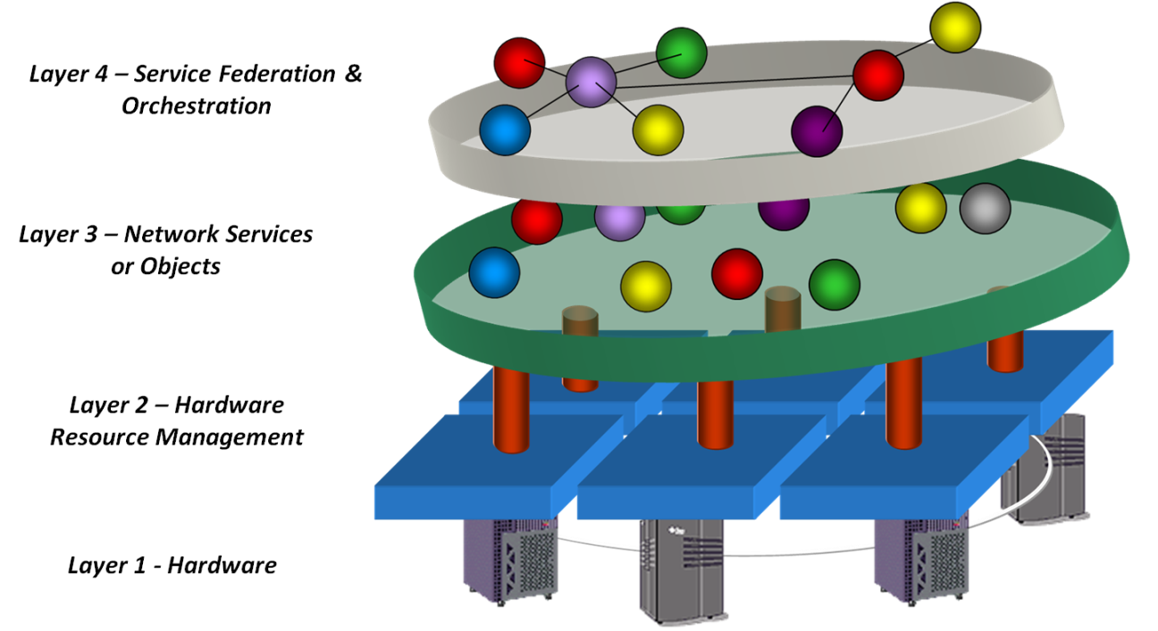
SORCER Terminology
Service Provider : a remote object accepting Exertions from service requestors and performs calculations. Can provide one or more services.
The grid: a collection of service providers on the network.
Exertion (think process representation or workflow): defines collaborations - service-oriented programs. An object that represents a process by specifying the relationship between services and the information passed between them.
Exertion
Service Requestor : an object that creates Exertions & submits them to the grid.
grid
Service Provider

Slide 27
Service Providers
Wrap existing applications with java to expose one or more functionalities(services) of the application to the SORCER Environment
Public class xxxProvider extends ServiceProvider implements xxxRemoteInterface, SorcerConstants{
public Context servicexxx(Context context) throws RemoteException {
}
}
Tight integration with c, c++, fortran etc.. using jna, jni and swig.
Note: Services Take a Context and return a Context
Robustness & Reuse
Your Computational Environment is only as good as your Wrapping!

Slide 28
Service Requestor(Client)
RequestorClass to construct exertions
Public class xxxRequestor extends SorcerRequestor implements, SorcerConstants{
Code to create Exertions & submit to the Sorcer environment
}
Anyone/thing can be a requestor – CAD, MATLAB, etc..

Slide 29
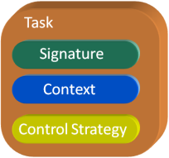
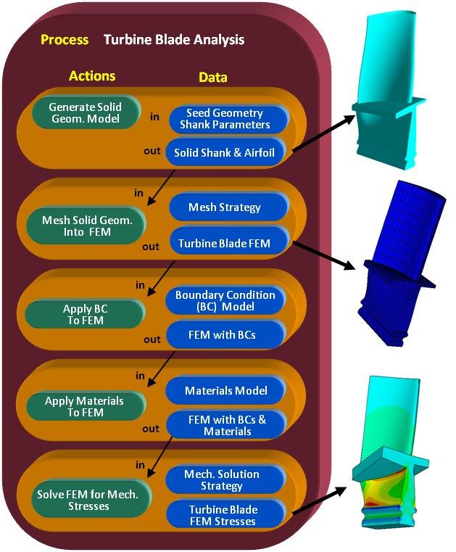
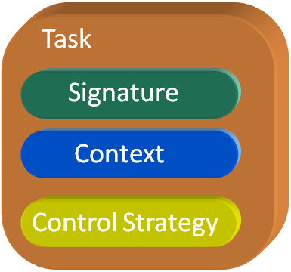
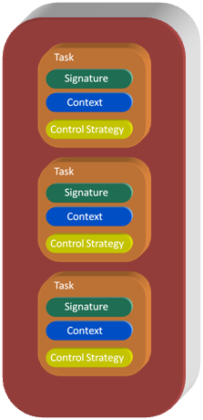

Exertion
Elementary Exertion
Composite Exertion
Engineering Example
Job
Job
Signature – identifies the Service
Context – contains input & output data/objects
Control Strategy – Guidance for Service
.
.
.
All are Objects

Slide 30
Building an Elementary Exertion - ServiceTask
ServiceTask
Class: sorcer.core.exertion.ServiceTask
A Constructor: public ServiceTask(String name, String description)
An Example: Exertion taskHi = new ServiceTask("hi", "Task to say hello”)
Signature
Class: sorcer.core.signature.ServiceSignature
A Constructor: public ServiceSignature(String methodName, Class<?> serviceType, String providerName)
An Example: Signature methodHi = new ServiceSignature("sayHi",
HelloRemoteInterface.class, “Hello Mac1”);
ServiceContext
Class: sorcer.core.context.ServiceContext
Note:
Context is a hashtable. (Name value pair).
A Constructor: public ServiceContext(String name)
An Example: Context contextHi = new ServiceContext("sayHiContext”);
ControlContext
Class: sorcer.core.context.ControlContext
A Constructor: public ControlContext()
An Example: Context controlContextHi = new ControlContext();

Slide 31
Building an Elementary Exertion - ServiceTask
ServiceTask
Signature
taskHi.addSignature(methodHi);
ServiceTask
Signature
taskHi.setContext(contextHi);
ServiceContext
ServiceTask
Signature
taskHi.setControlContext(controlContextHi);
ServiceContext
ControlContext
Requestor
To run the task in the SORCER Environment: taskHi.exert(null);

Slide 32
Building a Composite Exertion - ServiceJob
ServiceJob
Class: sorcer.core.exertion.ServiceJob
A Constructor: public ServiceJob(String name)
An Example: Exertion jobHiBy = new ServiceJob("HiBy");
ServiceJob
Adding tasks to the Job: jobHiBy.addExertion(taskHi)
ServiceJob
Adding a 2nd tasks to the Job: jobHiBy.addExertion(taskBy)
ServiceJob
Adding ControlContext to the Job: jobHiBy.setControlContext(controlContextHiBy);
To run the Job in the SORCER Environment: jobHiBy.exert(null);
ControlContext

Slide 33
SORCER Model & Variables
Models – consists of Variables, Filters and Evaluators.
Current available models – ResponseModel(including sensitivities) , ParametricModel,, OptimizationModel
Variables (Var) - can be dependent on other Variables enabling distributed functional programming. Variables can have multiple evaluators enabling multi-fidelity calculations for a specific variable’s value.
Evaluators – are used to determine the value of variables and their partial derivatives(chain rule works) with respect to their dependencies (Variables).
Current Evaluator Types – ModelEvaluator, ExertionEvaluator, ExpressionEvaluator, GroovyEvaluator, JepEvaluator, MethodEvaluator
Filters - are used to map the results of Evaluators to Variable Values. Think unix shell piping. Filters can be concatenated n times.
Current Filter Types – BasicFileFilter, ContextFilter, FileFilter, GrepFilter, ListFilter, MapFilter, ObjetFilter, PatternFilter, TextFilter
All are Objects

Slide 34
Variable - Value, Filters, Evaluators
Variable - Var
Value
Filter n
Filter …
Filter 2
Single
Scalar
Value
Filter 1
Evaluator
Computational
Entity. Creating
Large Amounts of Data

Slide 35
Basic Variable Structure
Variable
y1
Pipe of Filters
Evaluator
y1e1
y1f1
y1f12
y1f3
Pipe of Filters
dy1dx1f1
Evaluator
Differentiator
dy1dx1f2
dy1dx1
dy1dx2
dy1dx3
dy1dx1e1
.
.
.
Variables
. . .
dy1dx3e1
dy1dx1f1
dy1dx1f2
Note support for Sensitivities

Slide 36
Advanced Variable Structure
Functions of Functions
Variables
y1 | y2 | y3
…
Multidisciplinary
Evaluators
y1e1 | y1e2
…
Multi-fidelity
Drag via N-S Calc.
Drag via Surrogate Calc.
Differentiator y1e1d
Gradient y1e1g1
Evaluators
Gradient y1e1g2
dy1e1dx1
dy1e1dx2
dy1e1dx3
dy1e1dx4
dy1e1dx1e1 | dy1e1dx1e2
…
dy1e1dx1
dy1e1dx2
dy1e1dx3
dy1e1dx3
…
dy1e2dx1e1 | dy1e2dx1e2
Variables
…
…
…
Evaluators
dy1e1dx4e1 | dy1e1dx4e2
…
dy1e2dx4e1 | dy1e2dx4e2
…

Slide 37
Evaluators
Evaluators – are used to determine the value of variables and their partial derivatives(chain rule works) with respect to their dependencies (Variables). Evaluators do not necessarily produce a scalar value. The result can be an entire database or file. (for a given set of input an application creates many outputs)
Current Evaluator Types – ModelEvaluator, ExertionEvaluator, ExpressionEvaluator, GroovyEvaluator, JepEvaluator, MethodEvaluator, SOAEvaluator, FDEvaluator

Slide 38
Filters
Filters - are used to map the results of Evaluators to Variable Values. Think unix shell piping. Filters take the output of Evaluators and reduce it to a single scalar value necessary to define a Variable value. Filters can be concatenated n times.
Current Filter Types – BasicFileFilter, ContextFilter, FileFilter, GrepFilter, ListFilter, MapFilter, ObjetFilter, PatternFilter, TextFilter

Slide 39
SORCER Models
SORCER Models support
Analysis – (ResponsModel & ParametricModel)
multidisciplinary response analysis
multi-fidelity response analysis
multi-fidelity response sensitivities
Design Space Exploration (OptimizationModel)
Optimization
Multidisciplinary Optimization

Slide 40
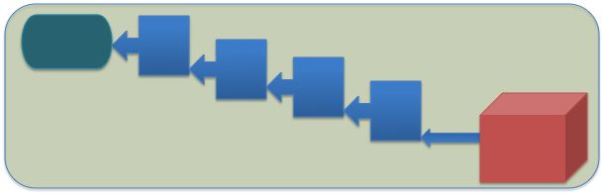
Model is a Collection of Variables
Model - M₁
y₁
y₄
y₂
y₅
y₃
y_{n}

Slide 41
Training Agenda
SORCER Overview
Creating your own workspace
Running Hello World Examples
Creating Providers & Publishing
Creating Requestors (Job, Task, Context) & Executing calling providers

Slide 42
“Hello World” Example
iGrid-10/modules/examples/hello
Create a single ServiceProvider that has three services: “sayHi”, “sayBy”, “sayHiBy”.
Example 1: Create a ServiceRequestor that creates a single ServiceTask to “call” the “sayHi” service.
Example 2: Create a ServiceRequestor that creates a ServiceJob that calls the “sayHi” service, “sayBy” service and the “sayHiBy” service and pass a string into the service, modify it and return.

Slide 43
HelloProvider: “sayHi”, “sayBy”, “sayHiBy” Services
Create a single ServiceProvider that has three services: “sayHi”, “sayBy”, “sayHiBy”.
INPUT Context
HelloProvider
OUTPUT Context
String: toWho
“sayHi” Service
String: Returned From " + providerName + " Hi " + toWho
String: toWho
“sayBy” Service
String: Returned From " + providerName + ” By" + toWho
String: toWho
“sayHiBy” Service
String: Returned From " + providerName + ” HiBy" + toWho
Steps to creating a service provider:
1. Create a generic Interface that has all the services (methods) that the provider will expose.
2. Create a Remote Interface that extends the generic Interface
3. Create a Provider class that extends ServiceProvider and implements the Remote Interface, and contains the business logic for each of the services defined in the Interface.

Slide 44
HelloInterface
engineering.provider.hello.HelloInterface.java
HelloProvider
package engineering.provider.hello;
import java.rmi.Remote;
import java.rmi.RemoteException;
import sorcer.service.Context;
public interface HelloInterface {
public Context sayHi(Context context)
throws RemoteException;
public Context sayBy(Context context)
throws RemoteException;
public Context sayHiBy(Context context)
throws RemoteException;
}
“sayHi” Service
“sayBy” Service
“sayHiBy” Service
“sayHi” Service
“sayBy” Service
“sayHiBy” Service
Generic Interface – Each Service takes a Context and returns a Context

Slide 45
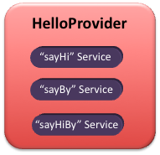
HelloRemoteInterface
engineering.provider.hello.HelloRemoteInterface.java
package engineering.provider.hello;
import java.rmi.Remote;
import java.rmi.RemoteException;
import sorcer.service.Context;
public interface HelloRemoteInterface extends HelloInterface, Remote {
public Context sayHi(Context context) throws RemoteException;
public Context sayBy(Context context) throws RemoteException;
public Context sayHiBy(Context context) throws RemoteException;
}
“sayHi” Service
“sayBy” Service
“sayHiBy” Service
Remote Interface enables calls from anywhere on the network

Slide 46
HelloProvider
engineering.provider.hello.HelloProvider.java
package engineering.provider.hello;
import java.rmi.RemoteException;
import sorcer.core.SorcerConstants;
import sorcer.core.provider.ServiceProvider;
import sorcer.service.Context;
import com.sun.jini.start.LifeCycle;
public class HelloProvider extends ServiceProvider implements
HelloRemoteInterface, SorcerConstants {
public HelloProvider(String[] args, LifeCycle lifeCycle)
throws Exception {
super(args, lifeCycle);
}
Constructor must be present for Jini service
…
Source continued on next slide
Providers contain the business logic for the services

Slide 47
HelloProvider
engineering.provider.hello.HelloProvider.java
public Context sayHi(Context context) throws RemoteException {
String providerName = getProviderName();
try {
String input = (String) context.getValue("in/value");
String output = "Returned From " + providerName + " Hi " + input;
context.putOutValue("out/value", output);
} catch (Exception e) {
e.printStackTrace();
}
return context;
}
“sayHi” Service
public Context sayBy(Context context) throws RemoteException {
String providerName = getProviderName();
try {
String input = (String) context.getValue("in/value");
String output = "Returned From " + providerName + ” By " + input;
context.putOutValue("out/value", output);
} catch (Exception e) {
e.printStackTrace();
}
return context;
}
“sayBy” Service
…
Source continued on next slide

Slide 48
HelloProvider
engineering.provider.hello.HelloProvider.java
public Context sayHiBy(Context context) throws RemoteException {
String providerName = getProviderName();
try {
String input = (String) context.getValue("in/value");
String output = "Returned From " + providerName + " HiBy " + input;
context.putOutValue("out/value", output);
} catch (Exception e) {
e.printStackTrace();
}
return context;
}
}
“sayHiBy” Service

Slide 49
“Hello World” Example
Create a single ServiceProvider that has three services: “sayHi”, “sayBy”, “sayHiBy”.
Example 1: Create a ServiceRequestor that creates a single ServiceTask to “call” the “sayHi” service.
Example 2: Create a ServiceRequestor that creates a ServiceJob that calls the “sayHi” service, “sayBy” service and the “sayHiBy” service and pass a string into the service, modify it and return.

Slide 50
“Hello World” Example
Conceptually what we would like to do
Hello
Service
sayHi to “Ray”
Hello-mac1
Service
Provider
Requestor
“Returned From Hello-mac1 Hi Ray”

Slide 51
HelloTaskRequestor
Service Requestor
Signature
ServiceContext
ServiceTask
ControlContext
Steps to creating a service requestor:
Create a class that may extend SorcerRequestor
Create and set the System Security Manager
Create the task/job with each exertion containing a Signature, ServiceContext and an optional ControlContext
Submit the task/job to the SORCER grid for execution

Slide 52
HelloTaskRequestor
engineering.requestor.hello.java
Requestor
public class HelloTaskRequestor implements SorcerConstants {
public static void main(String[] args) throws Exception {
if (System.getSecurityManager() == null)
System.setSecurityManager(new RMISecurityManager());
String hiProviderName, toWho;
hiProviderName = args[0];
System.out.println("Hi Service: " + hiProviderName);
toWho = args[1];
System.out.println("Name of person you want to speak to: " + toWho);
…
Source continued on next slide
Note: args[] is a string array that are supplied on the java command line. They are set in the helloTask-req-run.xml file.

Slide 53


HelloTaskRequestor
Requestor
engineering.requestor.hello.java
// Create the task
Exertion taskHi = new ServiceTask("hi", "Task to say hello");
// Create signatures for the Hi service and
// set the provider name accordingly from the online args
Signature methodHi = new ServiceSignature("sayHi",
engineering.provider.hello.HelloRemoteInterface.class, hiProviderName);
// Create the Context for the input/output data
Context contextHi = new ServiceContext("hiContext");
//populate the context with the input data
contextHi.putInValue("in/value", toWho);
// create an empty node to hold the output - This is provider dependent
contextHi.putValue("out/value", Context.EMPTY_LEAF);
System.out.println("\ttaskHi context = " + contextHi + "\n");
…
Source continued on next slide

Slide 54
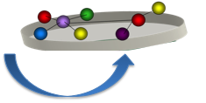
HelloTaskRequestor
engineering.requestor.hello.java
Requestor
// Create the Control context - this is optional,
// a default is created in the task
Context controlContextHi = new ControlContext();
// put the context into the task
((ServiceTask)taskHi).setContext(contextHi);
// put the signature into the task
((ServiceTask)taskHi).addSignature(methodHi);
// put the controlContext into the task
((ServiceTask)taskHi).setControlContext((ControlContext)controlContextHi);
// submit the task to the sorcer grid for execution
Exertion result = taskHi.exert(null);
// print the results
System.out.println("\n**************************");
System.out.println("\tsayHi Method Response = "
+ result.getExertions().get(0).getContext().getValue("out/value"));
System.out.println("\n**************************");
}

Slide 55
Running the HelloTask Example
Start your environment webster (if not running)
Execute iGrid-10/bin/webster/bin/webster-run.xml
Start the i-Grid basic services (if not running)
Execute i-Grid-10/bin/iGrid-min-boot.xml
Start the i-Grid service browser (if not running)
Execute i-Grid-10/bin/browser/bin/service-browser-run.xml
Start/publish the HelloProvider
i-Grid10/modules/examples/hello/hello/provider/bin/jeri-helloHi-run.xml
Should now see the HelloProvider in the Service Browser
Execute the HelloTaskRequestor
i-Grid10/modules/examples/hello/hello/requestor/bin/helloTask-req-run.xml

Slide 56
Running the HelloTask Example
The following should print out to the console:
**************************
sayHi Method Response = Returned From Hello-mac1 Hi Ray
**************************

Slide 57
Running the HelloTask Example
If you wish to change the service that is called or who to say hello to
Edit i-Grid10/modules/examples/hello/hello/requestor/bin/helloTask-req-run.xml
<target name="run.requestor">
<java classname="${requestor.class}" fork="yes">
<arg value="Hello-mac1" />
<arg value="Ray" />
<classpath refid="project.classpath" />
To change the name of your HelloProvider name
Edit i-Grid-10/bin/modules/examples/hello/hello/provider/bin/configs/helloHi-prv.config & republish your service
name="Hello-mac1";
Service Provider Name
Say Hello to
Your HelloProvider published name

Slide 58
“Hello World” Example
Create a single ServiceProvider that has three services: “sayHi”, “sayBy”, “sayHiBy”.
Example 1: Create a ServiceRequestor that creates a single ServiceTask to “call” the “sayHi” service.
Example 2: Create a ServiceRequestor that creates a ServiceJob that calls the “sayHi” service, “sayBy” service and the “sayHiBy” service and pass a string into the service, modify it and return.

Slide 59
“Hello World” Example
Conceptually what we would like to do
Hello-mac1 sayHi to “Ray”
Hello
Service
Hello-mac2 – take Hello-mac1 output and append sayBy to sayHi output
Requestor
Hello-mac3 – take Hello-mac2 output and append sayHiBy to sayBy output
Hello-mac1 sayHi to “Ray”
Hello-mac1
Service
Provider
Hello-mac2 sayBy to “Returned From Hello-mac1 Hi Ray”
Hello-mac2
Service
Provider
“Returned From Hello-mac3 HiBy Returned From Hello-mac2 By
Returned From Hello-mac1 Hi Ray”
Hello-mac3
Service
Provider
Hello-mac3 say HiBy to
“Returned From Hello-mac2 By
Returned From Hello-mac1 Hi Ray”

Slide 60
HelloJobRequestor
Service Requestor
sayHiTask
ServiceJob
sayHiTask output
sayByTask
ServiceJob
sayByTask input
sayByTask output
sayHiByTask
sayHiByTask input
ControlContext
Steps to creating a service requestor:
Create a class that may extend SorcerRequestor
Create and set the System Security Manager
Create the job with each exertion containing a Signature, ServiceContext and an optional ControlContext for each task
Place each task into the Job
Map the output from the sayHiTask to the sayByTask, and the output from the sayByTask to the sayHiByTask
Submit the job to the SORCER grid for execution

Slide 61
HelloJobRequestor
engineering.requestor.hello.HelloJobRequestor.java
Requestor
public class HelloJobRequestor implements SorcerConstants {
public static void main(String[] args) throws Exception {
if (System.getSecurityManager() == null)
System.setSecurityManager(new RMISecurityManager());
String hiProviderName, byProviderName, hiByProviderName, toWho;
hiProviderName = args[0];
System.out.println("Hi Service: " + hiProviderName);
byProviderName = args[1];
System.out.println("By Service: " + byProviderName);
hiByProviderName = args[2];
System.out.println("HiBy Service: " + hiByProviderName);
toWho = args[3];
System.out.println("Name of person you want to speak to: " + toWho);
…
Source continued on next slide
Note: args[] is a string array that are supplied on the java command line. They are set in the helloJob-req-run.xml file.

Slide 62




HelloJobRequestor
engineering.requestor.hello.HelloJobRequestor.java
Requestor
// Create the component tasks, and put the service signature in
// This constructor actually creates a default ControlContext
Exertion taskHi = new ServiceTask("hi", "Task to say hello");
Exertion taskBy = new ServiceTask("by", "Task to say by");
Exertion taskHiBy = new ServiceTask("hiby", "Task to say hiby");
// Create signatures for services the Hi, By, and HiBy and
// set the provider name accordingly from the online args
Signature methodHi = new ServiceSignature("sayHi", HelloRemoteInterface.class, hiProviderName);
Signature methodBy = new ServiceSignature("sayBy", HelloRemoteInterface.class, byProviderName);
Signature methodHiBy = new ServiceSignature("sayHiBy", HelloRemoteInterface.class, hiByProviderName);
// Create & populate the context for the task Hi
Context contextHi = new ServiceContext("sayHiContext");
contextHi.putInValue("in/value", toWho);
contextHi.putOutValue("out/value", Context.EMPTY_LEAF);
// Create & populate the context for the task By
Context contextBy = new ServiceContext("sayByContext");
// note the input for this task will come from the output from the Hi Task
contextBy.putInValue("in/value", Context.EMPTY_LEAF);
contextBy.putOutValue("out/value", Context.EMPTY_LEAF);
…
Source continued on next slide

Slide 63



HelloJobRequestor
engineering.requestor.hello.HelloJobRequestor.java
Requestor
// Create & populate the context for the task HiBy
Context contextHiBy = new ServiceContext("sayHiByContext");
// note the input for this task will come from the output from
//the By Task
contextHiBy.putInValue("in/value", Context.EMPTY_LEAF);
// populate the tasks with the signatures and the context
((ServiceTask)taskHi).addSignature(methodHi);
((ServiceTask)taskHi).setContext(contextHi);
((ServiceTask)taskBy).addSignature(methodBy);
((ServiceTask)taskBy).setContext(contextBy);
((ServiceTask)taskHiBy).addSignature(methodHiBy);
((ServiceTask)taskHiBy).setContext(contextHiBy);
// create the exertion job composed of the above tasks
Job job = new ServiceJob("HelloBy");
job.addExertion(taskHi);
job.addExertion(taskBy);
job.addExertion(taskHiBy);

Slide 64


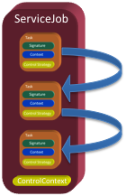
HelloJobRequestor
engineering.requestor.hello.HelloJobRequestor.java
Requestor
// create the control context and set access to push, and
// flow to sequential.
// Finally request that the execution time for the job
Context controlContextHiBy = new ControlContext();
((ControlContext)controlContextHiBy).setAccessType(Access.PUSH);
((ControlContext)controlContextHiBy).setFlowType(Flow.SEQ);
((ControlContext)controlContextHiBy).setExecTimeRequested(true);
// set the job control strategy
job.setControlContext((ControlContext)controlContextHiBy);
// create data context mappings from on task to the next
contextBy.map("out/value", "in/value", contextHiBy);
contextHi.map("out/value", "in/value", contextBy);
contextBy.map("out/value", "in/value", contextHiBy);
// execute the service job
Exertion result = job.exert(null);

Slide 65
Running the HelloJob Example
Start your environment webster (if not running)
Execute iGrid-10/bin/webster/bin/webster-run.xml
Start the i-Grid basic services (if not running)
Execute i-Grid-10/bin/iGrid-min-boot.xml
Start the i-Grid service browser (if not running)
Execute i-Grid-10/bin/browser/bin/service-browser-run.xml
Start/publish the three HelloProviders, (Hi, By, HiBy)
i-Grid10/modules/examples/hello/hello/provider/bin/jeri-helloHi-run.xml
i-Grid10/modules/examples/hello/hello/provider/bin/jeri-helloBy-run.xml
i-Grid10/modules/examples/hello/hello/provider/bin/jeri-helloHiBy-run.xml
Should now see the three HelloProvider in the Service Browser
Execute the HelloJobRequestor
i-Grid10/modules/examples/hello/hello/requestor/bin/helloJob-req-run.xml

Slide 66
Running the HelloJob Example
The following should print out to the console:
**************************
sayHi Method Response = Returned From Hello-mac1 Hi Ray
**************************
sayBy Method Response = Returned From Hello-mac2 By Returned From Hello-mac1 Hi Ray
**************************
sayHiBy Method Response = Returned From Hello-mac3 HiBy Returned From Hello-mac2 By Returned From Hello-mac1 Hi Ray

Slide 67
Running the HelloJob Example
If you wish to change the service that is called or who to say hello to
Edit i-Grid10/modules/examples/hello/hello/requestor/bin/helloJob-req-run.xml
<target name="run.requestor">
<java classname="${requestor.class}" fork="yes">
<arg value="Hello-mac1" />
<arg value="Ray2" />
<classpath refid="project.classpath" />
To change the name of your HelloProviders name
Edit i-Grid-10/bin/modules/examples/hello/hello/provider/bin/configs/helloHi,By,HiBy-prv.config & republish your service
name="Hello-mac1";
Service Provider Names
Say Hello to
Your HelloProvider published name

Slide 68
Creating your Own Provider & Requestor
Use existing files of providers & requestors as a template
Engineering/apps/serviceProvider_Requestor_Template
NEVER copy folders! Only Files (.svn hidden files will cause chaos)
You can use the eclipse export/import facility to “copy” folder structures. (export does not include .svn files). If using export make sure the eclipse environment is in sync with the file system. (right click “refresh” on folder to export)
Import – General-FileSystem

Slide 69
Creating your Own Provider & Requestor
Engineering/apps/serviceProvider_Requestor_Template
Export serviceProvider_Requestor_Template folder
Create new folder where the new service will be created
Import the folder that was exported into the new location
Change all the “servicetemplate” (file names and in files) to your provider package (example astros)
Chage all “ServiceTemplate” (file name and in files ) to your ProviderName (example AstrosProvider)

Slide 70
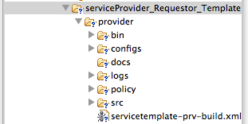
Creating your Own Provider & Requestor
To create a new Sorcer provider & requestor for a given provider in Eclipse the following folders and files need to be created.
Folders & hierarchy
provider - The provider folder will contain all the folders and files needed to create, compile and publish the provider. Below is the first level of folders and files required.

Slide 71

Creating your Own Provider & Requestor
The provider bin folder contains at a minimum an ant xml file that is used to publish the serviceTempletProviderImpl (found in the provider/src folder) class service to the sorcer registry. It can also contain an xml files that tests the serviceTempleProviderImp class.
The jeri-servicetemplate-prv-run.xml file is used to publish the service to the sorcer registry. It is essentially a java command with several java command line arguments being set. A typical set of arguments are:
<java jar="${jini.lib}/start.jar" fork="yes">
<sysproperty key="java.util.logging.config.file" value="${iGrid.home}/configs/sorcer.logging" />
<sysproperty key="java.security.policy" value="../policy/${provider.name}-prv.policy" />
<sysproperty key="java.rmi.server.codebase" value="${j1} ${j2} ${j3}" />
<sysproperty key="sorcer.provider.codebase" value="${j1} ${j2} ${j3} ${j4} ${j5} ${j6} ${j7}" />
<sysproperty key="sorcer.provider.classpath" value="${toString:project.classpath}" />
<sysproperty key="sorcer.provider.impl" value="${provider.class}" />
<sysproperty key="sorcer.provider.config" value="../configs/jeri-${provider.name}-prv.config" />
<sysproperty key="iGrid.home" value="${iGrid.home}" />
<sysproperty key="provider.properties" value="../configs/jeri-servicetemplate-prv.properties" />
<sysproperty key="sorcer.formats.file" value="${iGrid.home}/configs/data.formats" />
<arg value="${iGrid.home}/configs/startup-prv.config" />
<jvmarg value="-Xms128m" />
<jvmarg value="-Xmx512m" />
<jvmarg value="-Xss512m" />
<sysproperty key="jna.library.path" value="${local.lib}" />

Slide 72
Engineering Provider - ASTROS
Automated STRuctural Optimization System (ASTROS) – FEM for structures, panel code for aerodynamics. Performs static and dynamic aeroelastic optimization (structural sizing)
engineering.provider.astros.AstrosInterface.java
(iGrid-10/modules/engineering/apps/astros/provider/src/engineering/provider/astros/AstrosInterface.java)
public interface AstrosInterface {
public Context executeAstros(Context context)
throws RemoteException;
public Context computeLiftPerUnitSpan(Context context)
throws RemoteException;
public Context computeFlutterDamping(Context context)
throws RemoteException;
}
Three Services in the Provider

Slide 73
AstrosProviderImpl: “executeAstros”, “computeLiftPerUnitSpan”, “computeFlutterDamping” Services
engineering.provider.astros.AstrosProviderImpl.java in folder
iGrid-10/modules/engineering/apps/astros/provider/src/engineering/provider/astros/AstrosProviderImpl.java
OUTPUT Context
INPUT Context
AstrosProviderImpl
URL(s): astros.bdf files – maininput*, bdfinput(s), solInput, mapolInput, debugInput, assignDBInput, funPakInput,
caddbIndexFile, caddbEntityFile.
String: caddbPW
Objects: caddbQuery, lpus,
flutterDamping, gpwg
URL(s): astros.out,
caddbIndexFile,
caddbEntityFile.
Objects: lpus,
flutterDamping, gpwg
executeAstros
coputeLiftPerUnitSpan
computeFlutterDamping
Provider can run ASTROS in three ways: systemCall, slurm, JNA. All database queries are done using JNA. No File Parsing!

Slide 74
AstrosRequestor
Engineering.requestor.astros.AstrosRequestor.java in folder
iGrid-10/modules/engineering/apps/astros/requestor/src/engineering/requestor/astros/AstrosRequestor.java
The Requestor has three cases that it can run to test the provider services:
protected void init(String... args) throws Exception {
int test = new Integer(args[1]);
switch (test) {
case 1: astrosExecuteAstros(); break;
case 2: astrosComputeLiftPerUnitSpan(); break;
case 3: astrosComputeFlutterDamping(); break;
}
}

Slide 75
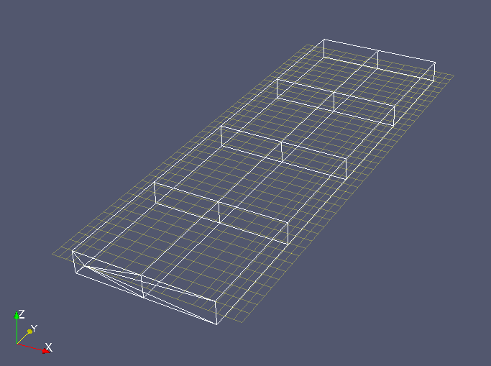
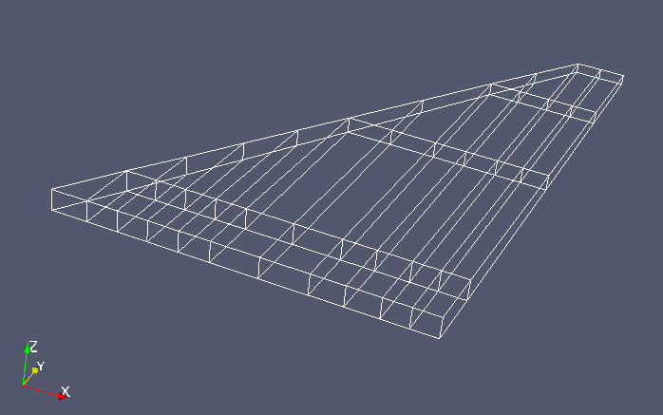
AstrosRequestor Example
Case 1 & 2: Rectangular Wing
Static Aeroelastic Analysis
Case 3: Fighter Wing
Flutter Analysis
M=1.1
Sea Level
M=0.7, q=5.0 psi
NZ=1g, Alpha=2.327
20 TE CS set

Slide 76
Running the AstrosRequestor Example
Start your environment webster (if not running)
Execute iGrid-10/bin/webster/bin/webster-run.xml
Start the i-Grid basic services (if not running)
Execute i-Grid-10/bin/iGrid-min-boot.xml
Start the i-Grid service browser (if not running)
Execute i-Grid-10/bin/browser/bin/service-browser-run.xml
Start/publish the AstrosProviderImpl (if not running)
i-Grid10/modules/engineering/apps/astros/provider/bin/jeri-astros-prv-run.xml
Should now see the AstrosProvider in the Service Browser
Execute the AstrosRequestor
i-Grid10/modules/engineering/apps/astros/requestor/bin/astrosRequestor-runner-run.xml (this should run case 1)
To run case 2 or case 3 edit the i-Grid10/modules/engineering/apps/astros/requestor/bin/astrosRequestor-runner-run.xml
<target name="run.requestor">
<java classname="${requestor.class}" fork="yes">
<arg value="engineering.requestor.astros.AstrosRequestor" />
<arg value=“1" />
Change this value to change cases (1,2,3)

Slide 77
AstrosRequestor:Case 1
i-Grid10/modules/engineering/apps/astros/requestor/bin/astrosRequestor-runner-run.xml
case 1: astrosExecuteAstros();
Runs the static aeroelastic analysis on rectangular wing & returns a URL to the output file & database files in the context.
Console Print of Context after analysis has completed
Subject = AstrosContext:
in/value/ASTROS/BDF1/INPUT = http://10.131.4.201:9000/astros/hw7/hw0SWMp7_grid.bdf
in/value/ASTROS/MAIN/INPUT = http://10.131.4.201:9000/astros/hw7/hw0SWMp7.d
out/value/ASTROS/DATABASE/PASSWORD = DNA
out/value/ASTROS/OUTPUT/D01FILE = http://10.131.4.201:9000/astros/provider/scratch/20111104-084630-1336e9dbc0b/ZSW.D01
out/value/ASTROS/OUTPUT/IDXFILE = http://10.131.4.201:9000/astros/provider/scratch/20111104-084630-1336e9dbc0b/ZSW.IDX
out/value/ASTROS/OUTPUT/OUTFILE = http://10.131.4.201:9000/astros/provider/scratch/20111104-084630-1336e9dbc0b/astrosResults.out
Paste this URL into a browser to view the astrosResults.out file (output file)

Slide 78
AstrosRequestor:Case 1
i-Grid10/modules/engineering/apps/astros/requestor/bin/astrosRequestor-runner-run.xml
case 1: astrosExecuteAstros();
out/value/ASTROS/OUTPUT/OUTFILE = http://10.131.4.201:9000/astros/provider/scratch/20111104-084630-1336e9dbc0b/astrosResults.out
TRIM RESULTS FOR TRIM SET 100 OF TYPE LIFT
-----------------------------------------------
MACH NUMBER 7.00000E-01
DYNAMIC PRESSURE 5.00000E+00
TRIM PARAMETERS:
DEFINITION LABEL FLEXIBLE RIGID
---------- ----- -------- -----
ANGLE OF ATTACK "ALPHA " 2.32700E+00 2.32700E+00 DEG (USER INPUT)
LOAD FACTOR "NZ " 3.86100E+02 3.86100E+02 (USER INPUT)
CONTROL SURFACE ROTATION "CS1 " -3.96100E+00 -3.96100E+00 DEG (USER INPUT)
CONTROL SURFACE ROTATION "CS2 " -1.56100E+00 -1.56100E+00 DEG (USER INPUT)
CONTROL SURFACE ROTATION "CS3 " -1.82800E+00 -1.82800E+00 DEG (USER INPUT)
CONTROL SURFACE ROTATION "CS4 " -2.35600E+00 -2.35600E+00 DEG (USER INPUT)
CONTROL SURFACE ROTATION "CS5 " -1.21700E+00 -1.21700E+00 DEG (USER INPUT)
CONTROL SURFACE ROTATION "CS6 " -3.76900E+00 -3.76900E+00 DEG (USER INPUT)
CONTROL SURFACE ROTATION "CS7 " 4.09100E+00 4.09100E+00 DEG (USER INPUT)
CONTROL SURFACE ROTATION "CS8 " 4.07500E+00 4.07500E+00 DEG (USER INPUT)
CONTROL SURFACE ROTATION "CS9 " -7.07000E-01 -7.07000E-01 DEG (USER INPUT)
CONTROL SURFACE ROTATION "CS10 " -4.02000E-01 -4.02000E-01 DEG (USER INPUT)
CONTROL SURFACE ROTATION "CS11 " -2.28600E+00 -2.28600E+00 DEG (USER INPUT)
CONTROL SURFACE ROTATION "CS12 " 7.46000E-01 7.46000E-01 DEG (USER INPUT)
CONTROL SURFACE ROTATION "CS13 " 1.28600E+00 1.28600E+00 DEG (USER INPUT)
CONTROL SURFACE ROTATION "CS14 " 9.67000E-01 9.67000E-01 DEG (USER INPUT)
CONTROL SURFACE ROTATION "CS15 " -1.73600E+00 -1.73600E+00 DEG (USER INPUT)
CONTROL SURFACE ROTATION "CS16 " 5.37000E-01 5.37000E-01 DEG (USER INPUT)
CONTROL SURFACE ROTATION "CS17 " -1.46400E+00 -1.46400E+00 DEG (USER INPUT)
CONTROL SURFACE ROTATION "CS18 " -2.15800E+00 -2.15800E+00 DEG (USER INPUT)
CONTROL SURFACE ROTATION "CS19 " 5.03000E-01 5.03000E-01 DEG (USER INPUT)
CONTROL SURFACE ROTATION "CS20 " 6.51800E+00 6.51800E+00 DEG (USER INPUT)

Slide 79
AstrosRequestor:Case 2
i-Grid10/modules/engineering/apps/astros/requestor/bin/astrosRequestor-runner-run.xml
Case 2: astrosComputeLiftPerUnitSpan();
Runs the static aeroelastic analysis on rectangular wing & compute Lift per unit span and return in an object.
Console Print of Context after analysis has completed
Subject = AstrosContext:
in/value/ASTROS/BDF1/INPUT = http://10.131.4.201:9000/astros/hw7/hw0SWMp7_grid.bdf
in/value/ASTROS/CADDB/QUERY = engineering.provider.astros.CADDBQuery@f4d5bc9
in/value/ASTROS/MAIN/INPUT = http://10.131.4.201:9000/astros/hw7/hw0SWMp7.d
in/value/ASTROS/OUTPUT/LPUS = engineering.provider.astros.AstrosLpus@1fc4f0f8
in/value/ASTROS/SCRATCH/DIRECTORY = /Users/raymondkolonay/workspace/iGrid-10/data/astros/provider/scratch/20111104-085811-1336ea86dac
out/value/ASTROS/DATABASE/PASSWORD = DNA
out/value/ASTROS/OUTPUT/D01FILE = http://10.131.4.201:9000/astros/provider/scratch/20111104-085811-1336ea86dac/ZSW.D01
out/value/ASTROS/OUTPUT/IDXFILE = http://10.131.4.201:9000/astros/provider/scratch/20111104-085811-1336ea86dac/ZSW.IDX
out/value/ASTROS/OUTPUT/OUTFILE = http://10.131.4.201:9000/astros/provider/scratch/20111104-085811-1336ea86dac/astrosResults.out
>>>>>>>>>> Lift Per Unit Span Results from ASTROS Run <<<<<<<<<<<<<
Spanwise cut appliedLpus rigidLpus flexLpus
1 54.16099197169145 36.29533404111861 17.86565801501274
2 54.86817342042924 37.06625717878342 17.801917264858886
3 57.32152642806372 39.58923983573912 17.732287615537643
.
.
39.39830290277799 28.066914667685825 11.331388533270607
40 28.906596819559734 21.190397143363953 7.716199538883908
Empty AstrosLpus object was input.
Object populated with data on output.

Slide 80
AstrosRequestor:Case 3
i-Grid10/modules/engineering/apps/astros/requestor/bin/astrosRequestor-runner-run.xml
case 3: astrosComputeFlutterDamping();
Runs the flutter analysis on fighter wing and compute fluttering damping values and return in an object.
Console Print of Context after analysis has completed
in/value/ASTROS/CADDB/QUERY = [engineering.provider.astros.CADDBQuery@87e9ce2, …..
in/value/ASTROS/MAIN/INPUT = http://10.131.4.201:9000/astros/fighter/fighter_flutterM1p1.d
in/value/ASTROS/SCRATCH/DIRECTORY = /Users/raymondkolonay/workspace/iGrid-10/data/astros/provider/scratch/20111104-121730-1336f5ee5e2
out/value/ASTROS/DATABASE/PASSWORD = WING
out/value/ASTROS/OUTPUT/D01FILE = http://10.131.4.201:9000/astros/provider/scratch/20111104-121730-1336f5ee5e2/NLAAN.D01
out/value/ASTROS/OUTPUT/DAMPING = engineering.provider.astros.AstrosFlutterOutput@1acc0e01
out/value/ASTROS/OUTPUT/GPWG = engineering.provider.astros.AstrosGPWG@4aab7165
out/value/ASTROS/OUTPUT/IDXFILE = http://10.131.4.201:9000/astros/provider/scratch/20111104-121730-1336f5ee5e2/NLAAN.IDX
out/value/ASTROS/OUTPUT/OUTFILE = http://10.131.4.201:9000/astros/provider/scratch/20111104-121730-1336f5ee5e2/astrosResults.out
task/provider = ENGINEERING-Astros-RMac@macdna.rb.rad-e.wpafb.af.mil:10.131.4.201
Nov 4, 2011 12:18:19 PM engineering.requestor.astros.AstrosRequestor astrosComputeFlutterDamping
INFO: Flutter Damping :
mode number Velocity Damping
1 5000.0 -0.08188183605670929
1 10000.0 -0.11725959181785583
1 18000.0 -0.19990922510623932
1 20000.0 -0.20551984012126923
1 24000.0 -0.20518758893013
2 5000.0 -0.05098726227879524
2 10000.0 -0.08072353154420853
2 18000.0 0.3754781484603882
2 20000.0 0.629492461681366
2 24000.0 1.1414759159088135
3 5000.0 -0.09921614825725555
3 10000.0 -0.29697275161743164
...
AstrosFlutterOutput object is output and populated with damping data..

Slide 81
List of Available Services
Modules/engineering, modules/engineering/apps
CONMIN
DOT
ANSYS
ASTROS
AVUS
EXCEL
FLOPS
GRIDGEN
MAELSTROM
MDICE
MSTCGEOM
M3CT
NASTRAN
VORTEXLATTICE
MATLAB
NOT UPDATED to IGRID-10 AS OF 7 Nov 2011

Slide 82
SORCER Model & Variables
Models – consists of Variables, Filters and Evaluators.
Current available models – ResponseModel(including sensitivities) , ParametricModel,, OptimizationModel
Variables (Var) - can be dependent on other Variables enabling distributed functional programming. Variables can have multiple evaluators enabling multi-fidelity calculations for a specific variable’s value.
Evaluators – are used to determine the value of variables and their partial derivatives(chain rule works) with respect to their dependencies (Variables).
Current Evaluator Types – ModelEvaluator, ExertionEvaluator, ExpressionEvaluator, GroovyEvaluator, JepEvaluator, MethodEvaluator
Filters - are used to map the results of Evaluators to Variable Values. Think unix shell piping. Filters can be concatenated n times.
Current Filter Types – BasicFileFilter, ContextFilter, FileFilter, GrepFilter, ListFilter, MapFilter, ObjetFilter, PatternFilter, TextFilter
All are Objects

Slide 83
SORCER Variables
SORCER Variables are distinguished by four attributes: type, kind, valueType, and mathType
SORCER Variable ValueType (only one)
Integer
Long
Double (Default)
Float
String
Object
Unknown
Undefined
SORCER Variable mathType (one or more combinations)
Continuous (default)
Discrete
Discrete_With_Order
Discrete_with_Math
Discrete_No_Order
Problem_Parameter
ReaL
SORCER Variable type (only one)
Design (default)
Response
SORCER Variable kind (one or more combinations)
Linked
Parameter
Bounded
Random
Constraint
Objective
INDEPENDENT
Example: skinThickness: Type:DESIGN, Kinds:BOUNDED,RANDOM, ValueType:DOUBLE, MathType: REAL, CONTINUOUS

Slide 84
Variable - Value, Filters, Evaluators
Variable - Var
Value
Filter n
Filter …
Filter 2
Single
Scalar
Value
Filter 1
Evaluator
Computational
Entity. Creating
Large Amounts of Data

Slide 85
Variable, Evaluator, Filter (VEF) Design Patterns
Lazy variable evaluation
getValue vs. evaluate (demand driven calculations)
Evaluator – Decorator pattern
Evaluator: getValue/evaluate implements EvaluationManagement
Outer evaluator calls on its inner one
Evaluator is observable and observer (functional programming)
Observer-Observable
setChanged
notify/update
Notes:
Function composition is a very powerful way of reusing code and building programs from pieces.
Object composition provides good support for building software from pieces.
Building complete partial results can be a waste of resources, as the next function in the composition chain may need only a few first elements from the partial result variable list, so computing the rest of the list would be a waste of time.
A variable is a generator that, on request (getValue), provides a response-object.

Slide 86
Basic Variable Structure
Variable
y1
Pipe of Filters
Evaluator
y1e1
y1f1
y1f12
y1f3
Pipe of Filters
dy1dx1f1
Evaluator
Differentiator
dy1dx1f2
dy1dx1
dy1dx2
dy1dx3
dy1dx1e1
.
.
.
Variables
. . .
dy1dx3e1
dy1dx1f1
dy1dx1f2
Note support for Sensitivities

Slide 87
Advanced Variable Structure
Functions of Functions
Variables
y1 | y2 | y3
…
Multidisciplinary
Evaluators
y1e1 | y1e2
…
Multi-fidelity
Drag via N-S Calc.
Drag via Surrogate Calc.
Differentiator y1e1d
Gradient y1e1g1
Evaluators
Gradient y1e1g2
dy1e1dx1
dy1e1dx2
dy1e1dx3
dy1e1dx4
dy1e1dx1e1 | dy1e1dx1e2
…
dy1e1dx1
dy1e1dx2
dy1e1dx3
dy1e1dx3
…
dy1e2dx1e1 | dy1e2dx1e2
Variables
…
…
…
Evaluators
dy1e1dx4e1 | dy1e1dx4e2
…
dy1e2dx4e1 | dy1e2dx4e2
…

Slide 88
Evaluators
Evaluators – are used to determine the value of variables and their partial derivatives(chain rule works) with respect to their dependencies (Variables). Evaluators do not necessarily produce a scalar value. The result can be an entire database or file. (for a given set of input an application creates many outputs)
Current Evaluator Types – ModelEvaluator, ExertionEvaluator, ExpressionEvaluator, GroovyEvaluator, JepEvaluator, MethodEvaluator, SOAEvaluator, FDEvaluator

Slide 89
Filters
Filters - are used to map the results of Evaluators to Variable Values. Think unix shell piping. Filters take the output of Evaluators and reduce it to a single scalar value necessary to define a Variable value. Filters can be concatenated n times.
Current Filter Types – BasicFileFilter, ContextFilter, FileFilter, GrepFilter, ListFilter, MapFilter, ObjetFilter, PatternFilter, TextFilter

Slide 90
SORCER Models
SORCER Models support
Analysis – (ResponsModel & ParametricModel)
multidisciplinary response analysis
multi-fidelity response analysis
multi-fidelity response sensitivities
Design Space Exploration (OptimizationModel)
Optimization
Multidisciplinary Optimization

Slide 91
Model is a Collection of Variables
Model - M₁
y₁
y₄
y₂
y₅
y₃
y_{n}

Slide 92
Model Construction
Constructing a Model Consists of Two Steps
Model Definition (Skeleton)
Defines the model Variables (design, response, parameters, objectives, constraints.
Defines the Variable Realizations, Evaluations, and Differentiation
Model Configuration (Muscle)
Develops the evaluators and filters for all variables and derivative variables.
Models can be created programmatically with or without
Operators (Functional Programming)

Slide 93
Model Construction Example Rosen-Suzuki Functions Definition

Slide 94
Model Definition (using functional programming operators)
sorcer.rs.ex7.model.RsResponseModelBuilder
examples/ex7
Model Definition (using functional programming operators)
// define the model
model = responseModel("Rosen-Suzuki Response Model",
designVars(vars(loop("i", 1,4),"x$i$")),
responseVar("f",
realization(
evaluation("FExacte", "fe",null,null))),
responseVars(loop("i", 1, 3),"g$i$",
realization(
evaluation("g$i$Exacte", "g$i$e",null,null)))
);
The above creates
ResponseModel: “Rosen-Suzuki Response Model”, which contains -
Vars: with names: “x1”,”x2”,”x3”,”x4”, type: DESIGN
Var: with name: “f”, type: RESPONSE, evaluationName:”Fexacte” , evaluatorName:”fe”
Vars: with names: “g1”,”g2”,”g3”, type: RESPONSE, evaluationName:”g1Exacte”, evaluatorName:”g1e”
evaluationName:”g2Exacte”, evaluatorName:”g2e”
evaluationName:”g3Exacte”, evaluatorName:”g3e”

Slide 95
Rosen-Suzuki Functions
sorcer.rs.ex7.model.RsResponseModelBuilder
Examples/ex7
Model Configuration (using operators and explicit programming)
fe = evaluator("fe","x1^2-5.0*x1+x2^2-5.0*x2+2.0*x3^2-21.0*x3+x4^2+7.0*x4+50.0");
fe.addArgs(model.getDesignVars("x1", "x2", "x3", "x4"));
model.setResponseEvaluator("f", fe);
// an alternative approach would be to do it declaratively
//var(model,"f","fe",evaluator("fe","x1^2-5.0*x1+x2^2-5.0*x2+2.0*x3^2-21.0*x3+x4^2+7.0*x4+50.0"),args("x1", "x2", "x3", "x4"));
Evaluator g1e = evaluator("g1e", "x1^2+x1+x2^2-x2+x3^2+x3+x4^2-x4-8.0");
g1e.addArgs(model.getDesignVars("x1", "x2", "x3", "x4"));
model.setResponseEvaluator("g1", g1e);
Evaluator g2e = evaluator("g2e","x1^2-x1+2.0*x2^2+x3^2+2.0*x4^2-x4-10.0");
g2e.addArgs(model.getDesignVars("x1", "x2", "x3", "x4"));
model.setResponseEvaluator("g2", g2e);
Evaluator g3e = evaluator("g3e", "2.0*x1^2+2.0*x1+x2^2-x2+x3^2-x4-5.0");
g3e.addArgs(model.getDesignVars("x1", "x2", "x3", "x4"));
model.setResponseEvaluator("g3", g3e);
Steps for Configuration: 1. Create Evaluator, 2. add Arguments/Dependencies to Evaluator,
3. Create Filter(s) if required, 4. Associate Evaluator with Var

Slide 96
Rosen-Suzuki Functions
Model Use (using the methods in an instantiated class )
// you can set the value of the independent variables
rm.setDesignVarValues(set("x1", 2.0), set("x2", 3.0), set("x3", 4.0), set("x4", 200.0));
// get the values of the responses for the new x values
rm.getRepsonses();
Data Table [x1,x2,x3,x4, f, g1,g2,g3]
[2.0, 3.0, 4.0, 5.0, 46., 44.0, 71.0, 24.0]
// additional examples of using the api
Var x4 = rm.getDesignVar("x4");
logger.info("\n\nx4 value: " + x4.getValue());
x4 value: 5.0
// examine the responseVar f
Var f = rm.getResponseVar("f");
ExpressionEvaluator ee = (ExpressionEvaluator) f.getEvaluator();
logger.info("\n\nexpression:\n" + ee.getName() + "/" + ee.getExpression());
fe/x1^2-5.0*x1+x2^2-5.0*x2+2.0*x3^2-21.0*x3+x4^2+7.0*x4+50.0
logger.info("\n\nresponse:\n" + ee.getName() + "/" + f.getValue());
fe/46.0

Slide 97
ModelContext
The ModelContext is used to query the model, update the model or configure the model.
If you want the values for variables or their derivatives. You use the ModelContext methods to set the appropriate path with a list of variables you desire values for. For example if you want a select set of response values from the model you would use
modelContext.setResponsesInfo(VarInfoList)
where VarInfoList is a list of VarInfo variables that you desire values for. If you set VarInfoList = null. The model will return the values for all ResponseVars in the model. This was demonstrated in the previous slide.

Slide 98
Rosen-Suzuki Function Optimization
Explorer Execution
Exact Function Optimization
outContext = (ExploreContext)explorer.explore(exploreContext);
********* CONMIN STATE **************
CONMIN Iteration # = 29
Objective Fuction fo = 6.00260795945281
Design Variable Values
x1 = 2.5802964087086235E-4 x2 = 0.9995594642481355 x3 = 2.000313835134211 x4 = -0.9986692050113675
Constraint Values
g1c = -0.002603585246998996 g2c = -1.0074147118087602 g3c = 4.948009193483927E-7
T
Termination Criterion
ABS(OBJ(I)-OBJ(I-1)) LESS THAN DABFUN = 5.0E-5 FOR 3 ITERATIONS
Evaluation Statistics
Number of Objective Evaluations = 88
Number of Constraint Evaluations = 88
Number of Objective Gradient Evaluations = 29
Number of Constraint Gradient Evaluations = 29
Analytic Optimum Results
fo = 6.0
X1=0.0, x2=1.0, x3=2.0, x4=-1.0
g1c=0.0, g2c=-1.0, g3c=0.0

Slide 99
MSTC SORCER Engineering Applications to Date
Hi-Fidelity Aeroelastic Analysis
Euler (AVUS), FEM (MSCNASTRAN), MDICE
Hi-Fidelity Induced Drag minimization
Euler (AVUS), Optimization (CONMIN, MATLAB)
2-D large amplitude airfoil motion trajectory Optimization
Unsteady Vortex Lattice Method (in-house UVLM), Opti (DOT)
Shape and sizing aeroelastic optimization
Euler (AVUS), FEM (MSCNASTRAN), MDICE, Opti (DOT) FD sensitivities
Demonstrated tight integration with C, C++, and FORTRAN using JNA (can make direct calls to any shared object)
Network configuration
Linux workstations
Linux cluster(2), Mac cluster(1)
SGI Irix
Windows
Mac Desktop
Mac laptop

Slide 100
Shape and sizing aeroelastic optimization
Minimize
Objective Function
Subject to
Inequality
Constraints
Side
Constraints
- Structural sizes, and planform sweep
Ernest Thompson – AFRL/RBSD
Notes:
Challenges

Slide 101
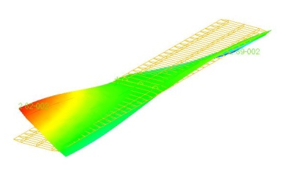
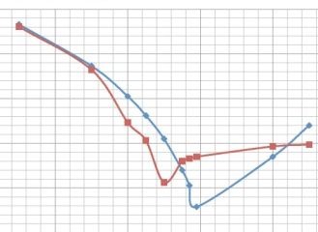
Min weight shape & sizing opti
- Euler Static Aeroelastic Calculations
q_rev
Mach
Ernest Thompson – AFRL/RBSD

Slide 102
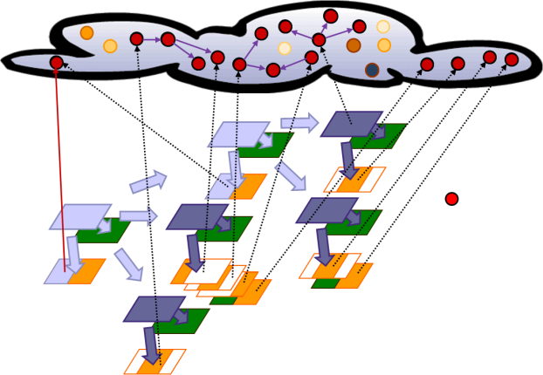











Sorcer network configuration for min weight (shape and sizing)
Coalescence
RBSDZ0010143
Avus
Whittle
NMEDA
Gladius
Client
Avus
Xserv2
Gothmog
Avus
Ernest Thompson – AFRL/RBSD

Slide 103
Concluding Remarks
MSTC is responsible for executing large scale system level MDA/MDO in a heterogenous computing environment
SORCER exposes Sun’s Jini connection Technology to create a service oriented programming and computing environment for large scale MDA/MDO
SORCER Functionality
Create providers and expose them as jini services.
Exertion Oriented Programming – Ability to orchastrate Services
Models for analysis, sensitvitities, and design
VEF – Functional demand driven computations
Space Computing

Slide 104
Appendix A
Configuring SORCER Env and Properties

Slide 105
Configuring SORCER Env and Providers
Properties in SORCER
OS Environment Variables
SORCER Environment Variables
SORCER Environment Properties File: sorcer.env
Ant XML Scripts
Provider Properties
Reading Properties
Scratch Directory
Recommendations

Slide 106
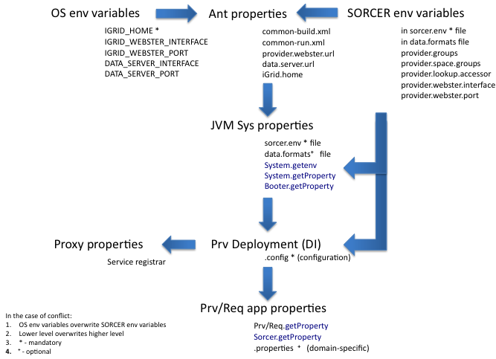
Properties in SORCER

Slide 107
OS Environment Variables
IGRID_HOME (required) the directory of your iGrid project
IGRID_WEBSTER_INTERFACE and IGRID_WEBSTER_PORT (optional) hostname and port of your code server (webster)
DATA_SERVER_INTERFACE and DATA_SERVER_PORT (optional)
You can specify your webster in the sorcer.env file
OS webster specification overrides sorcer.env

Slide 108
Shrinking Programs
One Large
Executable
Shared
Libraries
Shared
Classes
Mobile
Code

Slide 109
Three Neutralities & BT
Mobile
Proxy
Object
Discovery & Lookup
Discovery & Register
Service
Registry
Service
Proxy Object
Service
Provider
Requestor
Exported Classes
Code
Server

Slide 110
SORCER Environment Properties
SORCER environment variables specified in the file sorcer.env
The full set of these variables is given in configs/templates/sorcer-all.env,
In the beginning you can start with default values and set only those listed in configs/templates/sorcer.env
Sorcer.getProperty(String property);

Slide 111
SORCER Environment Properties File sorcer.env
# SORCER environment properties
# The OS environment variable IGRID_HOME must be set
# Groups to register/lookup
provider.groups=sorcer.TEST
provider.space.group=sorcer.TEST
#provider.space.name=JavaSpace
#provider.space.name=Blitz JavaSpace
#provider.worker.transactional=true
#worker.transactiona.lease.time=50000
# Service discovery/lookup
# comma separated URLs
#provider.lookup.locators=jini://localhost
# multicast and unicast discovery
provider.lookup.accessor=sorcer.util.ProviderAccessor
# unicast or mixed discovery
#provider.lookup.accessor=sorcer.util.ProviderLocator
# multicast only
#provider.lookup.accessor=sorcer.util.ProviderLookup
# unicast or mixed discovery with QoS capabilities
#provider.lookup.accessor=sorcer.util.QosProviderAccessor

Slide 112
SORCER Environment Properties File sorcer.env - continuation
# Code server configuration
provider.webster.interface=127.0.0.1
provider.webster.port=8000
# Data/file repository configuration
# Scratch directory format:
# ${data.root.dir}/${provider.data.dir}/${provider.scratch.dir}
# ${data.root.dir}/${requestor.data.dir}/${provider.scratch.dir}
# You can overwrite these properties in your provider properties
data.root.dir=${iGrid.home}/data
provider.data.dir=provider
requestor.data.dir=requestor
provider.scratch.dir=scratch
data.server.interface=${provider.webster.interface}
data.server.port=${provider.webster.port}

Slide 113
Ant XML Scripts
Scripts use:
Local properties and inherited properties from imported common-run.xml and common-build.xml files
OS environment and SORCER environment properties from sorcer.env as JVM system properties
the command line args to the configurations files on provider/requestor startup

Slide 114
In examples/ex2/bin/worker1-prv-run.xml
<project name="Run Worker Provider" default="run.provider" basedir=".">
<!-- system environment variables -->
<property environment="env" />
<import file="${env.IGRID_HOME}/modules/common-run.xml" />
<echo message="IGRID_HOME: ${iGrid.home}" />
<echo message="WEBSTER: ${provider.webster.url}" />
<!-- set property values here -->
<property name="provider.name" value="worker" />
<property name="provider.class" value="sorcer.ex2.provider.WorkerProvider" />
<property name="webster" value="${provider.webster.url}" />
<!-- provider classpath -->
<path id="project.classpath">
<pathelement location="${sorcer.lib}/${provider.name}.jar" />
<pathelement location="${sorcer.lib}/sorcer-prv.jar" />
<pathelement location="${sorcer.lib}/sorcer-lib.jar" />
<pathelement location="${jini.lib}/jsk-lib.jar" />
<pathelement location="${jini.lib}/serviceui.jar" />
<pathelement location="${lib}/rio/rio.jar" />
</path>
<!-- provider codeabse jars -->
<property name="j1" value="${webster}/${provider.name}-dl.jar" />
<property name="j2" value="${webster}/sorcer-prv-dl.jar" />
<property name="j3" value="${webster}/jsk-dl.jar" />
…
</project>

Slide 115
In examples/ex2/bin/worker1-prv-run.xml
…
<target name="run.provider">
<java jar="${jini.lib}/start.jar" fork="yes">
<sysproperty key="java.security.manager" value="" />
<sysproperty key="java.util.logging.config.file"
value="${iGrid.home}/configs/sorcer.logging" />
<sysproperty key="java.security.policy"
value="../policy/${provider.name}-prv.policy" />
<sysproperty key="sorcer.provider.codebase" value="${j1} ${j2} ${j3}" />
<sysproperty key="sorcer.provider.classpath"
value="${toString:project.classpath}" />
<sysproperty key="sorcer.provider.impl" value="${provider.class}" />
<sysproperty key="sorcer.provider.config"
value="../configs/${provider.name}1-prv.config" />
<sysproperty key="sorcer.env.file"
value="${iGrid.home}/configs/sorcer.env" />
<sysproperty key="iGrid.home” value="${iGrid.home}" />
<arg value="${iGrid.home}/configs/startup-prv.config" />
</java>
</target>
</project>

Slide 116
In examples/ex2/configs/worker1-prv.config
/*
* A SORCER Provider Jini configuration for the WhoIsIt Provider example.
*/
import net.jini.jeri.*;
import net.jini.jeri.tcp.*;
import sorcer.core.*;
import net.jini.core.entry.Entry;
import net.jini.lookup.entry.*;
import sorcer.ex1.provider.*;
sorcer.core.provider.ServiceProvider {
name="Worker1";
publishedInterfaces = new Class[] { sorcer.ex2.provider.Worker.class };
description = "SORCER Worker provider";
location = "AFRL/WPAFB";
entries = new Entry[] {
new Comment("Implements Worker interface with three operations"),
new Location("1", "218", "146-AFRL") };
exporter = new BasicJeriExporter(TcpServerEndpoint.getInstance(0), new BasicILFactory());
//application specific properties
properties="../configs/worker-prv.properties";
}

Slide 117
Provider Properties (application specific)
Provider loads application-specific properties defined in its local properties file.
The location and name of application-specific properties file is given by an entry property : properties="../configs/worker-prv.properties"; in your provider's component sorcer.core.provider.ServiceProvider in the corresponding provider’s *.config file.
# Worker Provider properties
//delayed execution time of the Worker.doIt operation
provider.sleep.time=1000

Slide 118
Location of sorcer.env and data.formats
The location of sorcer.env and data.formats files can be specified by the JVM system properties sorcer.env.file and sorcer.formats.file correspondingly
Default loaction is ${iGrid.home}/configs

Slide 119
Reading Properties
System.getenv
System.getProperty
Booter.getProperty
Sorcer.getProperty
myProvider.getConfiguration():Configuration
myProvider.getProperty
myRequestor.getProperty

Slide 120
Scratch Directory
myProvider.getScratchDirectory() : File
myProvider.removeScratchDirectory(File) : boolean
myProvider.getScratchURL(File) : URL
Based on properties: # Data/file repository configuration
# Scratch directory format:
# ${data.root.dir}/${provider.data.dir}/${provider.scratch.dir}
# ${data.root.dir}/${requestor.data.dir}/${provider.scratch.dir}
# You can overwrite these properties in your provider properties
data.root.dir=${iGrid.home}/data
provider.data.dir=provider
requestor.data.dir=requestor
provider.scratch.dir=scratch
data.server.interface=${provider.webster.interface}
data.server.port=${provider.webster.port}

Slide 121
Recommendations
For shared SORCER environment properties use ${iGrid.home}/configs/sorcer.env copied from ${iGrid.home}/configs/templates
Alternatively you can copy sorcer.env to your provider configs directory and indicate it by a JVM system property sorcer.env.file
The above applies to your sorcer.formats as well (sorcer.formats.file)
For your provider configuration use template files in ${iGrid.home}/modules/examples/ex2 for the application worker1 (in bin, configs, policy, and *bulild.xml)
Keep all applications-specific properties in your provider/requestor properties file specified as a system property or passed as the argument to JVM
Your scratch directory can be specified in sorcer.env or customized in your provider properties file with the same scratch directory properties. Local scratch specification takes precedence over sorcer.env specification
Full set of the SORCER environment properties and provider configuration in ${iGrid.home}/configs/sorcer-all.env and ${iGrid.home}/configs/provider-all-prv.config

Slide 122
FiperJob
. . .
Exertion
FiperMethod
FiperContext
FiperMethod
ControlConext

