Slide 1
ANDROID
Basics

Slide 2
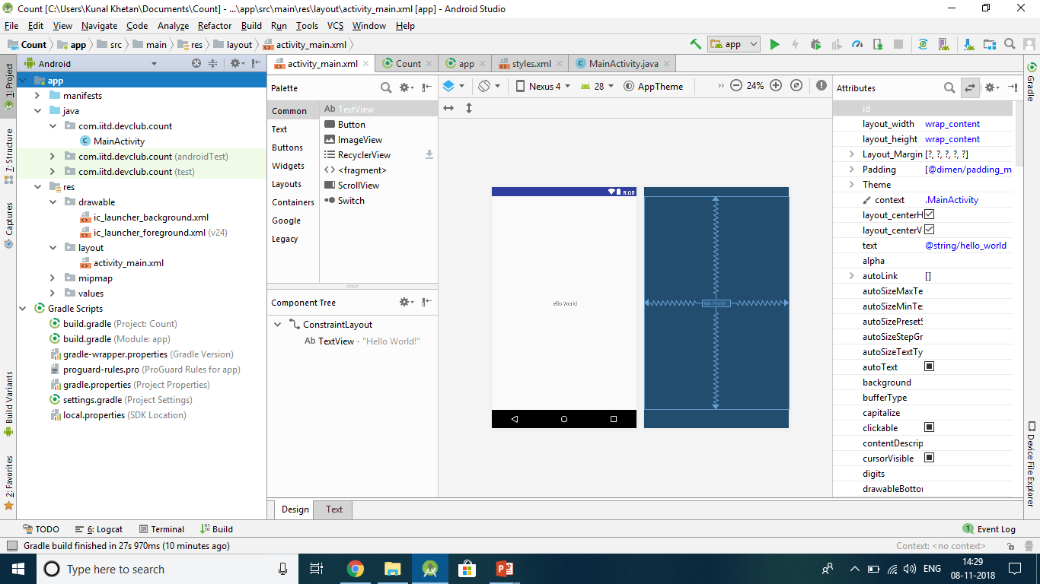
Anatomy of Android Application
Java
This contains the .java source files for your project. By default, it includes an MainActivity.java source file having an activity class that runs when your app is launched using the app icon.
res/drawable-hdpi
This is a directory for drawable objects that are designed for high-density screens.
res/layout
This is a directory for files that define your app's user interface.

Slide 3
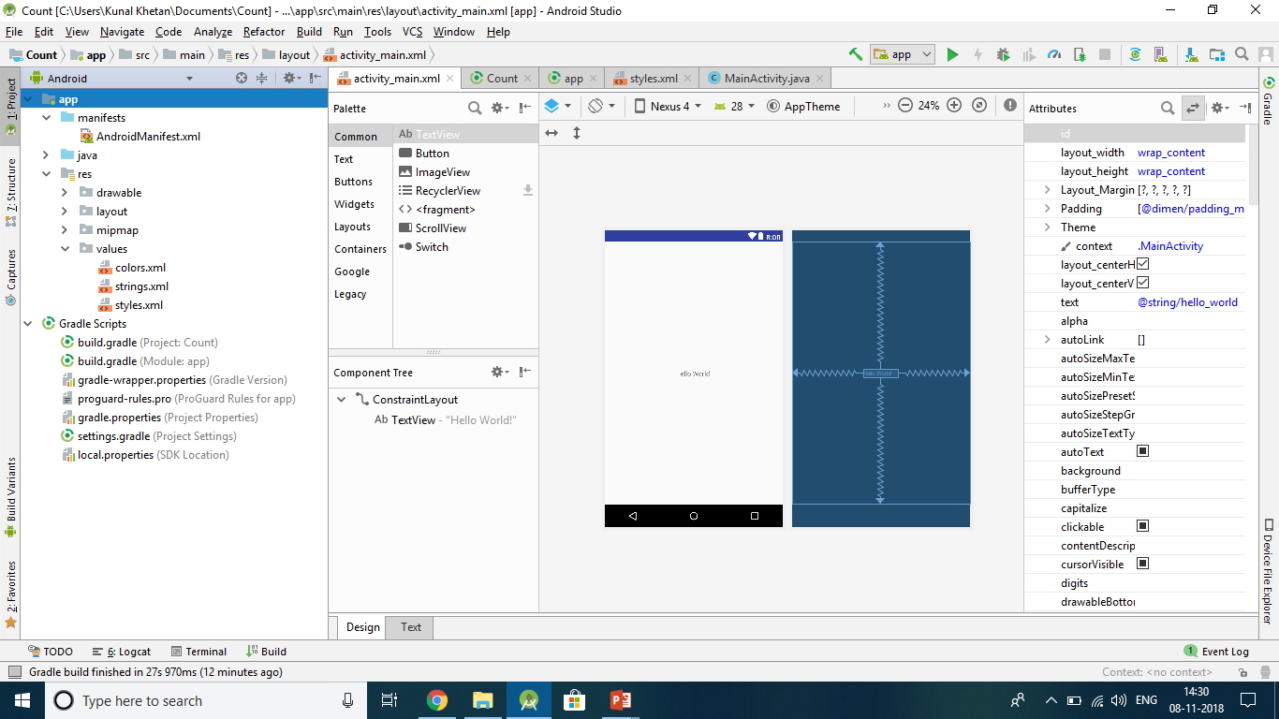
Anatomy of Android Application
res/values
This is a directory for other various XML files that contain a collection of resources, such as strings and colours definitions.
AndroidManifest.xml
This is the manifest file which describes the fundamental characteristics of the app and defines each of its components.
Build.gradle
This is an auto generated file which contains compileSdkVersion, buildToolsVersion, applicationId, minSdkVersion, targetSdkVersion, versionCode and versionName

Slide 4
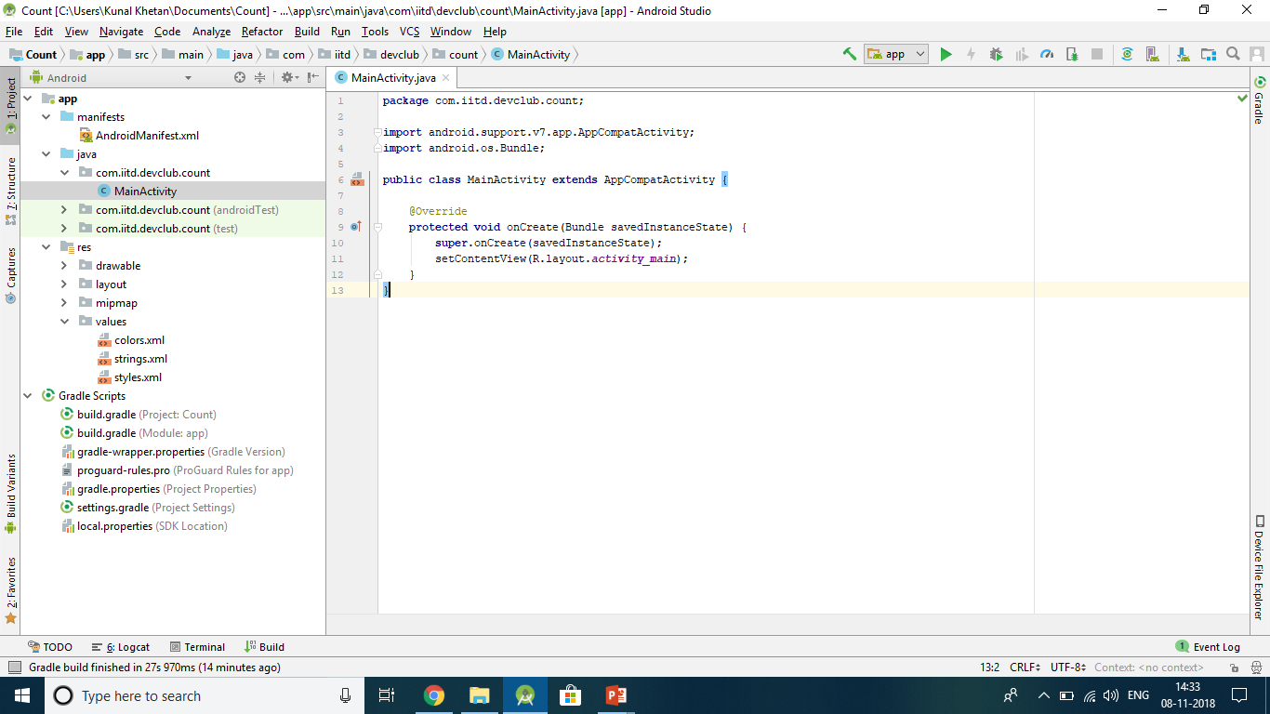
Activity
An activity represents a single screen with a user interface just like window or frame of Java.
If you have worked with C, C++ or Java programming language then you must have seen that your program starts from main() function. Very similar way, Android system initiates its program with in an Activity starting with a call on onCreate() callback method.

Slide 5
Layout
The layout defines the visual structure for your app. Android uses this structure to display the view elements on the screen. The most common are linear, relative and grid layouts but a combination is also possible.
Linear Layout: Textboxes, EditText, Button and all "views" will be displayed linearly i.e. one after the other.
Relative Layout: There is a relation between positions of the UI elements. For example, a button will always be 20dp to the right of an EditText regardless of the screen size.
Grid Layout: The name itself indicates the visual layout of the elements. The elements will be displayed in a grid format.

Slide 6
Basic Views in Android
TextView - A TextView displays text to the user and optionally allows them to edit it. A TextView is a complete text editor, however the basic class is configured to not allow editing.
ImageView - Android ImageView is one of the UI widget that is used to display images in the application.
Button - A Button is a Push-button which can be pressed, or clicked, by the user to perform an action.
EditText - A EditText is an overlay over TextView that configures itself to be editable. It is the predefined subclass of TextView that includes rich editing capabilities.

Slide 7
GUIDE TO MAKE A BASIC COUNTER APP
IN ANDROID STUDIO

Slide 8
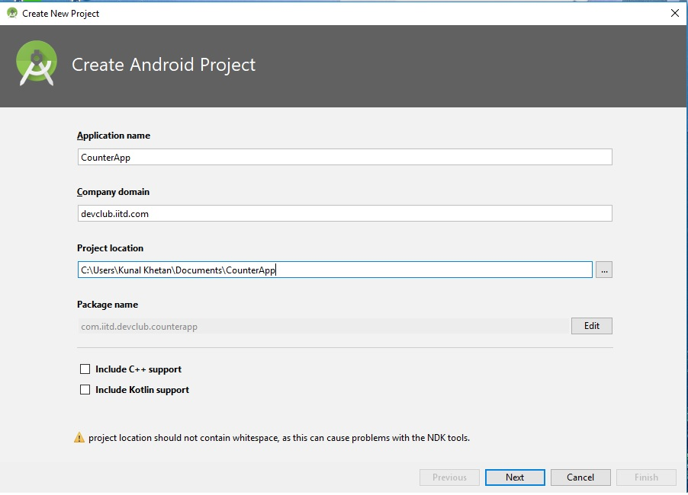
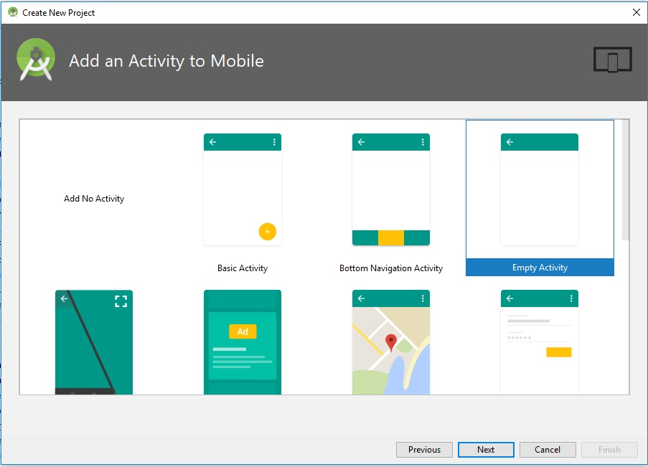
Download and install Android Studio : https://developer.android.com/studio/
Now,
Create a new android project and name it.
Proceed to the next screen and select an empty activity.
Click on next and finish.

Slide 9
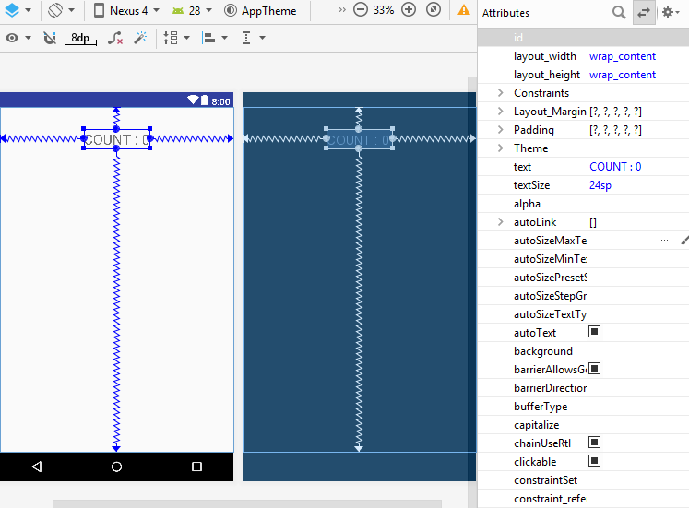
Now, modify the present “Hello, World” textview to make it look something like this. This can be done by dragging and dropping the textview onto the desired position.
To increase the textSize, we use the attributes bar on the right hand side.

Slide 10
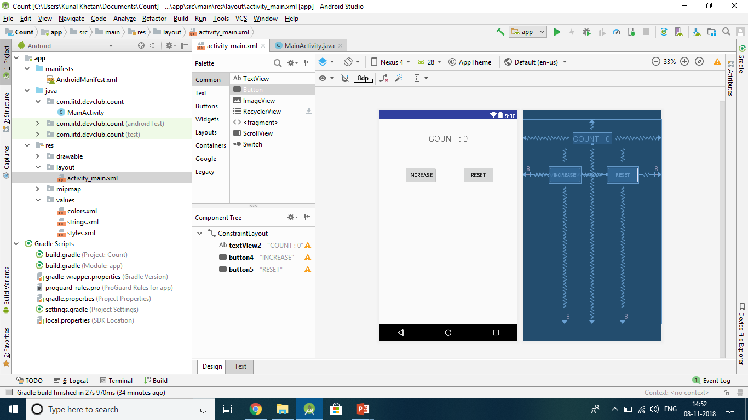
Now, by dragging and dropping, insert two buttons from the left palette.
Position the buttons in the following way. Rename them to indicate what they are meant for.
Constraint them vertically and horizontally.
To understand how ConstraintLayout works, refer –
http://developer.android.com/training/constraint-layout/

Slide 11
By dragging and dropping, insert two buttons from the left palette.
Position the buttons in the following way. Rename them to indicate what they are meant for.
Constraint them vertically and horizontally.
To understand how ConstraintLayout works, refer –
http://developer.android.com/training/constraint-layout/

Slide 12
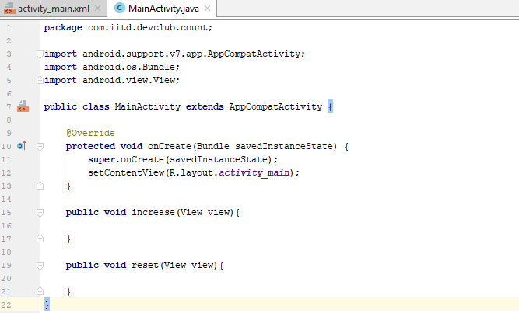
The layout of our app is now ready. We have been doing all this in the design section of the xml file. You may also look at the text version of this file and try to understand the syntax.
Let us now move onto implementing the count app. Set the onClick() method for both the button from the attributes menu on the right. Now open MainActivty.java.
Create methods increase() and reset().
For basic Java programming, refer - https://www.tutorialspoint.com/java/java_basic_syntax.htm

Slide 13
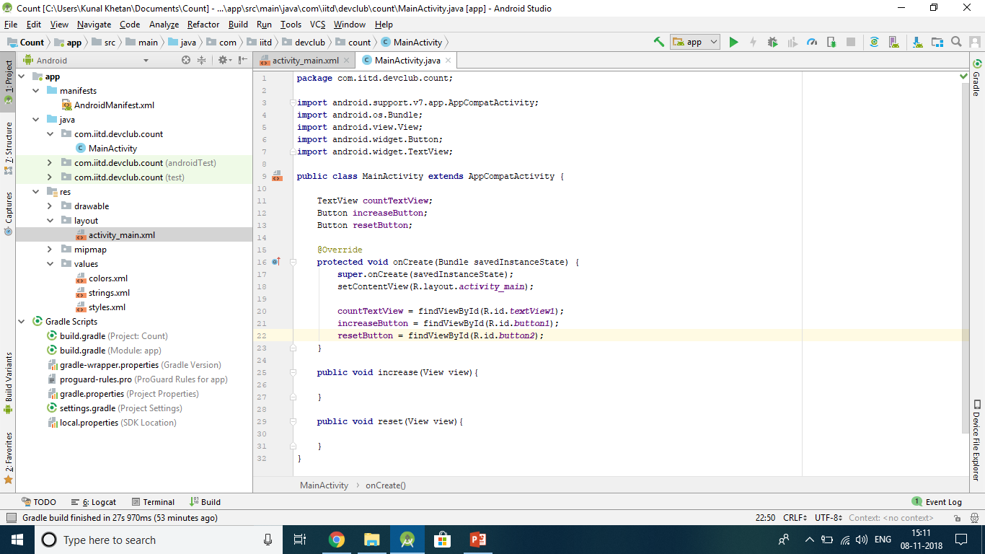
Move over to the layout section and see that there is an ID which is assigned to each view be it a button or a textView. We use these IDs to call these views in our Java file.
This can be done with the help of findViewByID function as shown –

Slide 14
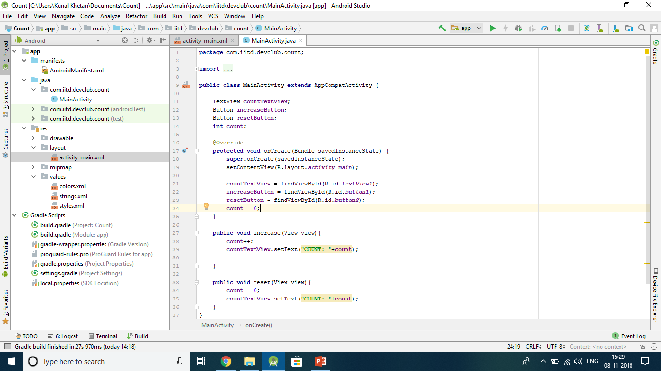
Initialize an integer variable count to 0. Write the increase() and reset() methods as follows -

Slide 15
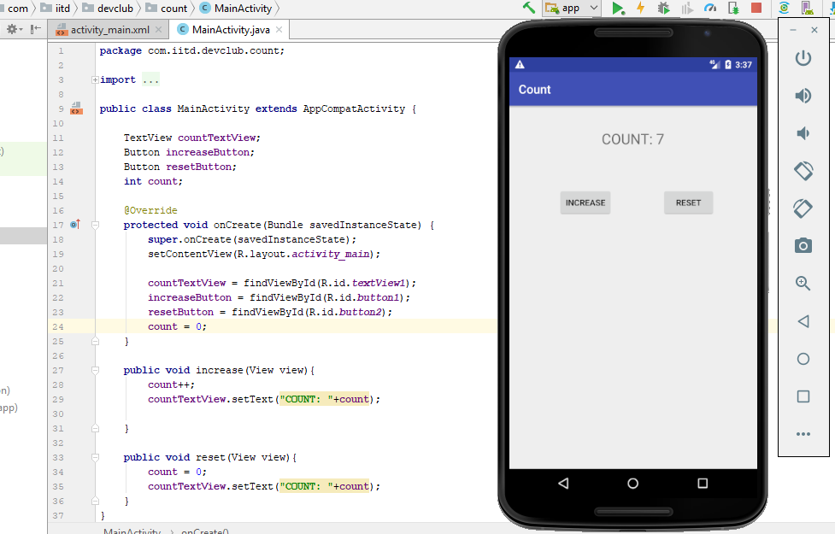
Our basic counter app is now ready. Run it on a virtual device or connect your mobile(Enable USB debugging).

Slide 16
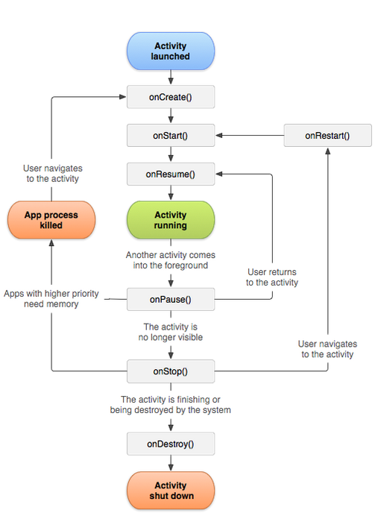
Life Cycle of an Activity
Read at: https://developer.android.com/guide/components/activities/activity-lifecycle
onCreate():
Called when the activity is first created. This is where you should do all of your normal static set up: create views, bind data to lists, etc. This method also provides you with a Bundle containing the activity's previously frozen state, if there was one. Always followed by onStart().
onRestart():
Called after your activity has been stopped, prior to it being started again. Always followed by onStart()
onStart():
Called when the activity is becoming visible to the user. Followed by onResume() if the activity comes to the foreground, or onStop() if it becomes hidden.

Slide 17
Life Cycle of an Activity
onResume():
Called when the activity will start interacting with the user. At this point your activity is at the top of the activity stack, with user input going to it. Always followed by onPause().
onPause ():
Called as part of the activity lifecycle when an activity is going into the background, but has not (yet) been killed. The counterpart to onResume(). When activity B is launched in front of activity A, this callback will be invoked on A. B will not be created until A's onPause() returns, so be sure to not do anything lengthy here.
onStop():
Called when you are no longer visible to the user. You will next receive either onRestart(), onDestroy(), or nothing, depending on later user activity.
Note that this method may never be called, in low memory situations where the system does not have enough memory to keep your activity's process running after its onPause() method is called.
onDestroy():
The final call you receive before your activity is destroyed. This can happen either because the activity is finishing (someone called finish() on it, or because the system is temporarily destroying this instance of the activity to save space. You can distinguish between> these two scenarios with the isFinishing() method.

Slide 18
Life Cycle of an Activity
When the Activity first time loads the events are called as below:
onCreate() onStart() onResume()
When you click on Phone button the Activity goes to the background and the below events are called:
onPause() onStop()
Return to or restart the activity and the below events will be called:
onRestart() onStart() onResume()
When you click the back button OR try to finish() the activity the events are called as below:
onPause() onStop() onDestroy()

Slide 19
What makes android applications different from normal applications made by programming languages ?

Slide 20
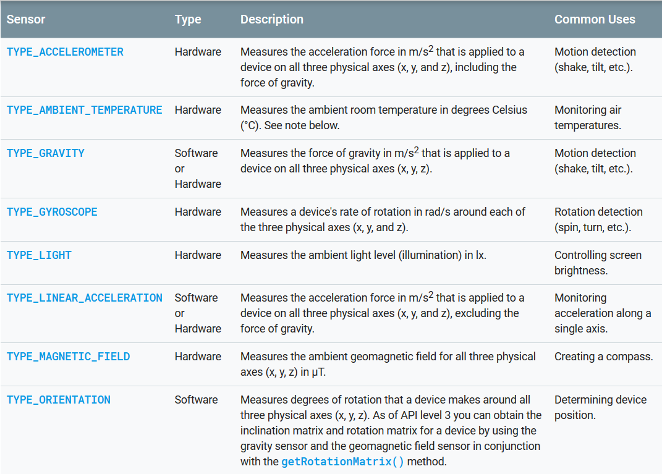
Smartphone Sensors !!

Slide 21
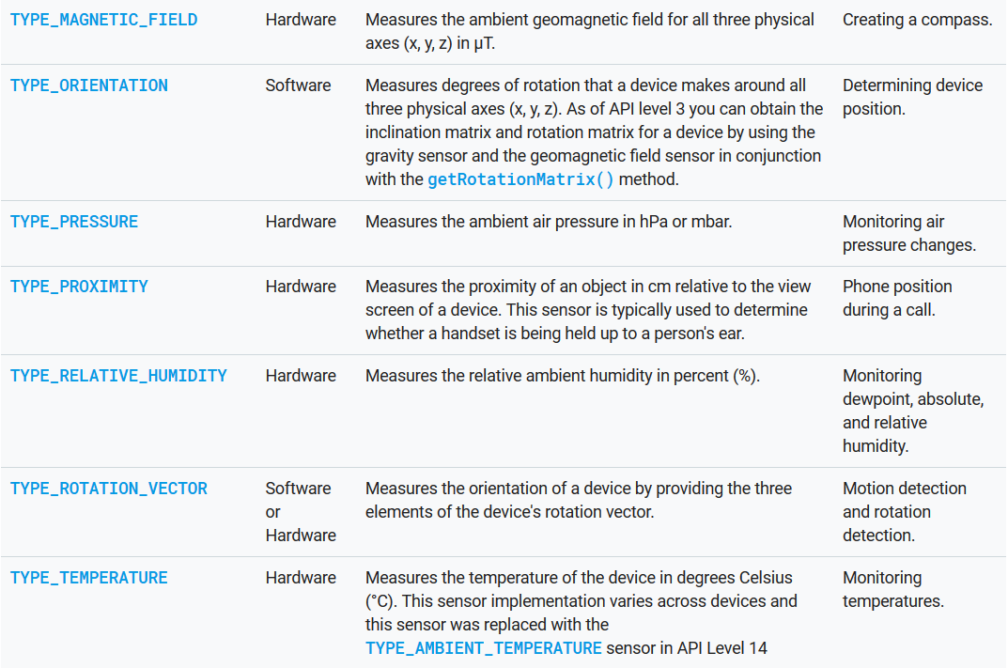

Slide 22
Read about all types of sensors here:
https://developer.android.com/guide/topics/sensors/
Basic Overview (Motion sensors):
https://developer.android.com/guide/topics/sensors/sensors_motion
Basic android accelerometer app example-
https://examples.javacodegeeks.com/android/core/hardware/sensor/android-accelerometer-example/

