Slide 1
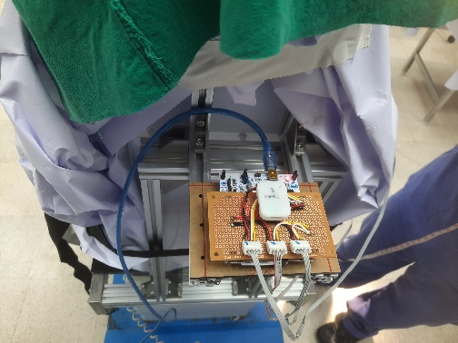
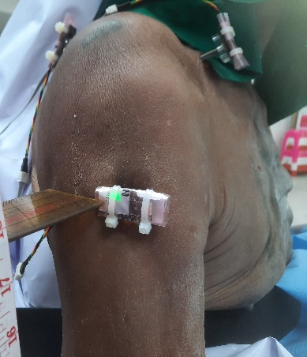
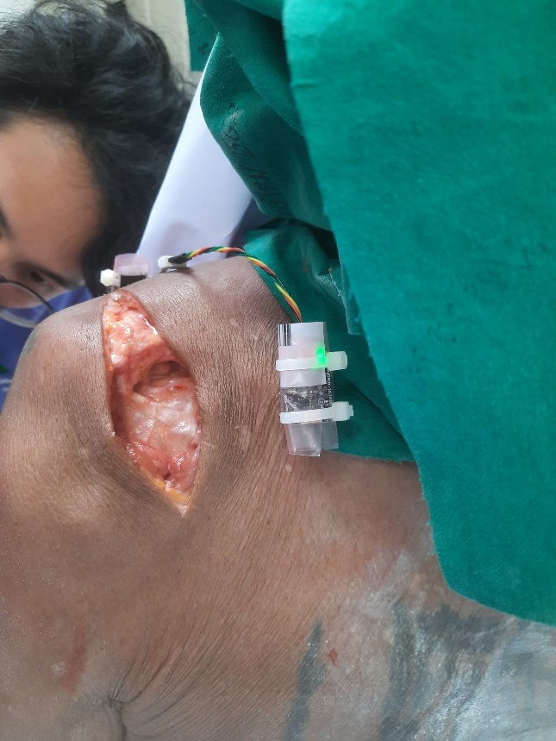
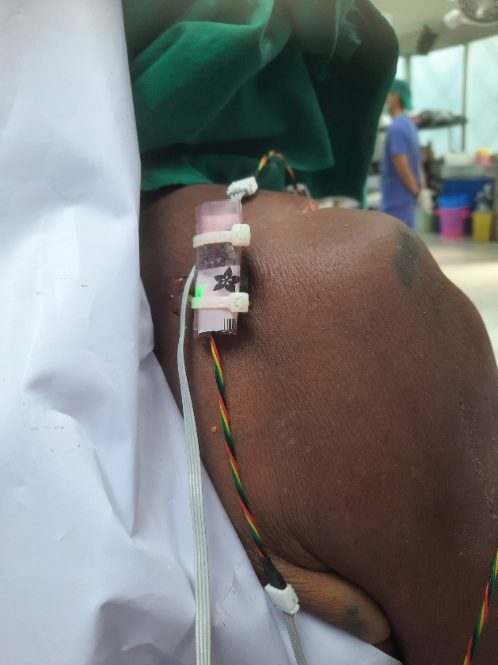
0 : Spin
1 : Clavicle
2 : Humerus
3 : Scapula bone
0 : Spin

Slide 2
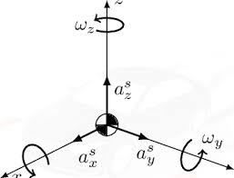
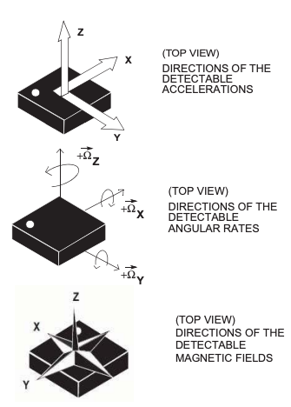
Calibration

Slide 3
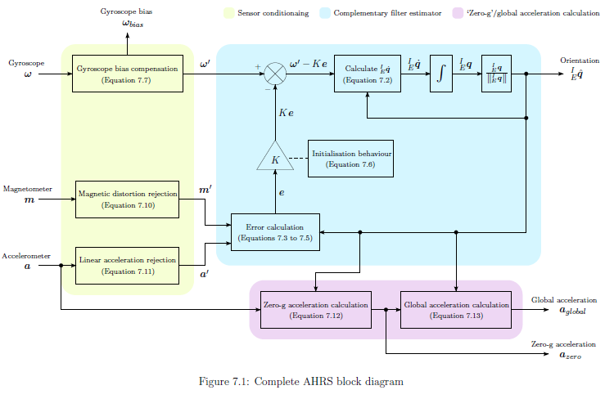

Slide 4
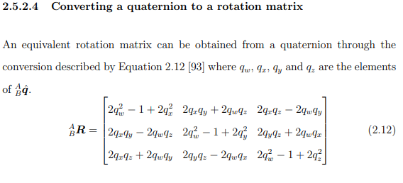

Slide 5
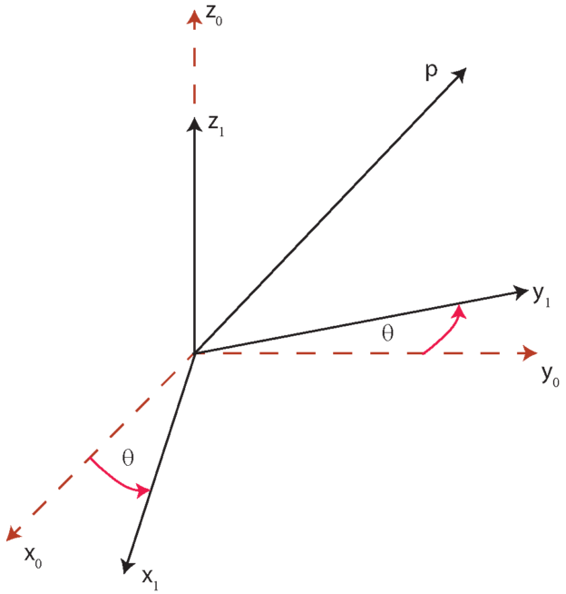


Slide 6
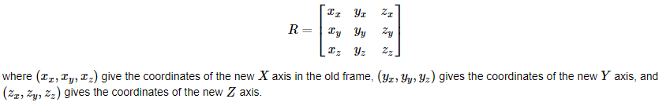
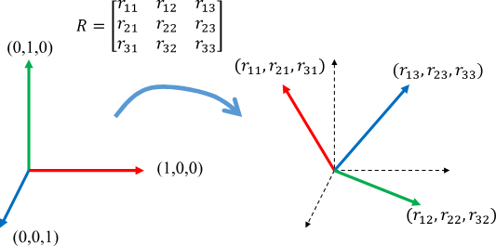
Reference Plane
Sensor Data

Slide 7
0R1 | U1 | V1 | W1
X0 | u.x | v.x | w.x
Y0 | u.y | v.y | w.y
Z0 | u.z | v.z | w.z
quivXhandle = quiver3(ox,oy,oz, ux,vx,wx, 'r');
quivYhandle = quiver3(ox,oy,oz, uy,vy,wy, 'g');
quivZhandle = quiver3(ox,ox,oz, uz,vz,wz, 'b');

Slide 8
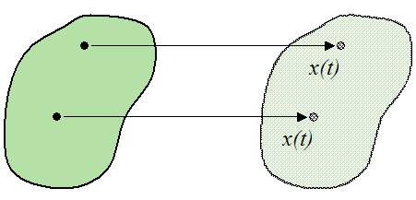




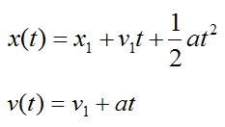
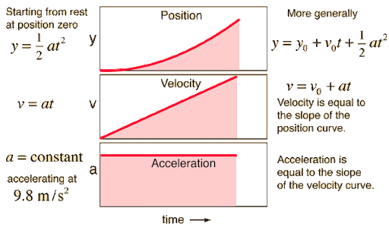
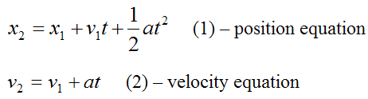
constant acceleration motion

Slide 9
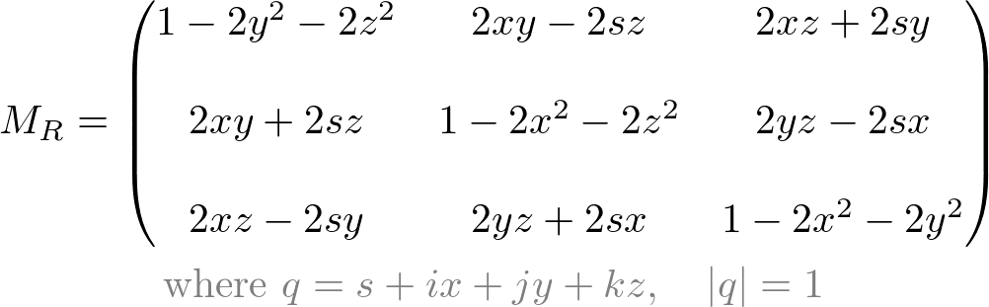
1
2
3
Import Data Gyro + Acceleration
Calculating Orientation Attitude and heading reference in
Quaternion format
Calculating Tilt-compensated {tiltAcc} = [R]*{acc}

Slide 10
3
4
Calculating Tilt-compensated {tiltAcc} = [R]*{acc}
Calculating Linear acceleration in Earth frame (subtracting gravity) {linearAcc} = {tiltAcc} – {0,0,1}

Slide 11
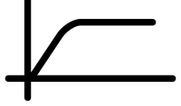
5
Integrating Linear Acceleartion linearVel = ∫{linearAcc} dxdydz
6
Remove drift Linear velocity
Butter worth high pass filter

Slide 12
7
Integrating Linear Velocity linerPos = ∫{linearVel} dxdydz
8
Remove drift Linear Position
Butter worth high pass filter

Slide 14
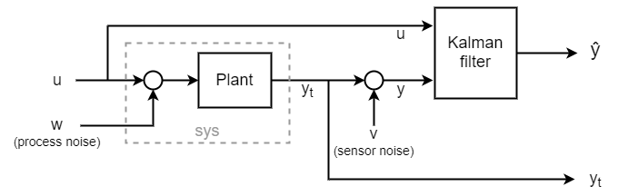

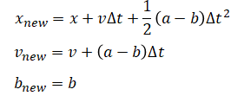
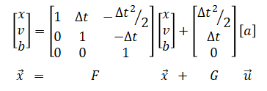
Kalman Filtering

Slide 15
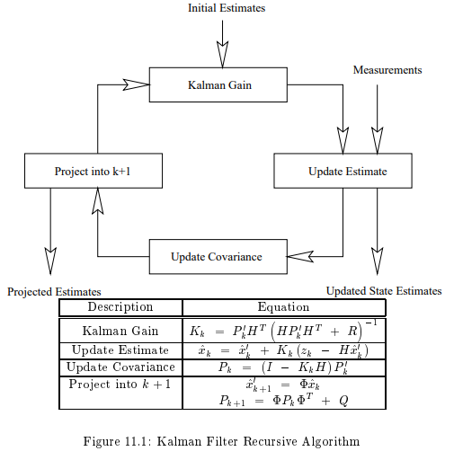
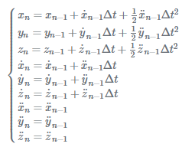
state vector

Slide 16
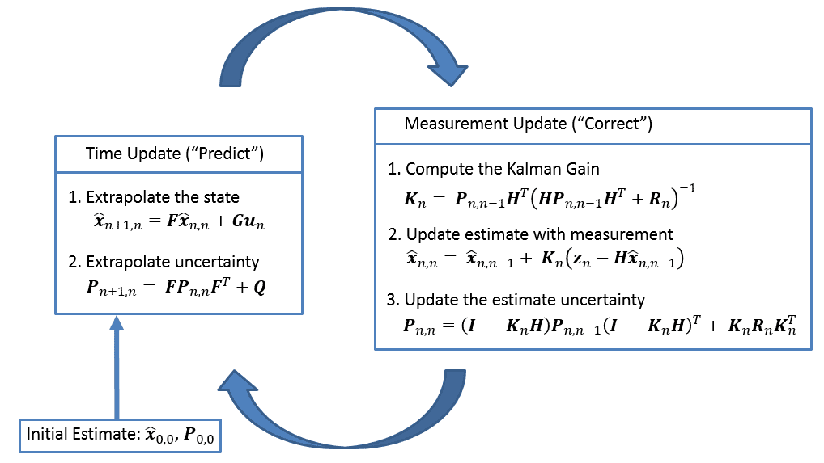
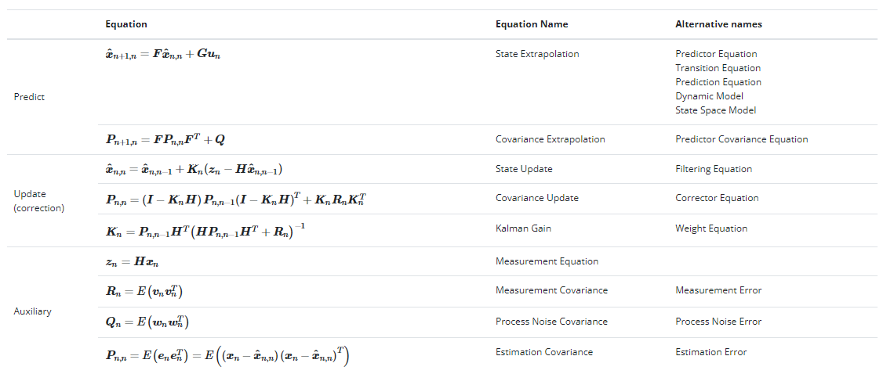

Slide 17
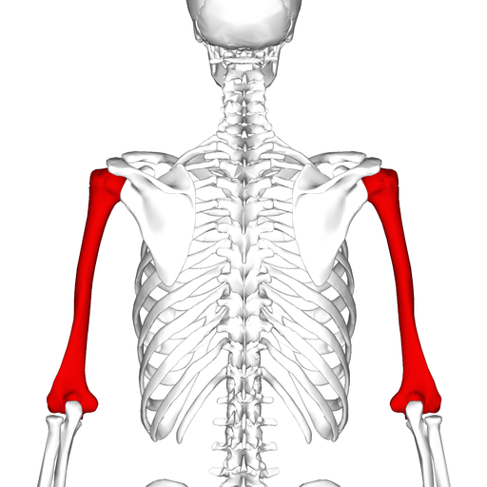

Slide 18
