Slide 1
Insert, select, drop and delete by pl/sql
Database management system
Prepared by:-
Name :- kunjkumar bharatbhai detroja
Roll no. :- 202
Enrollment no. :- 2021002170210016
Batch :- 4-B
Branch :- IT ENGINEERING

Slide 2
Topics used
Pl/sql
Procedure are used for insert, drop, delete, trigger and select

Slide 3
About the project
Insert ,drop, select ,delete and trigger procedure are made in pl/sql
You can also enter the parameters for select queries
If you update and delete data then it will store in another using trigger procedure and get update and delete from main tables

Slide 4
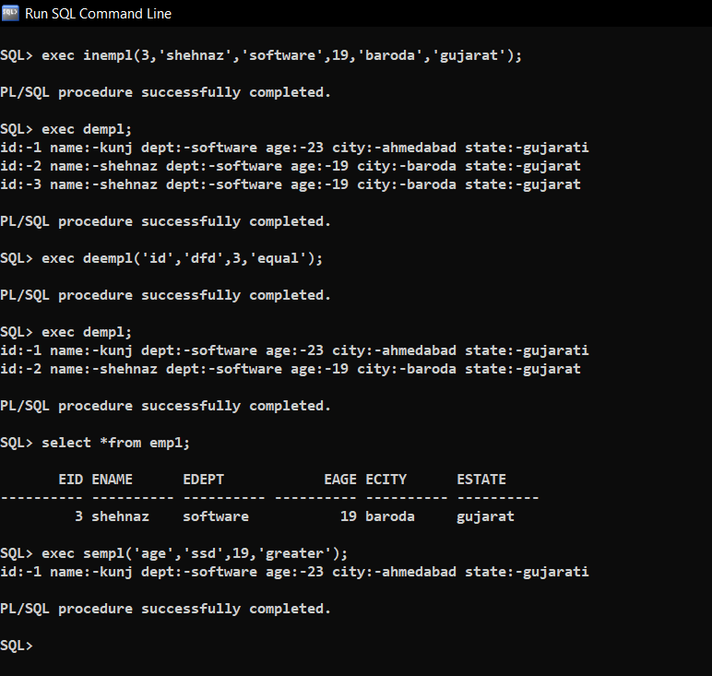
overview

Slide 5
Thank you

