Slide 1
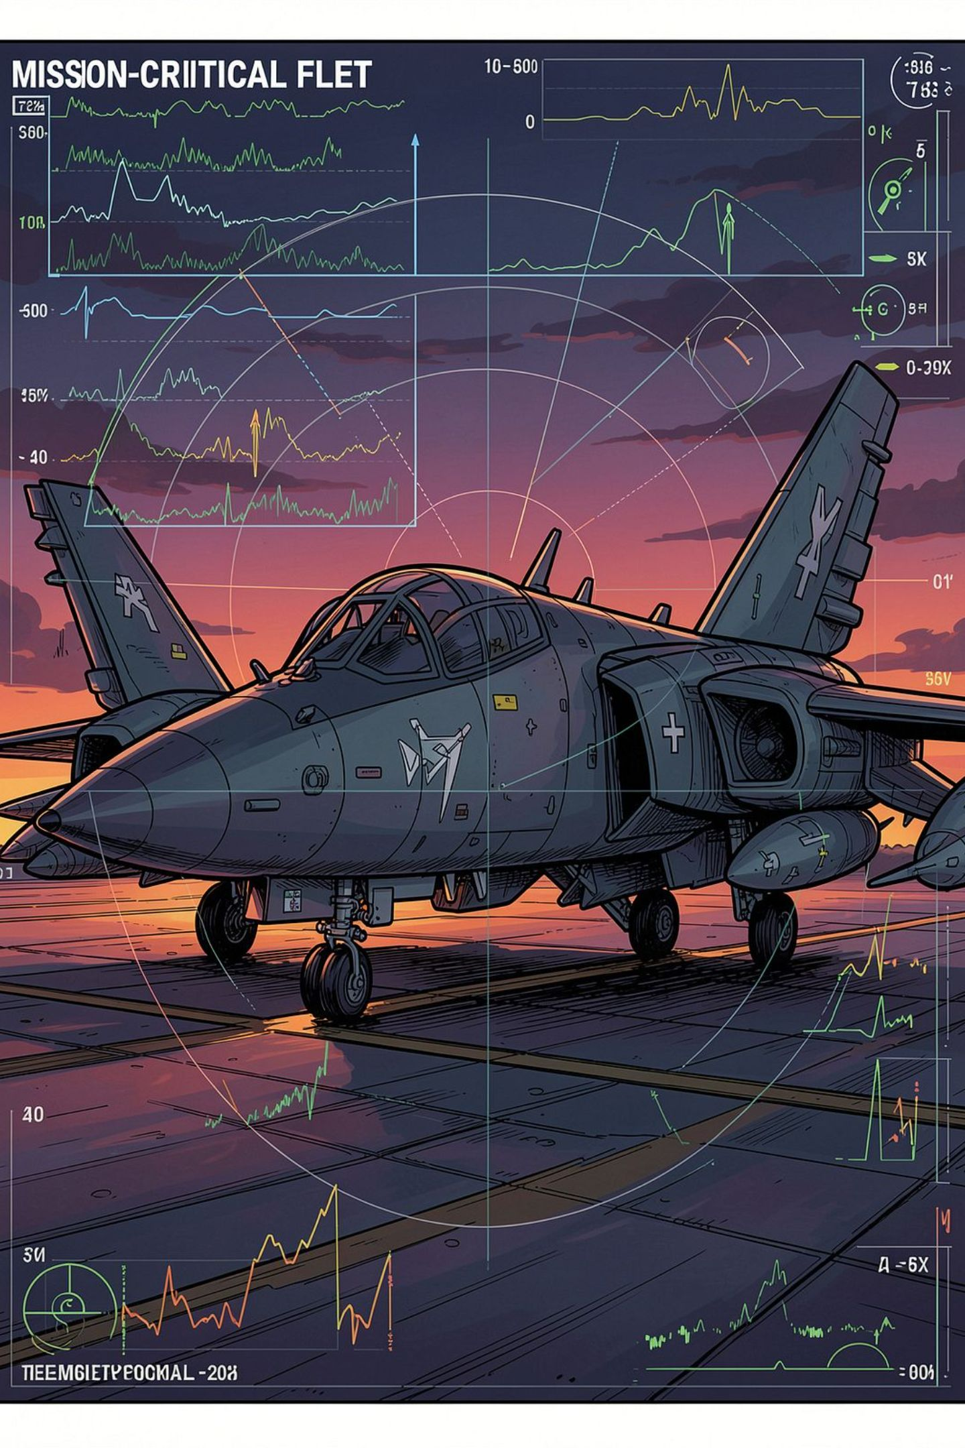
AI-POWERED PREDICTIVE MAINTENANCE
Mission Readiness AI
Predictive Maintenance Copilot for Mission-Critical Assets
From raw telemetry to predictive, explainable maintenance decisions.

Slide 2


THE PROBLEM
Failures Are Detected Too Late
Mission-critical fleets generate vast telemetry — yet maintenance still relies on fixed schedules, periodic inspections, and reactive fault detection. More telemetry doesn't mean better decisions.
Fleet Availability
Engineering Workload
Unexpected failures pull assets offline without warning
Unplanned maintenance spikes team burden and disrupts schedules
Fleet Readiness
Reduced confidence in which assets are truly mission-ready
The real question: Which asset is degrading, how much life remains, and what needs attention first?

Slide 3

OUR SOLUTION
Mission Readiness AI
A layered predictive-maintenance decision-support system that converts raw equipment telemetry into actionable maintenance intelligence.
Telemetry
Feature Eng.
RUL & Anomaly
Readiness
Different models answer different questions — RUL prediction estimates remaining life, anomaly detection flags unusual behavior, and the AI Copilot explains the why behind every recommendation.

Slide 4
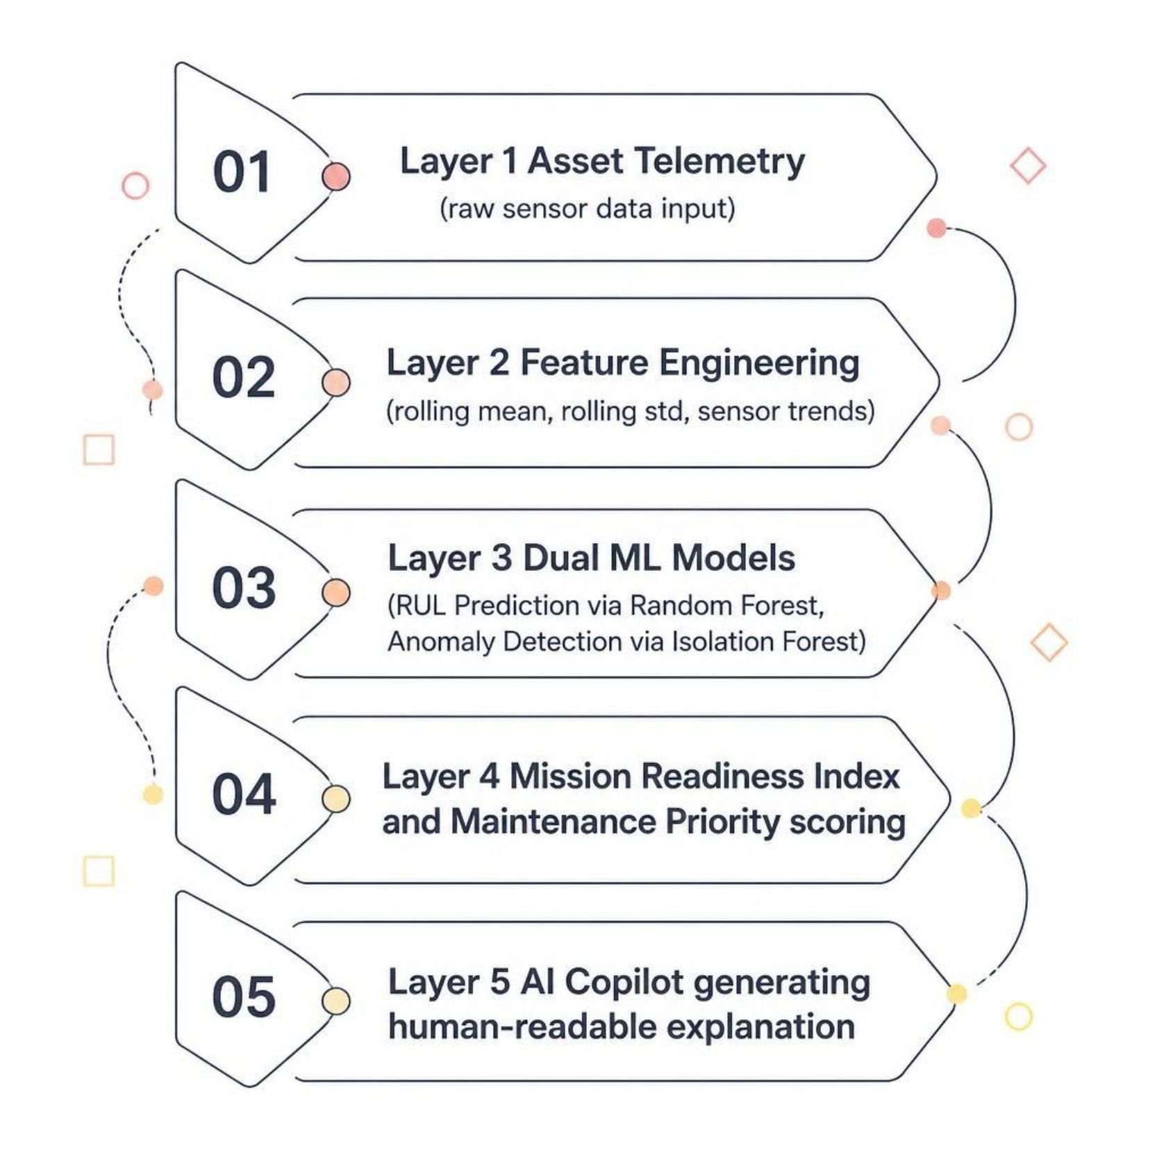
ARCHITECTURE
System Architecture
Feature Engineering
Recent operating behavior is captured using:
10-cycle rolling mean
10-cycle rolling standard deviation
Recent sensor trend / slope
This converts "What are the sensor values?" into "What is the asset's recent condition, variability, and trajectory?"

Slide 5
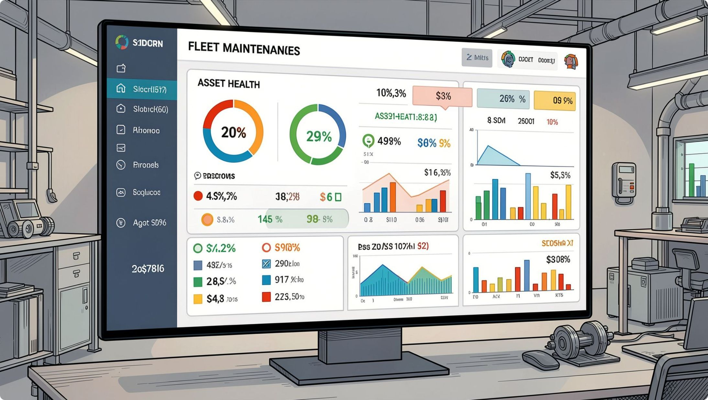

DEMO
Fleet-to-Asset Decision Support
Fleet View
Instantly identify READY, CAUTION, and CRITICAL assets with maintenance-priority ranking across the entire fleet.
Asset 40 — Example
Predicted RUL | 1.38 cycles
RUL Score | 0.92 / 100
Anomaly Severity | 80.17 / 100
Mission Readiness | 8.48 / 100
Maintenance Priority | 91.90 / 100
Status | CRITICAL
Recommendation: Prioritize maintenance inspection and engineering review. AI Copilot explains why using computed ML results and telemetry evidence.

Slide 6
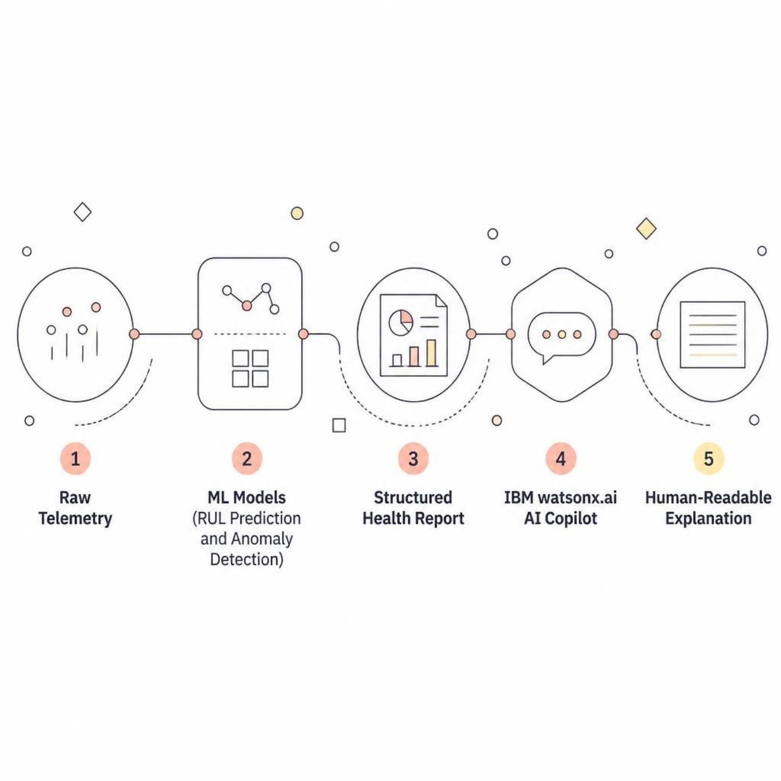
IBM TECHNOLOGY
IBM Technology Integration
How IBM Fits In
IBM watsonx.ai serves as the AI/LLM explanation layer — converting structured ML outputs into human-readable maintenance guidance. The AI Copilot explains the numbers; it does not calculate or override ML results.
watsonx.ai
AI Copilot
AI/LLM layer for generating human-readable explanations
Converts structured ML results into concise, actionable explanations

Slide 7
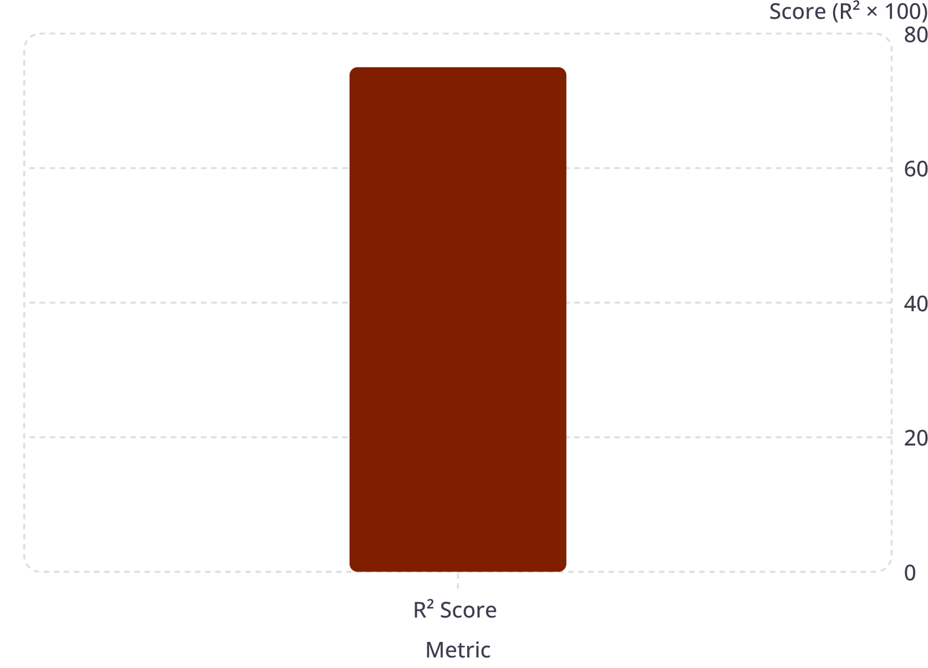

RESULTS
Prototype Results & Impact
RUL Model Performance
From Reactive to Predictive
01
Raw Telemetry
02
Predictive Insight
03
Early Awareness
04
Maintenance Prioritization
05
Engineering Review
Prototype benchmark results — not production-grade or real-world military performance claims.
MAE | 23.96 cycles
RMSE | 32.57 cycles
R² | 0.7538
Validated on 20 unseen engines — engine-level split reduces time-series leakage and tests real generalization.

Slide 8
OUR TEAM
Meet the Team
ML Engineer
Data / ML Engineer
Backend Developer
RUL prediction & model development
Anomaly detection & feature engineering
API & prediction pipeline
Frontend Developer
AI Engineer
Fleet dashboard & visualization
AI Copilot & explanations
Team Mission: Turning equipment telemetry into explainable maintenance intelligence.

