Slide 1


WELCOME DDS!
Attendance LinkTree

Slide 2
Credit Risk Modeling
By Kunj Patel and Aiden Murphy

Slide 3
What is Credit Risk?
Probability of losing a lender hold due to risk of default on a debt.
There are multiple types, which is what make this problem very broad. (Settlement Risk, Concentration Risk, Sovereign Risk, Default Risk etc)
For the coding we will focus on Default Risk

Slide 4
Types of Credit Risk:
Settlement Risk: Possibility that one or more parties will fail to deliver agreements of a contract. Often due to time differences in international transactions.
Concentration Risk: This risk arises when both large and small lenders has all assets in a single industry / location. Diversification is important to fix this issue.
Sovereign Risk: The probability that a foreign nation will fail to meet debt repayments. Influenced by political stability, economic policies etc.
Default Risk: This is the risk that a borrower will fail to repay interest on a loan. Can be assessed with credit scoring

Slide 5
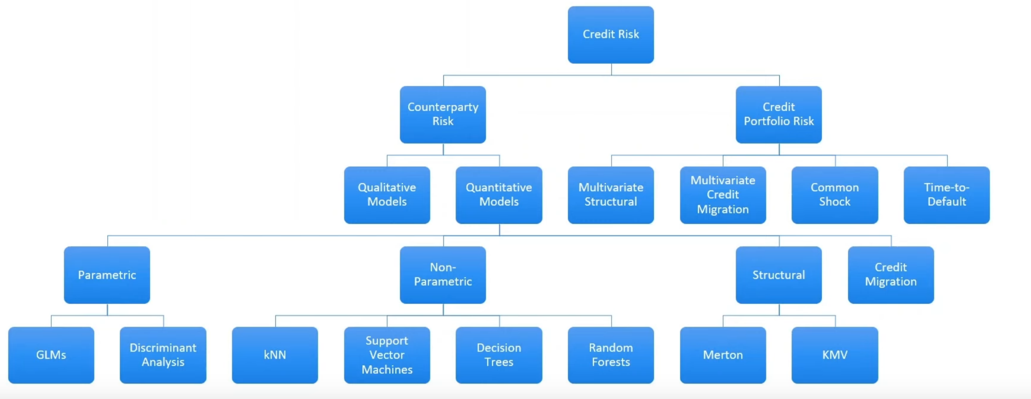
Model Approaches
Source: https://www.youtube.com/watch?v=NSfxb5hM3_g -By Paul Sweeting

Slide 6
Overview of GLMs
GLM (Generalized Linear Models): Used for modeling relations between a response variable and a predictor variable
Though it can be described as a flexible generalization of linear regression

Slide 7
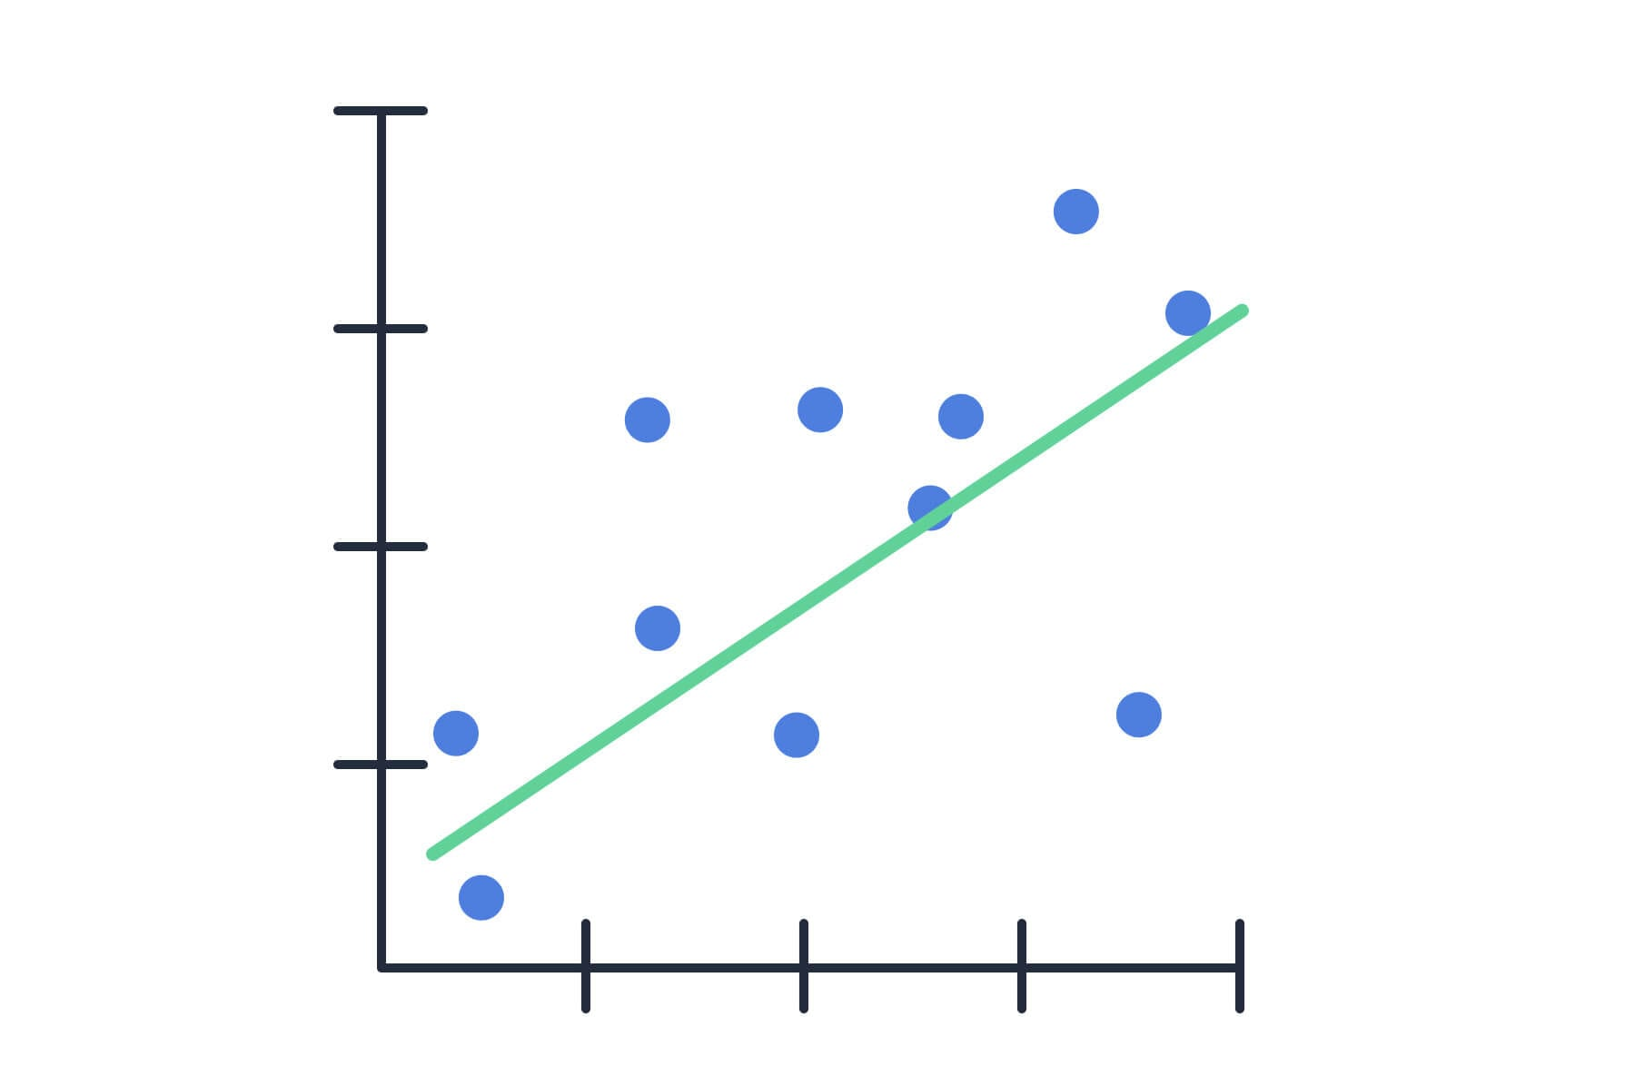
Linear Models
y
Assumptions
- y’s (Observation) are Independent.
- Each Observation comes from some normal distribution.
- The Means are related to predictor variables by a linear model
x

Slide 8
How do we Generalize?
Now GLM’s Change the Assumptions Slightly
Instead of just assuming data is from Normal Distribution, The y’s are coming from another Distribution
Instead of Means being related to predictor variables, Some function of the Mean is related to the predictor variable.

Slide 9
Let’s Code it Out
Data: https://www.kaggle.com/datasets/uciml/default-of-credit-card-clients-dataset/dat
Notebook:
https://colab.research.google.com/drive/1e7kTKiIoKXEoQMYW5LrctSSTYA-LXVa1?usp=sharing

Slide 10
References:
Meerkat Statistics (Link to Video)
Ben Lambert (Link to Video)
Quant Psych (Link to Video)

