Slide 1
Welcome to
Georgian College
COMP2003 – Relational Database !

Slide 2
Week of Sept 13th – 19th 2022 – Class Objectives:
Relational Database Review
Database Design
Creating Tables

Slide 3
Outline
The Need for Databases
Data Models
Relational Databases
Database Design
MYSQL data types
Create Databases
Create Tables

Slide 4
Database Management System (DBMS)
DBMS contains information about a particular enterprise
Collection of interrelated data
Set of programs to access the data
An environment that is both convenient and efficient to use
Database Applications:
Banking: transactions
Airlines: reservations, schedules
Universities: registration, grades
Sales: customers, products, purchases
Online retailers: order tracking, customized recommendations
Manufacturing: production, inventory, orders, supply chain
Human resources: employee records, salaries, tax deductions
Databases can be very large.
Databases touch all aspects of our lives
Notes:
4

Slide 5
Levels of a Database
Physical level: describes how a record (e.g., instructor) is stored.
Logical level: describes data stored in database, and the relationships among the data.
type instructor = record
ID : string; name : string; dept_name : string; salary : integer;
end;
View level: application programs hide details of data types. Views can also hide information (such as an employee’s salary) for security purposes.
Notes:
5

Slide 6
Data Types
What are Data Types
Character Data Types
Number Data Types
Date and Time Data Types
Notes:
6

Slide 7




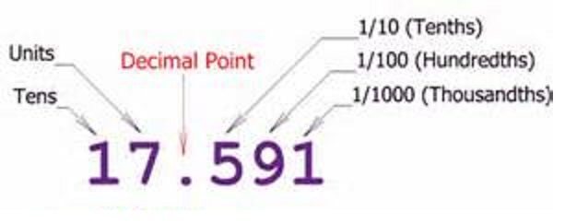
MySQL Server Data Types
MySQL Server associates columns, expressions, variables, and parameters with data types
Data types determine what kind of data can be held:
Integers, characters, dates, money, decimals, etc.

Slide 8
Character Data Types
Data Type | Range | Storage
CHAR(n), NCHAR(n) | 1-8000 characters 1-4000 characters | n bytes 2*n bytes
VARCHAR(n), NVARCHAR(n) | 1-8000 characters 1-4000 characters | n+2 bytes (2*n) +2 bytes
VARCHAR(MAX), NVARCHAR(MAX) | 1-2^31-1 characters | Actual length + 2

Slide 9
Character Data Types
Fixed
Variable
Regular
char
varchar
1 byte per char
Unicode
nchar
nvarchar
2 bytes per char

Slide 10
Integer Data Types
Data type | Range | Storage (bytes)
tinyint | 0 to 255 | 1
smallint | -32,768 to 32,768 | 2
int | 2^31 (-2,147,483,648) to 2^31-1 (2,147,483,647) | 4
Bigint | -2^63 - 2^63-1 (+/- 9 quintillion) | 8
bit | 1, 0 or NULL | 1

Slide 11
Other Numeric Data Types
Data type | Range | Storage (bytes)
decimal/numeric | 10^38 +1 through 10^38 – 1 when maximum precision is used | 5-17
money | -922,337,203,685,477.5808 to 922,337,203,685,477.5807 | 8
smallmoney | - 214,748.3648 to 214,748.3647 | 4
float /real | Approximate data type for floating point numeric data | 4-8

Slide 12
Date and Time Data Types
Data Type | Storage (bytes) | Date Range | Accuracy
DATETIME | 8 | January 1, 1753 to December 31, 9999 | 3-1/3 milliseconds
SMALLDATETIME | 4 | January 1, 1900 to June 6, 2079 | 1 minute
DATETIME2 | 6 to 8 | January 1, 0001 to December 31, 9999 | 100 nanoseconds
DATE | 3 | January 1, 0001 to December 31, 9999 | 1 day
TIME | 3 to 5 |  | 100 nanoseconds
DATETIMEOFFSET | 8 to 10 | January 1, 0001 to December 31, 9999 | 100 nanoseconds

Slide 13
Date and Time Data Types
Older versions of MySQL Server supported only DATETIME and SMALLDATETIME
DATE, TIME, DATETIME2, and DATETIMEOFFSET
MySQL Server doesn't offer an option for entering a date or time value explicitly
Dates and times are entered as character literals and converted explicitly or implicitly
For example, CHAR converted to DATETIME due to precedence

Slide 14
Working with Date and Time Separately
DATETIME, SMALLDATETIME, DATETIME2, and DATETIMEOFFSET include both date and time data
If only date is specified, time set to midnight (all zeroes)
If only time is specified, date set to base date (January 1, 1900)
DECLARE DateOnly DATETIME = '20120212';
SELECT DateOnly;
RESULT
-----------------------
2012-02-12 00:00:00.000

Slide 15
Data Type Precedence
Data type precedence determines which data type will be chosen when expressions of different types are combined
Data type with the lower precedence is implicitly converted to the data type with the higher precedence
Conversion to type of lower precedence must be made explicitly (with CAST or CONVERT function)
CHAR -> VARCHAR -> NCHAR -> NVARCHAR -> BIT -> TINYINT -> SMALLINT -> INT -> BIGINT -> MONEY -> DECIMAL -> TIME -> DATE -> DATETIME2 -> XML

Slide 16
Data Models
A collection of tools for describing
Data
Data relationships
Data semantics
Data constraints
Relational model
Entity-Relationship data model (mainly for database design)
Object-based data models (Object-oriented and Object-relational)
Notes:
16

Slide 17
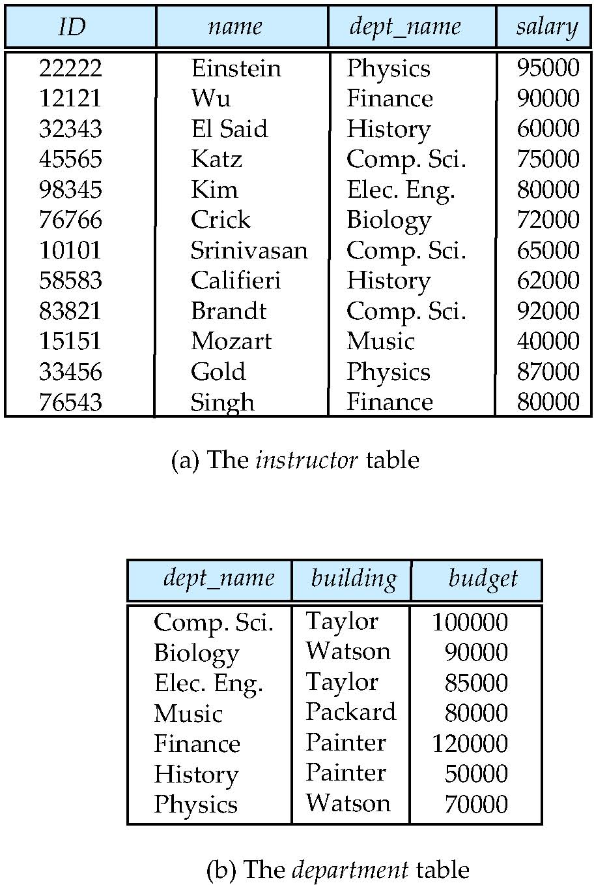
Relational Model
All the data is stored in various tables.
Example of tabular data in the relational model
Columns
Rows
Notes:
17

Slide 18
A Sample Relational Database
Notes:
18

Slide 19
Create Table Construct
An SQL relation is defined using the create table command:
create table r (A₁ D₁, A₂ D₂, ..., A_{n} D_{n}, (integrity-constraint₁), ..., (integrity-constraint_{k}))
r is the name of the relation
each A_{i} is an attribute name in the schema of relation r
D_{i} is the data type of values in the domain of attribute A_{i}
Example:
create table instructor ( ID char(5), name varchar(20), dept_name varchar(20), salary numeric(8,2))

Slide 20
Data Definition Language (DDL)
Specification notation for defining the database schema
Example: create table instructor ( ID char(5), name varchar(20), dept_name varchar(20), salary numeric(8,2))
DDL compiler generates a set of table templates stored in a data dictionary
Data dictionary contains metadata (i.e., data about data)
Database schema
Integrity constraints
Primary key (ID uniquely identifies instructors)
Authorization
Who can access what
Notes:
20

Slide 21
Integrity Constraints in Create Table
not null
primary key (A₁, ..., A_{n} )
foreign key (A_{m}, ..., A_{n} ) references r
Example:
create table instructor ( ID char(5), name varchar(20) not null, dept_name varchar(20), salary numeric(8,2), primary key (ID), foreign key (dept_name) references department);
primary key declaration on an attribute automatically ensures not null

Slide 22
Creating Tables Examples
Notes:
22

