Slide 1
Lesson 11

Slide 2
Class Objectives:
Views

Slide 3
Views
In some cases, it is not desirable for all users to see the entire logical model (that is, all the actual relations stored in the database.)
Consider a person who needs to know a customer’s loan number but has no need to see the loan amount. This person should see a relation described, in SQL, by
(select customer_name, loan_number from borrower, loan where borrower.loan_number = loan.loan_number )

Slide 4
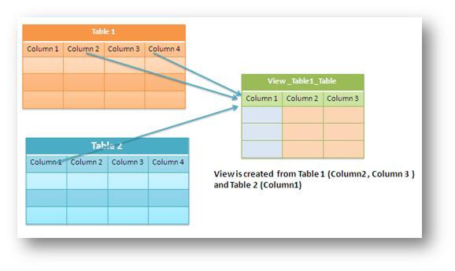
A View is a "Virtual Table". It is not like a simple table, but is a virtual table which contains columns and data from different tables (may be one or more tables)

Slide 5

View Definition
View is Virtual relation that does not necessarily actually exist in the database but is produced upon request, at time of request.

Slide 6
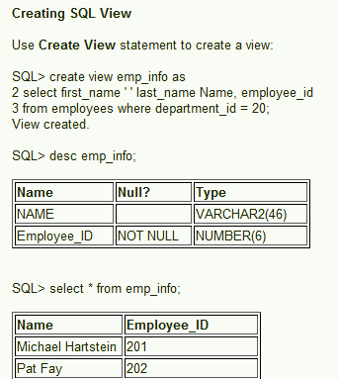

Slide 7
The best view for a particular purpose depends on the information the user needs.
For example, in a telephone directory, a user might want to look up the name associated with a number, without concern for the street address. The best view for this purpose would have two columns: the phone numbers (in numeric sequence) in the first column, and the name associated with each number
in the second column. Another user might want to look up the phone number associated with a street address, without any need to know the name. The best view for this purpose would have two columns: the street addresses (in alphanumeric order) in the first column, and the phone number in the second column.

Slide 8
Advantages of views
Security Each user can be given permission to access the database only through a small set of views that contain the specific data the user is authorized to see
Query Simplicity A view can draw data from several different tables and present it as a single table, turning multi-table queries into single-table queries against the view.
Structural simplicity Views can give a user a "personalized" view of the database structure, presenting the database as a set of virtual tables that make sense for that user.

Slide 9
Consistency A view can present a consistent, unchanged image of the structure of the database, even if the source tables are split, restructured, or renamed.
Data Integrity If data is accessed and entered through a view, the DBMS can automatically check the data to ensure that it meets the specified integrity constraints.

Slide 10
Following is an example to update the age of Ramesh:
1. SQL > UPDATE CUSTOMERS_VIEW
SET AGE = 35
WHERE name='Ramesh';
2. SQL > DELETE FROM CUSTOMERS_VIEW
WHERE age = 22;
3. You need a way to drop the view if it is no longer needed.
DROP VIEW CUSTOMERS_VIEW;

Slide 11
What is Materialized View in database
Materialized views are also logical view of our data driven by select query but the result of the query will get stored in the table or disk, When we see the performance of Materialized view it is better than normal View because the data of materialized view will stored in table and table may be indexed so faster

Slide 12
Whenever a query or an update addresses an ordinary view's virtual table, the DBMS converts these into queries or updates against the base tables.
A materialized view takes a different approach in which the query result is cached as a concrete table that may be updated from the original base tables from time to time. This enables much more efficient access, at the cost of some data being potentially out-of-date

Slide 13
In Views query result is not stored in the disk or database | Materialized view allow to store query result in disk or table.
when we create view using any table, rowid of view is same as original table | in case of Materialized view rowid is different.
Performance of View is less | More
In case of View we always get latest data | Materialized view we need to refresh the view for getting latest data.
No need any methods | In case of Materialized view we need some automatic method so that we can keep MV refreshed,
In case of view its only the logical view of table no separate copy of table | in case of Materialized view we get physically separate copy of table

Slide 14
Need of Materialized View
You can use materialized views to increase the speed of queries on very large databases.
Queries to large databases often involve joins between tables, aggregations such as SUM, or both. These operations are expensive in terms of time and processing power.

Slide 15
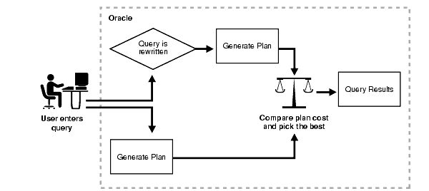
Materialized views improve query performance by PRE-CALCULATING join and aggregation operations on the database prior to execution and storing the results in the database. The query optimizer automatically recognizes when an existing materialized view can and should be used to satisfy a request. It then transparently rewrites the request to use the materialized view. Queries go directly to the materialized view and not to the underlying detail tables.

Slide 16
Types of Materialized Views
1) Read-Only : This type of MVs cannot send data back to the server Master tables. These server only one way communication i.e. from server to the client.
2) Updatable : This type of MVs can send the data, changed locally, back to the server.

Slide 17
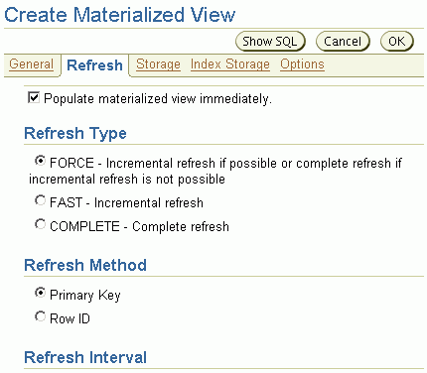
Refreshing Materialized Views
To keep a materialized view up to date, it needs to be refreshed.
There are three different ways to refresh a materialized view:
Complete
Fast
Force
Notes:
Refreshing Materialized Views
Initially, a materialized view contains the same data as in the source table. After the materialized view is created, changes can be made to the source table, and possibly also to the materialized view. To keep a materialized view's data relatively current with the data in the source table, the materialized view must be periodically refreshed. You can choose between complete, fast, and force refresh types.
Complete Refresh
To perform a complete refresh of a materialized view, the materialized view site executes the materialized view’s defining query against the table at the source site. The result set of the query replaces all the existing materialized view data. These are the characteristics for complete refreshes:
Complete refresh can be performed for any materialized view.
Complete refreshes can take substantially more time to perform than fast refreshes.
The base table on the source site does not need any additional structures to be built (such as a materialized view log) to support complete refreshes.
Fast Refresh
To perform a fast refresh, the materialized view site first identifies the changes which have occurred in the source table since the most recent refresh and then applies those changes to the materialized view.

Slide 18
Refresh Methods
1. Complete Refresh
essentially re-creates the materialized view
2. Fast Refresh (incrementally applies data changes )
To perform a fast refresh, first identifies the changes that occurred in the master since the most recent refresh of the materialized view and then applies these changes to the materialized view.
3. FORCE – does a FAST refresh in favor of a COMPLETE
The default refresh option

Slide 19
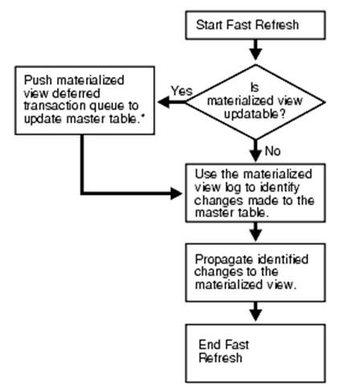
Materialized View Log for Fast Refresh
A materialized view log is required on a master if you want to perform a fast refresh on materialized views based on the master. The log is used to record changes to the master.
The log is designed to record changes to the master since the last refresh, and net changes since the last refresh can be identified.

Slide 20
End of Lesson Examples
Notes:
20

