Slide 1
Lesson 5

Slide 2
Class Objectives:
More SQL
CRUD review
ALTER TABLES
AUTOINCREMENT

Slide 3
Structure Modification

Slide 4
Database Operations (CRUD)
Create data in a table
A new actor has just appeared in a film
Read data from a table
Somebody has searched for an actor
Update data in a table
An actor has appeared in a new movie
Delete data in a table
A planned movie is cancelled

Slide 5
Structured Query Language (SQL)
The language that one uses to interface with a database
Allows a user to perform CRUD operations on a particular database

Slide 6
Create (INSERT)
Insert a row into the actors table containing id=5, name=“Nicole Kidman”, DOB=“06/20/1967” gender=“F”
INSERT INTO actors
VALUES (‘5’, ‘Nicole Kidman’, ‘06/20/1967’, ‘F’);
Note that the order of values depends on the way the table was created

Slide 7
Read (SELECT)
Get all rows and only the id column from the “actors” table
SELECT id
FROM actors;
Get all rows and columns from the “actors” table
SELECT *
FROM actors;
Get all rows and columns from the “actors” table whose name field is “Tom Cruise.”
SELECT *
FROM actors
WHERE name = ‘Tom Cruise’;
Get all rows and columns from the “actors” table whose name field is either “Tom Cruise” or “Katie Holmes.”
SELECT *
FROM actors
WHERE name = ‘Tom Cruise’
OR name = ‘Katie Holmes’;

Slide 8
Update (UPDATE)
Change Tom Cruise’s gender
UPDATE actors
SET gender = ‘F’
WHERE name = ‘Tom Cruise’;
Change Tom Cruise’s gender if he is a man
UPDATE actors
SET gender = ‘F’
WHERE name = ‘Tom Cruise’
AND gender = ‘M’;

Slide 9
Delete (DELETE)
Delete Tom Cruise from the table
DELETE FROM actors
WHERE name = ‘Tom Cruise’;

Slide 10
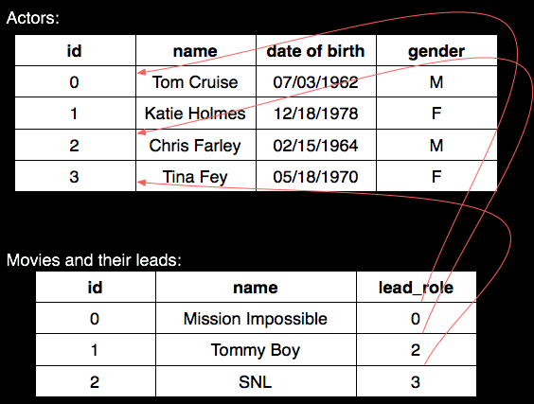
Relationships
Actor IDs are “Primary Keys” in the actor table
Actor IDs are “Foreign Keys” in the movie table

Slide 11
ACID
Atomicity
All or none
Consistency
Always in a legal state
Isolation
Each user is isolated from each other user
Durability
Can recover after a crash or power failure

Slide 12
Changing Tables
Sometimes you want to change the structure of an existing table
One way is to DROP it then rebuild it
This is dangerous, so there is the ALTER TABLE command instead
ALTER TABLE can
Add a new column
Remove an existing column
Add a new constraint
Remove an existing constraint

Slide 13
ALTERing Columns
Examples
ALTER TABLE Student
ADD COLUMN
Degree VARCHAR(50)
ALTER TABLE Student
DROP COLUMN Degree
To add or remove columns use
ALTER TABLE <table>
ADD COLUMN <col>
ALTER TABLE <table>
DROP COLUMN <name>

Slide 14
ALTERing Constraints
Examples
ALTER TABLE Module
ADD CONSTRAINT
ck UNIQUE (title)
ALTER TABLE Module
DROP CONSTRAINT ck
To add or remove columns use
ALTER TABLE <table>
ADD CONSTRAINT
<definition>
ALTER TABLE <table>
DROP CONSTRAINT
<name>

Slide 15
End of Lesson 5 Examples
Notes:
15

