Slide 1
ADVANCED BUSINESS ANALYTICS
MULTI-OBJECTIVE pROGRAMMING
NAZLI TURKEN

Slide 2


AGENDA
Soft Constraints and Goal Programming
Sum of Deviations
Weighted Sum of Deviations
Weighted Sum of Percentage Deviations
Multi-objective Optimization
Weighted Sum Method
Minimax Method
$ε$ Constraint Method
Data Envelopment Analysis

Slide 3
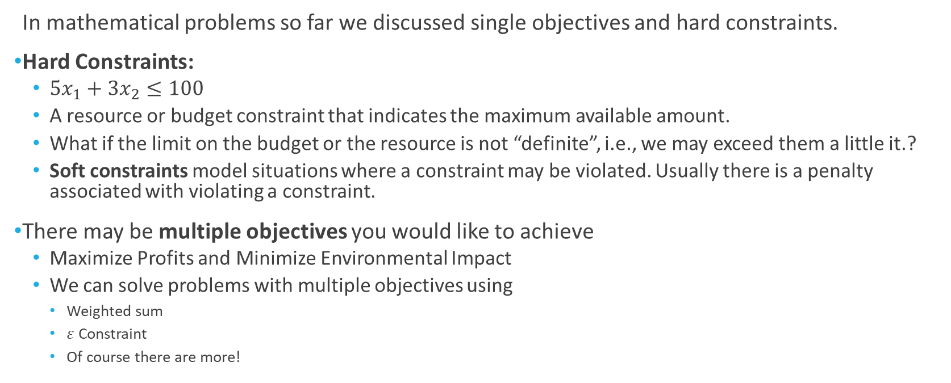
Multi-objective Optimization
In mathematical problems so far we discussed single objectives and hard constraints.
Hard Constraints:
${5x}_{1}+3x_{2}≤100$
A resource or budget constraint that indicates the maximum available amount.
What if the limit on the budget or the resource is not “definite”, i.e., we may exceed them a little it.?
Soft constraints model situations where a constraint may be violated. Usually there is a penalty associated with violating a constraint.
There may be multiple objectives you would like to achieve
Maximize Profits and Minimize Environmental Impact
We can solve problems with multiple objectives using
Weighted sum
$ε$ Constraint
Of course there are more!

Slide 4
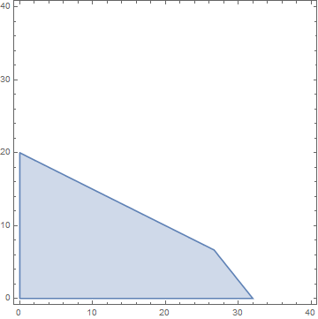
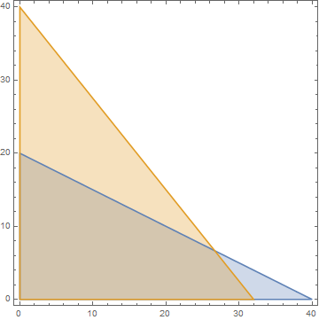

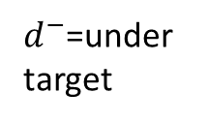
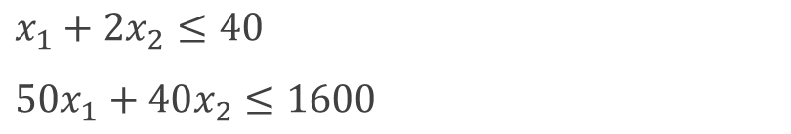

Goal Programming
Goal programming uses soft (or goal) constraints to approximately satisfy a number of goals.
$x_{1}+2x_{2}≤40$
${50x}_{1}+40x_{2}≤1600$
$x_{1}+2x_{2}≤40$
${50x}_{1}+40x_{2}+d^{−}−d^{+}=1600$
The intersection of the blue and pink regions are acceptable.
$d^{−}$=under target
$d^{+}$=over target
Feasible Region
Feasible Region

Slide 5
1. Goal Programming Susan Lovett Faux Plant Producer
Susan Lovett, a producer of faux home plants, has six suppliers from which she purchases raw materials. For the upcoming quarter, she is planning her supplier selection. She would like the demand of 50,000 faux plants to be approximately satisfied with a total cost of $250,000. However, she would also like the number of defects and the number of late deliveries to be approximately 0. Given the information on the next slide about the 6 suppliers, how much raw materials (in number of units) should Susan Lovett order from each supplier?

Slide 6
1. Goal Programming Susan Lovett Faux Plant Producer
Supplier | Price ($/unit) | Late Delivery Rate (%) | Defect Rate (%)
S1 | 3 | 0.25 | 0.40
S2 | 3.5 | 0.30 | 0.35
S3 | 4 | 0.15 | 0.30
S4 | 4.5 | 0.20 | 0.25
S5 | 5 | 0.40 | 0.20
S6 | 6 | 0.05 | 0.05

Slide 7
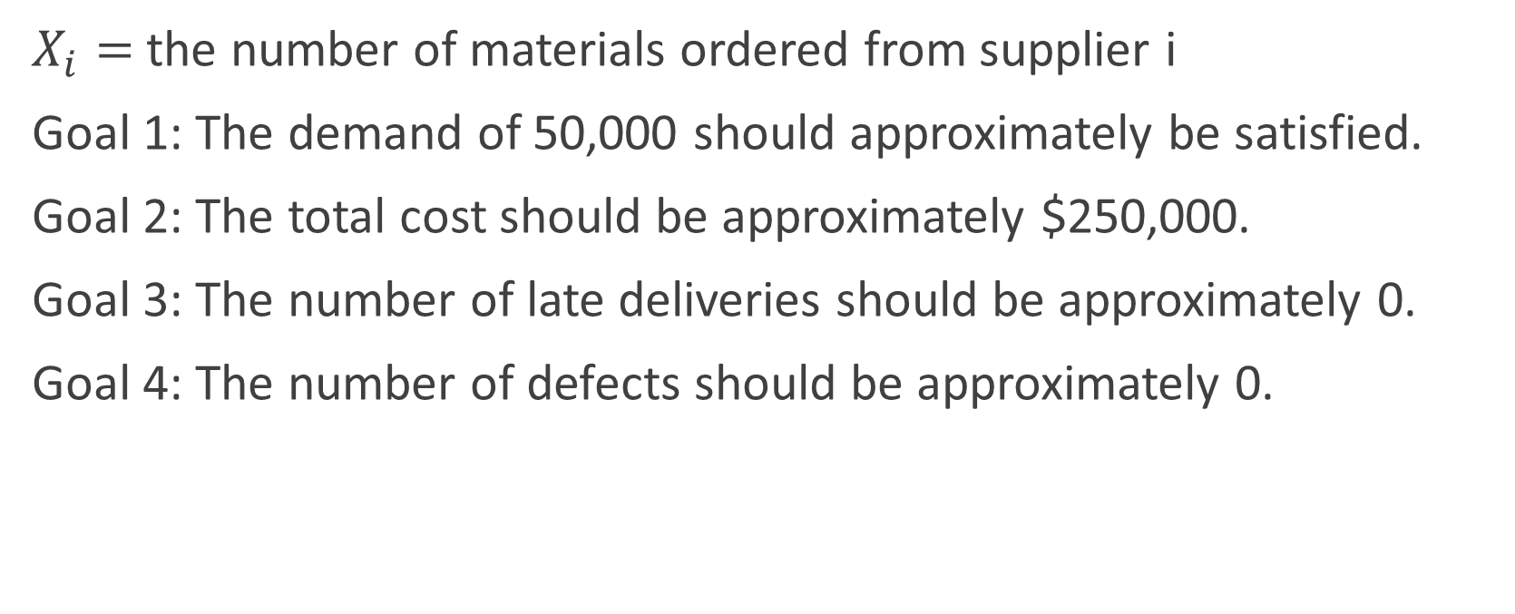
1. Goal Programming Susan Lovett Faux Plant Producer
$X_{i}=$ the number of materials ordered from supplier i
Goal 1: The demand of 50,000 should approximately be satisfied.
Goal 2: The total cost should be approximately $250,000.
Goal 3: The number of late deliveries should be approximately 0.
Goal 4: The number of defects should be approximately 0.

Slide 8
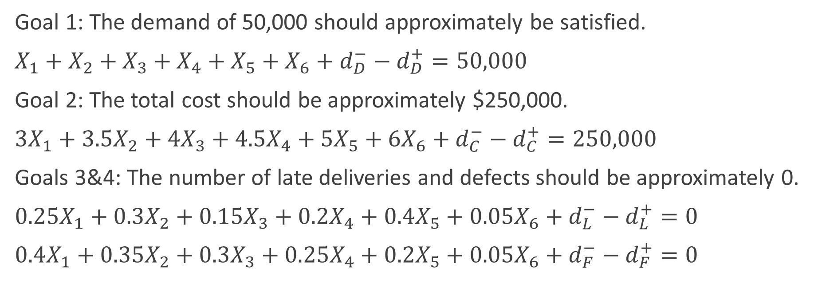
1. Goal Programming Susan Lovett Faux Plant Producer
Goal 1: The demand of 50,000 should approximately be satisfied.
$X_{1}+X_{2}+X_{3}+X_{4}+X_{5}+X_{6}+d_{D}^{−}−d_{D}^{+}=50,000$
Goal 2: The total cost should be approximately $250,000.
${3X}_{1}+{3.5X}_{2}+{4X}_{3}+{4.5X}_{4}+{5X}_{5}+{6X}_{6}+d_{C}^{−}−d_{C}^{+}=250,000$
Goals 3&4: The number of late deliveries and defects should be approximately 0.
${0.25X}_{1}+{0.3X}_{2}+{0.15X}_{3}+{0.2X}_{4}+{0.4X}_{5}+{0.05X}_{6}+d_{L}^{−}−d_{L}^{+}=0$
${0.4X}_{1}+{0.35X}_{2}+{0.3X}_{3}+{0.25X}_{4}+{0.2X}_{5}+{0.05X}_{6}+d_{F}^{−}−d_{F}^{+}=0$

Slide 9
1.Goal Programming
Types of objectives:
Sum of deviations
Shortcomings: $1 deviation from $250,000 or 1 unit deviation from 0 late deliveries are worth the same
Weighted sum of deviations
Shortcomings: The decision maker should know appropriate values for the weights
Weighted sum of % deviations
Shortcomings: Does not work well when the target is 0.

Slide 10
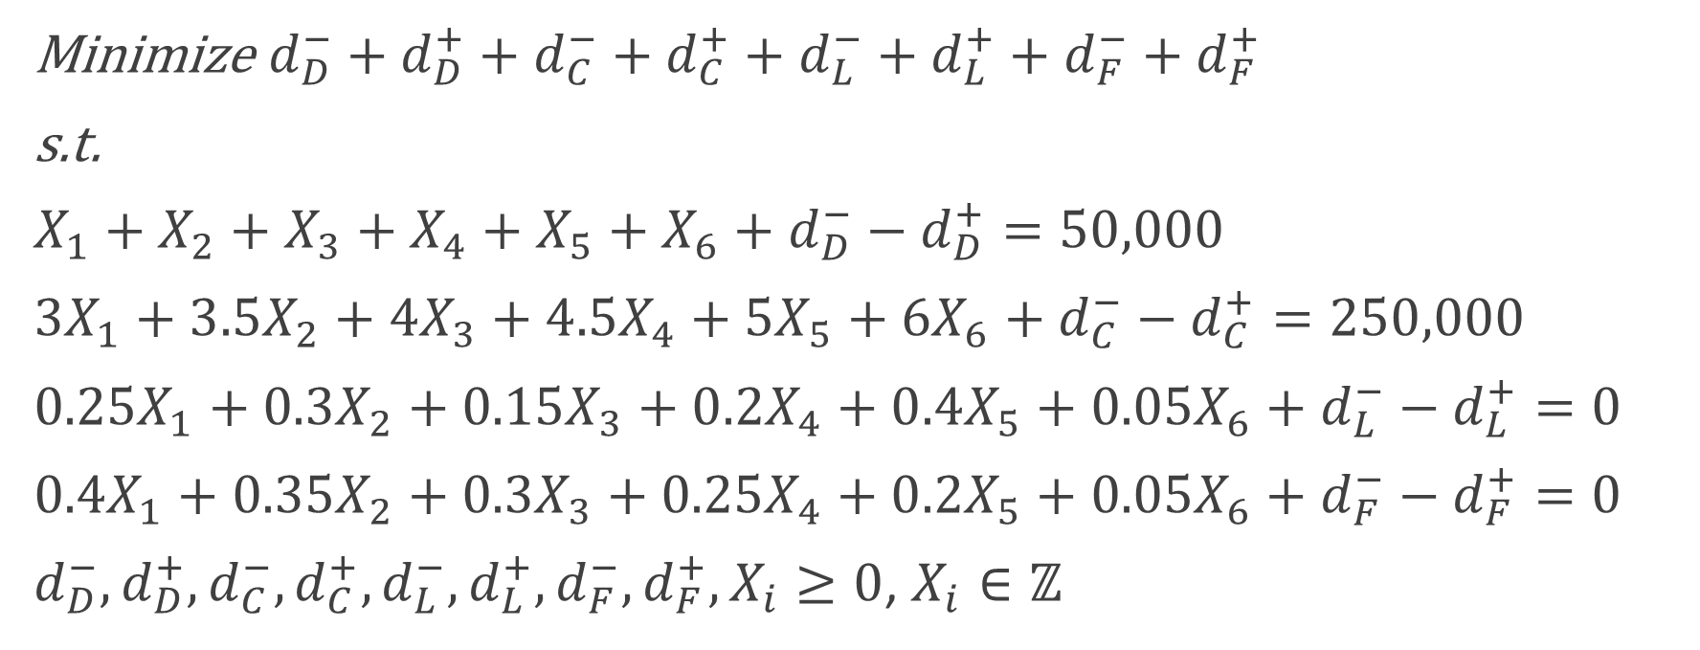
1. Goal Programming Susan Lovett Faux Plant Producer Sum of Deviations
Minimize $d_{D}^{−}+d_{D}^{+}+d_{C}^{−}+d_{C}^{+}+d_{L}^{−}+d_{L}^{+}+d_{F}^{−}+d_{F}^{+}$
s.t.
$X_{1}+X_{2}+X_{3}+X_{4}+X_{5}+X_{6}+d_{D}^{−}−d_{D}^{+}=50,000$
${3X}_{1}+{3.5X}_{2}+{4X}_{3}+{4.5X}_{4}+{5X}_{5}+{6X}_{6}+d_{C}^{−}−d_{C}^{+}=250,000$
${0.25X}_{1}+{0.3X}_{2}+{0.15X}_{3}+{0.2X}_{4}+{0.4X}_{5}+{0.05X}_{6}+d_{L}^{−}−d_{L}^{+}=0$
${0.4X}_{1}+{0.35X}_{2}+{0.3X}_{3}+{0.25X}_{4}+{0.2X}_{5}+{0.05X}_{6}+d_{F}^{−}−d_{F}^{+}=0$
$d_{D}^{−}, d_{D}^{+},d_{C}^{−}, d_{C}^{+}, d_{L}^{−},d_{L}^{+},d_{F}^{−},d_{F}^{+},X_{i}≥0$, $X_{i}∈ℤ$

Slide 11
1.Goal Programming
Types of objectives:
Sum of deviations
Shortcomings: $1 deviation from $250,000 or 1 unit deviation from 0 late deliveries are worth the same
Weighted sum of deviations
Shortcomings: The decision maker should know appropriate values for the weights
Weighted sum of % deviations
Shortcomings: Does not work well when the target is 0.

Slide 12
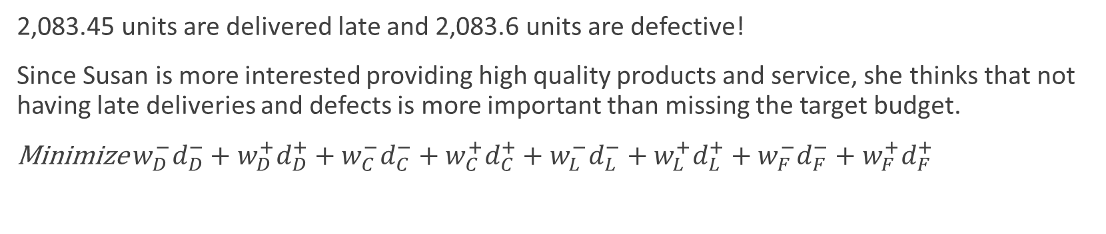
1. Goal Programming Susan Lovett Faux Plant Producer Sum of Weighted Deviations
2,083.45 units are delivered late and 2,083.6 units are defective!
Since Susan is more interested providing high quality products and service, she thinks that not having late deliveries and defects is more important than missing the target budget.
Minimize ${w_{D}^{−}d}_{D}^{−}+{w_{D}^{+}d}_{D}^{+}+w_{C}^{−}d_{C}^{−}+w_{C}^{+}d_{C}^{+}+{w_{L}^{−}d}_{L}^{−}+w_{L}^{+}d_{L}^{+}+w_{F}^{−}d_{F}^{−}+w_{F}^{+}d_{F}^{+}$

Slide 13
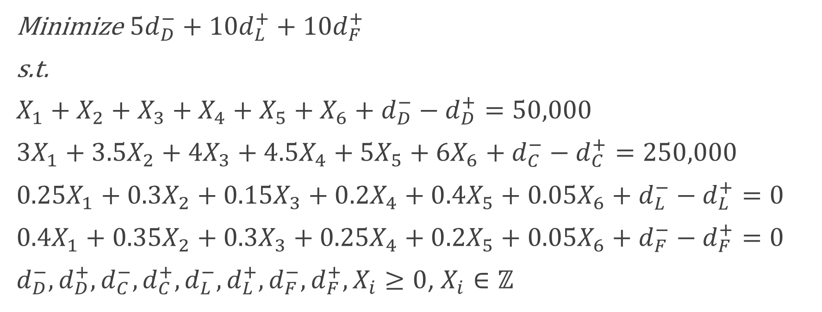
1. Goal Programming Susan Lovett Faux Plant Producer
Minimize ${5d}_{D}^{−}+10d_{L}^{+}+{10d}_{F}^{+}$
s.t.
$X_{1}+X_{2}+X_{3}+X_{4}+X_{5}+X_{6}+d_{D}^{−}−d_{D}^{+}=50,000$
${3X}_{1}+{3.5X}_{2}+{4X}_{3}+{4.5X}_{4}+{5X}_{5}+{6X}_{6}+d_{C}^{−}−d_{C}^{+}=250,000$
${0.25X}_{1}+{0.3X}_{2}+{0.15X}_{3}+{0.2X}_{4}+{0.4X}_{5}+{0.05X}_{6}+d_{L}^{−}−d_{L}^{+}=0$
${0.4X}_{1}+{0.35X}_{2}+{0.3X}_{3}+{0.25X}_{4}+{0.2X}_{5}+{0.05X}_{6}+d_{F}^{−}−d_{F}^{+}=0$
$d_{D}^{−}, d_{D}^{+},d_{C}^{−}, d_{C}^{+}, d_{L}^{−},d_{L}^{+},d_{F}^{−},d_{F}^{+},X_{i}≥0$, $X_{i}∈ℤ$

Slide 14
1. Goal Programming Susan Lovett Faux Plant Producer
What is the meaning of the objective here? Total weighted deviations.

Slide 15
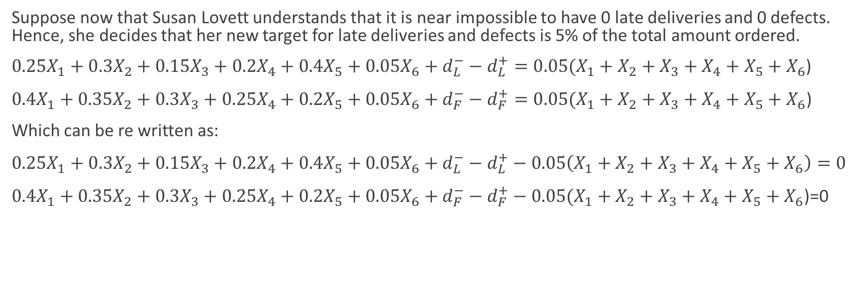
1. Goal Programming Susan Lovett Faux Plant Producer
Suppose now that Susan Lovett understands that it is near impossible to have 0 late deliveries and 0 defects. Hence, she decides that her new target for late deliveries and defects is 5% of the total amount ordered.
${0.25X}_{1}+{0.3X}_{2}+{0.15X}_{3}+{0.2X}_{4}+{0.4X}_{5}+{0.05X}_{6}+d_{L}^{−}−d_{L}^{+}=0.05(X_{1}+X_{2}+X_{3}+X_{4}+X_{5}+X_{6}$)
${0.4X}_{1}+{0.35X}_{2}+{0.3X}_{3}+{0.25X}_{4}+{0.2X}_{5}+{0.05X}_{6}+d_{F}^{−}−d_{F}^{+}=0.05(X_{1}+X_{2}+X_{3}+X_{4}+X_{5}+X_{6}\text{)}$
Which can be re written as:
${0.25X}_{1}+{0.3X}_{2}+{0.15X}_{3}+{0.2X}_{4}+{0.4X}_{5}+{0.05X}_{6}+d_{L}^{−}−d_{L}^{+}−0.05\left(X_{1}+X_{2}+X_{3}+X_{4}+X_{5}+X_{6}\right)=0$
${0.4X}_{1}+{0.35X}_{2}+{0.3X}_{3}+{0.25X}_{4}+{0.2X}_{5}+{0.05X}_{6}+d_{F}^{−}−d_{F}^{+}−0.05(X_{1}+X_{2}+X_{3}+X_{4}+X_{5}+X_{6}\text{)}\text{=0}$

Slide 16
1. Goal Programming Susan Lovett Faux Plant Producer
Late deliveries
Defects

Slide 17
1.Goal Programming
Types of objectives:
Sum of deviations
Shortcomings: $1 deviation from $250,000 or 1 unit deviation from 0 late deliveries are worth the same
Weighted sum of deviations
Shortcomings: The decision maker should know appropriate values for the weights
Weighted sum of % deviations
Shortcomings: Does not work well when the target is 0.

Slide 18
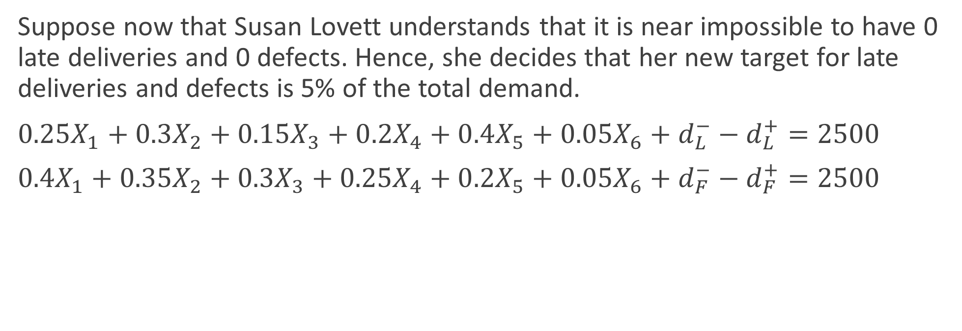
1. Goal Programming Susan Lovett Faux Plant Producer
Suppose now that Susan Lovett understands that it is near impossible to have 0 late deliveries and 0 defects. Hence, she decides that her new target for late deliveries and defects is 5% of the total demand.
${0.25X}_{1}+{0.3X}_{2}+{0.15X}_{3}+{0.2X}_{4}+{0.4X}_{5}+{0.05X}_{6}+d_{L}^{−}−d_{L}^{+}=2500$
${0.4X}_{1}+{0.35X}_{2}+{0.3X}_{3}+{0.25X}_{4}+{0.2X}_{5}+{0.05X}_{6}+d_{F}^{−}−d_{F}^{+}=2500$

Slide 19
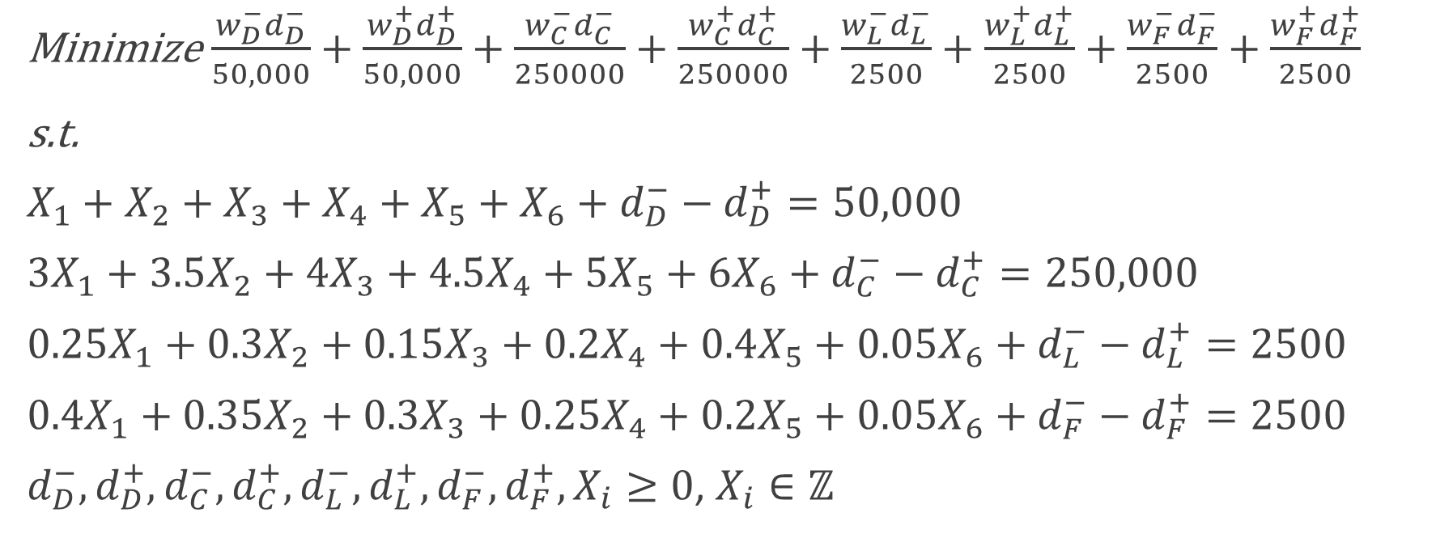
1. Goal Programming Susan Lovett Faux Plant Producer Sum of Weighted % Deviations
Minimize $\frac{{w_{D}^{−}d}_{D}^{−}}{50,000}+\frac{{w_{D}^{+}d}_{D}^{+}}{50,000}+\frac{w_{C}^{−}d_{C}^{−}}{250000}+\frac{w_{C}^{+}d_{C}^{+}}{250000}+\frac{{w_{L}^{−}d}_{L}^{−}}{2500}+\frac{w_{L}^{+}d_{L}^{+}}{2500}+\frac{w_{F}^{−}d_{F}^{−}}{2500}+\frac{w_{F}^{+}d_{F}^{+}}{2500}$
s.t.
$X_{1}+X_{2}+X_{3}+X_{4}+X_{5}+X_{6}+d_{D}^{−}−d_{D}^{+}=50,000$
${3X}_{1}+{3.5X}_{2}+{4X}_{3}+{4.5X}_{4}+{5X}_{5}+{6X}_{6}+d_{C}^{−}−d_{C}^{+}=250,000$
${0.25X}_{1}+{0.3X}_{2}+{0.15X}_{3}+{0.2X}_{4}+{0.4X}_{5}+{0.05X}_{6}+d_{L}^{−}−d_{L}^{+}=2500$
${0.4X}_{1}+{0.35X}_{2}+{0.3X}_{3}+{0.25X}_{4}+{0.2X}_{5}+{0.05X}_{6}+d_{F}^{−}−d_{F}^{+}=2500$
$d_{D}^{−}, d_{D}^{+},d_{C}^{−}, d_{C}^{+}, d_{L}^{−},d_{L}^{+},d_{F}^{−},d_{F}^{+},X_{i}≥0$, $X_{i}∈ℤ$

Slide 20
1. Goal Programming Susan Lovett Faux Plant Producer

Slide 21
1. Goal Programming
In goal programming, we are not necessarily finding “optimal” solutions but the most desirable solution.
The objective function value is an indicator of total deviation from goals and the solutions must be compared to find the most desirable case.
A large weight on a deviational variable will create a hard constraint.
There can be hard limits on deviational variables.
May use sensitivity analysis to evaluate different weights.

Slide 22
2. Multi-objective Optimization
Multi-objective optimization problems have more than one objective functions.
Can be considered as special types of goal programming models where the target values may not be known.

Slide 23
2. Multi-objective Optimization Customer Service Phone Line
The customer service phone line of a regional utilities company employs customer service agents to perform active work, i.e., answer customer calls, or inactive work, i.e., create documentation. The Utility Company currently employs 10 agents that can answer 10 calls an hour on average. The company estimates that the weekly demand for active work is at least 4000 calls and the weekly demand for inactive work is at least 50 hours a week. If the per hour profit from active work, inactive work, and from overtime are $3, $2.5, and $2, respectively, find the hours dedicated to active and inactive work per week that
(1) minimizes the overtime
(2) maximizes profits.

Slide 24
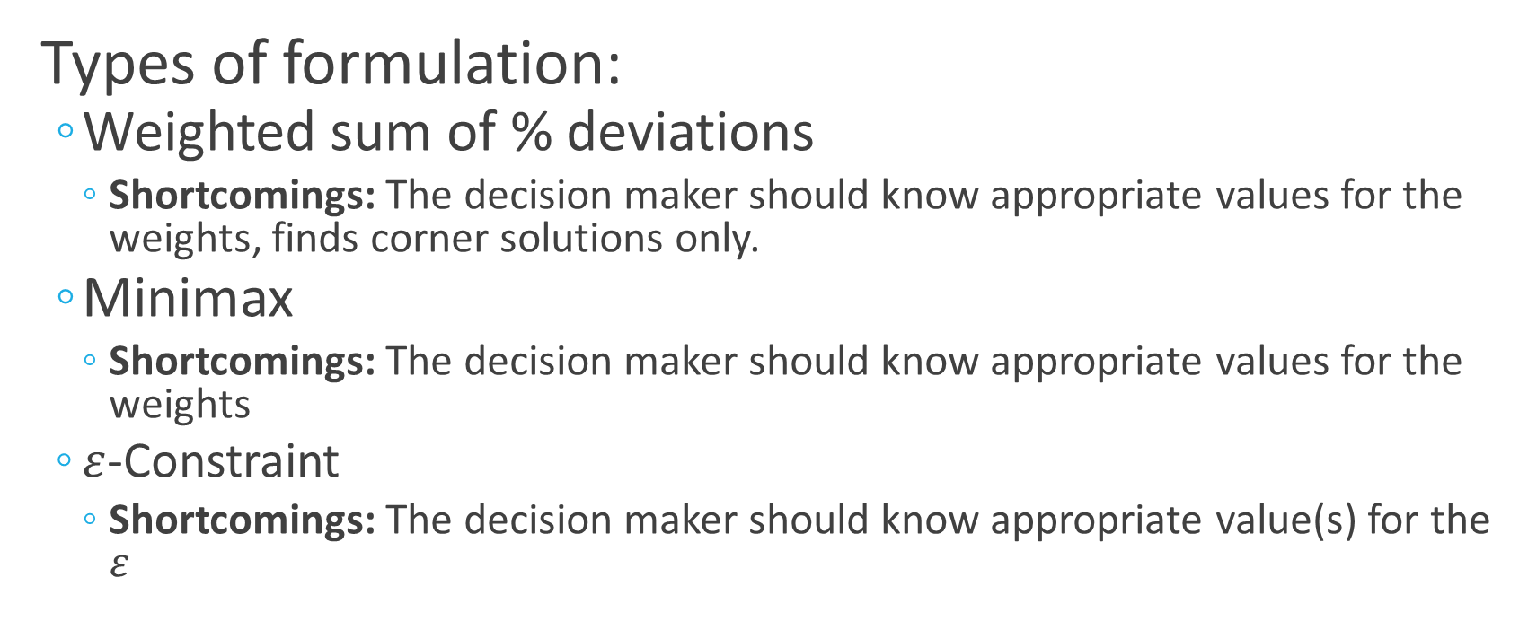
2. Multi-objective Optimization
Types of formulation:
Weighted sum of % deviations
Shortcomings: The decision maker should know appropriate values for the weights, finds corner solutions only.
Minimax
Shortcomings: The decision maker should know appropriate values for the weights
$ε$-Constraint
Shortcomings: The decision maker should know appropriate value(s) for the $ε$

Slide 25
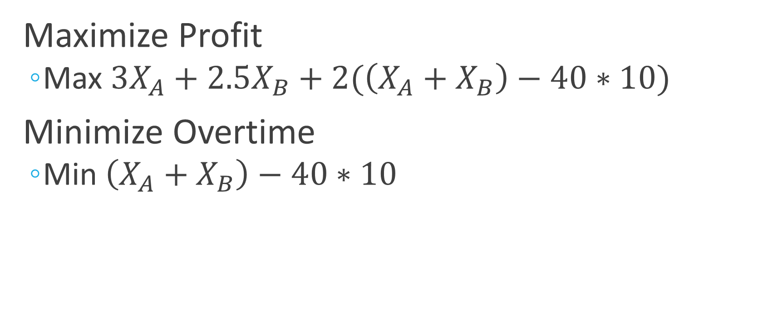
2. Multi-objective Optimization Customer Service Phone Line
Maximize Profit
Max $3X_{A}+2.5X_{B}+2(\left(X_{A}+X_{B}\right)−40∗10)$
Minimize Overtime
Min $\left(X_{A}+X_{B}\right)−40∗10$

Slide 26
2. Multi-objective Optimization Customer Service Phone Line
If the objectives had target values we could treat them like the following goals:
Goal 1: The total profit should be approximately t1.
Goal 2: The amount overtime should be approximately t2.
We can solve 2 separate LP problems, independently optimizing each objective, to find values for t1, t2.

Slide 27
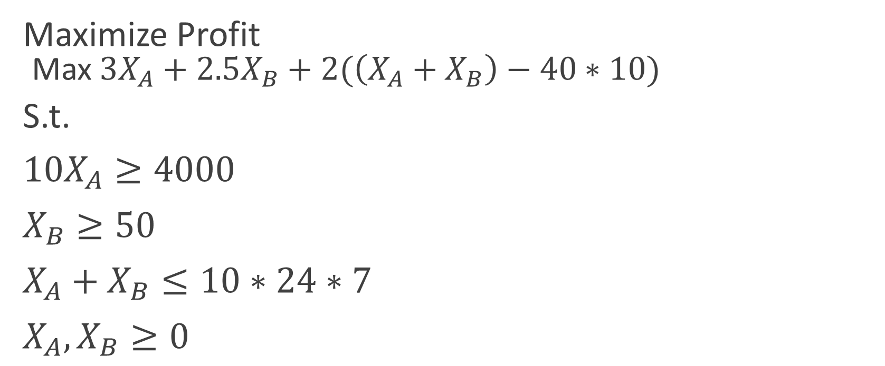
2. Multi-objective Optimization Customer Service Phone Line
Maximize Profit
Max $3X_{A}+2.5X_{B}+2(\left(X_{A}+X_{B}\right)−40∗10)$
S.t.
${10X}_{A}≥4000$
$X_{B}≥50$
$X_{A}+X_{B}≤10∗24∗7$
$X_{A},X_{B}≥0$

Slide 28
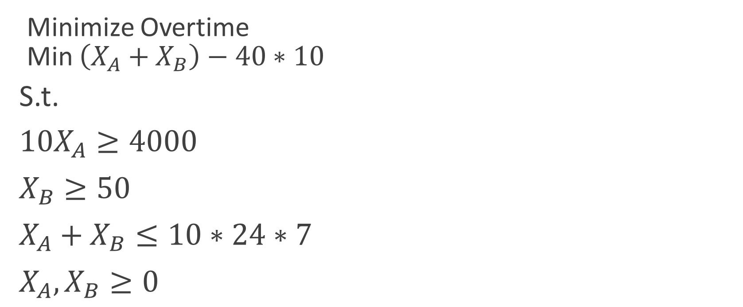
2. Multi-objective Optimization Customer Service Phone Line
Minimize Overtime
Min $\left(X_{A}+X_{B}\right)−40∗10$
S.t.
${10X}_{A}≥4000$
$X_{B}≥50$
$X_{A}+X_{B}≤10∗24∗7$
$X_{A},X_{B}≥0$

Slide 29
2. Multi-objective Optimization Customer Service Phone Line Sum of Weighted % Deviations
If the objectives had target values we could treat them like the following goals:
Goal 1: The total profit should be approximately 7575.
Goal 2: The amount overtime should be approximately 50.

Slide 30

2. Multi-objective Optimization Customer Service Phone Line
Min $\frac{1[7575−3X_{A}+2.5X_{B}+2\left(\left(X_{A}+X_{B}\right)−40∗10\right)] }{7575}+\frac{1[\left(X_{A}+X_{B}\right)−40∗10−50] }{50}$
S.t.
${10X}_{A}≥4000$
$X_{B}≥50$
$X_{A}+X_{B}≤10∗24∗7$
$X_{A},X_{B}≥0$

Slide 31
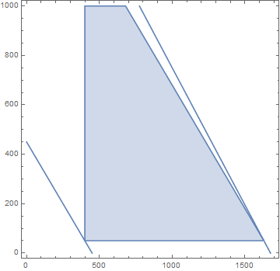
2. Multi-objective Optimization Customer Service Phone Line
Because sum of weighted deviations is a linear combination of the two objectives, we get a solution in the corners.
P1=RegionPlot[{10XA>=4000&&XB>=50&&XA+XB<=1680},{XA,0,1700},{XB,0,1000},PlotLegends->"Expressions"]
P2=ContourPlot[{((XA+XB)-40*10== 50)},{XA,0,1000},{XB,0,1700},PlotLegends->"Expressions"]
P3=ContourPlot[{3XA+2.5XB+2*((XA+XB)-400)== 7575},{XA,0,1700},{XB,0,1000},PlotLegends->"Expressions"]
Show[P1,P2,P3,PlotLegends->"Expressions"]
Feasible region
Overtime objective at 50
Max Profit Solution
Profit objective at 7575
Min Overtime Solution
Let’s plot the weighted sum of % deviations.

Slide 32
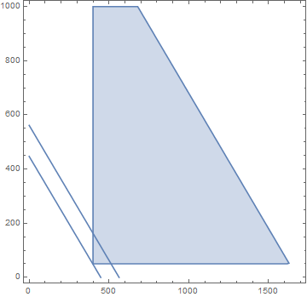
2. Multi-objective Optimization Customer Service Phone Line
Because sum of weighted deviations is a linear combination of the two objectives, we get a solution in the corners.
P1=RegionPlot[{10XA>=4000&&XB>=50&&XA+XB<=1680},{XA,0,1700},{XB,0,1000},PlotLegends->"Expressions"]
P4=ContourPlot[{(7575-(3XA+2.5XB+2*((XA+XB)-400)))/7575+((XA+XB)-40*10-50)/50== 3},{XA,0,1700},{XB,0,1000},PlotLegends->"Expressions"]
P5=ContourPlot[{(7575-(3XA+2.5XB+2*((XA+XB)-400)))/7575+((XA+XB)-40*10-50)/50== 0.81},{XA,0,1700},{XB,0,1000},PlotLegends->"Expressions"]
Show[P1,P4,P5, PlotLegends->"Expressions"]
Feasible region
Weighted sum of % objective at 3
The objective function is linear and improves in this direction.
Weighted sum of % objective at 0.78
Let’s change the weights.

Slide 33
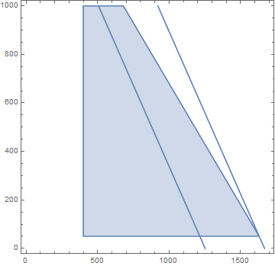
2. Multi-objective Optimization Customer Service Phone Line
Because sum of weighted deviations is a linear combination of the two objectives, we get a solution in the corners.
The weight of profit is now 50 and the value is 30.
P6=ContourPlot[{50*(7575-(3XA+2.5XB+2*((XA+XB)-400)))/7575+((XA+XB)-40*10-50)/50== 30},{XA,0,1700},{XB,0,1000},PlotLegends->"Expressions"]
P7=ContourPlot[{50*(7575-(3XA+2.5XB+2*((XA+XB)-400)))/7575+((XA+XB)-40*10-50)/50== 24.6},{XA,0,1700},{XB,0,1000},PlotLegends->"Expressions"]
Show[P1,P6,P7, PlotLegends->"Expressions"]
The objective function is linear and improves in this direction.
Weighted sum of % objective at 24.6

Slide 34
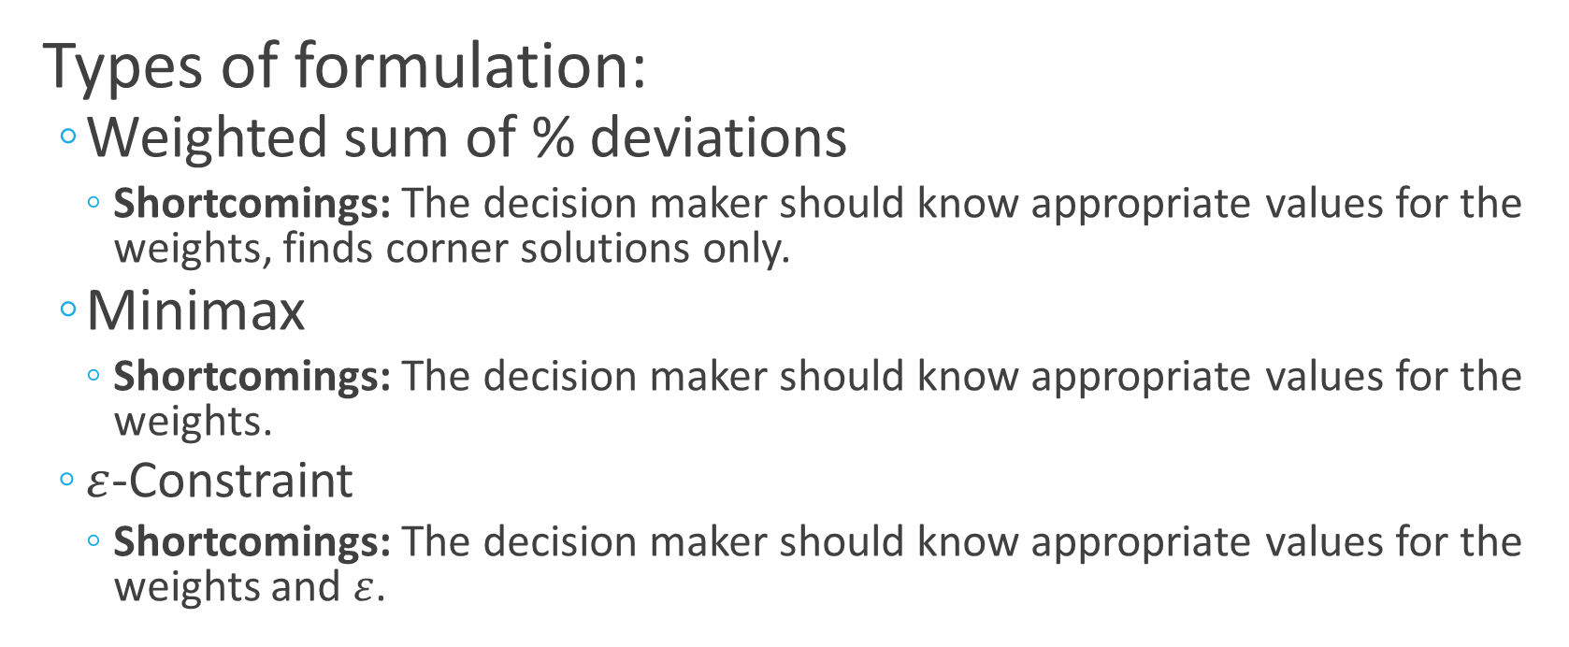
2. Multi-objective Optimization
Types of formulation:
Weighted sum of % deviations
Shortcomings: The decision maker should know appropriate values for the weights, finds corner solutions only.
Minimax
Shortcomings: The decision maker should know appropriate values for the weights.
$ε$-Constraint
Shortcomings: The decision maker should know appropriate values for the weights and $ε$.

Slide 35
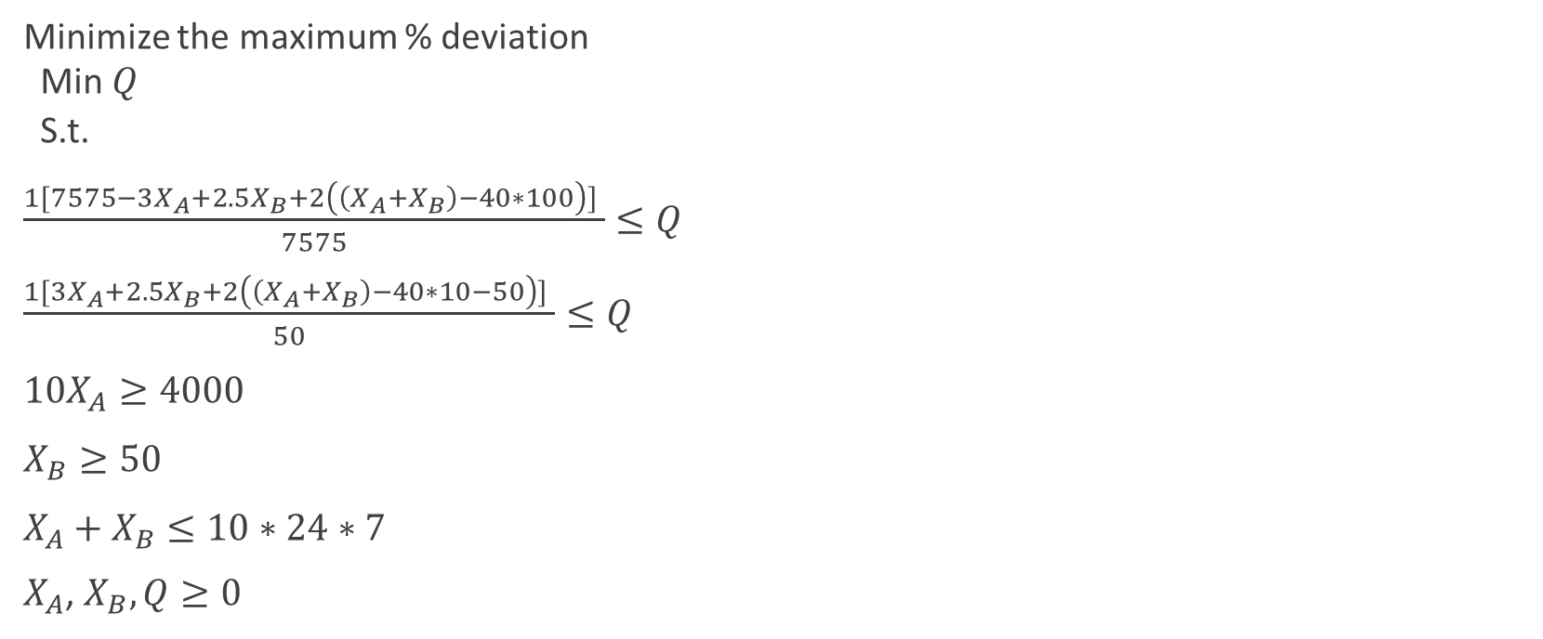
2. Multi-objective Optimization Customer Service Phone Line Minimax Objective
Minimize the maximum % deviation
Min $Q$
S.t.
$\frac{1[7575−3X_{A}+2.5X_{B}+2\left(\left(X_{A}+X_{B}\right)−40∗100\right)] }{7575}≤Q$
$\frac{1[3X_{A}+2.5X_{B}+2\left(\left(X_{A}+X_{B}\right)−40∗10−50\right)] }{50}≤Q$
${10X}_{A}≥4000$
$X_{B}≥50$
$X_{A}+X_{B}≤10∗24∗7$
$X_{A}$, $X_{B},Q≥0$
Let’s plot this!

Slide 36
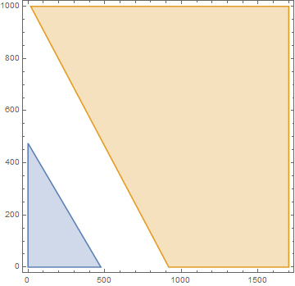
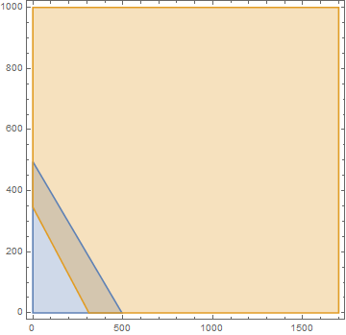


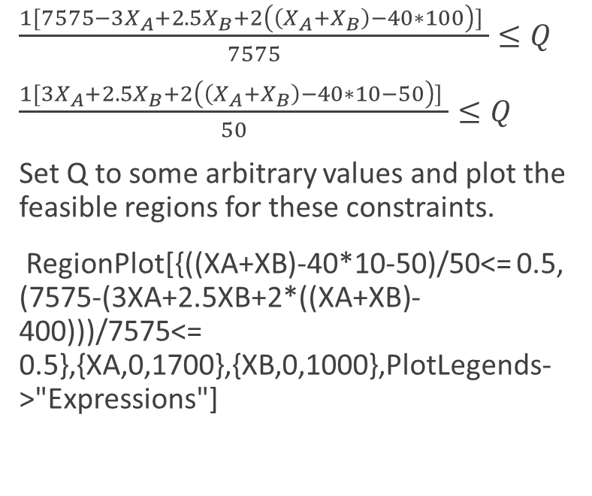
2. Multi-objective Optimization Customer Service Phone Line Minimax Objective
$\frac{1[7575−3X_{A}+2.5X_{B}+2\left(\left(X_{A}+X_{B}\right)−40∗100\right)] }{7575}≤Q$
$\frac{1[3X_{A}+2.5X_{B}+2\left(\left(X_{A}+X_{B}\right)−40∗10−50\right)] }{50}≤Q$
Set Q to some arbitrary values and plot the feasible regions for these constraints.
RegionPlot[{((XA+XB)-40*10-50)/50<= 0.5, (7575-(3XA+2.5XB+2*((XA+XB)-400)))/7575<= 0.5},{XA,0,1700},{XB,0,1000},PlotLegends->"Expressions"]
When Q=0.5, there is no feasible region that satisfies both constraints. What is the minimum Q value with a feasible region that satisfies all constraints?

Slide 37
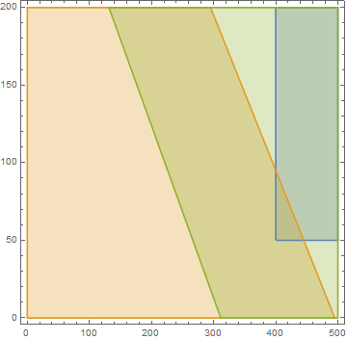
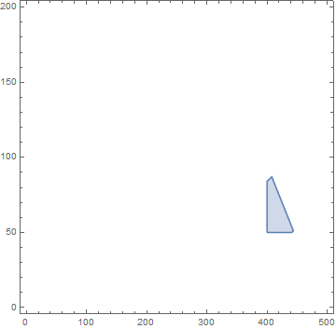

2. Multi-objective Optimization Customer Service Phone Line Minimax Objective
What is the minimum Q value with a feasible region that satisfies all constraints?
RegionPlot[{10XA>=4000&&XB>=50&&XA+XB<=1680,((XA+XB)-40*10-50)/50<= 0.9,(7575-(3XA+2.5XB+2*((XA+XB)-400)))/7575<= 0.9},{XA,0,500},{XB,0,200},PlotLegends->"Expressions"]
RegionPlot[{10XA>=4000&&XB>=50&&XA+XB<=1680&&((XA+XB)-40*10-50)/50<= 0.9&&(7575-(3XA+2.5XB+2*((XA+XB)-400)))/7575<= 0.9},{XA,0,500},{XB,0,200},PlotLegends->"Expressions"]
We can make Q even smaller! Let’s let Excel find it for us!

Slide 38
2. Multi-objective Optimization Customer Service Phone Line Minimax Objective

Slide 39
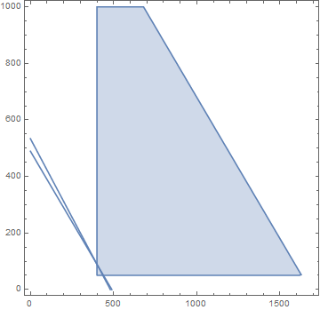
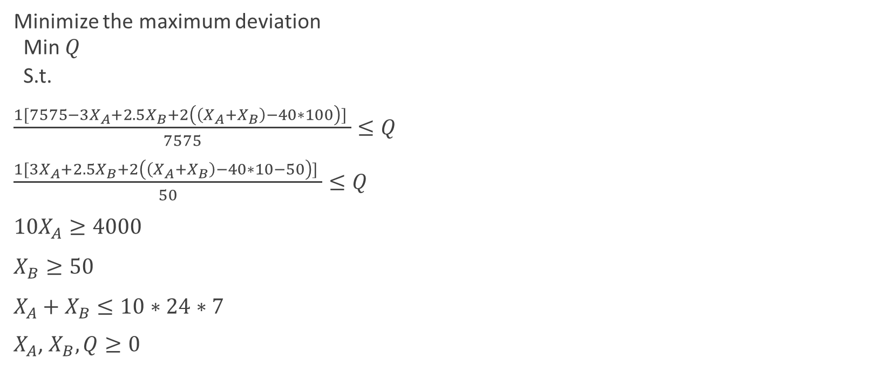
2. Multi-objective Optimization Customer Service Phone Line Minimax Objective
Minimize the maximum deviation
Min $Q$
S.t.
$\frac{1[7575−3X_{A}+2.5X_{B}+2\left(\left(X_{A}+X_{B}\right)−40∗100\right)] }{7575}≤Q$
$\frac{1[3X_{A}+2.5X_{B}+2\left(\left(X_{A}+X_{B}\right)−40∗10−50\right)] }{50}≤Q$
${10X}_{A}≥4000$
$X_{B}≥50$
$X_{A}+X_{B}≤10∗24∗7$
$X_{A}$, $X_{B},Q≥0$
Non-corner
Solution

Slide 40
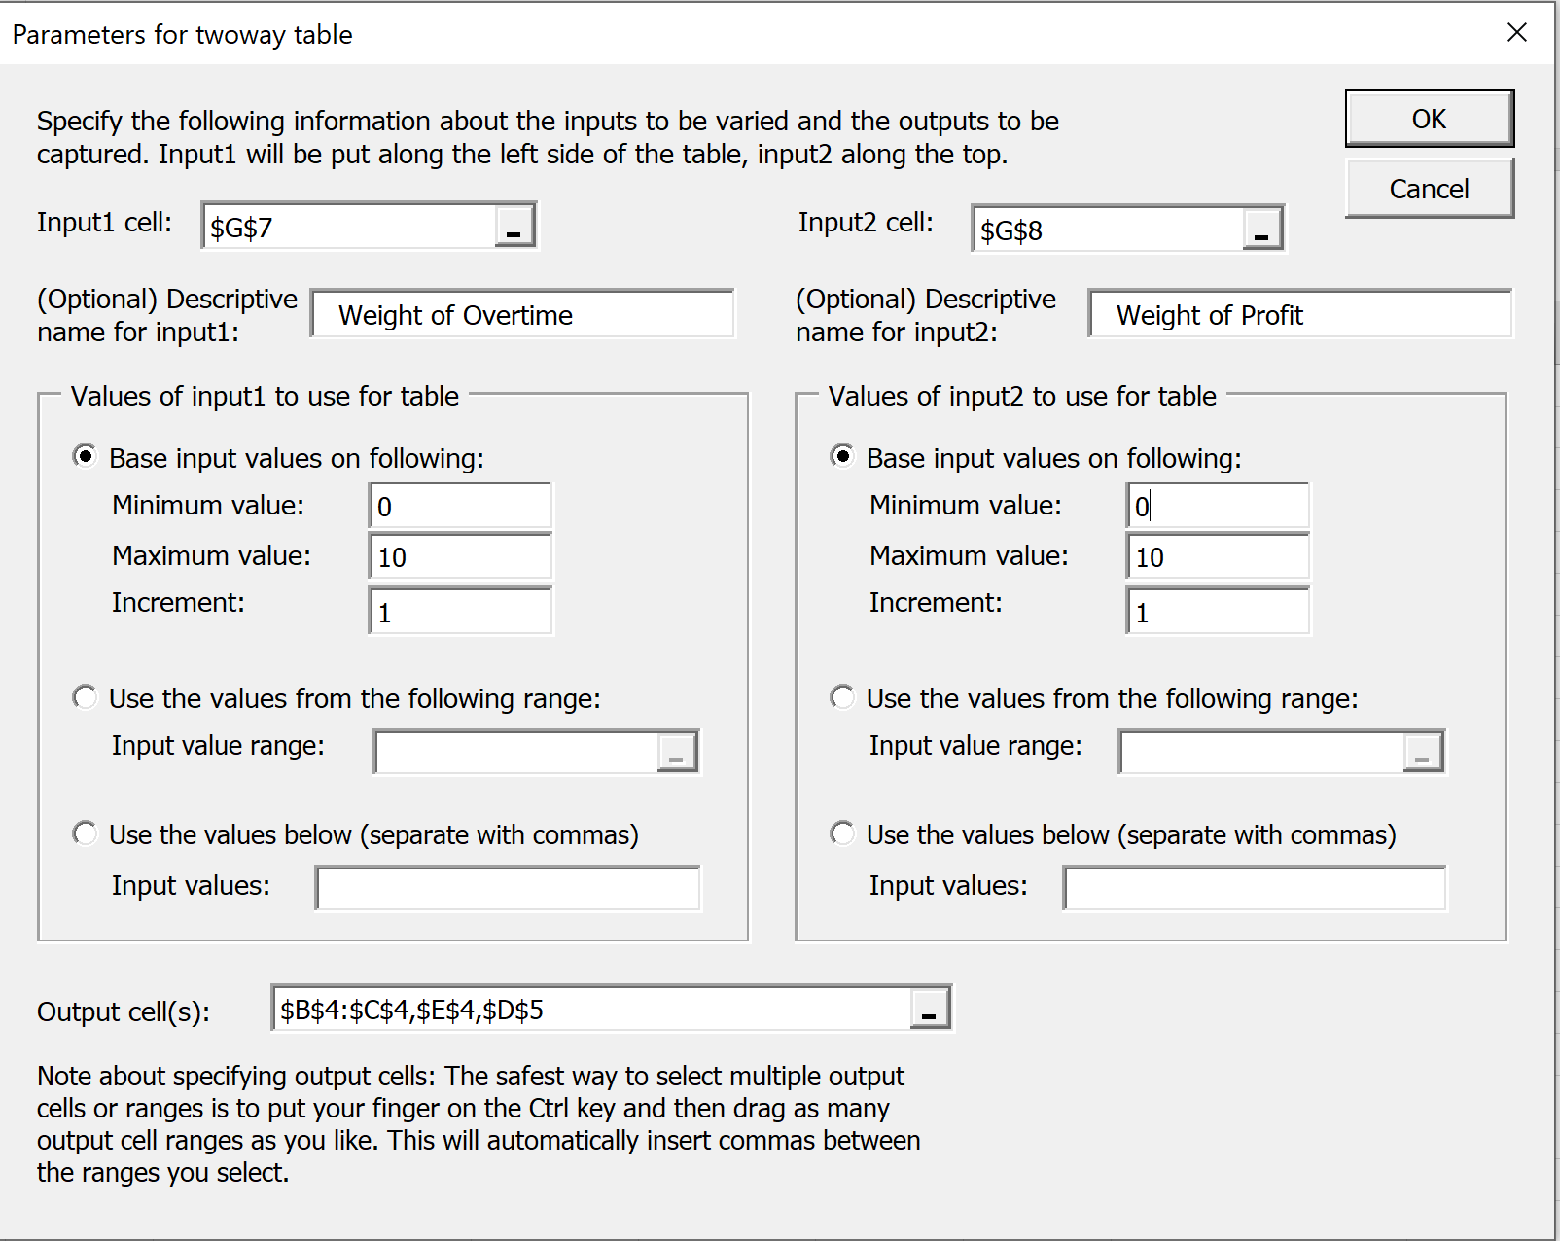

Slide 41
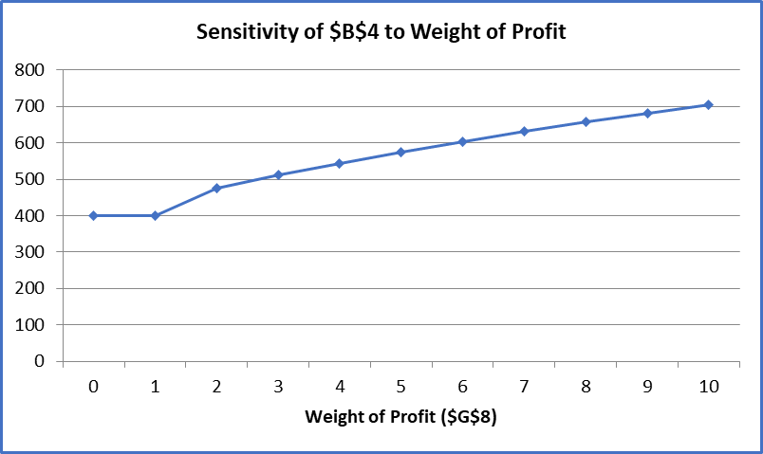
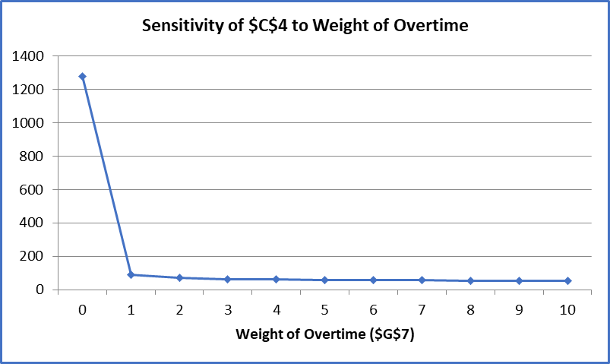
2. Multi-objective Optimization Sensitivity Analysis
Weight of Overtime=1
Weight of Profit=1

Slide 42
2. Multi-objective Optimization Sensitivity Analysis
Hours assigned to active work

Slide 43
2. Multi-objective Optimization Sensitivity Analysis
Hours assigned to inactive work

Slide 44
2. Multi-objective Optimization Sensitivity Analysis
Overtime in hours

Slide 45
2. Multi-objective Optimization Sensitivity Analysis
Profit in $
So maybe you would like to maximize profit while keeping overtime below a limit.

Slide 46

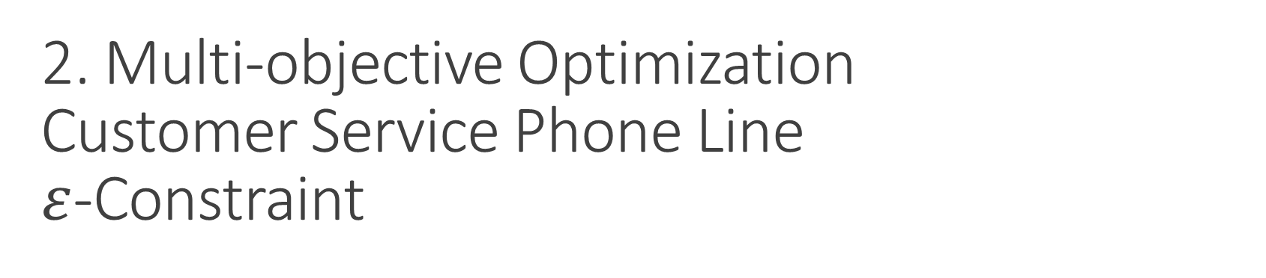
2. Multi-objective Optimization Customer Service Phone Line $ε$-Constraint
Max $3X_{A}+2.5X_{B}+2(\left(X_{A}+X_{B}\right)−40∗100)$
S.t.
$$\left(X_{A}+X_{B}\right)−40∗10≤80$$
${10X}_{A}≥4000$
$X_{B}≥50$
$X_{A}+X_{B}≤10∗24∗7$
$X_{A}$, $X_{B}≥0$

Slide 47

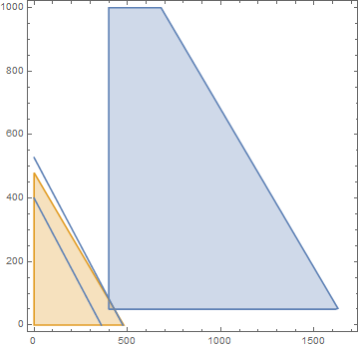
2. Multi-objective Optimization Customer Service Phone Line $ε$-Constraint
P1=RegionPlot[{10XA>=4000&&XB>=50&&XA+XB<=1680,(XA+XB)-40*10<= 80},{XA,0,1700},{XB,0,1000},PlotLegends->"Expressions"]
P2=ContourPlot[{3XA+2.5XB+2*((XA+XB)-400)== 1000},{XA,0,1700},{XB,0,1000},PlotLegends->"Expressions"]
P3=ContourPlot[{3XA+2.5XB+2*((XA+XB)-400)== 1575},{XA,0,1700},{XB,0,1000},PlotLegends->"Expressions"]
Show[P1,P2,P3,PlotLegends->"Expressions"]
Original Feasible region
Objective function improving in this direction
Feasible region for overtime constraint

Slide 48
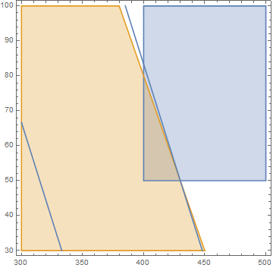
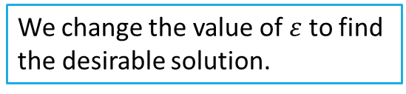
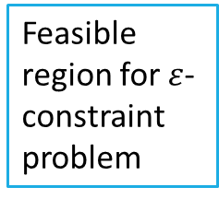
2. Multi-objective Optimization Customer Service Phone Line $ε$-Constraint
We change the value of $ε$ to find the desirable solution.
Feasible region for $ε$-constraint problem

Slide 49
2. Multi-objective Optimization Customer Service Phone Line $ε$-Constraint

Slide 50
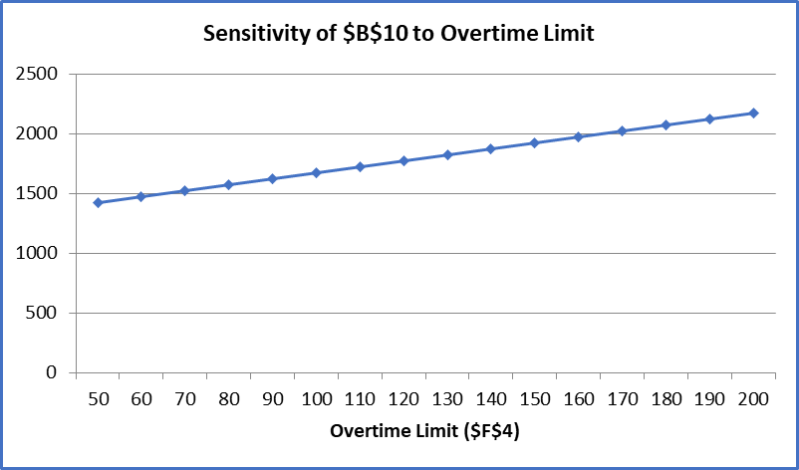
What is the profit level and the overtime you would like to achieve?

Slide 51
3. Data Envelopment Analysis Measurement and Benchmarking
How to evaluate performance of an organization
Manufacturing firm
A branch of a bank
Considerations:
1. multiple inputs and outputs
2. Different measurement units (KPIs), non-financial metrics
3. (possibly) conflicting metrics and perspectives
Q: Is there a way to somehow compare efficiency of organizations (or companies) within an industry?
Notes:
Another example is to use LP for benchmarking and evaluate the performance of a business org.
Is evaluation easy?
(Dating, how do you evaluate whether some is a keeper or not?)
Most evaluation are multi-dimensional?
How are you going to evaluate the performance of manufacturing firm?
What about bank?
Multiple resources (HR, raw materials, cash) are used.
Outputs are multi-dimensional: cash, quality, growth, retention rate.
Some measures are conflicting:
Minimizing the cost => maximizing the profit.
High quality -> Hinders growth.
Questions: Is there a way to somehow evaluate and compare the efficiency?
What are the “best practice” and under-performing units?

Slide 52
Ways to rank/benchmark
In some cases, a dominant metric exists
Hrs/transaction (in call center) , $sales/sq.-ft. (mall and casino)
Financial approach: convert everything to $.
Clustering or statistical discrimination (predictive analytics)
Problems:
In most organizations, many different mix of inputs and outputs
Some inputs/outputs cannot be valued in $ (non-profit)
Difference between efficiency and profitability.
One way to cope with these difficulties:
DEA (Data Envelopment Analysis)
Notes:
There can be several ways to rank/benchmark.
If there is a dominant metric.
Shopping mal $/sq.ft.
Another way to convert to $ (Cuba Gooding Jr. Show me the money)
Another way: insurance company use this to detect medical fraud. Statistical discrimination.
Problem. Many business org: Multi dimensional.
Different mix of inputs and outputs. Some of them (# of people helped) can not be $.
In other words, difference bet. Efficiency and profitability.
One way: DEA

Slide 53
Measurement and Benchmarking Intuition building.
 | Cost | Profit
Store 1 (Lauren) | $10K | $30K
Store 2 (Emily) | $10K | $40K
Which store performs better?
If there is only one input and one output, comparison is easy.
Notes:
To build intuition:
Two store, Lauren, Emily.
Both cost 10K, Lauren makes 30K, Emily 40K
Who is better? Emily.

Slide 54
Measurement and Benchmarking Intuition building: Multiple metrics
 | Cost | Profit | Satisfaction
Store 1 (Lauren) | $10K | $30K | 90
Store 2 (Emily) | $10K | $40K | 85
Which store performs better?
(The beauty is in the eye of the beholder.)
Notes:
It turns out while L makes less money, customers are happier.
(90 out of 100)
Emily makes more money, cust are slightly not happier.
Who performs better?

Slide 55
Measurement and Benchmarking Intuition building: Multiple metrics
 | Cost | Profit | Satisfaction
Store 1 (Lauren) | $10K | $30K | 90
Store 2 (Emily) | $10K | $40K | 85
Which store performs better?
(The beauty is in the eye of the beholder.)
Profit
If you are profit-centric?
If you are service-centric?
If you are using both? Exactly how?
Service
Notes:
If you care about profit more, who is more likely to be an winner?
Emily,.
If you care about satis more, who is more likely to be an winner?
Lauren.
Can we use both metrics? Exactly how?
Scoring: Depending on how you scale them, how much weight you give. The ranking might change.

Slide 56
Data Envelopment Analysis
Developed by Charnes, Cooper, Rhodes (1978)
Compares each organization (DMU, decision making unit) to other organizations.
measures the maximum (more on this later) relative efficiency of each DMU (compared to others) by dividing the data into 2 groups
Outputs: profit, customer satisfaction (The more, the better)
Inputs: labor hours, FTEs, costs (The less, the better)
How do we set the weights (scores)? This is the crux of DEA.
Notes:
DEA does exactly that.
CCR (1978)
Each organization (DMU) to other DMUs
For each organization, it measures the maximum relative efficiency by dividing the data into the two groups.
Outputs: profit, satisfcation (more is better)
Input (labor, cost, FTEs, complaints (less is better)
Measure the efficiency = ratio of weighted sum of output to weighted sum of inputs.
What weights should we use for inputs and outputs? This is the cruX of DEA.

Slide 57
DEA Illustrative example Metropolis National Bank
Metropolis National Bank operates five branches around the city of Baltimore. The five branches offer the same services and rely on identical mixes of labor and capital. As a result, the cost of operation is the same at each branch although the volumes of loans and deposit (in $K) processed differ. The following list summarizes the level of branch performance (per week).
 | Deposits | Loans | Expense
Branch 1 | 31 | 10 | 100
Branch 2 | 25 | 15 | 100
Branch 3 | 30 | 20 | 100
Branch 4 | 23 | 23 | 100
Branch 5 | 20 | 30 | 100
Notes:
To illustrate the idea behind the DEA, let’s do an example.
Bank has 5 branches:
For now, 3 metrics: # of new deposits, # of new loans, operating expense.
Since all of them have the same expense, it is a wash.

Slide 58
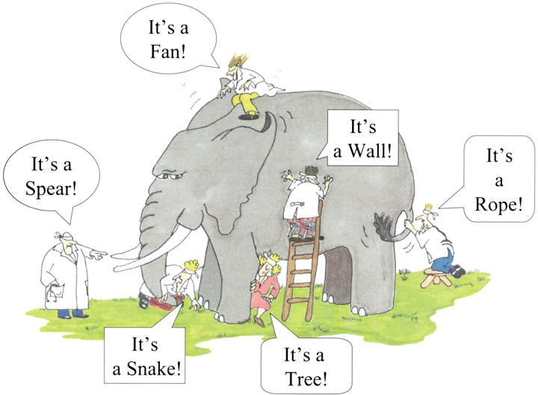
DEA Illustrative example Metropolis National Bank
What DEA asks…….(If B2 is a client)
DEA takes the view from one particular organization to find the best scoring rule for that organization.
DEA will be used to identify the efficient frontier organizations.
DEA alone does not tell you what is the most fair and precise scoring rule for benchmarking.
Notes:
Using LP,
DEA finds the best scoring rule for B2.
Rate the score for B2 with that scoring rule.
Make sense?

Slide 59
DEA Illustrative example Metropolis National Bank
A DMU is “efficient” (i.e., score of 1) if there is no other unit which is “clearly better” than the chosen portfolio.
No branch with same (or more) loan vol. and more deposit vol.
No branch with same (or more) deposit vol. and more loan vol.
Efficient Frontier:
the line connecting efficient units
Organization is on efficient frontier
Scores 1 (on a [0,1] scale) according to
some scoring rules.
Notes:
That is because that being on the efficient frontier means that
there is a scoring rule that will rank the branch the best possible score.
On a 0-1 scale: that will be 1.
For stores who is not on the frontier, we compared them on the ones on the frontier.
DEA does just that.

Slide 60
DEA: How do we measure the efficiency?
We compare the efficiency of an organization to the efficient frontier using HCU (Hypothetical comparison unit), which is a combination of organizations on the efficient frontier.
HCU 2’
DEA efficiency for business unit i:
Length of red line
Length of dotted line (HCU)
Branch 2: red line: 29.155
dotted line: 35.206,
Efficiency=
Notes:
Then how do we determine the efficiency of B2?
B2 is dominated by a mixture of B1 and B3.
Suppose that you can mix and match ones on the frontier, and create a hybrid organization
By mixing good things between B1 and B3, we can create a hypothetical organization for the sake of comparison.
Then Eff = Red line/Dotted Line.
Suppose that Red = 29.155, Orange dotted line that connects zero to the frontier= 35.883
Efficiency of B2 = 29.155/35.883 = 0. 8125.
Why do we use particular dotted line for the froniter? Why not the line that connect B5?
Best scoring rule. If we use any other line, it will be longer, thus the score of B2 decreases.

Slide 61
DEA: How do we measure the efficiency?
Question of DEA: What’s the best score for B2?
DEA efficiency for business unit i:
Length of red line
Length of dotted line (HCU)
HCU 2’
Can we get a better score for B2?
Why not?
Notes:
Comparing to any other point on the frontier only lowers the score.

Slide 62
DEA: How do we measure the efficiency?
What about branch 5?
Length of red line
Length of dotted line (HCU)
HCU5=B5
Notes:
Then, what about the branch 5?
Length of red/ Lenghth of Dotted.
One to find the best scoring rule for B5, that is the dotted line. = 36.06/36.06

Slide 63
DEA Formulation
Graphical method cannot apply to cases with multiple inputs and outputs.
Is there a formal approach to measure the efficiency of DMU unit i?
Multiple outputs j (y_{j}): loan volume, deposit volume, profit
Multiple inputs k (x_{k}): operating expense, labor
What is the best scoring rule (weights on inputs and outputs) for this organization?
If we use that particular scoring rule, what is the relative efficiency of this organization (on 0-1 scale)?
Decision variables
Notes:
In this case it was easy to figure out what is the best scoring rule. What if we have more than 2 dimensional inputs and outputs.
How do we measure the efficiency then?
Find the best scoring rule and what would be the resulting score of the organization under that rule?
We do that by linear programming.
Variables: weight given to output and input.

Slide 64
DEA Formulation for Branch 2 Metropolis banks II
outputs
inputs
 | Deposits | Loans | Expense | FTEs
Branch 1 | 31 | 10 | 100 | 5
Branch 2 | 25 | 15 | 100 | 5
Branch 3 | 30 | 20 | 100 | 5
Branch 4 | 23 | 23 | 100 | 6
Branch 5 | 20 | 30 | 100 | 5
A consultant for B2 chooses
the scoring rule (weights):
o_{D} and o_{L}
i_{E} i_{F}
1. Gives the best score for B2 (Maximize the score for B2)
2. All organizations’ efficiencies are on [0,1] scale.
Notes:
Suppose that we want to find the efficiency for B2.
In addition to Deposits, Loans, and Expense, suppose we also have the data for # of FTEs.
Which metric is considered as output? Which one is input?
What do you use? The more is better, the less is better.
Is more deposit better? Yes. D Output.
Is more loans better? Yes output
Is more expense better or less expense better? Input
Is more FTE better or fewer FTEs better? Input.
We want to determine the weight for each out put and input that is best for B2.
Find out the score of B2 on [0,1] scale.

Slide 65
DEA Formulation for Branch 2 Metropolis banks II
For all branches (1 through 5): Efficiency of branch i ≤ 1.
For given weights (o_{D}, o_{L}, i_{F}, i_{E})
e.g., Efficiency of B1 ≤ 1
How to make this into linear?
Similar constraint for B2, B3,….,B5
Notes:
For given scoring rule,
The efficiency of B2 is weighted some 25OD + 15Ol / 100IE +5 IF.
The question of DEA is which scoring rule is the best for B2?
Max ratio.
Is this linear or not? Can we make it linear?
To get some idea, is 1/2 , 2/4, 3/6 all the same. Thus, we can scale the denominator to be 1.
And maximize the numerator.
Max Weighted output
St. weidghed input = 1 (we scale input).
Is this linear or not?
We want the scoring rule so that the score of all branches will be between 0 and 1.
For example for given scoring rule,
Efficiency of B1 (31D, 10L) <= 1, ->
Is this linear?
How do we make it linear? Multiply both sides. And rearrange.
Weighted Output – Weighted inputs <=0 (Linear)
Since Efficiency of all 5 branches should be <= 1. 5 constraint.

Slide 66
DEA Formulation for Branch 2 Metropolis banks II
Notes:
Thus maximizing the ratio problem is equi to Max weighted output
Subsect to
(!) weighted inputs are scaled to 1.
Eff of branch I <= 1.
310D + 10OL –100i_{E} – 5IF =weighted outputs of B1 – weighted inputs of B1 <=0.
_{L}
Likewise, Eff of B2 <=1, weighted B2 outputs – weighted B2 imputs <=0
Likewise, Eff of B3 <=1, weighted B3 outputs – weighted B3 imputs <=0
…..
All weighted are positive.

Slide 67
DEA Formulation for Branch 2 in Excel: Interpreting the sensitivity report
Which constraints are binding?
In order for B2 to improve its efficiency, whom should it learn from?
Notes:
If B2 decides to improve its operations, who should B2 look up to?
Look at the sensitivity report.
B1<=1 and B3<=1. Are binding.
For the perspective of B2, B1 and B3 are efficient. (B1: deposit, B3 both).

Slide 68
DEA Formulation for Branch 4 in Excel: Metropolis banks II
Almost identical formulation: Only pink cells change the value.
Which branches are on the efficient frontier? Run sensitivity analysis by changing the branch numbers.
Notes:
This was the result for B2.
If the subject of study changes to B2, the scoring rule that is the best for B4 will be different.
How do we find that out?
Solve LP?
Almost similar structure.
Computing the weighed outputs, use B4 outputs.
Computing the weighted inputs, use B4 inputs (Apricot)
Do we do it manually? Smarter way to do this?
Place hodler for branch number. 3, 4, input change output change.
Index?
Run it.
0.920, 0.02, 0.02, 0.01, 0

Slide 69
DEA Formulation for Branch 4 in Excel: Metropolis banks II
Branches 1, 3, and 5 have efficiency scores of 1; hence, are on the efficient frontier.
Notes:
This was the result for B2.
If the subject of study changes to B2, the scoring rule that is the best for B4 will be different.
How do we find that out?
Solve LP?
Almost similar structure.
Computing the weighed outputs, use B4 outputs.
Computing the weighted inputs, use B4 inputs (Apricot)
Do we do it manually? Smarter way to do this?
Place hodler for branch number. 3, 4, input change output change.
Index?
Run it.
0.920, 0.02, 0.02, 0.01, 0

Slide 70
Important check points/remarks
A. Choosing inputs and outputs: For each metric,
If “more is better”⇒ outputs
If “less is better” ⇒ inputs
B. The beauty is in the eye of the beholder.
A separate LP solves DEA for each organization (e.g., B2)
- determines the best scoring rule (weights) for a given DMU.
- determines the efficiency if we use the above scoring rule.
If the score =1, the DMU is on the efficient frontier
If the score <1, the DMU is not on the frontier
C. Sensitivity report identifies which organizations to benchmark.
D. But, DEA does not tell you which ranking method is the most fair and/or adequate to use for benchmarking.
Notes:
2 critical steps:
(!) which metric is input, which one is output.
More is better -> Outputs, less is better-> inputs.
(2) You need to choose the subject of study. LP solves DEA for one branch.
In order to determine efficient frontier, you need to run multiple LP (one for each organization)
MAX 1, (On the frontier), not 1 (not on the frontier)
For each organization, the sensitivity report gives whom to look up to and benchmark.

