Slide 1
Chapter 7
Nonlinear Optimization Models
Winston/Albright
Practical Management Science, 6e
© 2019 Cengage. May not be scanned, copied or duplicated, or posted to a publicly accessible website, in whole or in part.

Slide 2

AGENDA
Nonlinear Programming Using GRG
Evolutionary Solver

Slide 3
Introduction (1 of 2)
In this chapter, we discuss a variety of interesting problems with inherent nonlinearities, from product pricing to portfolio optimization to rating sports teams.

Slide 4
Introduction (2 of 2)
It is probably accurate to state that truly linear models are hard to find.
The real world often behaves in a nonlinear manner, so when you model a problem with LP, you are typically approximating reality.
By allowing nonlinearities in your models, you can often create more realistic models. Unfortunately, this comes at a price - nonlinear optimization models are more difficult to solve.

Slide 5
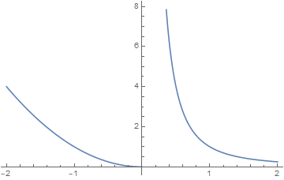
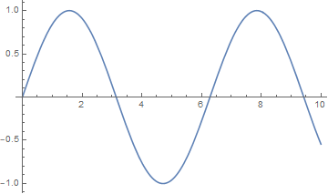
Nonconvex and/or Non-smooth Models
A nonconvex function
A discontinuous function

Slide 6
Nonconvex and/or Non-smooth Models The GRG Algorithm
The Generalized Reduced Gradient (GRG) algorithm to solve NLPs (works better with smooth functions).
GRG can also be used on LPs but is slower than the Simplex method.
Local optimal
Objective function level curves
Local and global optimal

Slide 7
Problems that Solver always solve correctly
Solver is guaranteed to solve certain types of NLPs correctly.
In some situations, if certain conditions hold, Solver is guaranteed to find the global optimum.
Conditions for maximization problems: both conditions below have to be true.
The objective function is concave or the logarithm of the objective function is concave, and
The constraints are linear.
Conditions for minimization problems:
The objective function is convex, and
The constraints are linear.

Slide 8
When assumptions do not hold (1 of 2)
There are many problems for which the conditions outlined previously do not hold or cannot be verified.
Because there is then some doubt whether Solver’s solution is the optimal solution, the best strategy is to
Try several possible starting values for the changing cells,
Run Solver from each of these, and
Take the best solution Solver finds.

Slide 9
Multistart option (2 of 2)
Because it is difficult to know where to start, the Multistart feature provides an automatic way of starting from a number of starting solutions.
It selects several starting solutions automatically, runs the GRG nonlinear algorithm from each, and reports the best solution it finds.

Slide 10
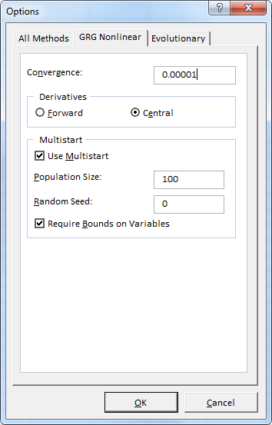
EXCEL GRG NONLINEAR OPTIONS
In the Convergence box, type the amount of relative change that you want to allow in the last five iterations before Solver stops with the message “Solver converged to the current solution.” Smaller values here usually mean that Solver will take more time, but will stop at a point closer to the optimal solution.

Slide 11
EXCEL GRG NONLINEAR OPTIONS
In the Derivatives group box, select Forward to estimate derivatives through forward differencing, or select Central to estimate derivatives through central differencing. Forward is the default choice. Central differencing yields more accurate derivatives, but requires twice as many calculations of the worksheet at each new trial solution.

Slide 12
EXCEL GRG NONLINEAR OPTIONS
Select the Use Multistart check box to use the multistart method for global optimization. If this box is selected when you click Solve, the GRG Nonlinear method will be run repeatedly, starting from different (automatically chosen) starting values for the decision variables. This process may find a better solution, but it will take more computing time than a single run of the GRG Nonlinear method.

Slide 13
EXCEL GRG NONLINEAR OPTIONS
In the Population Size box, type the number of different starting points (values for the decision variables) you want the multistart method to consider. The minimum population size is 10; if you supply a value less than 10 in this box, or leave it blank, the multistart method uses a population size of 10 times the number of decision variables, but no more than 200.

Slide 14
EXCEL GRG NONLINEAR OPTIONS
In the Random Seed box, type a positive integer number to be used as the (fixed) seed for the random number generator used to generate candidate starting points for the GRG Nonlinear method. If you enter a number here, the multistart method will use the same starting points each time you click Solve. If you leave this box blank, the random number generator will use a different seed each time you click Solve, which may yield a different (better or worse) final solution.

Slide 15
EXCEL GRG NONLINEAR OPTIONS
Select the Require Bounds on Variables check box to specify that the multistart method should run only if you have defined lower and upper bounds on all decision variables in the Constraints list box. The multistart method is far more effective if you define bounds on all variables; the tighter the bounds on the variables that you can specify, the better the multistart method is likely to perform.

Slide 16
Advertising response and selection models (1 of 3)
Decide how many ads to place on various television shows to reach the required number of viewers.
One general assumption of these types of models is that the “advertising response” - that is, the number of exposures - is linear in the number of ads. This means that if one ad gains, say, one million exposures, then 10 ads will gain 10 million exposures.
This is a questionable assumption at best.

Slide 17
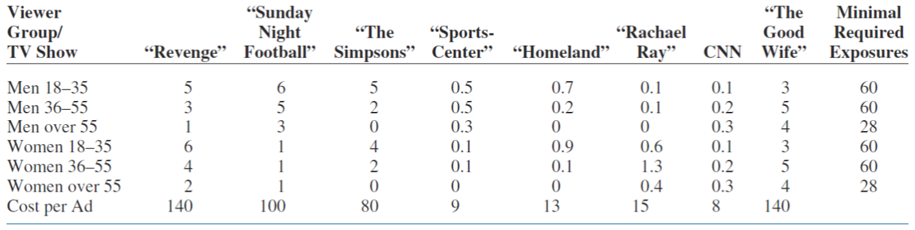
Advertising models (2 of 3)
Objective Find the minimum-cost advertising strategy that meets minimum exposure constraints.

Slide 18
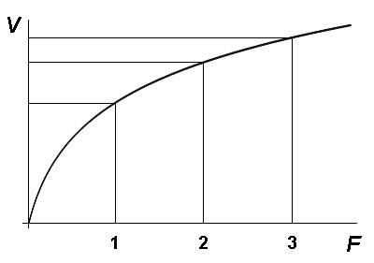
Advertising response and selection models (2 of 3)
More likely, there is a decreasing marginal effect at work, where each extra ad gains fewer exposures than the previous ad.
In fact, there might even be a saturation effect, where there is an upper limit on the number of exposures possible and, after sufficiently many ads, this saturation level is reached.

Slide 19
Advertising response and selection models (3 of 3)
In this section, we look at two related examples.
In the first example, a company uses historical data to estimate its advertising response function - the number of exposures it gains from a given number of ads. This is a nonlinear optimization model.
This type of advertising response function is used in the second example to solve a nonlinear version of the advertising selection problem from Chapter 4. Because the advertising response functions are nonlinear, the advertising selection problem is also nonlinear.
This model is demonstrated by Example 7.5

Slide 20
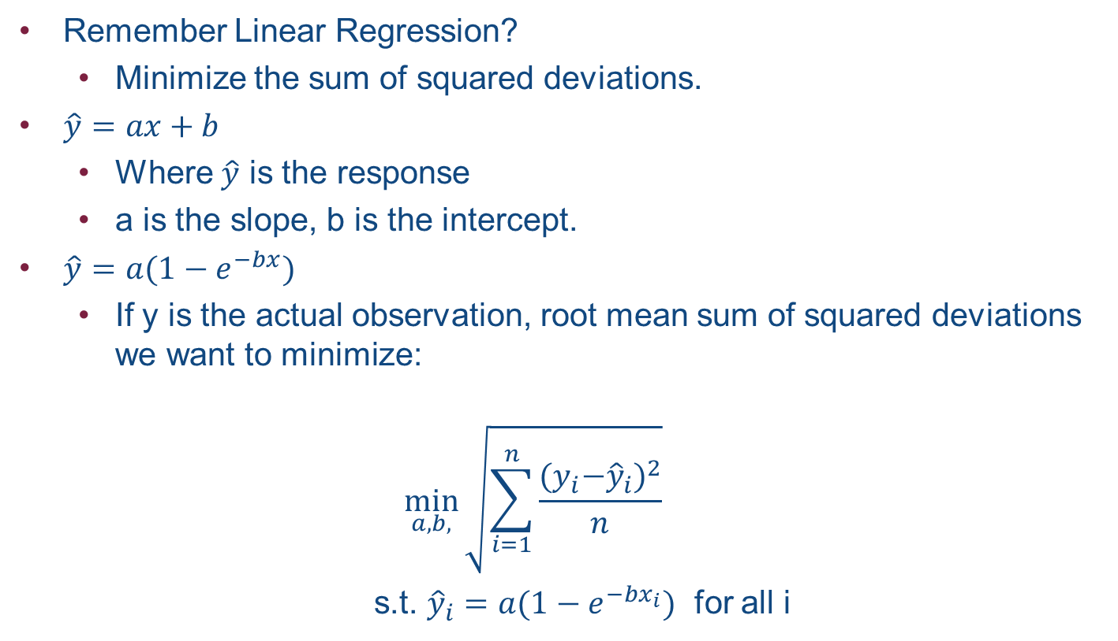
Modeling Nonlinear Advertising Response
Remember Linear Regression?
Minimize the sum of squared deviations.
$\hat{y}=ax+b$
Where $\hat{y}$ is the response
a is the slope, b is the intercept.
$\hat{y}=a(1−e^{−bx})$
If y is the actual observation, root mean sum of squared deviations we want to minimize:
$$\min_{a, b,}{\sqrt{\sum_{i=1}^{n}{\frac{{{(y}_{i}−{\hat{y}}_{i})}^{2}}{n}}}}$$
s.t. ${\hat{y}}_{i}=a(1−e^{−bx_{i}})$ for all i

Slide 21
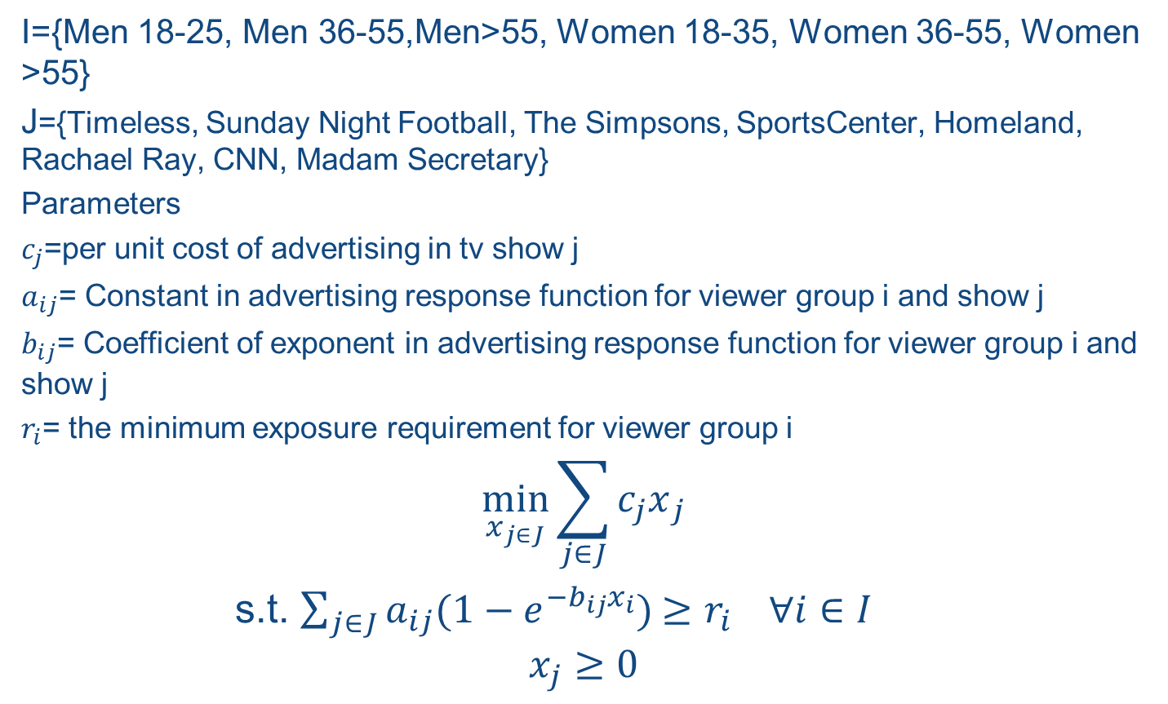
Modeling Advertising Plan
I={Men 18-25, Men 36-55,Men>55, Women 18-35, Women 36-55, Women >55}
J={Timeless, Sunday Night Football, The Simpsons, SportsCenter, Homeland, Rachael Ray, CNN, Madam Secretary}
Parameters
$c_{j}$=per unit cost of advertising in tv show j
$a_{ij}$= Constant in advertising response function for viewer group i and show j
$b_{ij}$= Coefficient of exponent in advertising response function for viewer group i and show j
$r_{i}$= the minimum exposure requirement for viewer group i
$$\min_{x_{j∈J}}{\sum_{j∈J}^{ }{{c_{j}x}_{j}}}$$
s.t. $\sum_{j∈J}^{ }{a_{ij}{(1−e^{−b_{ij}x_{i}})}^{ }≥r_{i} ∀i∈I}$
$$x_{j}≥0$$

Slide 22
Warehouse Location at Lafferty
The Lafferty Company wants to locate a warehouse from which it will ship products to four customers. The location (in the xy plane) of the four customers and the number of shipments per year needed are given in the Location spreadsheet. (All coordinates are in miles, relative to the origin (x,y)=(0,0).) A single warehouse must be used to service all the customers. Lafferty wants to locate the warehouse so that the total annual distance from the warehouse to the customers is minimized.

Slide 23
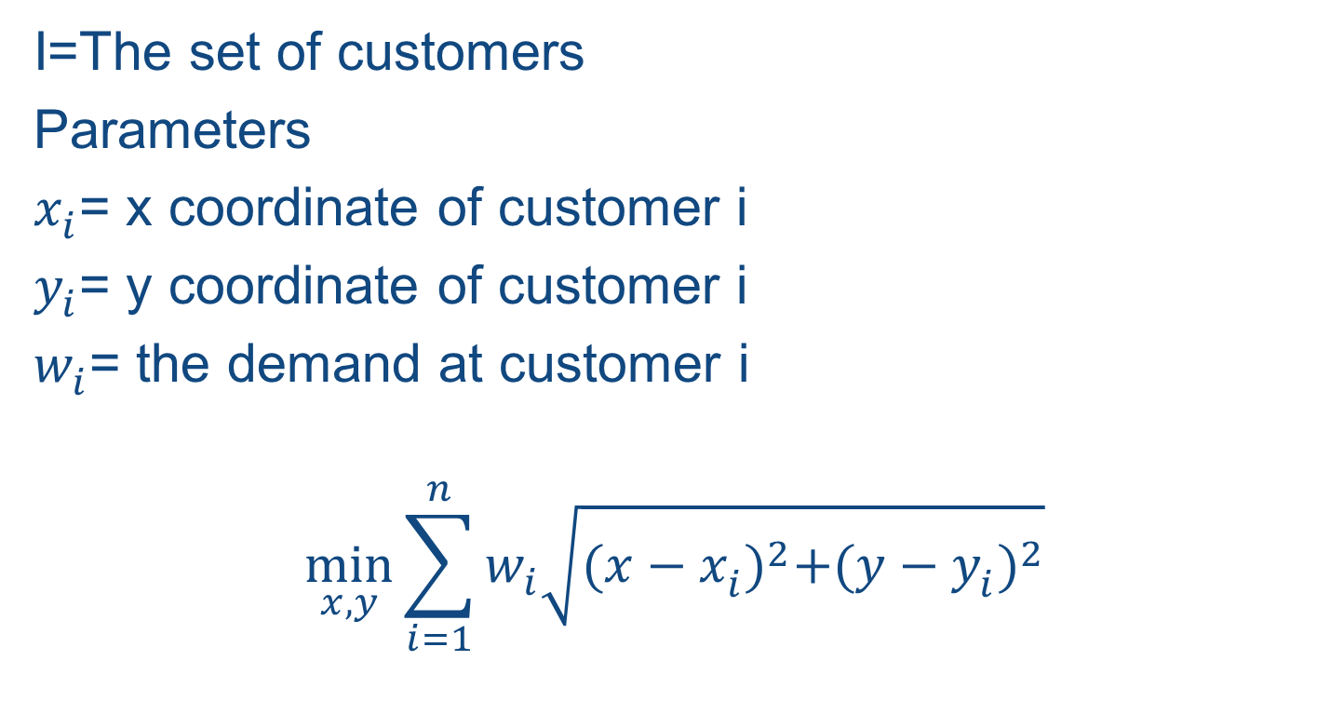
Warehouse Location at Lafferty
I=The set of customers
Parameters
$x_{i}^{ }$= x coordinate of customer i
$y_{i}^{ }$= y coordinate of customer i
$w_{i}^{ }$= the demand at customer i
$$\min_{x,y}{\sum_{i=1}^{n}{w_{i}^{ }\sqrt{{(x−x_{i}^{ })}^{2}+{(y−y_{i}^{ })}^{2}}}}$$

Slide 24
Models for rating sports teams
Sports fans always wonder which team is best in a given sport. Was Florida State, Auburn, or Michigan State the best team during the 2013 NCAA football season?
You might be surprised to learn that Solver can be used to rate sports teams.

Slide 25
Methodology for rating sports teams (1 of 2)
We first need to explain the methodology used to rate teams. Suppose that a team plays at home against another team. Then our prediction for the point spread of the game (home team score minus visitor team score) is Predicted point spread = Home team rating - Visitor team rating + Home team advantage
The home team advantage is the number of points extra for the home team because of the psychological (or physical) advantage of playing on its home field. Football experts claim that this home team advantage in the NFL is about 3 points. However, we will estimate it, as well as the ratings.

Slide 26
Methodology for rating sports teams (2 of 2)
We define the prediction error to be Prediction error = Actual point spread - Predicted point spread
We determine ratings that minimize the sum of squared prediction errors. To get a unique answer to the problem, we need to “normalize” the ratings - that is, fix the average rating at some nominal value.

Slide 27
Portfolio optimization models (1 of 2)
Given a set of investments, how do financial analysts determine the portfolio that has the lowest risk and yields a high expected return?
This question was answered by Harry Markowitz in the 1950s. For his work on this and other investment topics, he received the Nobel Prize in economics in 1990.

Slide 28
Portfolio selection models
Most investors have two objectives in forming portfolios: to obtain a large expected return and to obtain a small variance (to minimize risk).
The problem is inherently nonlinear because variance is a nonlinear function of the investment amounts.
The most common way of handling this two-objective problem is to require a minimal expected return and then minimize the variance subject to the constraint on the expected return.

Slide 29
Defining the Objective
Minimize the portfolio variance (risk).
Notes:
pT Cp

Slide 30
Defining the Constraints
Expected return
0.0764 p1 + 0.1343 p2 + 0.1493 p3 >= 0.12
Proportions
p1 + p2 + p3 = 1
p1, p2, p3 >= 0
p1, p2, p3 <= 1

Slide 31
Conclusion
A large number of real-world problems can be approximated well by linear models.
However, many problems are also inherently nonlinear.
We have illustrated several such problems in this chapter, including the important class of portfolio selection problems where the risk, usually measured by portfolio variance, is a nonlinear function of the decision variables.

Slide 32
Chapter 8
Evolutionary Solver: An Alternative Optimization Procedure
Winston/Albright
Practical Management Science, 6e
© 2019 Cengage. May not be scanned, copied or duplicated, or posted to a publicly accessible website, in whole or in part.

Slide 33
Introduction (1 of 2)
In Chapters 3 through 7, we used Excel’s Solver to solve many interesting and important problems.
Unfortunately, there are many optimization problems where Solver’s Simplex LP and GRG Nonlinear algorithms are unable to find optimal solutions.
However, genetic algorithms often perform well on optimization problems where Solver’s other algorithms perform poorly.

Slide 34
Introduction (2 of 2)
The purpose of this chapter is to illustrate some interesting models that cannot be solved by the Solver algorithms discussed in previous chapters, at least not easily or without tricks, but can be solved with genetic algorithms in a reasonably straightforward manner.
A nonconvex function
A discontinuous function

Slide 35
Introduction to genetic algorithms (1 of 4)
In the early 1970s, John Holland of the University of Michigan realized that many features espoused in the theory of natural evolution, such as survival of the fittest and mutation, could be used to help solve difficult optimization problems.
Because his methods were based on behavior observed in nature, Holland coined the term genetic algorithm to describe his algorithm.
Simply stated, a genetic algorithm (GA) provides a method of intelligently searching an optimization model’s feasible region for an optimal solution.

Slide 36
Introduction to genetic algorithms (2 of 4)
Biological terminology is used to describe the algorithm.
The objective function is called a fitness function.
Specification of values for all changing cells is called a chromosome.
For most problems, a GA codes changing cells in binary notation. For example, 1001 represents
1(2³) + 0(2²) + 0(2¹) + 1(2⁰) = 8 + 1 = 9

Slide 37
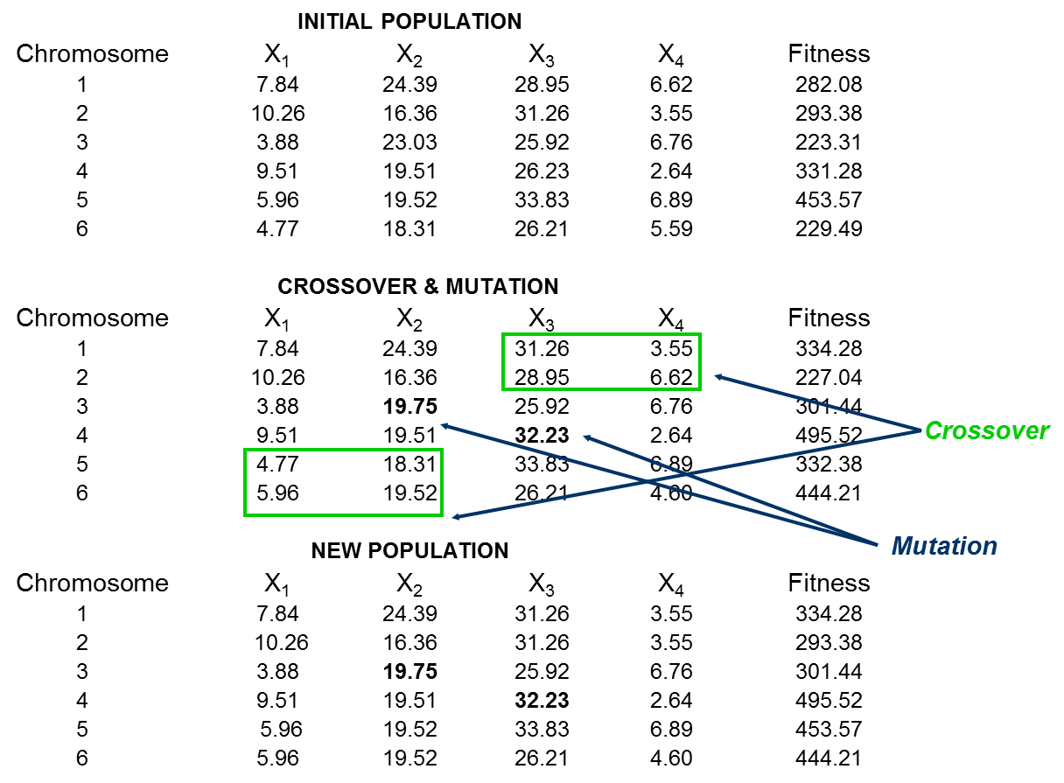

Slide 38
Using Evolutionary Solver (1 of 2)
Following is some general information about Evolutionary Solver:
Evolutionary Solver usually finds a good solution, but there is no guarantee that it will find the best solution.
A good starting solution - the values you place in the changing cells - usually helps Evolutionary Solver in its search for an optimal solution. However, the starting solution is not absolutely critical to success.
Much of the solution process is driven by random numbers that direct the search. Therefore, two people can get different solutions to the same problem. In fact, running Evolutionary Solver a second time can possibly yield a different solution! You can set a random seed parameter to get the same solution on two successive runs.

Slide 39
Using Evolutionary Solver (2 of 2)
After Evolutionary Solver has found a good solution, you can use the GRG Nonlinear Solver to try to find a slightly better solution. If there is no improvement, you can probably infer that the solution found by Evolutionary Solver is close to optimal.

Slide 40
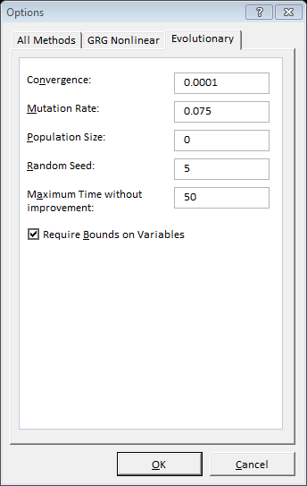
EXCEL EVOLUTIONARY SOLVER OPTIONS
In the Convergence box, type the maximum percentage difference in objective values for the top 99% of the population that Solver should allow in order to stop with the message “Solver converged to the current solution.” Smaller values here normally mean that Solver will take more time, but will stop at a point closer to the optimal solution.

Slide 41
EXCEL EVOLUTIONARY SOLVER OPTIONS
In the Mutation Rate box, type a number between 0 and 1, the relative frequency with which some member of the population will be altered or “mutated” to create a new trial solution, during each “generation” or subproblem considered by the Evolutionary method. A higher Mutation Rate increases the diversity of the population and the chance that a new, better solution will be found; but this may increase total solution time.

Slide 42
EXCEL EVOLUTIONARY SOLVER OPTIONS
In the Population Size box, type the number of different points (values for the decision variables) you want the Evolutionary method to maintain at any given time in its population of candidate solutions. The minimum population size is 10 members; if you supply a value less than 10 in this box, or leave it blank, the Evolutionary Solver uses a population size of 10 times the number of decision variables in the problem, but no more than 200.

Slide 43
EXCEL EVOLUTIONARY SOLVER OPTIONS
In the Random Seed box, type a positive integer number to be used as the (fixed) seed for the random number generator used for a variety of random choices in the Evolutionary method. If you enter a number here, the Evolutionary method will use the same choice each time you click Solve. If you leave this box blank, the random number generator will use a different seed each time you click Solve, which may yield a different (better or worse) final solution.

Slide 44
EXCEL EVOLUTIONARY SOLVER OPTIONS
In the Maximum Time without Improvement box, type the maximum number of seconds you want the Evolutionary method to continue without a meaningful improvement in the objective value of the best solution in the population, before it stops with the message “Solver cannot improve the current solution.

Slide 45
EXCEL EVOLUTIONARY SOLVER OPTIONS
Select the Require Bounds on Variables check box to specify that the Evolutionary method should run only if you have defined lower and upper bounds on all decision variables in the Constraints list box. The Evolutionary method is far more effective if you define bounds on all variables; the tighter the bounds on the variables that you can specify, the better the Evolutionary method is likely to perform.

Slide 46
Forming Fair Teams
The director of an MBA program wants to form project teams for the incoming class of students. There are 34 students and he wants to create 7 teams so that the average GMAT score for each team is as similar as possible.

Slide 47
The traveling salesperson problem (1 of 2)
One of the most studied management science problems (at least by academics) is called the traveling salesperson problem.
Although easy to state, the problem is very difficult to solve.
A salesperson must travel from his home base to a number of other cities, visiting each city exactly once, and finally return to his home base.
The goal is to find the route that has the shortest total distance.

Slide 48
The traveling salesperson problem (2 of 2)
For n cities, there are n! permutations of the numbers 1 through n.
This explosion in the number of permutations is what makes the problem so difficult.
Nevertheless, it is easy to model the problem in such a way that Evolutionary Solver can be used to find good, and possibly even optimal, solutions.
Example 8.7 illustrates the method.

Slide 49
The Traveling Salesperson Problem
Wolverine Manufacturing needs to determine the shortest tour for a drill bit to drill 9 holes in a fiberglass panel.

Slide 50
Loading products on a truck
A gas truck contains five compartments with the capacities listed on the spreadsheet Loading. Three products must be shipped on the truck, and there can be only one product per compartment. The demand for each product, the shortage cost per gallon, and the maximum allowable shortage for each product are listed on the spreadsheet Loading. How should the truck be loaded to minimize the shortage costs.

Slide 51
Conclusion (1 of 3)
This chapter contains cutting-edge material.
The Simplex LP and GRG Nonlinear Solvers have been available for several years to solve many linear, integer, and nonlinear problems.
However, they have not been able to solve the types of problems discussed in this chapter, except possibly by employing tricks or by using a lucky initial solution.

Slide 52
Conclusion (2 of 3)
With Evolutionary Solver now available to a large audience, a much wider variety of problems can be solved, and the spreadsheet models are usually straightforward - they do not require tricks.
Evolutionary Solver is typically much slower than other Solver algorithms, especially for linear models with many constraints, because it uses a totally different search procedure.

Slide 53
Conclusion (3 of 3)
Because of this, we do not recommend that you try Evolutionary Solver unless your model contains functions such as IF, COUNT, COUNTIF, SUMIF, MIN, MAX, and ABS that the other Solvers cannot handle reliably.
But if your model is formulated more naturally by using such functions, or if you can think of no other way of formulating it, then Evolutionary Solver can be very useful.

