Slide 1
TOPOLOGICAL DATA ANALYSIS IN TEXT CLASSIFICATION: EXTRACTING FEATURES WITH ADDITIVE INFORMATION
Kunlin

Slide 2
TDA Pipeline
Raw data => Summary of main features
Choose a dataset
Data representation
Data grouping
Network construction
Network/Graph feature extraction
Downstream task with other methods:
Statistics
Machine Learning
Operation Research
…

Slide 3
Overview
Motivation: defining shapes in the text
Topological features extraction from text
Homological persistence to reveal geometric structures
Finding:
Topological features help improve classification results
Only topological features are not sufficient

Slide 4
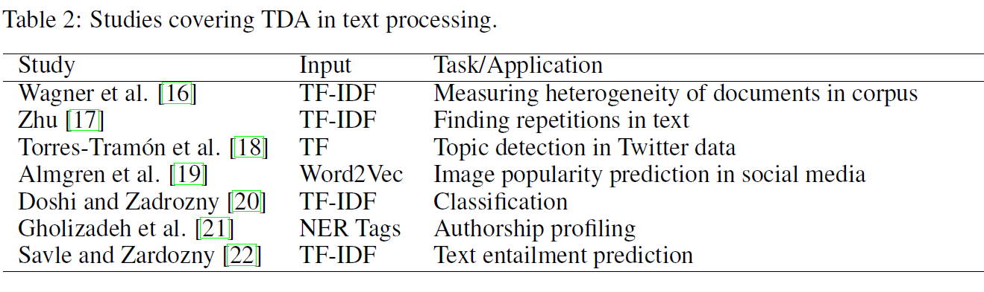
Background/Related Work/Literature Review
Topological Data Analysis:
Simplicial complexes for shape studying
Simplex: k-simplex → k+1 fully-connected data points
Betti numbers: i-th number → i-dimensional holes in a simplicial complex
Persistent homology: to find topological patterns of data
TDA in Text Processing

Slide 5
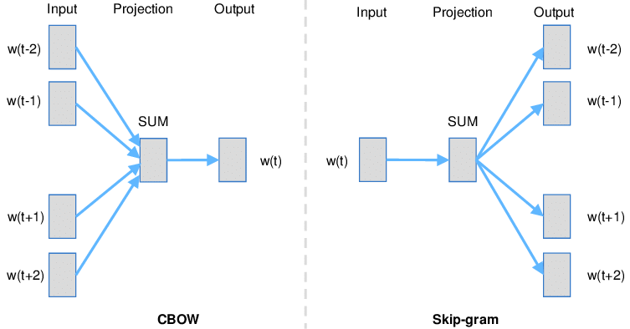
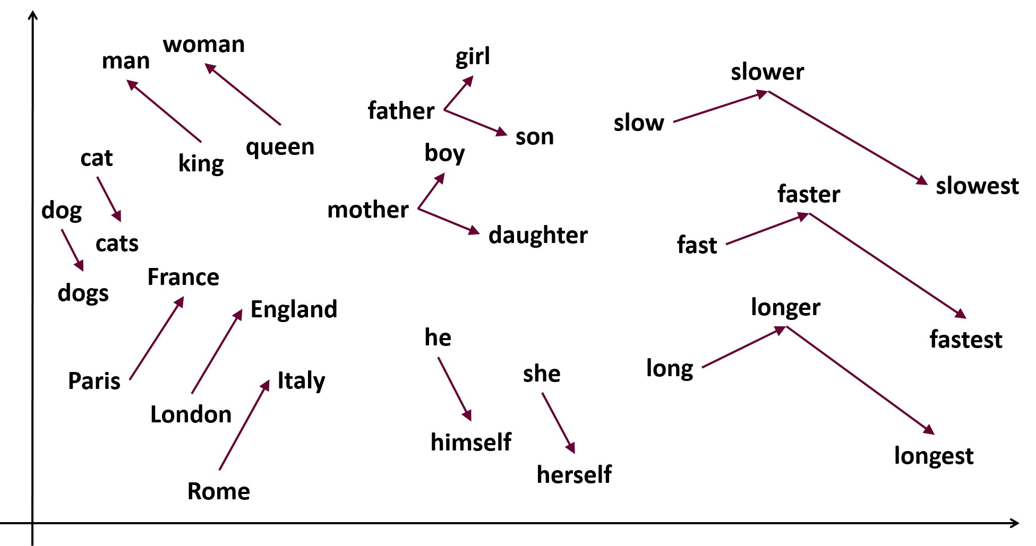
Word embeddings – word2vec

Slide 6
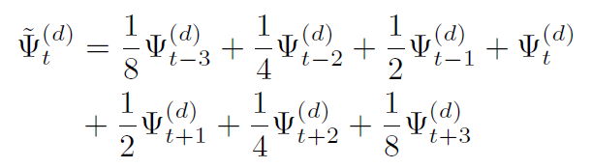
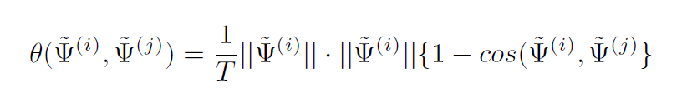

Method – word embeddings
Smoothing for word embedding:
Distance:
Thus get a graph:

Slide 7
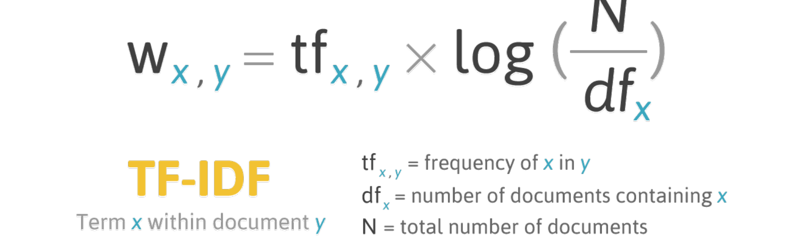
TF-IDF
To reflect how important a word is to a document in a collection or corpus.

Slide 8
Method – TF-IDF
Divide each document into 10 consecutive blocks of equal size.
Why 10?
Calculate TF-IDF for each block.
Summarize topological features:
# of loops
Avg diameter of birth
Avg diameter of duration
STD of birth diameters
STD of duration diameters

Slide 9
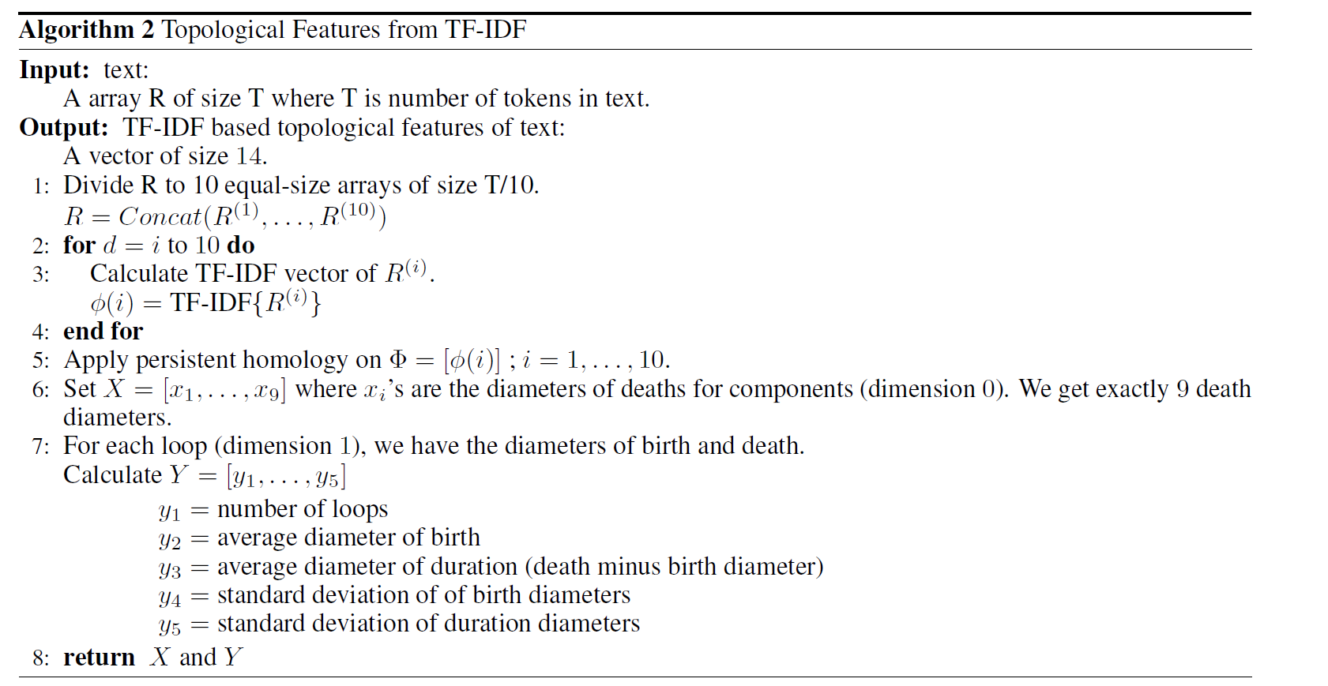
Method – TF-IDF

Slide 10
Method – TF-IDF

Slide 11
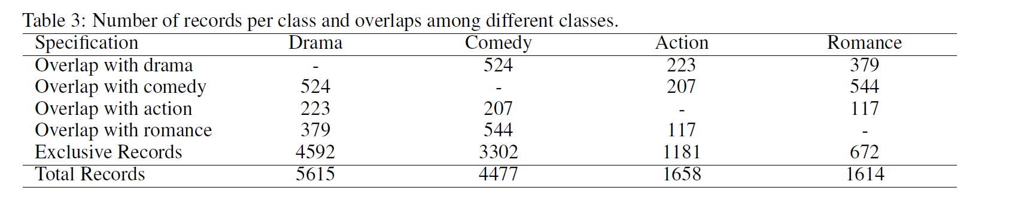
Experiments
Dataset: Wikipedia Movie plots
Four genres: Drama, Comedy, Action, Romance
Only keep plots with words > 200
Size of dataset: 11500
Train/Test: 2:1

Slide 12
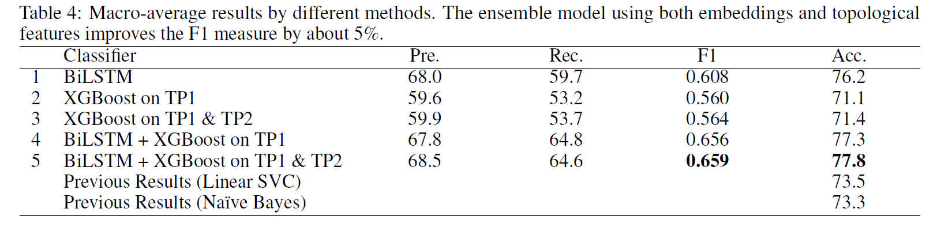
Results

