Slide 1
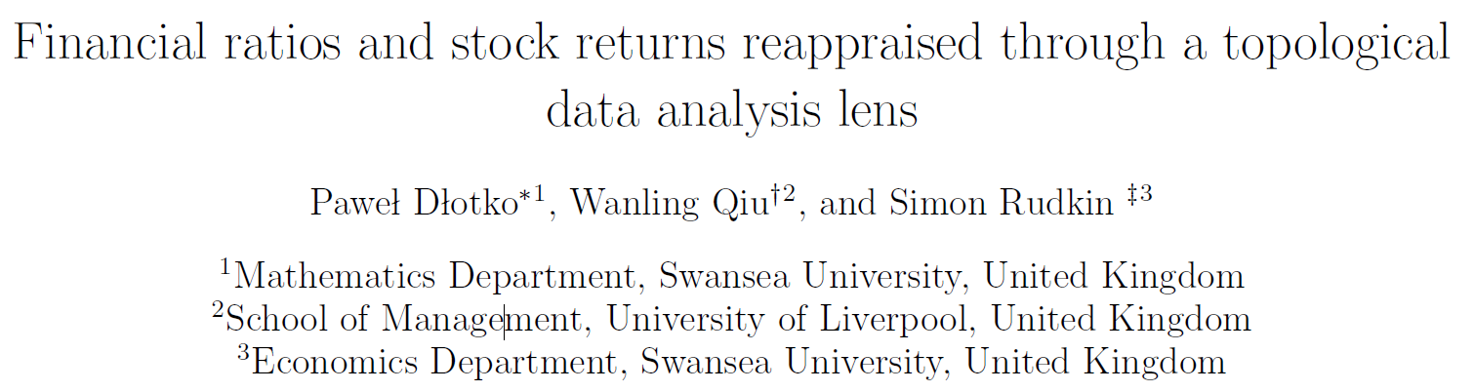
Financial ratios and stock returns reappraised through a topological data analysis lens
Kunlin

Slide 2
Overview
Motivation: relation between financial ratios and stock returns
TDA for visualization
Easy for investor to exploit

Slide 3
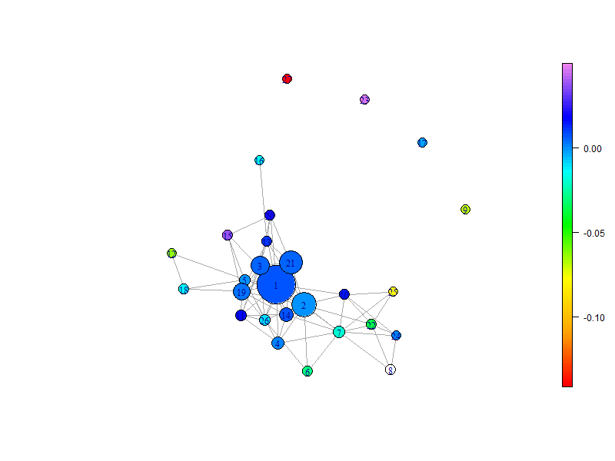
Background
Book-to-market ratio: 市值账面比的倒数
TDA Ball Mapper

Slide 4
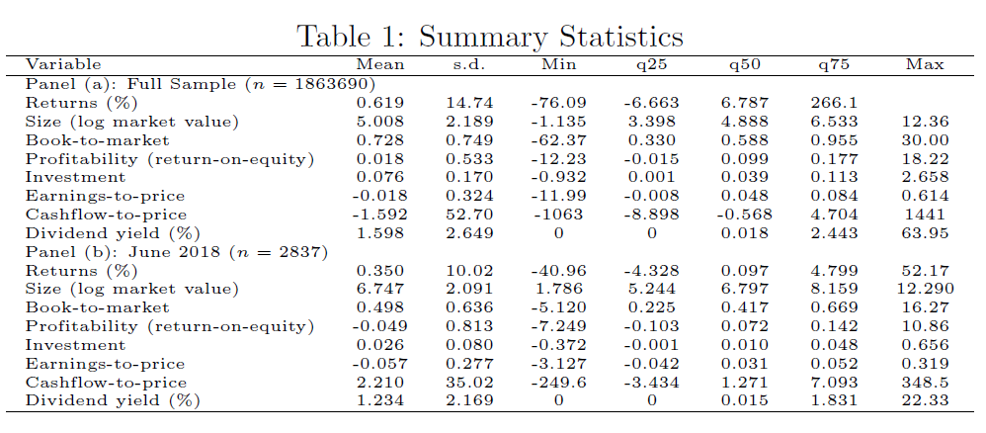
Data
Stock data: CRSP
Financial ratios
Time: 1976-2028

Slide 5
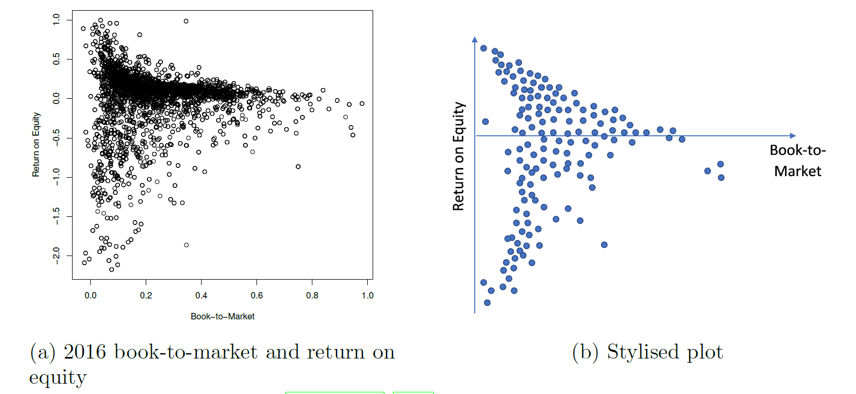
TDA Ball Mapper

Slide 6
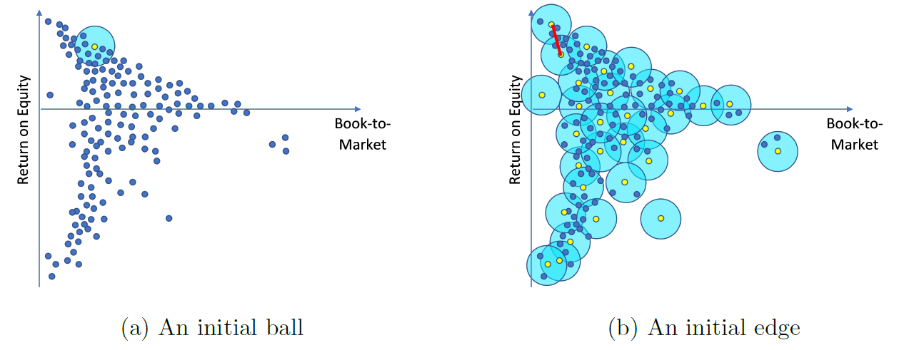
TDA Ball Mapper

Slide 7
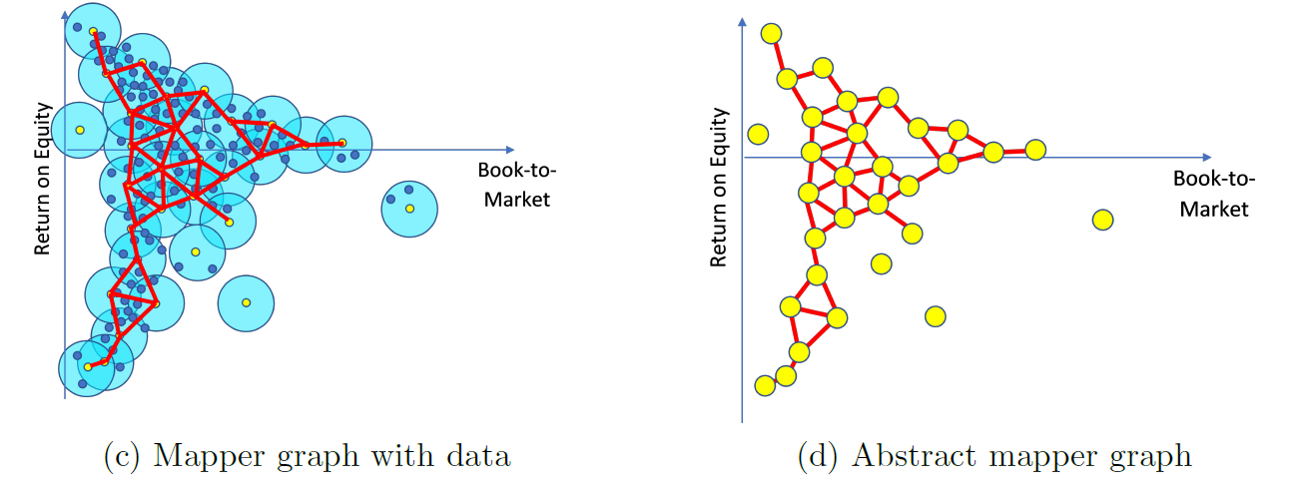
TDA Ball Mapper

Slide 8
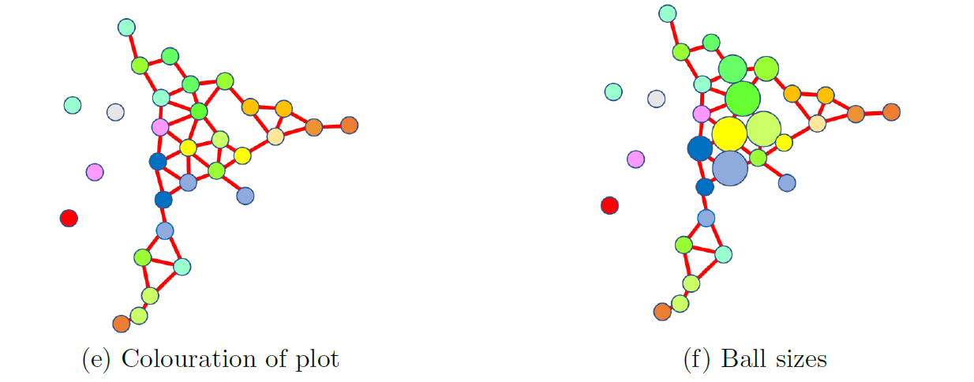
TDA Ball Mapper

Slide 9
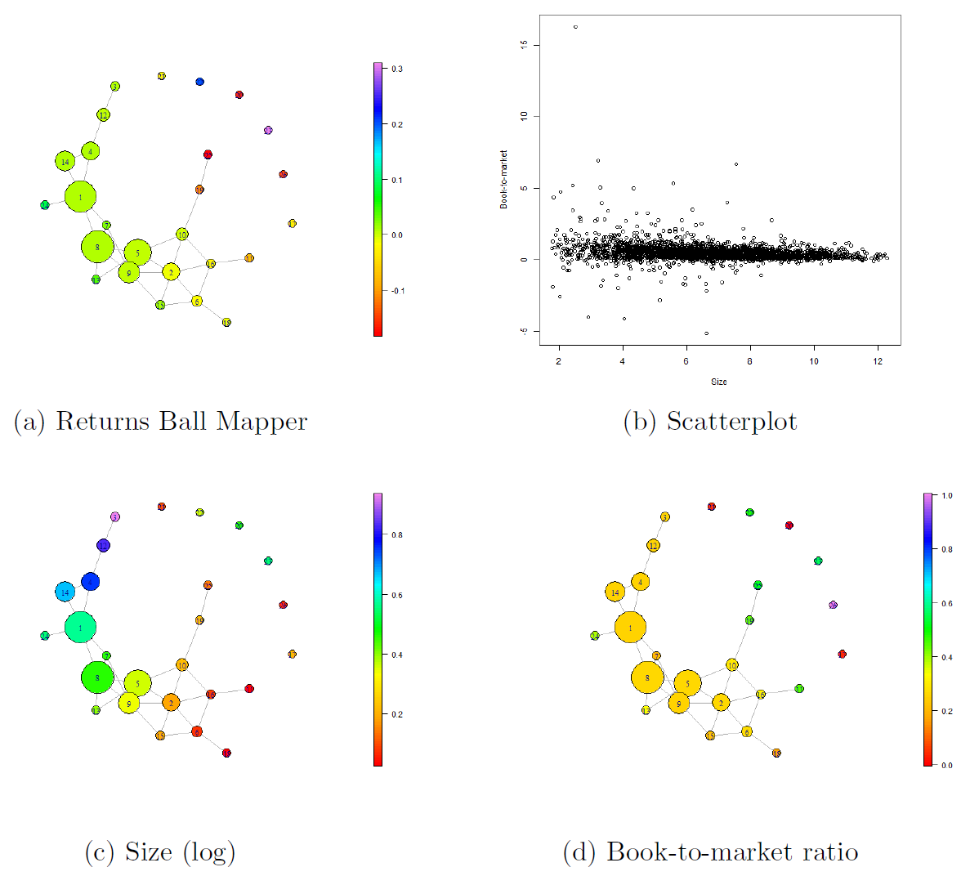
Bivariate Example

Slide 10
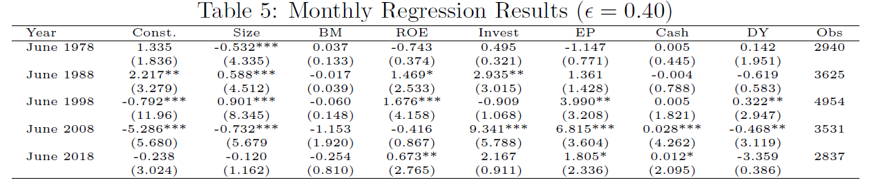
Regression

