Slide 1
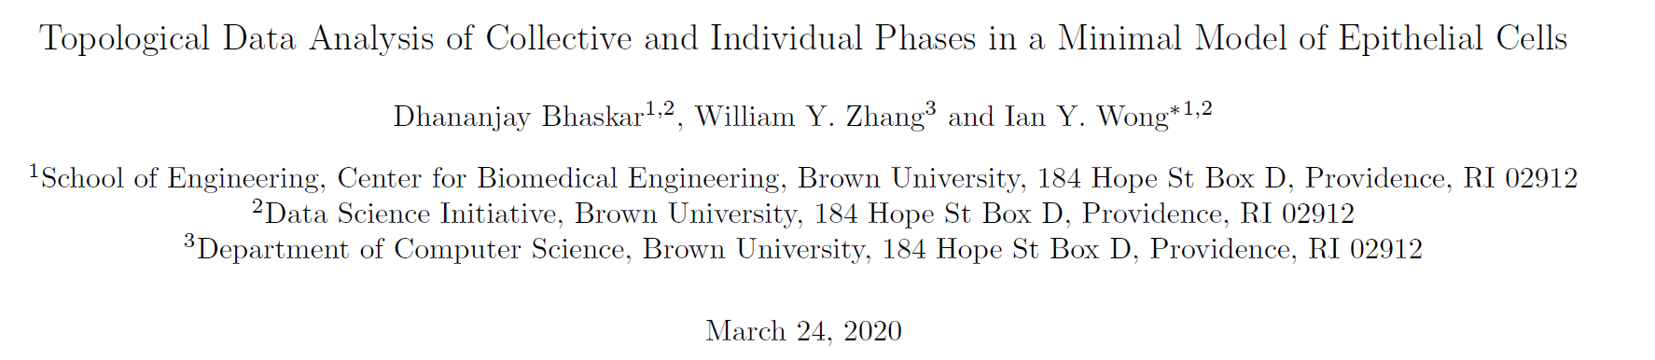
Topological Data Analysis of Collective and Individual Phases in a Minimal Model of Epithelial Cells
Kunlin

Slide 2
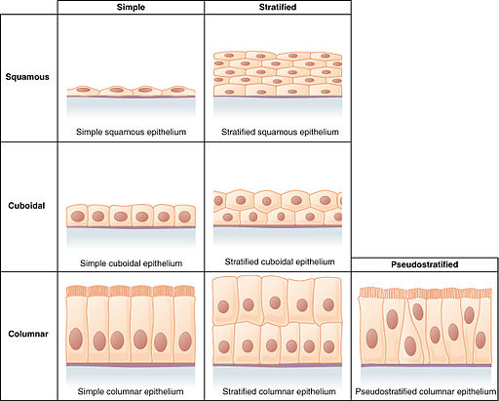
Overview
Epithelial Cells: 上皮细胞
Cell number and density can vary dramatically over time due to proliferation
Goal: An unbiased machine learning approach to analyze multiparticle clusters based on topological structure
Expectation: Robust to different population size

Slide 3
Overview
Why TDA:
Mathematical framework for visualizing underlying structure of high dimensional datasets based on spatial connectivity
Determine the stability of spatial connectivity between features at varying length scales (persistent homology)
Unbiased & unsupervised classification of distinct phases and tranistions
Model-agnostic approach to analyze active systems

Slide 4
Computational Model -- Setup
Cell → self-propelled particles
Particles travel at constant v but randomly polarize in new directions at constant intervals
Particles interact with neighbors through short-range repulsion and attractive interaction
Particles can proliferate at regular intervals unless surrounded by 4+ neighbors

Slide 5
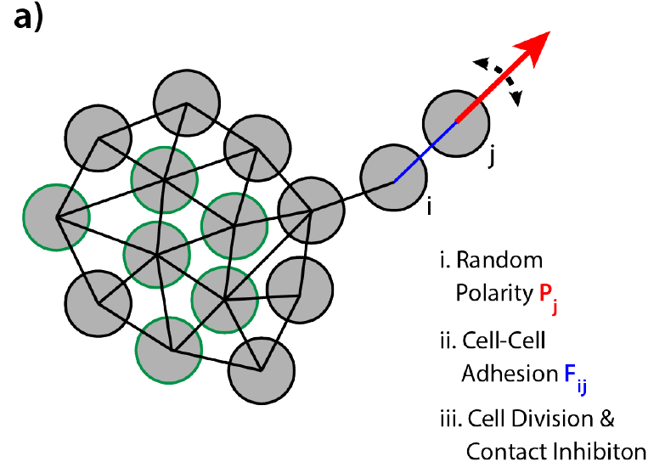
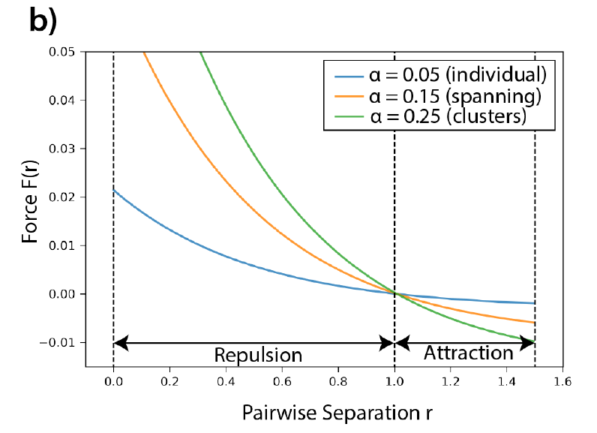
Computational Model -- Setup

Slide 6
Computational Model -- Setup
Simulation
200 particles
20*20
At initial stage, particles are ensure not too close to each other
Neighbors if r<1

Slide 7
TDA
Discrete data points (point cloud) → noisy sampling of lower-dimensional topological space
Represent point cloud by connected components at varying scale to extract topological features
2-D point cloud representing cell positions, edges and loops
Visualize robustness via topological barcodes (over different length)

Slide 8
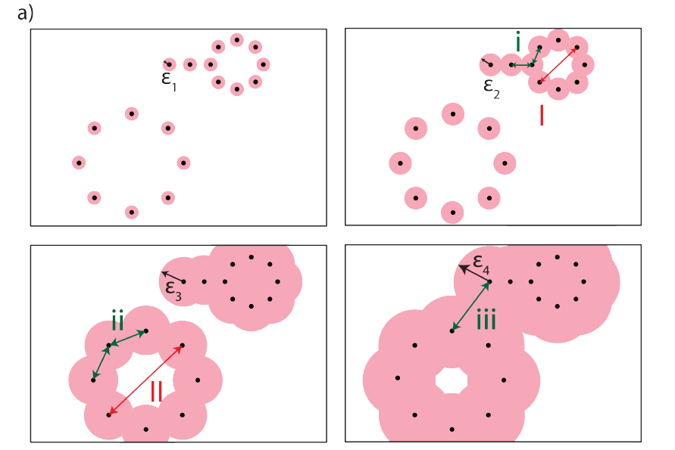
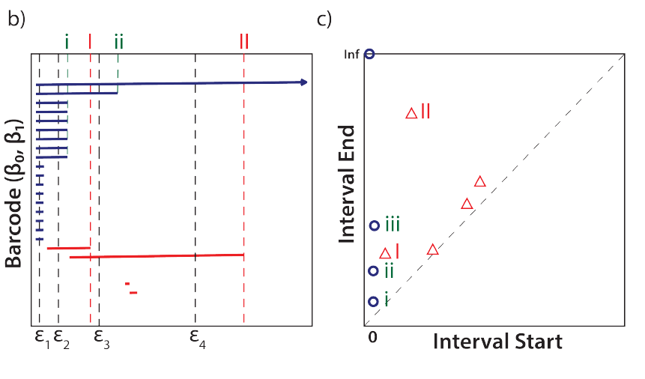
Topological Barcodes

Slide 9
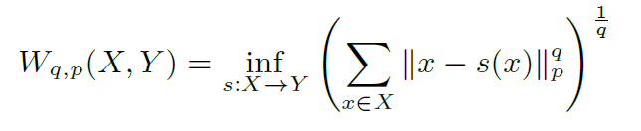
Wasserstein Distance
For comparison between two persistence diagrams X & Y
Bijection X → Y: off-diagonal points in X → off-diagonal points in Y
For unequal number of points → project to diagonal: ignore them

Slide 10
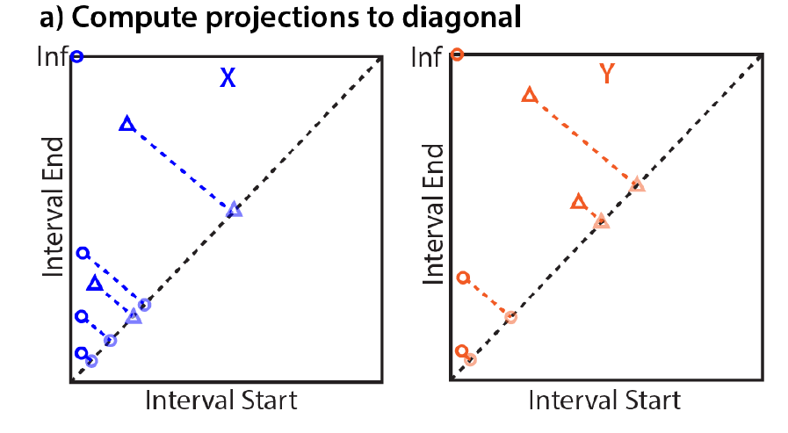
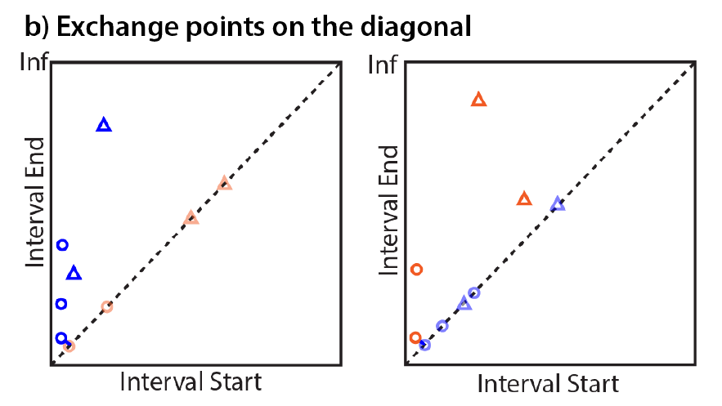
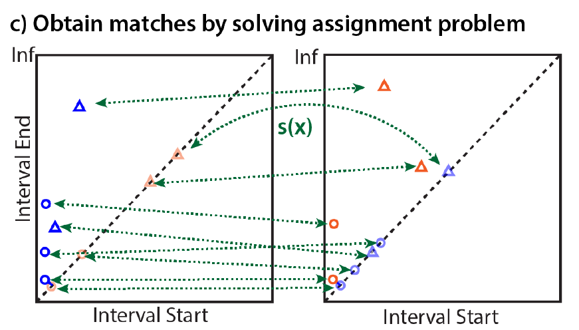
Wasserstein Distance

Slide 11
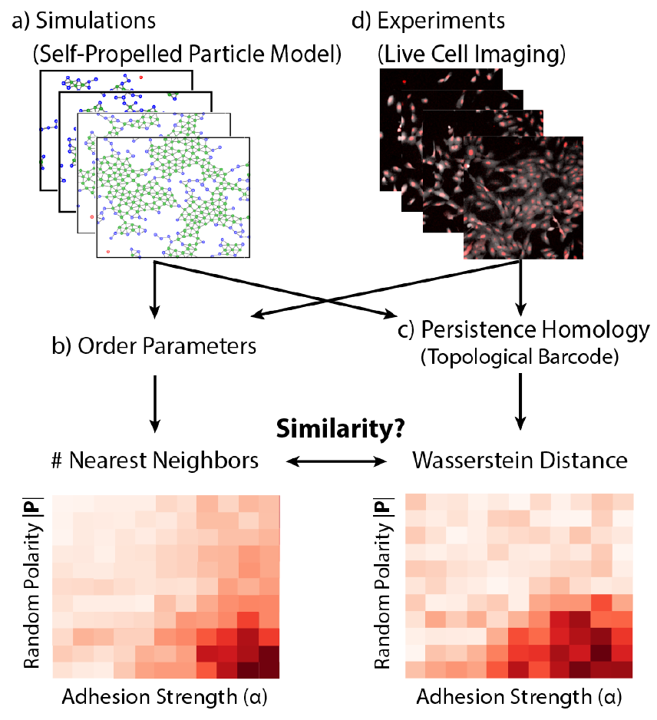
Results
Comparing Topological Structures using Wasserstein Distance

Slide 12
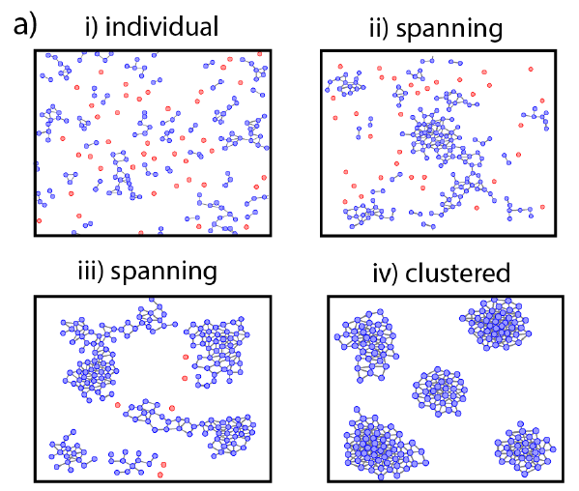
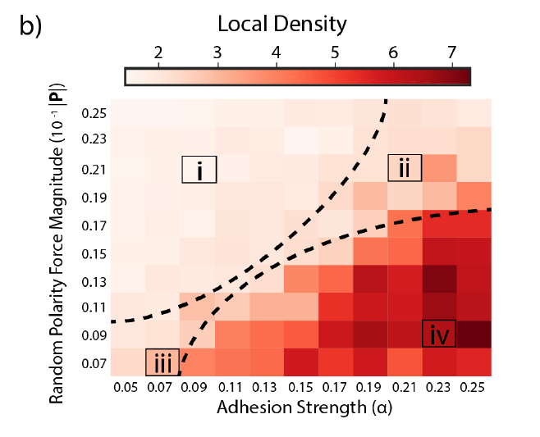
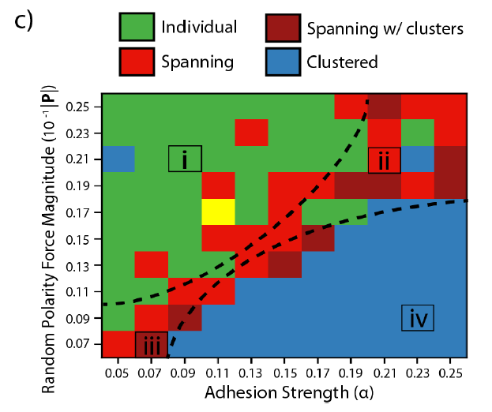
Results
Individual and Clustered Phases Exhibit Distinct Topological Structure at Constant Population Size

Slide 13
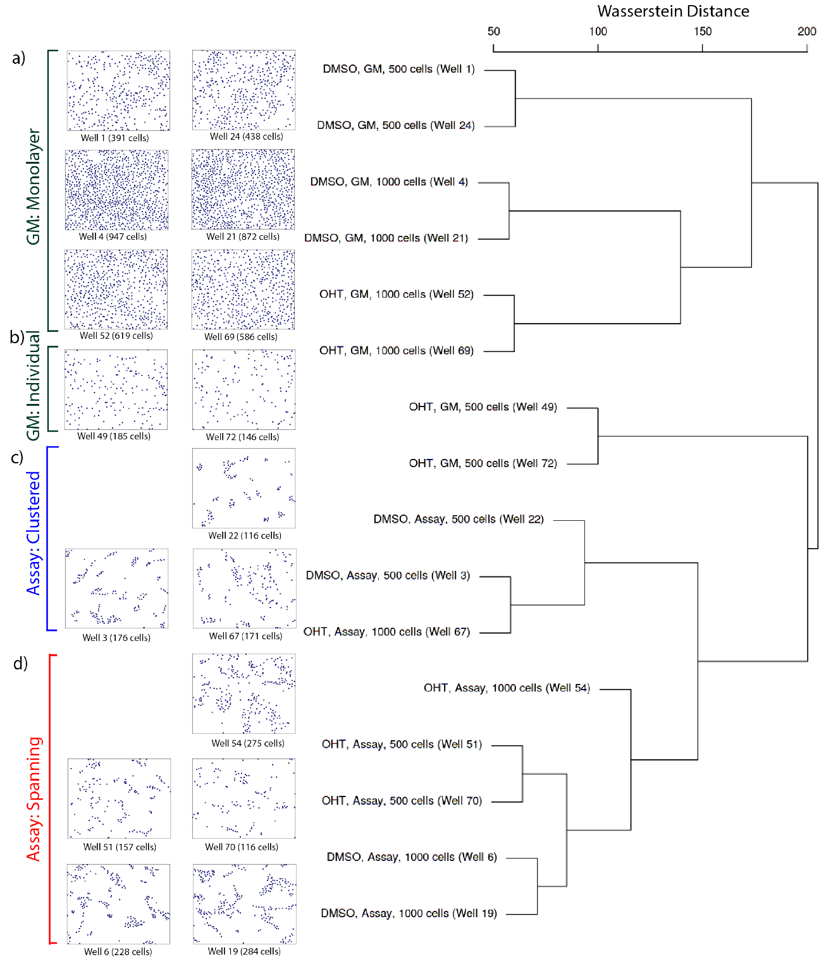
Results
Classification on experimental conditions

Slide 14
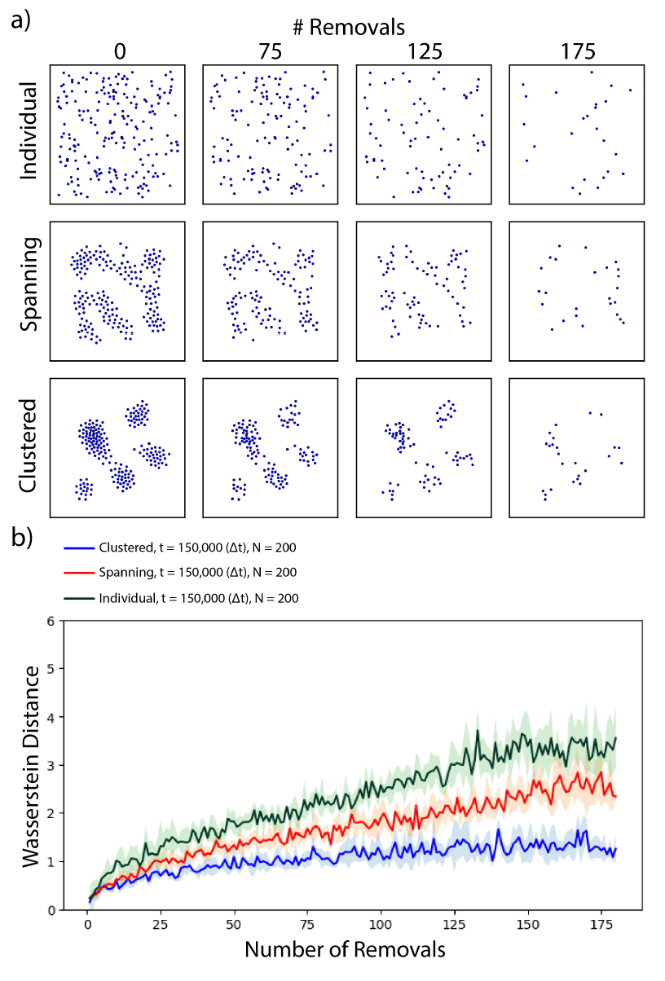
Results
Random removal

