Slide 1

Automatic Air Defense System

Slide 2
Automatic Air Defense System
Overview
The purpose of this presentation is to provide an overview of an automatic air defense system that utilizes the HC-SR04 ultrasonic sensor to detect, track, and respond to aerial threats.

Slide 3
Problem Statement
The goal is to develop an object detection system using ultrasonic sensors that scans the environment, detects objects, and verifies their presence with precision.
Methodology
The system uses a radar ultrasonic sensor for initial scanning and a pinpoint sensor for validation. The radar servo sweeps across a specified range, detecting objects within 20 cm, while the pinpoint sensor aligns to verify detection. The servo motors are controlled, and distances are measured using ultrasonic pulses.

Slide 4

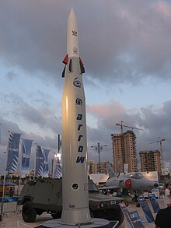
Introduction to Air Defense Systems
Threat detections
Identify and classify potential threats in the airspace using advanced sensors and algorithms.
Tracking and Targeting
Continuously monitor and precisely track the location and movement of detected threats.
Defensive Response
Initiate a controlled and effective defensive response, such as launching countermeasures or activating physical barriers.

Slide 5
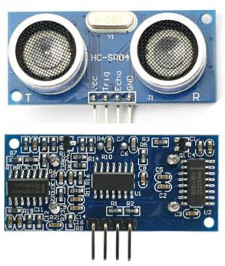
Ultrasonic Sensor: Working Principle and Applications
Ultrasonic Waves
The sensor emits ultrasonic waves that bounce off objects, measuring the time of flight to determine distance.
Applications
Used in various applications, including robotics, obstacle detection, and distance measurement systems.

Slide 6
Arduino UNO Microcontroller: Programming and Integration
Arduino UNO
The Arduino UNO is a popular microcontroller platform for which offers a user-friendly environment for programming and controlling electronic devices.
Programming
The Arduino IDE allows users to write code in C++, enabling control of the sensor data and the servo motors.

Slide 7
Algorithm Summary
Setup:
We set the pins for two ultrasonic sensors (Radar and Pinpoint) and two servo motors.
Initialize serial communication and set servos to their starting positions.
Main Loop:
The radar servo sweeps within a defined angle range (15° to 165°).
We now measure distance using the radar sensor.
If the radar detects an object (≤20 cm), align the pinpoint servo to the radar's angle.
Verify the object's presence with the pinpoint sensor and log the result.
Adjust the radar angle for continuous sweeping (increment or decrement).
Distance Calculation Function:
Trigger an ultrasonic pulse.
Measure the echo duration.
Calculate distance in cm using the formula: distance=duration×0.034/2

Slide 8
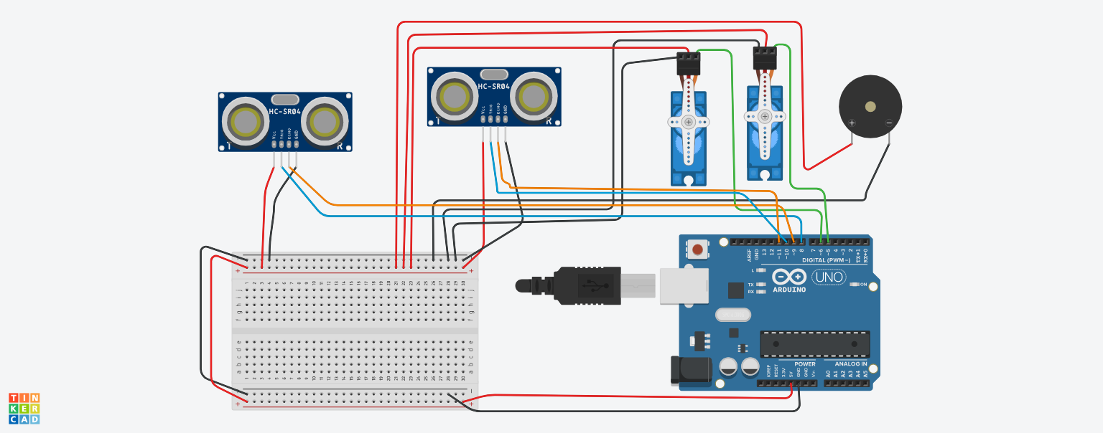
CIRCUIT DIAGRAM –

Slide 9

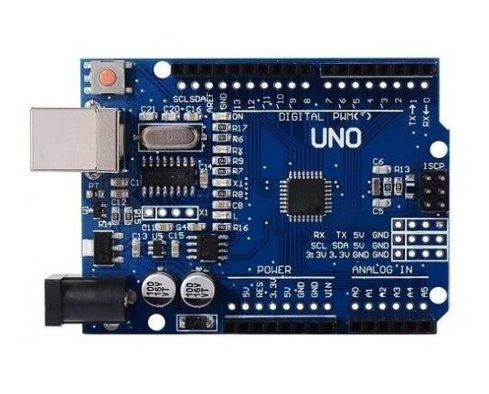

System Architecture and Component Connections
HCSR-04 :- The sensor detects the threat, sending data to the Arduino UNO.
Arduino UNO :- processes the data and controls the servo motors based on the threat's position.
Servo motors :- Adjust the platform's orientation to target the threat.
Buzzer :- It is used to generate a beeping sound when object is detected

Slide 10
Application in Real Life
1
Security
The system can be utilized for protecting critical infrastructure, military installations, and civilian areas.
Safety
By providing an automated defense mechanism, the system can improve safety and security in high-risk environments.
2

Slide 11
Results and discussion
Results-
The system successfully detects objects within a 20 cm range, aligns the pinpoint sensor to the radar's angle, and verifies object presence with high accuracy.
Discussion-
The combination of radar and pinpoint sensors provides reliable object detection, but accuracy can be improved with advanced sensors like LiDAR. Future work could focus on extending range and incorporating real-time data transmission.

Slide 12
Challenges
Accuracy
Air defense faces challenges like detecting stealth technologies and responding to hypersonic weapons. Coordinating systems in real-time during complex attacks adds to the difficulty.
Range
Range challenges in air defense technology include detecting and targeting threats at long distances while maintaining accuracy. Adapting to varying altitudes and speeds of modern aerial threats further complicates effective interception.

Slide 13
Conclusion and Future Enhancements
Conclusion
The system effectively detects objects using a radar sensor and aligns the pinpoint sensor for validation.
It demonstrates efficient scanning and object localization within a defined range.
Future Enhancements
Integrate multiple pinpoint sensors for enhanced accuracy.
Utilize LiDAR technology for improved range, precision, and 3D mapping capabilities.
Add wireless communication to transmit data remotely.
Implement AI for advanced object classification.

Slide 14
THANK YOU !

