Slide 1
Temporal Multiplexing via Trainable Synaptic Delays in SNNs
Progress Report · Steps 1–2 (Plans A, C, D)
SNN Async Delays Project · May 2026
Imperial College London

Slide 2
Research Question
given a fixed number of hidden neurons, can trainable synaptic delays allow the network to handle more parallel queries simultaneously, without sacrificing accuracy?
Primary Metric: Max K @ accuracy ≥ 90% under fixed h (neurons) and energy budget (spikes/trial)
Training Mode | Weights | Delays | Key Property
weights_only | Trained | Fixed at 0 | Baseline — no temporal routing
delays_only | Frozen (random) | Trained | Timing only — collapses on hard ops
weights_and_delays | Trained | Trained | Full model — primary condition
Task: 8 Boolean ops (NAND, AND, OR, XOR, …) | Network: 2 inputs → h LIF neurons → readout | Encoding: rate coding (A=1→400 Hz, A=0→10 Hz, dt=1 ms) | Delays: sigmoid-parameterised, learnable

Slide 3
Step 1: Single Boolean Op — Baseline Solvability
Config: 8 ops × 3 modes × h ∈ {10, 20, 50}, 200 epochs, seed=42, GPU
Hidden h | weights_only | delays_only | weights_and_delays
h = 10 | 0.853 | 0.706 | 0.924
h = 20 | 0.888 | 0.753 | 0.962
h = 50 | 0.893 | 0.753 | 0.974
Mean | 0.878 | 0.737 | 0.954
Runs ≥ 95% | 0 / 24 | 0 / 24 | 15 / 24
Energy (h=50): weights_and_delays 27.7 spk/trial vs weights_only 34.1 spk/trial → −19%
weights_and_delays dominates: +7–8% accuracy at every h
delays_only collapses on XOR/XNOR (mean 0.58 ≈ chance)
NAND selected for Step 2: most stable at 98.9% (h=50)
Energy bonus: 19% fewer spikes at higher accuracy with delays

Slide 4
Plan A: Serial Time Slots — Discovering the Alignment Mechanism
Design: K queries injected in K serial slots • Each slot: input window [0, 20ms) + readout window [20, 30ms) + gap [30, 35ms) • Per-slot independent readout • T = K × 35ms
K | w_and_d acc | weights_only_d0 acc | Gap
1 | 95.1% | 79.7% | +15.4%
2 | 95.7% | 78.4% | +17.3%
4 | 97.1% | 79.6% | +17.5%
8 | 97.1% | 79.4% | +17.7%
12 | 96.6% | 80.4% | +16.2%
20 | 97.3% | — | —
⚠ Mechanism = Time Alignment, not true multiplexing Weights-only fails because input ends at t=20ms while readout is [20,30ms]: membrane decays to 13.5% by readout start. Delays (median ≈9ms) shift spikes into the readout window. LIF decay (slot=35ms, τ=10ms) gives ~3% cross-slot residual → natural isolation.
Max K @ 95%: w_and_d = ≥20 (no ceiling) | weights_only = 0
Notes:
"Plan A is the most natural multi-query design. I divide the trial into K serial time slots — each slot is thirty-five milliseconds long, consisting of a twenty-millisecond input window, a ten-millisecond readout window, and a five-millisecond gap. Each query gets its own slot, and the readout for each query happens independently within that slot. So the total trial length scales as K times thirty-five.

Slide 5
Plan C: Simultaneous Multi-Channel — Alignment vs Capacity
Design: 2K dedicated input channels (A₀,B₀,…,Aₖ₋₁,Bₖ₋₁) • All K queries injected simultaneously • Fixed T=30ms • Single shared readout window
K | w_and_d (A) | w_only_d20 (B) | w_only_d0 (C) | A−B (capacity) | B−C (alignment)
1 | 97.3% | 95.7% | 80.1% | +1.6% | +15.6%
2 | 95.2% | 92.9% | 77.4% | +2.3% | +15.5%
4 | 93.2% | 89.4% | 77.0% | +3.7% | +12.4%
6 | 89.9% | 86.6% | 76.9% | +3.3% | +9.7%
8 | 88.6% | 86.5% | 76.0% | +2.2% | +10.5%
12 | 86.6% | 85.5% | 75.9% | +1.1% | +9.6%
Mean | — | — | — | +2.7% | +11.8%
Alignment effect B−C = +11.8% (4.3× larger) Capacity effect A−B = +2.7% Max K@90%: w_and_d=5, d=20=3, d=0=0
Conclusion: Delays' primary value is temporal alignment (+11.8%). Capacity gain (+2.7%) is real but small — 2K spatial channels already separate queries.
Notes:
The design change is: instead of serial slots, all K queries are injected simultaneously, and I give each query its own dedicated pair of input channels — so the network has two K input neurons. The trial length is fixed at thirty milliseconds regardless of K.
Condition B uses trainable weights but fixes all delays to a constant twenty milliseconds — so there is alignment but no adaptive timing.
Condition C is weights-only with delays fixed to zero — this is the no-delay baseline.
The A-minus-B column is the capacity effect — what trainable delays add on top of fixed alignment — and it averages just plus two-point-seven percent. The ratio is 4.3 times: alignment is the dominant contribution, four times larger than the capacity gain.
Now, the reason the capacity effect is small is that Plan C already gives the network an easy way to separate queries — dedicated input channels. Weights alone can learn to route the right channel to the right readout. So trainable delays only need to polish an already-good solution. This motivated Plan D: what happens if I take away those dedicated channels and force the network to rely entirely on timing?"

Slide 6
Plan D: Shared-Channel Sequential Injection — The Critical Test
Motivation: Plan C's capacity effect (+2.7%) is small because 2K spatial channels let weights do query separation. Plan D forces time-only separation.
Design Element | Plan A | Plan C | Plan D
Input channels | 2 shared | 2K dedicated | 2 shared
Query injection | Serial slots | Simultaneous | Serial sub-windows
Readout windows | K per-slot | 1 shared | 1 shared (all K)
Trial length T | K × 35ms | 30ms fixed | K × 10ms + 10ms
d=0 can separate? | ✓ (alignment) | ✓ (spatial) | ✗ (structurally impossible)
Why d=0 structurally fails in Plan D: • Weight w₊ⱼ cannot distinguish t=0 from t=10 — same weight fires identically for every query • Only delay d₊ⱼ routes query k's spikes to distinct readout timing • LIF residual: e⁻¹⁰ᵀ¹⁰ = 37% cross-slot membrane leakage • sub_win=10ms, τₘₑₘ=10ms chosen to demonstrate delay routing under realistic constraints
Timeline (K=3 example): [q₀: 0–10ms] [q₁: 10–20ms] [q₂: 20–30ms] | readout [30–40ms]
Single shared readout Linear(h, K) decodes all 3 answers simultaneously from the same hidden population.
Notes:
I go back to just two input channels — one for A, one for B — shared across all K queries. Queries are injected sequentially in sub-windows of ten milliseconds each. After all K sub-windows, there is a single shared readout window where the network must output all K answers simultaneously.
Because with only two shared input channels, the weights cannot distinguish one query from another. The weight from input A to hidden neuron j is a single scalar — it fires identically when A equals one, regardless of whether that happened in sub-window zero, one, or two.
The only thing that can encode which sub-window a spike came from is its timing. So delays are not merely helpful in Plan D — they are the only structural mechanism available. Weights-only with d equals zero is guaranteed to fail before I even run the experiment.

Slide 7
Plan D: Linear Readout Results — Max K@90% = 2
K | h=20 acc | h=50 acc (mean±std, 4 seeds) | ≥90%? (h=50)
1 | 94.9% | 95.05 ± 0.21% | ✓ (4/4)
2 | 91.2% | 92.20 ± 0.75% | ✓ (4/4)
3 | 83.5% | 87.52 ± 1.04% | ✗ (0/4)
4 | 82.9% | ~86% | ✗
5 | 80.9% | ~83% | ✗
Bottleneck Diagnosis h=20 → h=50 (+150% neurons): accuracy improves only +1–4% If neuron count were the bottleneck, we’d expect larger gains. True bottleneck: shared single readout Linear(h, K) must simultaneously decode K mixed membrane-potential signals where each query’s residual ≥37% leaks into the next slot.
d=0 baseline (all K): ~76–80% | Delay advantage at K=2: +16.2pp
Multi-seed stability (h=50): K=2 std=0.75%, K=3 std=1.04% — result is reproducible (4 seeds: 0, 1, 2, 42).
► Conclusion: Max K @ 90% = 2 with linear readout, regardless of h. The bottleneck is the decoder, not the SNN.
Notes:
At h=20, the network gets 94.9% at K=1 and 91.2% at K=2, just above the ninety percent threshold. K=3 drops to 83.5%. So Max K at ninety percent is 2 for h=20.
To test whether this is simply a capacity problem — not enough neurons — I ran the same experiment at h=50, and validated across four seeds.
The crucial observation is that going from h=20 to h=50 only improves K=3 accuracy by about four percentage points — from 83.5 to 87.5.
This suggests the bottleneck is not in the SNN representation but in the readout The delays are likely creating separable temporal features , it’s just linear readout not fit. The linear layer Linear(h, K) must simultaneously extract K independent binary answers from a shared population of neurons whose membrane potentials carry a mixture of all K query signals, each decayed version of the previous.
A linear decoder may simply not have enough expressive power to separate those signals. This is exactly the hypothesis I tested next with an MLP readout."

Slide 8
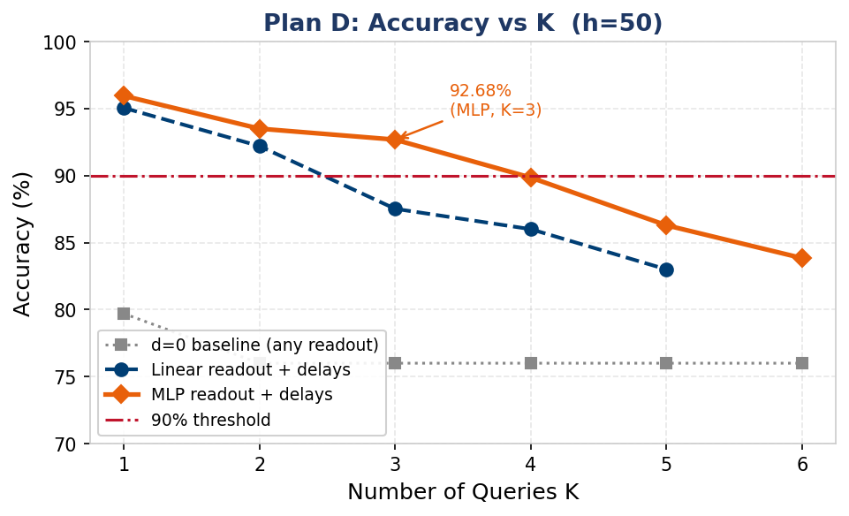
Plan D + MLP Readout — Advancing Max K@90% to 3
K | Linear readout | MLP readout | Δ (MLP−Lin) | MLP ≥90%?
1 | 95.05% | 95.95% | +0.9% | ✓
2 | 92.20% | 93.50% | +1.3% | ✓
3 | 87.52% | 92.68% | +5.2% | ✓
4 | ~86% | 89.85% | +3.9% | ✗ (0.15% short)
5 | ~83% | 86.29% | +3.3% | ✗
6 | — | 83.84% | — | ✗
MLP: Linear(h,h) → ReLU → Linear(h,K) | h=50, seeds 42+0 | Max K@90%: 2 → 3
MLP decoder unlocks K=3 by learning non-linear decision boundaries over the delay-structured hidden representations. K=4 is only 0.15% short — suggesting the ceiling may be soft.
Notes:
To test the hypothesis that the bottleneck is the linear decoder, I replaced it with a two-layer MLP: a linear layer from h to h neurons, then a ReLU nonlinearity, then a linear layer from h to K outputs.

Slide 9
Causal Ablation: Delays Are Necessary — MLP Alone Is Not Enough
Readout | Delay | K=2 acc | K=3 acc | Max K@90%
Linear | d = 0 (frozen) | ~76% | ~76% | 0
Linear | Trainable | 92.20% | 87.52% | 2
MLP | d = 0 (frozen) | 78.15% | ~77% | 0
MLP | Trainable | 93.50% | 92.68% | 3
• MLP + d=0 ≈ Linear + d=0 ≈ 77% — MLP adds nothing without delays
• Delays + Linear: +16.2pp at K=3 vs d=0 — delays create the representations
• Delays + MLP: +5.2pp on top of delays — MLP is a better decoder of delay representations
→ The failure at d=0 is representational, not a decoder limitation.
Trainable delays are the sole structurally necessary mechanism. d=0 fails regardless of readout type. MLP adds decoder precision on top of delay representations.
Notes:
is it the delays that matter, or could MLP be powerful enough to succeed on its own, even without delays? To answer this cleanly, I ran a two-by-two ablation.
The two factors are readout type — linear or MLP — and delay configuration — d equals zero or trainable. This gives four conditions.

Slide 10
Mechanism Summary: What Delays Actually Do
Plan | Design | Delays’ Role | Effect Size | Key Data
A (serial slots) | 2 shared ch. K × 35ms per-slot readout | Time alignment (shift spikes into readout window) | +15–18% vs d=0 | Max K@95% ≥20 (no ceiling found) d=0: K=0
C (simultaneous) | 2K channels T=30ms fixed 1 shared readout | Alignment (primary) + micro-capacity (secondary) | Align: +11.8% Capacity: +2.7% Ratio: 4.3× | Max K@90%: w&d=5, d20=3 d0=0
D (sequential) | 2 shared ch. K×10ms slots 1 shared readout | Structurally necessary routing (d=0 cannot work) | +16% vs d=0 at K=2 | Linear: K=2 @ 92.2% MLP: K=3 @ 92.7% d=0: ~77% (any readout)
The three plans are consistent: delays provide time alignment (+11–19%) as the primary benefit. True routing capacity (Plan D) is real but bounded by the shared readout bottleneck. Increasing h does not fix this — a non-linear decoder (MLP) is needed.

Slide 11
Conclusions
▶ 1. Trainable delays are structurally necessary for shared-channel temporal routing d=0 fails at K≥2 regardless of readout type (Linear or MLP): both ≤77% at K=3. This is a representational failure, not a decoder failure. Ablation is clean and causal.
▶ 2. The dominant contribution of delays is time alignment, not multiplexing capacity Alignment effect (+11.8–19%, Plans A/C/D) is 4.3× larger than the capacity effect (+2.7%, Plan C). True temporal multiplexing requires careful design (Plan D) to isolate and measure.
▶ 3. Delays create temporally structured representations exceeding linear decodability Max K@90%: d=0 → 0, delays+Linear → 2, delays+MLP → 3 (h=50, multi-seed validated). MLP adds +5.2% on delay representations; adds nothing without delays.
Energy bonus: weights_and_delays achieves higher accuracy with ~19% fewer spikes vs weights_only (27.7 vs 34.1 spk/trial at h=50)

