Slide 1
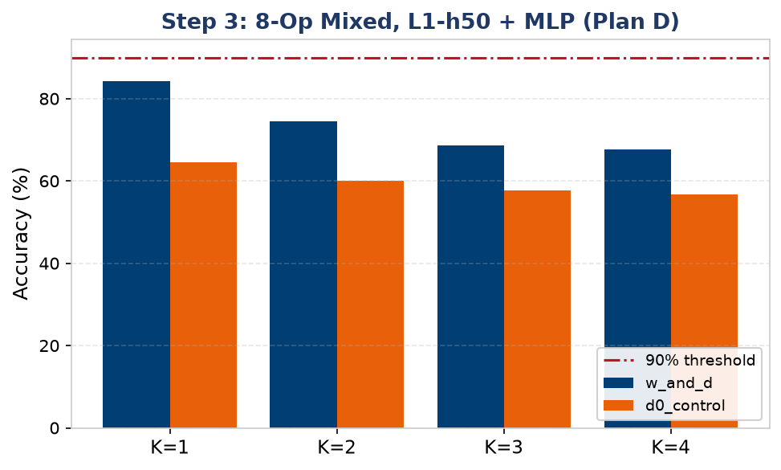
Step 3: Does Temporal Multiplexing Generalise to Mixed Ops?
Design: same Plan D structure (2 shared channels, sequential sub-windows, single readout) but each query now applies a DIFFERENT boolean op, signalled by one-hot op-identity input channels. Tests whether delay-based routing survives operation heterogeneity, not just query heterogeneity.
Delay gap persists: +19.8pp (K=1) down to +10.9pp (K=4) — same order of magnitude as same-op Plan D (+14-19% to +34%).
Max K@90% = 0 for both models — but this is a DATA/TASK ceiling, not a routing failure: only ~500 samples/op (8 ops) and XOR/XNOR drag the mean down.
d0 collapses toward the label prior at higher K — same structural failure mode seen in every shared-channel topology so far.

Slide 2
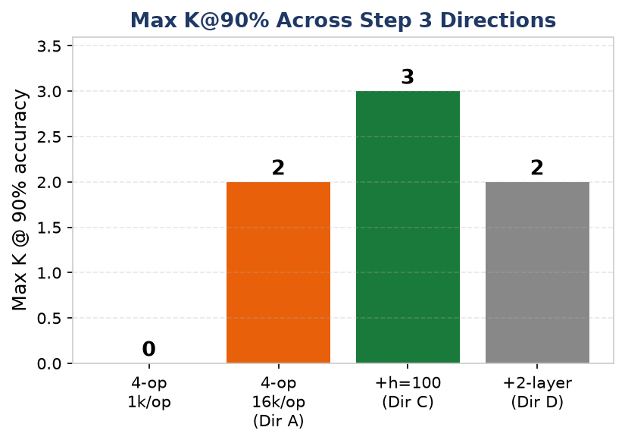
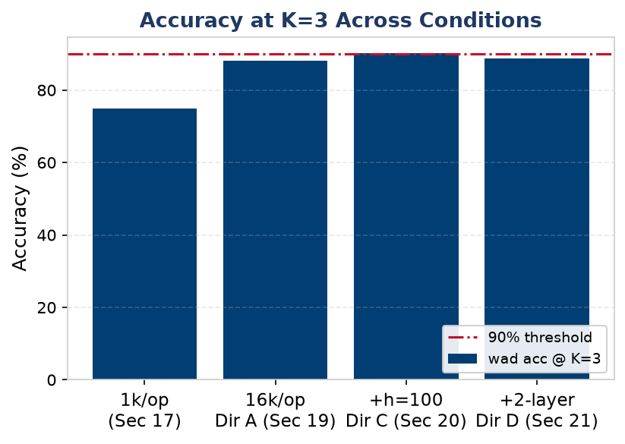
Step 3 Progression: Data, Then Capacity, Close the Gap
Direction A (4× data, 1k→16k/op): K=1 accuracy 87.7%→96.5%; Max K@90% rises 0→2 — the bottleneck was data sparsity, not the delay mechanism.
Direction C (+capacity, h=50→100): Max K@90% rises 2→3, matching single-op NAND's ceiling exactly — d0 stays flat, confirming delays (not width) convert capacity into routing.
Direction D (2-layer h50+h50, same 100-neuron budget): Max K@90% falls back to 2 — splitting the budget into layers hurts mixed-op routing too (same readout_in-halving confound that Section 27 later resolves for single-op NAND).

Slide 3
Step 3 Conclusions: Mixed-Op Multiplexing Confirms the Same Mechanism
▶ 1. The delay advantage generalises to mixed operations +11–34pp over d0 across every Step 3 condition (8-op and 4-op, 1k and 16k samples/op) — operation heterogeneity does not break delay-based temporal routing.
▶ 2. Data volume, not the delay mechanism, was the dominant early bottleneck 4× more training data (1k→16k/op) alone lifted Max K@90% from 0 to 2 — w_and_d absorbs extra data; d0_control stays flat, confirming delays are what convert data into capability.
▶ 3. Width helps, naive depth hurts — same lesson as single-op NAND, now confirmed for mixed ops h=50→100 (Dir C) raises Max K@90% to 3, matching single-op NAND. Splitting into 2 layers at the same 100-neuron budget (Dir D) drops it back to 2 — depth only helps once the readout-input confound is fixed (see Section 27, single-op, later in this talk).
This sets up Step 4: having shown the mechanism generalises across operations, Step 4 next asks whether it generalises across input/output STRUCTURE.

