Slide 1
Step 4: Pattern Taxonomy — When Are Delays Actually Necessary?
Update since last meeting · Three new output-structure topologies + a depth-ablation correction
SNN Async Delays Project · June 2026
Imperial College London

Slide 2
Recap: Where We Left Off
Plan D (shared-channel, sequential queries) established the central claim: trainable delays are structurally necessary when K queries share both input channels and a single readout window. d=0 plateaus at ~77% regardless of readout type; MLP readout pushes Max K@90% from 2 to 3.
Open question raised at last meeting: is this necessity a general property of shared-channel SNNs, or an artifact of this one input/output structure?
Step 4 answers this by varying the I/O structure while holding the core mechanism (shared channels, sequential sub-windows, LIF + delays) fixed:
Topology 1 — one-query, many-op: 1 broadcast input → K_ops independent outputs
Topology 2 — many-query, one-out: K sequential inputs → 1 aggregate output
Topology 3 — many-query, many-op, one-out: combines both (mixed ops + aggregation)
Plus: a depth ablation revisited the single-op (NAND) ceiling and found a new best result.

Slide 3
The Pattern Taxonomy
Topology | Input | Output | Tests
Plan D (done) | K shared-channel sequential | K independent logits | Baseline: delay-as-router necessity
T1: one-query-many-op | 1 broadcast pair | K_ops independent logits | Does necessity require input-side collision?
T2: many-query-one-out | K shared-channel sequential | 1 aggregate logit (majority / AND) | Does necessity survive output-side compression?
T3: many-query-many-op -one-out | K shared-channel, mixed ops | 1 aggregate logit | Do routing + op-mix + aggregation compound?
Design logic: Plan D conflated two things — input-side temporal collision and output-side multiplicity. T1 isolates the output side (no input collision); T2 isolates the compression side (input collision, but 1 output); T3 stacks all three.

Slide 4
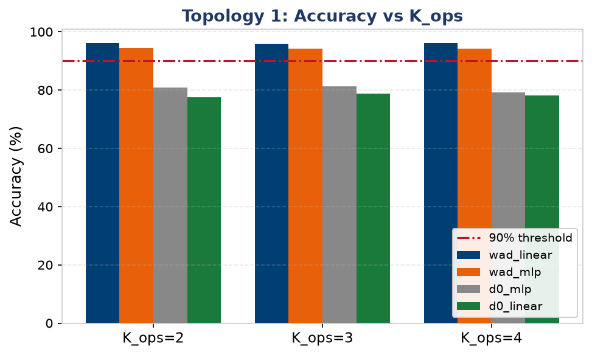
Topology 1: One-Query, Many-Op — Delays Are NOT Necessary
Design: single shared (A,B) pair in ONE input window → K_ops readout heads, each learning a different op (AND/OR/NAND/NOR) of the same input. No input-side collision — each head already has its own readout weights.
wad-vs-d0 gap is flat (+14–19pp) across K_ops — does NOT grow, unlike Plan D (+16%→+34%).
Linear readout beats MLP here (reversal of Plan D): K_ops heads already separate; MLP's nonlinear mixing adds inter-head competition instead of helping.
No capacity ceiling found within K_ops ≤ 4 — wad_linear stays ≥95% throughout.
d=0 collapses to the label prior (OR/NOR plateau exactly at 75.6% = P(label=1)).
Notes:
Topology 1 shows us that the structural necessity of delay does not stem from output multiplicity, but from input-side temporal collisions.

Slide 5
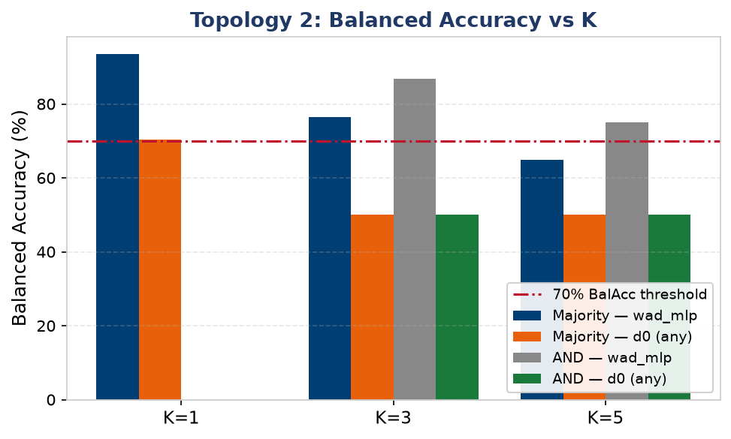
Topology 2: Many-Query, One-Out — Delays ARE Necessary
Design: keeps Plan D's input side exactly (K NAND queries, sequential sub-windows, 2 shared channels) but collapses the K-logit readout to ONE aggregate logit — majority vote, or AND-of-results (cleaner: trivial baseline ≈ 50% balanced acc).
d=0 balanced accuracy ≈50% at K≥3 for both aggregations — identical structural failure to Plan D (confirmed via spike-flow plots: zero readout-window activity).
MLP beats linear here (opposite of T1): aggregating K sequential signals into one decision needs nonlinear counting/thresholding, not K independent linear sums.
Max K@BalAcc≥70%: K=3 (majority vote, matches Plan D's ceiling); K=5 (AND-of-results — conjunctive structure extends the ceiling further).

Slide 6
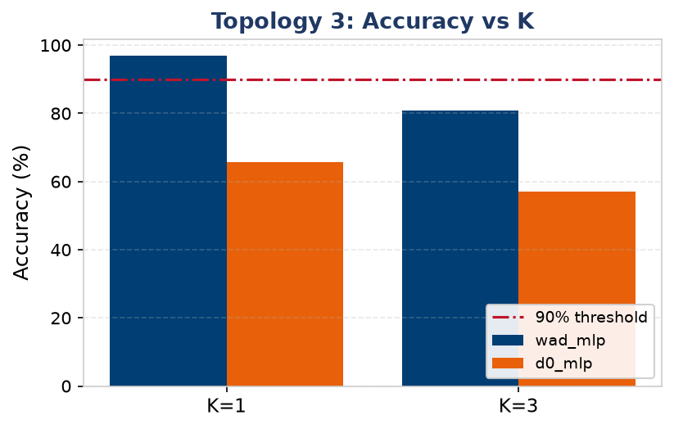
Topology 3: Mixed-Op + Aggregation — Bottlenecks Compound
Design: Topology 2's K→1 majority vote combined with Step 3's mixed-op input (4 ops, h=100, n_train=16000) — the most demanding composition in the taxonomy.
Topology | Delay needed? | Max K@90% (wad) | d0 failure mode
Plan D | Yes — structural | 3 (MLP, h=50) | Weight-symmetry, ~77%
T1: one-query-many-op | No — marginal | 4 (all pass) | Slight alignment loss
T2: many-query-one-out | Yes — structural | K=3 (BalAcc) | Label-prior collapse
T3: many-many-one-out | Yes — structural | 1 | Label prior + op-mix
Delay gap: +31.4pp (K=1), +23.9pp (K=3) | Max K@90%: wad_mlp = 1, d0_mlp = 0
Max K@90%=1 sits below Direction C's K=3 (mixed-op only, h=100) and T2's K=3 (aggregation only, h=50) — routing + op-mix + aggregation compound multiplicatively, not additively.

Slide 7
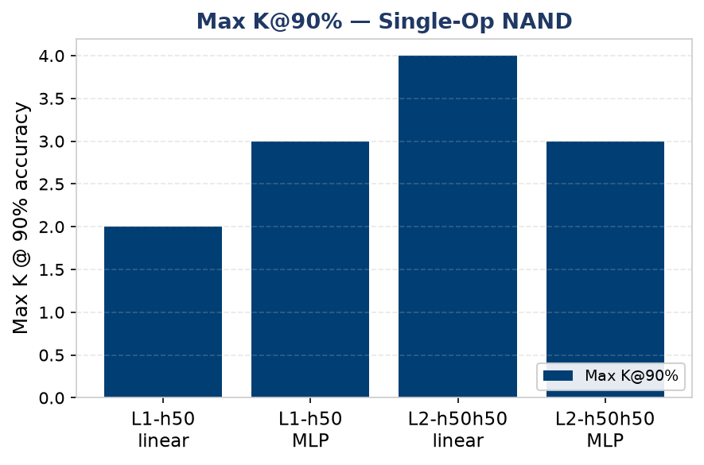
Section 27: Depth Revisited — New Best Result for Single-Op NAND
Earlier (Sections 13-14) we concluded a 2nd hidden layer doesn't help — but that test split a fixed 50-neuron budget into 25+25, halving the readout's input dimension. This experiment removes that confound: L2-h50h50 uses two FULL 50-neuron layers (readout_in=50, matching L1-h50) — 100 neurons total, no budget cut.
L2-h50h50-linear reaches Max K@90%=4 — the best single-op NAND result in the whole project, beating the previous best (L1-h50-MLP, K=3).
Confirms the earlier "depth hurts" finding was an artifact of the readout-input cut (50→25), not of depth itself: more neurons + matched readout_in together help.
First reversal of linear<MLP at K=4 (91.1% vs 89.7%): the 2nd spiking layer's own LIF nonlinearity already supplies the separation MLP used to add on top of L1.
Open caveat: no L1-h100 single-op control was run, so depth vs. raw neuron count (100 total either way) isn't fully disentangled — flagged in the paper's Future Work.

Slide 8
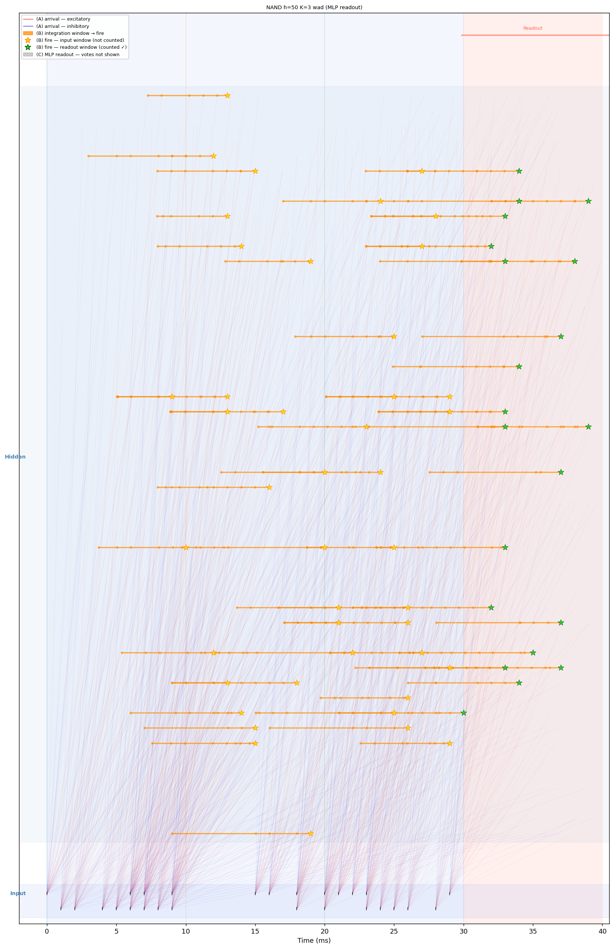
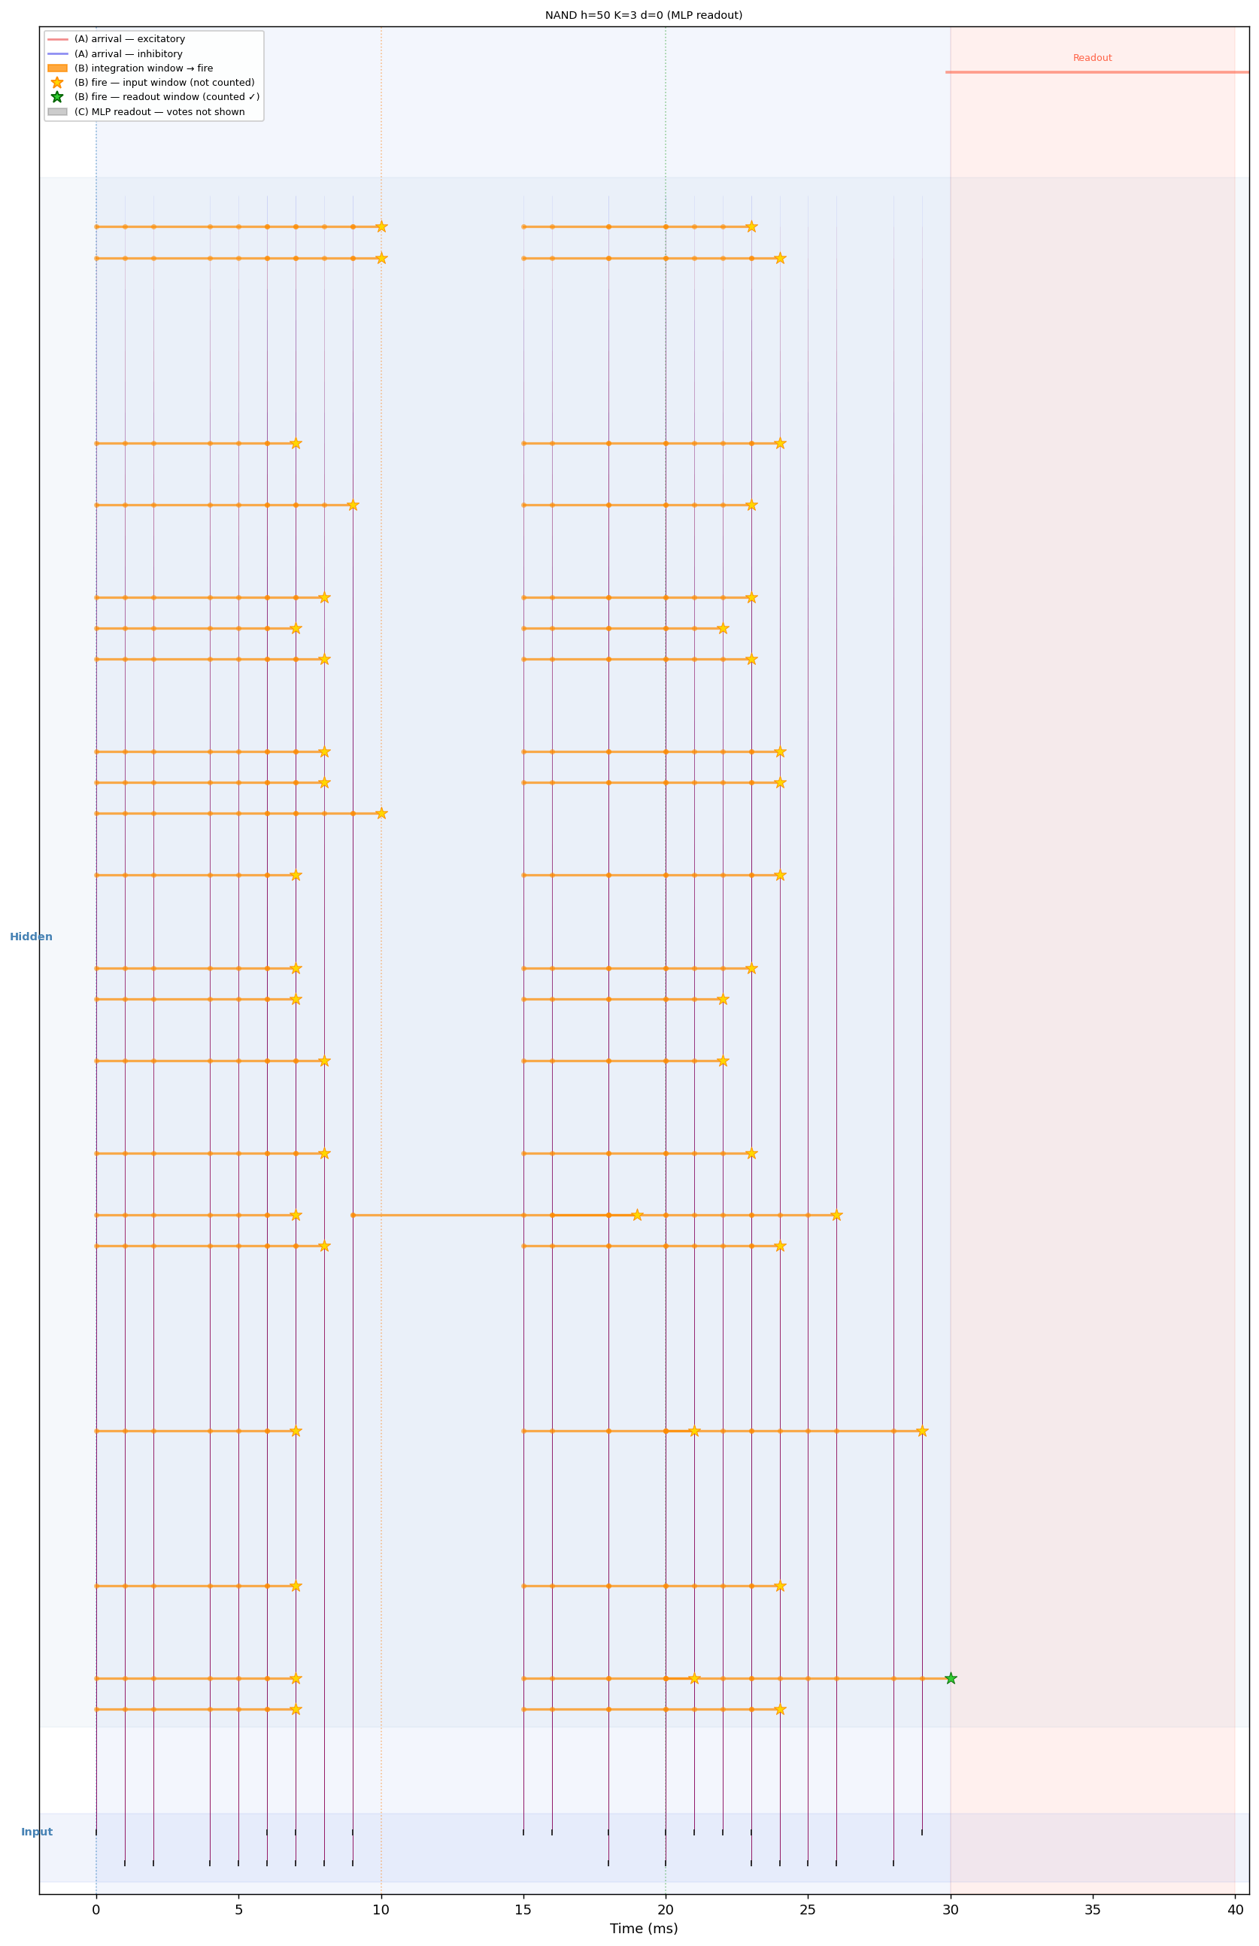
Mechanism: How Delays Route Information in Time
Same setup (Plan D, K=3, MLP readout) — only the delay condition differs.
Trainable delays (wad_mlp) — 92.7% acc
No delays (d0_mlp) — ~77% acc

Slide 9
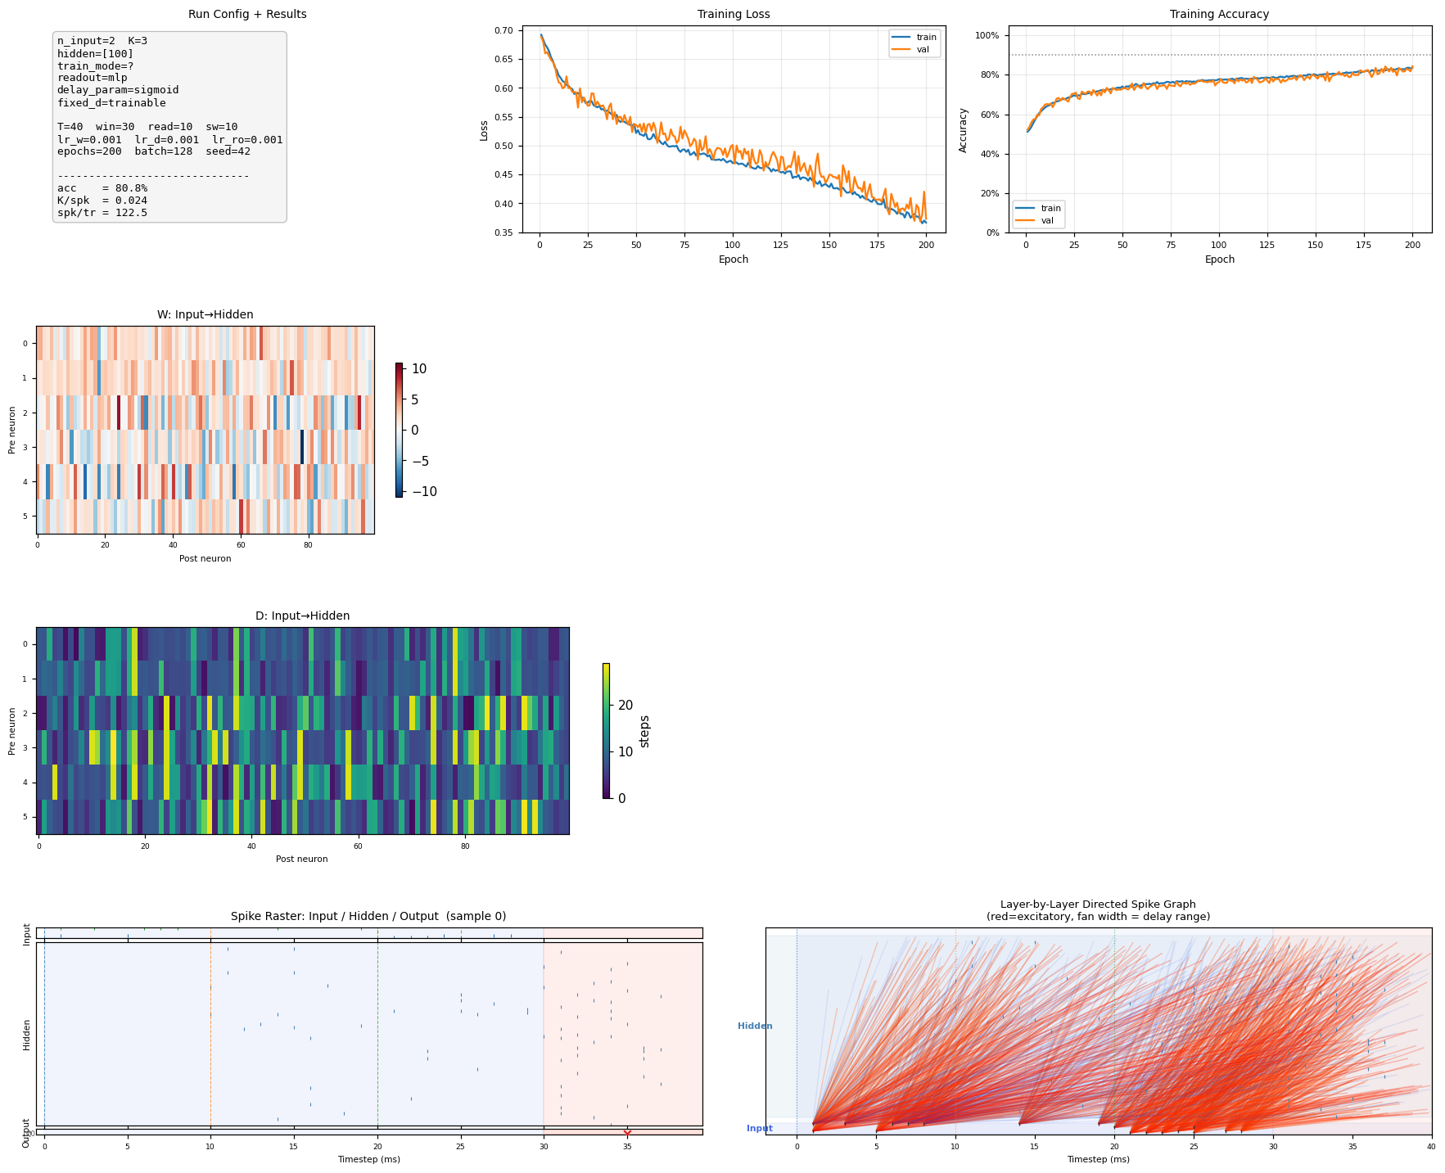
Diagnostic Panel Example — Topology 3, K=3, wad_mlp
One run, one figure: spike raster (sorted by first-spike time, coloured by sub-window), delay heatmap, and readout trace — this is what "routing" looks like inside the network.

Slide 10
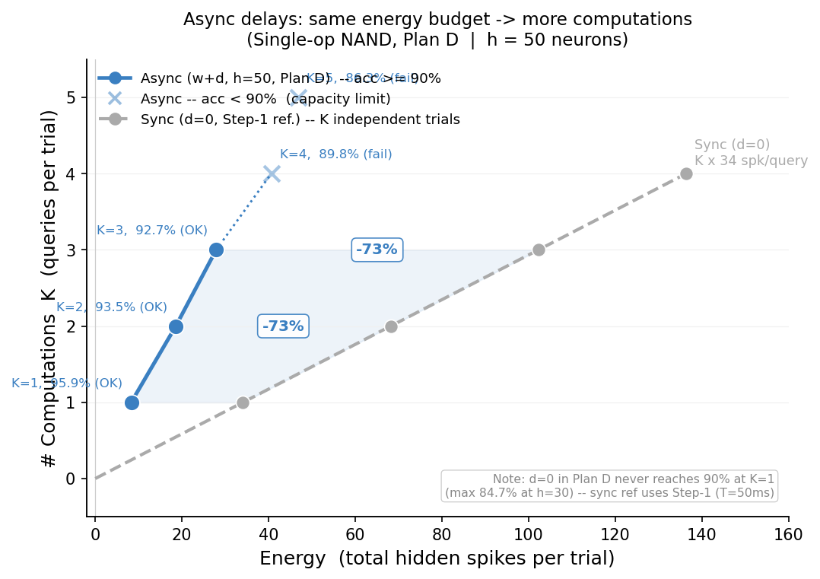
Energy / Computation Trade-off
Same energy budget (spikes/trial) buys ~3-4× more computations with async delays vs. synchronous (K independent trials) baseline — up to -73% energy for the same K.

Slide 11
Conclusions: Delays Are Necessary in Every Shared-Channel Topology
▶ 1. Structural necessity tracks input-side collision, not output multiplicity T1 (output multiplicity, no input collision): delays optional, pure alignment (+14-19pp flat). Plan D / T2 / T3 (input collision present): delays structurally necessary, d=0 collapses to label prior.
▶ 2. Best readout type flips with topology — there's no universal answer K-parallel-outputs (T1): Linear wins — heads already separate, MLP adds harmful coupling. K-to-1 aggregation (T2/T3) or K-sequential-routing (Plan D): MLP wins — needs nonlinear counting/decoding.
▶ 3. Independent bottlenecks compound multiplicatively under composition Routing (Plan D, K@90%=3) + mixed-op competition (Dir C, K@90%=3) + aggregation (T2, K=3) individually each reach K=3 — but T3 (all three combined) only reaches K=1.
Plus: depth (L2-h50h50) extends single-op Max K@90% to 4 — the project's best result so far, with the budget-confound from Sections 13-14 now resolved.

Slide 12
Next Steps
Locate the true T1 ceiling: sweep K_ops ∈ {5,6,8} using all 8 canonical boolean ops (current K_ops≤4 shows no ceiling at h=50).
Run the missing L1-h100 single-op NAND control to fully disentangle Section 27's depth effect from raw neuron count.
Write up the Pattern Taxonomy as a dedicated section/table for the paper — the 4-row comparison (Plan D / T1 / T2 / T3) is a clean, self-contained contribution.
Investigate whether T3's compounding bottleneck is fixable with the width/data levers that worked for Step 3 Direction A/C (more data, larger h), or is a hard ceiling.
Decide whether a 3rd aggregation function (e.g. parity / XOR-of-results) is worth adding to T2 for a fuller picture before finalising the taxonomy.

