Slide 1
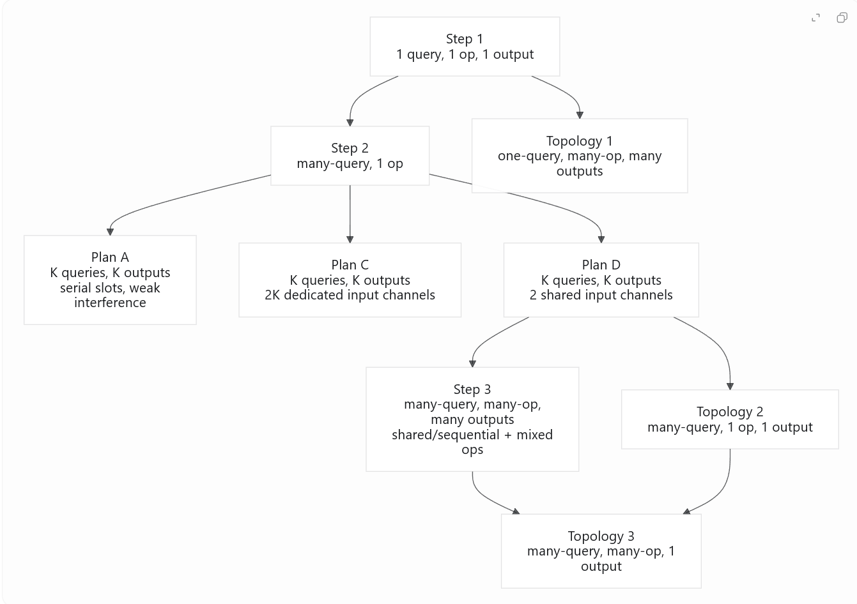
How Step 4 Connects to Steps 1-3
These topologies are not a brand-new branch of the project: they are a controlled refactor of the same question. Each one isolates a different bottleneck that earlier steps mixed together.
Step 1: one query, one op, one output. Baseline solvability.
Step 2: many queries, one op. Plan A / C / D change how queries share time and channels.
Step 3: many queries, many ops, many outputs. Mixed-task setting without output compression.
Topology 1: removes input collision, keeps multiple outputs.
Topology 2: keeps shared-channel input, compresses K answers into one final decision.
Topology 3: mixes different ops and also compresses to one final decision.
Reading guide: Topology 1 asks whether delays are still needed when the same input is broadcast once. Topology 2 asks what changes when K per-query answers must be fused into one scalar output. Topology 3 stacks both difficulties together.

Slide 2
Topology Structures at a Glance
One query (A, B)
Shared hidden SNN No input collision
AND
OR
NAND
NOR
T1
K independent readout heads
q1
Shared hidden SNN Delay-based routing
1 agg
T2
Sequential sub-windows on 2 shared channels
majority or AND over K per-query answers
q2
q3
q1 + op1
Shared hidden SNN Routing + op separation
1 agg
T3
Shared channels + mixed op identity
one final decision after mixed-op processing
q2 + op2
q3 + op3
Aggregate output means the network no longer emits K separate answers. Instead, the readout must compress the whole trial into one binary verdict, such as whether the majority of queries are correct-1 or whether all queried NAND results are 1.

