Slide 1
Fitness Buddy – Ai companion
IBM AICTE PROJECT
Presented By: Ayush
Student name : Ayush Nayak
College Name & Department : AP Shah Institute of Technology ,
Thane and Computer Science Engineering

Slide 2
OUTLINE
Problem Statement
Technology used
Wow factor
End users
Result
Conclusion
Git-hub Link
Future scope
IBM Certifications

Slide 3
Problem Statement
People often struggle to stay motivated and informed about fitness routines, meal planning, and healthy lifestyle tips. Access to personalized, on-demand fitness advice is limited and time-consuming.
Proposed Solution: A conversational AI chatbot named Fitness Buddy that provides instant workout suggestions, motivational tips, and healthy meal ideas using IBM Watson Assistant Lite on IBM Cloud Lite.

Slide 4
Technology used
IBM cloud lite services
Natural Language Processing (NLP)
Retrieval Augmented Generation (RAG)
Prompt-based AI technology for conversational flows
IBM Granite model

Slide 5
IBM cloud services used
IBM Cloud Watsonx AI Studio
IBM Cloud Watsonx AI runtime
IBM Cloud Agent Lab
IBM Granite foundation model

Slide 6
Wow factors
Fully implemented on the IBM Cloud Lite free tier with no upgrades required
Simple to build and deploy without complex data storage
Provides friendly, accurate fitness, meal planning, and motivation advice
Customizable prompt-based conversational flow
Easily integrated as a web chat widget for immediate user access

Slide 7
End users
Fitness enthusiasts and beginners
Students and working professionals looking for quick fitness guidance
Health coaches seeking a supplementary assistant
Anyone wanting motivational support for a healthy lifestyle

Slide 8
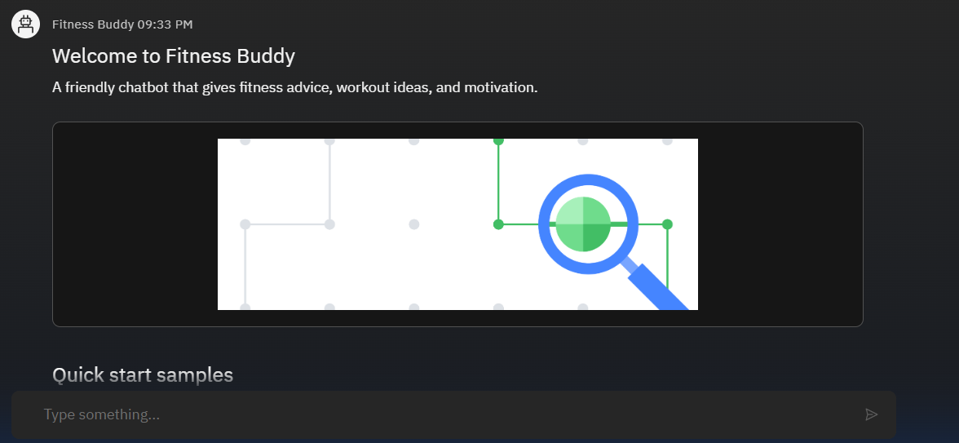
Results

Slide 9
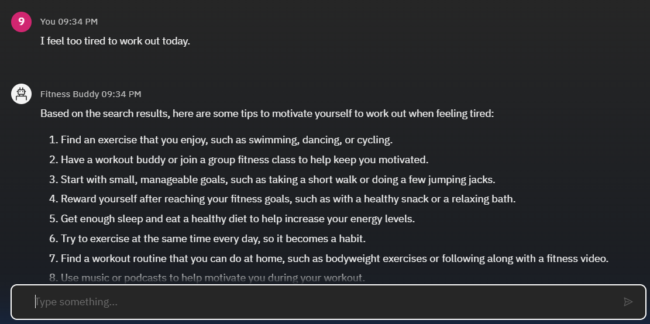
Results

Slide 10
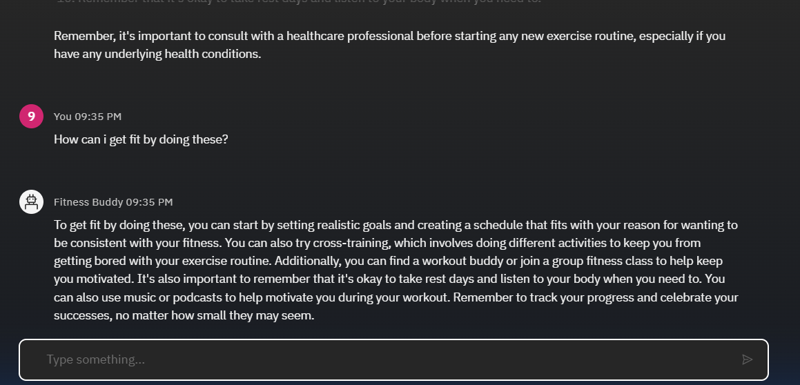
Results

Slide 11
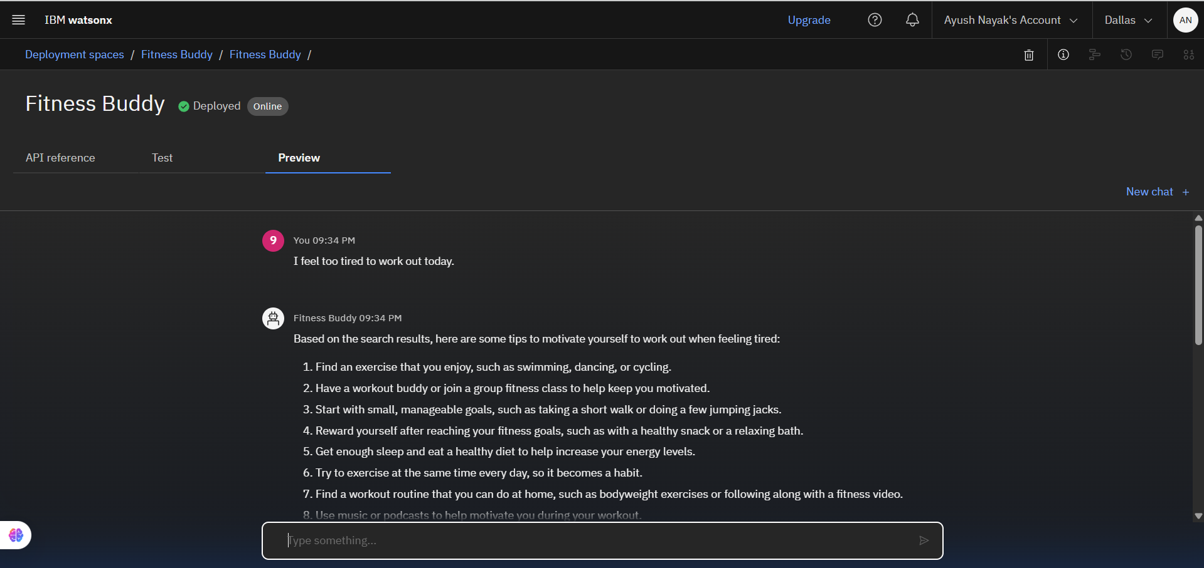
Results
Deployed AI Agent

Slide 12
Conclusion
The Fitness Buddy AI agent leverages IBM Cloud Lite free services to provide accessible and motivating health and fitness advice. This project showcases prompt engineering as a powerful no-cost solution for creating conversational AI assistants efficiently.

Slide 13
GitHub Link
https://github.com/Ayush-Nayak/IBM-Cloud-Fitness-Buddy

Slide 14
Future scope
Extend with user profile tracking for personalized plans
Add voice interaction through IBM Watson Speech-to-Text and Text-to-Speech
Integrate with wearable fitness devices for real-time feedback
Expand to multi-language support for diverse users
Enhance with RAG-based knowledge retrieval for richer contextual advice

Slide 15
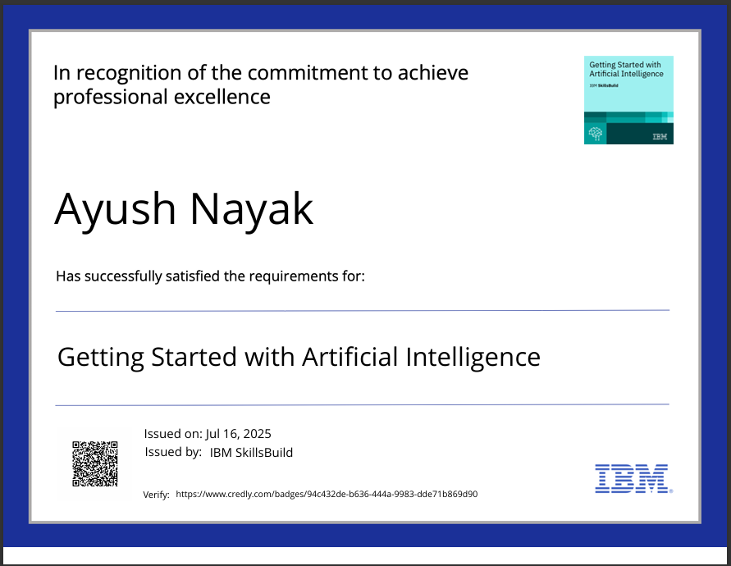
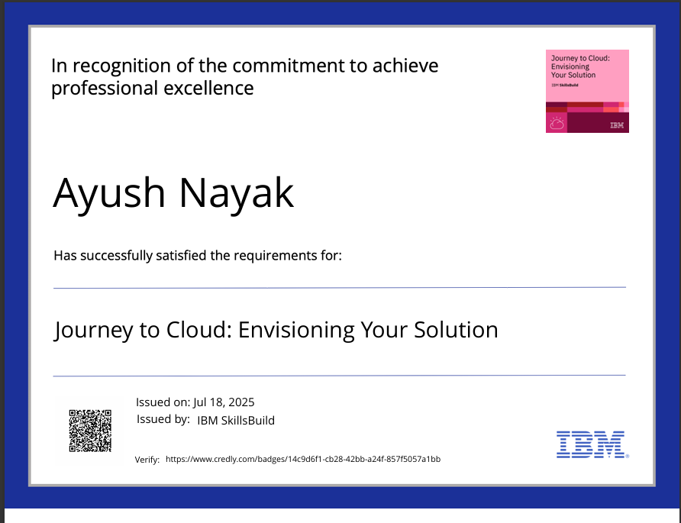
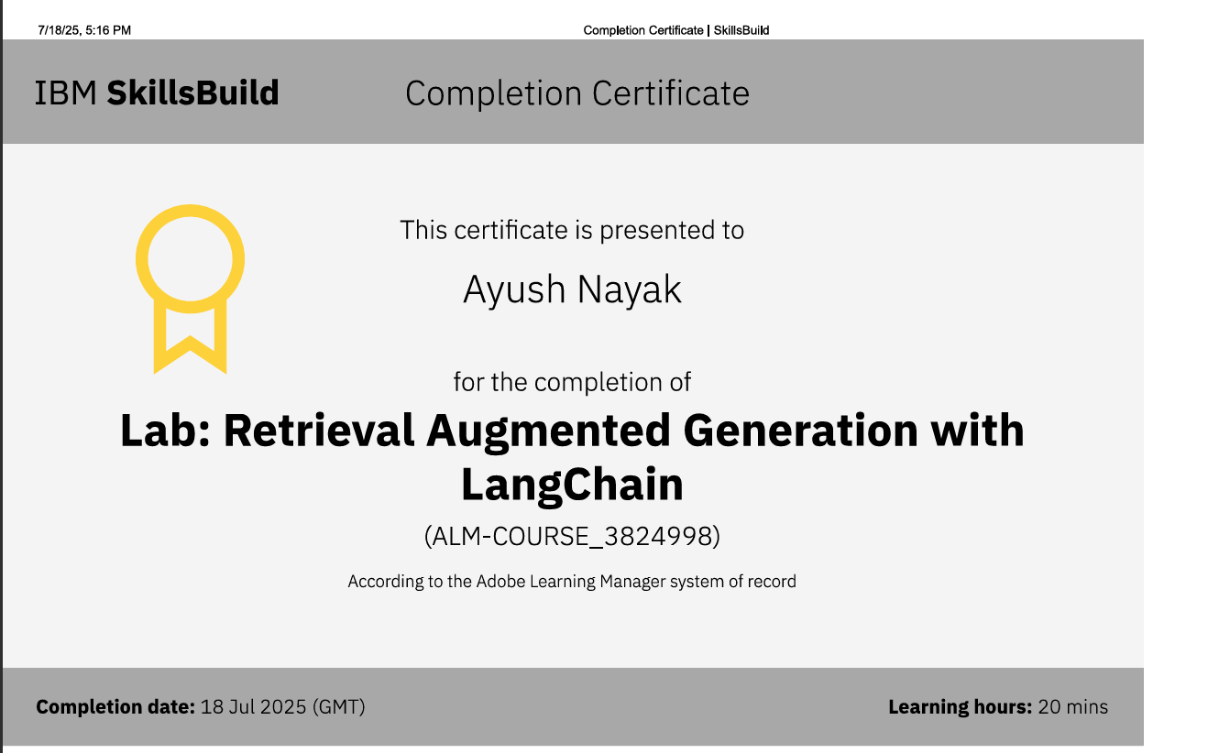
IBM Certifications

Slide 16
THANK YOU

