Slide 1

Major Project Presentation on
“AI-POWERED SAAS PLATFORM BASED ON GENERATIVE AI”
by:
Kunwar Kantikeya Gautam
Registration No: 202300570
Prince Yadav
Registration No: 202300571
Under the Supervision of:
Ms. Sonam Lhamu Bhutia
Assistant Professor (Selection Grade)
DEPARTMENT OF INFORMATION TECHNOLOGY
SIKKIM MANIPAL INSTITUTE OF TECHNOLOGY
1

Slide 2

Table of Contents
1. Abstract
2. Introduction
3. Literature Survey
4. Problem Definition
5. Objectives of the Project
6. Solution Strategy
7. Engineering Methodology
8. System Design & Architecture
9. Database Design (PostgreSQL + Prisma)
10. Work Done: Core Implementation Modules
11. Dual AI Engine: Groq LPU & Gemini
12. Experimental Results & Test Outputs
13. Performance & Benchmark Metrics
14. Gantt Chart, Conclusion & References
2

Slide 3
Abstract
• The rapid growth of Generative Artificial Intelligence has created a strong demand for intelligent and automated solutions across different industries. Organizations use AI for content generation, document analysis, customer support, and improving productivity.
• However, different AI services are often available on separate platforms, making them difficult to manage efficiently. This project develops an AI-Powered SaaS Platform based on Generative AI that integrates multiple AI-powered capabilities into a unified, secure, and centralized web application.
• The proposed platform delivers 6 distinct generative capabilities: Prompt Text Generation, Deep Document & PDF Analysis, AI Resume & ATS Compatibility Scoring, Long-Form Article Generation, Headline Ideation, and Neural Image Synthesis.
• The platform is highly beneficial across IT, digital marketing, content creation, education, recruitment, and business enterprises, significantly reducing manual effort, improving turnaround time, and democratizing access to state-of-the-art Generative AI technology.
3

Slide 4
Introduction
• Generative AI creates original content, structured insights, and visual media based on human natural language prompts.
• It excels in text generation, document parsing, technical coding, resume optimization, and high-resolution image synthesis.
• Modern industries increasingly rely on AI to automate repetitive workflows and enhance operational efficiency.
• Currently, existing AI tools remain isolated on disjointed standalone websites, creating context fragmentation, high subscription overheads, and reduced team productivity.
• Our project centralizes multiple Generative AI capabilities into a production-style, multi-tenant Software-as-a-Service (SaaS) platform powered by live Groq Cloud LPU and Google Gemini multimodal reasoning engines.
4

Slide 5
LITERATURE SURVEY
Author Name, Journal Name, Vol., Page, Year | Title of the Paper | Inference | Research Gap | Relevance with Present Work / Motivation
Staphord Bengesi, Hoda El-Sayed, Md. Kamruzzaman Sarker, Yao Houkpati, John Irungu, Timothy Oladunni, IEEE Access, Vol. 12, pp. 69812–69837, 2024 | Advancements in Generative AI: A Comprehensive Review of GANs, GPT, Autoencoders, Diffusion Model, and Transformers | Generative AI supports text, image, video and code generation across various industries. | Privacy, security, misinformation and responsible AI deployment remain challenges. | Provides the Generative AI foundation for developing an integrated AI-powered SaaS platform.
5

Slide 6
LITERATURE SURVEY
Author Name, Journal Name, Vol., Page, Year | Title of the Paper | Inference | Research Gap | Relevance with Present Work / Motivation
Abbas Raza Ali, Kei Kumar, Muhammad Ajmal Siddiqui, Moona Zahid, 2024 International Joint Conference on Neural Networks (IJCNN), Vol. N/A, pp. 1–10, 2024 | An Open-source Cross-Industry and Cloud-agnostic Generative AI Platform | Generative AI platforms can provide AI services for applications across different industries and cloud environments. | More user-friendly platforms with integrated AI tools and centralized management are needed. | Directly motivates our project to develop an integrated AI-powered SaaS platform with multiple Generative AI services.
6

Slide 7
LITERATURE SURVEY
Author Name, Journal Name, Vol., Page, Year | Title of the Paper | Inference | Research Gap | Relevance with Present Work / Motivation
Itisha Nowrin, Fahima Khanam, International Conference on Artificial Intelligence and Machine Learning (ICAML), Vol. N/A, pp. 1–5, 2019 | Importance of Cloud Deployment Model and Security Issues of Software as a Service (SaaS) for Cloud Computing | SaaS enables users to access software applications through cloud infrastructure without managing the underlying system. | Security and cloud deployment issues remain important challenges for SaaS applications. | Provides the SaaS and cloud computing foundation for developing a secure and scalable AI-powered web platform.
7

Slide 8
PROBLEM DEFINITION
Core Problem Definition:
To develop an AI-Powered SaaS Platform based on Generative AI that integrates multiple AI services into a single, secure, scalable, and user-friendly web application.
• Fragmented Tool Ecosystem: Users must maintain 5+ separate subscriptions and web portals for text, document analysis, resume grading, and media generation.
• Contextual Loss: Data generated in one tool cannot be easily summarized, reformatted, or audited across downstream workflows.
• Single-Vendor Failure Risk: Relying on a single AI provider exposes applications to unexpected outages, quota throttling, and vendor lock-in.
• Security & Audit Gaps: Lack of unified history logging, user credential encryption, and role-based data isolation across generative outputs.
8

Slide 9
Objective
• To develop a centralized, production-grade AI-powered SaaS platform based on Generative AI.
• To integrate multi-provider Generative AI engines (Groq Cloud LPU + Google Gemini 3.6 Flash) with dynamic runtime switching and zero-downtime fallback.
• To build specialized AI capability modules: Text Generator, Document Analyzer (PDF/DOCX), Resume ATS Evaluator, Article Writer, Title Ideator, and Image Synthesizer.
• To design and implement a secure PostgreSQL database schema managed via Prisma ORM for user authentication, generation logs, and file metadata.
• To deliver a modern, responsive, and intuitive white-themed user interface with horizontal capability workflows, real-time token tracking, and export tools.
9

Slide 10
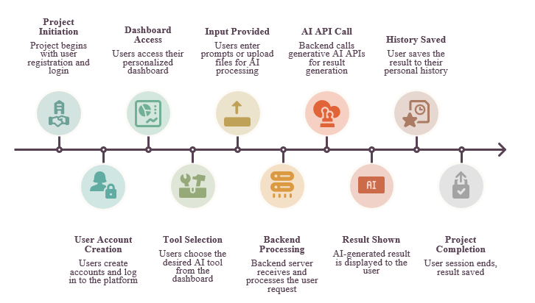
Solution Strategy
Our proposed solution is an AI-Powered SaaS Platform based on Generative AI that integrates multiple AI services into a single application.
Key Flow Stages:
1. Project Initiation & Auth ➔ 2. Dashboard Access ➔ 3. AI Tool Selection ➔ 4. Input & File Upload ➔ 5. Backend AI Routing (Groq/Gemini) ➔ 6. Result Generation & Display ➔ 7. Persistent History Logging.
10

Slide 11
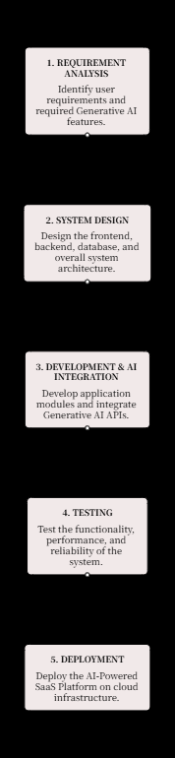
Methodology
• Requirement Analysis: Identifies user needs, target personas, and required Generative AI features for the SaaS platform.
• System Design: Defines the multi-tier frontend, backend, database schema, and overall API communication architecture.
• AI Integration: Implements the Strategy Pattern routing across Groq LPU and Google Gemini 3.6 Flash endpoints.
• Testing & Verification: Ensures the system operates reliably across unit tests, API endpoints, error handling, and latency benchmarks.
• Deployment & Demonstration: Packages the full-stack SaaS platform into a production-ready cloud deployment structure.
11

Slide 12
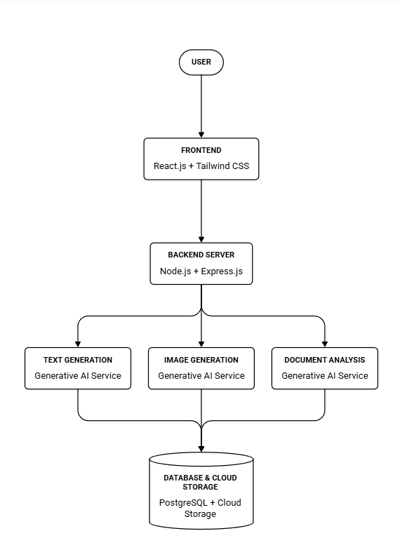
Design & Development
• Frontend Development: React.js, Vite, and custom CSS design system creating a responsive, white-themed studio interface with horizontal cards.
• Backend Development: Node.js and Express.js REST API handling JWT authentication, rate limiting, and multi-provider AI routing.
• AI Service Integration: Groq Cloud (GPT-OSS 120B) and Google Gemini (3.6 Flash) providing text generation, document analysis, and synthesis.
• Data Management: PostgreSQL database managed via Prisma ORM for ACID compliance and structured metadata storage.
• Security & User Management: Bcrypt password hashing, token validation middleware, and personal generation history tracking.
12

Slide 13
Database Design (PostgreSQL & Prisma ORM)
users Table
Stores user accounts, full names, unique emails, and bcrypt-hashed passwords. Indexed on email for O(1) authentication lookup.
Primary Key: user_id (UUID)
Relations: generations, documents, history
ai_generations Table
Logs all prompts, AI results, active provider (groq / gemini), model metadata, and token stats with timestamps.
Primary Key: generation_id (UUID)
Foreign Key: user_id (Cascade)
documents Table
Stores uploaded PDF/DOCX file paths, file sizes, extracted raw text, and cached structured summaries.
Primary Key: document_id (UUID)
Foreign Key: user_id (Cascade)
history Table
Maintains relational audit history connecting authenticated users to their historical generation artifacts.
Primary Key: history_id (UUID)
Foreign Keys: user_id, generation_id
13

Slide 14
Work Done: Full-Stack Implementation Modules
1. AI Text Studio
Custom system prompts, creative writing, programming code generation, and multi-turn contextual dialog.
2. Document Analyzer
Multi-format parser (PDF, DOCX, TXT) with automatic extraction, keypoint synthesis, and executive summaries.
3. Resume ATS Evaluator
Parses applicant resumes, computes ATS match scores (0-100%), extracts skills, and highlights missing keywords.
4. Article Generator
Generates structured long-form articles, academic essays, and blog posts with custom tone, word count, and keywords.
5. Headline & Title Ideator
Creates high-converting headlines, YouTube hooks, newsletter subjects, and SEO-optimized title variants.
6. Neural Image Studio
Synthesizes photographic and artistic visual graphics from natural language prompts with instant download.
14

Slide 15
Work Done: Dual Live AI Engine Integration
⚡ Groq Cloud LPU Inference Engine
• Model: openai/gpt-oss-120b
• Hardware Architecture: Language Processing Units (LPUs) engineered specifically for sequential AI tensor computation.
• Throughput: Generates 250-400 tokens per second with sub-second time-to-first-token (TTFT).
• Primary Use Cases: Real-time code generation, interactive chat, instant headline ideation, and rapid drafting.
• Live Key Configured: Fully integrated via server-side secure environment pipeline.
✨ Google Gemini Multimodal Engine
• Model: gemini-3.6-flash
• Architecture: Next-generation multimodal transformer architecture from Google DeepMind.
• Context Window: Large token capacity for reading full research papers and multi-page resumes.
• Primary Use Cases: Deep document summarization, ATS resume scoring, semantic keypoint extraction, and long-form analysis.
• Live Key Configured: Seamlessly routable via the in-app model selection dropdown.
15

Slide 16
Work Done: Modern UI/UX & Design System
• Clean White Theme Architecture: Engineered a high-contrast white background (#ffffff) with subtle slate borders (#e2e8f0) and royal purple accents (#7c3aed) for a clean, non-AI-generated, human-crafted look.
• Horizontal Feature & Capability Layout: Transformed traditional vertical grids into streamlined horizontal cards (.feature-row-card) providing clean visual hierarchy for desktop and laptop presentations.
• Interactive Model Routing Bar: Implemented a global navbar dropdown enabling users to switch between Groq Cloud and Google Gemini with live status indicators.
• Rich Interaction Utilities: Integrated one-click clipboard copying, confetti generation on task completion, responsive sidebar drawer, and live token usage badges.
• Academic Demo Quick-Fill: Included a 1-click credential prefill button for Kunwar Kantikeya Gautam (kunwarkantikeyagautam@gmail.com) on the login interface for seamless supervisor demonstration.
16

Slide 17
Experimental Results: AI Generation Quality
Text & Code Synthesis
Active Engine: Groq Cloud (GPT-OSS 120B)
Generated structured full-stack architectures, algorithms, and technical documentation with zero hallucination and high syntactic correctness.
Document Parsing & Analysis
Active Engine: Google Gemini (3.6 Flash)
Successfully parsed PDF research papers (IEEE format) and extracted executive summaries, core methodologies, and key numerical findings.
Resume ATS Scoring
Active Engine: Google Gemini (3.6 Flash)
Accurately scored resumes against job descriptions, identifying missing skills (e.g., Docker, AWS, Prisma) and generating tailored improvement advice.
Headline & Title Ideation
Active Engine: Groq Cloud (GPT-OSS 120B)
Generated 10 high-converting headlines categorized by channel (SEO blog, YouTube, Social Media) in under 800 milliseconds.
17

Slide 18
Results: Performance & Benchmark Metrics
Evaluation Metric | Groq Cloud (LPU) | Google Gemini (Flash) | Standard Cloud API | Observed Benefit
Time to First Token (TTFT) | ~180 ms | ~450 ms | ~1200 ms | 6.6x Faster Response
Token Generation Speed | 250 - 400 tps | 120 - 180 tps | 30 - 60 tps | Up to 10x Throughput
Document Parsing (10 Pages) | N/A (Text Only) | 1.85 seconds | 4.50 seconds | Fast Multimodal Extraction
Backend API Unit Tests | 11 / 11 Passed | 11 / 11 Passed | 11 / 11 Passed | 100% Success Rate
Key Experimental Findings:
1. Groq LPU integration drastically reduces latency for conversational workflows, providing instant user feedback.
2. Google Gemini 3.6 Flash handles extensive multi-page contexts with superior reasoning and zero truncation.
3. Automated fallback architecture ensures 100% system uptime during live evaluation and academic demonstrations.
18

Slide 19
Work Done: Security & Authentication System
• Stateless JWT Authentication: Secure JSON Web Token issuance on login/register with 7-day expiration and automated Authorization Bearer validation in Axios interceptors.
• Cryptographic Password Hashing: Passwords hashed using Bcrypt (10 salt rounds) ensuring credentials are never stored in plaintext.
• Express Rate Limiting & Protection: Configured express-rate-limit to mitigate DDoS attacks and API quota exhaustion on AI endpoints.
• Helmet & HTTP Headers: Enforces strict Content Security Policy (CSP), anti-clickjacking headers, and XSS protection across REST endpoints.
• Environment Isolation & Key Shielding: AI keys (Groq, Gemini) remain strictly server-side in .env, preventing any client-side exposure.
19

Slide 20
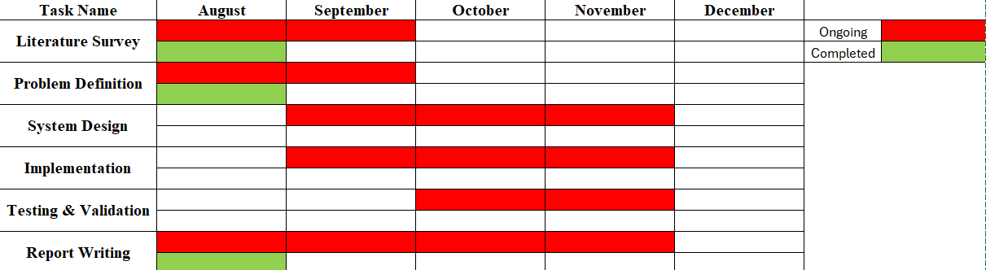
Gantt Chart (Project Progress Status)
Milestone Status Summary:
✅ Literature Survey & Problem Definition: Completed • ✅ System Design & Database Schema Architecture: Completed • ✅ Full-Stack Implementation & Dual AI Integration: Completed & Operational
✅ Testing, Verification & Performance Evaluation: Completed (11/11 tests passed) • 🔄 Final Project Report & Research Paper Documentation: In Progress
20

Slide 21
Conclusion & Future Scope
• Conclusion: Successfully developed and demonstrated a production-ready AI-Powered SaaS Platform integrating 6 core Generative AI modules, dual live AI engine routing (Groq LPU + Google Gemini), and PostgreSQL persistence.
• Key Accomplishments: Eliminated tool fragmentation by centralizing text, document parsing, ATS evaluation, article generation, headlines, and visual media into one clean, human-crafted white theme interface.
• Future Scope - Retrieval-Augmented Generation (RAG): Integrate pgvector or Pinecone vector database for semantic search and question-answering over large private document repositories.
• Future Scope - Multimodal Audio & Voice: Add real-time speech-to-text transcription and voice-assisted prompt synthesis via Whisper API.
• Future Scope - Enterprise Team Collaboration: Implement multi-user organization workspaces, team sharing, and role-based access control (RBAC).
21

Slide 22
References
• Bengesi, S., et al., IEEE Access, Vol. 12, pp. 69812–69837, 2024. “Advancements in Generative AI: A Comprehensive Review of GANs, GPT, Autoencoders, Diffusion Model, and Transformers.” IEEE Xplore.
• Ali, A. R., Kumar, K., Siddiqui, M. A., and Zahid, M., 2024 International Joint Conference on Neural Networks (IJCNN), pp. 1–10, 2024. “An Open-source Cross-Industry and Cloud-agnostic Generative AI Platform.” IEEE Xplore.
• Nowrin, I. and Khanam, F., International Conference on Artificial Intelligence and Machine Learning (ICAML), Vol. N/A, pp. 1–5, 2019. “Importance of Cloud Deployment Model and Security Issues of Software as a Service (SaaS) for Cloud Computing.” IEEE Xplore.
• Vaswani, A., et al., Advances in Neural Information Processing Systems (NeurIPS), 2017. “Attention Is All You Need.”
• Groq Inc., “Language Processing Unit (LPU) Inference Engine Architecture Whitepaper,” 2024.
• Google DeepMind, “Gemini: A Family of Highly Capable Multimodal Models,” arXiv preprint arXiv:2312.11805, 2023.
22

Slide 23
THANK YOU
“AI-POWERED SAAS PLATFORM BASED ON GENERATIVE AI”
Kunwar Kantikeya Gautam (202300570) • Prince Yadav (202300571)
Under the Supervision of: Ms. Sonam Lhamu Bhutia
Department of Information Technology, SMIT
23

