Slide 1
Title Pocket Money:- Earn, Save, Spend

Slide 2
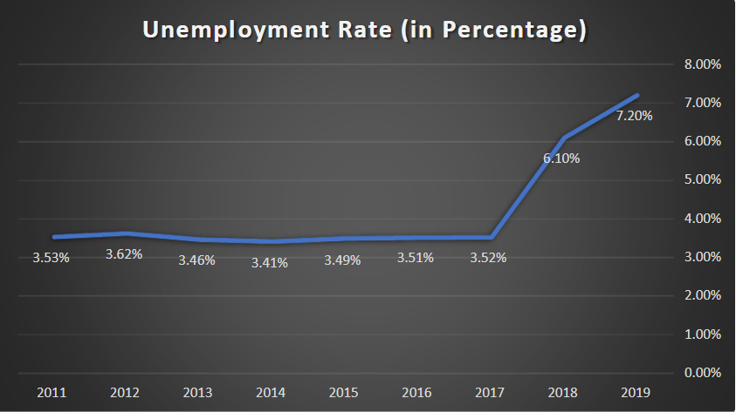
Problem Statement:
Part time job culture is less in India as compare to other countries like USA, Canada, South Korea etc.
Unemployment rate of youths during graduation is approx.80%.
Around 47% graduates in India are not suitable for any kind of industry role.

Slide 3
Solution:
Each student can’t have industry related skills so there must be any platform which will provide money for following their hobby or prefer skill.
Start-up can provide internships, freelancing or contract base work for student.
This system not only provides jobs to student but student can create job for others using this application.

Slide 4
System Design:
Front-End:
React Js
React Bootstrap
Database:
Firebase
Email:
SMPT Js

Slide 5



Technical Survey:
Single login page for job seeker and job provider.
Job seeker can apply for job and also can create a job or post a job.
This application mainly intended towards students.
Registration is lifetime free for users.
PocketMoney

Slide 6
Future Scope:
Application tracking.
Security management.
Improvement in secure communication.
This application can be copied by other platforms so for preventing that, system will be updated regularly.
Market growth will be exponential in future due to increase of start-up and content creator culture in india.

Slide 7
Thank You..

