Slide 1
Fintech590 Week05
Kunyu Liu

Slide 2
Problem 1

Slide 3
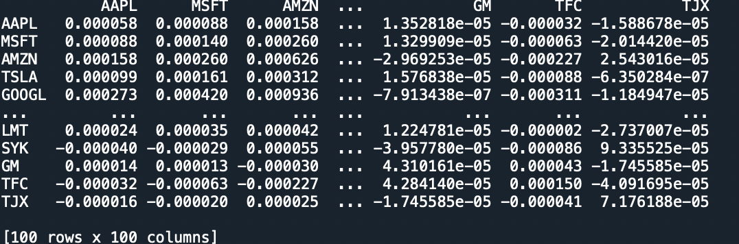

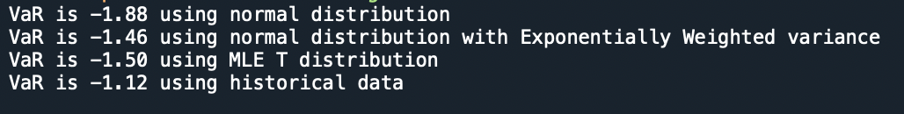
Problem 2

Slide 4
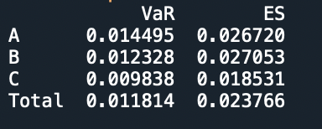
Problem 3

