Slide 1
Fintech 590 Week 04
Kunyu Liu

Slide 2

Problem 1
Classical Brownian motion
$P_{t}=P_{t−1}+r_{t}$,
$r_{t}\sim N(0,σ^{2})$
Expected value of $P_{t}$ is$P_{t−1}$
Standard Deviation of $P_{t}$ is $σ$.

Slide 3

Arithmetic Return System
$P_{t}=P_{t−1}(1+r_{t})$, $r_{t}\sim N(0,σ^{2})$
Expected value of $P_{t}$ is$P_{t−1}$
Standard Deviation of $P_{t}$ is $P_{t−1}∗σ$.

Slide 4
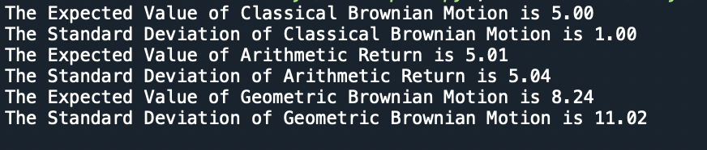

Geometric Brownian Motion
$P_{t}=P_{t−1}∗e^{r_{t}}$, $r_{t}\sim N(0,σ^{2})$
Expected value of $P_{t}$ is$P_{t−1}$
Standard Deviation of $P_{t}$ is $P_{t−1}∗e^{σ}$.

Slide 5
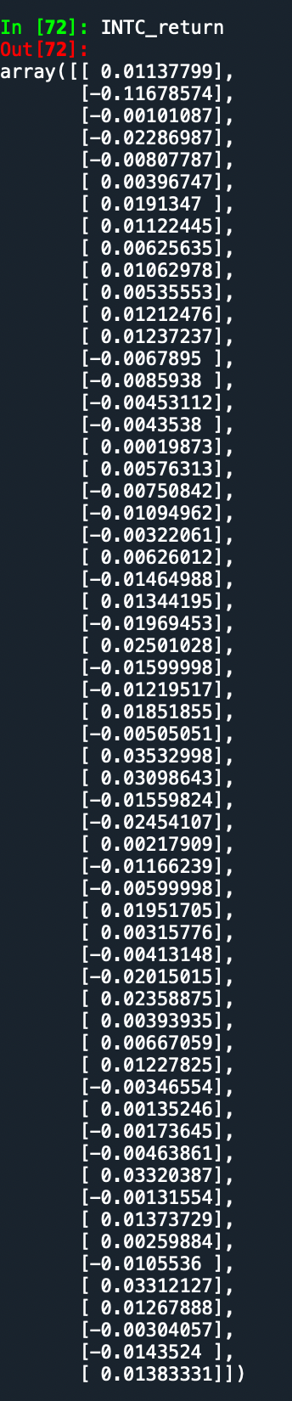
Problem 2
Calculate the arithmetic returns for INTC

Slide 6
Calculate VaR
Using a normal distribution.
Using a normal distribution with an Exponentially Weighted variance
(λ = 0. 94)

Slide 7
Using a MLE fitted T distribution.
Using a Historic Simulation.

Slide 8
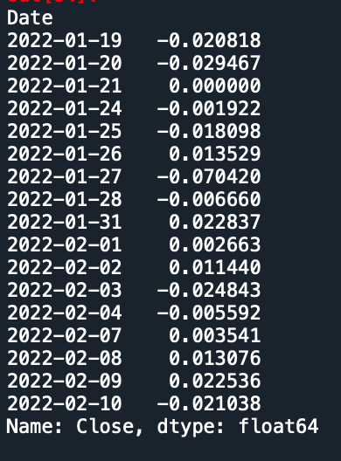
Download new data

Slide 9
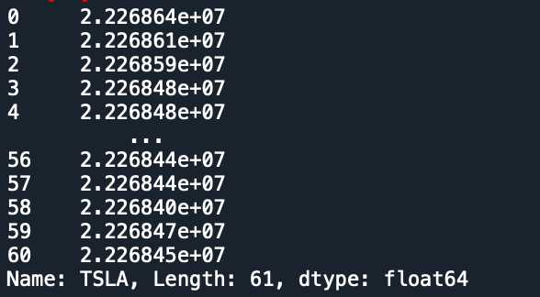
Problem 3
Portfolio A

Slide 10
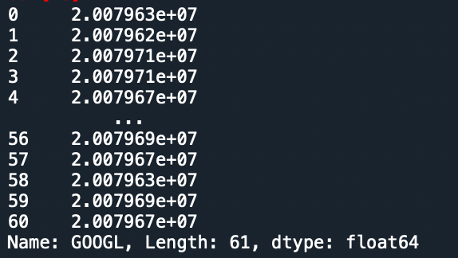
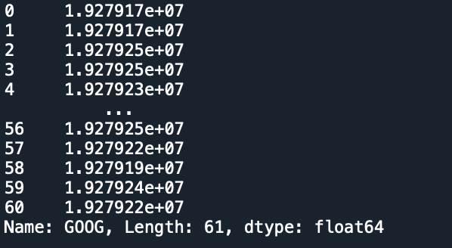
Portfolio B
Portfolio C

Slide 11
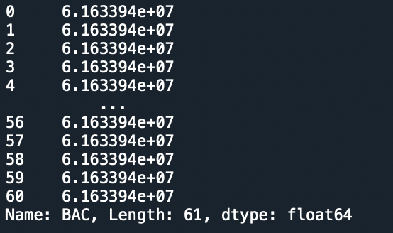
Total Portfolio

