Slide 1
Fintech 590 Week 07
Kunyu Liu

Slide 2
Problem 1
delta of call option using closed form: 0.51
delta of put option using closed form: -0.49
gamma of call option using closed form : 0.04
gamma of put option using closed form : 0.04
vega of call option using closed form : 19.78
vega of put option using closed form : 19.78
theta of call option using closed form: -21.63
theta of put option using closed form: -22.09
rho of call option using closed form: 0.07
rho of put option using closed form: -0.08
carryRho of call option using closed form: 7.61
carryRho of put option using closed form: -7.30

Slide 3
delta of call option using forward difference method: 0.51
delta of put option using forward difference method: -0.49
gamma of call option using forward difference method: 0.00
gamma of put option using forward difference method: 0.00
vega of call option using forward difference method: 19.78
vega of put option using forward difference method: 19.78
theta of call option using forward difference method: -21.63
theta of put option using forward difference method: -22.09
rho of call option using forward difference method: -0.36
rho of put option using forward difference method: -0.36
carry rho of call option using forward difference method: 7.61
carry rho of put option using forward difference method: -7.30

Slide 4
call option value using binomial tree valuation: 3.85
put option value using binomial tree valuation: 7.18
delta of call option using binomial tree valuation: 0.54
delta of put option using binomial tree valuation: -0.03
gamma of call option using binomial tree valuation: 0.00
gamma of put option using binomial tree valuation: 0.00
vega of call option using binomial tree valuation: 19.62
vega of put option using binomial tree valuation: 19.62
theta of call option using binomial tree valuation: -21.88
theta of put option using binomial tree valuation: -41.90
rho of call option using binomial tree valuation: 6.55
rho of put option using binomial tree valuation: 0.7

Slide 5
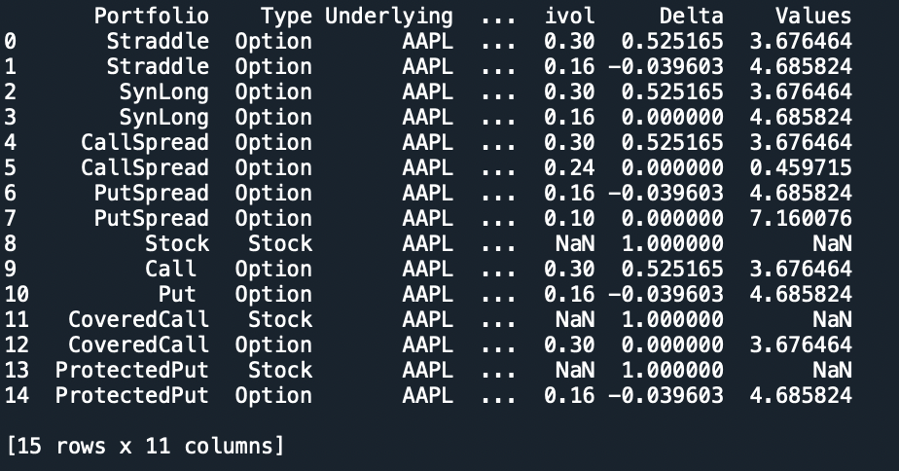
Problem 2

Slide 6
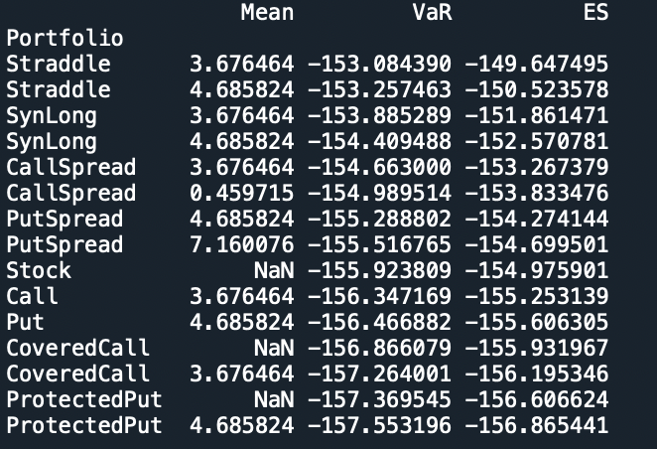

Slide 7
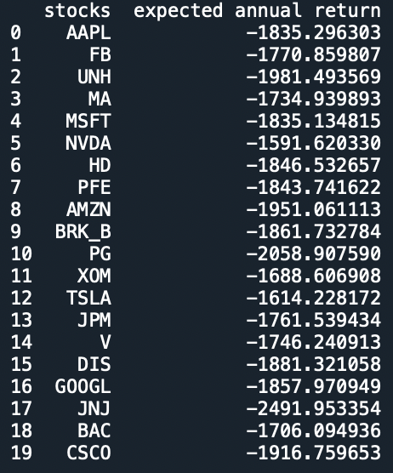
Problem 3

