Slide 1
Fintech590 Week03
Kunyu Liu

Slide 2
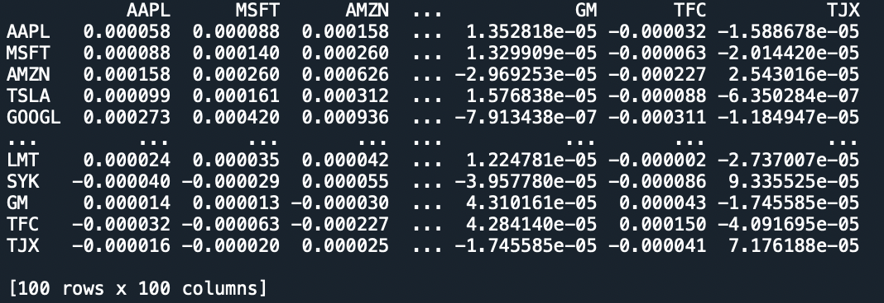
Problem1
λ = 0.5
Exponentially weighted covariance matrix:

Slide 3
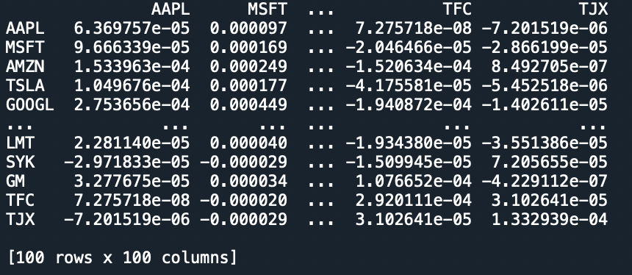
λ = 0.7 Exponentially weighted covariance matrix:

Slide 4
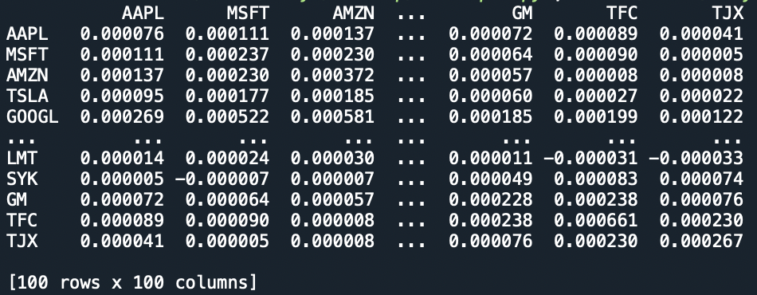
λ = 0.9 Exponentially weighted covariance matrix:

Slide 5
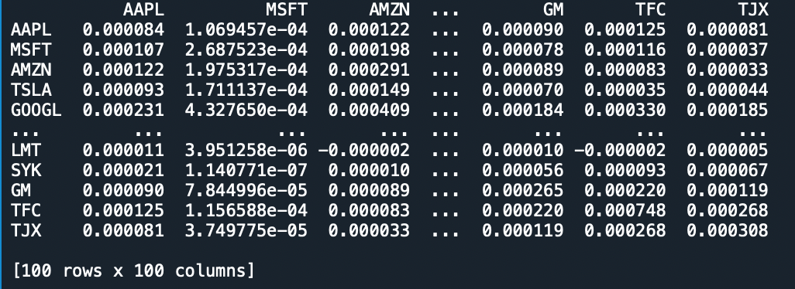
λ = 0.97 Exponentially weighted covariance matrix:

Slide 6
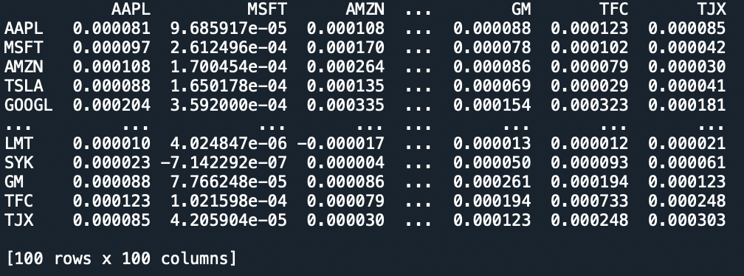
λ = 0.99 Exponentially weighted covariance matrix:

Slide 7
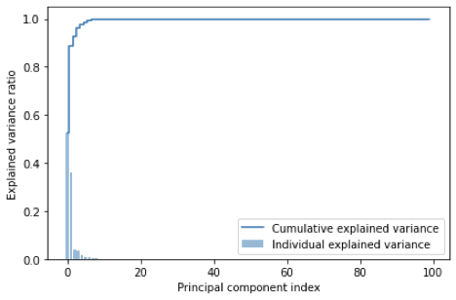
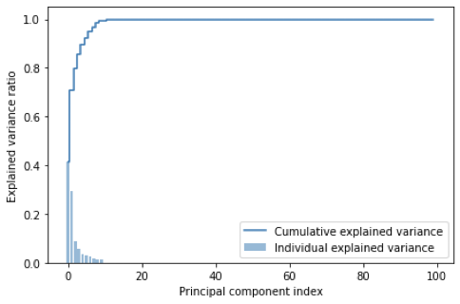
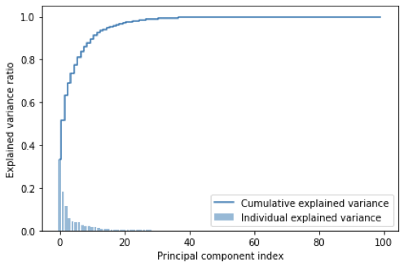
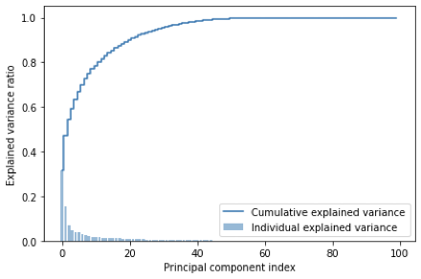
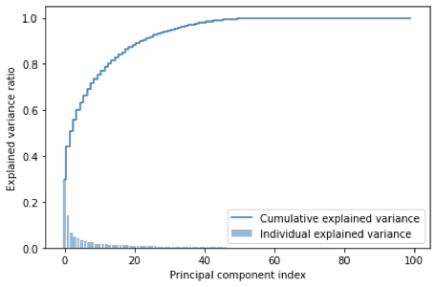
PCA cumulative variance explained:
λ = 0.5
λ = 0.7
λ = 0.9
λ = 0.97
λ = 0.99

Slide 8



Problem2
Implement Higham’s 2002 nearest psd correlation function:
Compare run time:

Slide 9


When N increases:

Slide 10
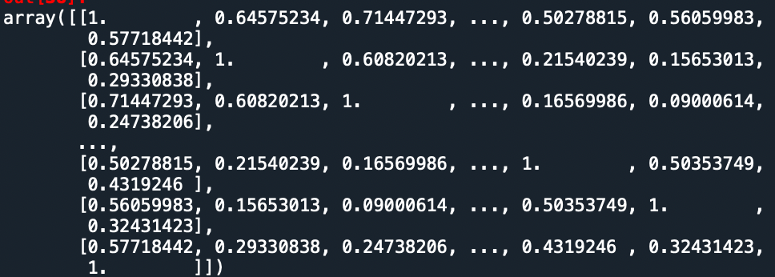
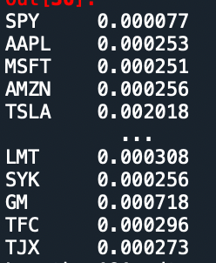
Problem3
Pearson correlation :
Pearson variance:

Slide 11
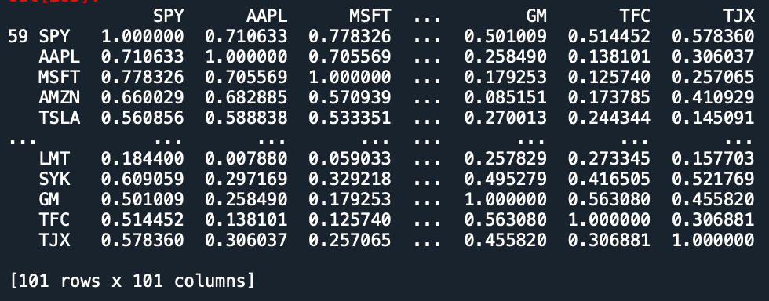
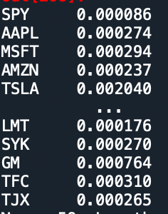
EW correlation:
EW variance :

Slide 12
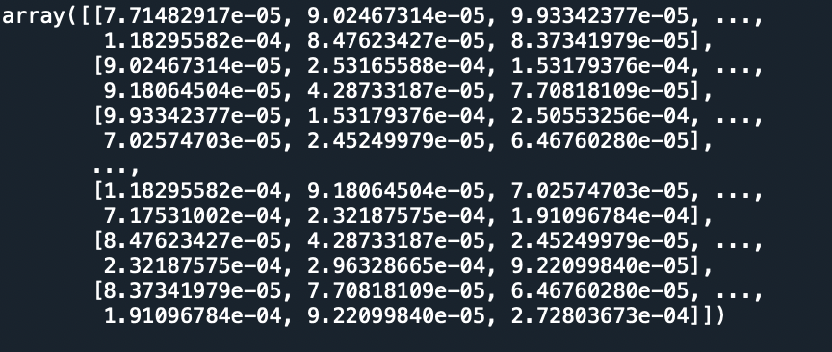
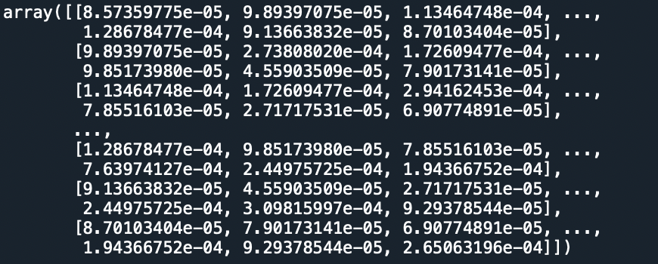
4 different covariance matrices: covariance matrix 1 :Pearson correlation + var() covariance matrix 2 :Pearson correlation + EW var()

Slide 13
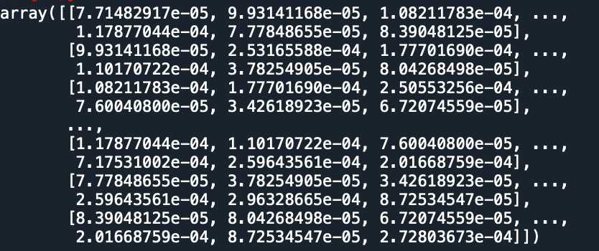
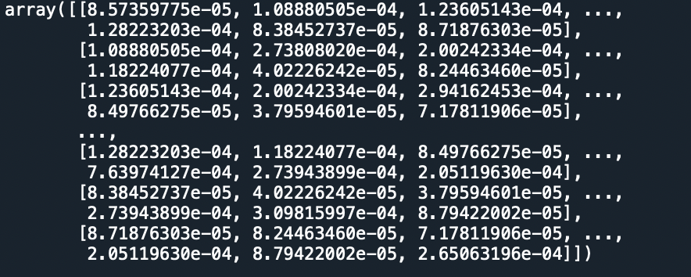
covariance matrix 3 : EW correlation + var()
covariance matrix 4 :EW correlation + EW var()

Slide 14
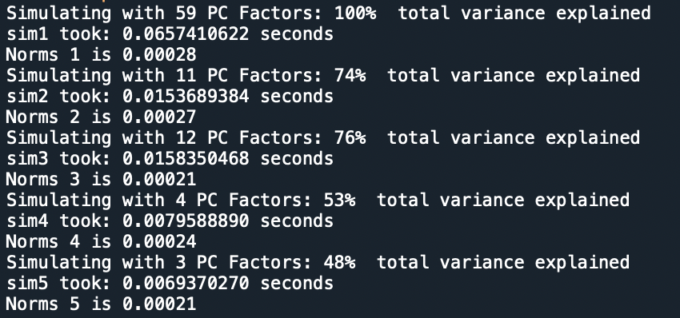
PCA simulate: 1. cov1_df: Pearson correlation + var()

Slide 15
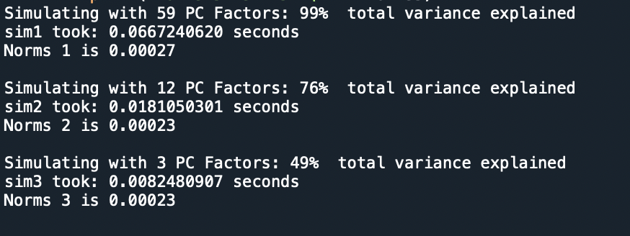
2. cov2_df: Pearson correlation + EW var()

Slide 16
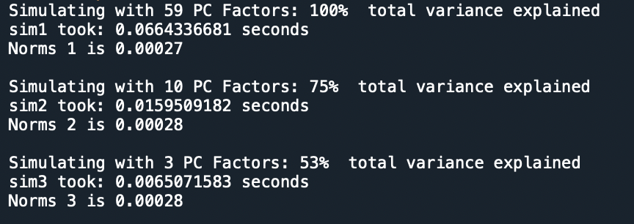
3.cov3_df: EW correlation + var()

Slide 17
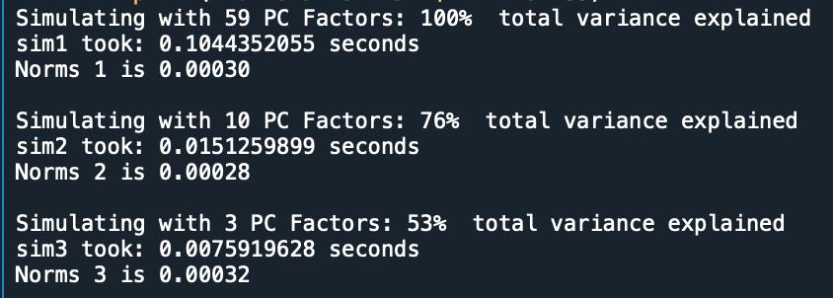
4. cov4_df : EW correlation + EW var()

Slide 18
Thank you !

