Slide 1
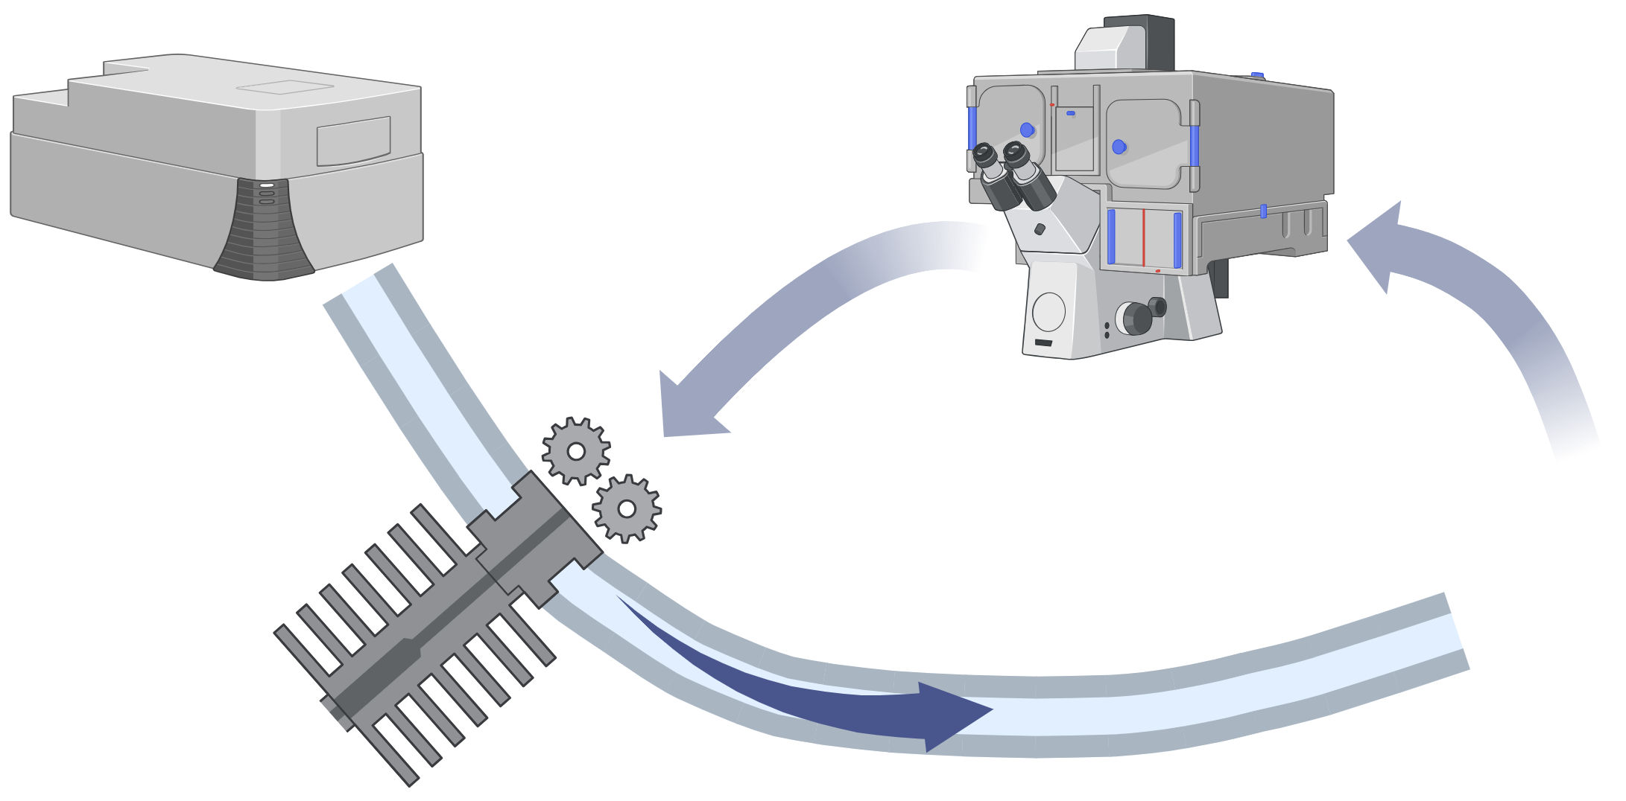

Controlled bending
Imaging
Pump laser
1030 nm
Adaptive modulation of multimodal nonlinear pulse propagation
Fiber shaper
Filtered excitation
1100$±$25 nm
Multimode fiber (MMF)

