Slide 1
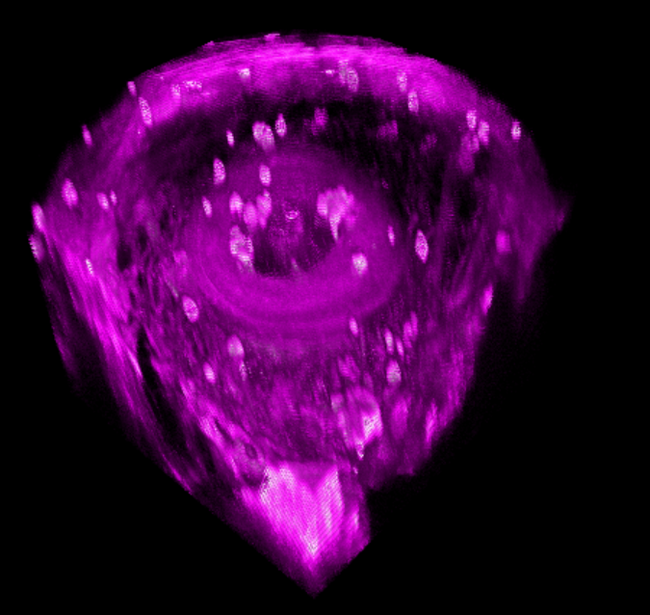
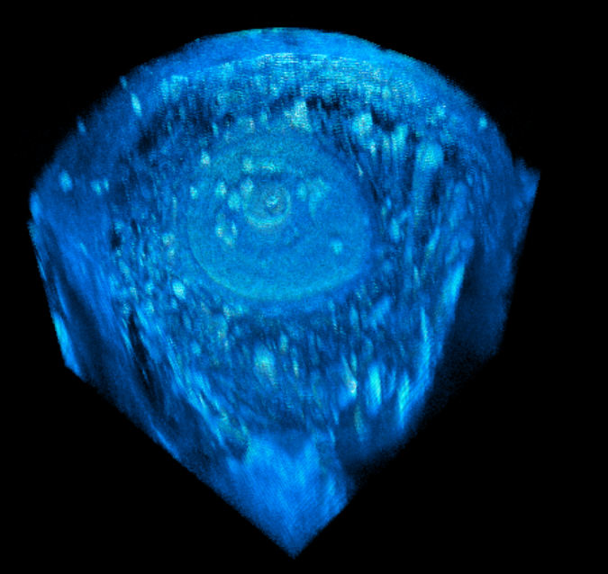
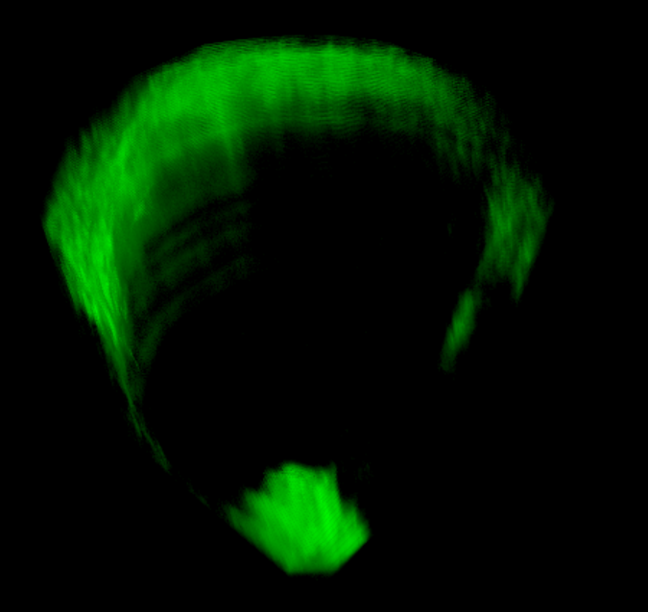
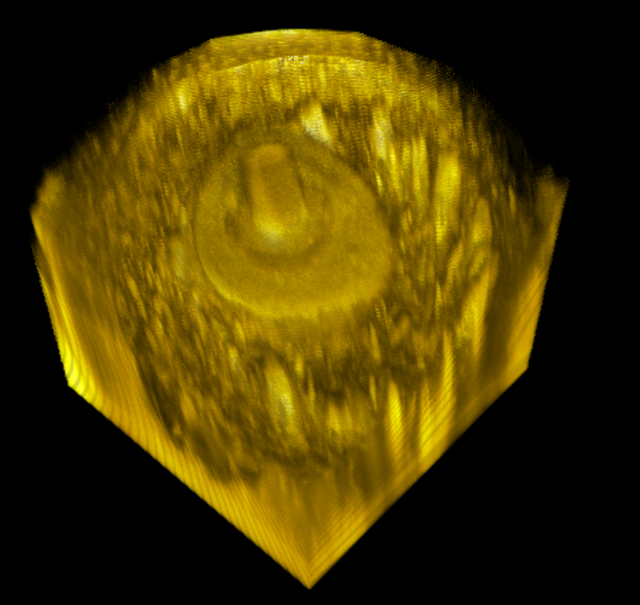
Fig 4. Demo 2: deep imaging
Results: deep imaging over 300 um
Mechanism: high peak power improves depth penetration
THG
3PAF
0
0
100
100
200
200
300
300
SHG
2PAF
0
0
100
100
200
200
300
300
Notes:
Technical part
NADH is better in SLAM
The use of longer wavelength and higher order nonlinearity – which one is the main reason
750 1100
Bio part
Tie to tech strength
Imaging organoids – Jason new, 750 1100 comparison
Energy at different depth

