Slide 1
phase-shift
circuit
power
amplifier
…
…
phase-shift
circuit
patch

Slide 2

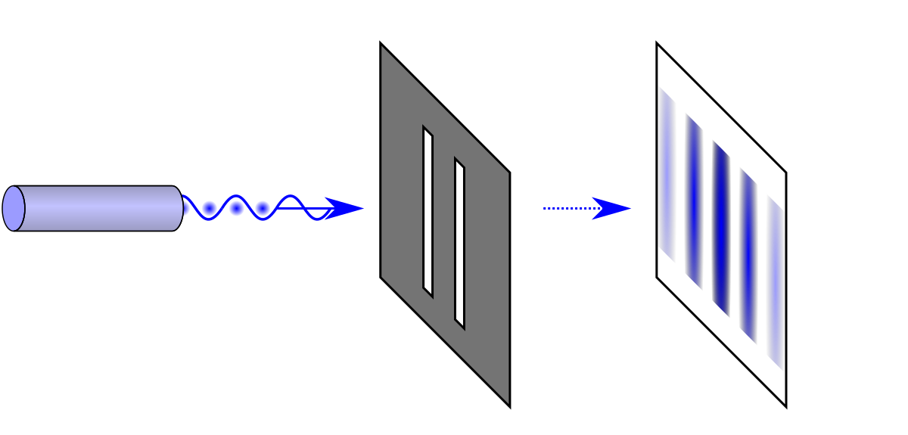
User
IRF
Sensing RIS
Base station

Slide 3
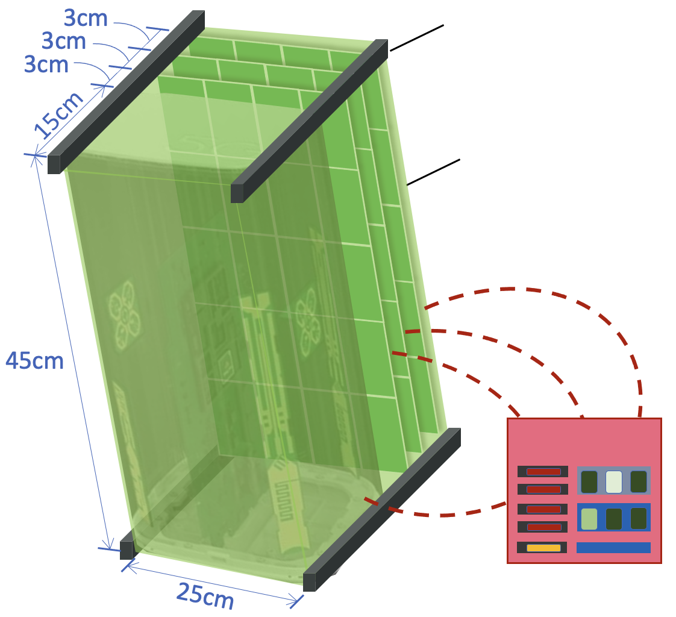
US-RIS
Supporting
materials
User
Absorbing
materials
Controller

