Slide 1
On-line Retail Order Grouping Using Constrained Clustering
Chengfei Wang, Ai-Te Kuo, Li Sun

Slide 2

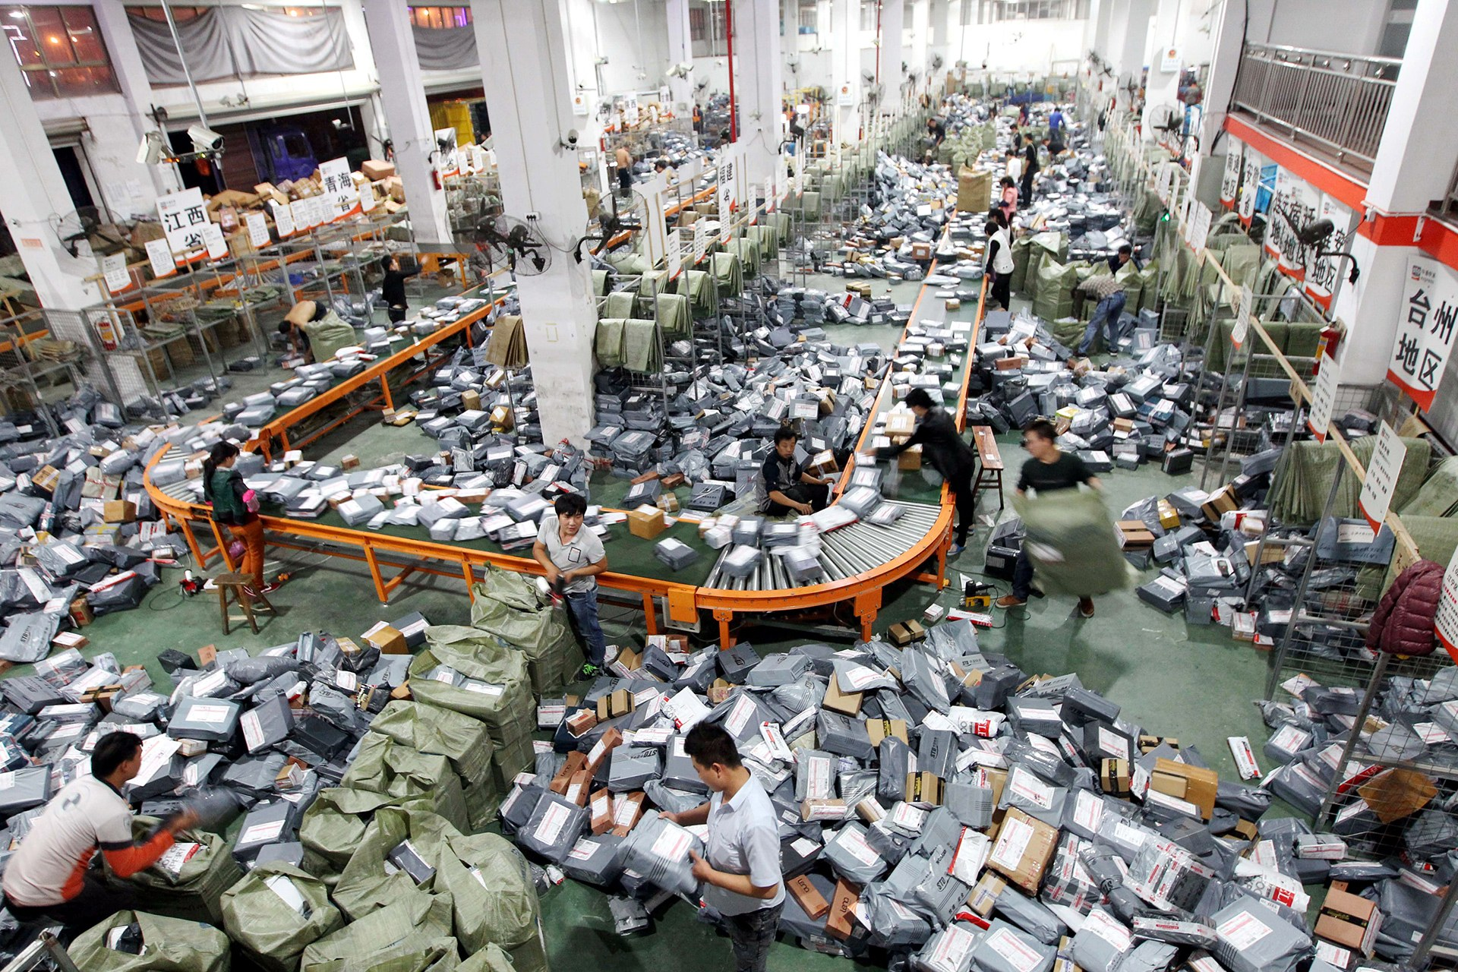
Motivation

Slide 3









Problem description
⁞

Slide 4
Challenges
How to define the objective function?
Consider the ultimate goal: minimizing costs
How to define the similarity between orders?
Items, locations (warehouses, distribution centers, customers)
Mixed type of attributes (category and numerical)
How to satisfy the balancing constraints?
The workloads of different distribution centers should not differ greatly
How to handle the high-dimensional and sparse dataset?
Huge amount of SKUs
Limited items in each order

Slide 5
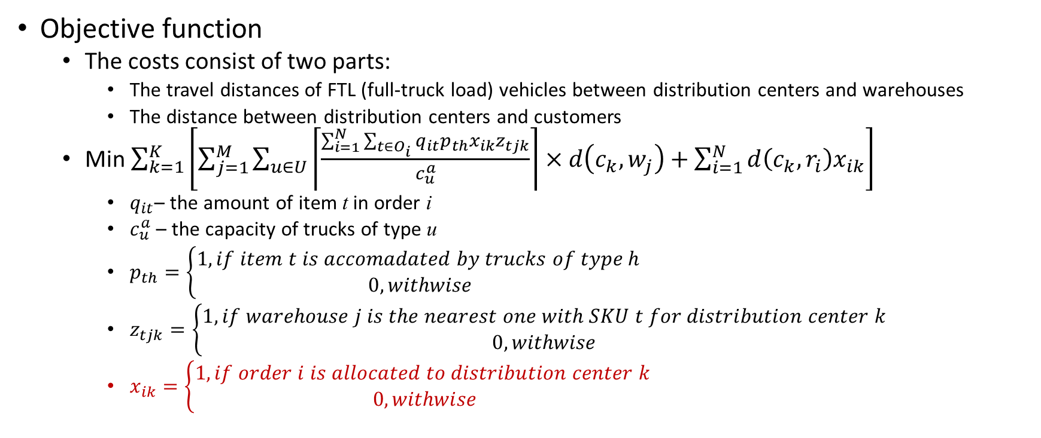
Solution
Objective function
The costs consist of two parts:
The travel distances of FTL (full-truck load) vehicles between distribution centers and warehouses
The distance between distribution centers and customers
Min $\sum_{k=1}^{K}{\left[\sum_{j=1}^{M}{\sum_{u∈U}{\left\lceil \frac{\sum_{i=1}^{N}{\sum_{t∈O_{i}}{q_{it}p_{th}x_{ik}z_{tjk}}}}{c_{u}^{a}}\right\rceil }×d\left(c_{k},w_{j}\right)}+\sum_{i=1}^{N}{d\left(c_{k},r_{i}\right)x_{ik}}\right]}$
$q_{it}$– the amount of item t in order i
$c_{u}^{a}$ – the capacity of trucks of type u
$p_{th}=\left\{\begin{aligned}1, if item t is accomadated by trucks of type h \\ 0, withwise\end{aligned}\right.$
$z_{tjk}=\left\{\begin{aligned}1, if warehouse j is the nearest one with SKU t for distribution center k \\ 0, withwise\end{aligned}\right.$
$x_{ik}=\left\{\begin{aligned}1, if order i is allocated to distribution center k \\ 0, withwise\end{aligned}\right.$

Slide 6
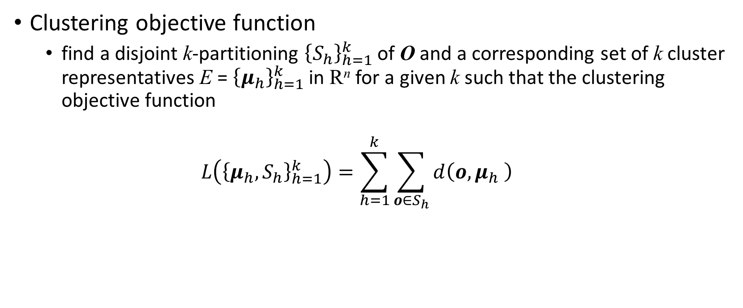
Solution
Clustering objective function
find a disjoint k-partitioning ${\left\{S_{h}\right\}}_{h=1}^{k}$ of O and a corresponding set of k cluster representatives E = ${\left\{μ_{h}\right\}}_{h=1}^{k}$ in R^{n} for a given k such that the clustering objective function
$$L\left({\left\{μ_{h},S_{h}\right\}}_{h=1}^{k}\right)=\sum_{h=1}^{k}{\sum_{o∈S_{h}}{d\left(o,μ_{h} \right)}}$$

Slide 7
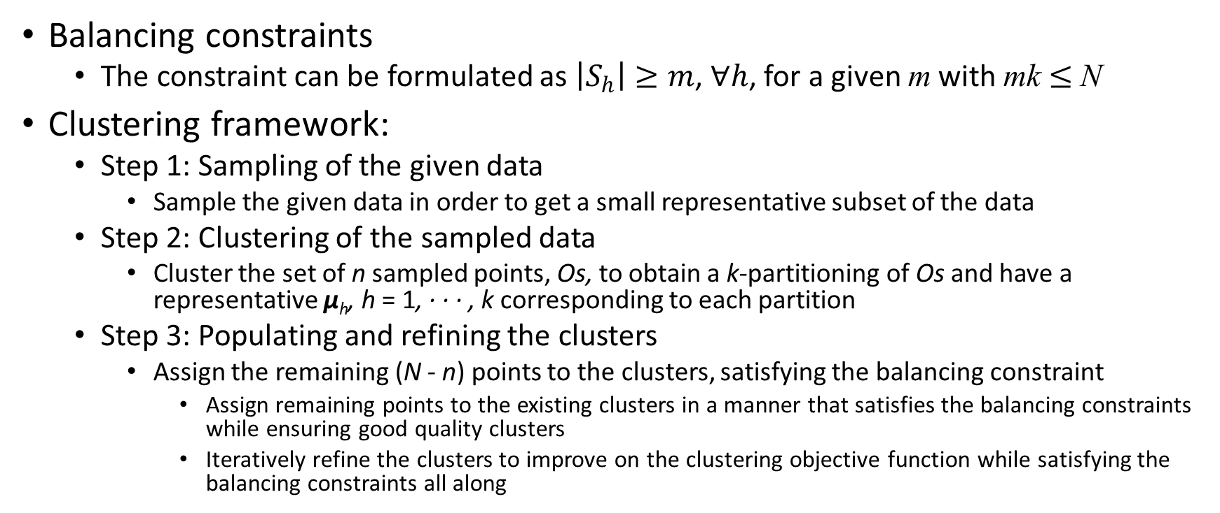
Solution
Balancing constraints
The constraint can be formulated as $\left|S_{h}\right|≥m$, $∀h$, for a given m with mk $≤$ N
Clustering framework:
Step 1: Sampling of the given data
Sample the given data in order to get a small representative subset of the data
Step 2: Clustering of the sampled data
Cluster the set of n sampled points, Os, to obtain a k-partitioning of Os and have a representative μ_{h}, h = 1, · · · , k corresponding to each partition
Step 3: Populating and refining the clusters
Assign the remaining (N - n) points to the clusters, satisfying the balancing constraint
Assign remaining points to the existing clusters in a manner that satisfies the balancing constraints while ensuring good quality clusters
Iteratively refine the clusters to improve on the clustering objective function while satisfying the balancing constraints all along

Slide 8
Solution
Similarity
Mixed type of attributes: K-modes?
High-dimensional and sparse data

Slide 9
Dataset
On-line retail dataset in UCI Machine Learning Repository (http://archive.ics.uci.edu/ml/datasets/online+retail)
The dataset is a transnational data set which contains all the transactions occurring between 01/12/2010 and 09/12/2011 for a UK-based and registered non-store on-line retail. The company mainly sells unique all-occasion gifts.
Modification:
Generate the locations of facilities and customers, as well as the SKU information in warehouses and capacity details in distribution centers.

Slide 10
Data preprocessing
Originally: 541909 tuples
Data cleaning
Remove the incomplete data remove the data whose country is not the United Kingdom.
354345 tuples
3950 unique customers
3645 unique items

Slide 11
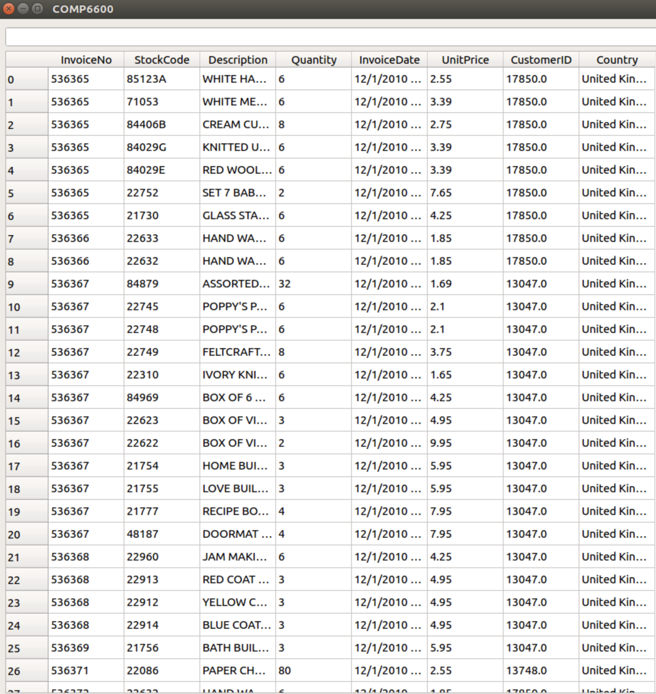

Slide 12
What are left…
Define the clustering objective function
Implement the clustering algorithm
Evaluate the algorithm on the chosen dataset

Slide 13
Thank you for attention!

