Slide 1
INFO20003 Database Systems
Kuoyuan Li
Week 2

Slide 2
Agenda Today
Review of the Database Development Lifecycle– 20 mins
Case study – identify entities, business rules and attributes (Q2) – 30 mins

Slide 3
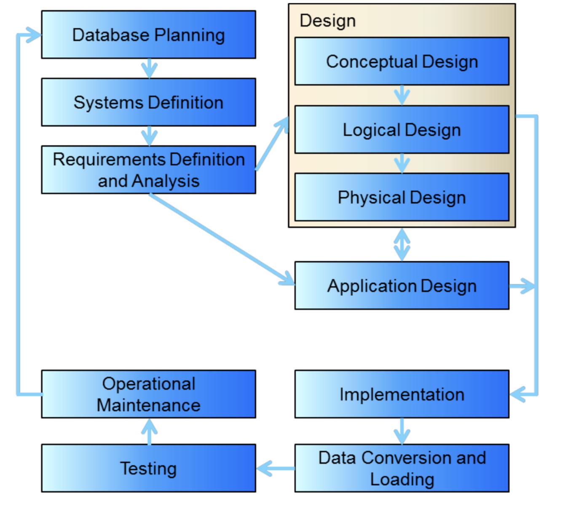
Development lifecycle
Notes:
Database planning: Planning how to do the project, Understanding how the enterprise works.
Systems Definition: Specifying scope and boundaries (Users, Application areas), How does the system interfere with other organisational systems

Slide 4
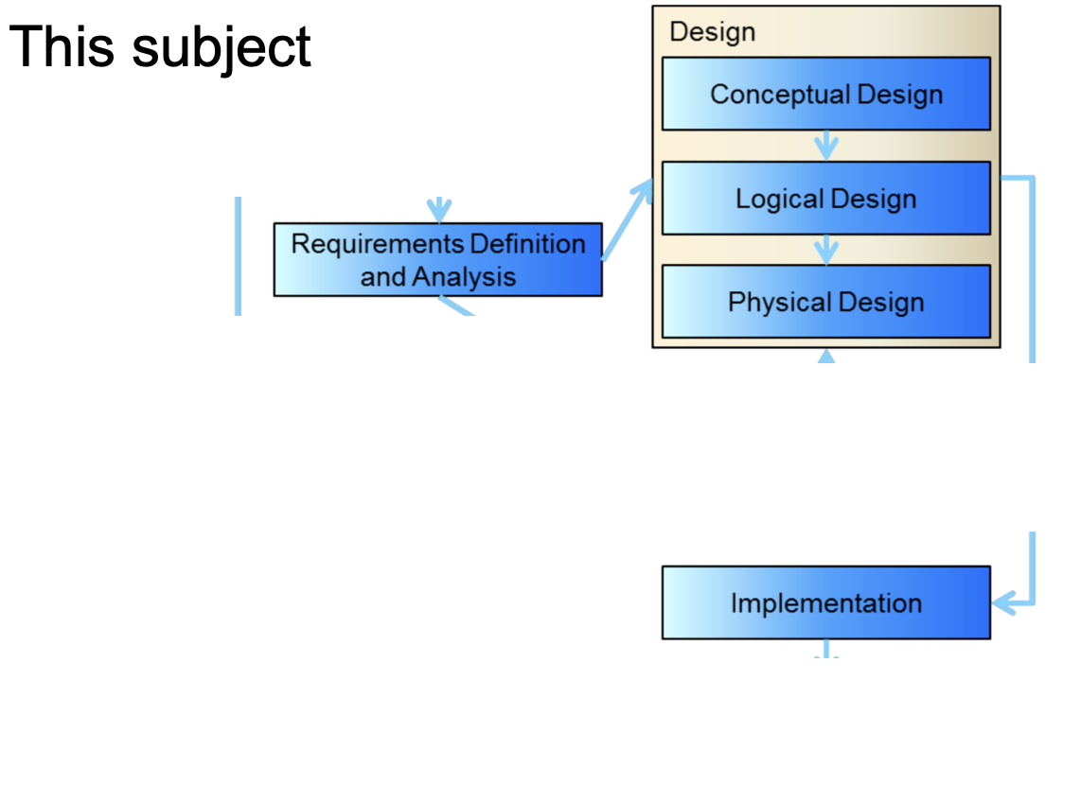
Development lifecycle

Slide 5

Development lifecycle
A. The purpose of each stage and what do we, as database designers, need to do in each stage
Database planning:
Planning (at a high level) how to do the project
Understanding how the enterprise works.
Planning how the stages be completed efficiently and effectively

Slide 6

Development lifecycle
A. The purpose of each stage and what do we, as database designers, need to do in each stage
System definition:
Specifying scope and boundaries
How the system operate from different perspective
How it interfere in other organisational systems.

Slide 7

Development lifecycle
A. The purpose of each stage and what do we, as database designers, need to do in each stage
Requirements Definition and Analysis:
Collect and analysis of requirements
Description of the data used or generated
Details of how the data is to be used or generated.
Case study will be given for this subject, containing all the requirements.

Slide 8
Development lifecycle
A. The purpose of each stage and what do we, as database designers, need to do in each stage
MCQ: distinguish conceptual design, logical design and physical design
PollEv.com/likuoyuan440

Slide 9

Development lifecycle
A. The purpose of each stage and what do we, as database designers, need to do in each stage
Conceptual design:
Construction of a model of the data used in the database, independent of all physical considerations.
ER and EER diagrams.

Slide 10
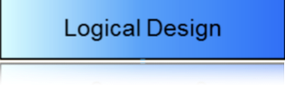
Development lifecycle
A. The purpose of each stage and what do we, as database designers, need to do in each stage
Logical Design:
The model of the data to be used is based on a specific data model, but independent of a particular database management system.
e.g. relational data model, (JSON, XML)

Slide 11

Development lifecycle
A. The purpose of each stage and what do we, as database designers, need to do in each stage
Physical Design:
The description of the implementation of the database on secondary storage (non-volatile , long-term storage) is created.
The base relations, indexes, integrity constraints, security, etc. are defined using the SQL language.

Slide 12

Development lifecycle
A. The purpose of each stage and what do we, as database designers, need to do in each stage
Application Design:
Design of the user interface and the application programs that use and process the database

Slide 13

Development lifecycle
A. The purpose of each stage and what do we, as database designers, need to do in each stage
Implementation:
Physical realization of the database and application designs.
Programming phase

Slide 14

Development lifecycle
A. The purpose of each stage and what do we, as database designers, need to do in each stage
Data conversion and loading:
Needed when a new database is replacing an old system.
The existing data will be transferred into the new database.

Slide 15

Development lifecycle
A. The purpose of each stage and what do we, as database designers, need to do in each stage
Testing:
Find errors and analyze performance, robustness and adaptability.

Slide 16

Development lifecycle
A. The purpose of each stage and what do we, as database designers, need to do in each stage
Operational maintenance:
Monitoring: the performance of the system is observed. If the performance of the system falls below an acceptable level, tuning or reorganization of the database may be required.
Maintaining and upgrading the database system: when new requirements arise, the new development lifecycle will be done.

Slide 17
Development lifecycle
B. Tasks that are performed in the conceptual design stage to generate a conceptual model.

Slide 18
Development lifecycle
B. Tasks that are performed in the conceptual design stage to generate a conceptual model.
1. requirement analysis: identify entities and relationships
Entities: real-world object or concept distinguishable from other objects or concepts
Each entity is described using a set of attributes.

Slide 19
Development lifecycle
B. Tasks that are performed in the conceptual design stage to generate a conceptual model.
2. identify and document business rules.
Allow the identification of relationships, participation rules and constraints in creating a correct data model. They also allow designers to understand business processes, and the nature, role and scope of the data

Slide 20
Development lifecycle
B. Tasks that are performed in the conceptual design stage to generate a conceptual model.
3. identify what information about these entities and relationships should be stored in the database.
From this, a database schema is developed and displayed as an ER model (diagram), using the basic constructs of entities, relationships and attributes.

Slide 21
Development lifecycle
c. How do you refine a conceptual model to convert it to a logical model (Relational)?
Refine: double-check with business rules, cover everything states in the requirements, and do not cover anything that is not in there.
Convert to logical model:
Resolve relationship, create foreign keys
…

Slide 22
Development lifecycle
d. What must be done to transform a logical model to a physical model (Relational) ?
Convert to physical model:
Choose data type
Add data related constraints (Null/Not null)
…

Slide 23
Question
More about logical and physical model will be discussed next week
Questions?

Slide 24
Case study
Group/Individual case study
I will randomly assign you to a breakout room
1. Already have a study group/Want to do it with a friend?
Choose the room where you friends in and jump into it
2. Don’t want be in a group for now?
Although I strongly encourage you to do it in a group, if you want to do it alone, you can come to the main room and mute yourself.

Slide 25
Case study
You can work on padlet, or use Zoom share whiteboard
https://padlet.com/kuoyuanli1/defg046zjqg91xro

Slide 26
Case study
A cinema chain operates a number of cinemas. Each cinema has several screens, numbered starting from 1. The chain keeps track of the size (in feet) and seating capacity of every screen, as well as whether the screen offers the Gold Class experience.
The cinema chain owns hundreds of movie projectors – both film projectors (16 mm and 35 mm) and digital projectors (2D and 3D). The chain stores key information about each projector, namely its serial number, model number, resolution and hours of use. Each movie screen has space for a single projector; technicians must be able to identify which screen each projector is currently projecting onto.
A wide range of movies are shown at these cinemas. The system should keep track of the last time a movie was shown on a particular screen. The marketing department needs to know the movie’s title and year of release, along with the movie’s rating (G, PG, M, MA15+ or R18+).
Each cinema has a numeric ID, name and address. For cinemas that are not owned outright, the business also keeps track of yearly rent. The system needs to be able to generate weekly activity reports for the chain’s chief operating officer.

Slide 27
Case study
a. Identify the entities.

Slide 28
Case study
a. Identify the entities.
Cinema
Screen
Projector
Movie
Q: How about Cinema chain? Why?

Slide 29
Case study
a. Identify the entities.
Cinema
Screen
Projector
Movie
Q: How about Cinema chain? Why?
A: not an entity in this scenario.
1. Only one instance.
2. There is no data to store about it.
So: Do not normally include the actual business or company whose business processes you are modeling.

Slide 30
Case study
b. Identify the business rules

Slide 31
Case study
b. Identify the business rules
Each cinema has several screens, numbered starting from 1
Each movie screen has space for a single projector
Technicians must be able to identify which screen each projector is currently projecting onto.
The system should keep track of the last time a movie was shown on a particular screen

Slide 32
Case study
c. For any three identified entities, list the attributes.

Slide 33
Case study
c. For any three identified entities, list the attributes.
Cinema (ID, name, address, yearly rent)
Screen (number, size, seating capacity, has Gold Class?)
Projector (format [16 mm film/35 mm film/2D digital/3D digital], serial number, model number, resolution, hours of use)
Movie (title, year of release, rating)

Slide 34
Question
Questions?

