Slide 1
INFO20003 Database Systems
Kuoyuan Li
Week 6

Slide 2
Agenda Today
Storage and Indexing review
Exercises

Slide 3
Storage and Indexing review
Storage and Indexing
Database management systems store information on disks (normally hard disks)
Involves many READ and WRITE operations when data is accessed: high cost
READ: transfer of data from the disk to main memory (RAM)
WRITE: transfer data from RAM to the disk

Slide 4
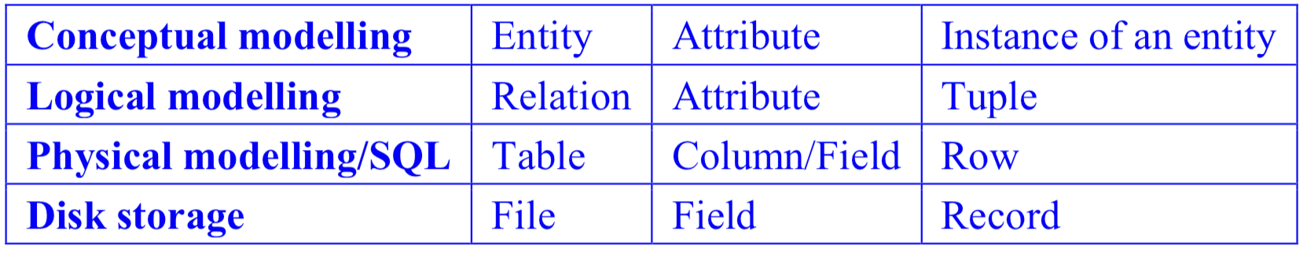
Storage and Indexing review
Storage and Indexing
Alternative terms used with respect to disk storage

Slide 5
Storage and Indexing review
Storage and Indexing
Files, pages and records
record: an individual row of a table and has a unique rid (disk address of the page containing the record).
eg. rid (3, 7) refers to the seventh record from third page
page: an allocation of space on disk or in memory containing a collection of records. (every page is the same size)
file: a collection of pages containing records (In simple database scenarios: single table)

Slide 6
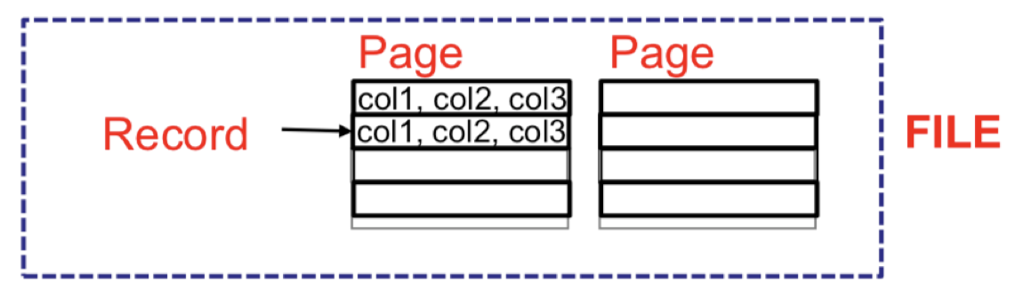
Storage and Indexing review
Storage and Indexing
Files, pages and records

Slide 7
Storage and Indexing review
Storage and Indexing
File organisations
defines how file records are mapped onto pages (stored on disk).
Heap file organization
Sorted file organization
Index file organization

Slide 8
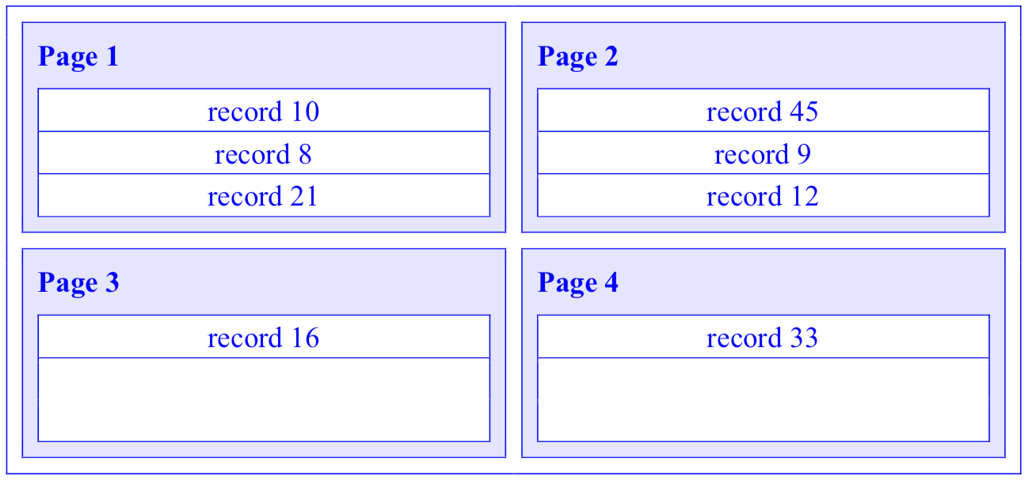
Storage and Indexing review
Storage and Indexing
Heap file organisation:
No ordering, sequencing or indexing
Suitable when retrieving all records
Slow search
Quick insert

Slide 9
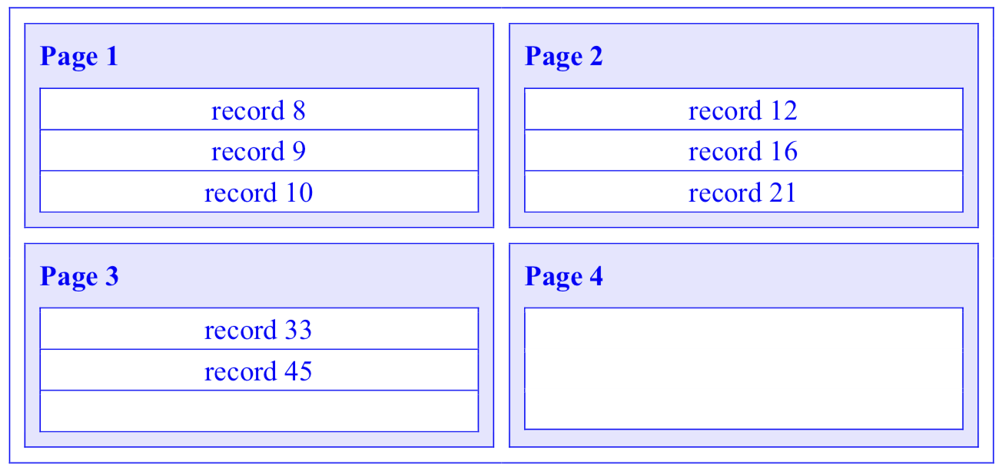
Storage and Indexing review
Storage and Indexing
Sorted file organization:
sequential order based on the search key (not PK or FK)
Quick search for search key(especially on range)
Slow insert

Slide 10
Storage and Indexing review
Storage and Indexing
Index file organization:
Any subset of the fields of a table is indexed based on queries that are frequently run against the database
Quick search on the subset attributes
Different index could be built
Different types index could be chosen
Insert depend on types

Slide 11
Storage and Indexing review
Storage and Indexing
What is index?
made up of data entries which refer back to the data in the relation. (k, rid) k: search key, rid: record ID.
speeds up selection on the search key fields
search key: subset of the attributes of a relation on which the index is built (not be relation’s key!!!)
stored in an index file, in contrast to the data file which contains the actual records themselves

Slide 12
Storage and Indexing review
Storage and Indexing
Type of index 1
clustered: data records in the data file have the same order as data entries of the index
unclustered: data records in the data file are not sorted by search key/data entries
primary: on the primary key of the relation
secondary: on any other set of attributes

Slide 13
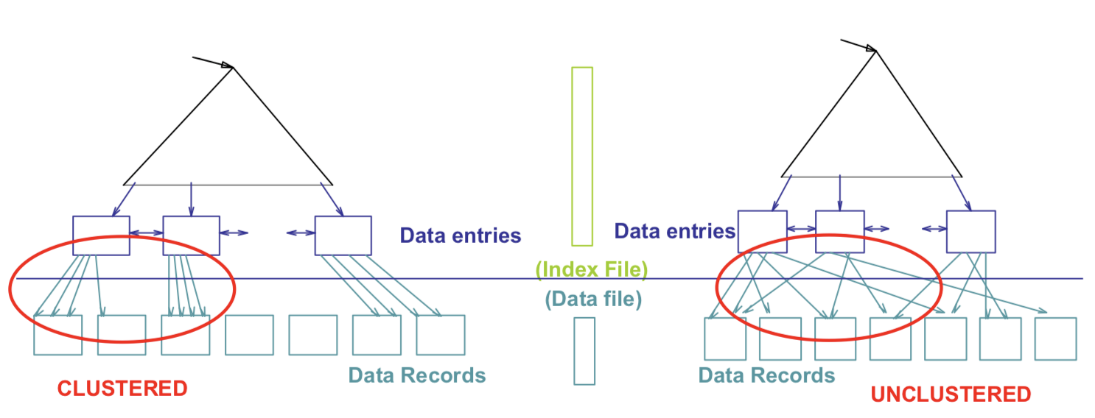
Storage and Indexing review
Storage and Indexing
Type of index 1

Slide 14
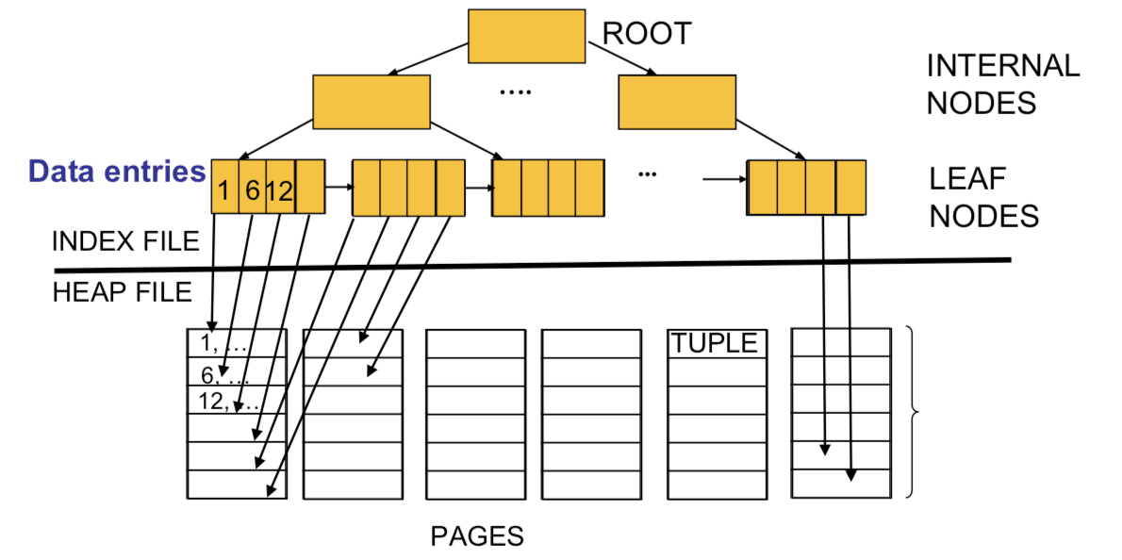
Storage and Indexing review
Storage and Indexing

Slide 15
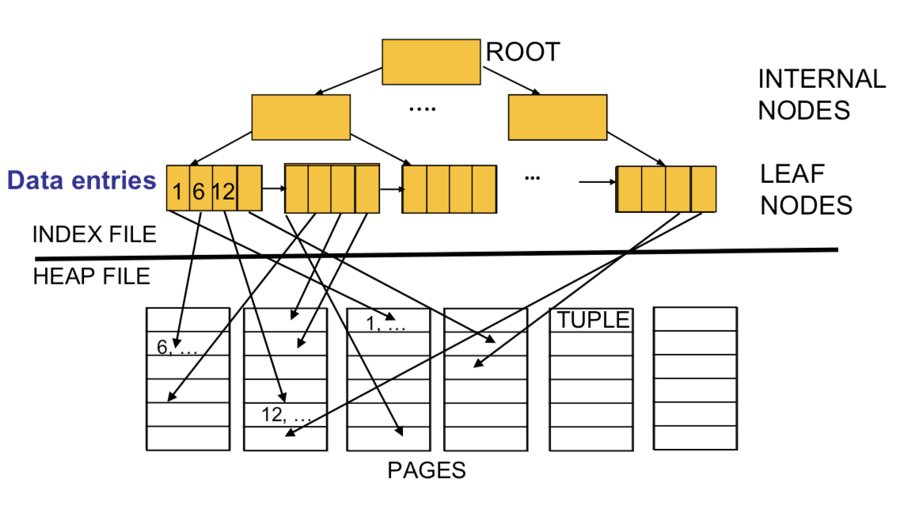
Storage and Indexing review
Storage and Indexing

Slide 16
Storage and Indexing review
Storage and Indexing
How to choose index
Which relations are accessed frequently?
Which attributes are retrieved?
Which attributes are involved in selection, join and other conditions?
If a query involves updating the relation, what attributes are affected?

Slide 17
Storage and Indexing review
Storage and Indexing
Index
Coming next 2 weeks: how to analyze a given query plan and see if a better query plan exists with an additional index
In general: make SELECT queries faster but slow down the updates
Indexes also require additional disk space.

Slide 18
Storage and Indexing review
Storage and Indexing
Type of index 2
Hash-based indexing: hash function h(r) is applied, where r is the field value.
Output: point to a bucket which refers to the primary page and other overflow pages if there is any. These buckets contain a representation (k, rid) for data entries.
best suited to support equality selections
How to build: not in this subject

Slide 19
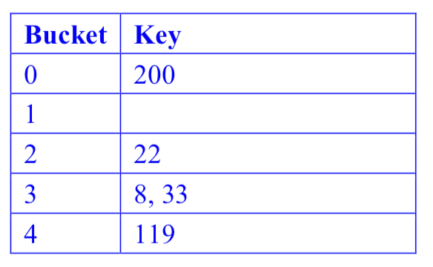
Storage and Indexing review
Storage and Indexing
Hash Index
Suppose you are given 5 buckets and h(k) = k % 5 where % is the modulus (remainder) operator. Insert 200, 22, 119, 8, and 33 into a hash table.

Slide 20
Storage and Indexing review
Storage and Indexing
Type of index 3
B-tree index: sorting data on search key and maintaining a hierarchical search data structure (B+ tree) that will direct the search to the respective page of the data entry
Insertion in such a structure is costly as the tree is updated with every insertion or deletion.
Good for: equal or range selections
How to build: not in this subject

Slide 21
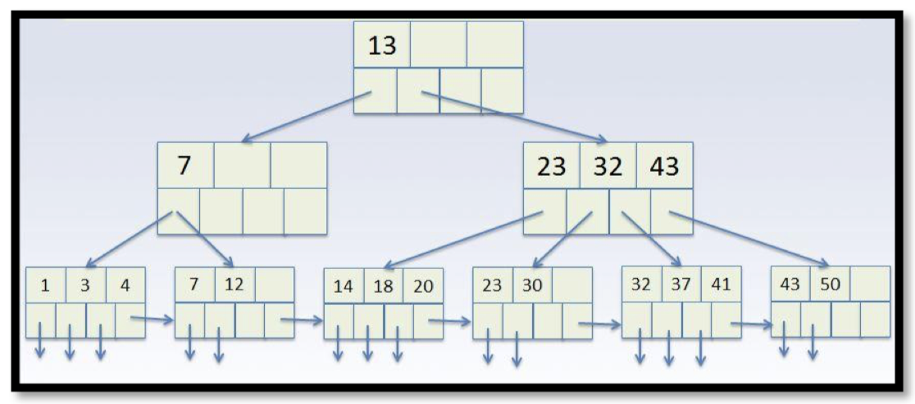
Storage and Indexing review
Storage and Indexing
B-tree index
Start at the root.
Internal nodes, search the keys to find the range K belongs in and follow that pointer.
For leaf nodes (nodes with no child nodes), search the keys to find K and follow the pointer to find the data record.

Slide 22
Storage and Indexing review
Any questions?

Slide 23
Exercise
Group/Individual Exercises
I will randomly assign you to a breakout room
1. Already have a study group/Want to do it with a friend?
Choose the room where you friends in and jump into it
2. Don’t want be in a group for now?
Although I strongly encourage you to do it in a group, if you want to do it alone, you can come to the main room and mute yourself.

Slide 24
Exercise
Choosing an index
You are asked to create an index on a suitable attribute. What are the important aspects you will analyse to make this decision? To get you started, the following might help you by providing scaffolding to the discussion:
Primary vs. secondary index
Clustered vs. unclustered index
Hash vs. tree indexes

Slide 25
Exercise
Choosing an index
You are asked to create an index on a suitable attribute. What are the important aspects you will analyse to make this decision? To get you started, the following might help you by providing scaffolding to the discussion:
Primary vs. secondary index
Primary: records are retrieved based on the value of primary key.
Secondary: fields that are frequently queried.
Generally, a table should always have a primary index (in fact, MySQL creates one automatically).

Slide 26
Exercise
Choosing an index
Clustered vs. unclustered index
Clustered: consists of a frequently-executed condition to check for a range, however expensive to maintain
Unclustered: fields that are frequently queried.
Equality conditions: same (if the search key does not have duplicate values.)
More than one combination of columns is used in range queries, choose the most frequently used combination and make those fields search keys of the clustered index

Slide 27
Exercise
Choosing an index
Hash vs. tree indexes
Hash: equality queries, faster than B-tree
Tree: range queries, creating a B-tree index

Slide 28
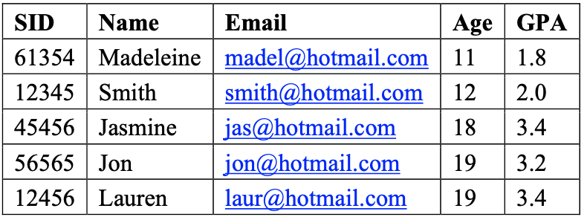
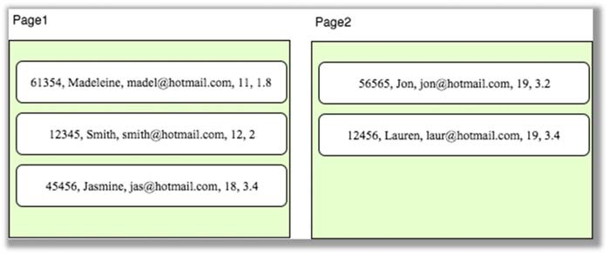
Exercise
2. Data entries of an index:
Consider the following instance of the relation Student (SID, Name, Email, Age, GPA):
As you can see the tuples are sorted by age and we are assuming that the order of tuple is the same when stored on disk. The first record is on page 1 and each page can contain only 3 records. The arrangement of the records is shown below:
Show what the data entries of the index will look like for:
An index on Age
An index on GPA

Slide 29
Exercise
Show what the data entries of the index will look like for:
a.An index on Age
Search key and rid in the format (a, b)
a is the page number and b is the record number.

Slide 30
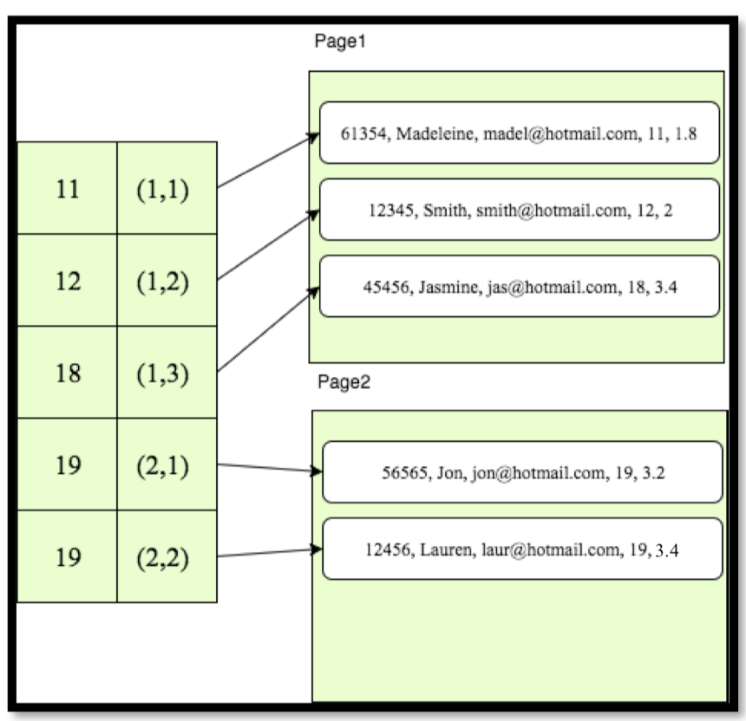
Exercise
Show what the data entries of the index will look like for:
a.An index on Age
search key and rid in the format (a, b)
a is the page number and b is the record number.
Clustered index

Slide 31
Exercise
Show what the data entries of the index will look like for:
b. An index on GPA
search key and rid in the format (a, b)
a is the page number and b is the record number.

Slide 32
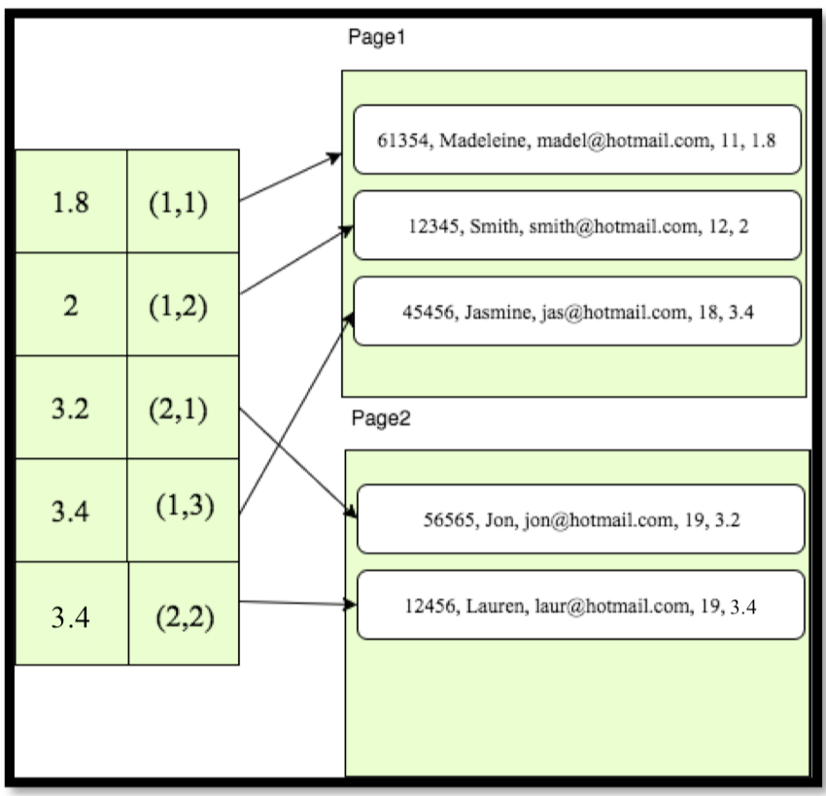
Exercise
Show what the data entries of the index will look like for:
b. An index on GPA
search key and rid in the format (a, b)
a is the page number and b is the record number.
Unclustered index

Slide 33
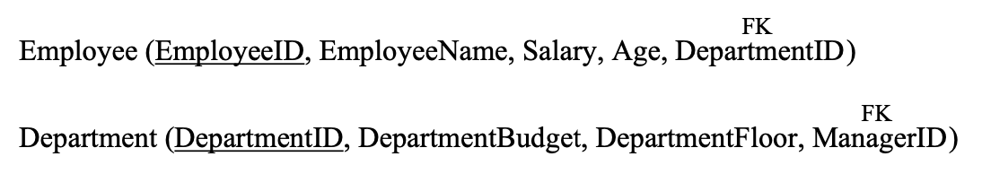
Exercise
3. Consider the following relations:
In the database, the salary of employees ranges from AUD10,000 to AUD100,000, age varies from 20-80 years and each department has 5 employees on average. In addition, there are 10 floors, and the budgets of the departments vary from AUD10,000 to AUD 1million.
Given the following two queries frequently used by the business, which index would you prefer to speed up the query? Why?

Slide 34
Exercise
3. Consider the following relations:
a. SELECT DepartmentID FROM Department WHERE DepartmentFloor = 10
AND DepartmentBudget < 15000;
A) Clustered hash index on DepartmentFloor B) Unclustered hash Index on DepartmentFloor C) Clustered B+ tree index on (DepartmentFloor, DepartmentBudget) D) Unclustered hash index on DepartmentBudget E) No need for an index

Slide 35
Exercise
3. Consider the following relations:
a. SELECT DepartmentID FROM Department WHERE DepartmentFloor = 10
AND DepartmentBudget < 15000;
A) Clustered hash index on DepartmentFloor B) Unclustered hash Index on DepartmentFloor C) Clustered B+ tree index on (DepartmentFloor, DepartmentBudget) D) Unclustered hash index on DepartmentBudget E) No need for an index
Range query!

Slide 36
Exercise
3. Consider the following relations:
b. SELECT EmployeeName,Age,Salary
FROM Employee;
A) Clusteredhashindexon(EmployeeName,Salary)
B) Unclustered hash Index on (EmployeeName, Age)
C) Clustered B+ tree index on (EmployeeName, Age, Salary)
D) Unclustered hash index on(EmployeeID,DepartmentID)
E) No need for an index

Slide 37
Exercise
3. Consider the following relations:
b. SELECT EmployeeName,Age,Salary
FROM Employee;
A) Clusteredhashindexon(EmployeeName,Salary)
B) Unclustered hash Index on (EmployeeName, Age)
C) Clustered B+ tree index on (EmployeeName, Age, Salary)
D) Unclustered hash index on(EmployeeID,DepartmentID)
E) No need for an index
get requested attributes with an index-only scan
Index-only scan: An index scan without subsequently accessing the data pages; accessing the index only
(and we can avoid accessing the table completely)

Slide 38
Exercise
Any questions

