Slide 1
INFO20003 Database Systems
Kuoyuan Li
Week 4

Slide 2
Agenda Today
Additional concepts in ER modeling
Simple case study
3.Bus company case study – conceptual and logical modeling

Slide 3
Additional concepts in ER modeling
Multivalued and composite attributes
Multivalued attributes:
More than one value at the same time,
E.g. phone numbers, skills, languages spoken, etc.
Drawn using a double outline.
Composite attributes:
Have multiple components and can be broken down into multiple attributes
E.g. a name that can be stored as first name and last name.
Drawn by branching the sub-attributes off the composite attribute.

Slide 4
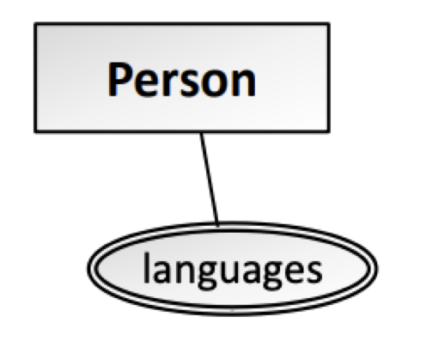
Additional concepts in ER modeling
Multivalued and composite attributes
Multivalued attribute in conceptual model:
Multivalued attribute in logical Model:
Person(PId, Name, …)
Language(LId, LanguageName, PId (FK) )

Slide 5
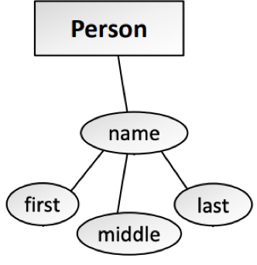
Additional concepts in ER modeling
Multivalued and composite attributes
Composite attribute in conceptual Model:
Composite attribute in logical Model:
Person(PId, … , FirstName, MiddleName, LastName)
Person(PId, … )
Name(NameId, FirstN, MiddleN, LastN, PId(Fk))

Slide 6
Additional concepts in ER modeling
Unary relationships
between an entity and itself
between multiple instances of the same entity
have different cardinalities and constraints just like ordinary binary relationships (one-to-one, one-to-many, many-to-many)
When having different constraints(e.g. one-to-many, participation constraints), label the ends to make it clear what the constraints apply to

Slide 7
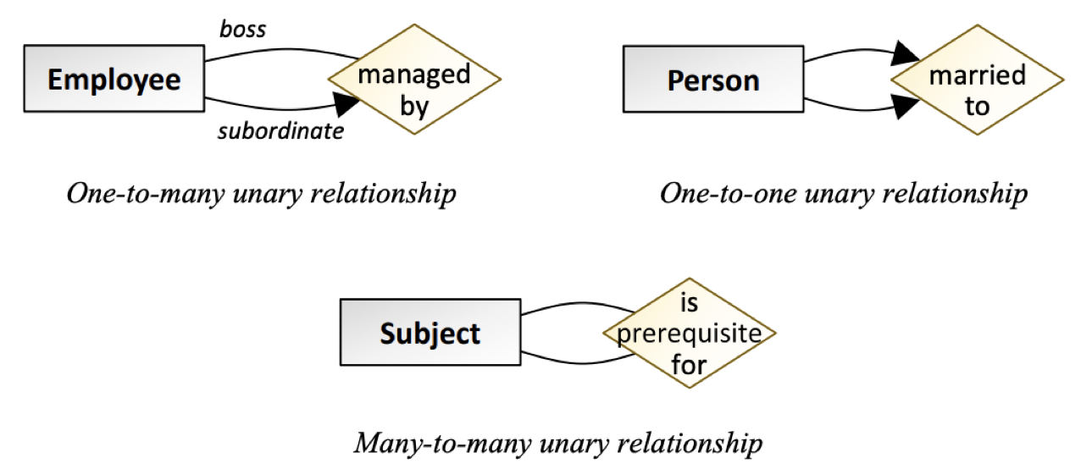
Additional concepts in ER modeling
Unary relationships examples

Slide 8
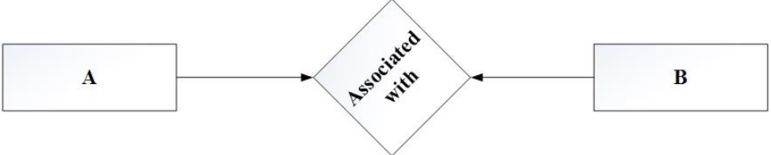
Additional concepts in ER modeling
Resolve relationships in logical model
One to one:

Slide 9
Small Case Study
https://pollev.com/likuoyuan440

Slide 10
Additional concepts in ER modeling
Resolve relationships in logical model
One to one:
1: A (AId, … , BId (FK) …)
B (BId, …)
OR
2: A (AId, …)
B (BId, … , AId (FK) ….)

Slide 11
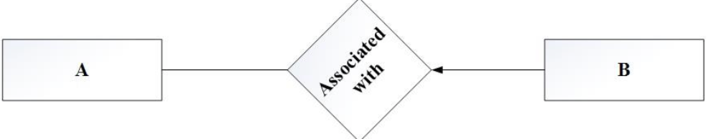
Additional concepts in ER modeling
Resolve relationships in logical model
One to many:

Slide 12
Additional concepts in ER modeling
Resolve relationships in logical model
One to many:
A (AId, …, )
B (BId, …, Aid (FK),…)

Slide 13
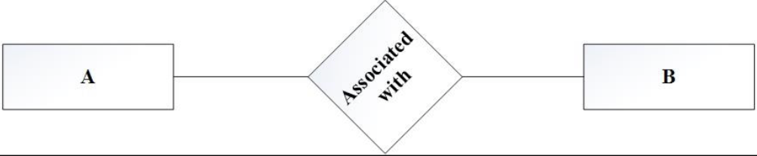
Additional concepts in ER modeling
Resolve relationships in logical model
Many to many:

Slide 14
Additional concepts in ER modeling
Resolve relationships in logical model
Many to many:
A (AId, …)
RAB (AId (PFK), BId (PFK), …)
B (BId, …)

Slide 15
Additional concepts in ER modeling
Any questions?

Slide 16
Small Case Study
Australia’s corporate regulator, ASIC, stores a range of information about every Australian company, including the name, the nine-digit ACN (Australian Company Number), the date of registration and deregistration, and the names of the company’s directors. Every company has a registered address, made up of the street address, suburb, state and postcode. A company may be owned by another company; in this situation ASIC keeps track of the company’s parent company.
Use this information to model a “company” entity using Chen’s notation.

Slide 17
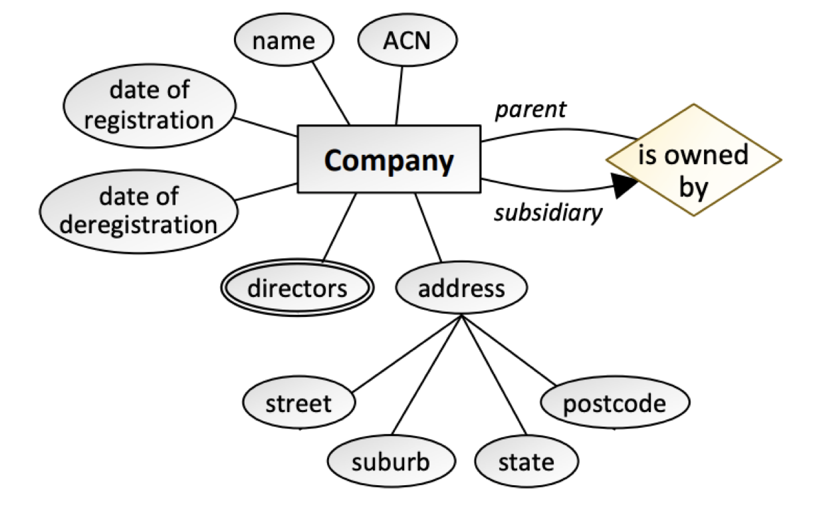
Small Case Study

Slide 18
Case study
Group/Individual case study
I will randomly assign you to a breakout room
1. Already have a study group/Want to do it with a friend?
Choose the room where you friends in and jump into it
2. Don’t want be in a group for now?
Although I strongly encourage you to do it in a group, if you want to do it alone, you can come to the main room and mute yourself.

Slide 19
Case Study
A bus company owns a number of buses. Each bus is allocated to a particular route, although some routes may have several buses. Each route passes through a number of towns. One or more drivers are allocated to each stage of a route, which corresponds to a journey through some or all of the towns on a route. Some of the towns have a depot where buses are kept – each bus always returns to its allocated depot at the end of the day.
Each of the buses is identified by its registration number and can carry different numbers of passengers, since the vehicles vary in size and can be single or double-decked. Each route is identified by a route number and information is available on the average number of passengers carried per day for each route. Drivers have an employee number, name, address, and sometimes a telephone number, and the names of the training courses they have completed need to be stored.

Slide 20
Case Study
a. Identify the entities.
Bus ← Each bus is allocated to a particular route
Route ← Each route passes through a number of towns
Stage ← One or more drivers are allocated to each stage of a route
Town ← Some of the towns have a depot where buses are kept
Depot ← Some of the towns have a depot where buses are kept
Driver ← One or more drivers are allocated to each stage of a route

Slide 21
Case Study
b. Identify the relationships (use business rules to identify relationships). State all the key constraints and participation constraints.
A bus company owns a number of buses. Each bus is allocated to a particular route, although some routes may have several buses. Each route passes through a number of towns. One or more drivers are allocated to each stage of a route, which corresponds to a journey through some or all of the towns on a route. Some of the towns have a depot where buses are kept – each bus always returns to its allocated depot at the end of the day.
Each of the buses is identified by its registration number and can carry different numbers of passengers, since the vehicles vary in size and can be single or double-decked. Each route is identified by a route number and information is available on the average number of passengers carried per day for each route. Drivers have an employee number, name, address, and sometimes a telephone number, and the names of the training courses they have completed need to be stored.

Slide 22
Case Study
c. Draw a conceptual model and populate entities with appropriate attributes (use Chen’s notation).
Lucidspark(whiteboard) workspace:
Group 1:
https://lucid.app/lucidspark/invitations/accept/inv_8723f3d8-7e16-4460-b51b-9b527890b990
Group 2:
https://lucid.app/lucidspark/invitations/accept/inv_b8ffd1af-dd8c-46b7-9572-094cc3d0b97f
Group 3:
https://lucid.app/lucidspark/invitations/accept/inv_5e2de11d-8cbe-4eb0-a6cf-b215de84da2d

Slide 23
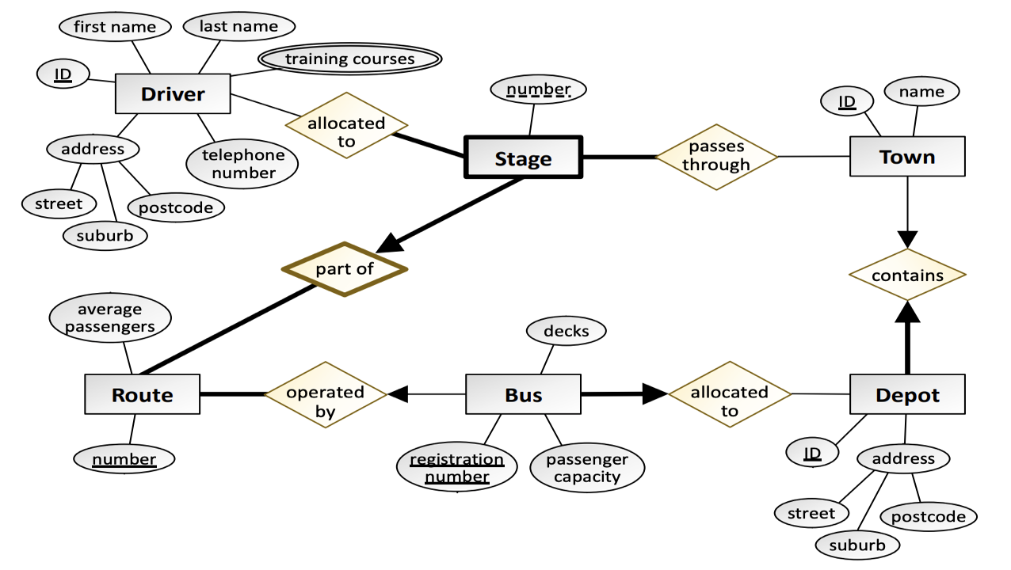
Case Study
c. Draw a conceptual model and populate entities with appropriate attributes (use Chen’s notation).

Slide 24
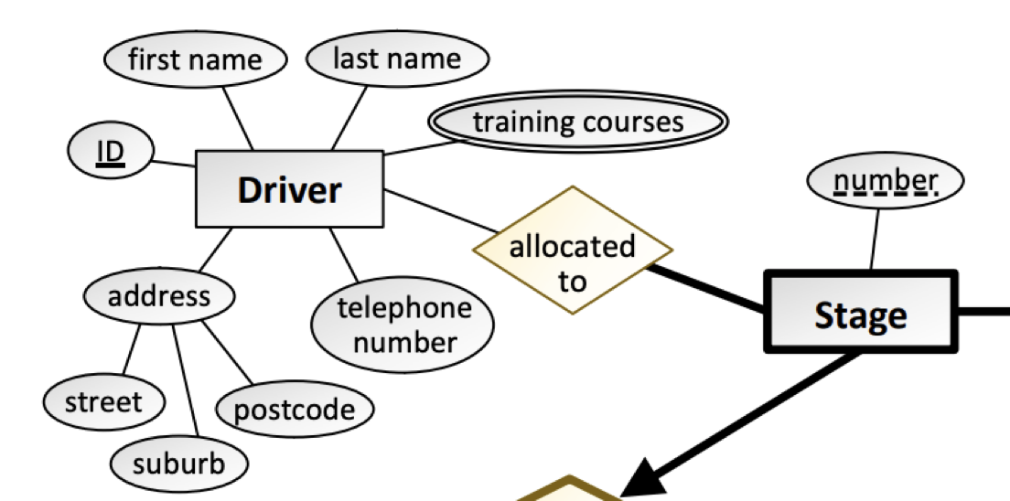

Case Study
d. Discuss the logical modeling of the Driver entity.
resolve multivalued and composite attributes
Resolve relationships

Slide 25
Case Study
d. Discuss the logical modeling of the Driver entity.
Driver (DriverID, FirstName, LastName, AddressStreet, AddressSuburb, AddressPostcode, PhoneNumber)
DriverTrainingCourses (FK, TrainingCourseName)

Slide 26
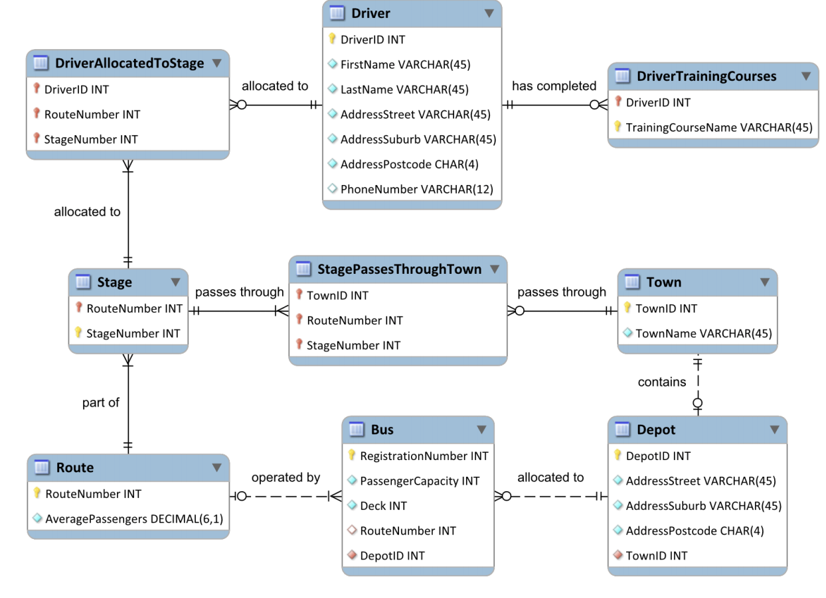
Case Study
The logical design for the remaining tables, after resolving all relationships

Slide 27
Case study
Any questions?

